Slide 1
The Greek programme for energy efficiency in the private building sector
WORKSHOP
The European Green Deal and the National Energy and Climate Plan in Greece
Wednesday 20 October 2021

Slide 2
Energy efficiency in the private building sector
EXOIKONOMO I, 2011-2015
EXOIKONOMO II – 1st phase, 2018
EXOIKONOMO II – 2nd phase, 2019
EXOIKONOMO II – AUTONOMO, 2020
EXOIKONOMO 2021 & 2022

Slide 3
Energy efficiency in the private building sector
Basic objectives
Improving the energy efficiency of the housing building stock
energy upgrade of a great number of households
attraction to the programme of low income households, by providing stronger incentives to them
Characteristics
mix of incentives (grant & loan)
subsidy of the given interest
set an energy target (upgrade of 3 energy categories)
eligible interventions:
Installing insulation in the whole building (roof & walls)
Replacement of frames and glass of windows (glass panels)
Upgrade of the heating and hot water system
Upgrade of solar water heater systems, heat pumps, etc.
PVs (net metering) & energy storage systems in Exoikonomo-Autonomo

Slide 4
EXOIKONOMO I Financing (2 SOPs, 4 ROPs, Private Funding)
Final Budget
EUR 408.2 m.
EUR 307.2 m.
EUR 101 m.
GRANTS
REVOLVING FUND
Grants up to 70% to 3 categories of Homeowners
Maximum eligible budget of interventions (including VAT): not exceed 15,000 € per property

Slide 5
EXOIKONOMO II Financing (1 SOP, 11ROPs, Private Funding)
Budget of Phase A (3/2018)
EUR 503 m
EUR 68m
OP CEI
EUR 397.7 m OP CEI
+ EUR 37.3 m ROP
REVOLVING FUND
GRANTS
Budget of Phase B (9/2019)
(No change in criteria / incentives)
EUR 275 m
EUR 136.7m OP CEI
+ EUR 23.6m ROP
+EUR 80.7 m Nat. Res
EUR 34 m
National Resources
REVOLVING FUND
GRANTS
Maximum eligible budget of interventions (including VAT): not exceed EUR 25 000 € per property

Slide 6
EXOIKONOMO-AUTONOMO Financing (1 SOP, 13 ROPs, Private Funding)
Final Budget
EUR 896.8 m.
EUR 804.8 m.
EUR 92 m.
GRANTS
REVOLVING FUND
Maximum eligible budget of interventions (including VAT): not exceed 48,000 € per property

Slide 7
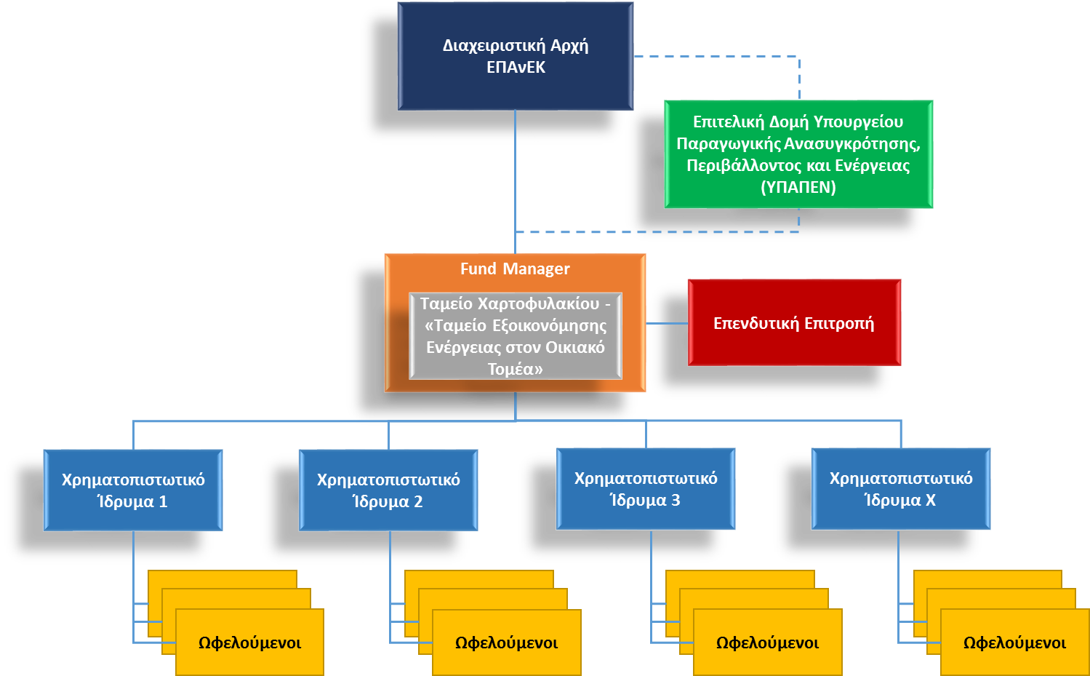
EXOIKONOMO II & EXOIKONOMO-AUTONOMO
Organizational Structure
MANAGING AUTHORITY
OP CEI
2014-2020
MINISTRY
OF
ENVIRONMENT & ENERGY
Programme
“EXOIKONOMO ΙΙ and EXOIKONOMO-AUTONOMO”
INVESTMENT
COMMITTEE
Bank
1
Bank
2
Bank
…
Bank
10
Final Recipients
Final Recipients
Final Recipients
Final Recipients

Slide 8
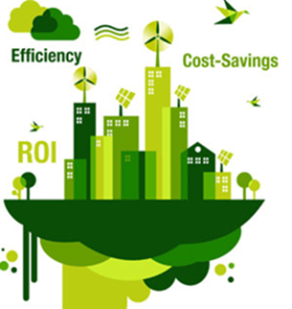
EXOIKONOMO II & EXOIKONOMO-AUTONOMO
Creation of a MIS Platform for submission / evaluation of applications
Upgrade of given top eligible expenditure limits
Eligibility of remuneration for issuing permits / studies needed
Improved graduation of income categories (7 categories instead of 3)
Energy Target
EXOIKONOMO II: Increased energy target (40% of energy saving for the categories1-2, & 70% for the categories 3-7)
EXOIKONOMO – AUTONOMO: Upgrade of 3 energy categories
Loan is Optional Evaluation of submissions by a central body (Fund Manager – evaluation of loan by banks)

Slide 9
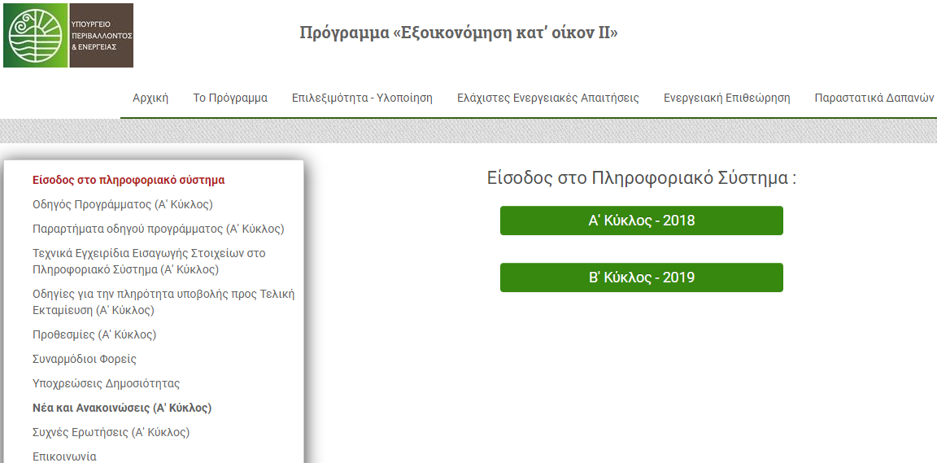
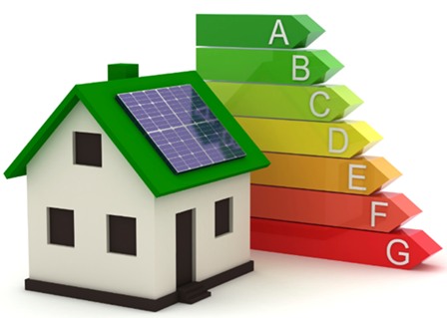
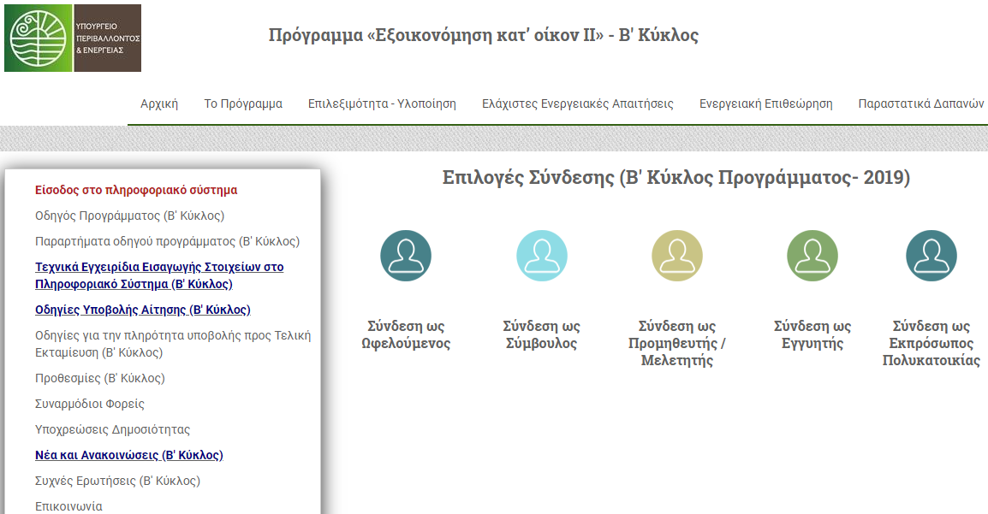
EXOIKONOMO II
MIS (platform for applications)

Slide 10
EXOIKONOMO I & II Summary
540 mil €
total budget (Loans & Grants)
63.000
completed projects
593 mil €
total eligible cost (private fund incl.)
1.040 GWh
energy savings
42.5%
Av. reduction of energy consumption
778 mil €
total budget (Loans & Grants)
52.000
Currently completed projects
838 mil €
total eligible cost (private fund incl.)
1.655 GWh
current energy savings
59%
Av. reduction of energy consumption
Digitalization
Speed

Slide 11
EXOIKONOMO 2021 & 2022
Financing: EUR 1,35 billion (RRF)
Energy renovation of at least 105.000 households
Incentives for energy poor households
Higher grant
Guarantee for loans
Characteristics
mix of incentives (grant & loan)
subsidy of the given interest
set an energy target (upgrade of 3 energy categories)
Introduction of electronic building identity
maximum eligible budget of interventions (including VAT): not exceed 28,000 € per property

Slide 12
Thank you for your attention
Yanna Nikou
Head of the Executive Authority of the PA, Energy Sector
Ministry of Environment and Energy

