Slide 1
New Opportunities for Solar Energy and Energy Storage in the Context of Recovery
Jan Fousek
Solar Association CZ, Chairman of the Supervisory Board
Association for Energy Storage AKU-BAT CZ, CEO

Slide 2
Content
Solar Energy in the Czech Republic
Energy Storage in the Czech Republic
Modernisation Fund

Slide 3
Solar Energy in the Czech Republic

Slide 4
Solar energy in 2020
The market continues to grow, but still too slowly:
51 MWp connected in 2020
6293 PV plants connected 2020
Increase of 104 % compared to 2019
The growth rate looks good at first glance, but the number was not too hard to achieve given the fact that for almost a decade no solar projects were built in Czechia
Medium-sized rooftop PV plants dominate, no large ground installations:
22 % of commercial rooftop installations (by number of plants)
56 % of commercial rooftop installations (by capacity)
0 ground-mounted plants (no support in last decade)

Slide 5
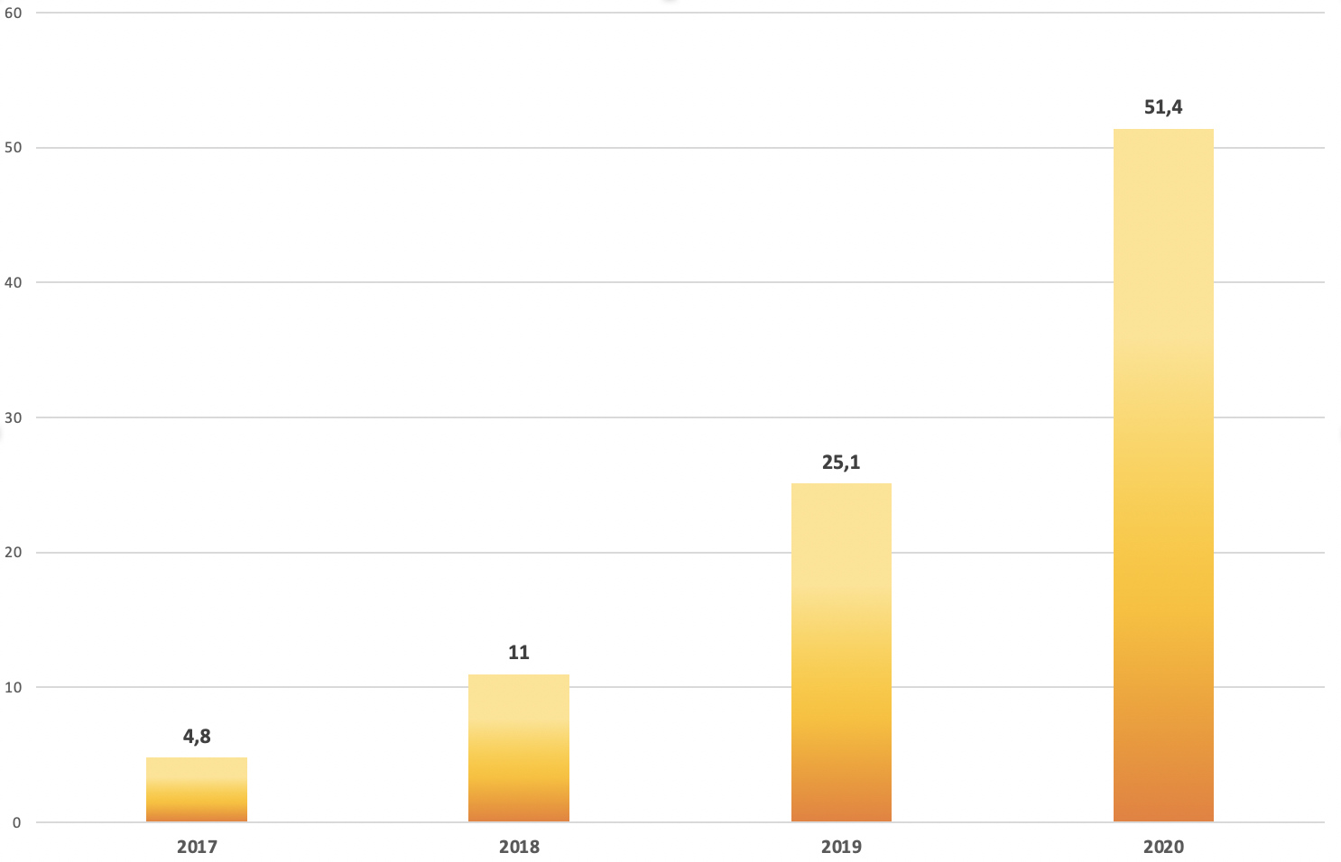
PVP growth 2017 – 2020 (in MW)

Slide 6
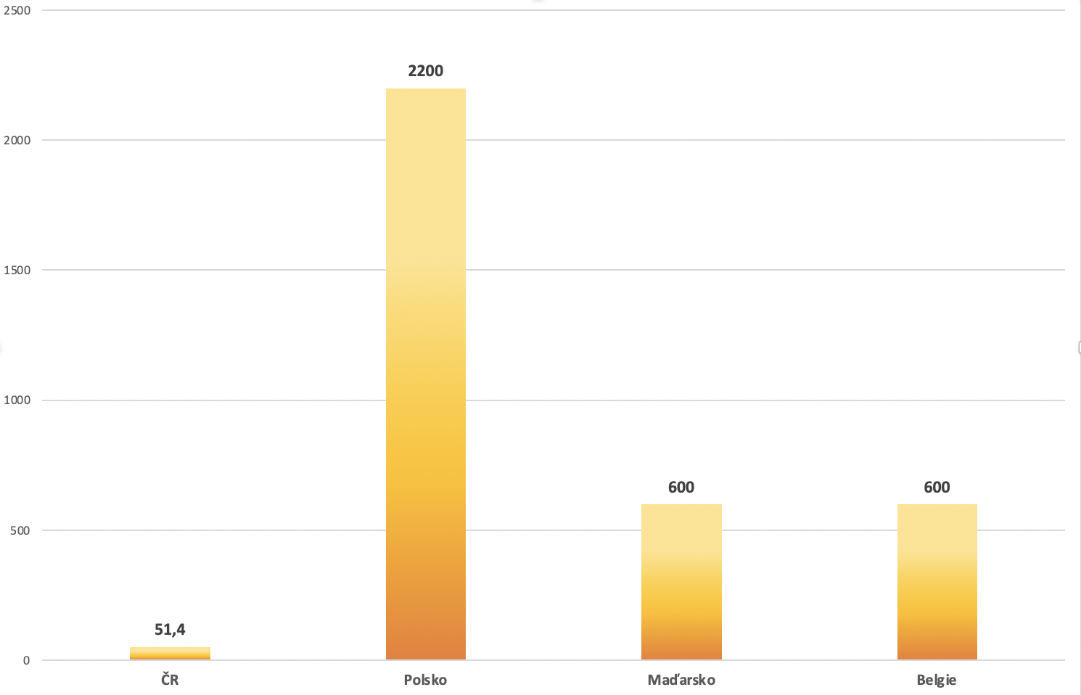
Comparison with other countries (2020)
Czech Republic Poland Hungary Belgium
* In megawatts

Slide 7
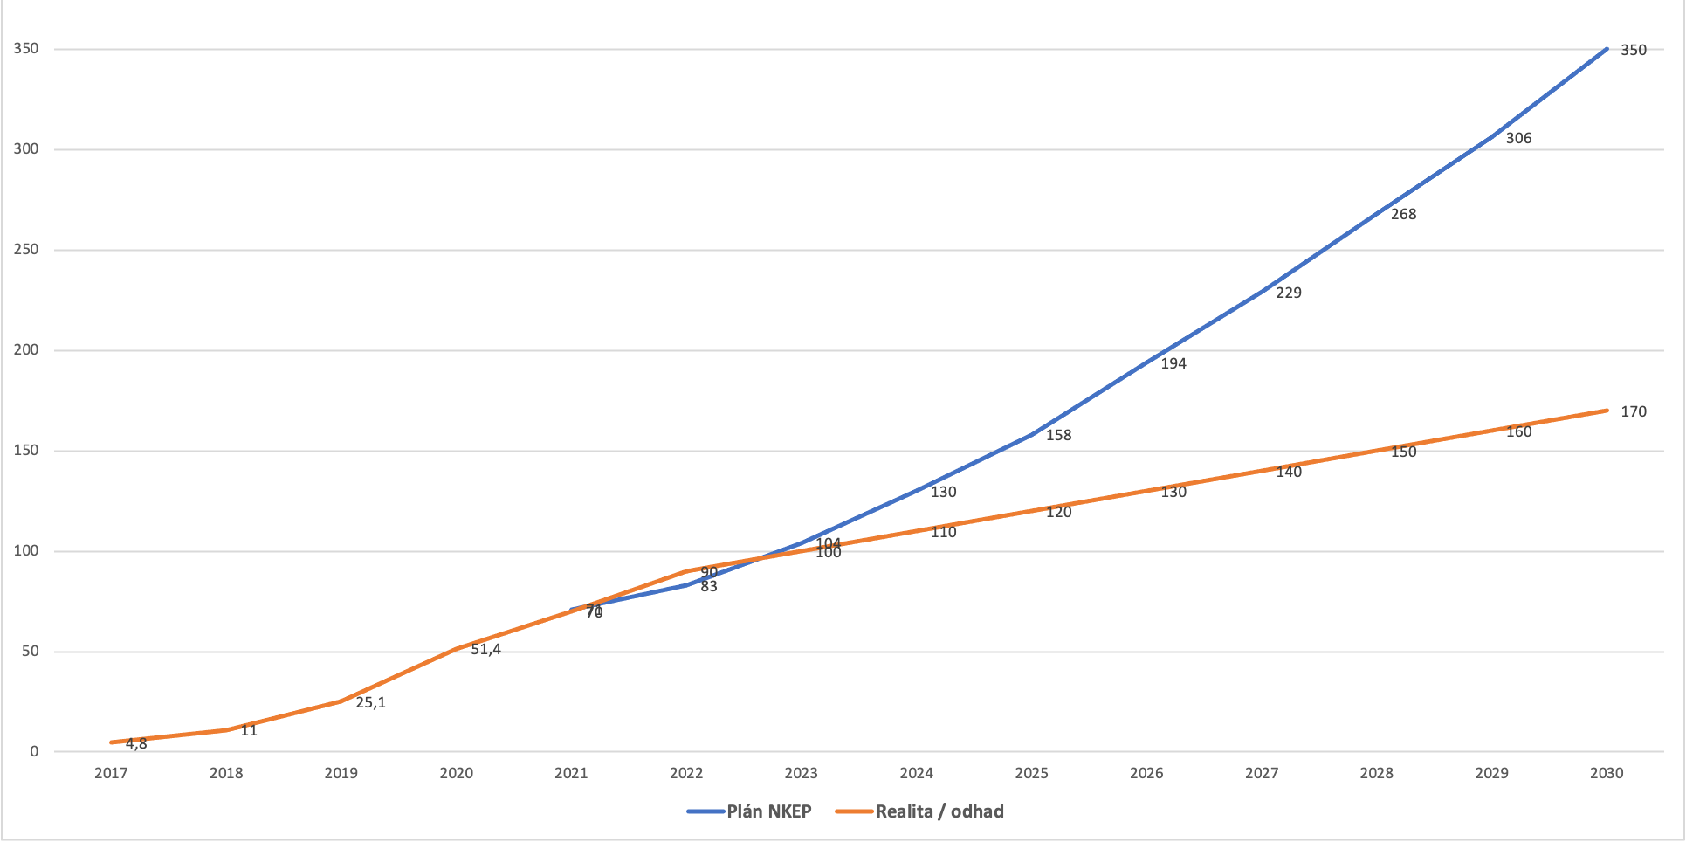
Meeting the 2030 targets (in MW)
* BAU scenario without expected growth of PV installations from Modernisation fund!

Slide 8
Meeting the 2030 targets
The current growth is far too slow, but huge potential for RES in Modernisation Fund (and potentially auctions also for solar?)
Huge untapped potential of utility-scale PVP – especially on industrially polluted areas and land unsuitable for agriculture
Need for new trends – agrivoltaics, floating PV, solar facades
Need to speed up the growth of RES also in Prague - only 1.2 MWp was built in Prague – 2.3 % of all installations

Slide 9
Barriers & challenges
Very unstable and unpredictable legislative environment
New efforts to cut subsidies for existing PV installation – another retroactive measures (potential RES overcompensation, solar levy)
Efforts of large traditional energy companies and „coal-lobby“ to delay the transposition of the European legislation
Strong public stigmatisation of PV owners by state leaders to be „solar barons/tycoons“
Unreasonable excluding PV from RES auctions
Strong need of systematic support for RES in the form of a state strategy
Energy storage only with spinning reserves, not stand-alone (allowed by Czech TSO (ČEPS) in his Code since the 1st of January 2021, but still not possible to issue a licence for energy storage)

Slide 10
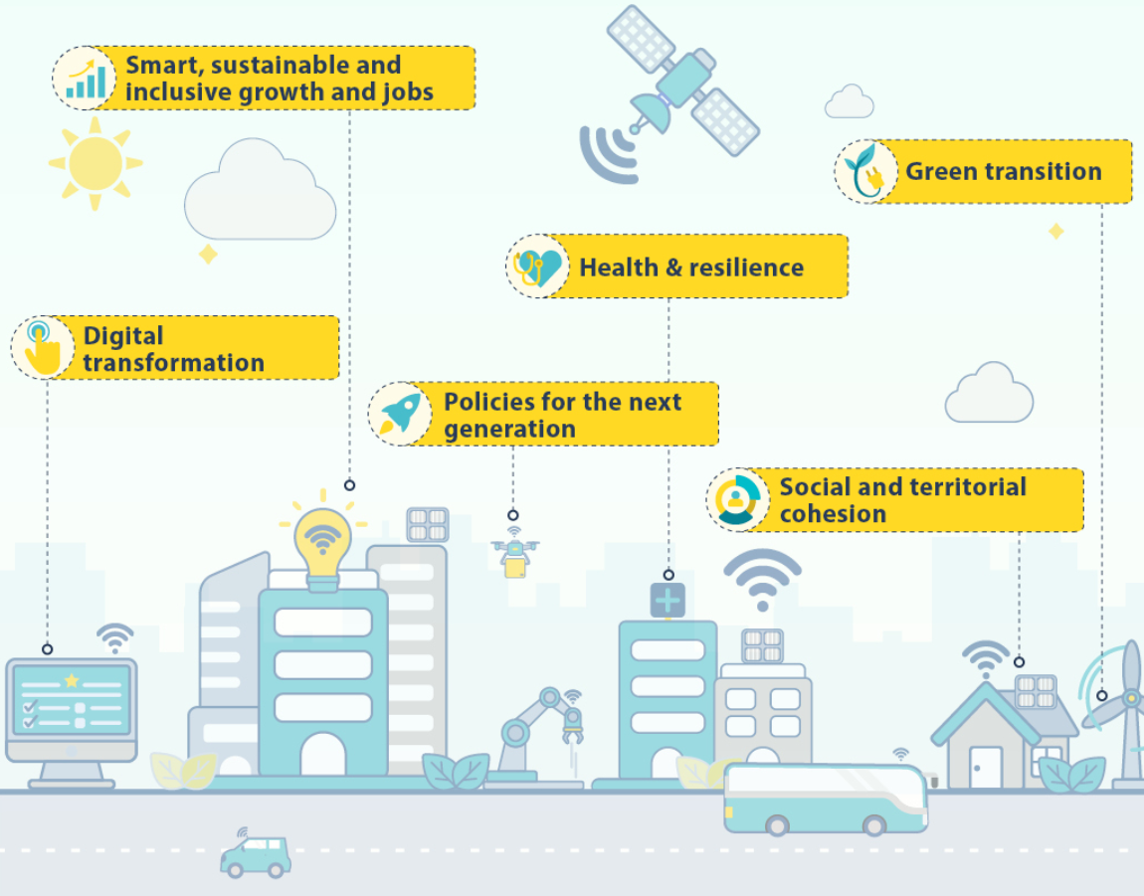
Contribution of solar to the Recovery
Potential to provide jobs in regions with high unemployment rate
At the time of COVID, PV helps families and companies to „survive“ (PV as kind of insurance against worse time)
Can be built quickly, cheaply, easily and „anywhere“ – where it is economically reasonable or necessary (e.g. transition of coal regions – Just Transition Fund)
Can attract large investments quickly and boost the economy when it is necessary (like in 2009-2010 after the financial crisis)

Slide 11
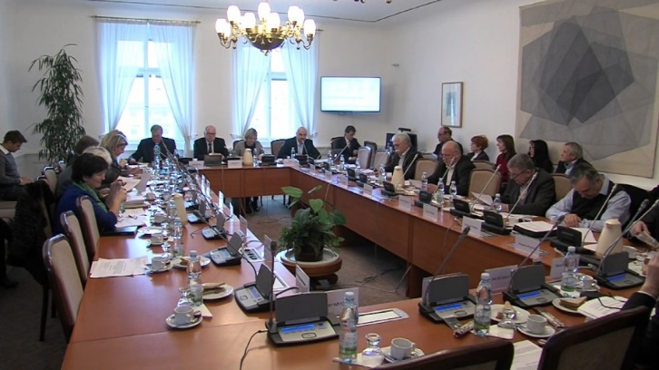
Novelization of the RES Support Act
Ongoing novelization of very important legal Act, which will have a fundamental impact on PV and all RES in the following decade (and further)
The amendments to the novelisation will be discussed on 17th March by the Economic Committee of the Chamber of Deputies
Crucial for existing projects as well as for future solar development
Proposed cuts of subsidies for existing projects
- The government wants to „save tax payer´s money“, but proposed cuts can seriously affect thousands of investors and bank loans
Introduces auctions for RES, but does not permit solar projects
- Ministry expects PV investors to receive only investment support (e.g. Modernisation Fund) to finance their projects

Slide 12
Energy Storage in the Czech Republic

Slide 13
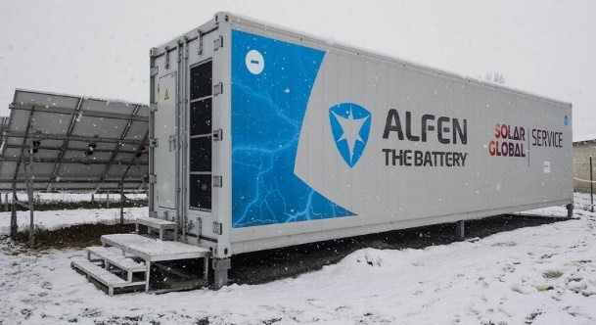
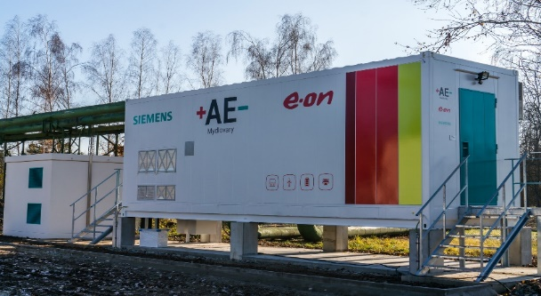
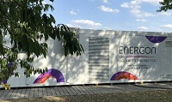
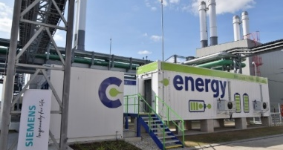
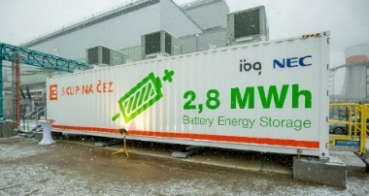
Existing large-scale batteries in CZ
Stand-alone
BESS Prakšice (2017): 1 MW, 1.2 MWh
BESS Mydlovary (2018): 1 MW, 1.75 MWh
BESS Obořiště (2018): 1 MW, 1.3 MWh (moved to DE)
Behind-the-meter
BESS Planá (2019): 4 MW, 2.5 MWh
BESS Tušimice (2019): 4 MW, 2.8 MWh
+ other projects of smaller batteries in tens of megawatts

Slide 14
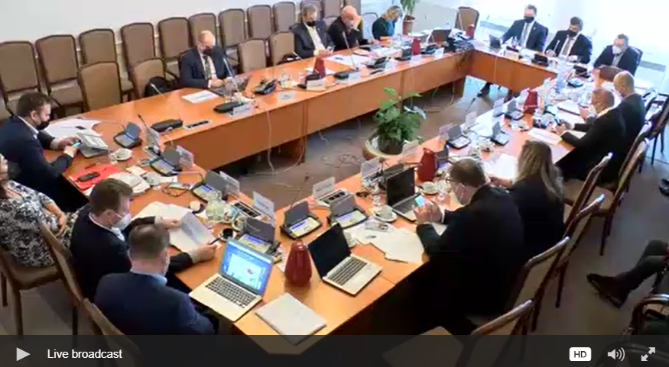
Novelization of the existing Energy Act
In 2020, we initiated an amendment (to the currently ongoing novelization of the Energy Act) for the energy storage – the proposal was finalized last summer
All relevant parties (Ministry of Industry and Trade, Czech TSO (ČEPS), all DSOs, Energy Regulatory Office (ERÚ) etc.) proposed their changes and comments and the legal act was passed to the Parliament - we expected the act to be widely accepted
In January 2021, first reading in the Chamber of Deputies took place
17th of February, the Economic Committee of the Chamber of Deputies discussed the amendment for energy storage – some objections were raised and the amendment has to be modified until the next plenary meeting in March
Unfortunately, we are facing a lot of negative pressure from the Association of district heating, which hardly oposses legal anchoring of the special licence for energy storage (as demanded by the EU until 30.6.21!) and influence the members of the committee (even those who have previously expressed their support by signing the amendment)

Slide 15
Code of TSO (ČEPS) – positive changes
Last year, Czech TSO „ČEPS“ presented an update of the Code of Transmission System
Effective since the 1st of January 2021
Positive changes towards modern energy:
Stand-alone battery systems (BESS) allowed to provide flexibility services (but the licence is missing in the legislation)
Also smaller aggregated RES + BESS will be allowed to provide flexibility services (group of households with PVs and batteries, group of cogeneration units etc.)

Slide 16
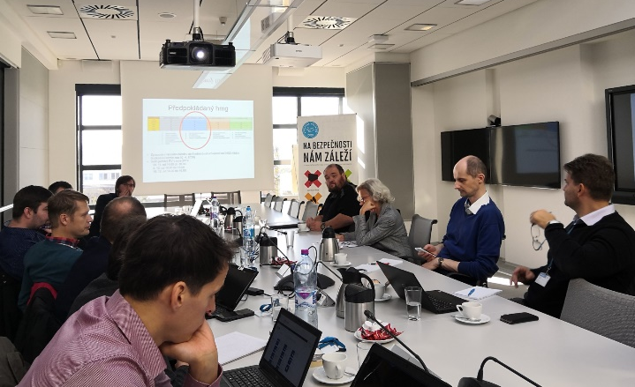
New Energy Act – in preparation
Works started in November 2019 – AKU-BAT & the Union of Modern Energy were a part of the working groups
In March 2020, works were interrupted due to COVID-19, but the white paper was finished by the Ministry of Industry and Trade and passed by the Government
Energy storage included in full extent (in accordance with Clean Energy Package)
The white paper has undergone interdepartmental proceedings and the paragraph proposal should be finished until June 2021
Effectiveness expected in 2-3 years, maybe later (depending on the elections in October 2021)

Slide 17
Barriers & challenges
Legislation
„Both“ Energy Acts – the novelized one and the new one
Code of the Czech TSO (ČEPS)
Clean Energy Package & other legal acts of the EU
Efforts to delay transposition of the European legislation by district heating and coal lobby
Lobbying of last few (but influential) traditional energy companies (mainly because of threat to potentially loose part of the income from ancillary services)
Strong reluctance towards PV – negative impact on energy storage
Generally low support of RES and criminalization of the sector by top politicians since (and because of) the solar boom in 2010

Slide 18
Modernisation Fund

Slide 19
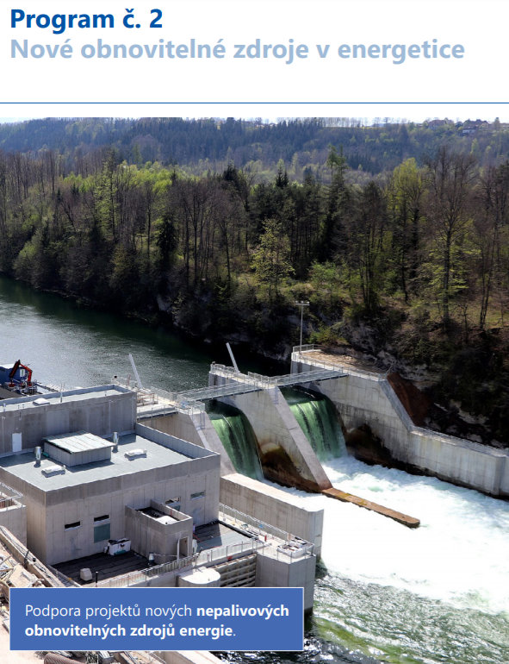
Programme RES+
Programme RES+ („New Renewable Sources in Energy“) is one of 9 programmes of the Modernisation Fund (MdF) – the scheme was approved in January this year
39 % of finances allocated to RES+ (largest share) – about 2.3 billion EUR
RES+ focused on supporting projects of new non-fuel RES, especially PV, but also energy storage (only as a part of the source), wind power plants and small hydro power plants
For PV in particular:
Preferred in areas affected by industry, mining, etc.
Buildings-integrated (roofs, facades)
Agrivoltaics, floating PVs, green hydrogen production and other innovative technologies

Slide 20
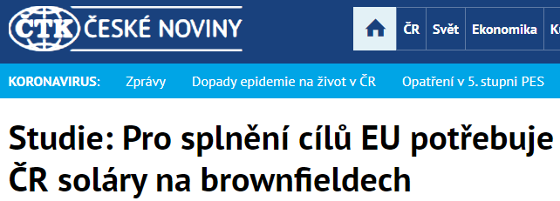
Our participation on fund´s settings
Intensive work of Solar Association, AKU-BAT and Union of Modern Energy
Communication with the Ministry of Environment on regular basis, submission of official comments, organazing press conferences, issuing press releases, etc.
Results:
The division of funds at 60 % for EU ETS entities and 40% for non-EU ETS – instead of originally proposed 70 % and 30 %
Solar as rooftop installations as well as larger RES (especially PV on brownfields, dumps and areas of former mines)
Agrivoltaics as an exception to the ban on construction on agricultural land
…and others

Slide 21
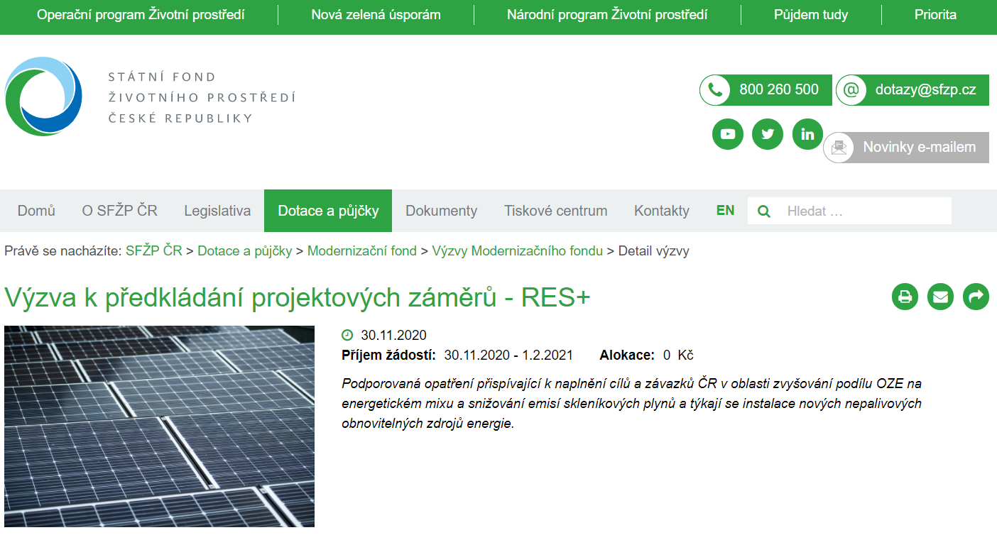
Current situation
Until the 1st of February, the obligation to register the project in the so-called pre-registration call, so that it is then possible to apply for the grant itself (the project did not have to have a final form) – the official call probably in March
The pre-registration call will be issued every year or half a year, always a few months before the official call
10.000+ received pre-registration requests for hundreds of billion CZK (all expectations exceeded several times)
Enormous demand for large-scale PV - requests for more than 20 GW!

Slide 22
THANK YOU FOR YOUR ATTENTION Jan Fousek +420 777 889 640 jan.fousek@solarniasociace.cz fousek@akubat-asociace.cz

