Slide 1
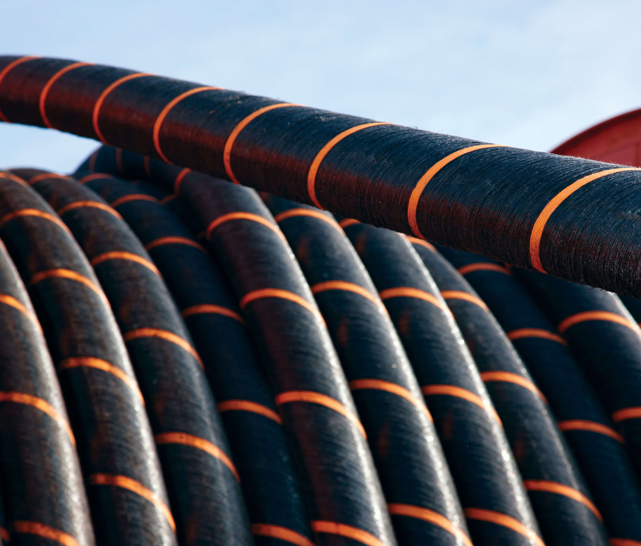
The economic benefits of a closer EU-UK cooperation in the North Seas
Matt Hinde, Head of EU Affairs
March 2025

Slide 2
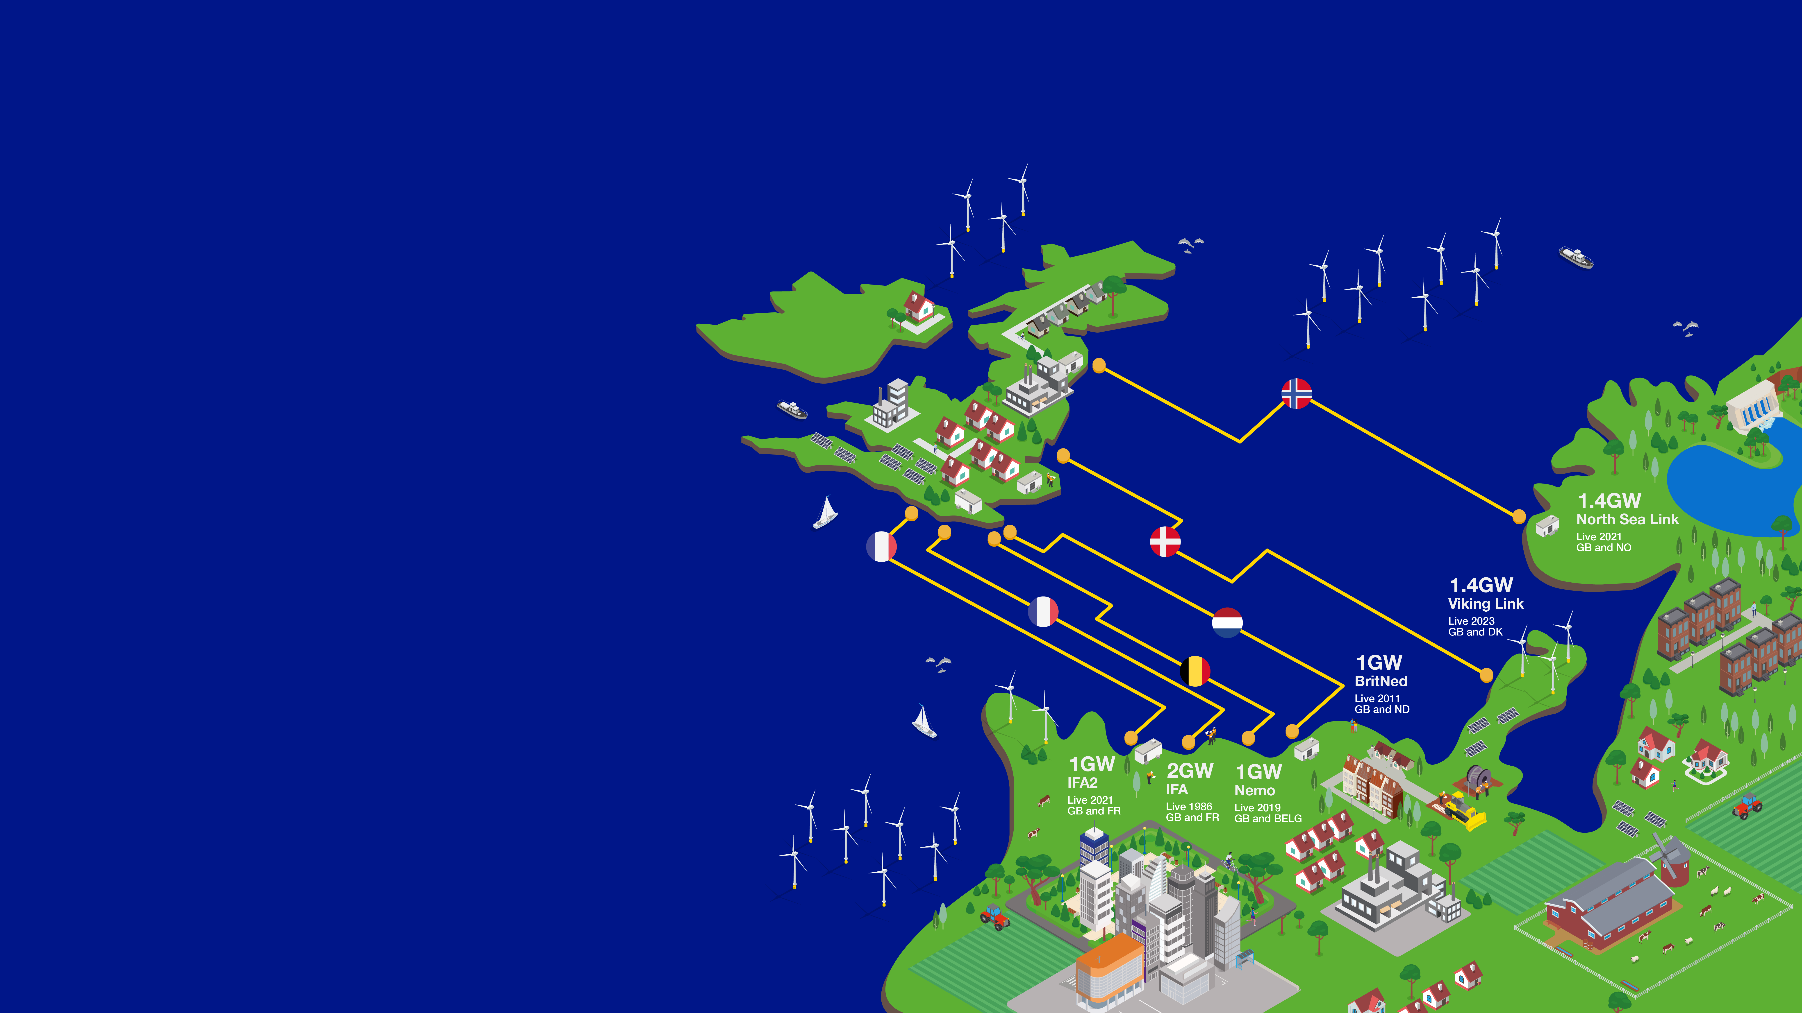






The power of partnerships
National Grid’s interconnectors connect the UK to Norway, the Netherlands, Belgium, France and Denmark
7.8GW
National Grid and our European partners jointly own and operate ~7.8GW of interconnector capacity, which is enough to power 8 million UK homes.

Slide 3
