Slide 1
Integrating ukraine and moldova into the south east european power grid&Market
IPM 21 March 2025, 12.30-14.00, Susanne Nies

Slide 2
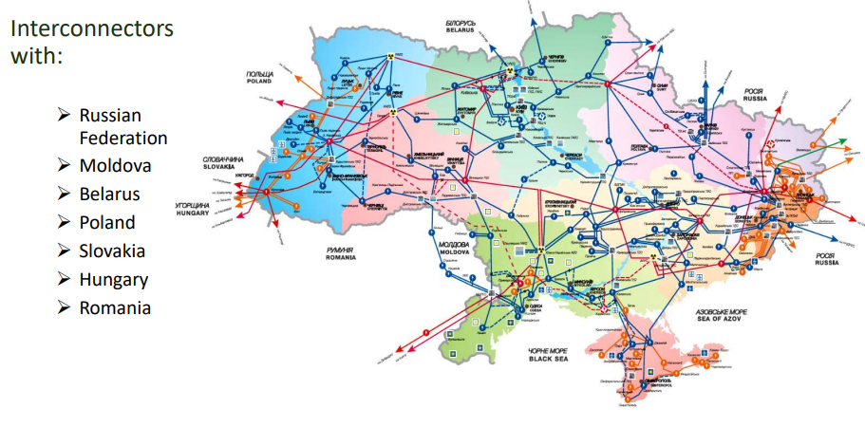
Ihistory
INTERCONNECTORS OF UKRAINE WITH SEVEN NEIGHBORING COUNTRIES
Source: CIGRE (2018)

Slide 3
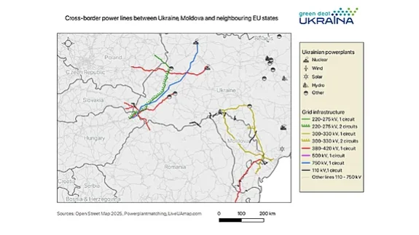
INTERCONNECTORS OF UKRAINE WITH EU/Moldova
Source: CIGRE (2018)

Slide 4
CHANGES TO AGREED EXPORTS/IMPORTS BASED ON VARIOUS ENTSO-E ANNOUNCEMENTS, 2022-2024
Date | Export to Ukraine | Import from Ukraine | Comments
16 March 2022 | 0 MW | 0 MW | Emergency Synchronisation Ukraine-ENTSO-E (Continental Europe) decided by the EU Commission and the ENTSO-E. In the first two stages of synchronisation, there were no commercial exchanges.
26 April 2022 | 0 MW | 0 MW | Ukraine becomes an ENTSO-E observer member. The first phase of synchronisation trialling was successfully finished.
30 June 2022 | - | 100 MW | Start of commercial trading through Moldova-Romania.
16 February 2023 | 700 MW | 400 MW | Massive Russian attacks on energy infrastructure from September 2022 to Spring 2023 ended exports from Ukraine.
27 March 2023 | 850 MW | 400 MW | Emergency assistance was agreed upon between the EU and Ukraine.
15 April 2023 | 1050 MW | 400 MW | Start of commercial power exchanges through the rehabilitated Rzeszów- Khmelnytskyi line.
20 June 2023 | 1200 MW | 400 MW
1 December 2023 | 1700 MW/h | 400 MW/h | The ENTSO-E announces that as of 1 January 2024, Ukrenergo will become the 40th full member of the ENTSO-E.
27 February 2024 | 1700 MW/h | 550 MW/h
March to December 2024 | No change | No change | Massive attacks on Ukraine energy system started in 2024 on March 22nd, with a major attack on May 8th and in November 2024. More than 9 GW of thermal capacities lost. Russian energy terrorism continues with now more than 30 attack waves in 2024 alone.
1 December 2024 | 2100 MW/h | No change | ENTSO-E announces, on October 29th 2024, to increase the export capacity limit to Ukraine and Moldova to 2.1 GW. In addition, the capacity limit will be reassessed on a monthly basis from March 2025.
Source: Authors' own compilation, based on information from Ukrenergo and the ENTSO-E.

Slide 5
Speed up building transmission projects
SPEED UP EXISTING – AND DELAYED – INTERCONNECTION PROJECTS BETWEEN UKRAINE AND SLOVAKIA, UKRAINE AND ROMANIA
Pivdennoukrainska NPP (UKR)—Isaccea (ROU)
Purpose: Construction of 400 kV transmission line
Fin. Instrument: Late submission to the TYNDP 2024 accepted (i.e., precondition to PCI)
Commissioning (planned): 2028 (potentially operational by 2026)
Note: Would end Moldova’s dependency on Transnistrian MGRES TPP
Veľké Kapušany (SVK) - Mukacheve (UKR)
Purpose: Rehabilitation of overhead line
Start: 2013
Tech. details: 53 km, 400 kV
Fin. Instrument: PCI - Late submission to the TYNDP 2024 accepted
(i.e., a precondition to PCI)
Commissioning (planned): 2026

Slide 6
Speed up building transmission projects
SPEED UP EXISTING – AND DELAYED – INTERCONNECTION PROJECTS BETWEEN UKRAINE AND SLOVAKIA, UKRAINE AND ROMANIA
Rzeszów (POL) – Khmelnytskyi (UKR)
Purpose: Rehabilitation of the line and repowering it as a 400 kV line
Commissioning: 2023
Capacity (present): 550 MW
Challenges: Impedance
Solutions:
Impedance control devices
Power electronics, or so-called FACTS
Replacing parts of the overhead line with sections of underground cable
Buffer batteries

Slide 7
Use all available grid enhancing technologies
USE OF ADVANCED TECHNOLOGIES TO OPTIMIZE THE FUNCTIONING OF EXISTING GRIDS
e.g., Dynamic Line Rating (DLR), power electronics
Dynamic Line Rating (DLR)
Timeframe for the DLR deployment: Less than 6 months
Planned start of installation: Summer 2024
Grid transmission capacity increase: 10-30 % (Note: Especially during winter)
Challenges: ENTSO-E permission is needed to ensure additional capacity on interconnectors
(Current cap: 2.1 GW)
Solutions: Political pressure to accelerate the deployment
URGENT ACTION NEEDED: The 2035 implementation deadline is TOO LATE.

Slide 8
Decentralisation, regulation and 110kV grids
Well-developed network with 11 existing 110 kV lines to Moldova
Moldova (5 lines), Transnistria (6 lines)
Slovakia (uprate 35kV line to 110kV) formerly was 110kV
DSO framework is crucial
RES investment is crucial
GreenDealUkraina: forthcoming
Study on DSOs in Ukraine

Slide 9
Address market short-falls in Ukraine and Moldova
Forthcoming report (June 2025) by
GreenDealUkraina
On the regional power market integration of Ukraine
Market coupling foreseen for 2027
Currently explicit auctions through JAO
Auctions outside of JAO Ukraine, Moldova and Romania
Several market shortfalls in Ukraine that prevent from importing the allowed capacities /2.1 GW

Slide 10
Ensure efficient coordination between Ukraine and the Bordering countries
Regional collaboration network: Boost regional integration through UEMIP (Ukraine and Moldova Energy Market Integration Plan)
Example: Use experience from BEMIP (Baltic Energy Market Integration Plan)
Address: Mid- and long-term needs
Address Market coupling: East European CCR?
Question: Is setting up a working group within CESEC a straighforward solution?

Slide 11
Susanne.nies@helmholtz-berlin.de
www.greendealukraina.org

