Slide 1
Tackling High Power Prices and Market Volatility South-East Europe Policy Lense
Julian Popov
Strategic Perspectives
Former Minister of Environment and Water, Bulgaria (2013, 2023-24)
21 March 2025

Slide 2
Three European priorities affect our energy policies
Security – Russian invasion, US turn, global uncertainties
Competitiveness – catching up and overtaking
Net Zero – decarbonisation goals remain
Can we combine them?
How can SEE contribute?

Slide 3
The energy problems SEE faces
Low energy efficiency
High energy prices, volatility and unpredictability
Gas determines power price, including in low-gas countries (Bulgaria)
Lower wind deployment
SEE-CE grid bottleneck
Underdeveloped hydro storage potential
Western Balkans – insignificant solar and wind development
Western Balkans – delayed market coupling
Low R&D spending

Slide 4
Combining security, competitiveness and NZ?
Defence – from 2% to 3% and beyond
Competitiveness - €800bn annual increase of investment
Net Zero – carbon price, RES investment, grids
Solutions:
R&D and pilot deployment for overlapping DC&NZ technologies – space, energy efficiency, reduction of oil dependency, AI, process optimisation.
Rapid increase of RES, storage, grids for energy sovereignty

Slide 5
Gas – we need to lower its role in electricity price setting
Gas is not a transitional fuel. Data shows this.
Gas – high prices, high volatility, high security risk – low taxes
Gas is a security risk, and not only Russian gas
Gas is moving into the balancing niche, but
Batteries might squeeze gas out of the balancing niche
Storage – hydro&batteries – factor for lowering prices and volatility
We need to create competition for gas in all corners

Slide 6
How the SEE can contribute to the EU priorities
Activate CESEC – regional cooperation is key
Low natural gas use (in some countries)
High solar, wind and hydro potential
Expanding EU power market area
North-South and SE-NW climate complementarity
Market integration and interconnections (add WB, upgrade grid)
Proximity to other energy systems (Turkey, North Africa, Gulf, Ukraine, Caucasus – the HVDC future)
Opportunity for new market areas

Slide 7
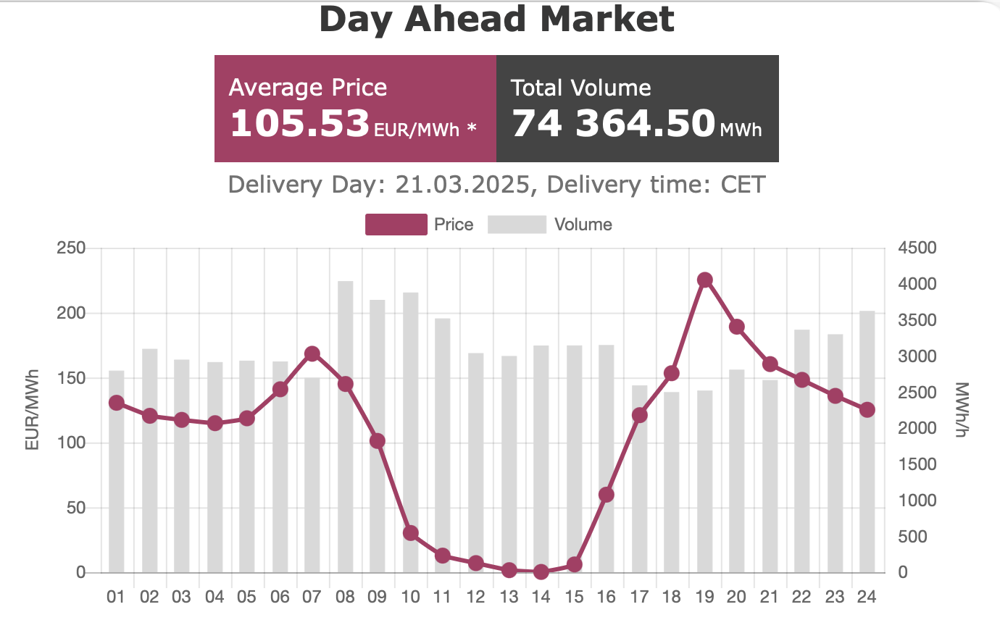
High and volatile electricity prices (Bulgaria today)

Slide 8
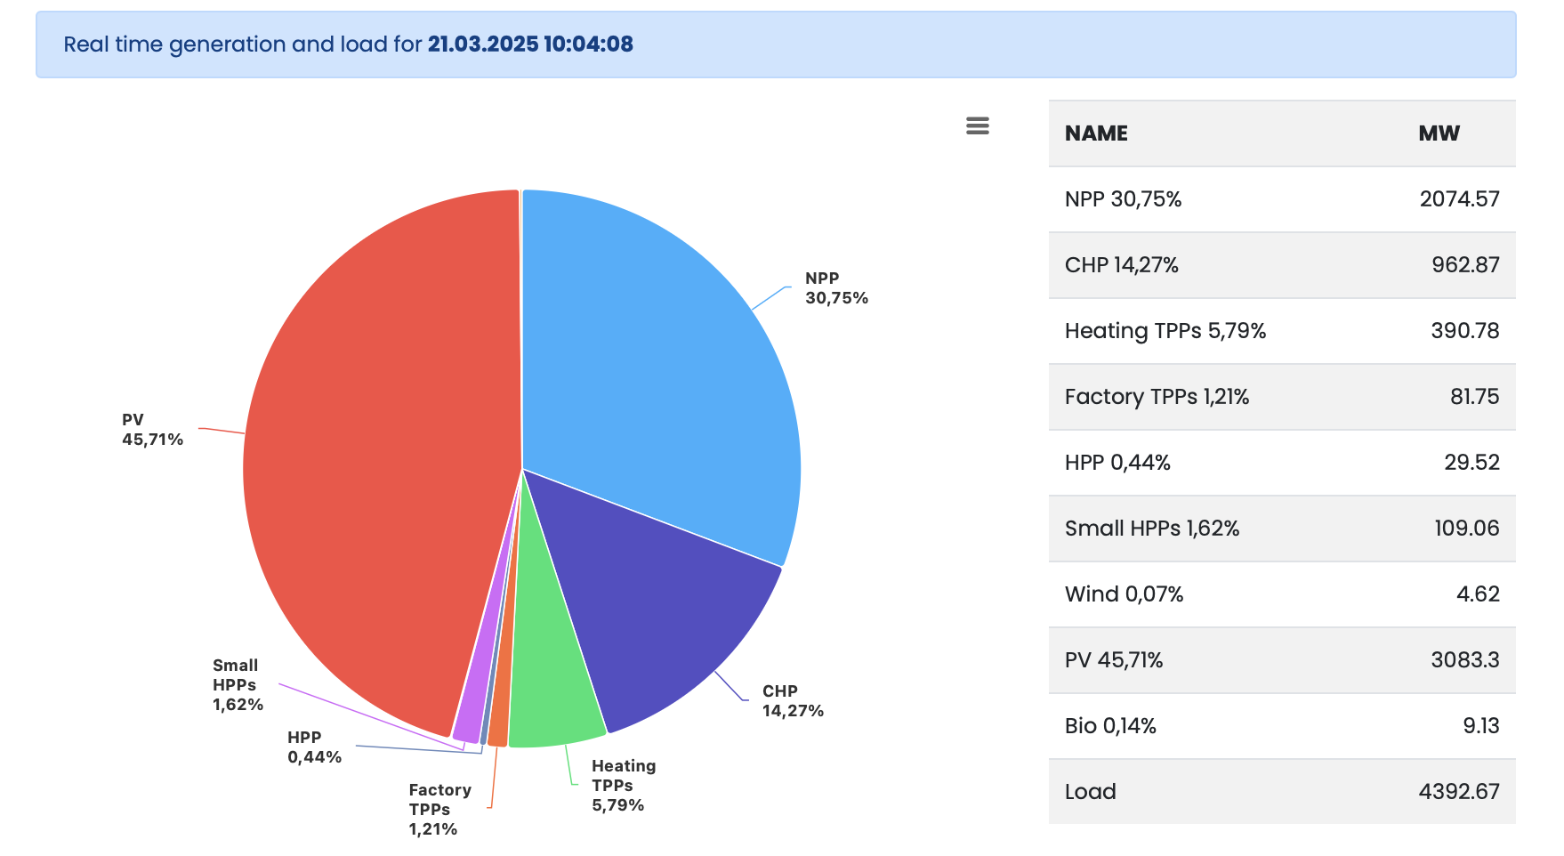
Strong growth of solar, underdeveloped wind (Bulgaria today)

Slide 9
Wind-Solar Complementarity

Slide 10
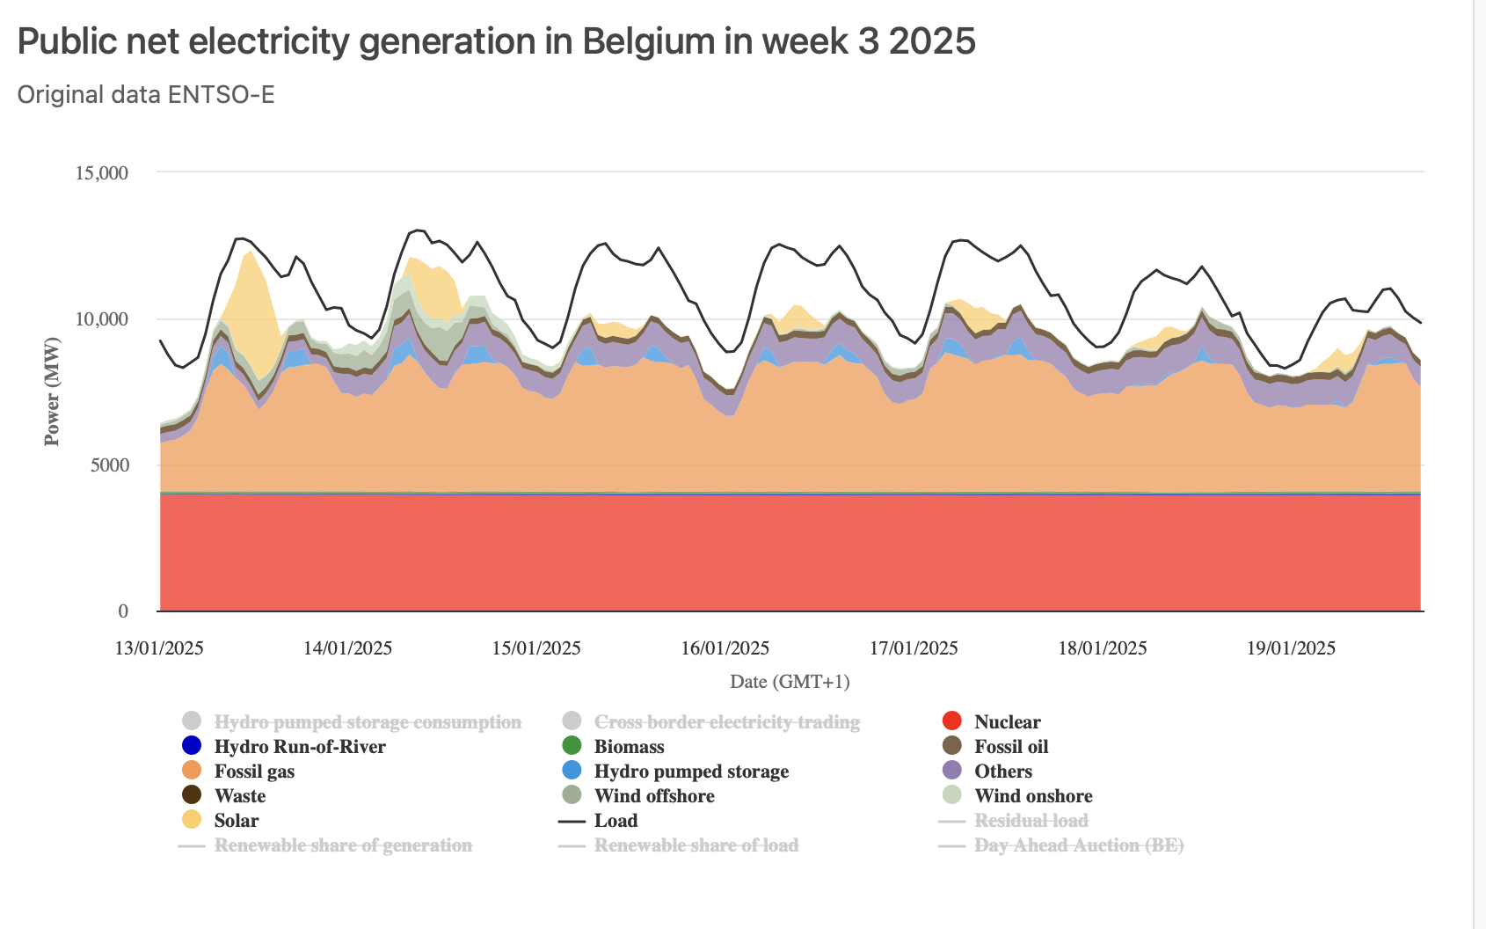
North-South Complementarity

Slide 11
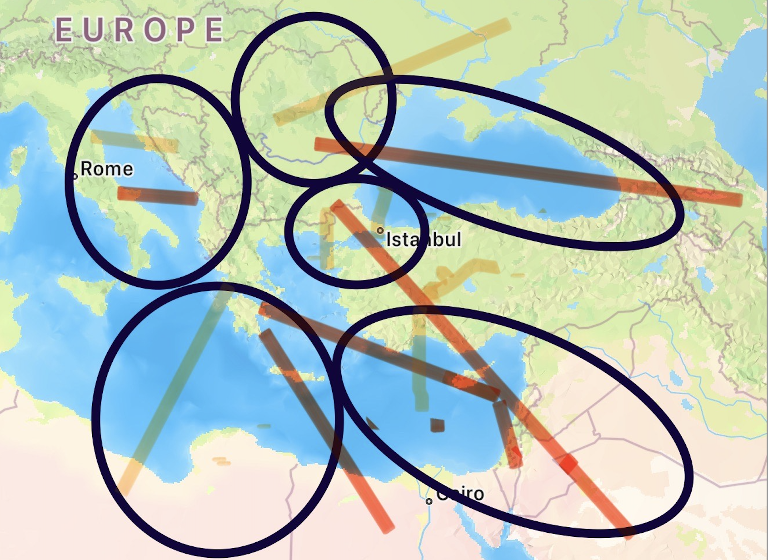
New Market and Grid Areas, the HVDC future
Black Sea
Mediterranean
Adriatic
Turkey
Gulf
Ukraine

Slide 12
What doesn’t work?
Flat subsidies
Profit restrictions
Market closure
Returning ETS revenue to coal and gas
100% (or close) subsidies for building retrofit
New nuclear is unlikely to have any effect before 2040
“H2 ready” infrastructure”
“Gas as a transitional fuel”

Slide 13
Ten Solutions
Encourage further expansion of solar and batteries
Accelerate wind to complement solar. Remove barriers.
Encourage market signals—let prices guide investments and behaviour.
Efficiency, optimisation, flexibility, demand side management
Reduce natural gas dependency on the energy system.
Target the support for energy poverty and strategic sectors
Deploy AI, it is not just a trendy story
Integrate markets – market coupling with Western Balkans
Build grids —strengthen infrastructure to avoid bottlenecks
Plan the HVDC future

Slide 14
Tackling High Power Prices and Market Volatility South-East Europe Policy Lense
Julian Popov
Strategic Perspectives
Former Minister of Environment and Water, Bulgaria (2013, 2023-24)
21 March 2025

