Slide 1
Decarbonisation and System Integration
of Heating and Cooling
25th Inter-Parliamentary Meeting
on renewable energy and energy efficiency
21 March 2025
European Commission – DG ENERGY
Matthieu Ballu
Renewables and Energy System Integration

Slide 2
Importance of heating and cooling in the EU
Half of all energy use in the EU
More than 70% of that is still fossil – mostly gas
Affordability, energy security
Slow progress on decarbonisation
Addressed in several new pieces of EU legislation: energy efficiency, renewable energy

Slide 3
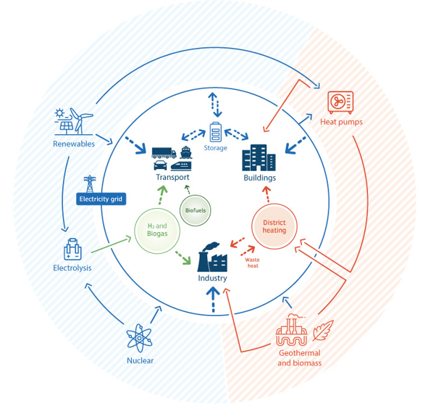
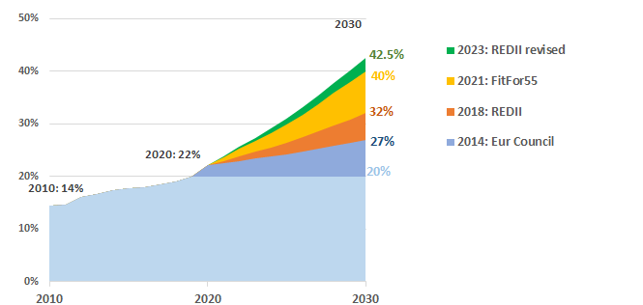
Energy system of tomorrow: decarbonised, integrated

Slide 4
Energy system integration: the way forward to decarbonise heating and cooling
Integrated planning (electricity, heat and gas; EU, national and local);
Energy efficiency;
Electrification and flexibility (heat pumps, storage);
Renewable heat (Geothermal, solar thermal);
Excess heat recovery.

Slide 5
New policy framework – important elements in place
Increased targets for renewable H&C;
Shorter permitting deadlines (incl. for large heat pumps);
January 2025: end of subsidies for fossil boilers
Signal for phase-out of fossil boilers by 2040
All new buildings to be zero-emission buildings:
2028 public buildings
2030 all new buildings

Slide 6
New policy framework – implementation challenges
Local heating and cooling plans in 1000 largest EU municipalities: complex for local authorities;
Challenge of decarbonisation of district heating and cooling networks;
New business models need to be created;
Switch to efficient and clean heat still expensive, complex. Electricity vs gas cost, skills needed.

Slide 7
Perspectives: affordability, competitiveness, security, 2040
2025:
Action Plan for Affordable Energy and Clean Industrial Deal:
Lower energy cost
Build future-proof infrastructure, markets and value chains
2026:
Heating and cooling strategy
Electrification Action Plan

Slide 8
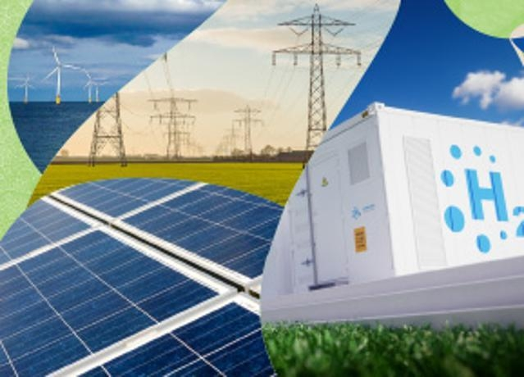
Thank you for your attention!
© European Union 2020
Unless otherwise noted the reuse of this presentation is authorised under the CC BY 4.0 license. For any use or reproduction of elements that are not owned by the EU, permission may need to be sought directly from the respective right holders.
Thank you!
matthieu.ballu@ec.europa.eu

