Slide 1
Narratives for the Competitiveness of Industry Christiane Egger
OÖ Energiesparverband
christiane.egger@esv.or.at

Slide 2
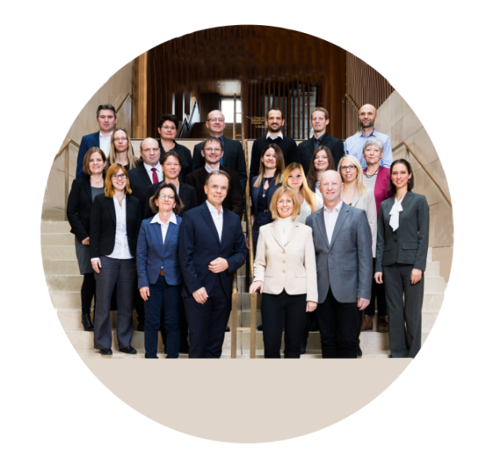
OÖ Energiesparverband The Energy Agency of Upper Austria
Services for households companies public sector
Our work
energy transition climate neutrality
energy efficiency renewables e-mobility
Advice
Information
Funding Networking
Training
Research

Slide 3
The region of Upper Austria
Capital: Linz
Population: 1.5 million
Industrial heartland of Austria
>25 % of Austrian exports
89 % renewable electricity
68 % space heating from renewables
41 % renewables in industry
3.5 billion Euro annual investments
in the energy transition

Slide 4
This project has received funding from the European Union’s LIFE Programme under Grant Agreement No. 101076918

Slide 5
Climate neutrality
Investment barriers
Know-how barriers
Mindset barriers

Slide 6
Climate neutrality =
transformation of industry and society at times where a lot of change is already happening
Status quo (=fossil-fuel based) perceived to be "safe" (as it worked well in the past)

Slide 7
Clean Industrial Deal:
"Decarbonisation is a powerful driver of growth"

Slide 8
Clean Industrial Deal:
"Decarbonisation is a powerful driver of growth" Are enough people truly convinced of this?
Are you truly convinced?

Slide 9
Clean Industrial Deal:
"Decarbonisation is a powerful driver of growth"
New narratives are needed!

Slide 10
The images in people's minds
Expensive
Energy transition
Climate
Not interesting for me

Slide 11
Narratives: Gaining buy-in from wider groups in society
Renewable energy makes us stronger
Less dependent from other countries
Cool jobs
Less CO₂

Slide 12
Narratives: We also need to overcome counter-narratives ("killer arguments")
Let's get serious about the industrial energy transition!
We do not have the technologies yet.
China and US don't do it, why should we?
The investments are too high

Slide 13
WHY is climate neutrality
a good deal
for businesses and for countries?

Slide 14
Why industry decarbonisarion? To keep industry in Europe!
Energy security, lower risks
Stable energy costs
Cleantech innovation
Investments and jobs
Modernisation and productivity increase
Climate protection

Slide 15
IS THIS "NICE TO HAVE" OR A "MUST HAVE"?

Slide 16
DO WE REALLY HAVE A CHOICE?
Will yesterday's world come back (soon)?
pre Ukraine war
pre Chinese manufacturing boom
pre Trump
The critical question is the speed of the transition.

Slide 17
Can we afford it? Example Germany 2023 - 2045
Investments in the energy transition and energy costs
Business as usual scenario
13,300 billion Euro total costs
20% investment costs
80% energy costs
plus further investments required after 2045
Source: PwC

Slide 18
Can we afford it? Example Germany 2023 - 2045
Investments in the energy transition and energy costs
Business as usual scenario
13,300 billion Euro total costs
20% investment costs
80% energy costs
plus further investments required after 2045
Accelerated transition scenario
13,200 billion Euro total costs
40% investment costs
60% energy costs
no further investments required after 2045
Source: PwC

Slide 19
Goal: Upper Austria - leader in the energy transition and climate neutrality
competitiveness and quality of life through the energy transition (and not: despite of)
tackling energy in buildings,
industry and transport
market leadership in innovative energy products and services
innovation - investment - involvement public bodies, citizens and businesses

Slide 20
Goal: Upper Austria - leader in the energy transition and climate neutrality
competitiveness and quality of life through the energy transition (and not: despite of)
Industry: 42 % of our energy consumption
tackling energy in buildings,
industry and transport
market leadership in innovative energy products and services
innovation - investment - involvement public bodies, citizens and businesses

Slide 21
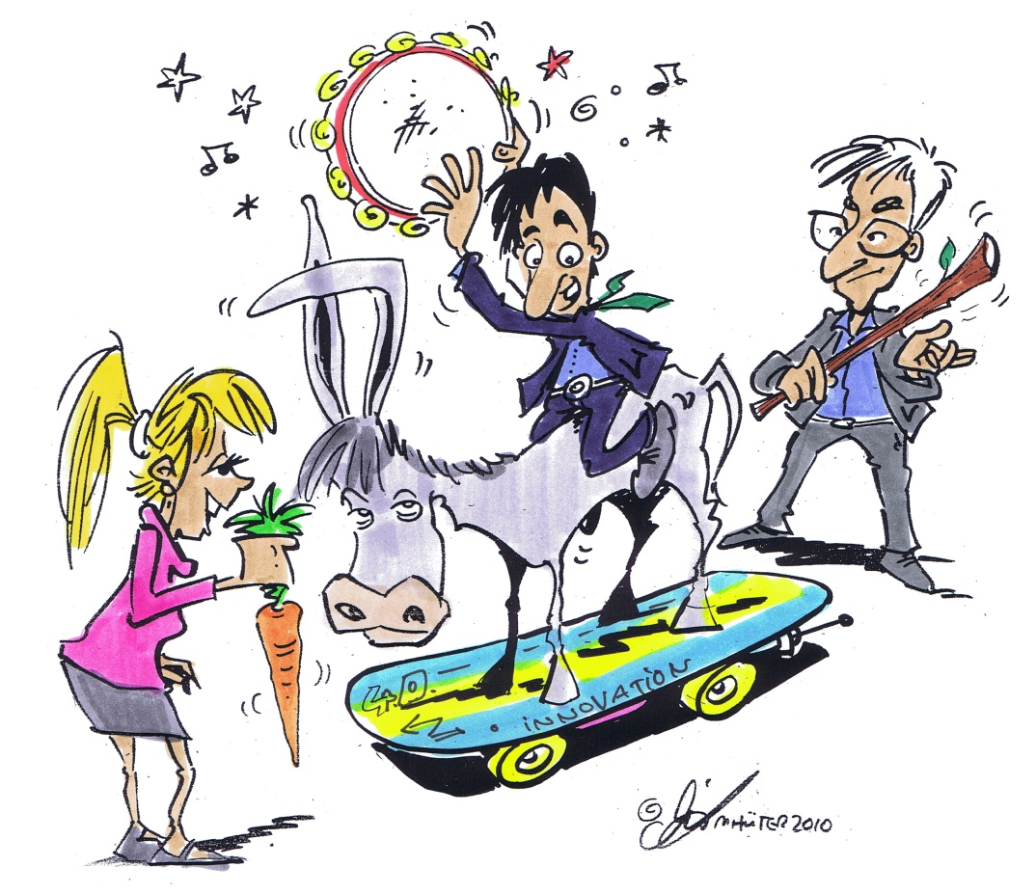
Upper Austria's policy approach: Carrots, sticks, tambourines and a skateboard

Slide 22
Policies in Upper Austria: Industrial Energy Transition Leader
Innovation Ecosystem: industry, researchers and public bodies work together (NEFI)
Funding: 3 billion Euro from the federal government for the industrial energy transition
Cleantech: Support for developing products and services for the world markets (CTC)
Skills: Dedicated university and school programmes
41 % renewables in industry energy consumption
Narrative: We show how companies are becoming climate-neutral and increase their competitiveness and profits
We show how companies are becoming climate-neutral and thereby increase their competitiveness and profits.

Slide 23
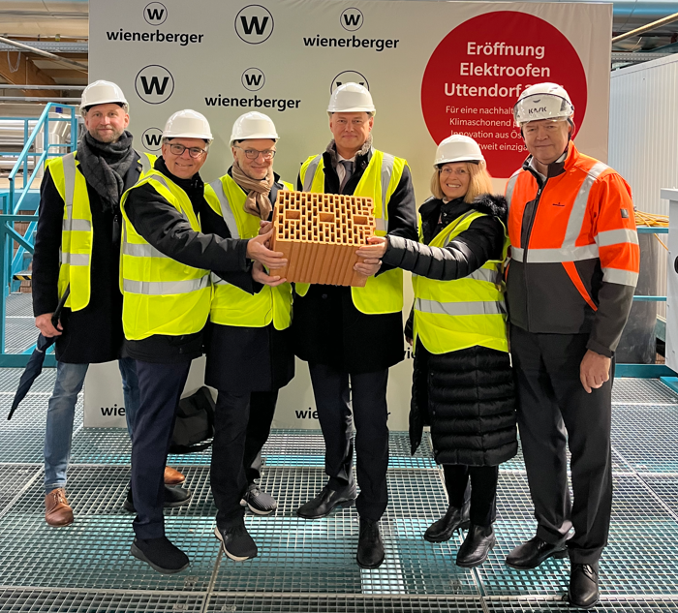
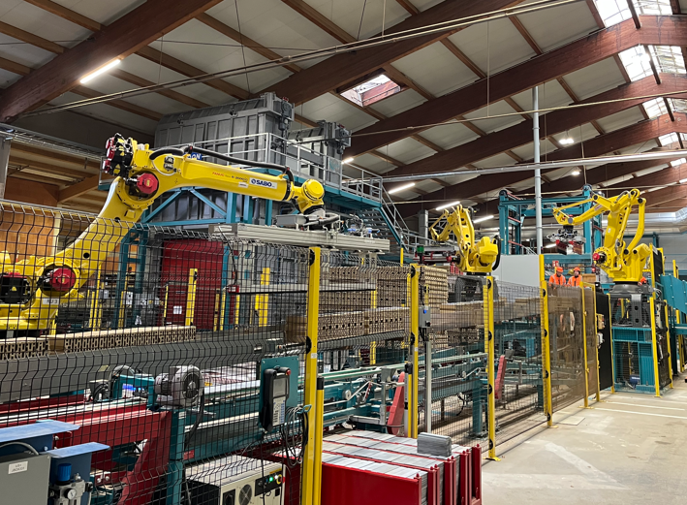
First climate-neutral brick factory in operation!
Wienerberger, the world's largest brick manufacturer with over 200 plants worldwide
Factory in Upper Austria pioneers the company's climate-neutrality pathway
Innovative combination of measures: - electrification (one of largest electric furnaces), 4 HT heat pumps - a new clay mix - advanced energy efficiency measures (-30 % consumption)
30 million Euro investments, 7 million Euro subsidies
Ambitious strategy for the roll-out
Key driver: to remain "climate-competitive" with the construction material wood
Benefits after 3 months of full operation: - productivity increase (shorter firing times) - higher worker safety - improved product quality

Slide 24
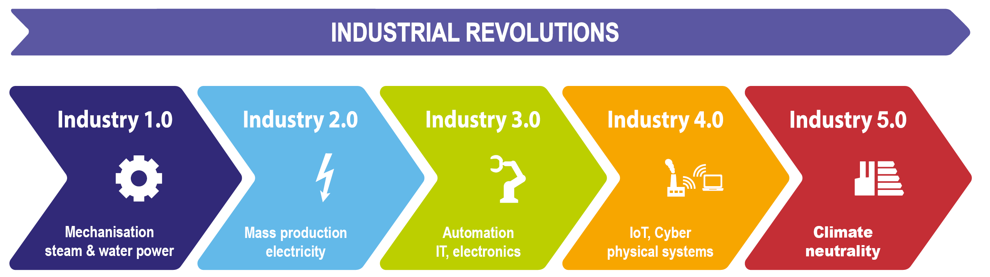
Industrial Revolutions
© Christiane Egger, OÖ Energiesparverband
Industry 5.0: Independence from fossil fuels is a decisive factor for competitiveness -> now economic survival

Slide 25
INDUSTRIAL ENERGY TRANSITION AS QUICKLY AS POSSIBLE!

Slide 27
Economic benefits of the industrial energy transition
Decrease of energy costs
Risk reduction: decreasing dependence of imported gas and price fluctuations
Company image: improving employee loyalty and employer brand for future staff
Productivity increase: improved work conditions, reduction of waste heat
Customer requirements: fulfilling requirements within global/local supply chains
Reporting obligations: GHG information required by banks and customers, fulfilling reporting obligations

Slide 28
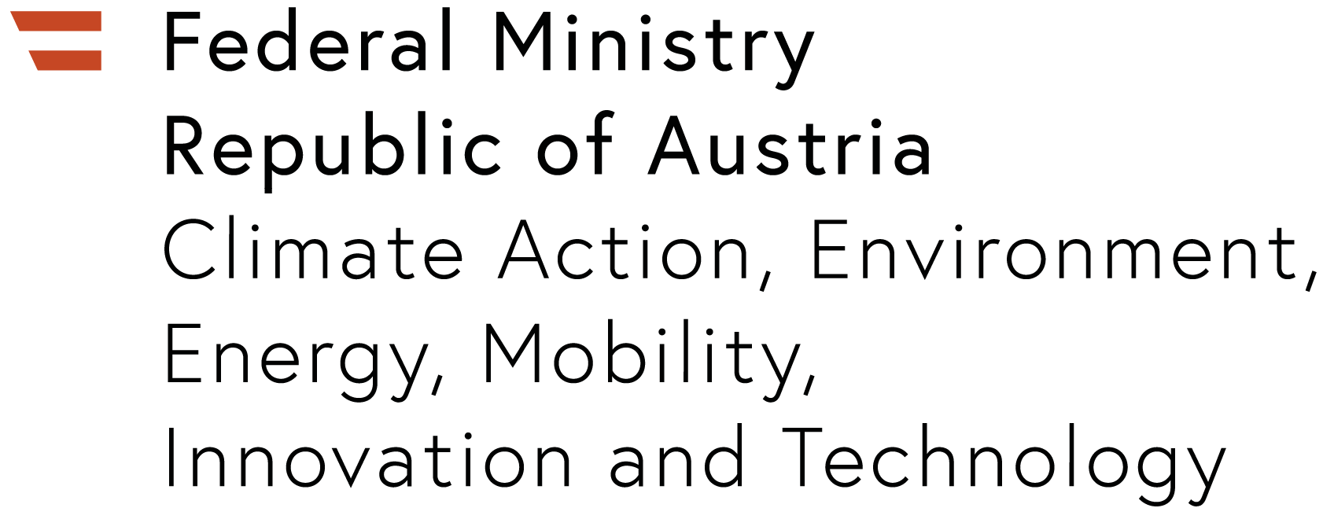
F&E Plattform NEFI: New Energy for Industry
NEFI: The Austrian R&D platform for the industrial transformation
National innovation network (2016-2031)
Focus: technologies for the decarbonisation of industrial energy systems
Geographic focus on the two industrial regions Upper Austria and Styria
Approx. 120 partners from industry, RTOs and public institutions
25 sub-projects, total investments 100 million Euro, 40 million Euro public funding

