Slide 1
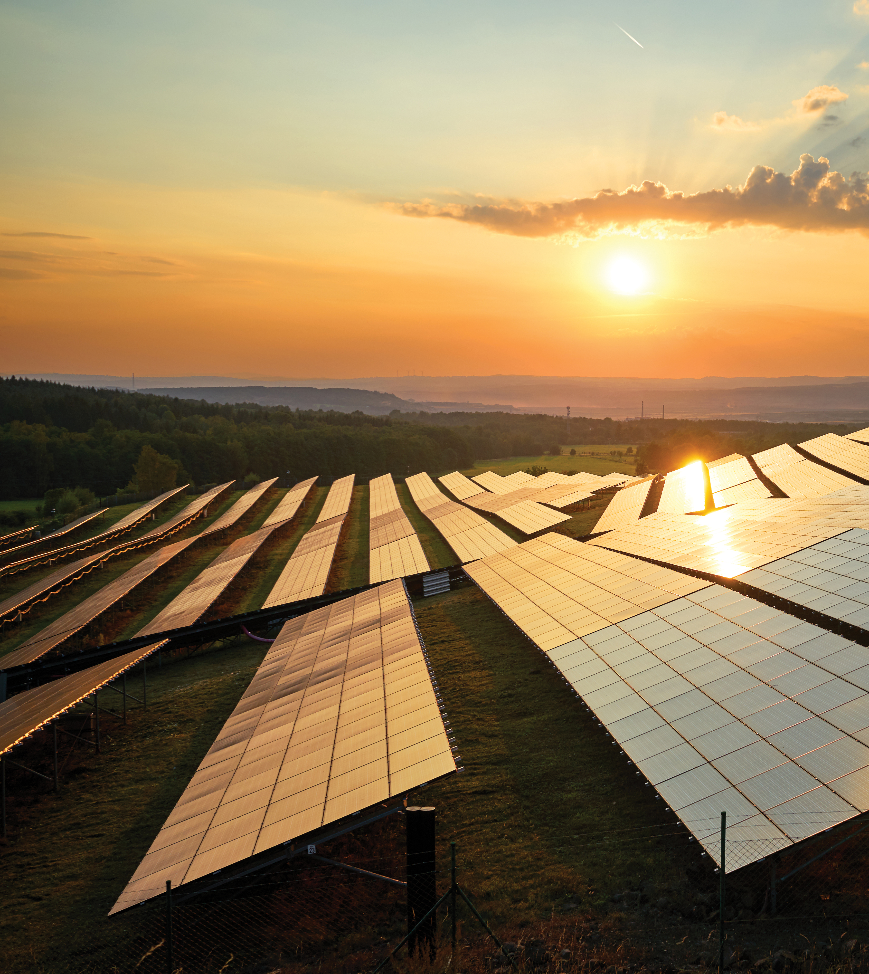
Solar Energy today - big, fast and affordable worldwide and in Europe
Walburga Hemetsberger, CEO SolarPower Europe
Eufores, 20 March 2025

Slide 2
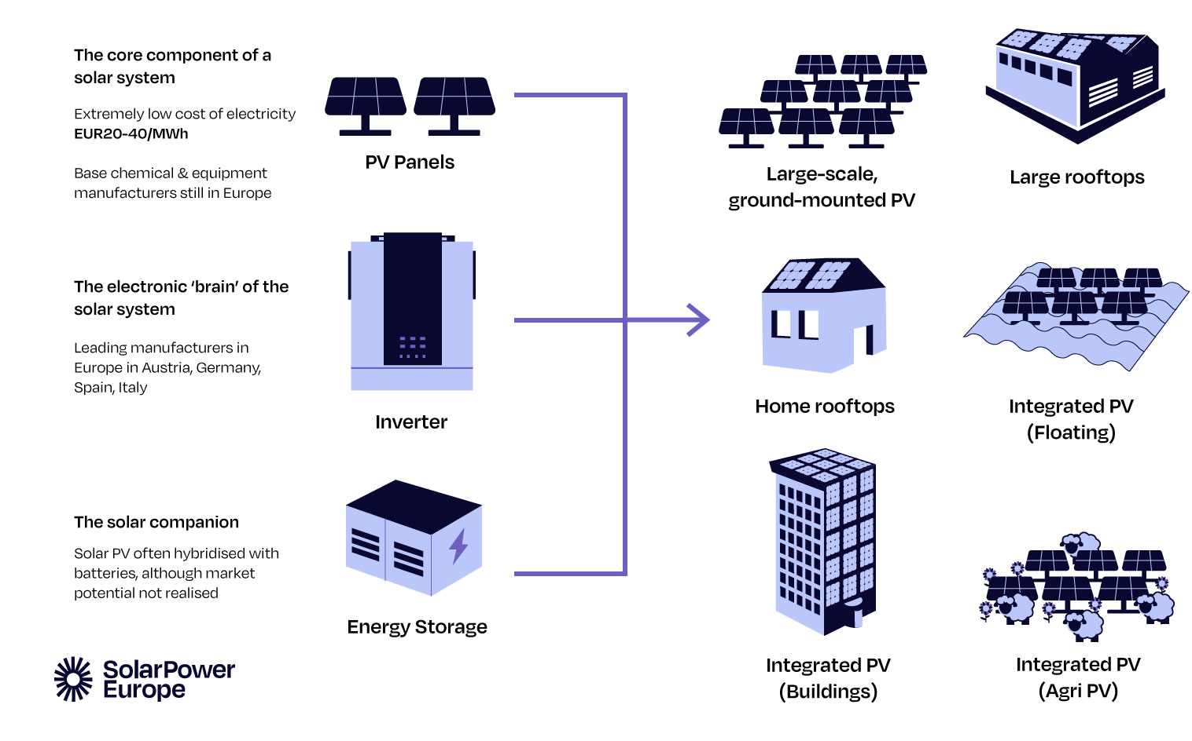
Solar?

Slide 3
330 GW
65.5 GW
800.000
Installed capacity at the end of 2024 – almost 10% of Europe’s power production
Installed in 2024: new market record for the fourth consecutive year
EU solar jobs end 2024 – 87% of solar workforce working in deployment of solar
Notes:
Here are 3 numbers to remember from our EU Market Outlook 2024

Slide 4
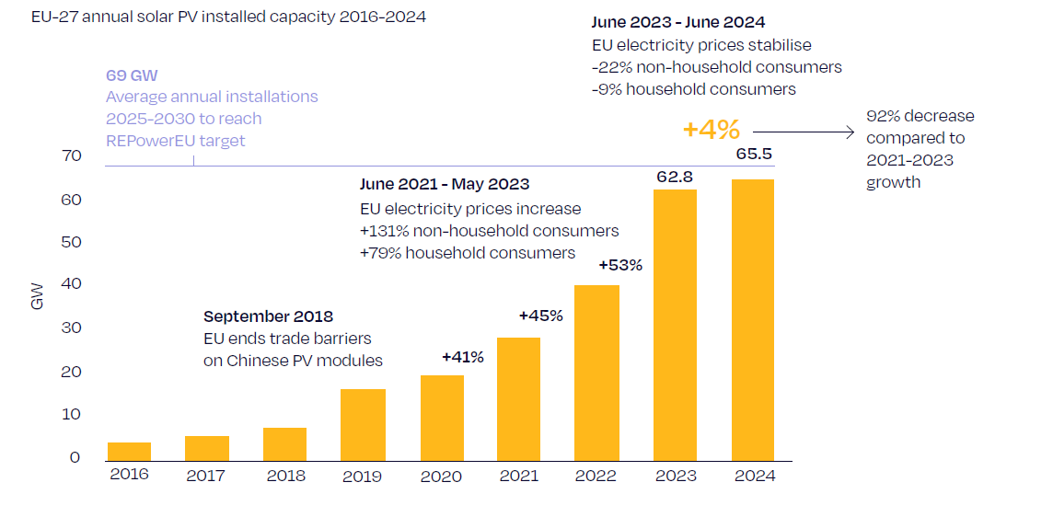
Steep solar growth in the last years
Notes:
In 2024, the European Union installed 65.5 GW of solar PV, marking the eighth consecutive year of record-breaking annual additions. However, the annual growth rate decelerated significantly to 4.4% compared to the robust 41-53% observed during 2021-2023. This slowdown was expected, as the exceptional surge in 2022 and 2023 was largely driven by soaring electricity prices during the energy crisis (see Fig. 1).
The slowdown is not too surprising. Following the solar boom during the gas crisis, the urgency of going solar has waned for citizens as their bills have normalised. Developers face deceleration for different reasons. The energy system has not kept up with the solar growth curve, and building bankable utility-scale solar becomes more challenging as grid and flexibility bottlenecks tighten.
We did see already strong growth rates earlier – from 2018-2019 by 110%, but that was after the MIP was cancelled and the market was much smaller.
Policy need to pick up to meet target / solar helped for power prices to stablise / now policy has to step up

Slide 5
EU solar goes past coal generation for the first time in 2024

Slide 6
EU wind and solar overtake fossil power in the first half of 2024

Slide 7
Solar generation is surging in every EU country

Slide 8
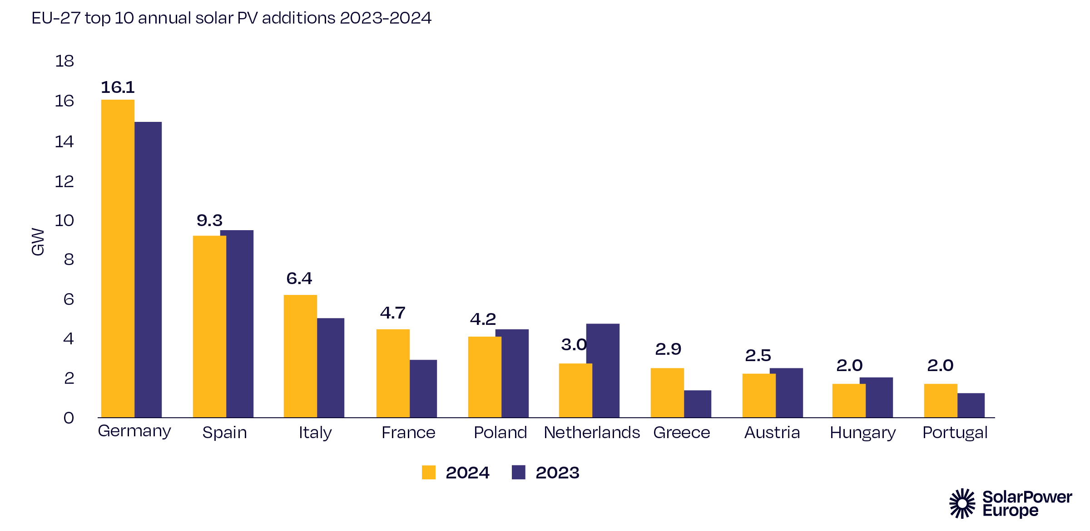
Top 10 EU Solar Markets
Notes:
While most of the markets are influenced by common EU-wide energy price and energy market trends, such as lower electricity prices, limited energy storage capacity and insufficient system flexibility, each country is confronted with somewhat different local policy frameworks and a solar sector at a different evolutionary stage, thus experiencing its own unique set of challenges and drivers that shape its solar market dynamics
Despite the challenges faced in the 10 largest solar markets, there has been only minimal changes in the ranking in 2024, with only two new entries – Greece, now ranked 7th, and Portugal, on 10th place – replacing Sweden and Belgium (see Fig. 13).
In 2024, 2.0 GW of newly installed capacity was needed to enter the top 10, up from 1.5 GW in 2023.
At the same time, 16 out of 27 EU Member States added more than 1 GW of solar capacity in 2024 – that’s another all-time record and 2 more than in 2023 (see Chapter 5 for more details of the GW-scale markets in the EU).

Slide 9
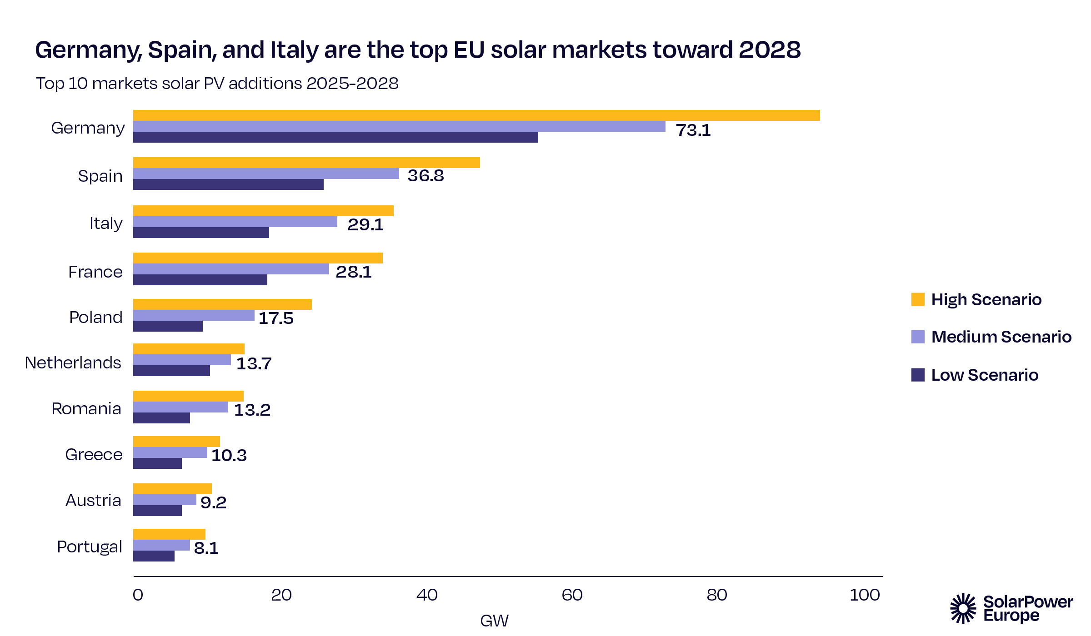
Notes:
The distribution of future solar PV installations across the EU is expected to remain dominated by the current largest markets. Over the next four years, Germany is projected to lead with 73.1 GW of new capacity, followed by Spain with 36.8 GW, Italy with 29.1 GW, France with 28.1 GW, and Poland with 17.5 GW (see Fig. 22). In our Medium Scenario, the top 3 markets (Germany, Spain, Italy) are expected to add 139 GW between 2025-2028, representing 46% of the EU’s new solar capacity. Including France and Poland, the top 5 markets’ share increases to 61%.
Individual projections reflect a more tempered outlook compared to our forecast from June 2024. Germany’s anticipated additions are down by 16%, and Spain’s by 4%. Italy is expected to grow more but very modestly by 2%, while France stands out with a 15% upward revision. Poland is revised downward by 5%. All other top markets have been downgraded too, except for Romania which is expected to grow 4% more.

Slide 10
Green Policy - outdated?

Slide 11
Europe’s Security

Slide 12
Europe’s Competitiveness

Slide 13
Avoiding costs from Climate disasters

Slide 14
Not feasible?

Slide 15
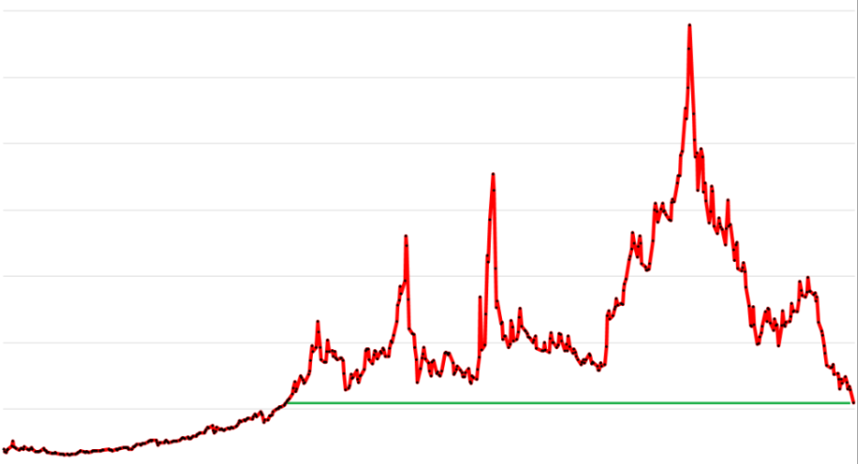
Volatility?
→ Natural Gas prices (ICE Dutch TTF) 2021 - 2023
Source: investing.com

Slide 16
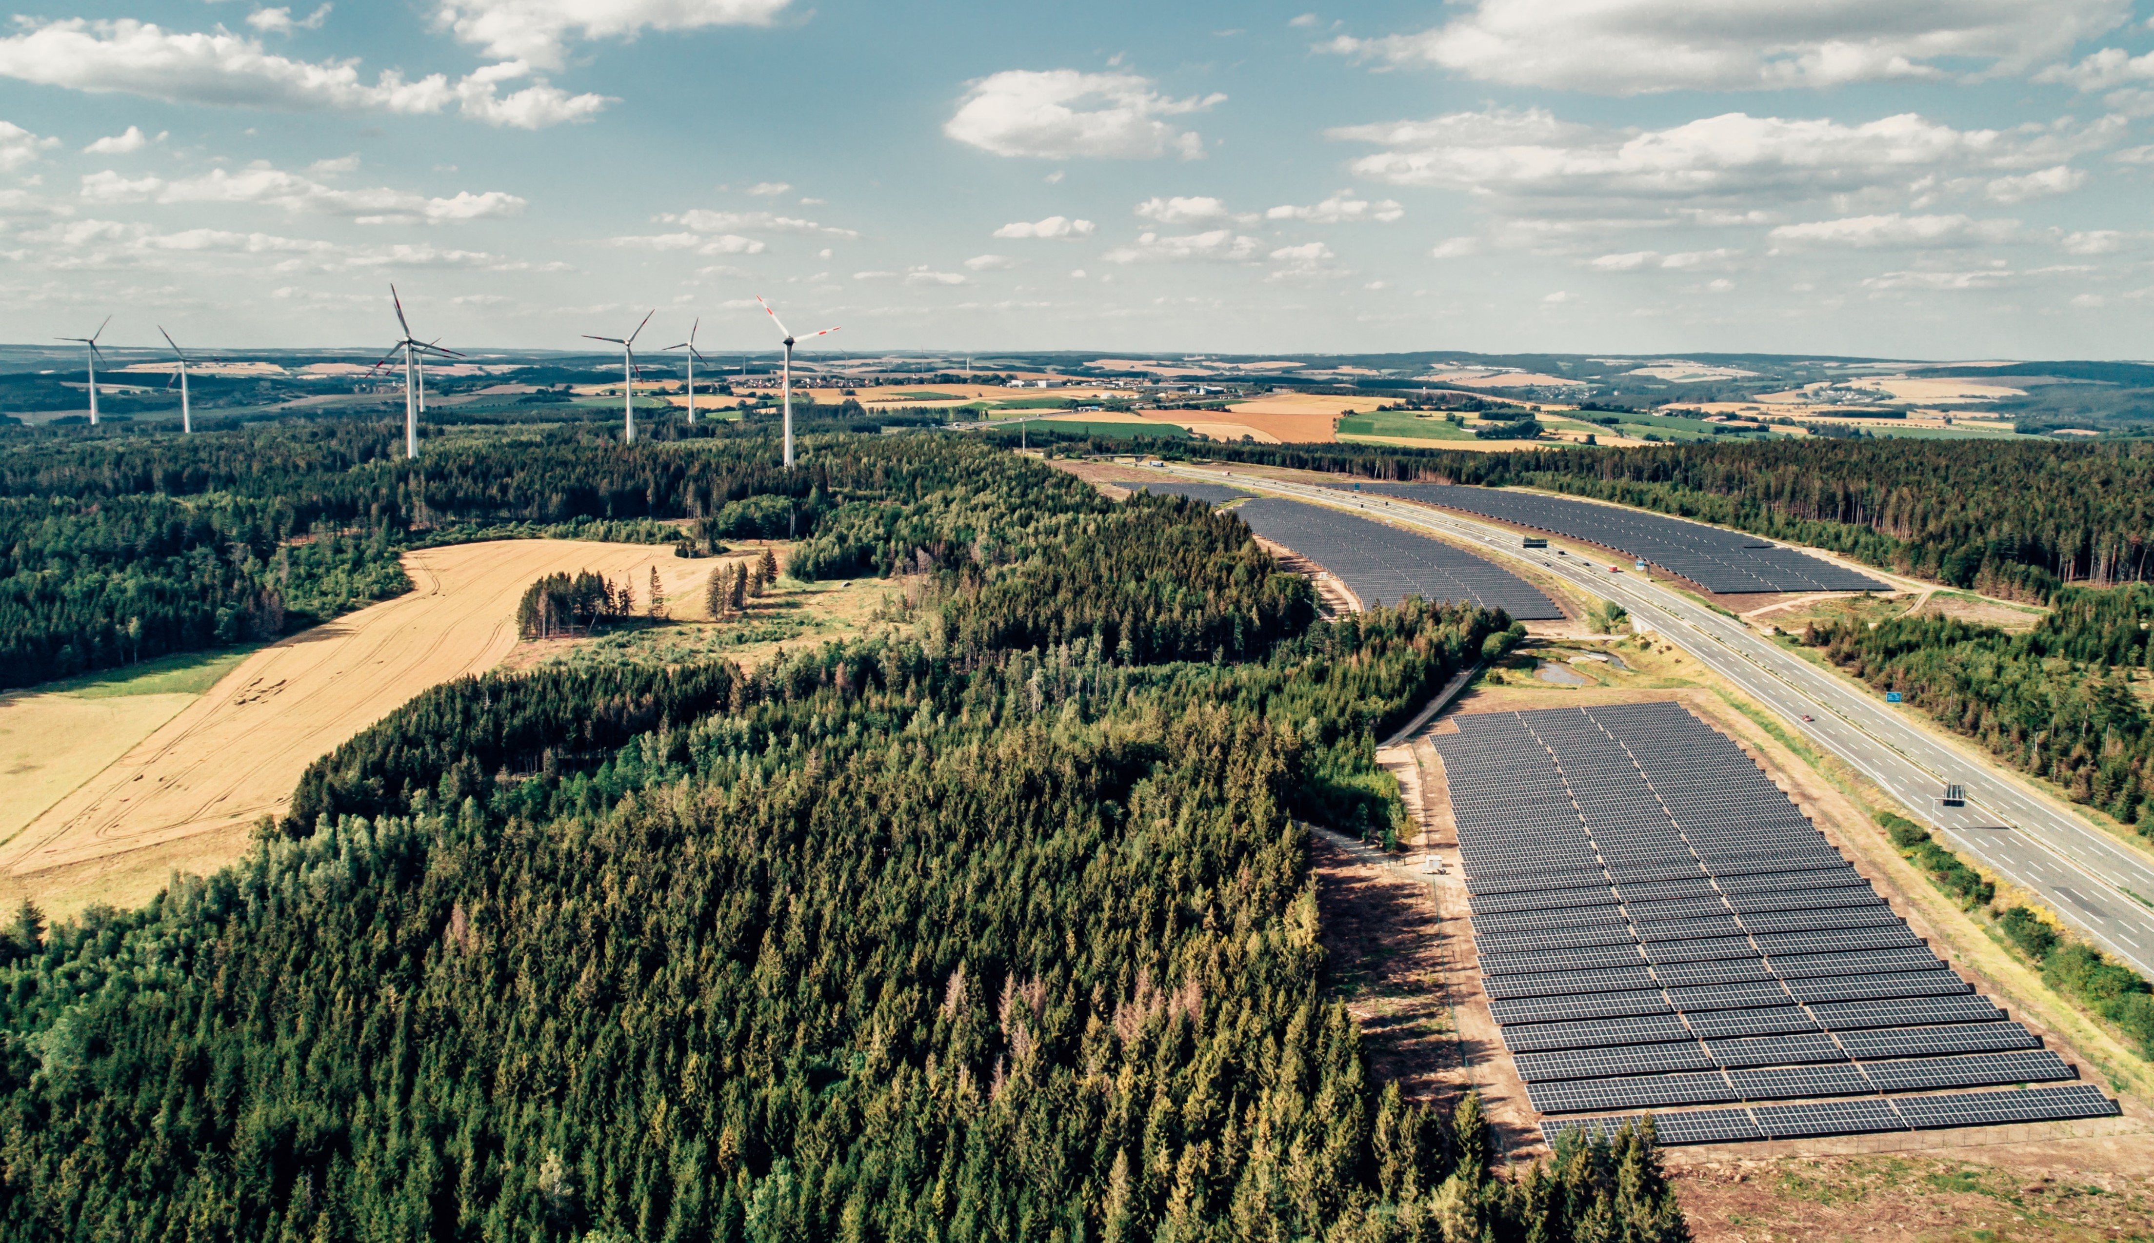
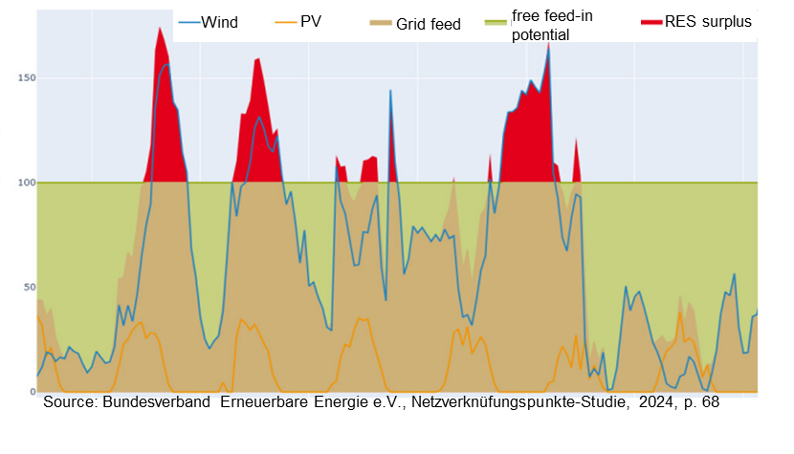
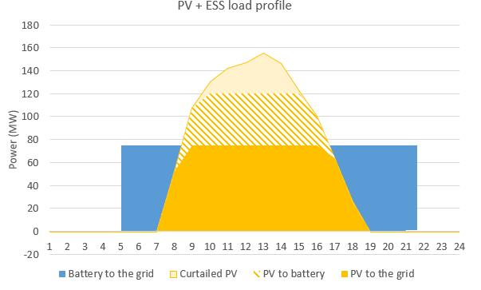
Solution: Combining technologies complementing each other
Solar + Wind
Solar + Storage

Slide 17
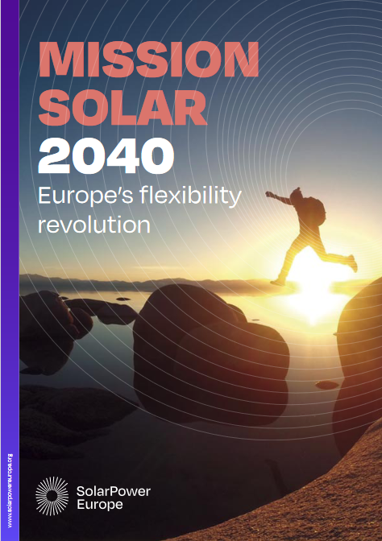
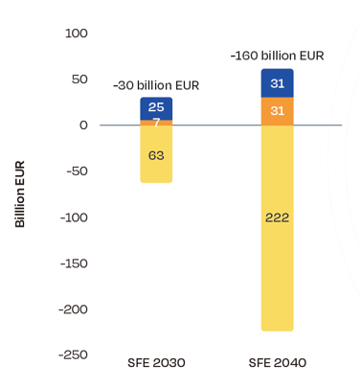
Solution: Adding Flexibility to the System
Annual Energy System Costs 2030 and 2040 in a highly flexible, electrified scenario compared to a scenario with little of such features.
EU average wholesale
electricity price (SFE Scenario), with more efficient technologies
Solar curtailment share (%)
Notes:
This only translates into direct financial benefits to consumers via direct electrification. Then, solar starts to heavily contribute to Europe’s competiveness and energy security
2040 modelling shows that solar + flexibility + electrification is critical:
Total system costs
Market prices
Curtailment

Slide 18
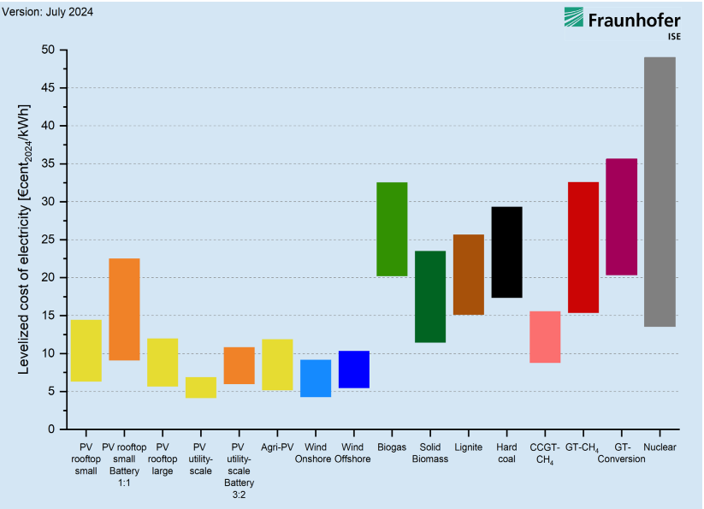
Solar & wind are the cheapest power generation technologies
Expensive?
Solar & Wind
PV & Batteries
Solar + battery storage is already today cheaper then fossil flexibility in many cases

Slide 19
How much can Solar contribute by 2030?

Slide 20
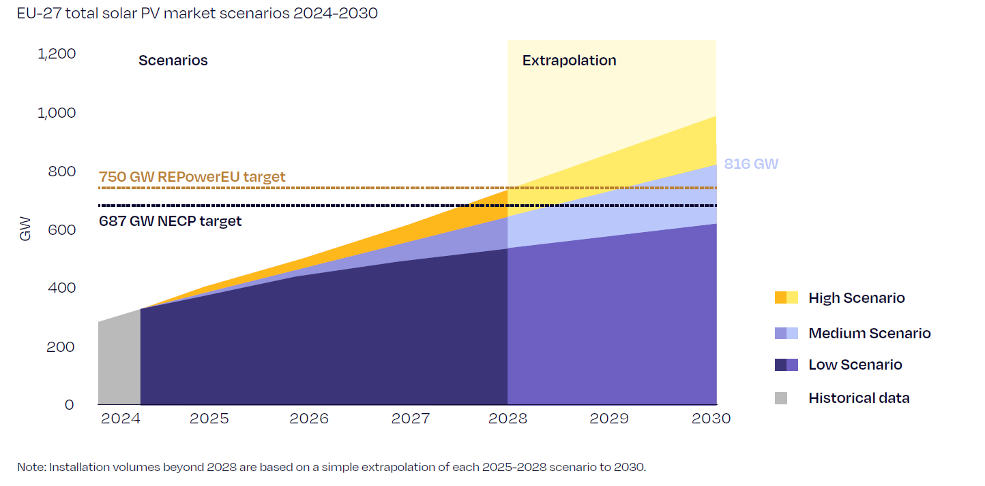
Solar will continue to grow
Notes:
The good news: Our Medium Scenario suggests that the EU solar market is still on track to meet the REPowerEU target of 750 GWDC (600 GWAC) by 2030 as well as the less ambitous NECP target.
The most likely total operating solar capacity deployed in the EU by 2030 is projected to reach 816 GW, which is still 9% above the EU Commission’s target.
However, our forecast has decreased by 8% or 74 GW from 890 GW in our previous analysis only 6 months, when we published our GMO. And 1 year ago, we were even estimating the market to reach 902
A further slowdown in the solar market in the coming years could jeopardise Europe’s solar commitment. The Low Scenario, estimating 644 GW by 2030, falls significantly short of the REPowerEU target by 14% or 100 GW.

Slide 21
Let’s get it done

Slide 22
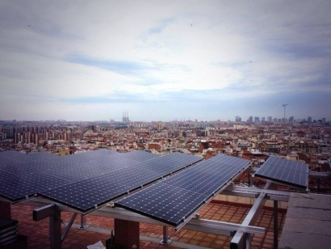
Maintain an investment-friendly environment

Slide 23
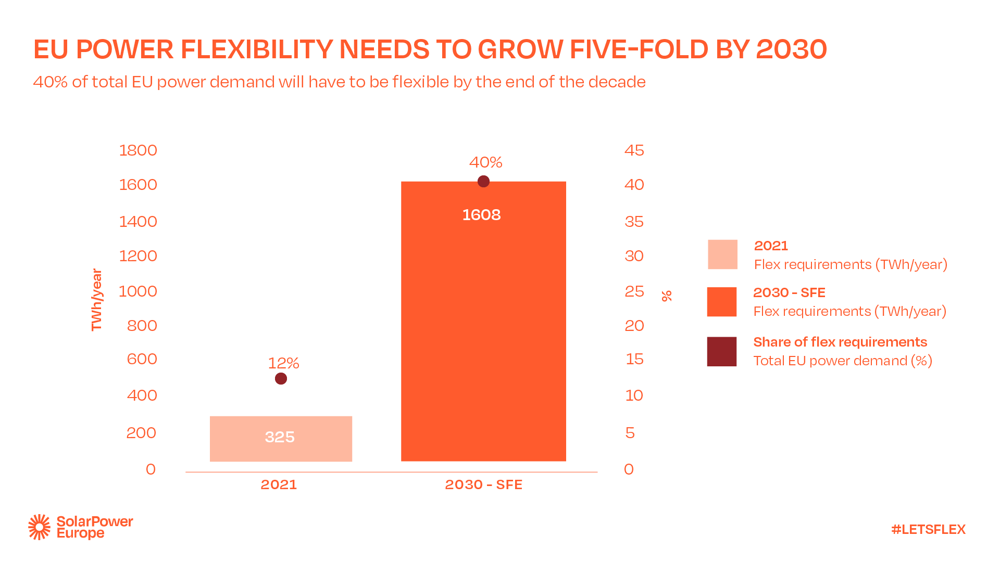

Slide 24
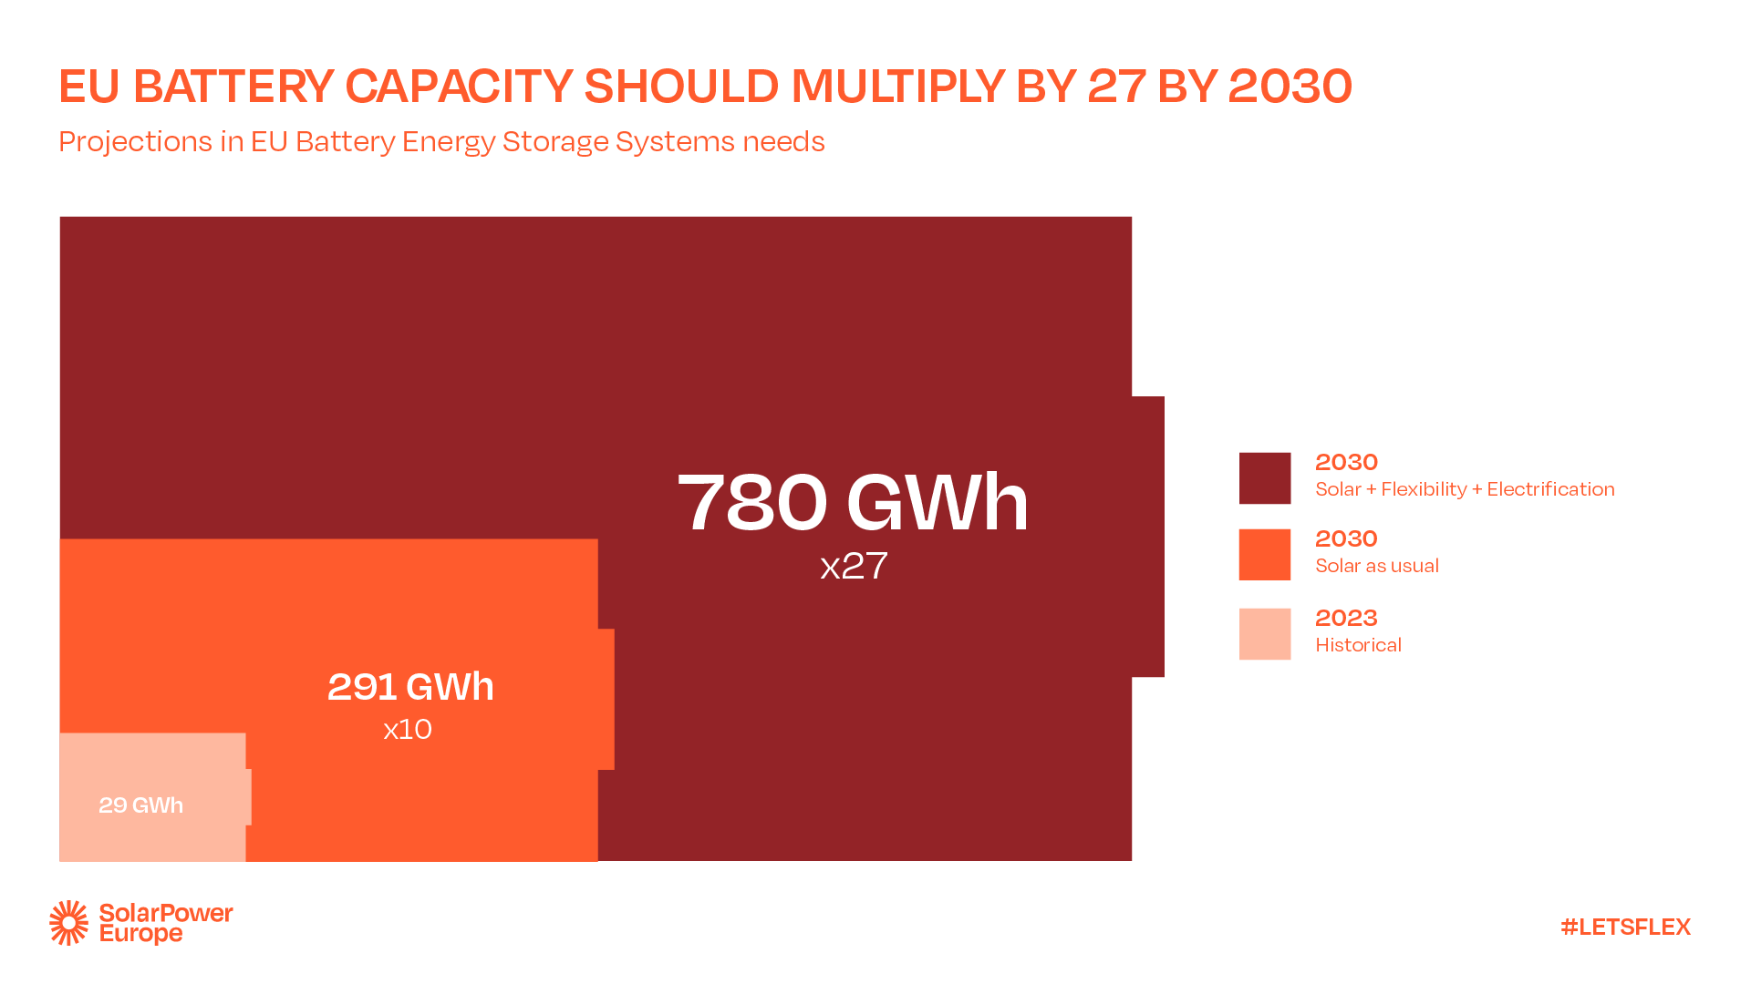

Slide 25
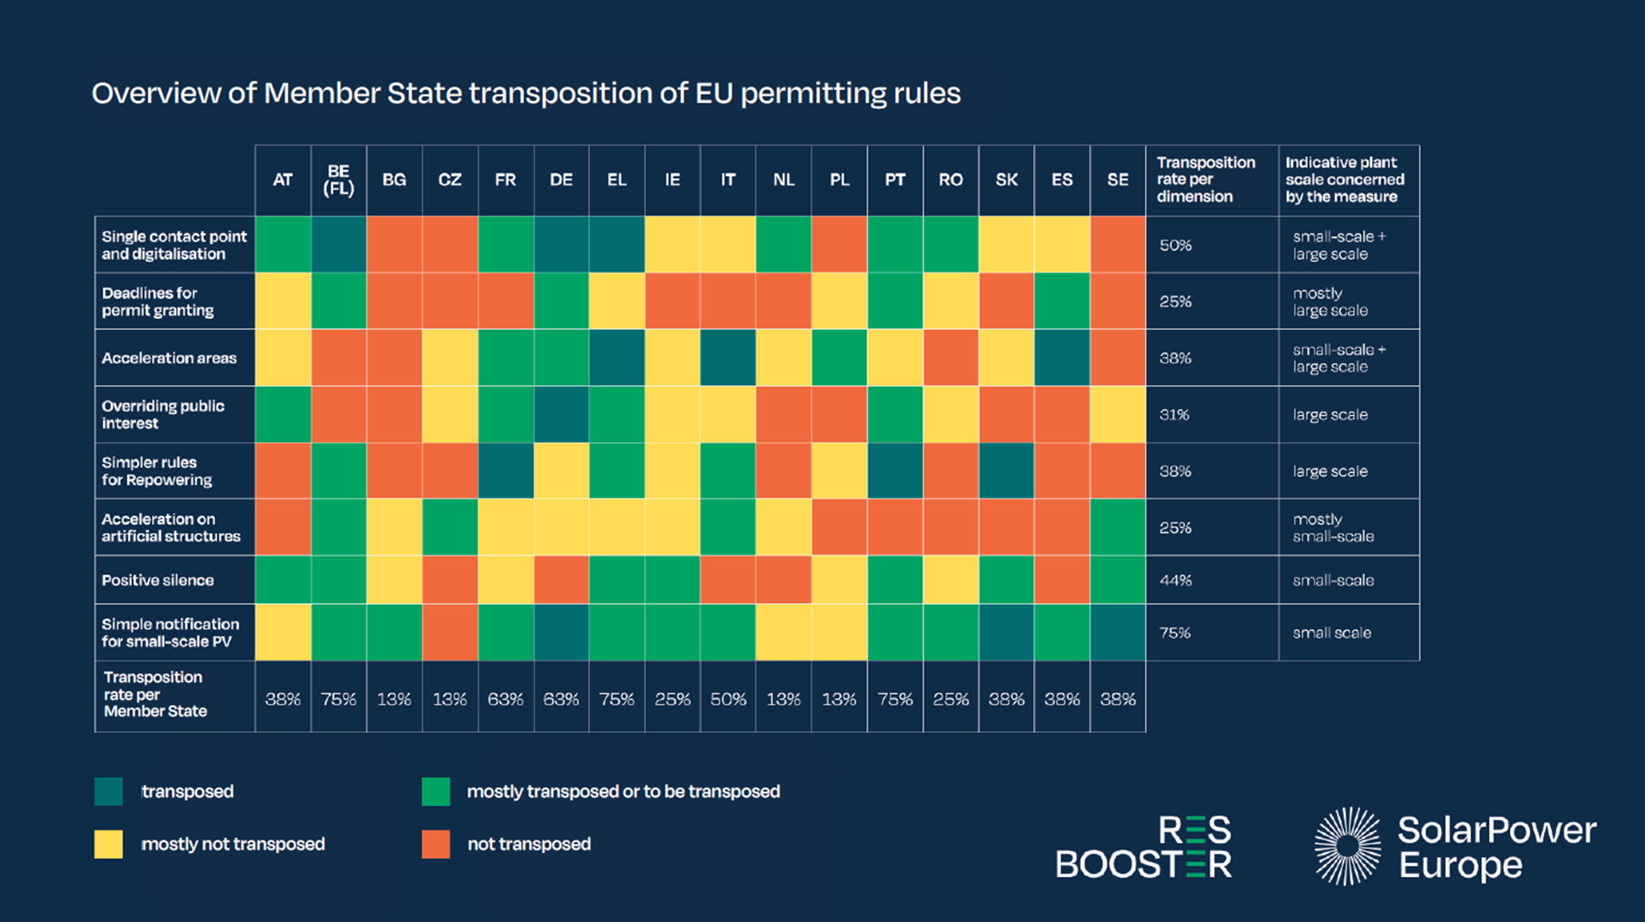
Speed up permitting

Slide 26
Promote dual use of land – to the benefits of all stakeholders

Slide 27
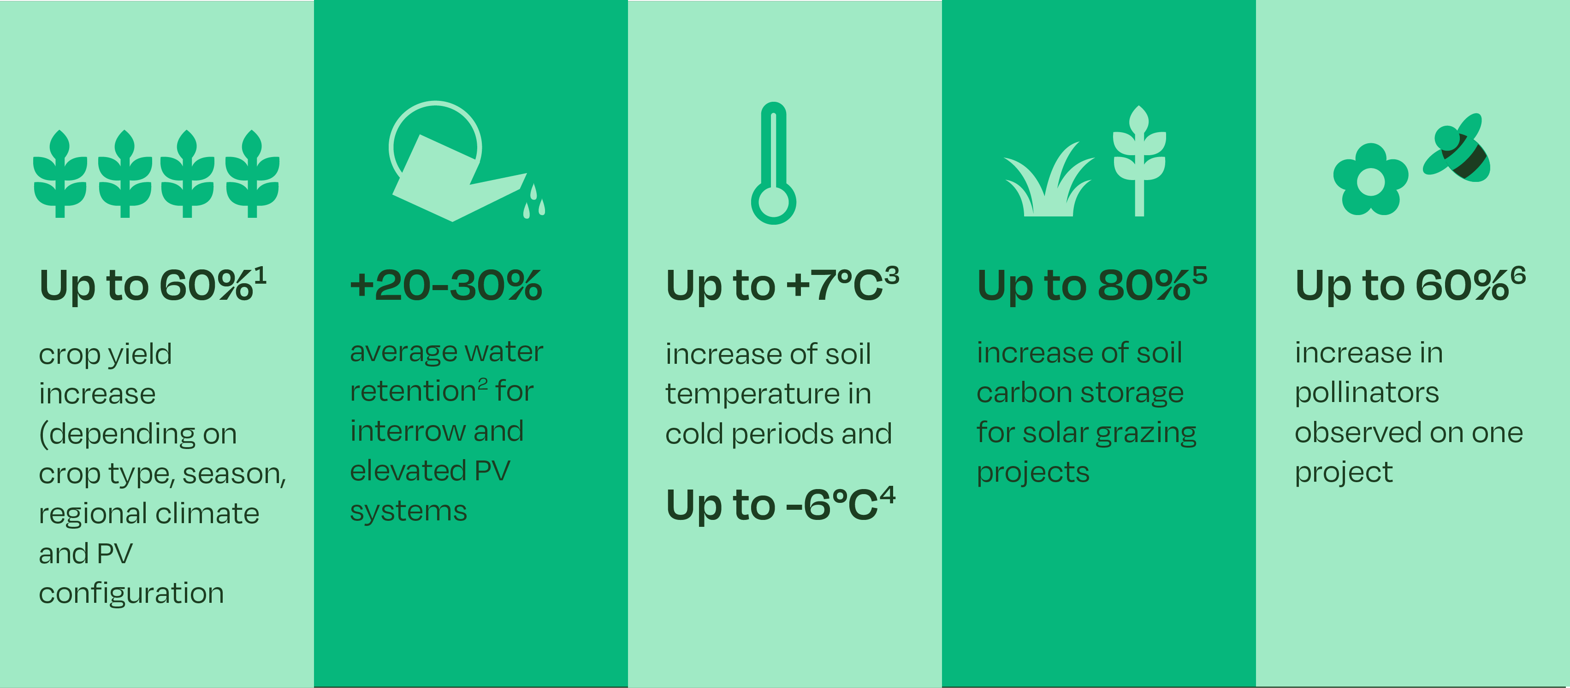
Agrisolar offers a win-win-win for the farming sector, the energy sector and society at large.
Notes:
Agrisolar creates additional income for farmers, most often through land lease payment from the developers, and/or by directly providing agricultural infrastructure for farmers, and/or through reduction on energy bills. Such revenues contribute to the economic viability of the farm, and generates an income that helps farmers invest into transitional activities such as organic farming, agroforestry or electrification.
Agrisolar comes with agronomic benefits for farmers. While some systems require removing some productive land, they generally result in substantial increases in crop yield. They also in general support savings on water usage.
Agrisolar reinforces farmers’ environmental and nature restoration activities. The shade coming from agrisolar installations have a notably positive impact on pollinator population and soil quality under the panels.

Slide 28
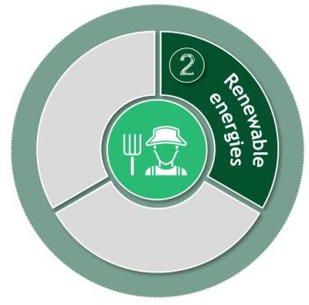
Farmer's P&L perspective | Significant profit benefits through Agri-PV
Archetype 3: 1,000 ha
Large crop farm Average size
1,000 ha
Cropland
0 ha
Grassland
Leasing & service model on 100 hectares of cropland
(10% of total farm land)
Illustrative
Phase 1—Preparation
Phase 2—Transition
Phase 3—Expansion
Phase 4—Steady state
Cleaning equipment upfront investment non-substantial for large crop farm
777k€ p.a.
Impact
~245k€ p.a.
Steady lease and service revenues
with minimal operational impact
532k€ p.a.
Copyright © 2024 by Boston Consulting Group. All rights reserved.
through Agri PV
344k€ p.a.
Conventional profit level (baseline)
Regen Ag profit level
RegenAg incl. renewable energies
First field transition
Note: Excluding subsidies; assuming purely conventional farming as starting point mixed farm with 140 ha cereal & oil seed, 60 ha corn, 100 ha grassland Source: Expert & farmer interviews; BayWa r.e.; BCG analysis
Source: BCG
6

Slide 30
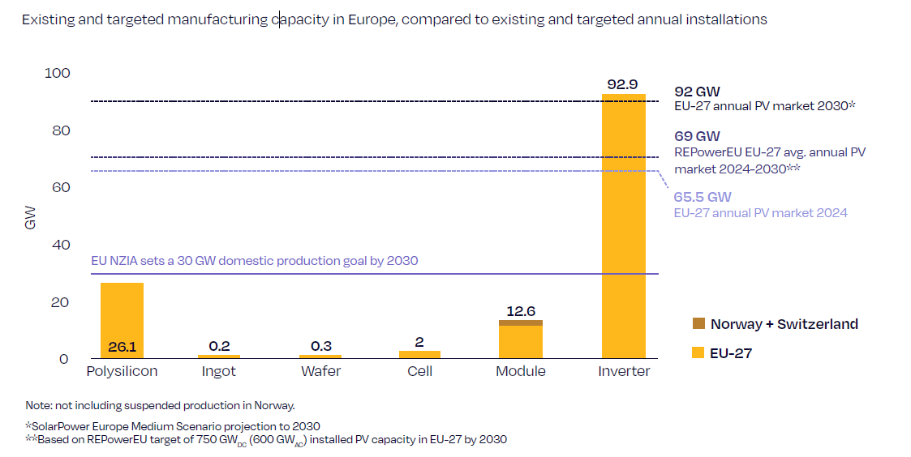
Europe and Member States needs to act to reach the 30 GW solar manufacturing target
Notes:
Solar manufacturing in Europe faced a challenging year in 2024. After another solar boom year in 2023, with demand growing by over 50%, market dynamics changed in 2024. While demand hardly grew in Europe, PV product prices continued its steep down-hill trajectory. The global surge in new manufacturing capacities coming online in 2023 and 2024 have been causing unseen supply-demand imbalances, forcing module and other component prices to plummet to unsustainable levels. This has put immense pressure on EU and global PV manufacturers, with announcements of closures and bankruptcies, particularly in the module segment during 2024.
While we saw module capacity coming down, inverter capacity has even increased year on year.

Slide 31
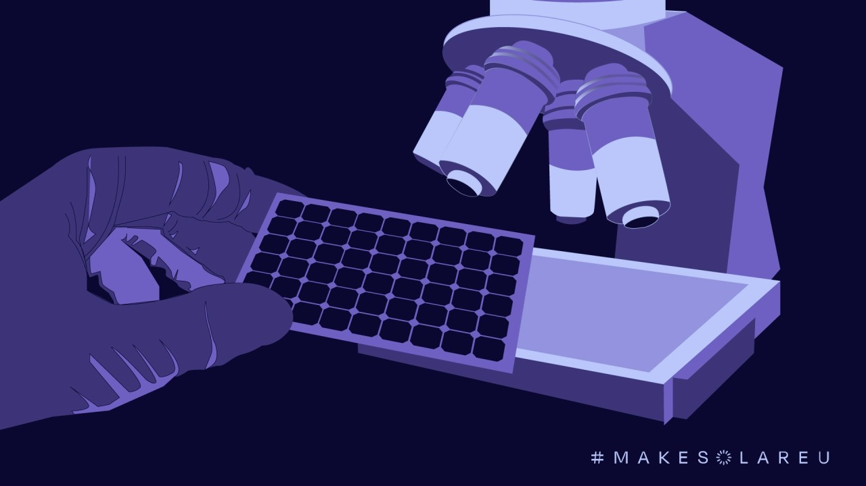
What needs to be done?
Push: Cover OPEX for factories, using the Industrial Decarbonisation Bank and IPCEI
Pull: Member States to adopt resilience policies and provide clarity on market access standards, including via auctions
Strengthening the EU inverter industry

Slide 33
www.solarpowereurope.org

