Slide 1
Heat transition and the role of geothermal energy
21.03.2025
Dr. Karin Thelen, Chief Renewables Officer
Member of the Management Board, Stadtwerke München GmbH (SWM)
SWM intern
SWM intern
Vertraulich

Slide 2
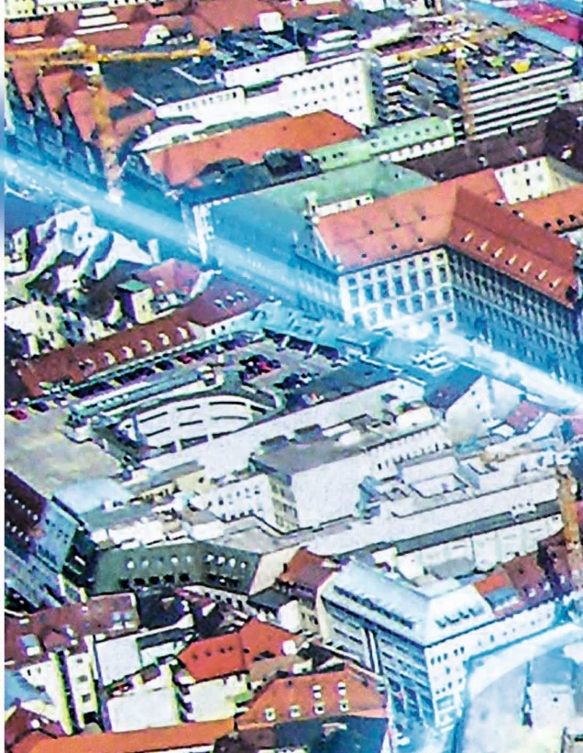
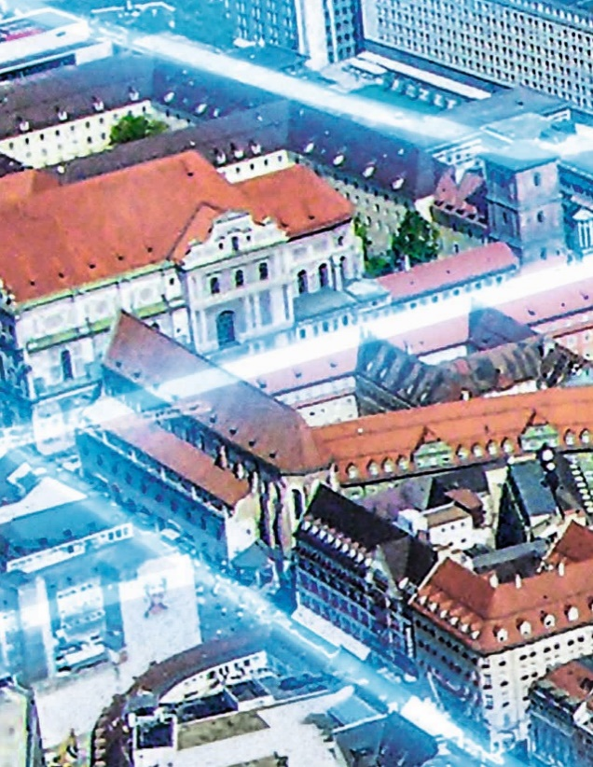
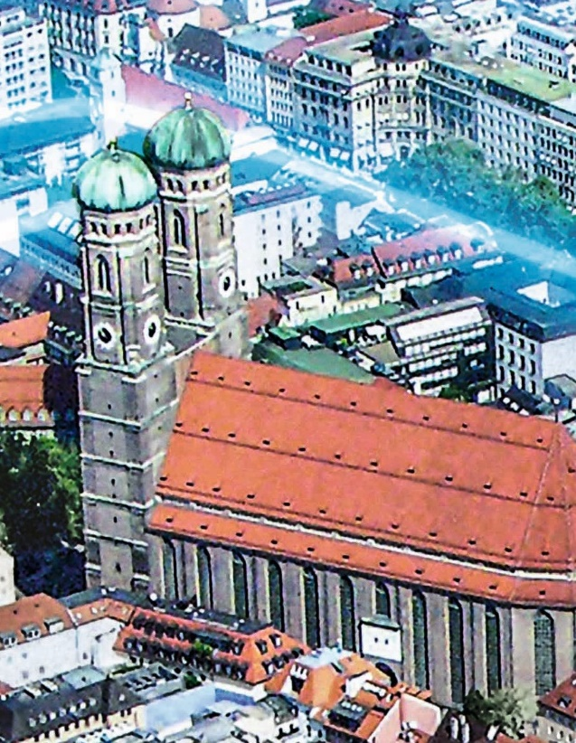
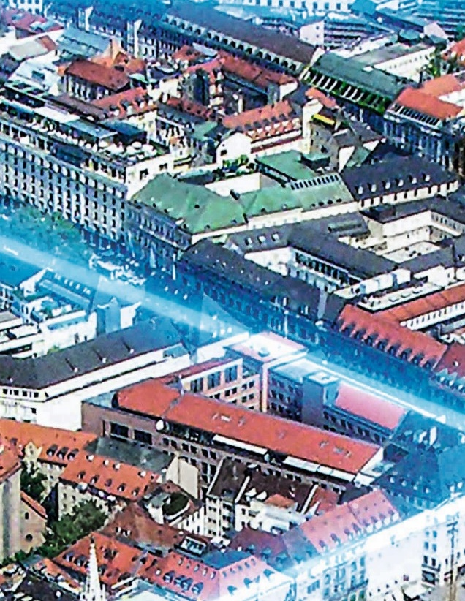
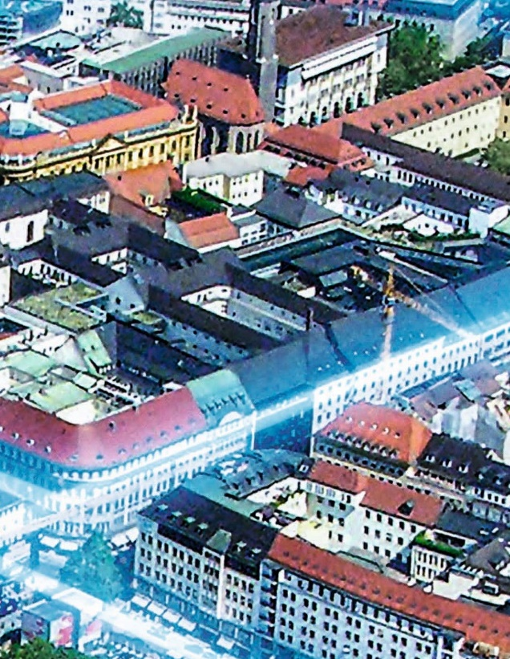
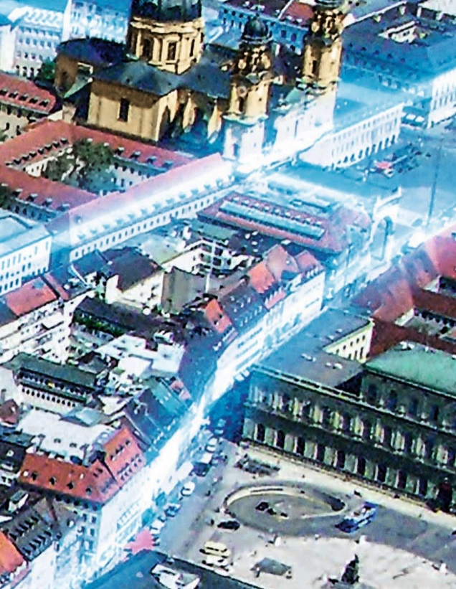
Our services keep Munich running around the clock.
About SWM
Reliable and climate-friendly
power supply
Climate-compatible
heat supply
Highly efficient and sustainable
mobility services
Secure supply of fresh drinking water, directly from the source
Fiber-optic cables for high-speed Internet
Leisure and health services for all in the M-Bäder
Notes:
Our mission: We keep Munich running around the clock.
For many decades, we have supplied the people of Munich with energy (electricity, gas, heating, cooling) and drinking water from the foothills of the Bavarian Alps. We are a pioneer of renewable energy technologies (incl. solar, wind and geothermal). Our services also include customized energy solutions (e.g. photovoltaic installations, charging solutions and heat pumps), network management for energy and water networks, distribution and sales.
We are committed to providing modern, environmentally compatible mobility services in Munich through our subsidiary, MVG – with local public transport services (underground, bus and tram) as well as intelligent mobility concepts and increasingly customized services (MVG Rad, MVGO). And, of course, we are driving e-mobility forward (M-Ladelösung, public charging stations).
We are expanding the fiber-optic network in Munich through our telecommunications subsidiary, M-net.
We offer one of the most advanced public pool systems in Germany, with 18 public pools (incl. indoor and outdoor) as well as 10 saunas. In addition, we operate an ice-skating center and two fitness and leisure centers.
In total, we provide fundamental services for the people of Munich and perform vital tasks in shaping the city’s future.

Slide 3
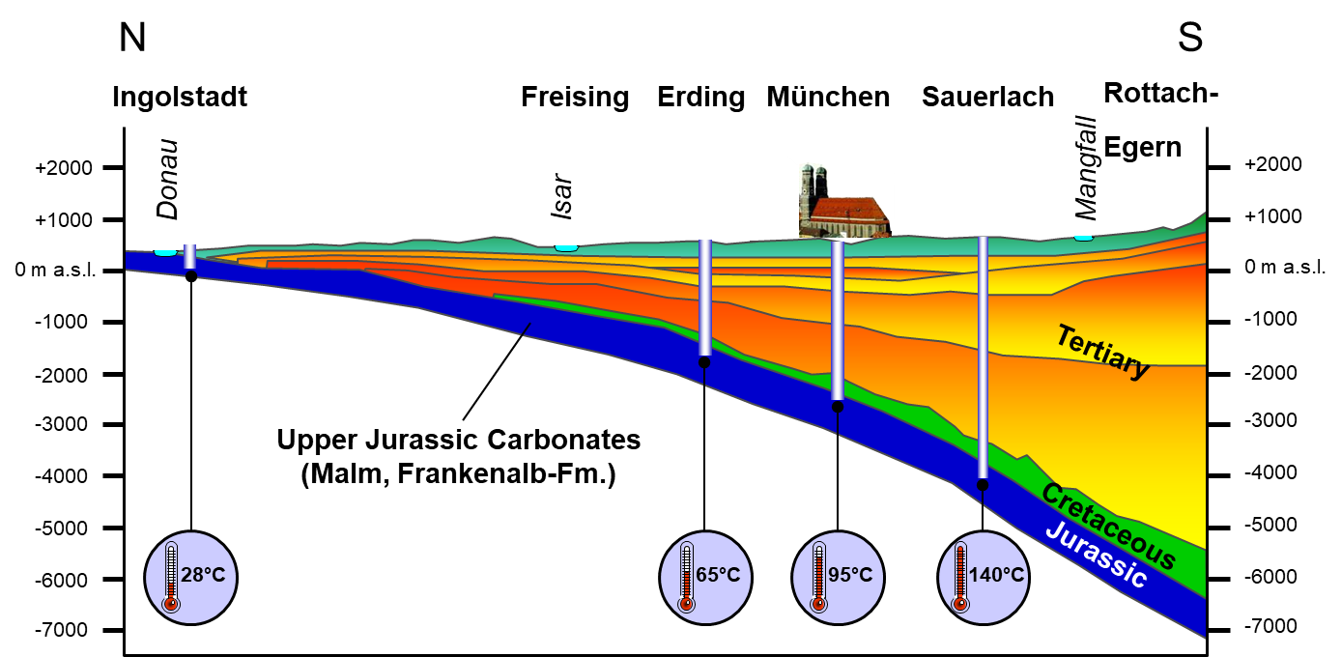
Geological Situation
Strategic overview
21.03.25 / Stadtwerke München

Slide 4
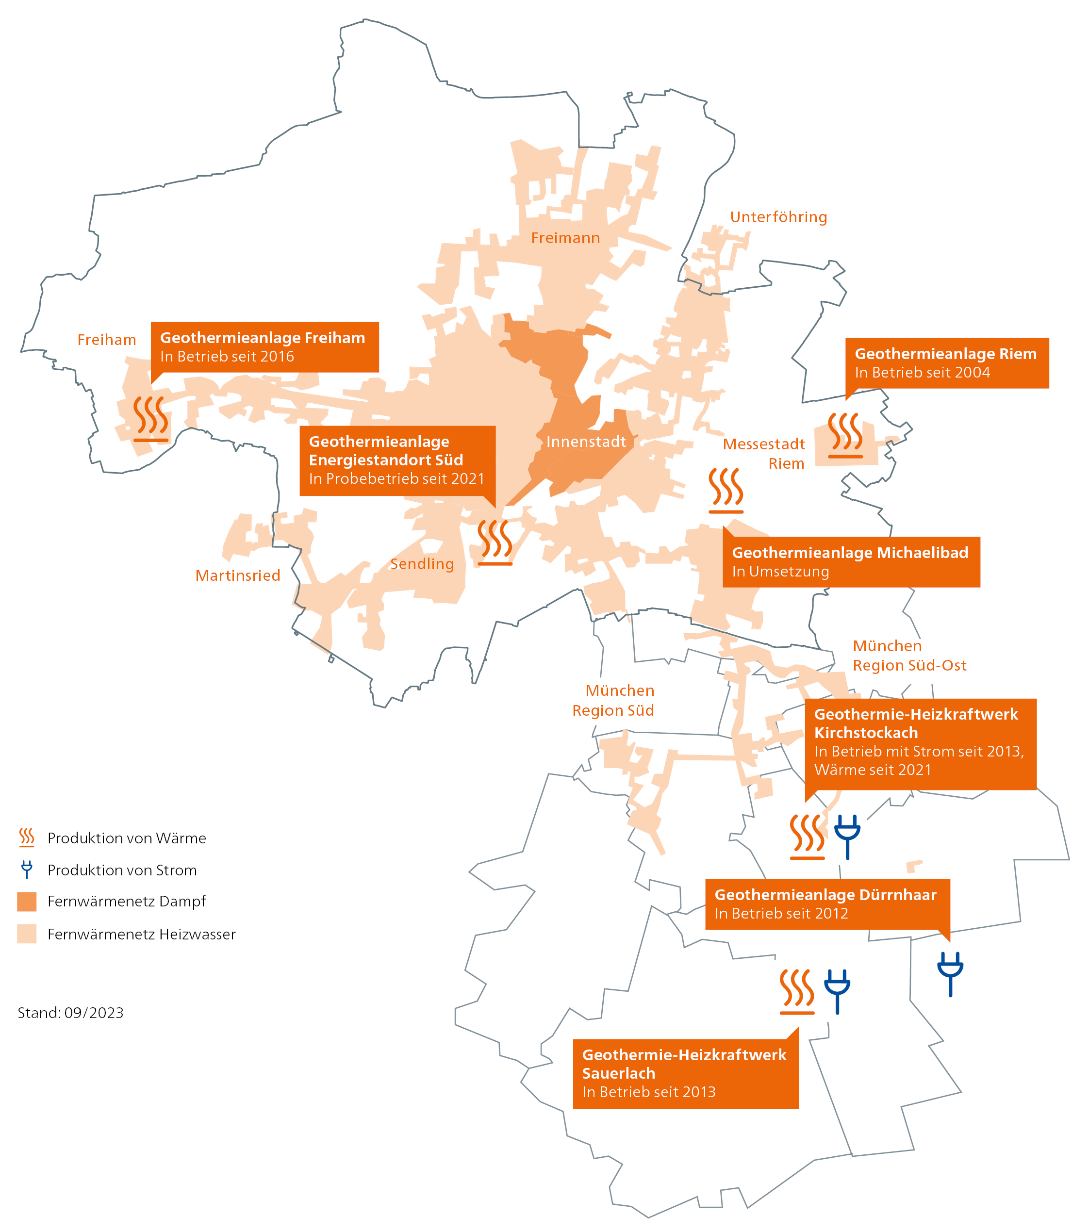
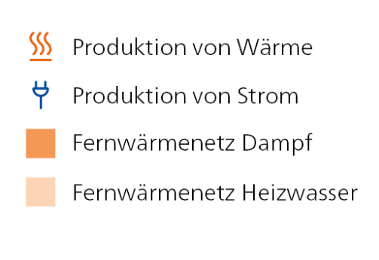
Current Geothermal plants
Expansion of thermal utilization of geothermal energy in Munich
80 °C
6 geothermal plants in operation
1 geothermal plant under construction
Overall: 15 wells with 185 MWth
Freiham geothermal heat plant
in operation since 2016
Riem geothermal heat plant
in operation since 2004
Energiestandort Süd geothermal heat plant
in operation since 2021
100 °C
Michaelibad geothermal plant
Under construction
120 °C
Kirchstockach geothermal CHP plant
In operation producing electricity since 2013, heat since 2021
Dürrnhaar geothermal power plant
In operation since 2012
Heat generation
Electricity generation
District heating network - steam
Sauerlach geothermal CHP plant
In operation since 2013
140 °C
District heating network – hot water
21.03.25 / Stadtwerke München
Notes:
SWM operates a district heating network comprising around 950 kilometers of pipelines. Today, it is already supplying environmentally friendly heat to many households. When it comes to deep geothermal energy, Munich enjoys more favorable natural conditions than almost anywhere else in Germany.
We already operate six geothermal plants in and around Munich and continue to expand our geothermal portfolio. For example, we are currently planning to construct further geothermal plants, including on the edge of the premises of Munich’s Michaelibad (public pool complex). This seventh geothermal plant is set to start operation in 2034 and generate enough heat to supply more than 75,000 Munich citizens.
We are further augmenting the potential of deep geothermal energy by deploying large-scale heat pumps, which further cool the return flow in district heating networks and thereby enhance the output from geothermal boreholes. Plans for the first large-scale heat pump at Michaelibad are currently being drawn up.

Slide 5
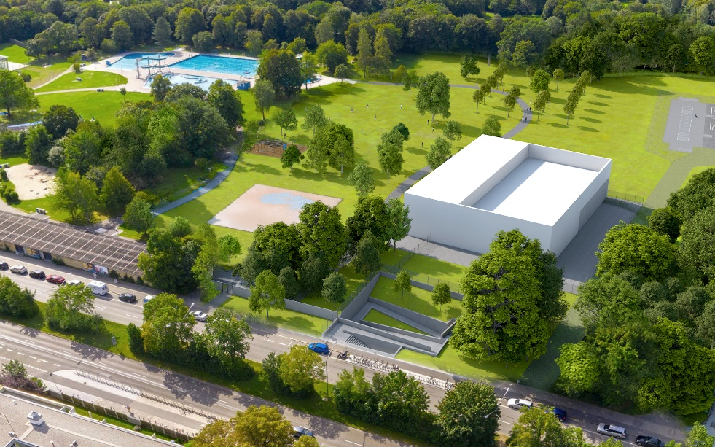
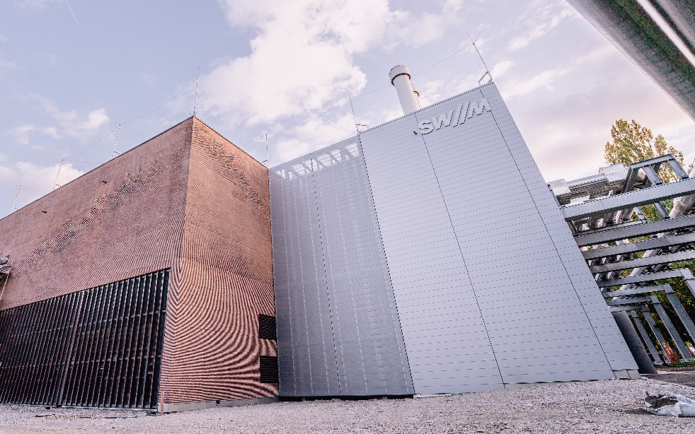
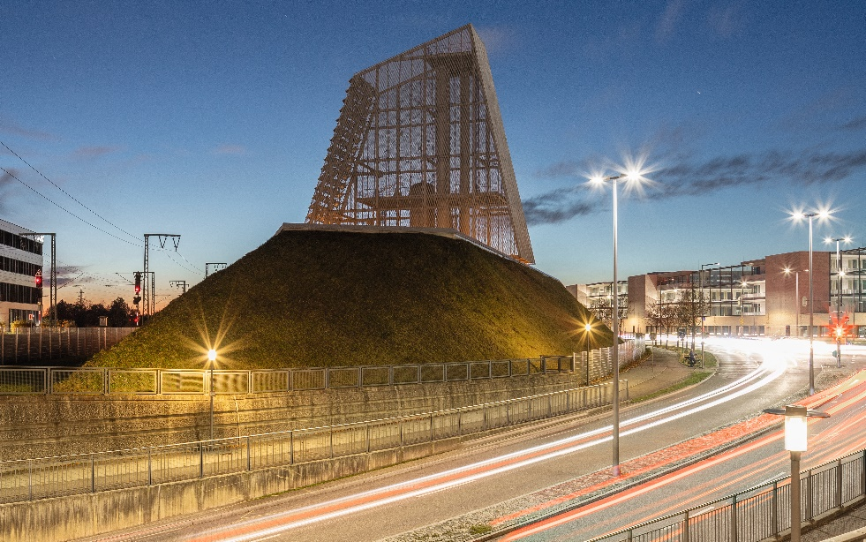
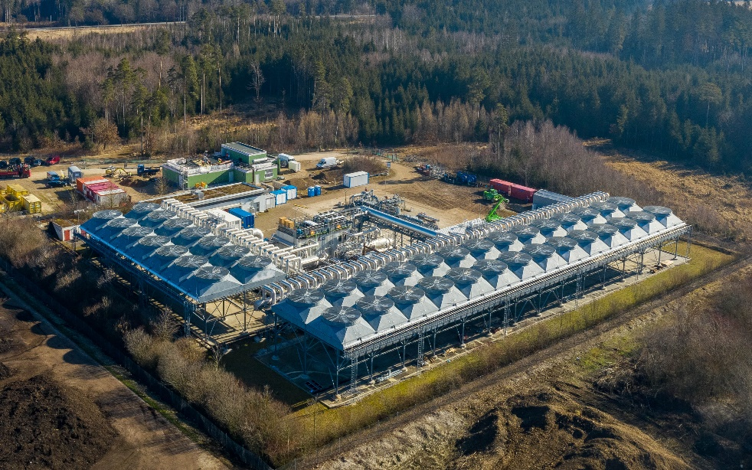
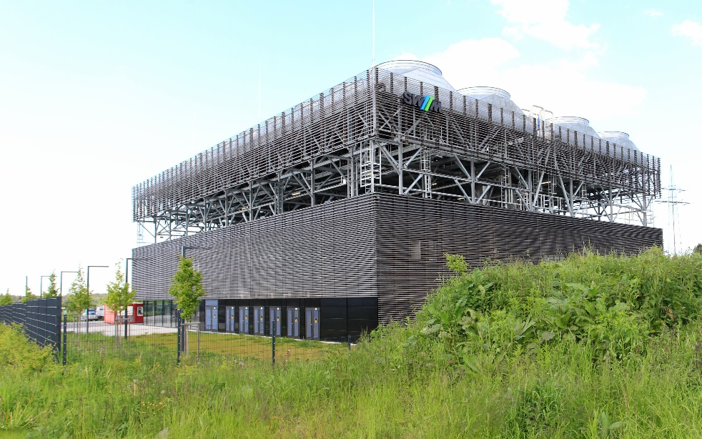
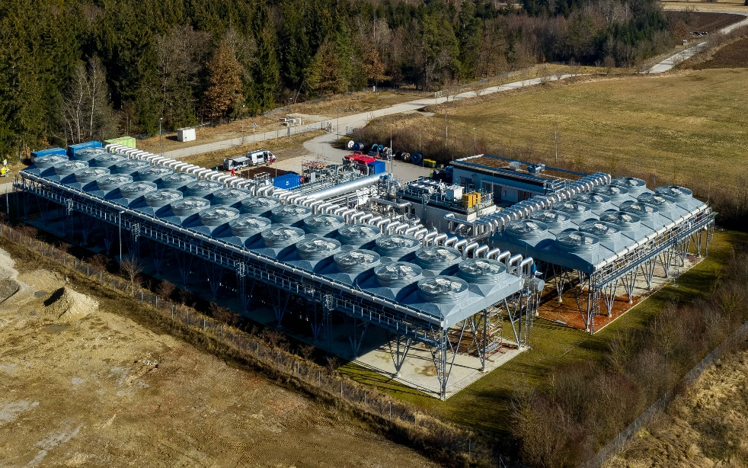
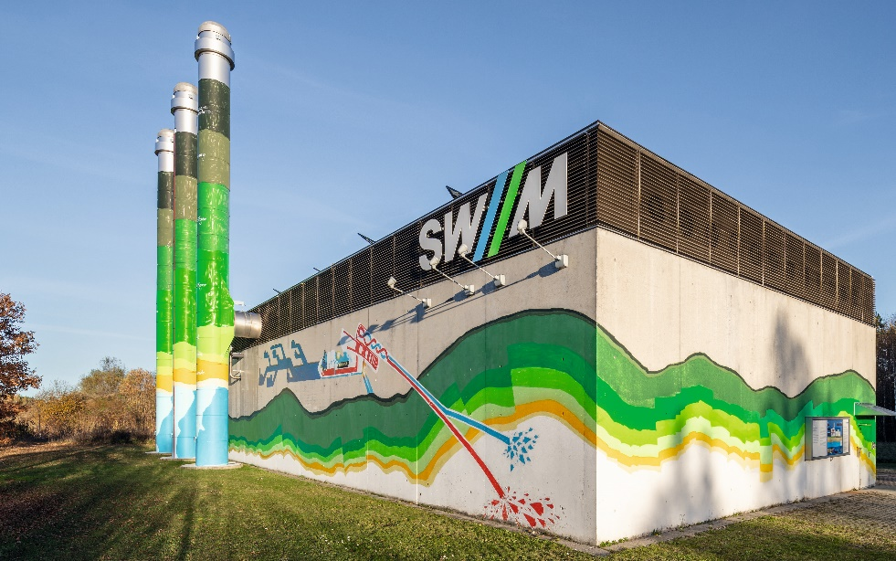
Geothermal power plants
Michaelibad geothermal plant
Under construction
Energiestandort Süd geothermal heat plant in operation since 2021
Freiham geothermal heat plant
in operation since 2016
Kirchstockach geothermal CHP plant
In operation producing electricity since 2013, heat since 2021
Sauerlach geothermal CHP plant
In operation since 2013
Dürrnhaar geothermal power plant
In operation since 2012
Riem geothermal heat plant
in operation since 2004
21.03.25 / Stadtwerke München

Slide 6
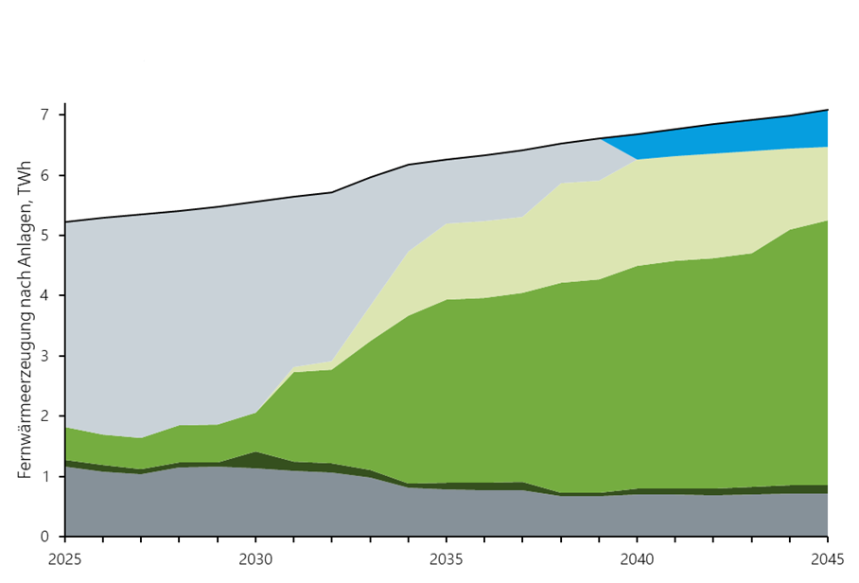
District heating will become increasingly climate-friendly between now and 2045
Expansion of thermal utilization of geothermal energy in Munich
Future: > approx. 65 wells with 800 MWth
Heat pumps up to 10 systems with 500 MWth
District heating generation by plant, TWh
Changes in energy sources for district heating plants between now and 2045
Hydrogen plants
Natural gas plants
Large-scale heat pumps
Geothermal plants
Biomass plants
Waste incineration plants and others
Summery
21.03.25 / Stadtwerke München
Notes:
Conventional energy generation sourcing fossil fuels will decrease over time and will make district heating “greener” as a result. Heat from geothermal energy and, to a lesser extent, from heat pumps, are important building blocks in this process. Biomass plays a somewhat smaller role.
Nevertheless, waste incineration will continue to play an important role in district heating (accounting for around one-fifth of generation). In the future, the CO₂ produced through the so-called “thermal conversion” of waste – which cannot be fully avoided – will have to be captured and stored in accordance with statutory regulations.
Looking to the long term, SWM is making plans to use (green) hydrogen in its central generation facilities (heating plants and CHP plants) and is currently examining the necessary retrofitting measures. Hydrogen therefore has the potential to replace natural gas in heat generation processes – provided that it is available in sufficient quantities.

Slide 7
Planned measures in the district heating transformation plan
District heating transformation plan
(all figures refer to to district heating) | Current status | Target 2045 (according to transformation plan) | Delta
Heat sales | approx. 4.4 TWh | approx. 5.8 TWh | +32 %
Peak load | approx. 1.9 GW | approx. 2.7 GW | +42 %
Number of geothermal plants | 15 wells with approx. 185 MW_{th} (without Riem) | > 65 wells with max. 800 MW_{th} (without Riem) incl. the requirements of co-operation partners | +330 %
Number of heat pumps | - | Up to 10 systems with max. 0.5 GW _{th} | -
Further information | Two biomass CHP plants, downstream plants for thermal waste treatment including CO₂ separation, H₂ conversion of existing plants, six heat transfer stations and expansion of new booster stations
Route length | approx. 1,000 km | approx. 1,600 km | +60 %
Customer connections | approx. 3.2 GW | approx. 5.0 GW | +56%
Total investments:
approx. 9.5 billion euros
Heat quantities and network lengths for district heating today and up to 2045
Notes:
The transformation plan is a comprehensive package of measures to restructure and expand the district heating system in Munich. It provides for the densification and expansion of the district heating network as well as the decarbonisation of district heating generation, primarily with the help of geothermal plants. Heat pumps, two biomass cogeneration plants, downstream plants for thermal waste treatment and the conversion of existing CHP plants to hydrogen are also part of the district heating conversion.

Slide 8
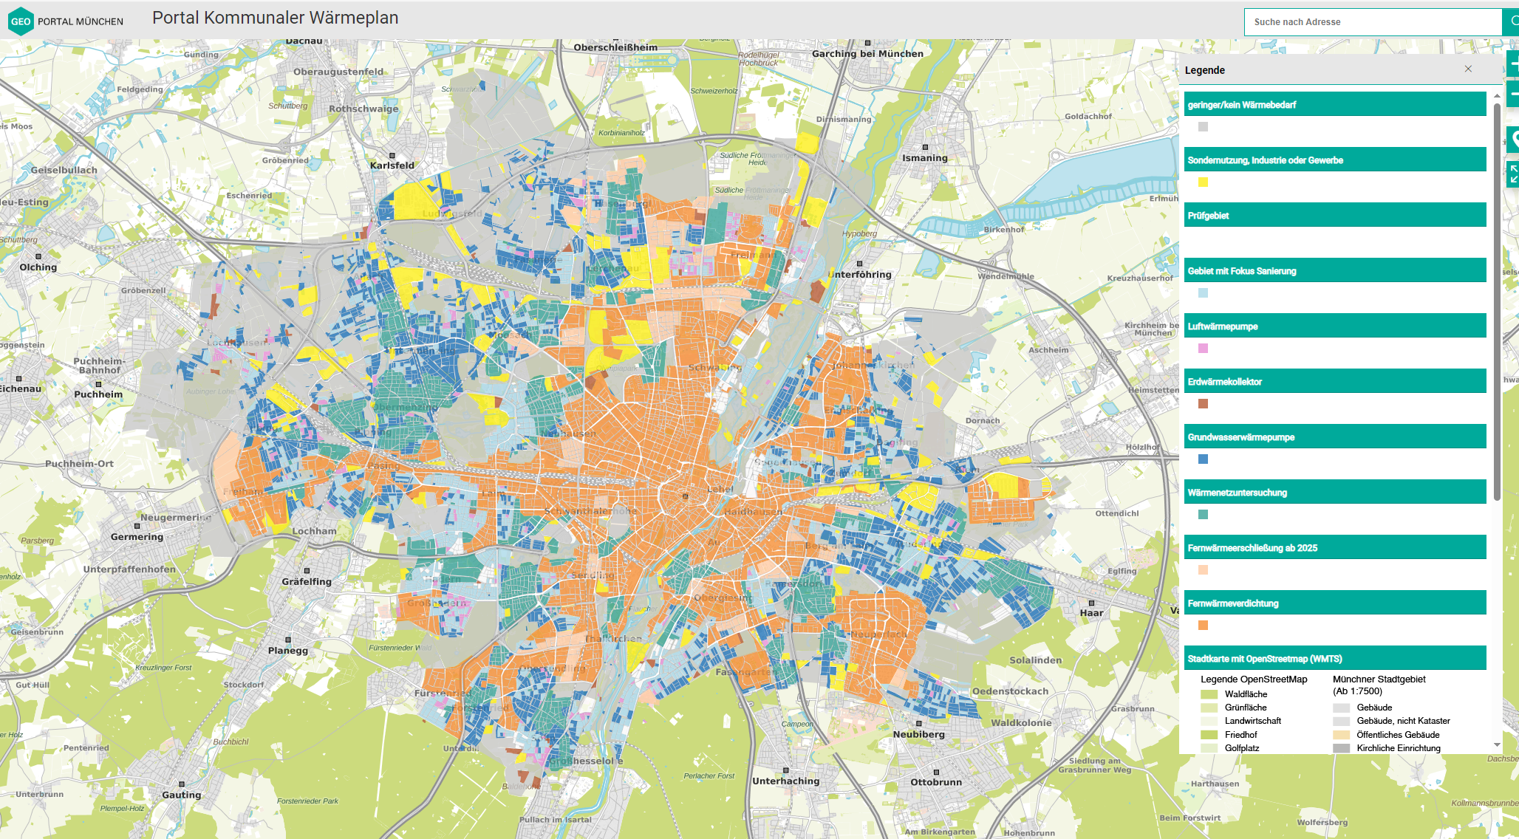
Municipal heat planning
Expansion of thermal utilization of geothermal energy in Munich
Munich was the first municipality in Bavaria to draw up a heating plan. The first draft was approved by the city council on May 15, 2024
…and published: Portal Kommunaler Wärmeplan (muenchen.de)
The expansion and optimization of heating networks plays an important role in this. Municipal heat planning in Munich is on the home stretch!
21.03.25 / Stadtwerke München
Notes:
SWM operates a district heating network comprising around 950 kilometers of pipelines. Today, it is already supplying environmentally friendly heat to many households. When it comes to deep geothermal energy, Munich enjoys more favorable natural conditions than almost anywhere else in Germany.
We already operate six geothermal plants in and around Munich and continue to expand our geothermal portfolio. For example, we are currently planning to construct further geothermal plants, including on the edge of the premises of Munich’s Michaelibad (public pool complex). This seventh geothermal plant is set to start operation in 2034 and generate enough heat to supply more than 75,000 Munich citizens.
We are further augmenting the potential of deep geothermal energy by deploying large-scale heat pumps, which further cool the return flow in district heating networks and thereby enhance the output from geothermal boreholes. Plans for the first large-scale heat pump at Michaelibad are currently being drawn up.

Slide 9
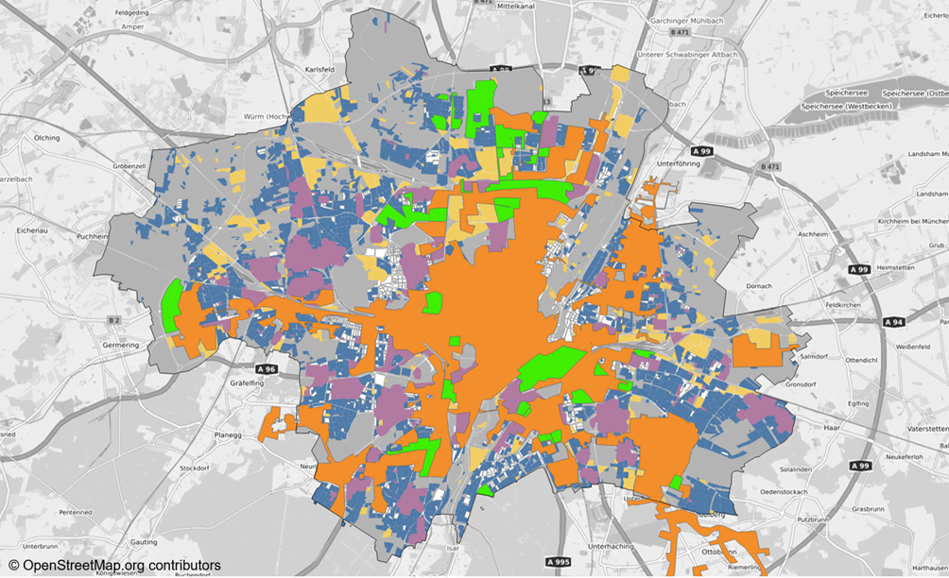
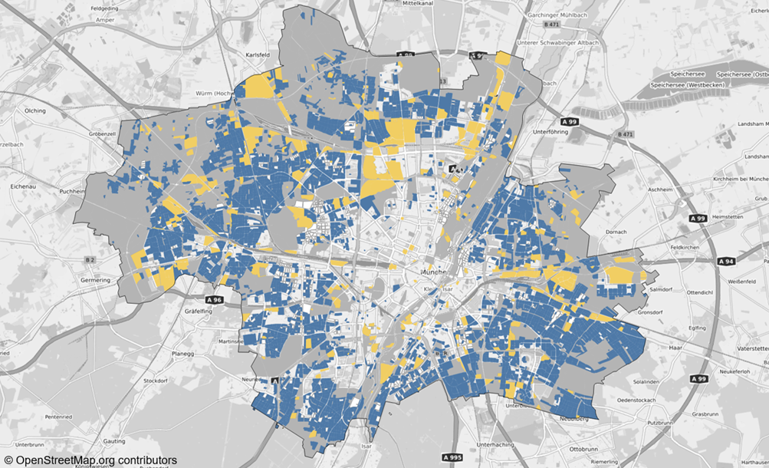
District heating and decentralised solutions complement each other well
Expansion of thermal utilization of geothermal energy in Munich
The layers in the maps partially overlap. District heating overlaps all other layers (→District heating is prioritized)
The map on the right shows the decentralized potential (blue) without district heating and local heating networks
All areas inkl. district heating
Decentralised potential
District heating
Heat network investigation
Inspection area
District heating in 2025
Decentral solutions
Special use, industry
Areas with no or low demand
21.03.25 / Stadtwerke München

Slide 10
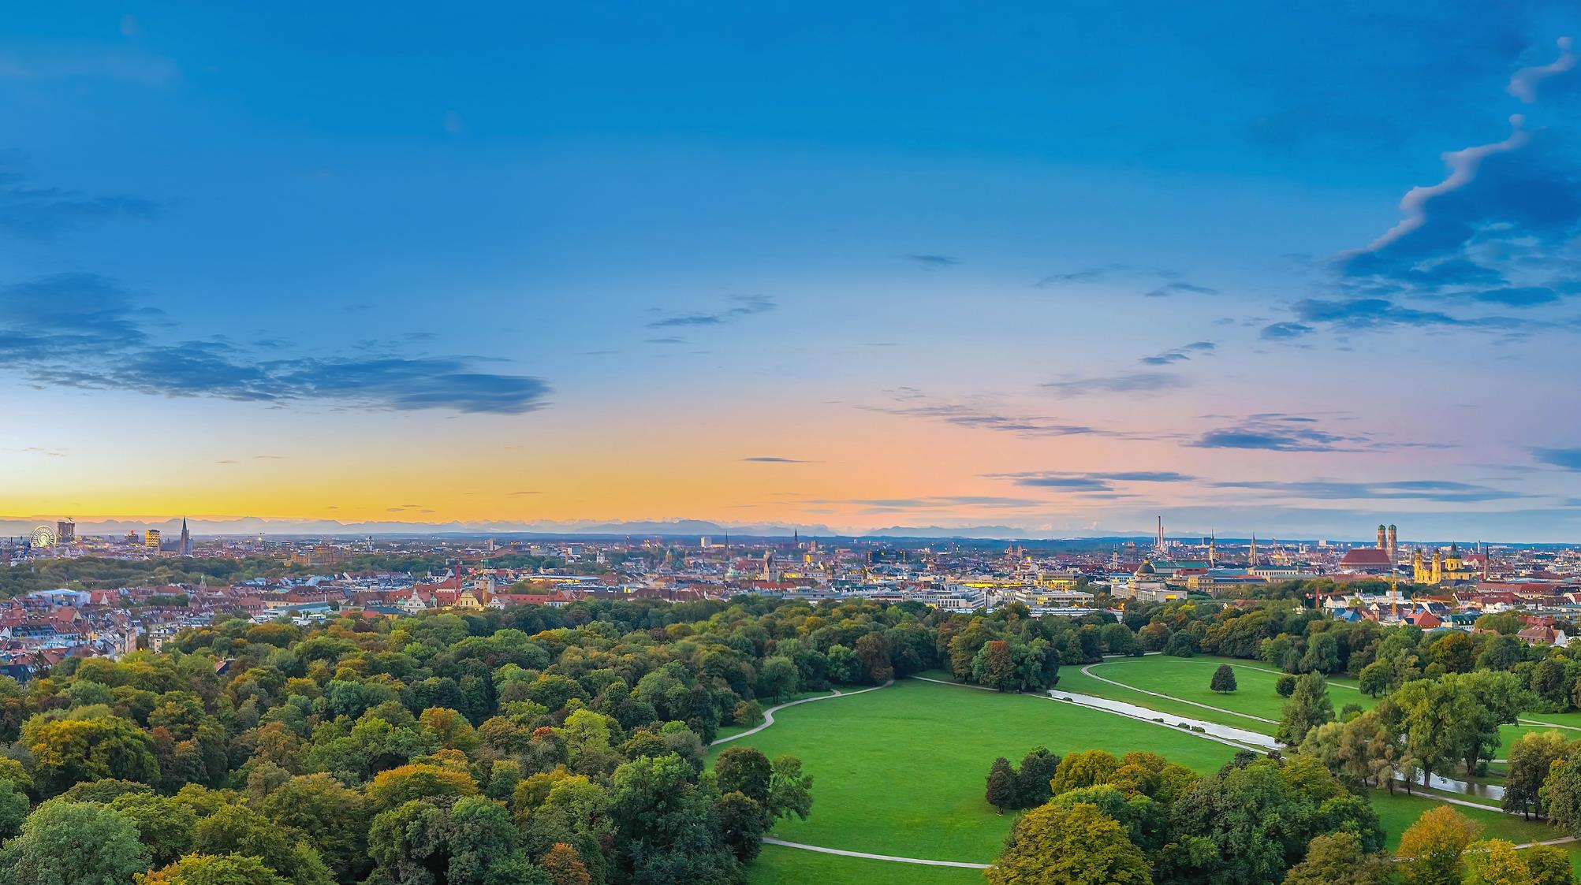
Thank you for your attention.

