Slide 1
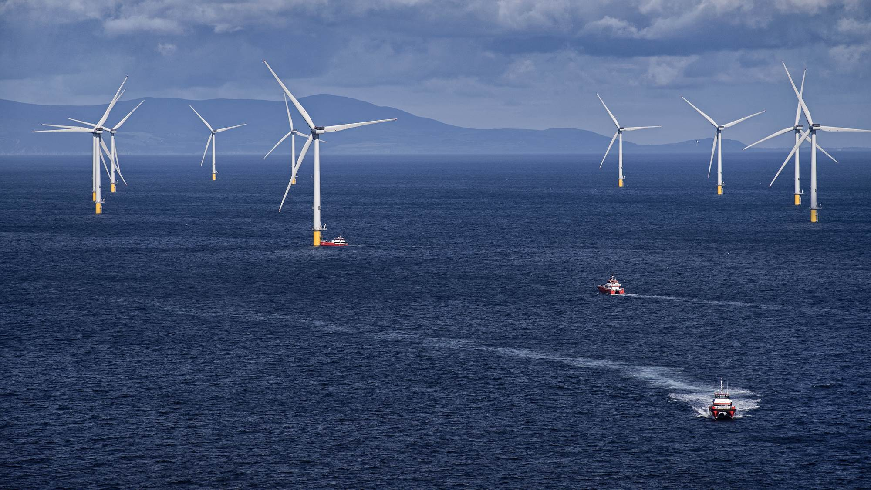
IPM2025, Session 8: The internal electricity market and grids
Øyvind Vessia – 21 March 2025 – yvess@orsted.com
1

Slide 2
We have succeeded in profoundly transforming Ørsted
CO₂ reduction
g CO₂e/kWh (scope 1 & 2)
Green transformation
EBITDA, DKKbn, %
Renewable capacity
Installed capacity, GW
Profitability
Adjusted ROCE², %
Share of renewables
96%
32¹
18.2
10.1
9.6
^{99%}
6.0
^{16%}
0.8
7%
2007
2024
2007
2024
2007
2024
2007
2024
Notes: 1. Including EBITDA from new partnerships 2. ‘Adjusted ROCE’ excludes impairments.
Source: Ørsted Annual Report 2024
2

Slide 3
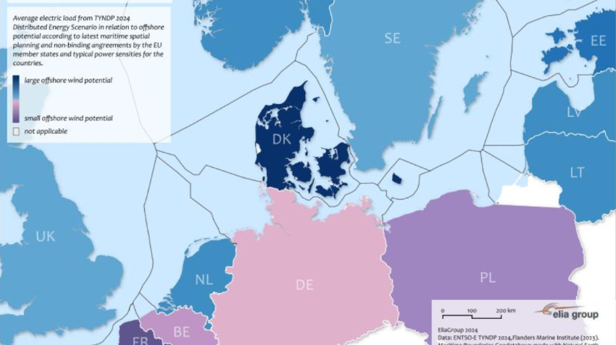
Map from Elia – “Going with the wind”

Slide 7
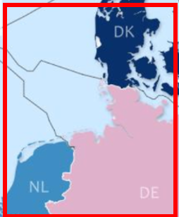
Confusing times
Germany earning 12.6 Bn € during auction of 7 GW sites during the summer of 2023
Zero bids in Denmark winter 2024/2025
What is the cost difference?
Zero bids winter 2024
X Bn € paid in concession payments summer 2023

Slide 8
30% costs to be saved by moving the DE windfarm to DK
Using the same grid connection – just longer cable, costs can be reduced by 29 – 33 % by moving to DK
In addition, revenues are increased by 10 - 30 % due to higher value
29 - 33% cost reduction (LCOE)
Heavily waked, reducing full-load hours

