Slide 1
Flexible consumers and prosumers:
the advantages of a decentralised and digitalised electricity system
IPM25, 21 March 2025
House of Representatives of Belgium, Brussels

Slide 2
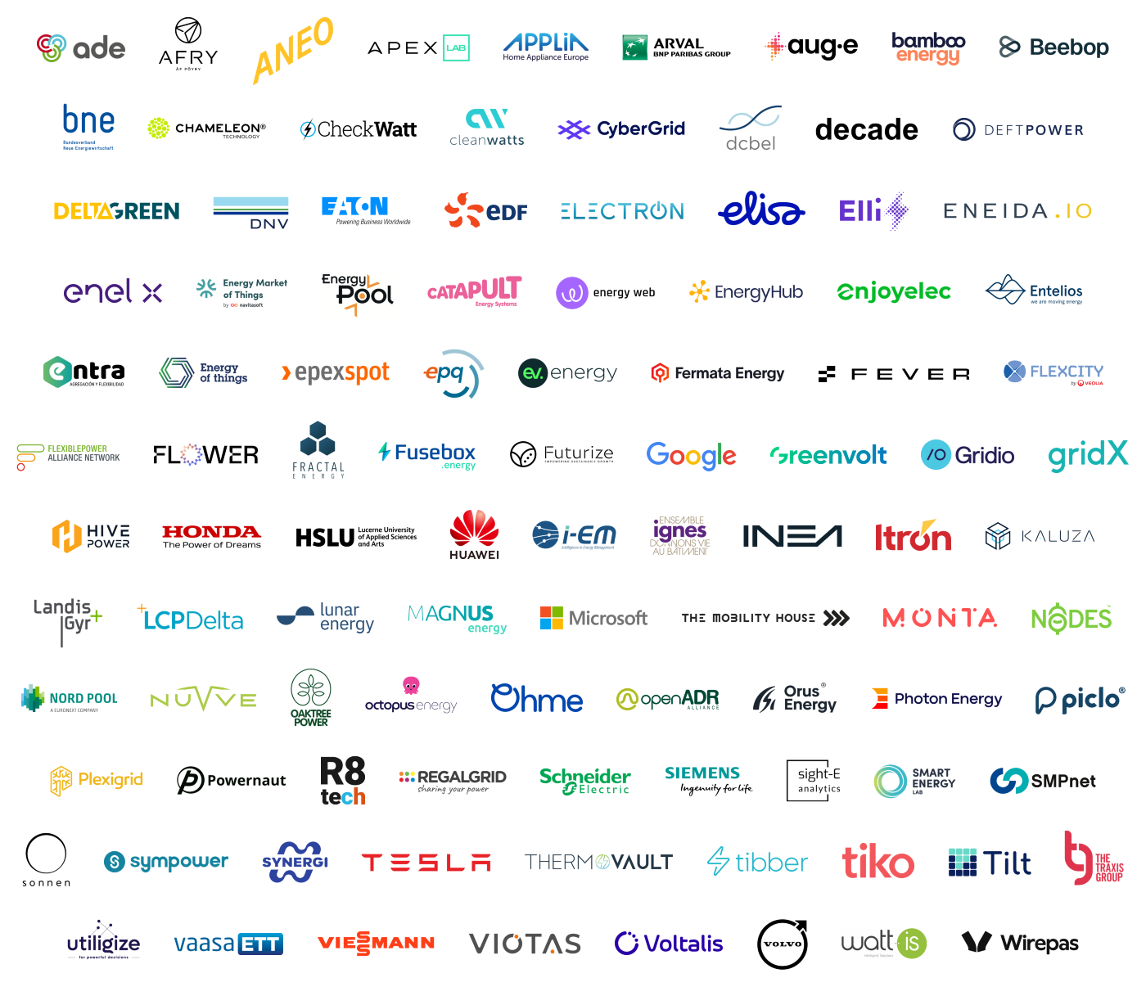
smartEn – Smart Energy Europe, the voice of the Flexible Demand Management Industry
Companies offering technologies, services and business models to activate the flexibility from all energy consumers
(from households to energy intensive industries)

Slide 3
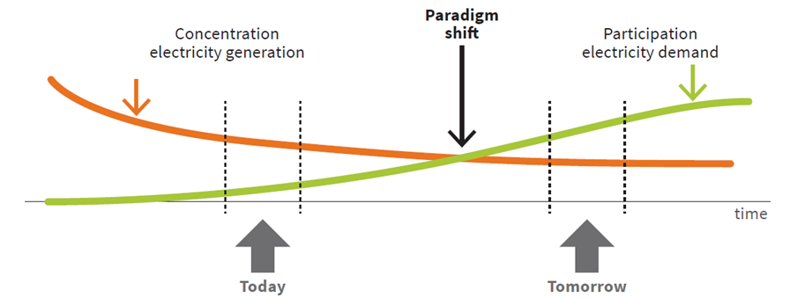
Paradigm shift in electricity supply and demand
Active consumers
Prosumers
Source: Jorge Vasconcelos, EU Electricity Reform, May 2022

Slide 4
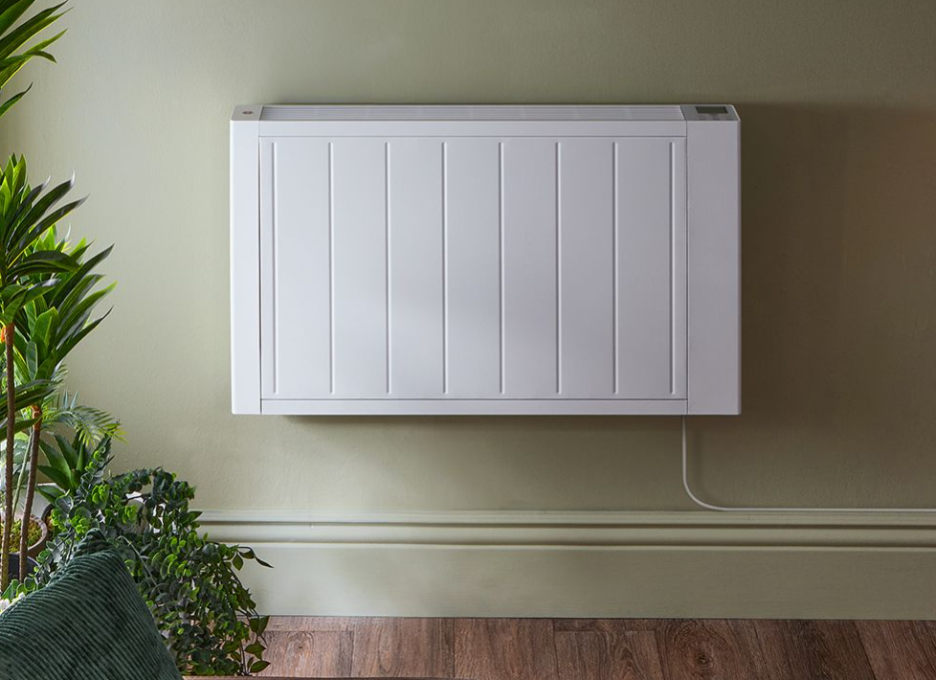
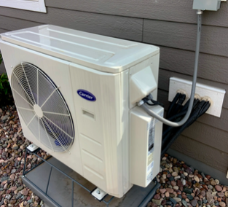
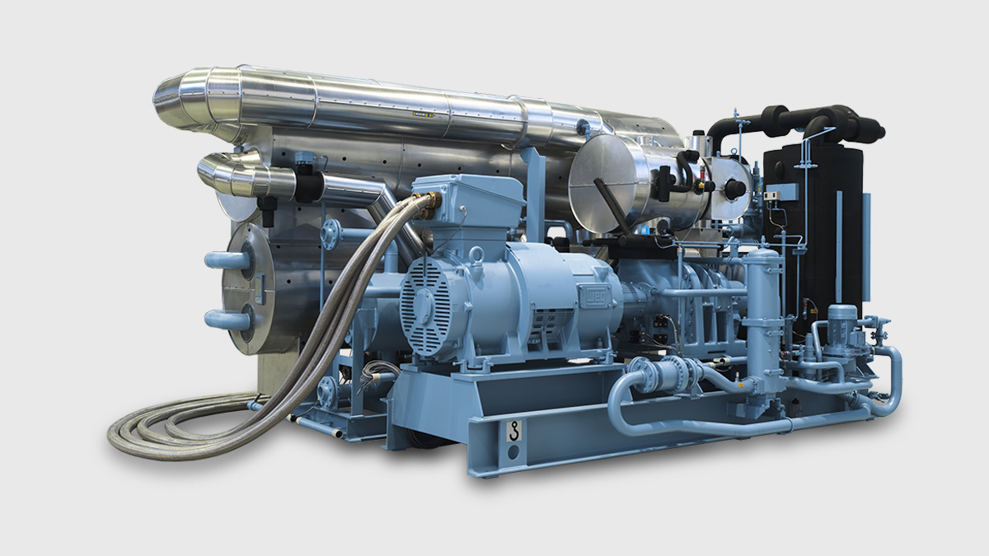
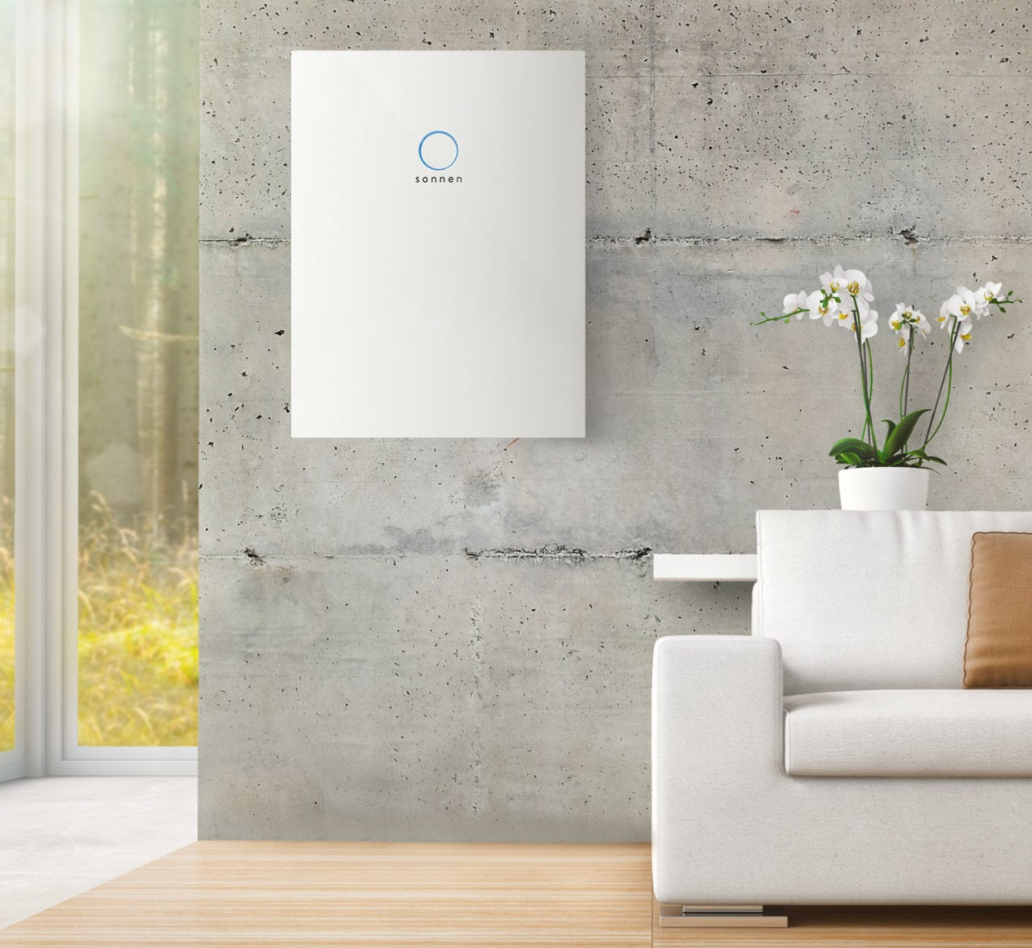
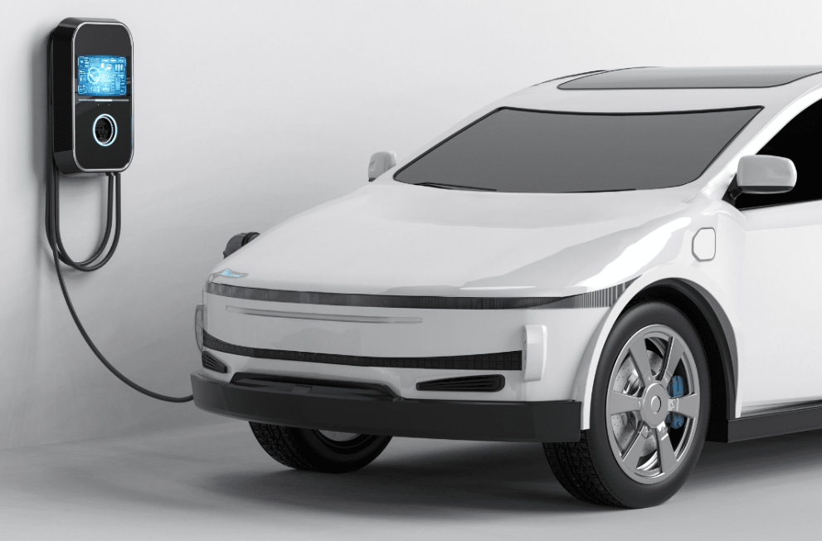
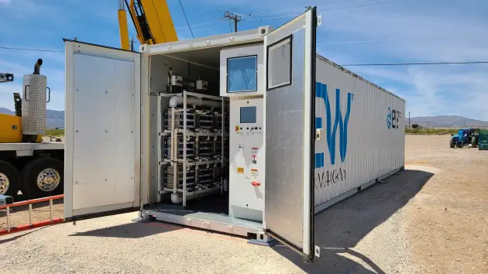
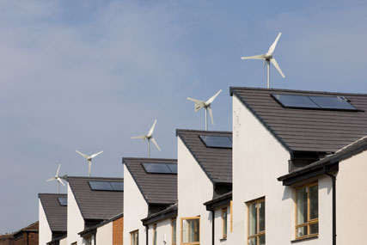
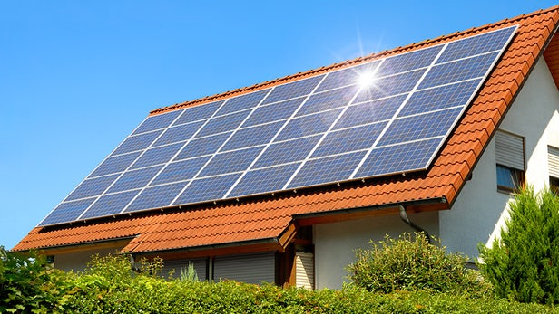
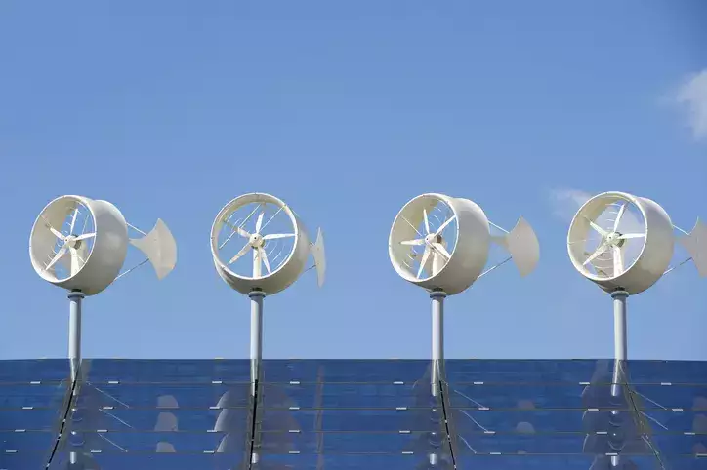
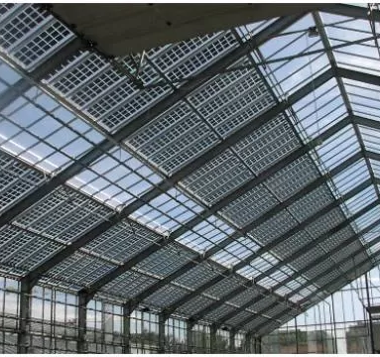
Decentralised Energy Resources (DER): new sources of flexibility in consumers’ premises
Controllable loads
Energy storage
Small scale RES generation

Slide 5
DER need to reply to external signals to activate their flexibility
Distribution System Operators
Flexible
Demand
Management
Industry
Decentralised Energy Resources in homes, offices, vehicles, SMEs and Energy Intensive Industries
Transmission System Operators
Day-ahead and Intraday Electricity Markets
*** IF possible, consumers become from passive end-users to active, flexible players ***

Slide 6
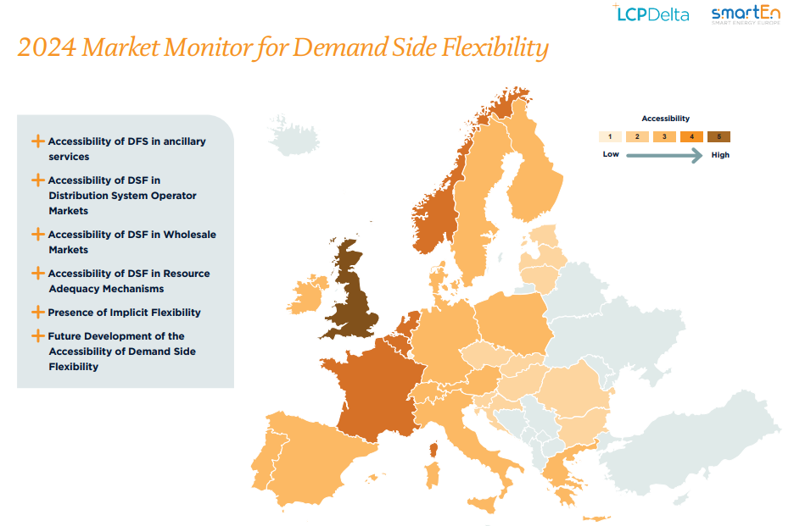
Is it happening? NOT at the needed speed & volumes
Source: smartEn/LCP-Delta, “2024 Market Monitor for Demand-side Flexibility”, February 2025

Slide 7
Barriers to Demand-side Flexibility in many States
Limited access and exchange of essential energy data
Restrictions to the participation of all DERs to all elect. Markets & mechanisms
Limited access to price signals
Lack of frameworks to innovative services and local initiatives
Limited market-based procurement from all DERs by system operators
Limited
transformation of vehicles, buildings, industries into
flex assets
No valorisation of DSF in planning & system-wide assessment

Slide 8
Barriers to Demand-side Flexibility: EU provisions paving the way forward
Art 6, 7, 8 , 12, 13,
19g, 19h, 21, 22 ER,
Art 20a RED
Art 27, Annex XIII EED,
Art 4, 11, 19 ED,
Art 18 ER
Art 20 AFIR
Art 20, 23, 24, 34 ED
Art 16 EPBD
Art 7b, 50, 57 ER
Art 20a RED
Limited access and exchange of essential energy data
Restrictions to the participation of all DERs to all elect. Markets & mechanisms
Limited access to price signals
Lack of frameworks to innovative services and local initiatives
Limited market-based procurement from all DERs by system operators
Limited
transformation of vehicles, buildings, industries into
flex assets
No valorisation of DSF in planning & system-wide assessment
Art 5, 14, 15 AFIR
Art 3, 10, 11, 12,
13, 14, 15, 18, 19,
25, 26, Annex II, IV, V,
VIII EPBD
Art 6a, 33 ED
Art 11, 22, 29 EED
Art 15a, 18, 20a, 22a,
Annex IV RED
Art 31, 32, 36, 40,
54 ED
Art 7a, 57 ER
Art 13, 15, 15a, 16,
17 ED
Art 22 RED
Art 3, 27 EED
Art 32, 51 ED
Art 18, 19e, 19f, 20 ER
Art 15, 15b RED

Slide 9
70 key EU provisions driving Demand-side Flexibility
Electricity Regulation
Energy Efficiency Directive
Art 6, 7, 7a, 7b, 8, 12, 13, 18, 19e, 19f, 19g, 19h, 20, 21, 22, 50, 57
Art 3, 11, 22, 27, 29, Annex XIII
Electricity Directive
Energy Performance of Buildings Directive
Art 4, 6a, 11, 13, 15, 15a, 16, 17, 19, 20, 23, 24, 31, 32, 33, 34, 36, 40, 51, 54
Art 3, 10, 11, 12, 13, 14, 15, 16, 19, 25, 26
Renewable Energy Directive
Alternative Fuel Infrastructure Regulation
Art 15, 15a, 15b, 18, 20a, 22, 22a
Art 5, 14, 15, 20

Slide 10
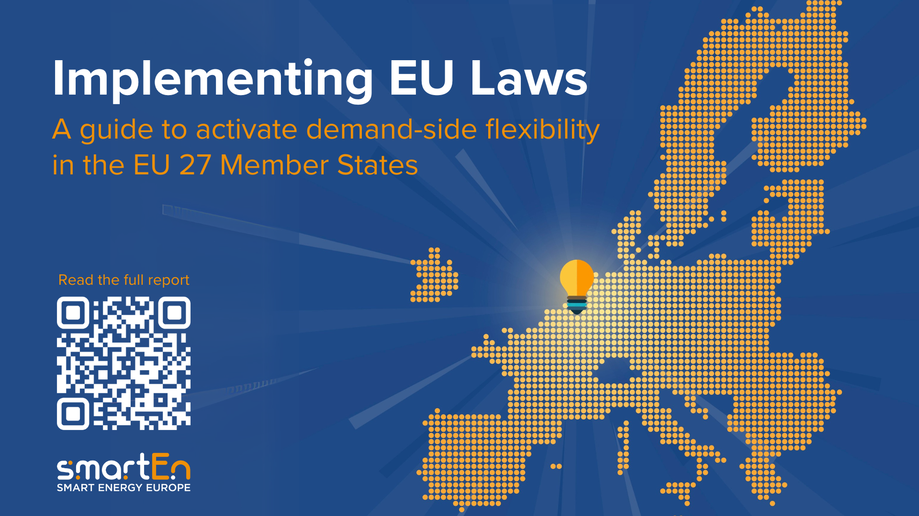

Slide 11
Why is it urgent to activate Demand-side Flexibility?
Win-win-win for Energy Affordability, Industrial Competitiveness and Resilience
37.5 million tonnes (8%) saved in GHG emission/year
Avoidance of at least 60 GW of peak generation capacity, saving €2.7 billion/year
€11.1–29.1 billion/year saved in grid CAPEX investments
37.5 million tonnes (8%) saved in GHG emission/year
Avoidance of at least 60 GW of peak generation capacity, saving €2.7 billion/year
€11.1–29.1 billion/year saved in grid CAPEX investments
Energy System
Consumers
Renewable energy curtailment reduced by 15.5 TWh (61%)
37.5 million tonnes (8%) saved in GHG emission/year
Avoidance of at least 60 GW of peak generation capacity, saving €2.7 billion/year
€11.1–29.1 billion/year saved in grid CAPEX investments
Consumers with flexible assets benefit directly, more than €71 billion/year
All consumers benefit from lower wholesale prices and system costs, over €300 billion/year
Source: smartEn/DNV study, “2030 Demand-side Flexibility: Quantification of benefits in the EU”, September 2022

Slide 12
Do you want to know more?

Slide 13
Thanks
info@smarten.eu
www.smarten.eu
Notes:
Back-up questions
For your session:
• Can system efficiency and industrial competitiveness go hand in hand?
• Do you have an example where industry is already successfully integrated in demand response?
General Q&A:
• Do you consider the proposed solutions to be easily implementable in other MS?
• What actions at EU level are needed to promote further the solutions presented today?
• How could we make the EE1st more attractive to decision makers to convince them to look more favourably at energy efficiency alternatives?

