Slide 1
Getting Closer: The Key Role of National Parliaments for the energy transition and modernization of Europe’s industries
Yolanda Garcia Mezquita
Head of Unit TF2
DG Energy

Slide 2
European Union
unique construction
two main directions of development enlargement & deeper integration
EU institutions & independent Member States: strong partnership and close cooperation
subsidiarity principle
Competences
national shared EU level

Slide 3
Competitiveness compass
Closing the innovation gap
A joint strategy for decarbonisation & competitiveness
Increasing security & reducing excessive dependencies
Clean Industrial Deal &
Action Plan for Affordable Energy

Slide 4
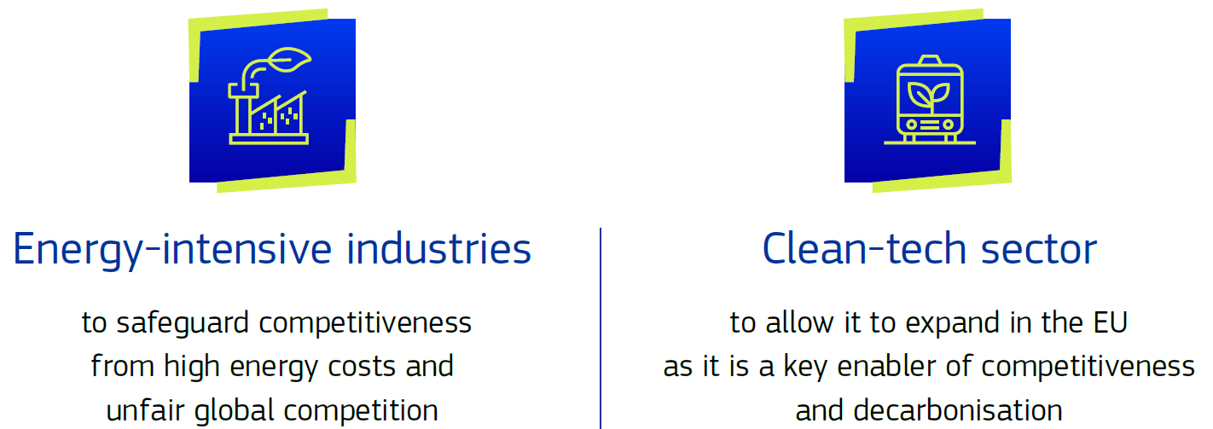
Clean Industrial Deal
Focuses on:
With six business drivers:
(1) Affordable energy, (2) lead markets, (3) financing, (4) circularity and access to materials, (5) global markets and international partnerships and (6) skills.

Slide 5
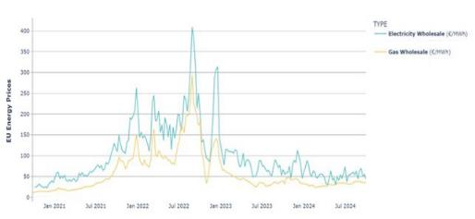
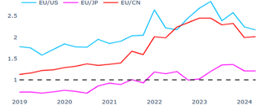
Where we are – energy sector at a cross-roads
Effects of high energy prices in Europe
Retail electricity prices for industry have almost doubled
Energy poverty affects more than 46 million Europeans
Gap in energy prices between EU & competitors is growing
What’s driving up energy costs?
Reliance on fossil fuel imports causing price volatility & high supply costs.
Inefficiencies & lack of electricity system integration
Increasing system costs covered by network charges & taxes and levies.

Slide 6
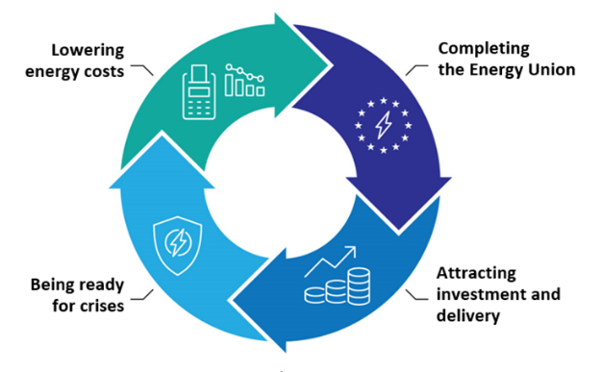
Action Plan for Affordable Energy 4 Pillars, 8 Actions
Action 1: Making electricity bills more affordable
Action 2: Bring down the costs of electricity supply
Action 3: Improve gas markets for fair energy prices
Action 4: Energy efficiency: delivering energy savings
Action 5: Completing the Energy Union
Action 7: Security of supply for price stability
Action 8: Price crisis preparedness
Action 6: A tripartite contract for affordable energy for Europe’s industry

Slide 7
Pillar I: Lowering energy costs
Action 1
Making electricity bills more affordable
Action 2
Bring down costs of electricity supply
Action 3
Ensuring well-functioning gas markets
Action 4
Energy efficiency – delivering energy savings
2025
2025
2026
More efficient network charges
Long-term electricity supply contracts
2025
2025
Ensuring well-functioning gas markets
An energy efficiency market of European dimension
Reduced permitting times
Reduced taxes & levies
Harnessing EU purchasing power to get a better deal for imported natural gas
Give consumers access to more efficiency appliances & products
Grid expansion & modernisation
Increased retail competition
Boosting flexibility

Slide 8
Pillar II: Completing the Energy Union
Q1 2026
2025
Electrification Action Plan
Clean Energy Investment Strategy
2026
From 2025
Roadmap on Digitalisation & AI
Deeper Electricity Market Integration
Q1 2026
Timing tbc
Heating & Cooling Strategy
Simplify, strengthen & modernise Energy Union governance

Slide 9
Pillar III: Attracting investment & ensuring delivery A tripartite contract
Member States
EIB
Regulatory & taxation framework
Policy clarity
Business environment with scale, visibility and off-take demand
European Commission
Affordable energy to power for economic growth
Goods needed by consumers, EU economic growth & employment
Clean energy producers
Energy consuming industry
Energy demand & long-term energy contracts
Affordable energy supplies to remain globally competitive

Slide 10
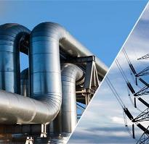
Pillar IV: Being ready for potential crises
Security of supply & price stability
Price crisis preparedness
New regulatory framework
Avoid price peaks during energy crises
Increase cross-border access to cheap electricity
When necessary

Slide 11
Benefits to European consumers
Lowering electricity taxation
Potential to approx. halve tax component of energy bills.
Accelerating electrification share by 40% by 2030
€32 billion/year in energy system cost savings in 2030
Electricity market integration, renewables, flexibility
40% lower wholesale electricity prices on average in the EU.
Energy market integration
€40-43 billion per year in benefits for EU citizens by 2030.
The full delivery of the Action Plan for Affordable Energy can enable the EU’s fossil fuel import bill to drop year after year towards €130 billion of savings per year by 2030, representing an estimated 0.65% of GDP by 2030.

Slide 12
The EU in 2024 General report on the activities of the European Union
‘The proper functioning of EU interinstitutional processes, including the involvement of the Member States’ national parliaments and the EU’s consultative committees and decentralised agencies, is key to the success of EU policymaking.’

Slide 13
Thank you for your attention !
Fill in copyright information.

