Slide 1
The EU’s internal electricity market and grids: challenges for the years ahead
EUFORES conference in the European Parliament
Brussels, 21 March 2025
Christian Zinglersen, ACER Director

Slide 2
Integrated markets bring benefits - okay, fine, but what about in crises?

Slide 3
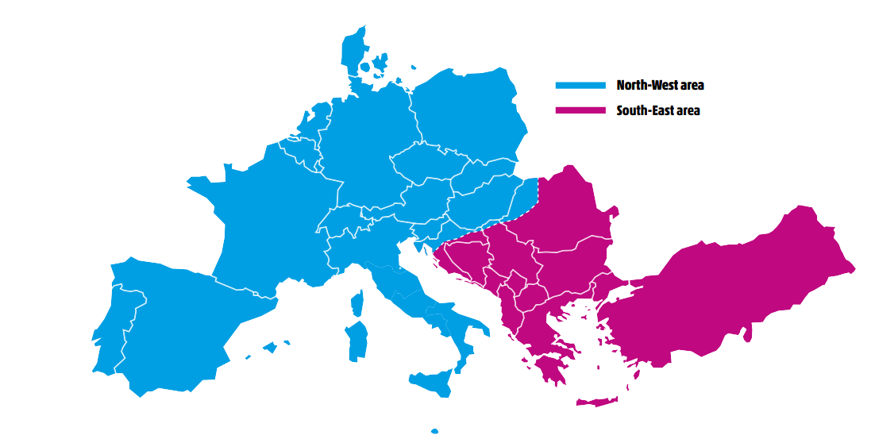
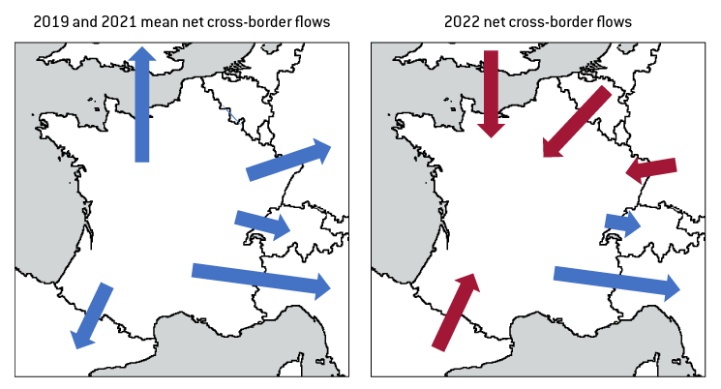
Tackling security of supply together
France became a huge importer of electricity during the energy crisis
In 2021, a major operational incident split Continental Europe into two parts
Note: The length of the arrow is directly proportional to the amount of electricity imported or exported.
Source: ENTSO-E’s report of the Continental Europe Synchronous Area Separation on 8 January 2021, 15 July 2021.

Slide 4
Tackling security of supply together
France became a huge importer of electricity during the energy crisis
In 2021, a major operational incident split Continental Europe into two parts
Note: The length of the arrow is directly proportional to the amount of electricity imported or exported.
Source: Zachmann, G., C. Batlle, F. Beaude, C. Maurer, M. Morawiecka and F. Roques (2024) ‘Unity in power, power in unity: why the EU needs more integrated electricity markets’, Policy Brief 2024/03, Bruegel, February 2024

Slide 5
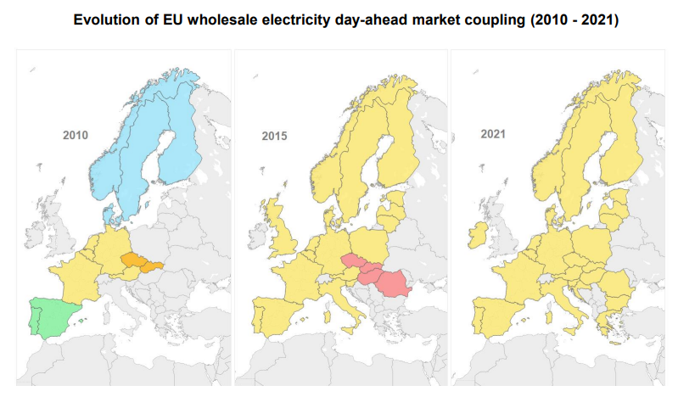
The benefits of integrated electricity markets
Evolution of EU wholesale electricity day-ahead market coupling, 2010-2021
How large are the benefits from cross-border trade in the EU?
€ 34 bn/yr.
Source: ACER’s assessment of the EU Wholesale Electricity Market Design, April 2022.

Slide 6
A competitiveness ‘snapshot’ & the interplay of electricity and gas

Slide 7
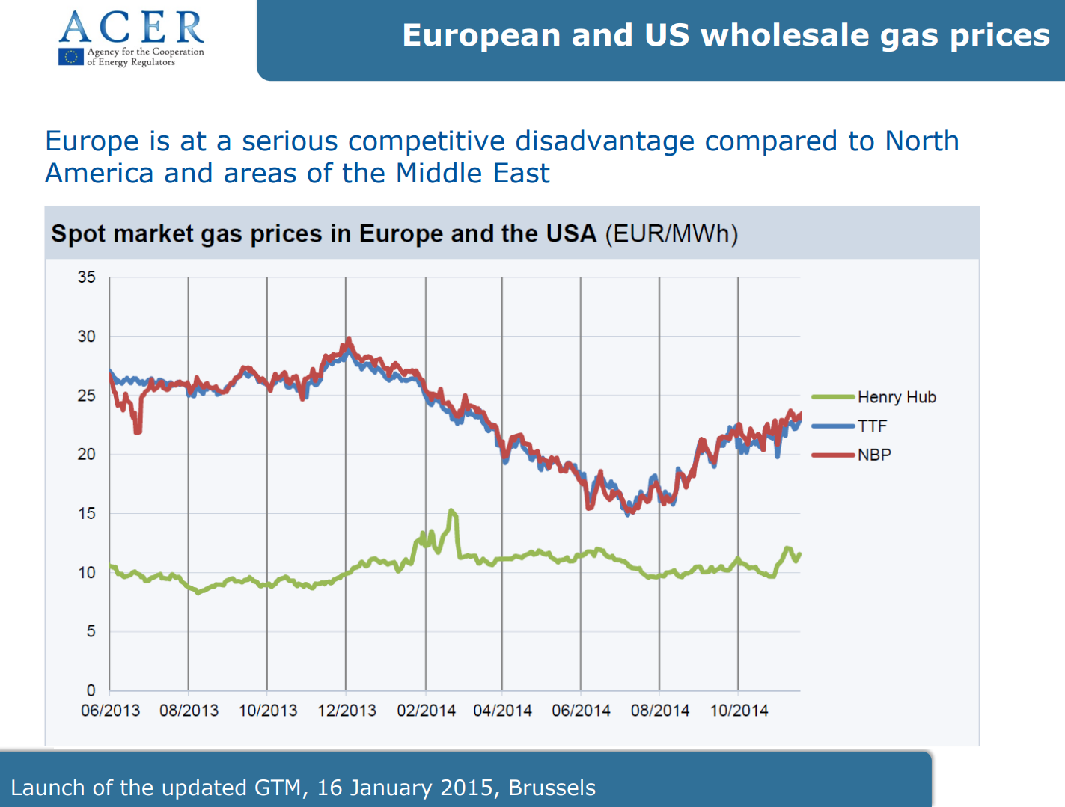
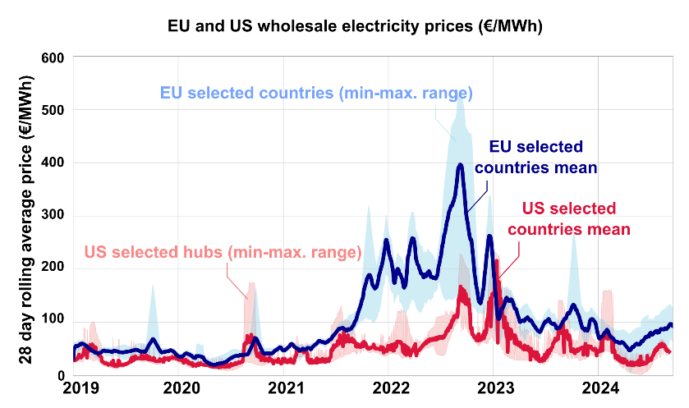
Our competitiveness challenges are recent …
or are they?
Source: ACER (left), Bruegel (right).

Slide 8
Gas markets are evolving & increasingly global
Price evolution of global gas benchmarks, 2021-2024 (EUR/MWh)
Geopolitical uncertainty; Russian supply disruption; costly storage injections
Russian invasion of Ukraine
EU demand weak; high storage stocks; mild weather; continuous LNG supply backed by new import infrastructure; limited Asian LNG demand
Tighter global LNG market due to rising global gas demand, geopolitical tensions; uncertainty about Ukraine transit flows; colder weather
Greater availability of Norwegian supply; comfortable storage position; continued tepid European demand
The EU has largely returned to a more stable gas supply, supported by reducing demand, ample LNG import capacity and adequate storage levels. However, this balance remains fragile. An anticipated surge in LNG supply from late 2026 is expected to drive prices down.
Source: ACER based on ICIS Heren. Note: The Dutch Title Transfer Facility gas hub (TTF) and the United States Henry Hub are used as benchmarks for European and American gas prices respectively.

Slide 9
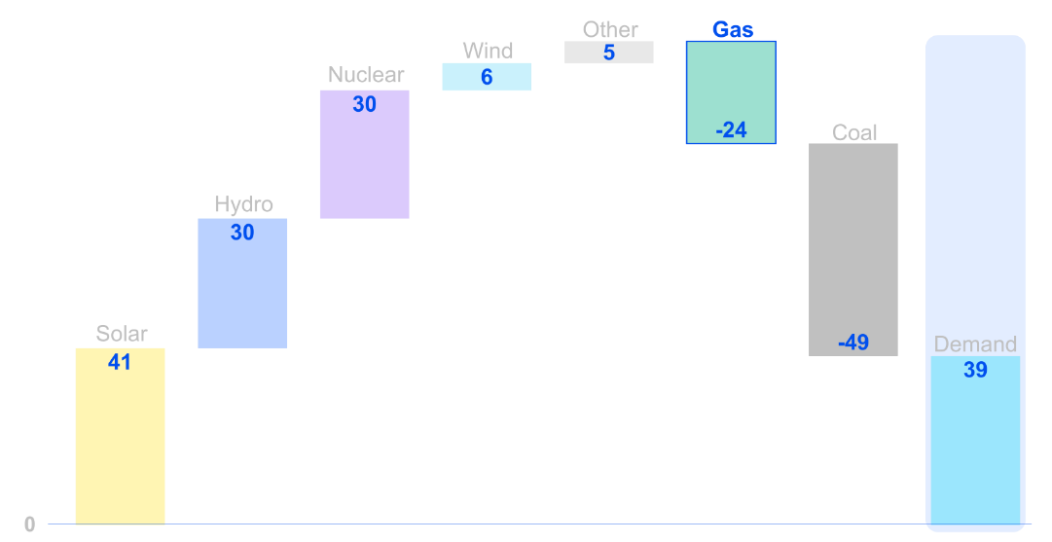
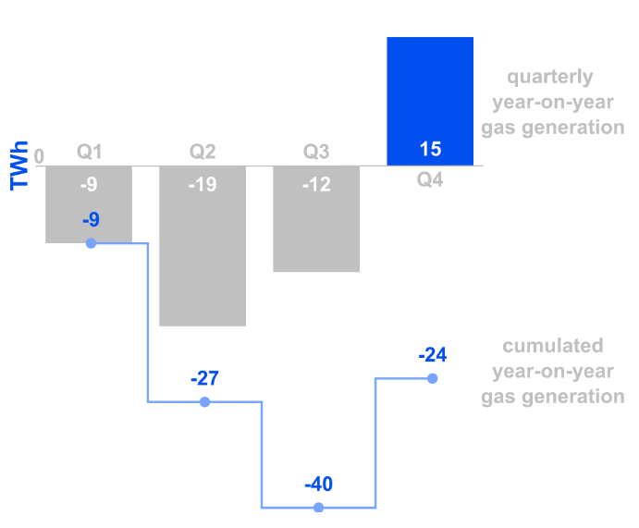
Relationship between gas and electricity is evolving
Electricity generation in 2024: Solar confirmed its leading role in the transition, whilst nuclear and hydro come back Year-on-year changes for the main generation technologies in the EU-27/EEA(Norway), 2024 (TWh)
Adverse weather in last months of 2024 limited the decline in gas-generated electricity Year-on-year changes for gas generation in the EU-27/ EEA(Norway), 2024 (TWh)
Source: ACER calculations based on ENTSO-E Transparency Platform.

Slide 10
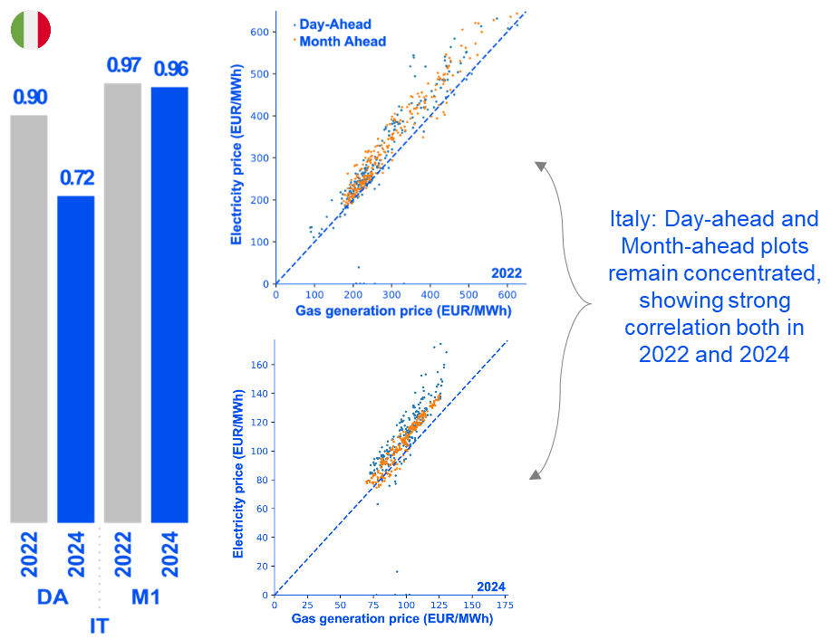
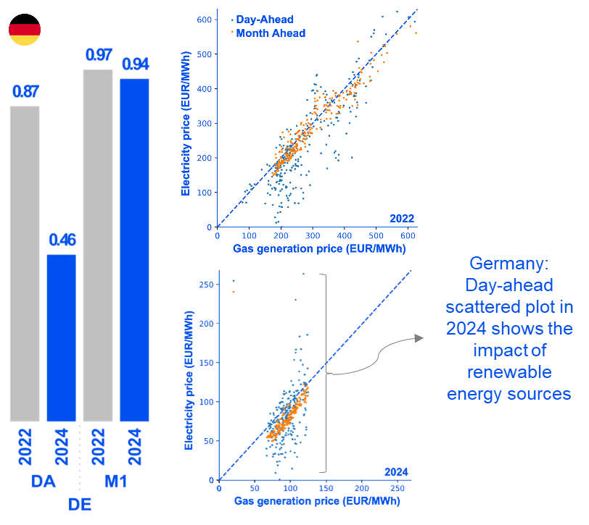
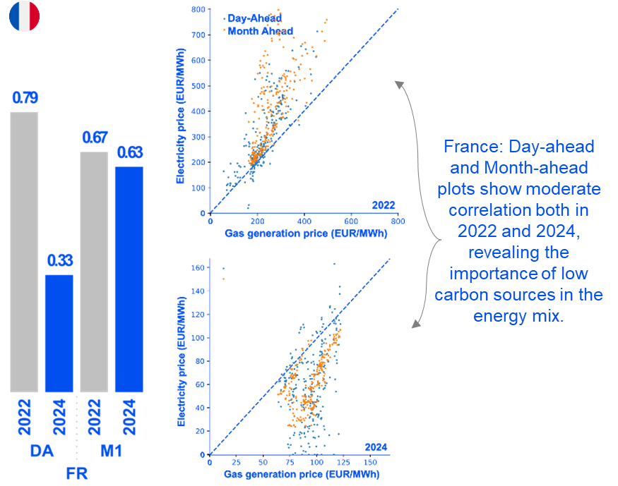
Impact on Member States differ per varying electricity mix
In 2024, the link between gas and electricity prices in Italy remained similar to 2022. In Germany, long-term electricity and gas prices remained closely linked, but renewable deployment has reduced gas influence on short-term electricity prices. In France, gas had significantly less impact on electricity prices, with the return of nuclear capacity.
Source: ACER calculations based on ENTSO-E Transparency Platform.

Slide 11
Impact on Member States differ per varying electricity mix
In 2024, the link between gas and electricity prices in Italy remained similar to 2022. In Germany, long-term electricity and gas prices remained closely linked, but renewable deployment has reduced gas influence on short-term electricity prices. In France, gas had significantly less impact on electricity prices, with the return of nuclear capacity.
Source: ACER calculations based on ENTSO-E Transparency Platform.

Slide 12
Impact on Member States differ per varying electricity mix
In 2024, the link between gas and electricity prices in Italy remained similar to 2022. In Germany, long-term electricity and gas prices remained closely linked, but renewable deployment has reduced gas influence on short-term electricity prices. In France, gas had significantly less impact on electricity prices, with the return of nuclear capacity.
Source: ACER calculations based on ENTSO-E Transparency Platform.

Slide 13
Recent ACER monitoring insights

Slide 14
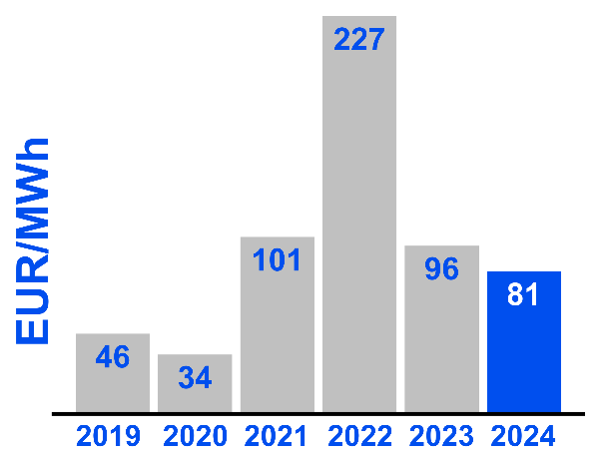
First, the good news
Day-ahead prices at their lowest since 2021 …
Average annual day-ahead electricity prices, EU-27 /EEA(Norway), 2019-2024 (EUR/MWh)
… but with notable regional and seasonal variations
Average annual day-ahead electricity prices & year-on-year difference in the EU-27 /EEA(Norway), 2024 (EUR/MWh, %)

Slide 15
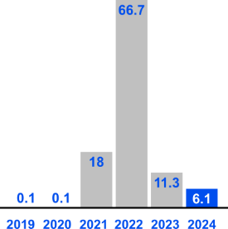
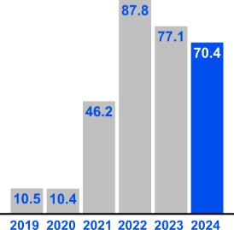
Electricity prices reveal a need for short-term flexibility
Fewer extreme price spikes after the crisis …
… but strong price swings persist
Share of hours and number of days with electricity prices above 150€/MWh, EU-27/EEA(Norway), 2024
Number of days with price swings above 50€ and average within-day price difference, EU-27/EEA(Norway), 2024
Electricity prices are now less extreme, but frequent swings within a day remain. This signals shifting supply-demand patterns that call for more short-term flexibility.
Annual percentage of the time when prices were above 150 EUR/MWh, EU-27/EEA (Norway), 2019-2024 (%)
Annual percentage of days when price variation per day was greater than 50 EUR/MWh, EU-27/EEA(Norway), 2019-2024 (%)
Source: ENTSO-E Transparency Platform.

Slide 16
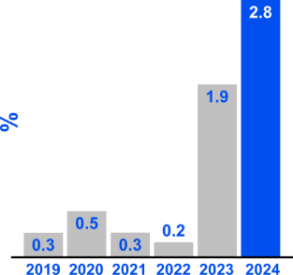
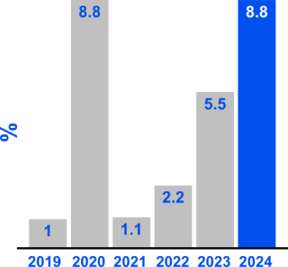
Also, negative and low electricity prices increased
Surge in negative electricity prices across the EU in 2023 intensifies further in 2024.
Percentage of the time and number of days when prices were negative (left) and below 5€/MWh (right), EU-27/EEA(Norway), 2024
Annual percentage of the time when prices were negative, EU-27/EEA (Norway), 2019-2024 (%)
Annual percentage of the time when prices were <5EUR/MWh, EU-27/EEA (Norway), 2019-2024 (%)
Occurrences of negative prices had risen by 12 times in 2023; they increased further by half in 2024. Better subsidy designs and overall tariffs reflecting local constraints could encourage renewable producers to align output with system needs, reducing negative price episodes.
Source: ACER calculations based on ENTSO-E Transparency Platform.

Slide 17
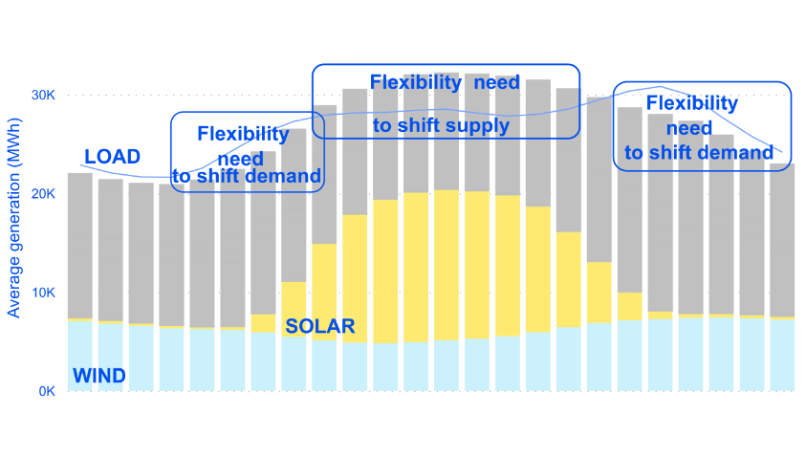
Short-term flexibility solutions exist; uptake must grow
The gap between midday solar oversupply and evening demand is growing.
Renewables induce short-term flexibility needs Hourly averages of energy generation in Spain, 2024 (MWh)
Demand-response, interconnections and batteries are key Flexibility services provided by various technologies, sorted according to their duration¹
Real time
Day/week
Month/year
Demand-side response
Energy efficiency
Batteries
Storage (depending on the technology)
Hydro storage
Hydrgen/biomethane
Electricity network - interconnections
Gas storage
Thermal generation unit
In real time, the gap between midday solar oversupply and evening demand is growing. Solutions exist to manage this gap e.g. access to demand-side response¹, battery deployment, and cross-border trade through interconnections². For longer-term flexibility, the role of gas storage remains central.
Note: 1. See the ACER report on Demand response and other distributed energy resources (December 2023) and the upcoming ACER report on No-regret measures to remove barriers to demand response (April 2025) 2. See the yearly ACER report on Capacities for cross-zonal electricity trade and congestion management.

Slide 18
Case in point? – price volatility in Central & Eastern Europe

Slide 19
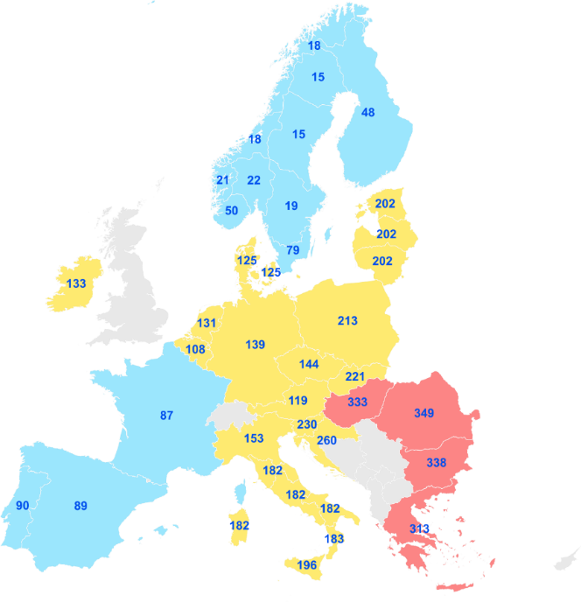
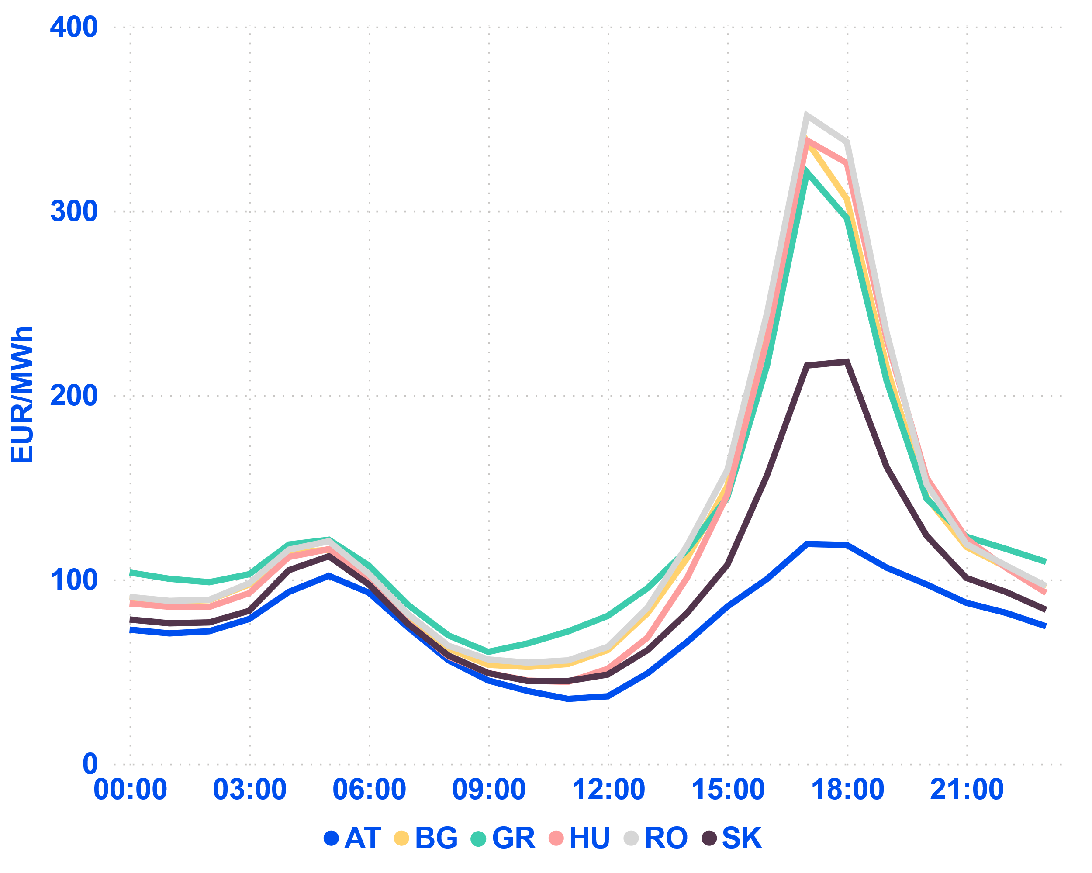
Zooming in on ‘summer developments’
Average day-ahead prices, EU-27/EEA(Norway), July to September 2024 at 17:00 UTC (EUR/MWh)
Evolution of average day-ahead prices in select EU bidding zones, July to September 2024 (EUR/MWh)
Source: ACER calculations based on ENTSO-E’s transparency platform.

Slide 20
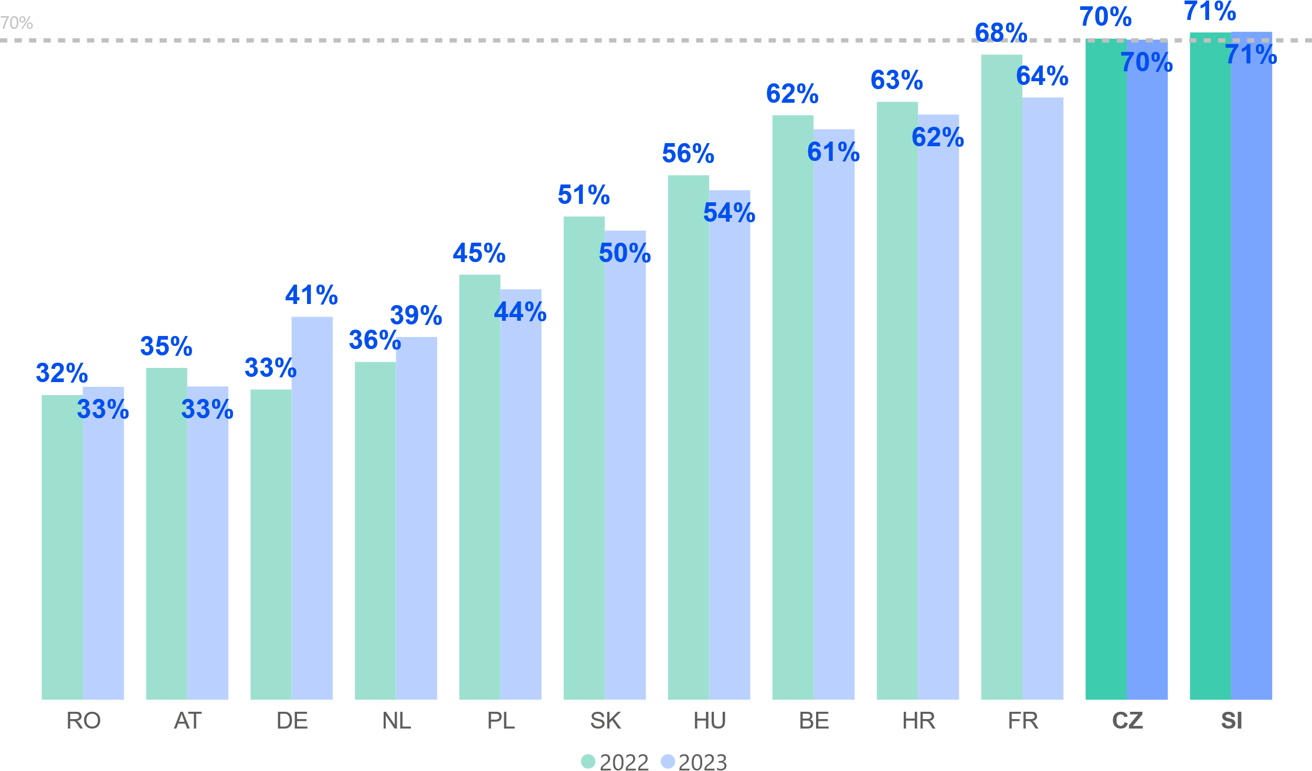
More interconnector capacity needs to be made available
There is limited progress towards 70%
Average minimum hourly margin available for cross-zonal trade in the Core capacity calculation region per Member State – H2 2022-2023 (% of Fmax)
“ACER estimates that, during the summer of 2024, meeting the 70% requirement would have yielded between 10 and 25% of additional margin of capacity in the most relevant bottlenecks [affecting Central Eastern Europe].”
Source: ACER’s report on capacities for cross-zonal trade of electricity and congestion management, July 2024. ACER Opinion issued on 10 April 2024. Background note for TTE Council of 16 December 2024.

Slide 21
Sneak peek …
12 actions to unlock flexibility in the electricity markets at the national level
“As for the future, your task is not to foresee it, but to enable it”
Antoine de Saint Exupery
REVISED REGULATIONS
MARKET ACCESS
ACER’s “Unlocking flexibility” report: No-regret measures to remove barriers to demand response (April 2025)

Slide 22
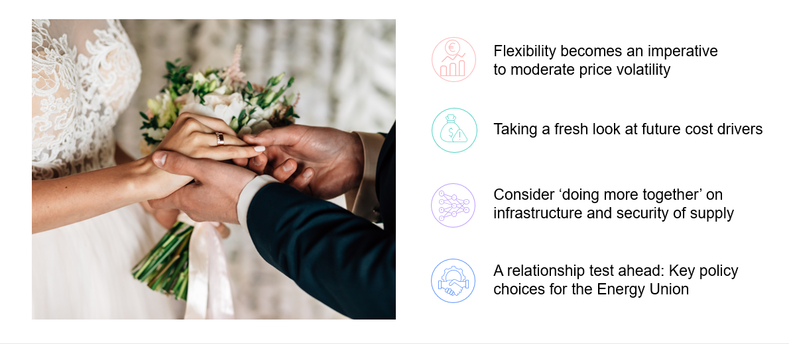
All in all, might it be time to renew (or revisit) initial vows?

Slide 23
ACER is hiring! Join us in powering Europe’s energy future.

Slide 24
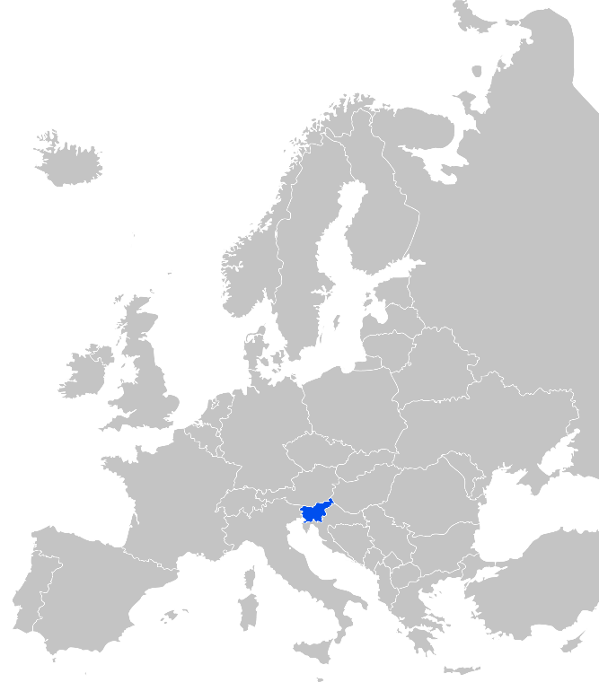
ACER role and governance
Supporting the integration of energy markets in the EU (by common rules at EU level). Primarily directed towards transmission system operators and power exchanges.
Contributing to efficient trans-European energy infrastructure, ensuring alignment with EU priorities.
Monitoring energy markets to ensure that they function well, deterring market manipulation and abusive behaviour.
Where necessary, coordinating cross-national regulatory action.
Governance: Regulatory oversight is shared with national regulators. Decision-making within ACER is collaborative and joint (formal decisions requiring 2/3 majority of national regulators). Decentralised enforcement at national level.
Headquartered in Ljubljana, Slovenia. Engaged across the EU.

Slide 25
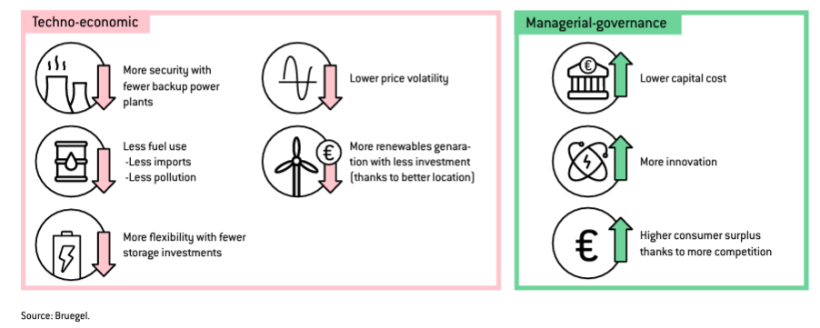
‘Doing more together’ holds benefits
Further [energy market] integration could increase (…) benefits to up to EUR 40-43 billion per year by 2030 …
Regional cooperation across Europe, underpinned by better interconnectivity and closer coordination, can reduce the need for flexibility investments by up to 20% …
Source: Zachmann, G., C. Batlle, F. Beaude, C. Maurer, M. Morawiecka and F. Roques (2024) ‘Unity in power, power in unity: why the EU needs more integrated electricity markets’, Policy Brief 2024/03, Bruegel, 14 February 2024.

Slide 26
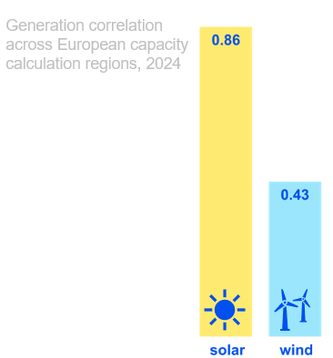
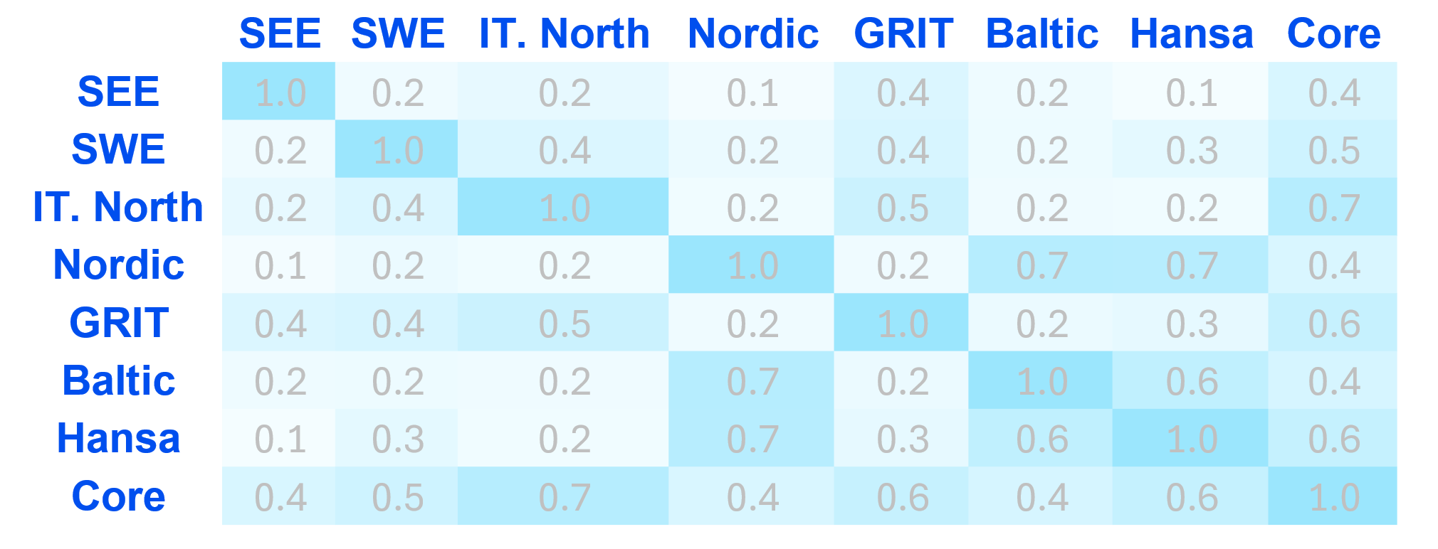
Example: enhanced regional coordination of renewables
Wind generation offers significant complementarity across regions, while solar is highly correlated, thus less relevant as an import-compensating resource.
Example: The Nordic and Core region show moderate correlation. Surplus wind generation can be exported from one region to the other.
Correlation of on-shore wind generation across European capacity calculation regions, 2024
Wind generation is more regionally complementary than solar, which relies more on storage uptake in high-solar saturation areas for capturing value. Better coordination of wind and solar across Europe can raise capacity factors and reduce variability.
Source: ENTSO-E transparency platform + Bruegel policy brief from 14 February 2024 (previous slide).

Slide 27
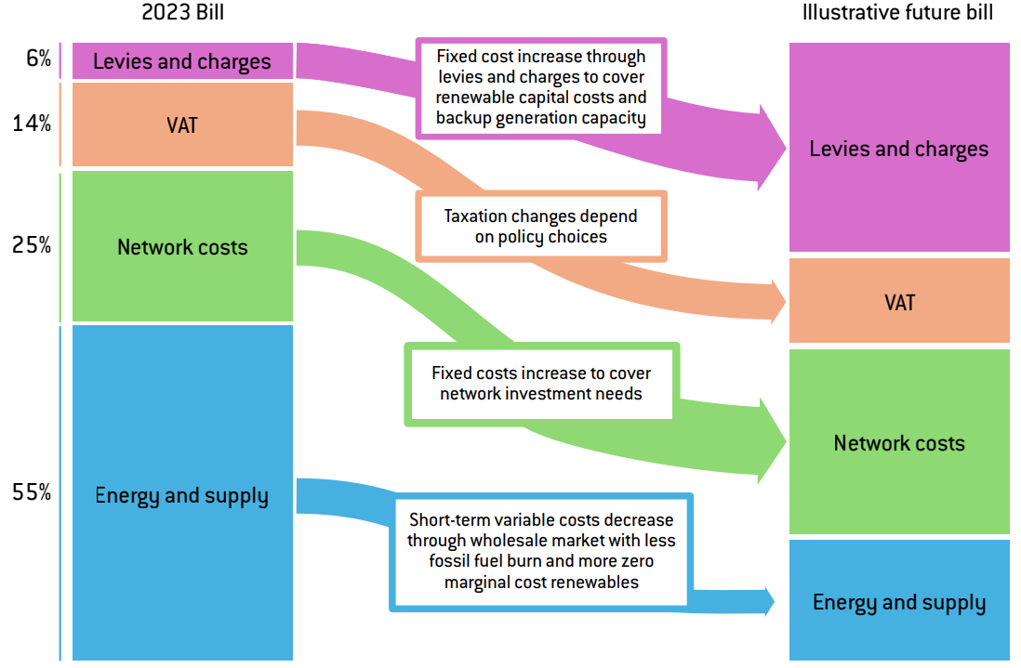
Shift in cost drivers ~ shift in focus?
Expected changes in electricity cost components with the energy transition
Source: Bruegel, Decarbonising for competitiveness: four ways to reduce European energy prices, December 2024.

Slide 28
Network costs at risk of doubling by 2050
Grid costs are expected to increase …
… while electricity costs should decrease
Innovative grid technologies can help:
20-40 % increase in overall network capacity by 2040
35 % reduction in conventional expansion costs by 2040
+87% between 2022 and 2050
60
48
36
EUR/MWh
16
32
32
29
20
12
2022
2030
2040
2050
legacy grid costs
new grid costs
Source: ACER’s monitoring of electricity infrastructure development to support a competitive and sustainable energy system, 16 December 2024. Numbers (right) from CurrENT and Compass Lexecon: Prospects for Innovative Power Grid Technologies, June 2024

Slide 29
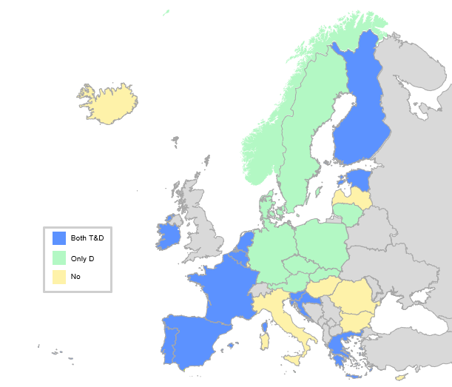
Sneak peek …
Grid tariffs play a role, too.
Flexibility needs make flat grid tariffs costly, pushing Time of Use forward… Time of use tariffs in Europe, 2023
"The future is already here – it's just not very evenly distributed“
William Gibson
ACER’s report on network tariff practices: “Getting the signals right: electricity network tariff methodologies in Europe” (March 2025)

