Slide 1
The Future of Geothermal Energy
Heymi Bahar
Paris – 21 March 2025

Slide 2
Geothermal energy is versatile
Total final energy consumption of geothermal energy by end-use, 2023
1.5 EJ
Geothermal energy accounts for less than 1% of global energy demand and it is primarily consumed in the form of heat with geothermal heat pumps and district heating accounting for two-thirds of its total consumption

Slide 3
Alternative approaches to harness geothermal energy are developing
Conventional (hydrothermal), and next-generation geothermal concepts

Slide 4
Technology breakthroughs are unlocking geothermal energy’s vast potential
Renewables technical resource potential
Over 2200 TW
7-8 km
5-7 km
3-5 km
Next-generation geothermal technical potential can be 60 times more than today’s installed power capacity worldwide, second after solar PV. This full potential can meet 140-times global electricity demand today.

Slide 5
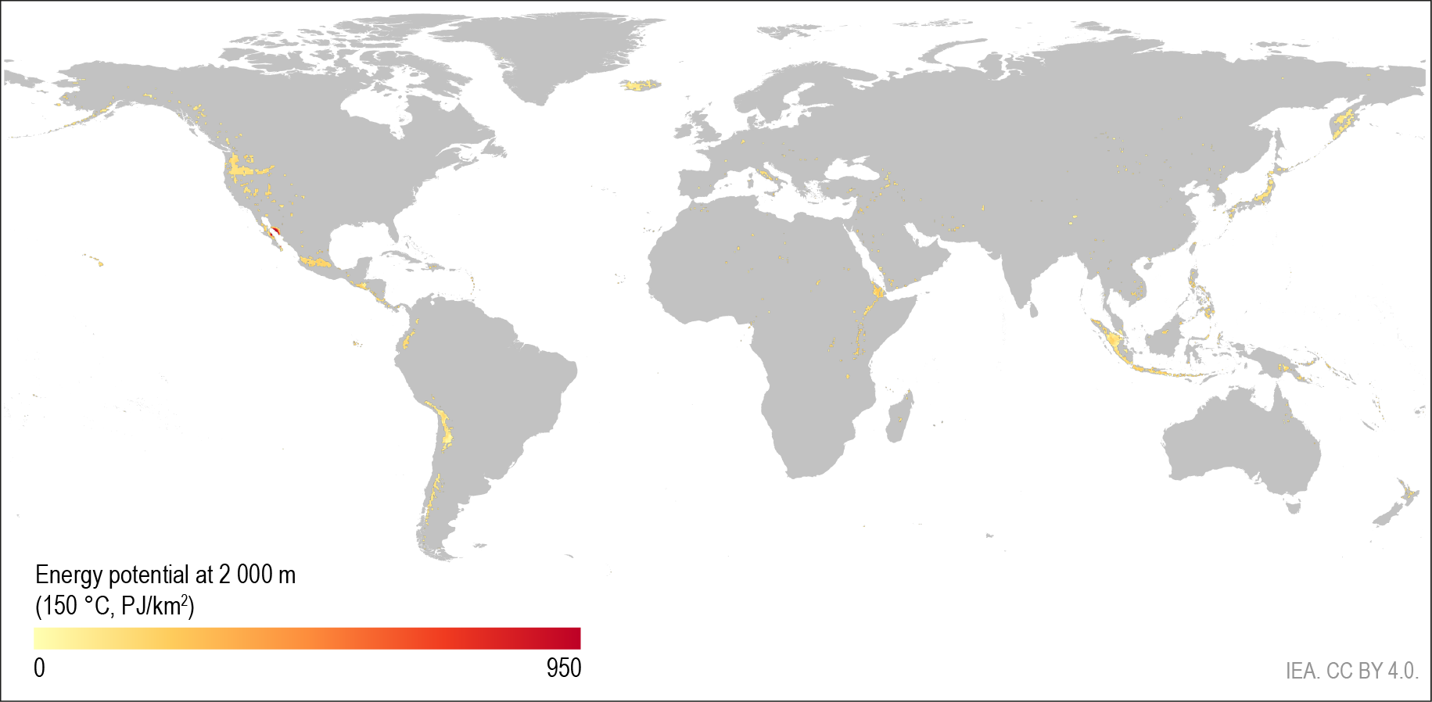
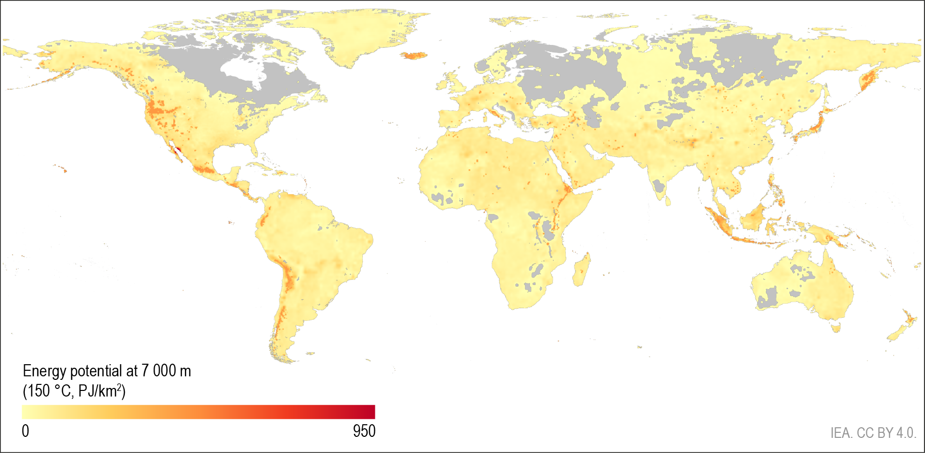
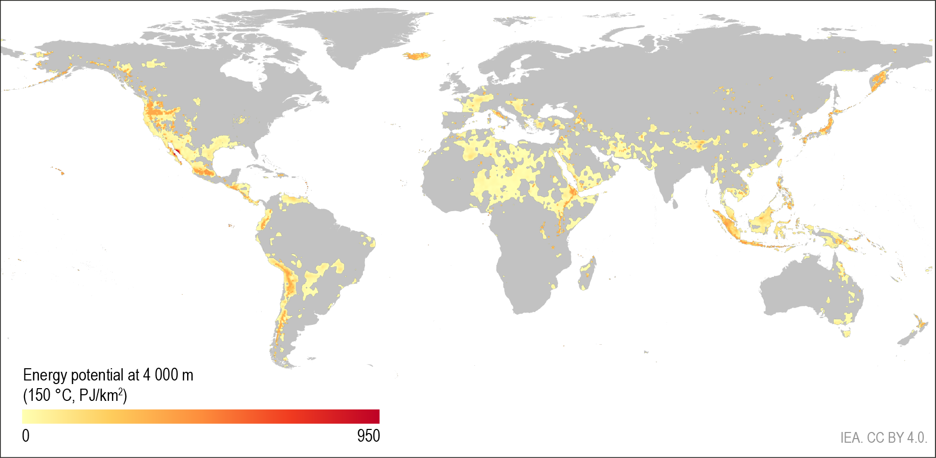
Geothermal potential is everywhere once deeper
Source: based on Project InnerSpace GeoMap

Slide 6
Large overlapping competencies between geothermal and oil and gas
Share of geothermal technology investment that overlaps with oil and gas industry skills and expertise
Conventional
Enhanced Geothermal Systems
Closed loop - AGS
12%
7%
12%
18%
24%
37%
11%
7%
40%
57%
65%
11%
Evaluation, planning and management
Drilling and completions
Surface facilities
Other
For every dollar invested in geothermal, between 65-80%
has a significant overlap with the skills and expertise of the oil and gas industry.

Slide 7
Oil and gas industry expertise can drive down geothermal costs
Enhanced Geothermal Systems total construction costs
USD per kW
16 000
12 000
Research
8 000
Economies of scale
Spillover
4 000
0
2023
Cost reductions
Low level of transfer
Further cost reductions
High level of transfer
Surface facilities
Drilling and completions
Evaluation and planning
A high level of knowledge transfer and productivity gains from the oil and gas industry could reduce next-generation geothermal costs by nearly three-quarters.

Slide 8
Cost reductions can open a huge market for geothermal
LCOE of next-generation geothermal with high transfer
Market potential for next-generation geothermal
250
800
Rest of world
GW
Europe
200
Dollars per MWh
600
Southeast Asia
150
India
400
China
100
United States
Solar PV utility (2013-2023)
200
50
2025
2030
2035
2025
2035
2050
Rapid cost reductions could unlock over 800 GW of next-generation geothermal by 2050 with the largest markets in China, the United States, India, Southeast Asia and Europe

Slide 9
Huge market opportunities for next-generation geothermal
Market potential for next-generation geothermal
Cumulative investments (Billion USD)
Share of electricity generation growth to 2050
3 000
60%
2 400
50%
40%
1 800
30%
1 200
20%
600
10%
0%
2025
2030
2035
2040
2045
2050
Solar PV
Wind
Geothermal
Nuclear
Hydro
Bioenergy
Electricity only
Industrial heat
CHP
Market opportunities for next-generation geothermal could attract investment totally USD 1 trillion by 2035, and it could meet 15% of global electricity demand growth to 2050, plus provide heat in industry and buildings

