Slide 1
ENTSO-E’s Role in Grid Planning and Development
21 March 2025
Christelle Verstraeten
ENTSO-E Head of Policy, Communications and Stakeholder Management

Slide 2
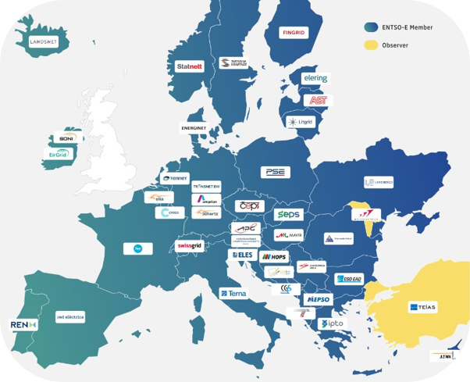
Introduction to ENTSO-E
500.000 km of transmission lines
520 million citizens
ENTSO-E, established in 2009, represents 40 TSOs from 36 countries
ENTSO-E is the Association for the cooperation of TSOs, entities with public service and EU mandates on:
Security of power system
Optimal functioning and development of electricity markets
Climate-neutrality by 2050

Slide 3
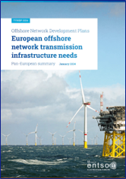
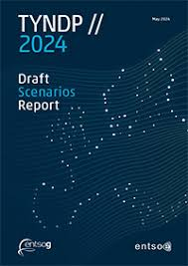
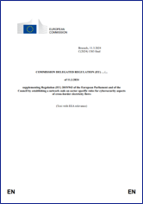
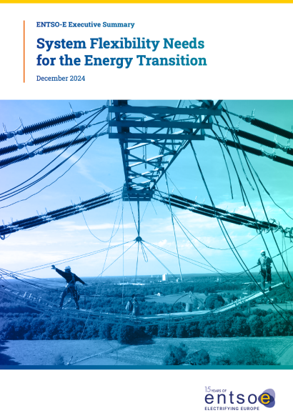
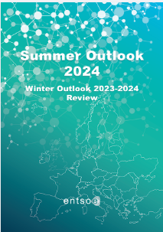
What we deliver ?
Legally mandated tasks
Conducts security of supply and adequacy analysis
Develops and implements technical rules (e.g. Network Codes)
Coordinates long-term grid planning
Coordinates research, development and innovation activities
Develops platforms for data sharing with market participants
Synchronisation of Ukraine, Baltics with Continental Europe (co-operation between TSOs)
EU Action Plan for Grids (co-operation with manufacturers and distribution)
Identification of flexibility needs (Electricity Market Design package)

Slide 4
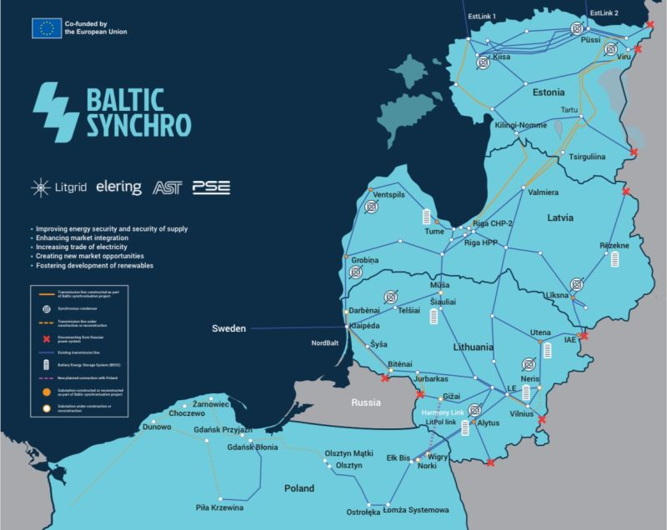
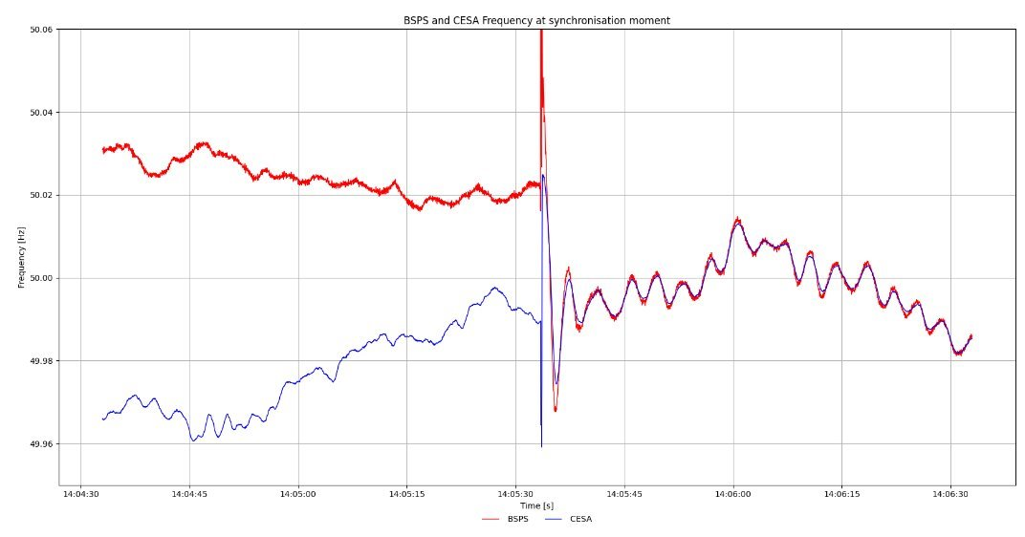
Baltic Synchronisation
7-8 February, Vilnius
The approval of the Baltic States CFI Agreement by Continental Europe TSOs in 2019 was the beginning of a six years period of hard work. Today we reached our common target – the synchronization. From now on we have the same frequency from Lisbon to Tallin (our common heart beat) which means that we instantaneously support each other and that we also share our instabilities.
This is like living in the same house - we warmly welcome the Baltic TSOs in the Continental Europe TSOs family.
Albino Marquez, Convenor of RG CE

Slide 5
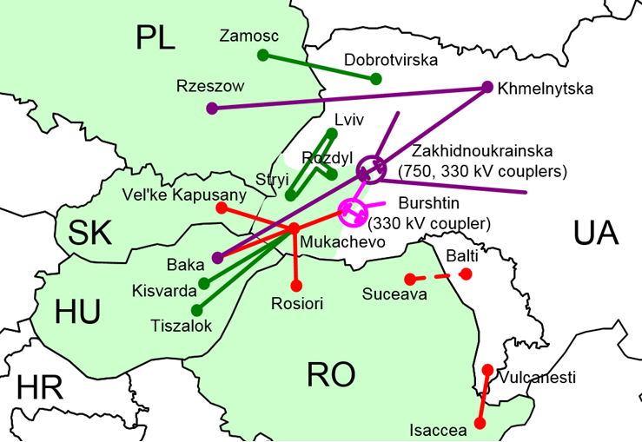
Electricity import capacity to Ukraine-Moldova
Increase of the capacity available for the market during the winter 2024-25
In order to increase the commercial import capacity for the winter 2024-25, new calculations were performed on a specific grid model representative for the winter situation.
In addition, TSOs identified new remedial actions which were integrated into the calculations.
As a result, the commercial import capacity to Ukraine and Moldova will be increased to 2.100 MW during the winter on a permanent basis when all interconnections are in operation. This increase of 400 MW will be applicable from 1 December 2024.
As previously, the import capacity will be shared between the 5 relevant borders.​
In total, the sum of commercial capacity and emergency assistance could reach up to 2.350 MW during the winter.
The commercial import capacity will be reassessed more frequently in the spring, leading to more dynamic changes of the capacity available for the market.​

Slide 6
Key Challenges of Grid Planning
Ensuring cybersecurity in increasingly digitalised network
Keeping energy costs fair for citizens amidst rapid transitions.
Supply Chain: Increase speed of installation
Protecting physical infrastructure, especially in regions like the Baltic and North Sea
Securing financing and regulatory frameworks for long-term grid investments.

Slide 7
ENTSO-E Ten-Year Network Development Plan (TYNDP)
ENTSO-E’s comprehensive plan for the future European electricity system
Key Objectives
Decarbonisation: Achieving net-zero emissions by 2050
Infrastructure Development: Supporting renewable energy integration.
System Resilience: Enhancing grid reliability.
Strategic Focus Areas
Renewable Integration: Connecting large-scale renewables.
Cross-Border Interconnections: Strengthening electricity flows.
Innovation and Digitalization: Utilising advanced technologies.

Slide 8
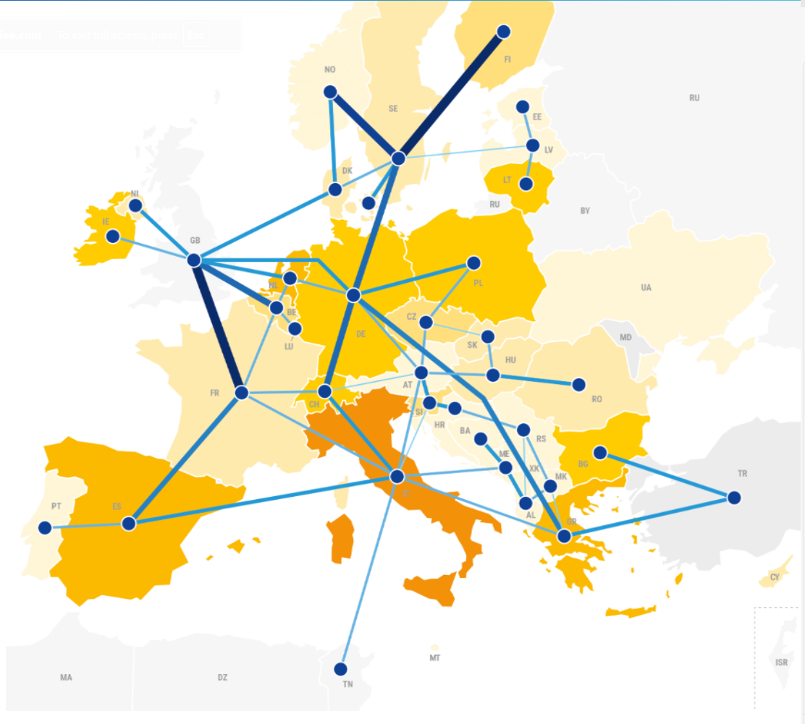
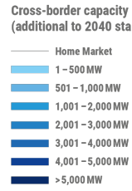
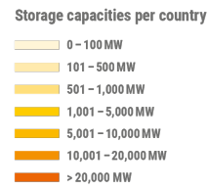
TYNDP 2024: Setting Investment Priorities
Ten-Year Network Development Plan 2024
Comprehensive plan for the future European electricity system based on multi-energy scenarios
+88 GW
€5Bn/yr
Cross-border capacity by 2030
in investments
€8Bn/yr
Savings in system costs
19Mil.Tn/yr
of CO2 emissions reduced
30 TWh/yr
Yearly decrease in RES curtailment by 2030
2030

Slide 9
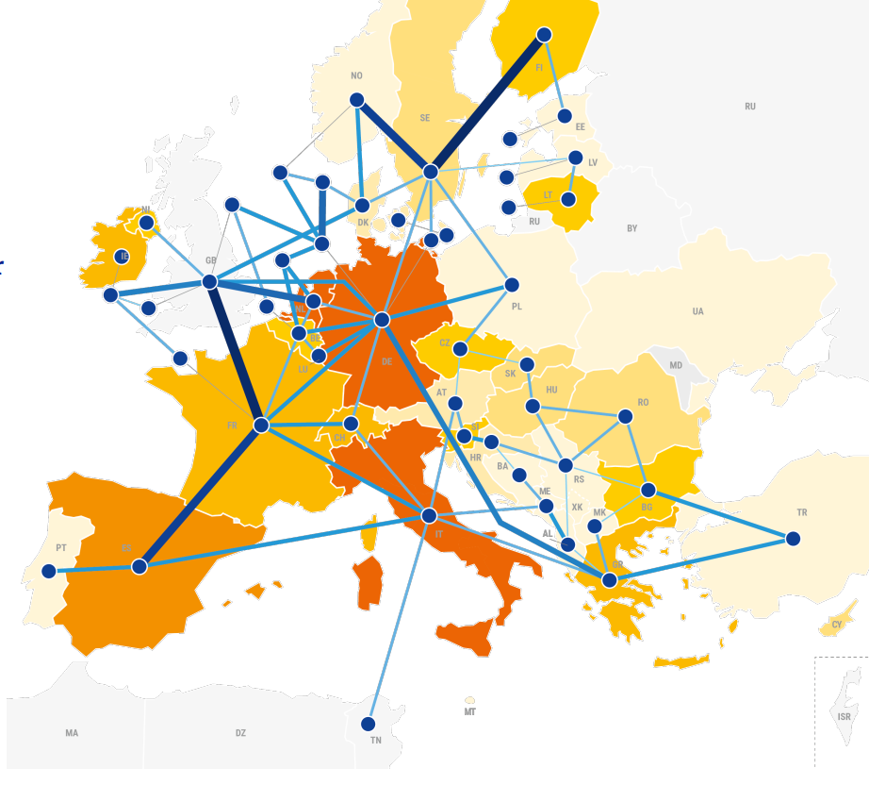
TYNDP 2024: Setting Investment Priorities
Ten-Year Network Development Plan 2024
Comprehensive plan for the future European electricity system based on multi-energy scenarios
+108 GW
Cross-border capacity by 2040 (double compared to today)
114 TWh/yr
Yearly decrease in RES curtailment by 2040
€2 saved
For each euro invested
Existing projects expected to:
4.1 Mil.
Jobs created by 2040
2040
€247Bn
Increase in European GDP by 2040

Slide 10
Key Areas for Additional Grid Investments

Slide 11
Priorities for Grid Development
Clear and Stable Investment Framework
• Financial Support Mechanisms
• Cross-border Coordination
Onshore and Offshore Holistic Planning
Integrated System Planning
Anticipatory Investments
Streamlining and Simplifying
Simplification of Permitting Rules and Administrative Processes
Stakeholder Engagement
Strong Supply Chain
Diversification strategy
Resilient supply
Commitment in the form of Investments:
€362 Bn
€31-41 Bn
€393-403 Bn
by 2050 for connecting generation capacities
for expansions between jurisdictions for offshore hybrid corridors
of minimum total investments for offshore transmission connecting RES

Slide 12
Thank you

