Slide 1
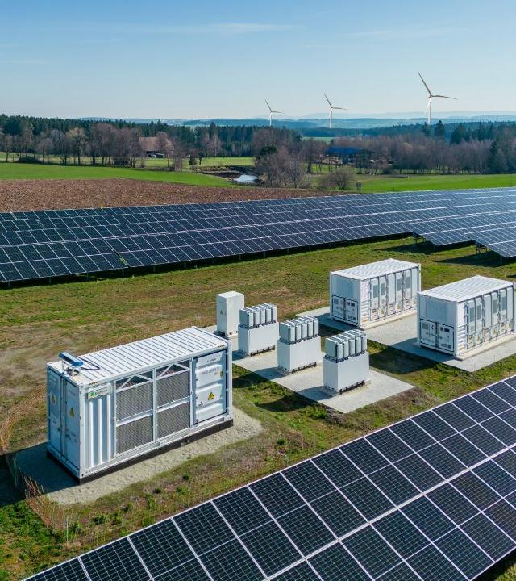
The contribution of Solar PV to secure electricity system Dries Acke Deputy CEO SolarPower Europe

Slide 2
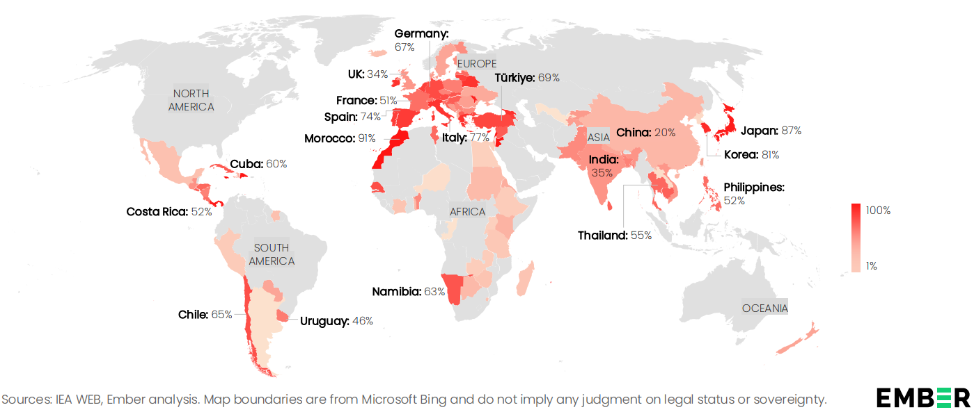
Renewable-based electrification is a security imperative for EU
EU is highly dependent on energy imports

Slide 3
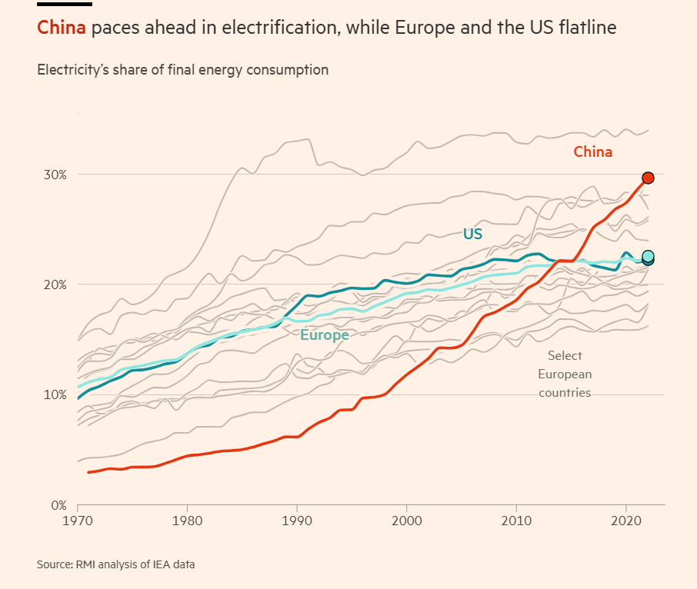
EU is falling behind on electrification compared to China and other fossil importing economies

Slide 4
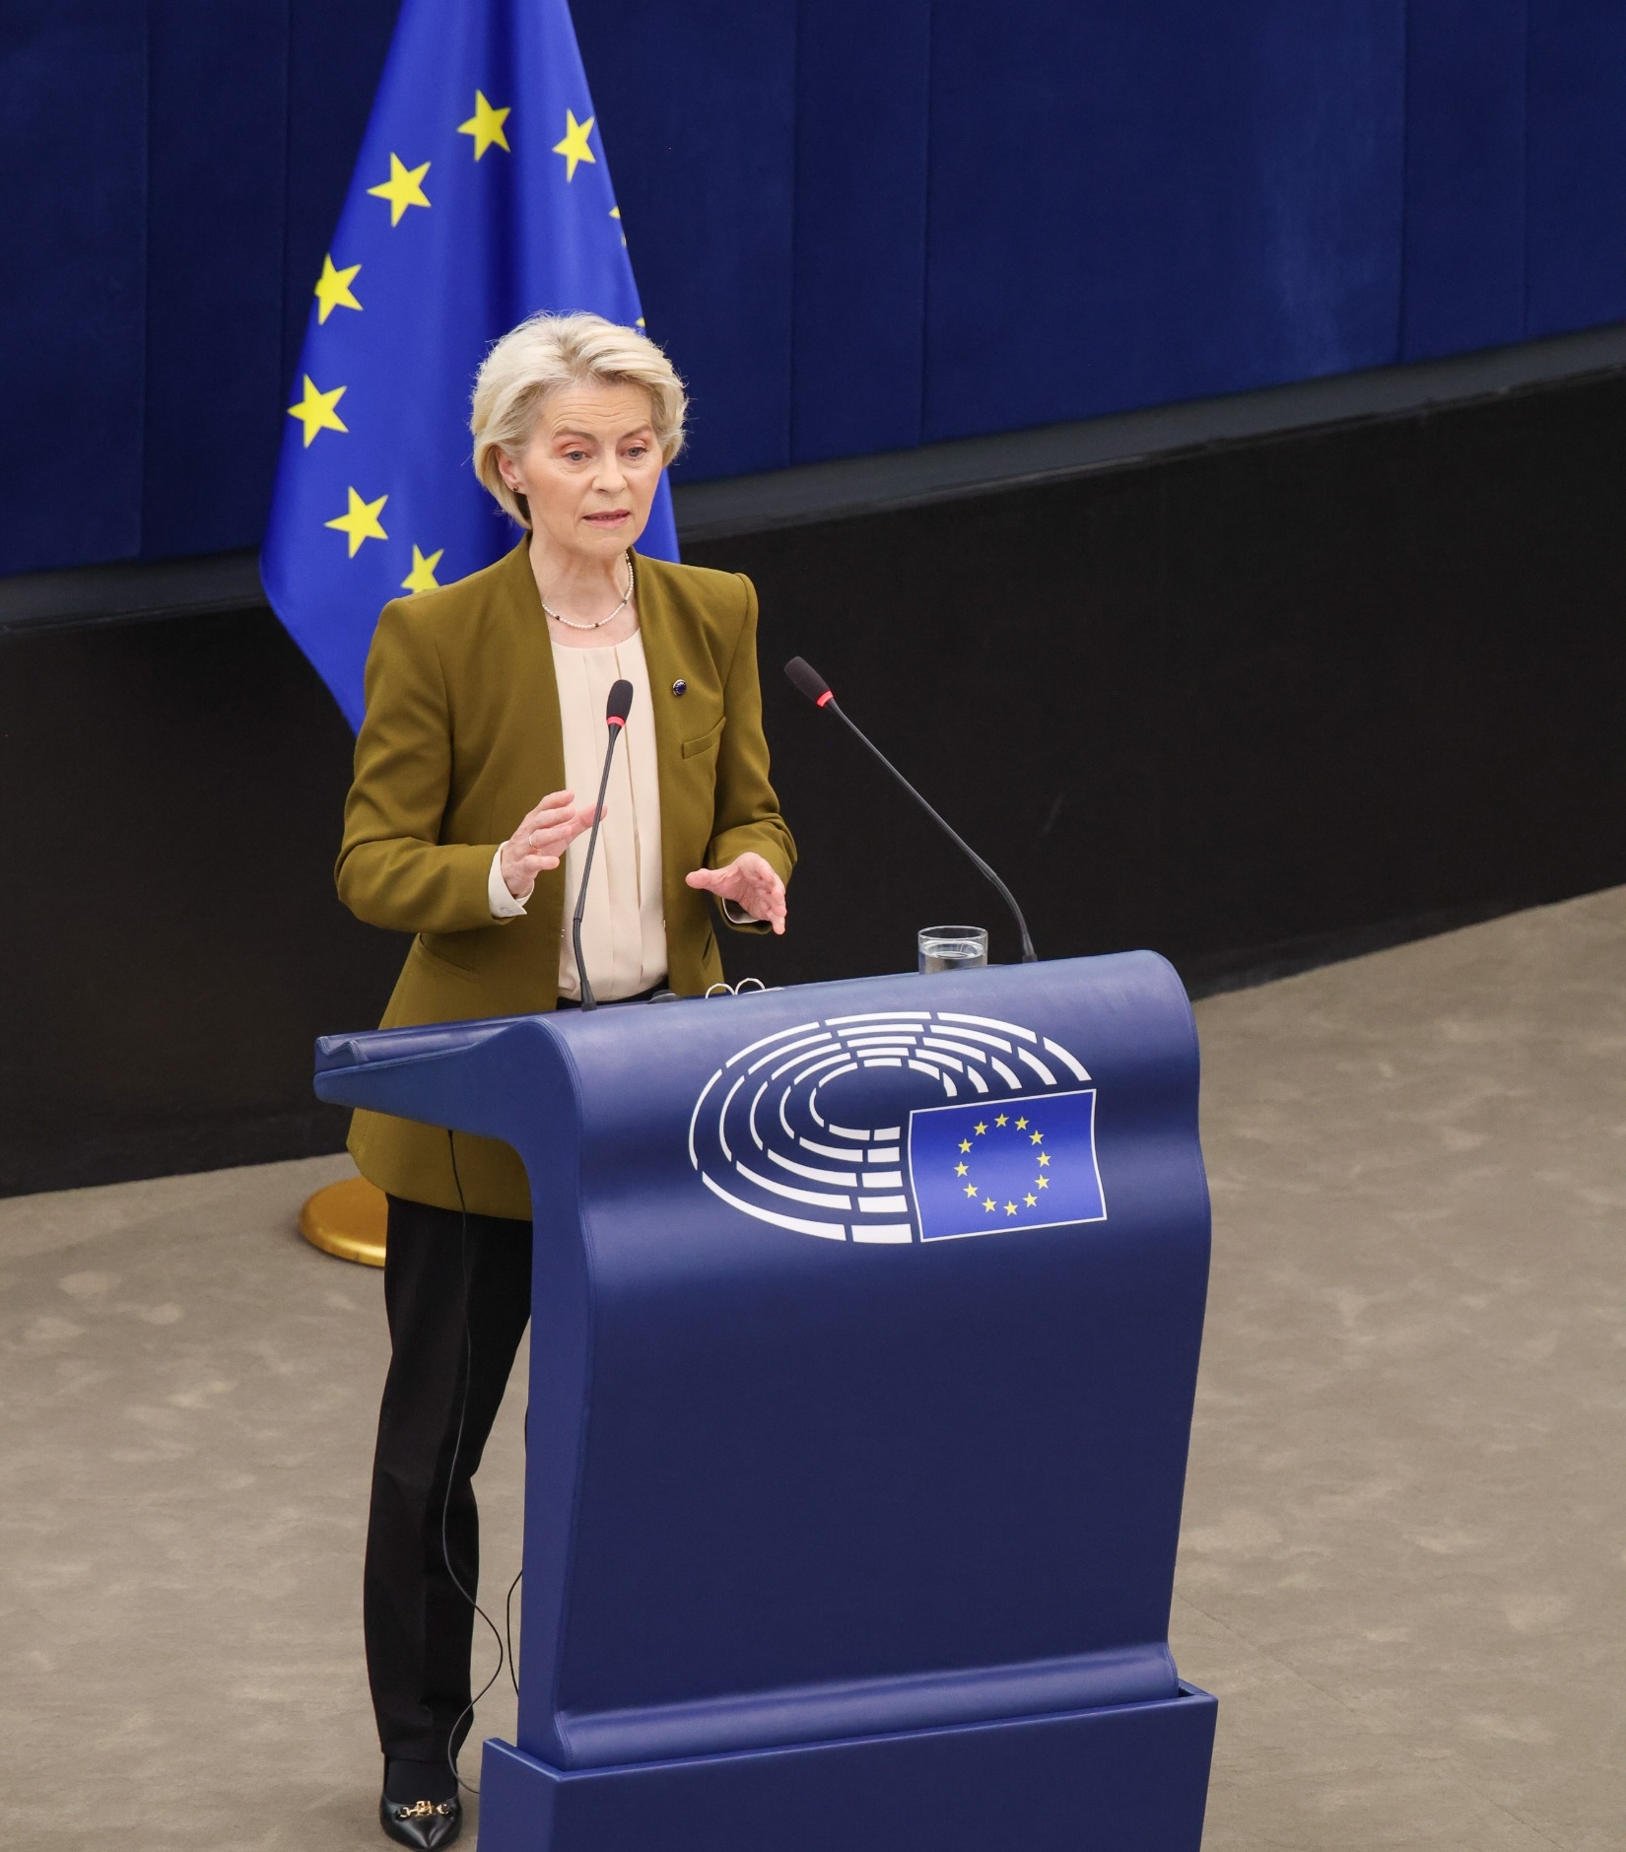
“The future is electric”
“Europe stays the course on renewables”

Slide 5
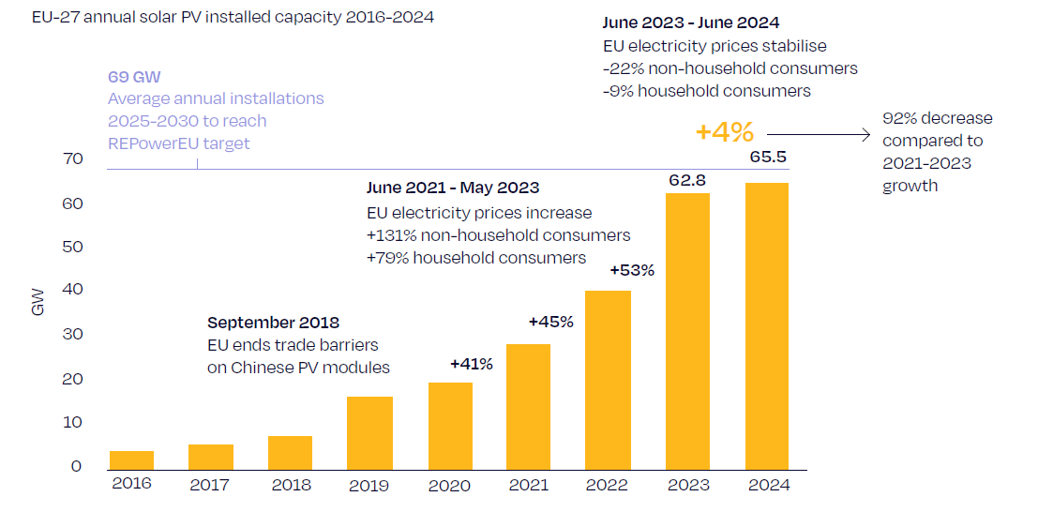
Stellar solar growth in the last years…
Notes:
However, the annual growth rate decelerated significantly to 4.4% compared to the robust 41-53% observed during 2021-2023. This slowdown was expected, as the exceptional surge in 2022 and 2023 was largely driven by soaring electricity prices during the energy crisis (see Fig. 1).
The slowdown is not too surprising.
Following the solar boom during the gas crisis, the urgency of going solar has waned for citizens as their bills have normalised.
Building bankable utility-scale solar becomes more challenging as grid and flexibility bottlenecks tighten.
Negative electricity prices challenge the business case for all larger installations, including C&I rooftop solar.
Policy need to pick up to meet target / solar helped for power prices to stablise / now policy has to step up

Slide 6
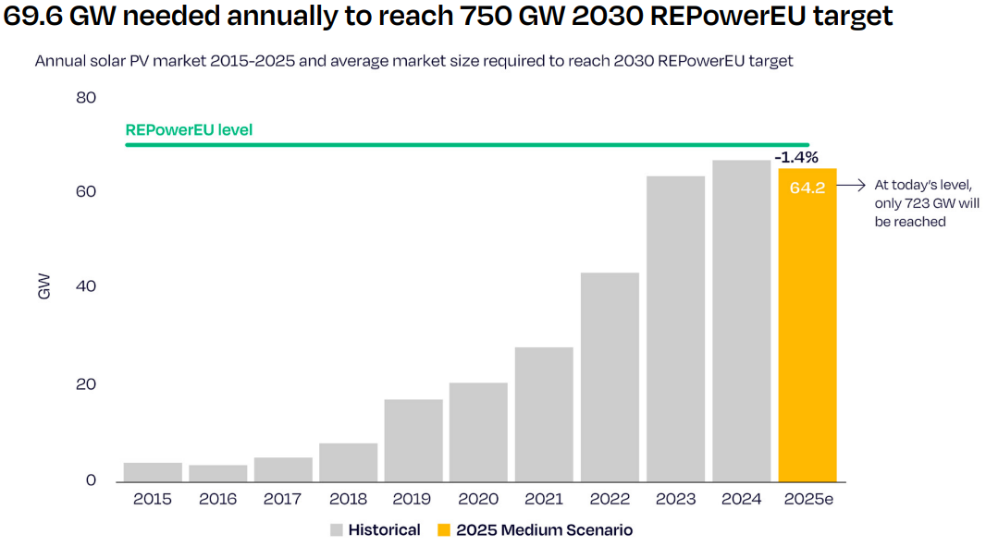
… but slowing down – and likely contracting in 2025
At least 70GW per year needed to reach EU 2030 RES target

Slide 7
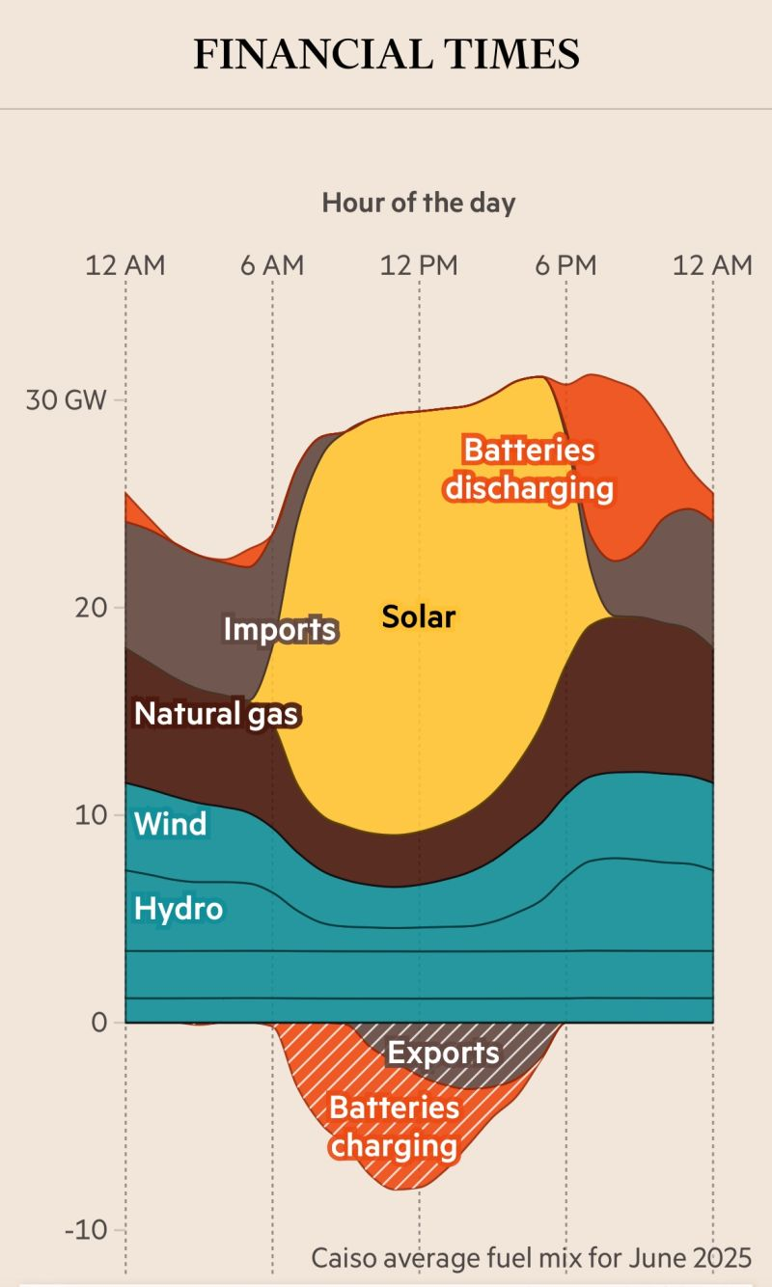
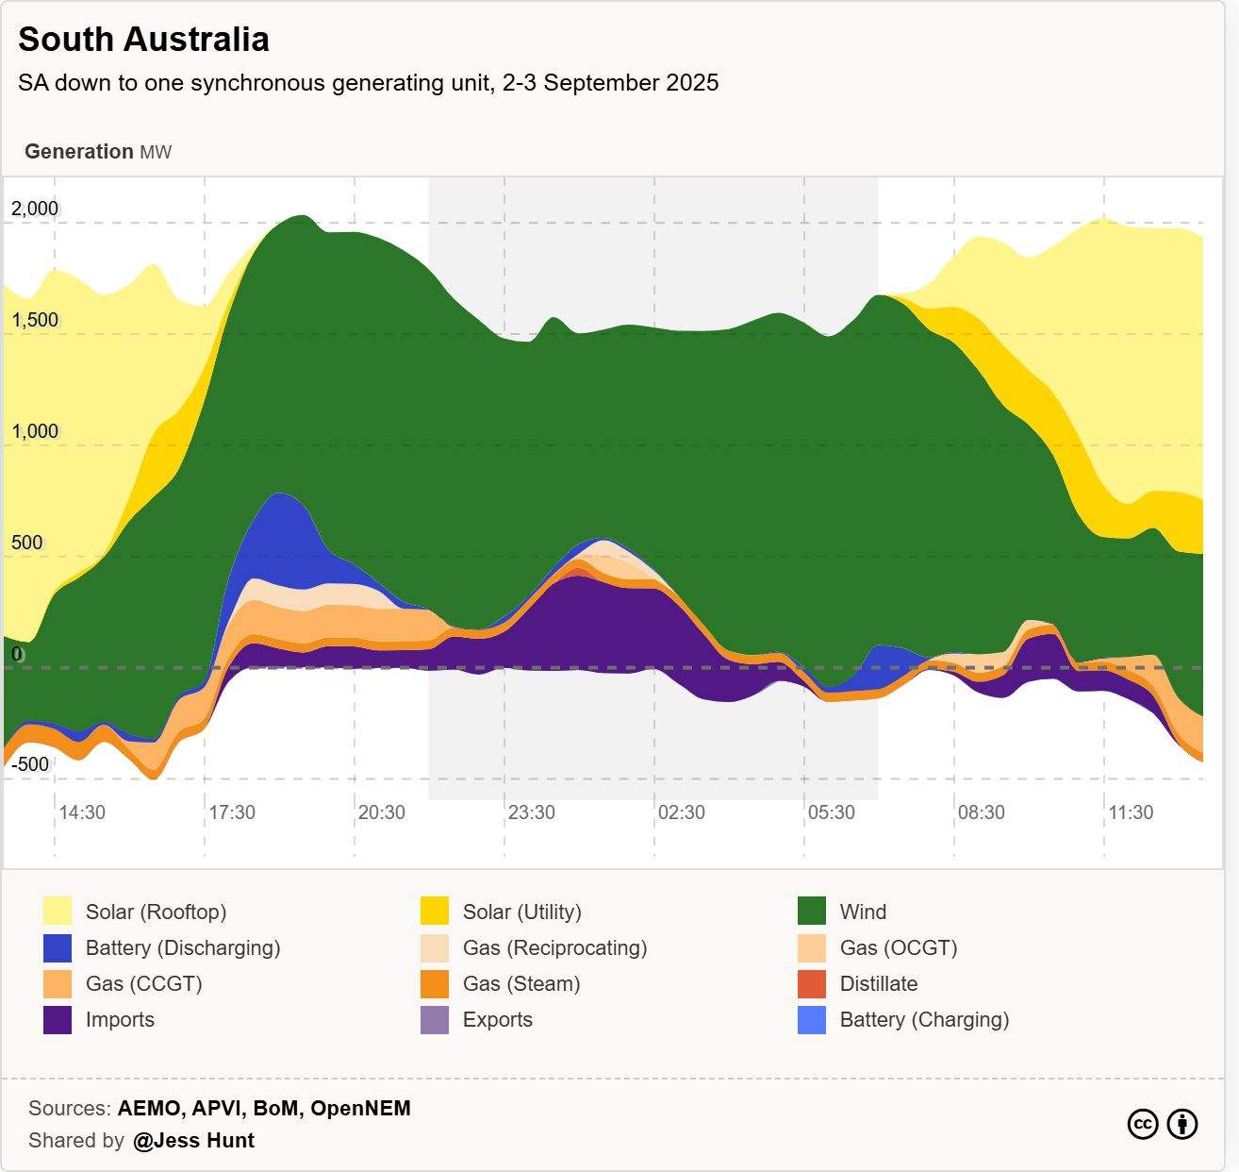
Renewables + flexibility are reliable and secure – it’s a proven concept
Notes:
I. Introduction:
Solar PV is currently the fastest-growing and most cost-effective source of electricity worldwide. At the same time, supply chains are heavily concentrated outside Europe, mainly in China, which exposes us to operational, economic, and geopolitical risks. The Net-Zero Industry Act aims to close that gap.
We at SolarPower Europe, wanted to know the cost gap for EU-made solar modules and identify policy levers for reshoring production in line with the Net-Zero Industry Act ambitions for 2030.
This is why we conducted the “Solar Manufacturing Study”, done by Fraunhofer ISE for SolarPower Europe, which we are going to launch tomorrow at 17:00 with a presentation and panel discussion here at EUPVSEC.
While the study is officially published tomorrow, you get an exclusive first look at its findings today.
II. Slide 1
The cost gap for EU-made modules is significant: producing a module in Europe costs roughly 10.3 €ct/Wp more than in China, mainly due to higher labor, equipment, building, and material costs.
This image shows the impact of NZIA-compliant PV Module Types vs. Current Market Price for three different cases.
^{1rst} bar: Fully EU Scaled (6 EU components) - A fully EU scaled module with six EU-made components would cost around 19.0 €ct/Wp. However, if produced at scale, it could still remain within the NZIA’s 15% allowable LCOE threshold.
^{2nd} bar: The NZIA EU High option, which includes EU-made solar cells, modules, and glass (three EU components), also costs 19.0 €ct/Wp. This results in a 14.5% higher LCOE than the current market price and would require 0.75 €ct/kWh support.
3rd bar: NZIA Low - The NZIA EU Low option, with EU-made solar cells but module manufacturing in Southeast Asia (three components), has a lower cost of 15.4 €ct/Wp, leading to a 9.4% LCOE gap and requiring 0.49 €ct/kWh support.
4th bar: By contrast, the NZIA Southeast Asia option, which includes no EU-made components but three Southeast Asian components, is the cheapest NZIA-compliant alternative at 13.2 €ct/Wp. It shows only a 6.4% LCOE gap versus the market and requires just 0.33 €ct/kWh support, meaning it outcompetes all options that include EU components.
5th bar: The Current PV Market Price: 8.7 €ct/Wp (baseline)
Conclusion?
NZIA compliance does not require EU-made components → Southeast Asian production remain cheapest.
15% allowable NZIA cost premium is enough for EU-made modules if scaled, but they remain uncompetitive vs. SEA.
Policy gap: Without Made-in-EU bonus criteria, the NZIA support will not be enough to reshore PV manufacturing to Europe. With the right policy mix, this gap can be reduced (see slide 2)

Slide 8
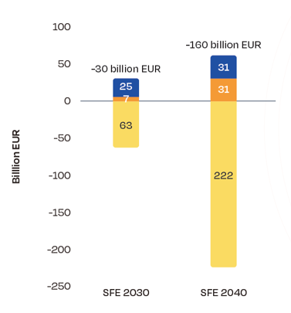
Renewables + flexibility also comes with macro-economic and competitiveness benefits
Savings in Annual System Costs
Lower wholesale
electricity price
Lower curtailment rates, improving the business case renewables
@Solarpower Europe, Mission Solar 2040 Study
Notes:
This only translates into direct financial benefits to consumers via direct electrification. Then, solar starts to heavily contribute to Europe’s competiveness and energy security
2040 modelling shows that solar + flexibility + electrification is critical:
Total system costs
Market prices
Curtailment

Slide 9
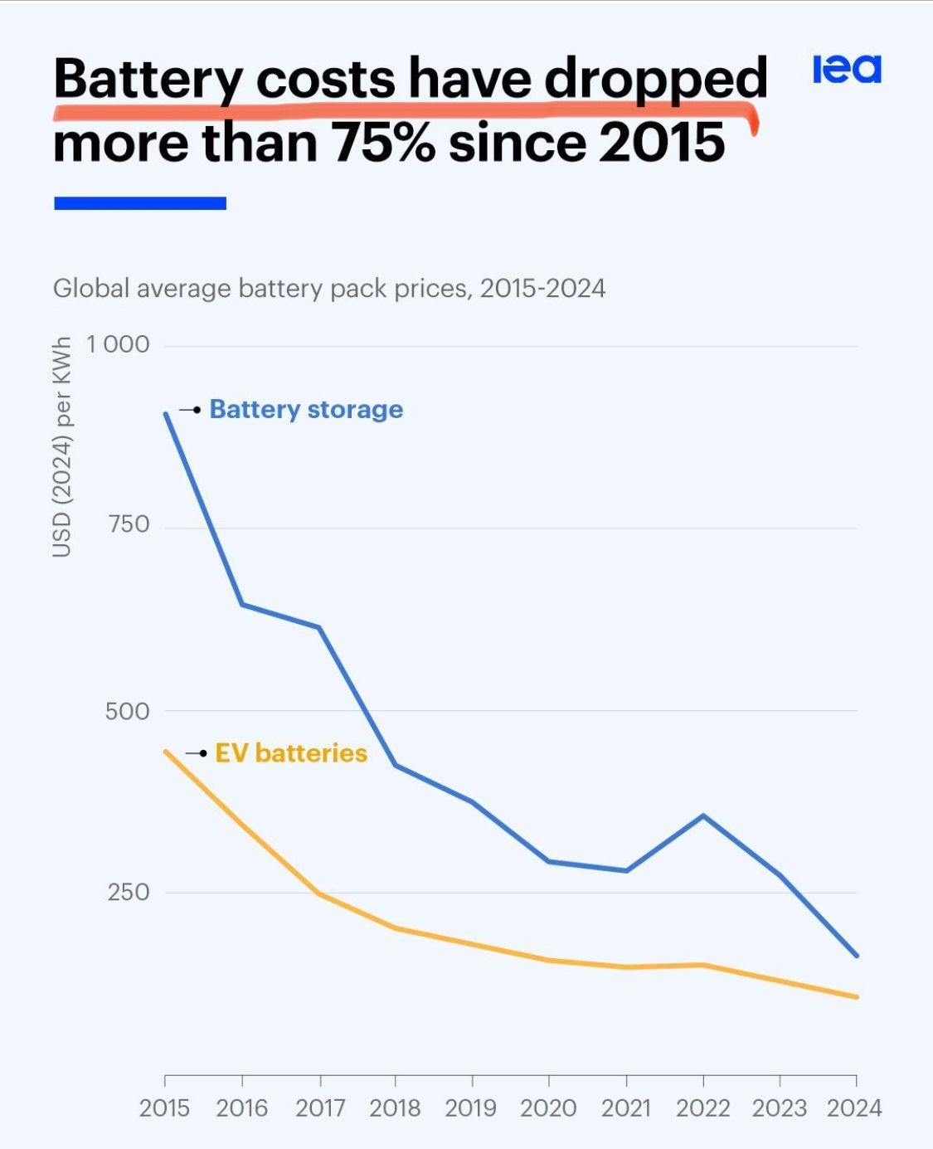
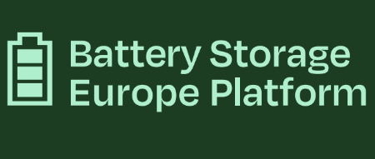
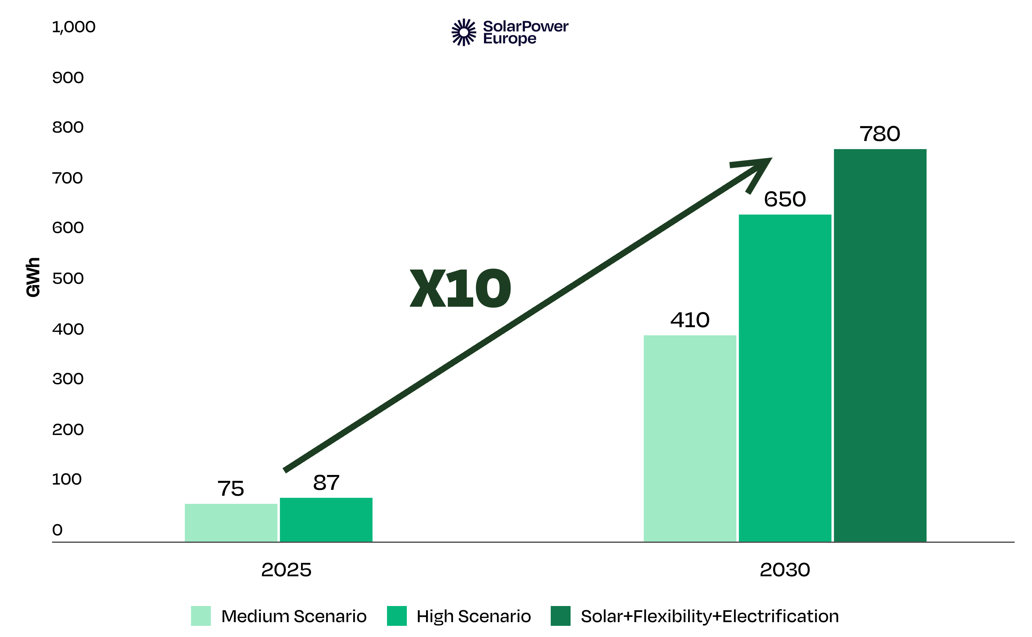
Game-changer: the opportunity of Battery Energy Storage Systems
PV and BESS demand

Slide 10
Strong cybersecurity measures are key
Fully implement recently agreed legislation: the Cyber Resilience Act for products and the Network and Information System Directive for system operators
Additional action to plug cybersecurity gaps:
Develop a specific cybersecurity standard for Decentralised Energy Resources.
Keep the control over software updates and data flows from internet-connected devices within the EU, similar to approach in Lithuania -> no remote-controllability from actors outside the EU

