Slide 1
How wind delivers security and competitiveness for Europe
Giles Dickson, WindEurope CEO
17 October 2025

Slide 2

Wind energy in Europe
56%
11%
24%
73
5
33%
31%
8
0.1
17
27%
14%
32
30%
1
291 GW
29%
8
4%
0.1
5
2
12
30%
16%
10
14%
6
20%
of Europe’s
electricity demand
N/A
24
2
16%
1%
0.4
31
14%
12%
25%
11%
4
1%
28%
0.1
0.3
3
13
1
8%
1%
0.2
0.6
14
4%
11%
1
0.1
0.1
22%
6
5
GW installed
4%
0.2
Wind share of electricity demand

Slide 3
Offshore wind in Europe
26%
N/A
37 GW
0.1
0.2
N/A
17%
16
3
14%
9%
5
9
4%
of Europe’s
electricity demand
2
6%
1%
2
GW installed
Wind share of electricity demand

Slide 4



Offshore build-out per country 2015-2035*
*2025-35 pipeline reflects developers' estimates of projects to be commissioned - It does not represent WindEurope's expectations over the period

Slide 5

Average cost of new power plants
North West Europe 2023 (€ XX = levelised cost of electricity in €/MWh)
€188 - €279
€122 - €131
€60 - €106
€44 - €66
€46 - €61
Offshore
Onshore
Solar PV
Gas
Nuclear
Source: Ørsted, Bloomberg New Energy Finance

Slide 6


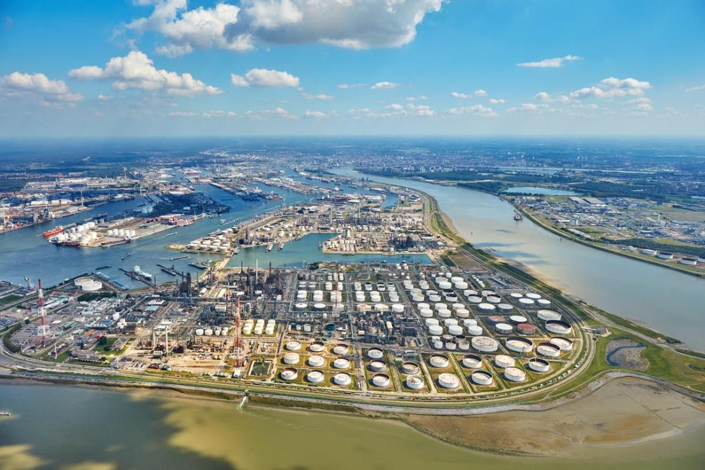
Offshore wind decarbonises heavy industry
© Thyssenkrupp AG
© Aluminium Duffel
© Total Energies

Slide 7
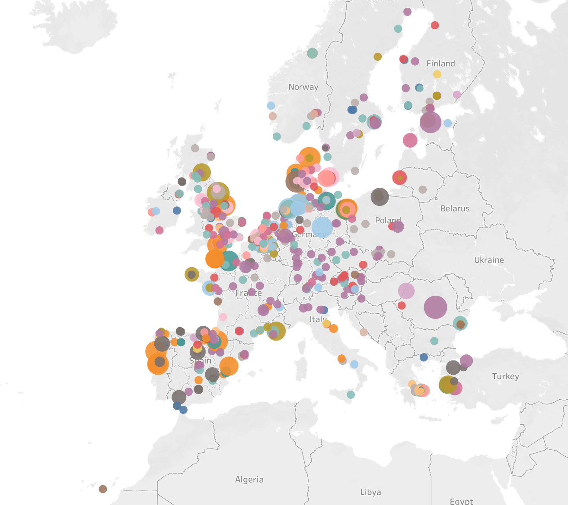

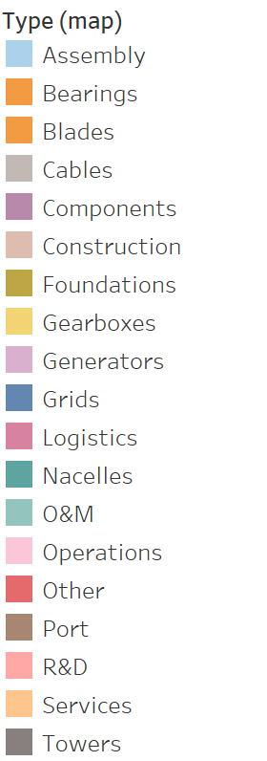
Wind employs 370,000 people
Based on EU +UK, Updated December 2024

Slide 8


Economic benefits of offshore wind in Europe
1 new offshore wind turbine
=
€45m
to the economy
€11bn
EU GDP contribution
© Vestas

Slide 9
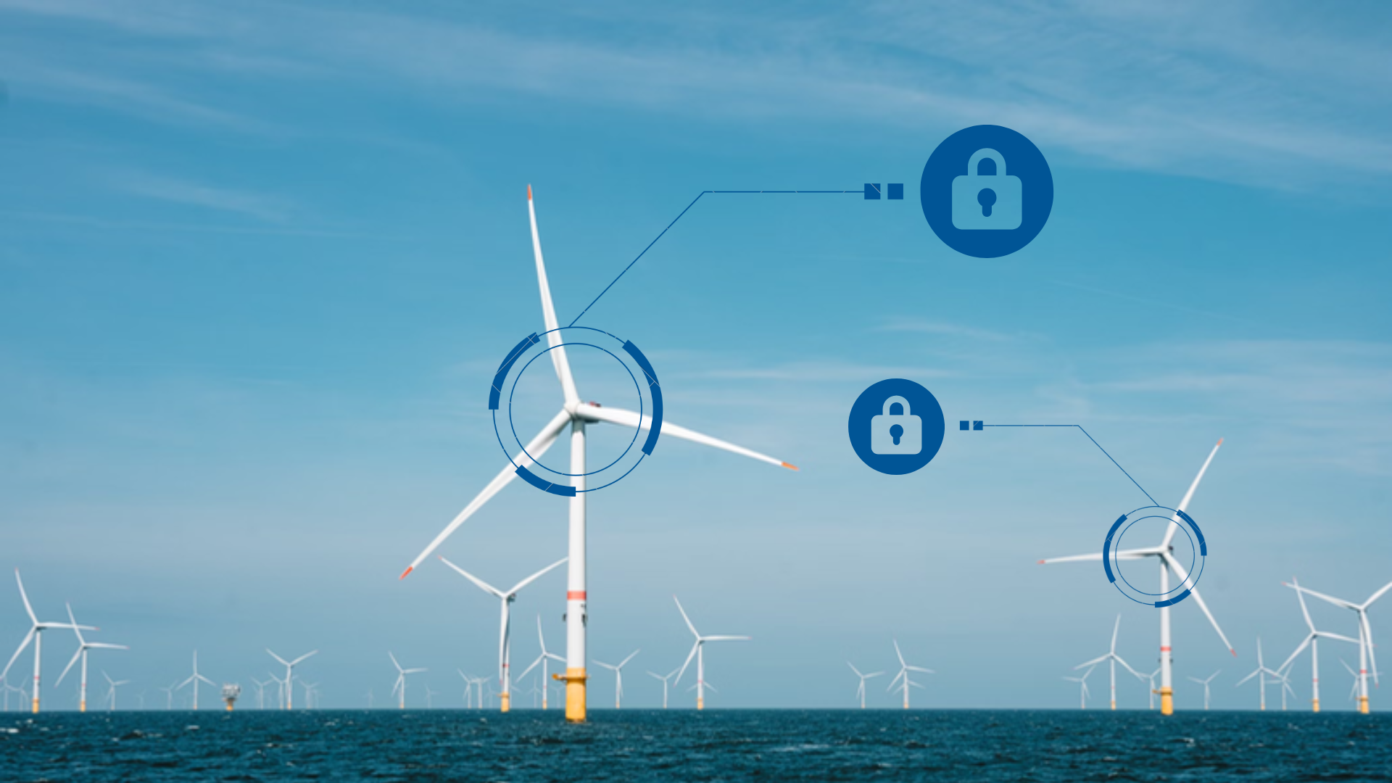
Cyber & data security

Slide 10
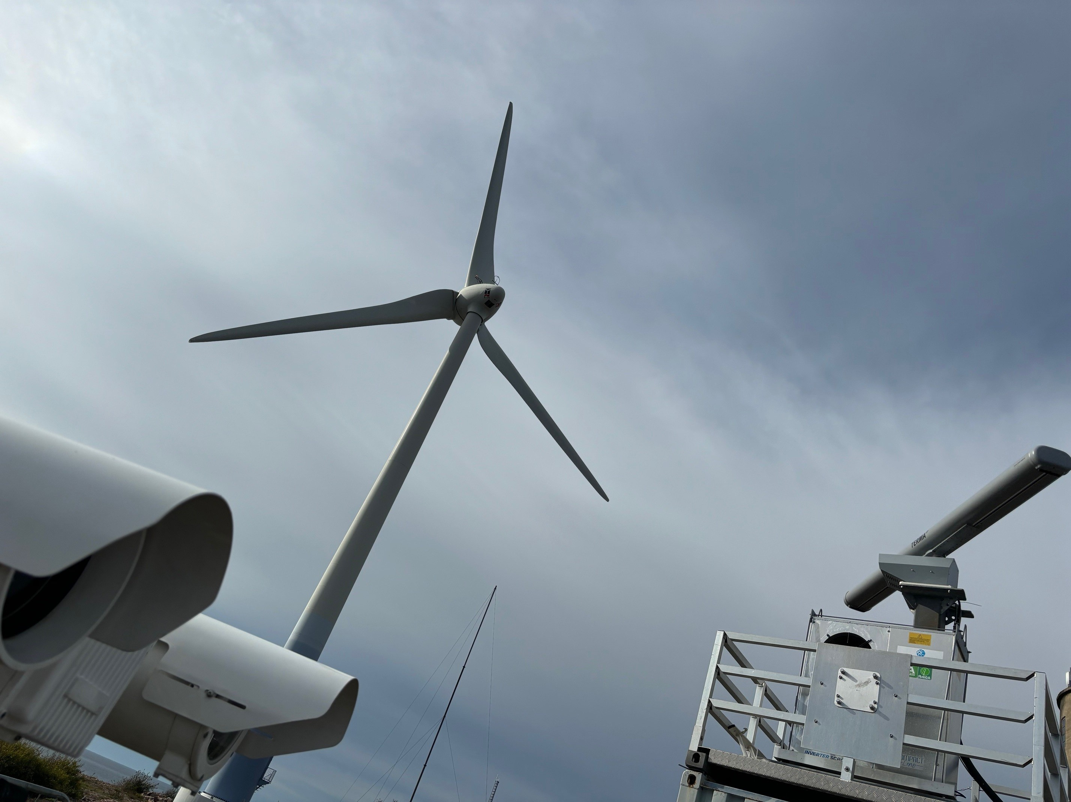
Offshore wind gives us more eyes at sea
Source: UK MOD © Crown copyright 2019

Slide 11
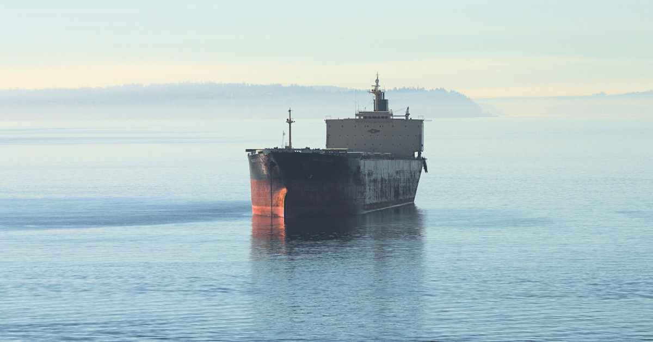
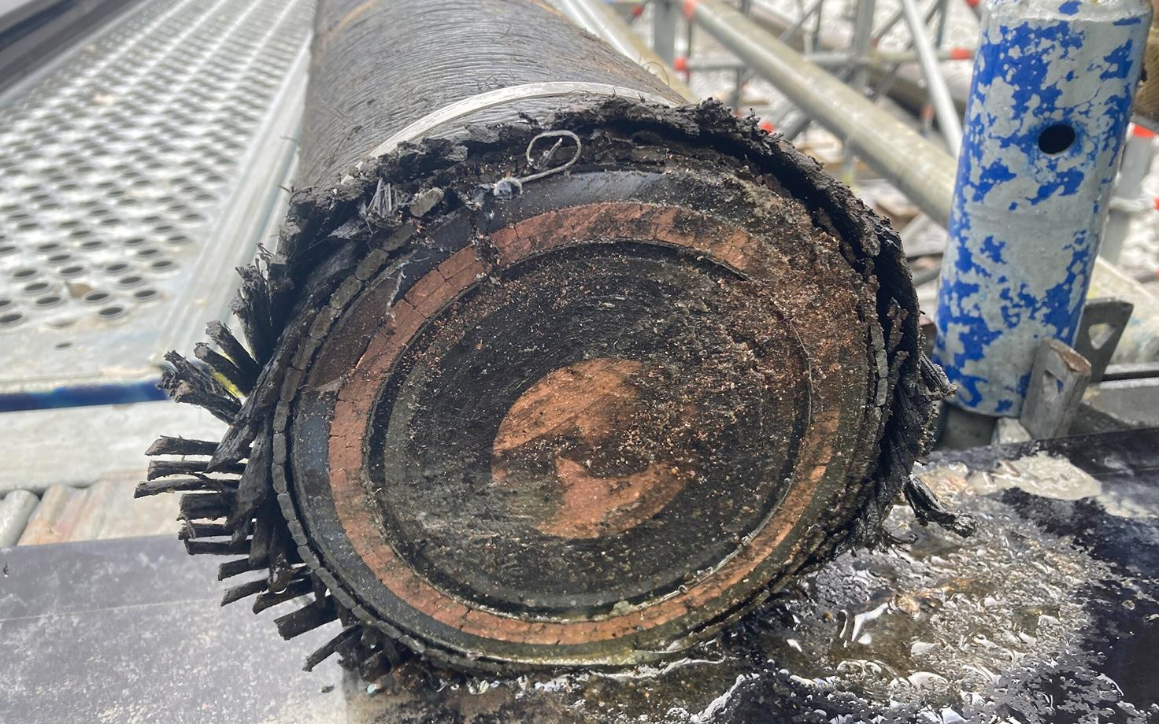
Hybrid warfare
Image for representation purposes only. Source: Marine Insight,
EstLink 2 repair work in July 2024. Source: Rene Kundla/ERR

Slide 12
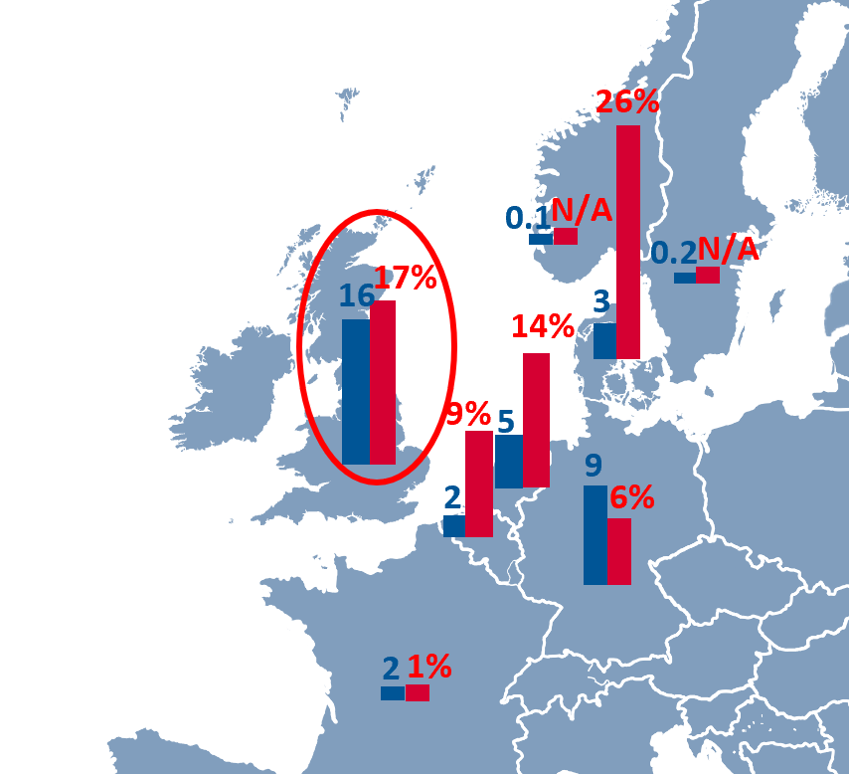
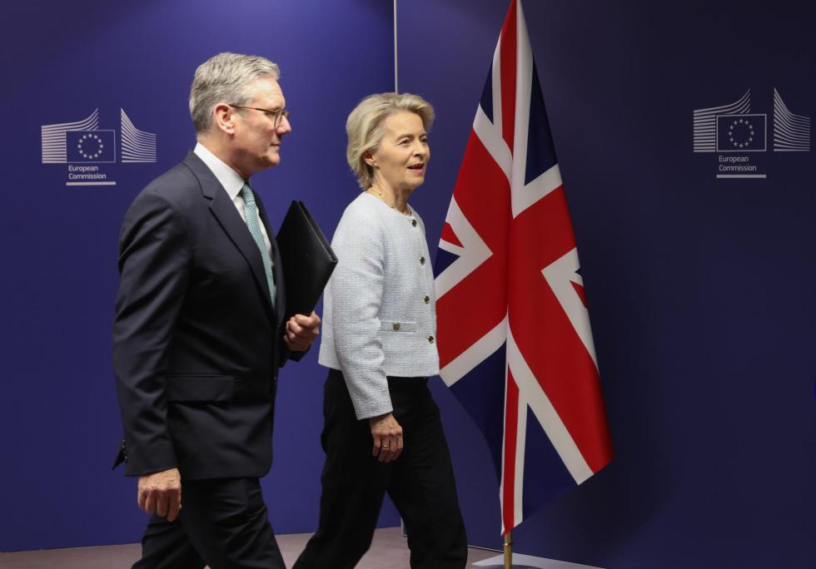
EU/UK relations
Copyright/source: EFE/EPA/Olivier Hoslet

Slide 13







Let’s stay connected!

