Slide 1
17/18 October 2025 Copenhagen
Inter-Parliamentary Meeting on Renewable Energy and Energy Efficiency (IPM25 Copenhagen)
“Accelerating the energy transition in a world of geopolitical unrest”
Cross-Party Conference
Why a 2040 energy efficiency target is a must to reach EU’s climate and energy security goals
Wolfgang Eichhammer
Fraunhofer Institute for Systems and Innovation Research ISI
Utrecht University
Institute for European Energy and Climate Policy IEECP

Slide 2
Exploring Electrification Strategies
Residential/Commercial
Transport
Industry
Discussing (additional) Energy Efficiency Policies and Measures
Conclusions for the discussion on the 2040 carbon neutrality frame and the question of 2040 energy efficiency targets

Slide 3
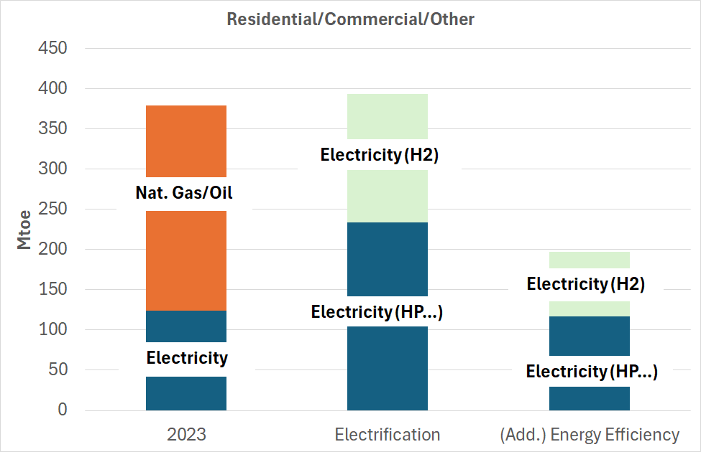
Electrification // (additional) Energy Efficiency Residential & Commercial Sectors
(additional)
Energy Efficiency
Electrification
Heat pumps („two thirds of free for energy“)
Hydrogen-based heating, e.g. synthetic methane (H2 Electricity)
Rebound-effects (e.g. larger surfaces, more appliances, spread of AI and data centres)
Enhanced insulation strategies for heating and cooling (including functional buildings
Eco-design policies
Non-electricity based heat (decarbonsied district heating, solar thermal, bioenergy)
New Trends: Shared Economy, Prosumaging, energy communities

Slide 4
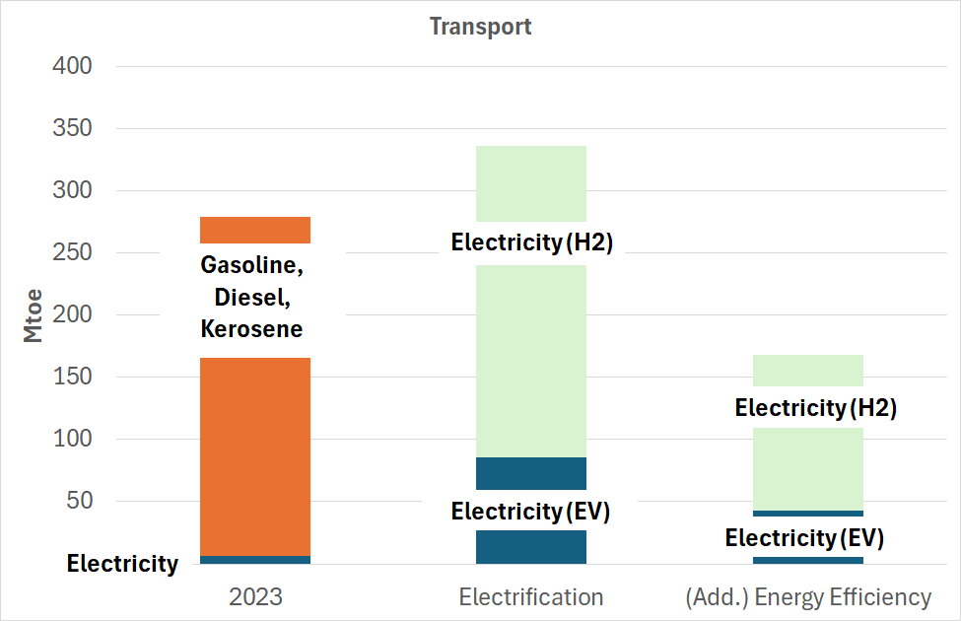
Electrification // (additional) Energy Efficiency Transport Sector
(additional)
Energy Efficiency
Electrification
EV („5 times higher efficiency than synthetic fuels“)
Hydrogen-based transport: heavy trucks, kerosene, Maritime fuels (H2 Electricity)
Rebound-effects (e.g. SUVs)
Light weight
More efficient vehicles (incl. ships, airplanes and trains)
Eco-design policies
Modal shift
New Trends: Shared Economy, behavioural policies,…

Slide 5
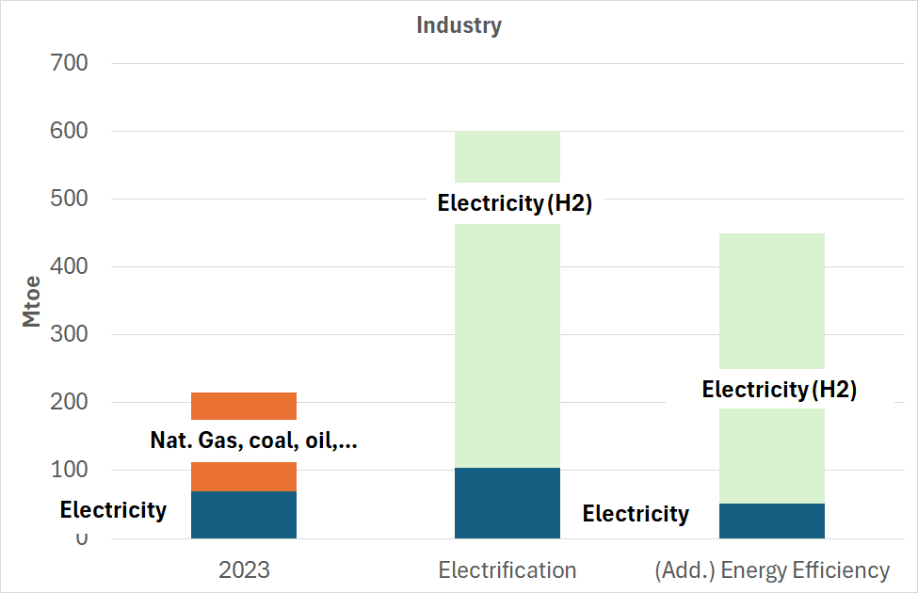
Electrification // (additional) Energy Efficiency Industry Sector
(additional)
Energy Efficiency
Electrification
Industrial heat pumps
Further electrification gas-based processes (steam generators)
Hydrogen-based energy intensive processes (iron/steel…)
Question of importing hydrogen, of moving some of the new H2-based processes abroad
Electricity motors and applications (70% of present electricity uses)
Steam generators (30% of present thermal uses)
Eco-design policies
Circular economy strategies (including material substitution)
R&D for improving energy-efficiency of energy intensive processes (cement, ammonia, steel...)

Slide 6
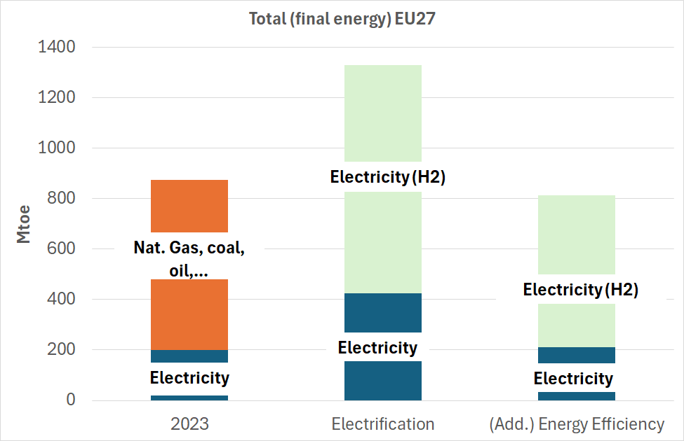
Electrification // (additional) Energy Efficiency Overall final energy
(additional)
Energy Efficiency
Electrification
Overall final energy only increases by 50% (given the efficiency of the main electricification processes)
H2 electricity major driver for increase
Able to keep final energy demand at or below present levels
Electricity demand increases also with a factor 3-4
Share of H2-based processes has major influence

Slide 7
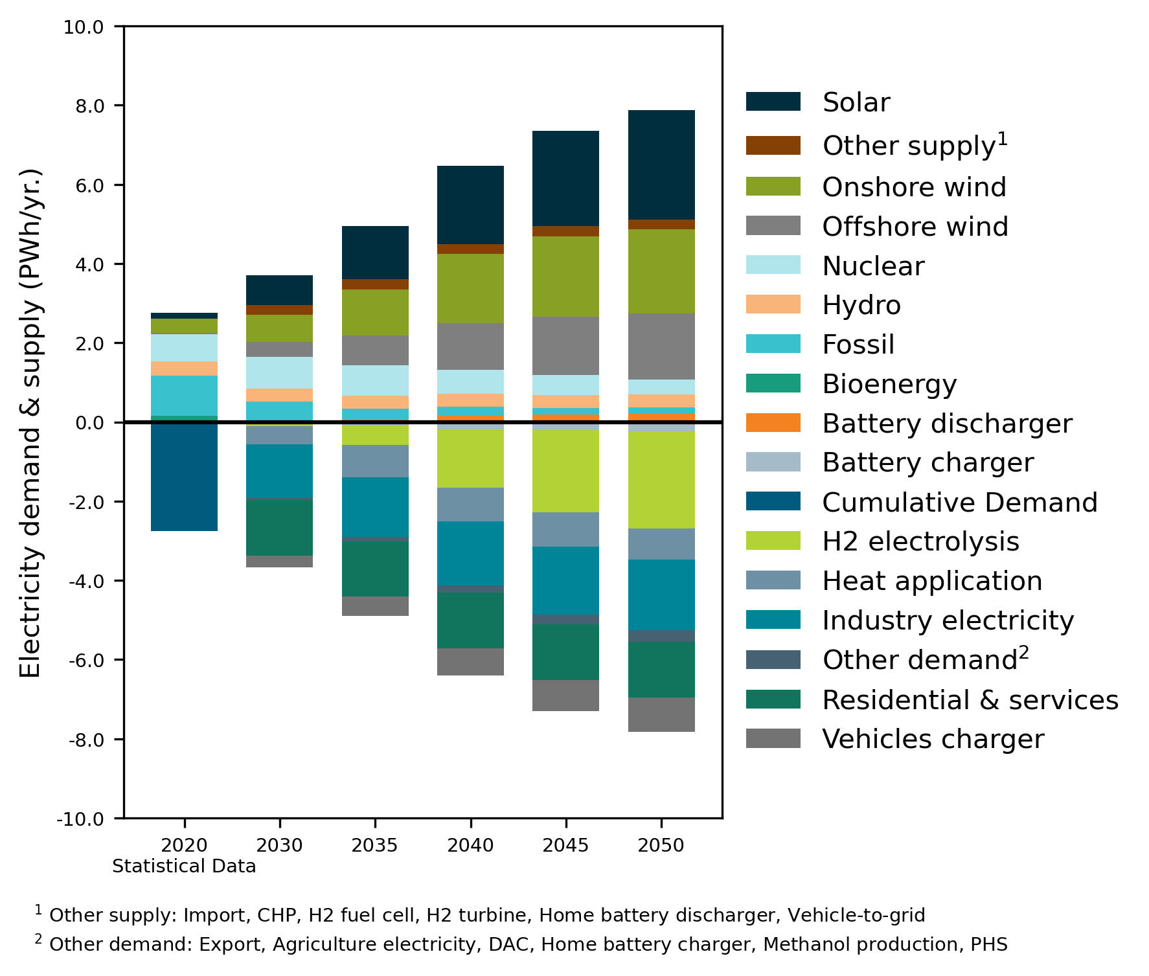
Results of the Study “Fraunhofer IEG/ISI, d-fine: Integrated European Energy Infrastructures”
CN: Cross-sectoral, National view | CE: Cross-sectoral, European view
SN: Sectoral, National view | SE: Sectoral, European view
Electricity Demand & Supply in the EU
Sectoral policy dimension
National policy dimension
Both the electrification of demand sectors and the increased hydrogen demand require a tripling of the electricity supply and renewable energy to increase ninefold.
In particular, the capacities of solar and wind energy plants on the supply side and the demand from electrolysers are growing.
Source: Fraunhofer IEG/ISI, d-fine: Integrated European Energy Infrastructures

Slide 8
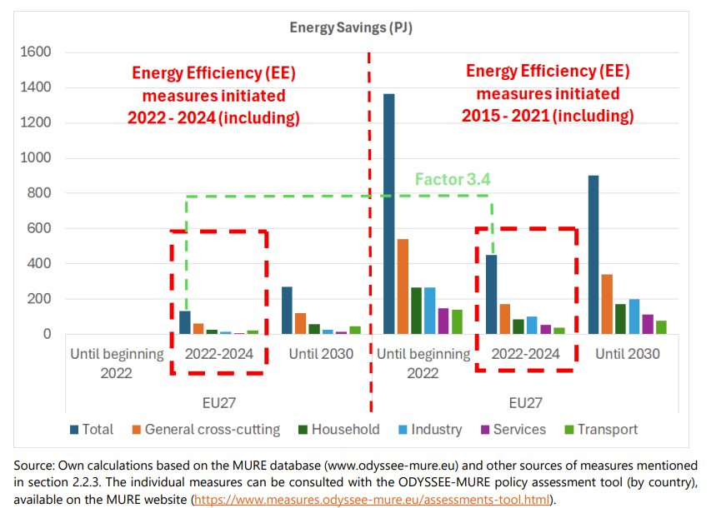
The strategic contribution of energy efficiency to supply security
Urgency
Strategy
https://op.europa.eu/o/opportal-service/download-handler?identifier=9f833801-5c6e-11f0-a9d0-01aa75ed71a1&format=PDF&language=en&productionSystem=cellar

Slide 9
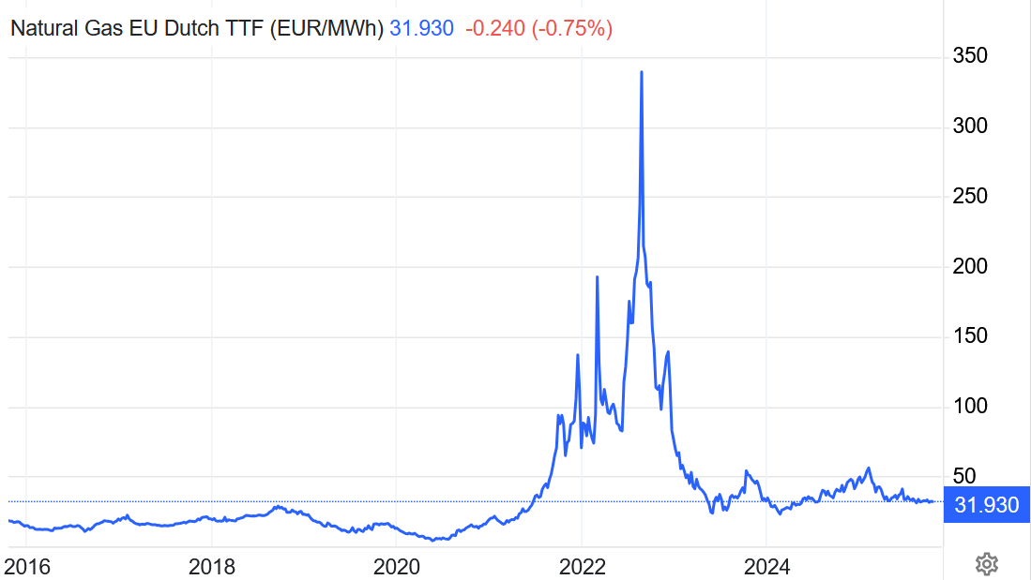
Gas price in Europe (with or without strategic energy efficiency measures)
without strategic Energy Efficiency Measures 2015-2022
with „correct“ achievement of 2020 targets
https://tradingeconomics.com/commodity/eu-natural-gas

Slide 10
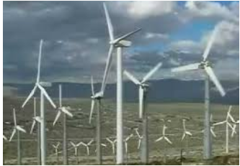
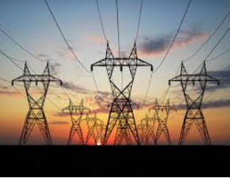

Why Energy Efficiency and the Energy Efficiency First Principle are important – even in a world with a lot of renewables…

Slide 11
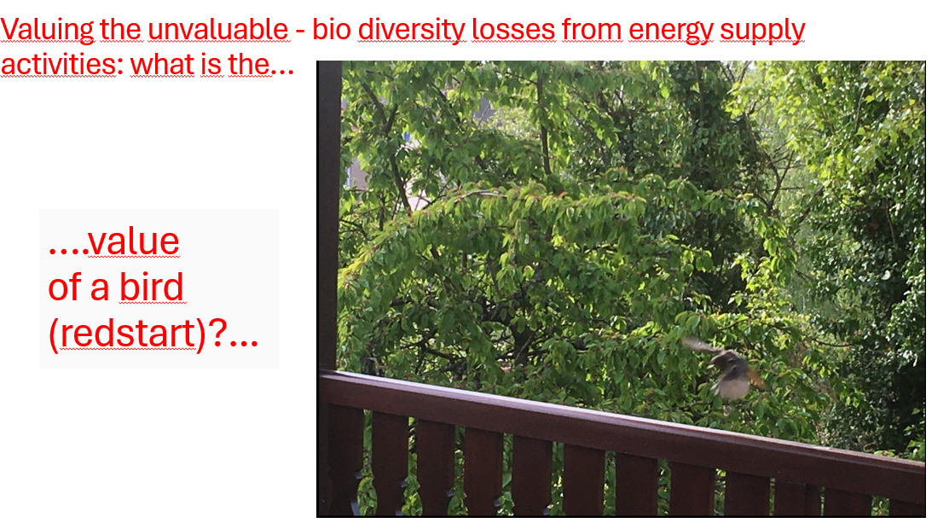

Valuing the unvaluable:
Energy Efficiency – a safety strategy towards the unknown
Some impacts are difficult to establish…
But not valuing them, even if methodologies need to develop, is also a choice!

Slide 12
Conclusion
Jean de la Fontaine : « Rien ne sert de courir ; il faut partir à point ».
The strategic approach to Energy Efficiency over the last decade has protected us in the recent past (Ukraine war) from worse impacts.
This argues for a structured approach for Energy Efficiency, including a proper 2040 target and accompanying policy frame (EED, EBPD, ….)
Energy pricing instruments have an important role in this: They are an important class of instruments to guide decision making (but not the only one…).
We do not need to make energy cheap but „affordable“. Cheap renewables will help in this but a competitive and efficient economy is NOT arising from cheap energy
Many elements I cannot discuss any more but which have been discussed in the last 2 days: supply security, new dependencies, critical materials and technologies, the unknowns of biodiversity….

Slide 13
Contact
Wolfgang Eichhammer
Fraunhofer Institute for Systems and Innovation Research ISI, wolfgang.eichhammer@isi.fraunhofer.de
Utrecht University
Institute for European Energy and Climate Policy IEECP

