Slide 1
The advantages of electrification for citizens and sovereinity
Kristian Jensen
Green Power Denmark

Slide 2

Natural gas covers around 20 percent of EU’s energy consumption
EU Total Energy Consumption (1.000) Petajoule
2014
Natural gas accounts for approx. 19% of total EU energy consumption
2023
Natural gas accounts for approx. 20% of total EU energy consumption
61
62
63
64
64
63
61
58
58
56
12 (19%)
12 (20%)
13 (21%)
14 (22%)
14 (21%)
14 (22%)
14 (24%)
14 (23%)
12 (21%)
11 (20%)
2014
2015
2016
2017
2018
2019
2020
2021
2022
2023
Other types
Natural gas
Renewables
Note:
Source: Eurostat

Slide 3
The EU is dependent on gas – coming from countries outside the EU
EU Gas Supply
Million m³
2014
Imported gas accounted for approx. 45% of total EU gas supply.
2023
Imported gas accounts for approx. 60% of total EU gas supply.
9%
3%
27%
32%
6%
4%
17%
10%
6%
52%
35%
2014
2015
2016
2017
2018
2019
2020
2021
2022
2023
European Production
European Biogas
Russia
USA
Middle East
Other Imports
Note: : Imports from Norway are included in the EU’s gas supply.
Source: Eurostat

Slide 4
The US will always have access to cheaper gas than Europe
The difference in the price of natural gas between the US and the EU EUR/MWh
Continued dependency on gas - regardless of the source – is not a long-term solution
The price difference corresponds to the extra cost of converting and transporting gas from USA to Europe
EU
US
01-01-2022
01-01-2023
01-01-2024
01-01-2025
01-01-2026
01-01-2027
01-01-2028
Note: : The prices are benchmark prices at the two gas hubs, Henry Hub and TTF. That is, net gas prices without taxes and transport costs..
Source: Montel (Syspower)

Slide 5
We can, however, match the rest of the world on electricity prices
Electricity prices for businesses in selected countries
EUR/kWh
Italy
Germany
EU27
France
Spain
Denmark
Sweden
USA
China
Note: Elpriserne for Europa er baseret på Eurostat H2 2024 mens priserne for Kina og USA er september 2024. Prisen er inkl. Alle omkostninger til strømkøb.
Kilde: Eurostat og Global Petrol Prices

Slide 6
A household can expect to save 1.335 EUR each year
Estimated yearly savings between heat pump and oil/gas boiler for a single-house
EUR/year (2024-price index)
Potential yearly saving replacing all gas boilers
~ 0,4 bn EUR
1550 EUR
1335 EUR
2025
2035
Note:: Calculated using a large sample of actual households in Denmark using registerdata from Statistics Denmark. Savings are only single-house buildings or terraced houses under 350 square meters.
Source: Green Power Denmark using Statistics Denmarks registry data

Slide 7
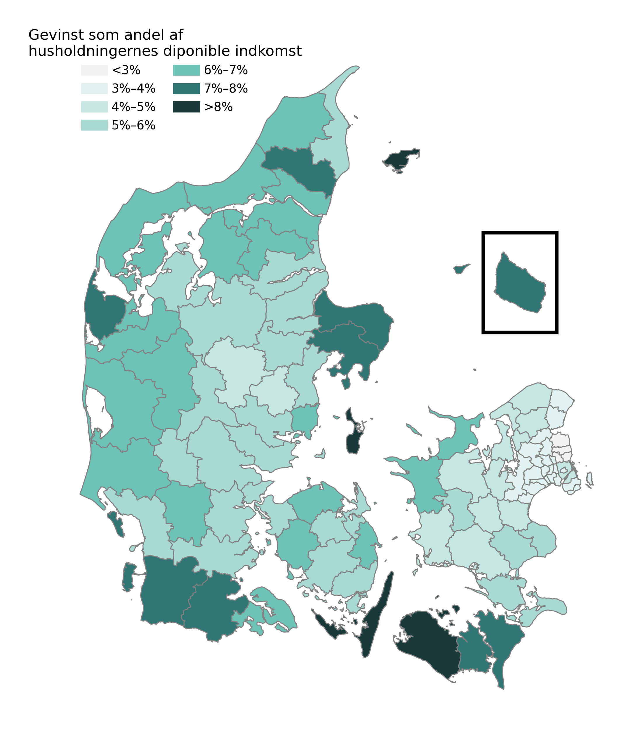
A household can expect to save 1.335 EUR each year – and relative savings are largest in rural areas
Estimated yearly savings between heat pump and oil/gas boiler for a single-house
EUR/year (2024-price index)
Savings relative to disposable income by municipality
%
1550 EUR
1335 EUR
2025
2035
Note:: Calculated using a large sample of actual households in Denmark using registerdata from Statistics Denmark. Savings are only single-house buildings or terraced houses under 350 square meters.
Source: Green Power Denmark using Statistics Denmarks registry data

Slide 8
Wind- and solarpower decreased the average spotprice in 2024 in Denmark
The total estimated savings from lower cost of electricity
(EUR/kWh)
~ 0,7 bn EUR
Average actual spotpris in 2024
Average estimated spotpris in 2024 – with energy mix like in the 2000’s

Slide 9
Thank you

