Slide 1
European Heat Pump Association
Social leasing for Heat Pumps and its practicalities
Paul Kenny, Director General European Heat Pump Association

Slide 2
Agenda
Why heat pumps?
Heat pumps for all
Approaches for different sectors
Practical solutions for social leasing

Slide 3
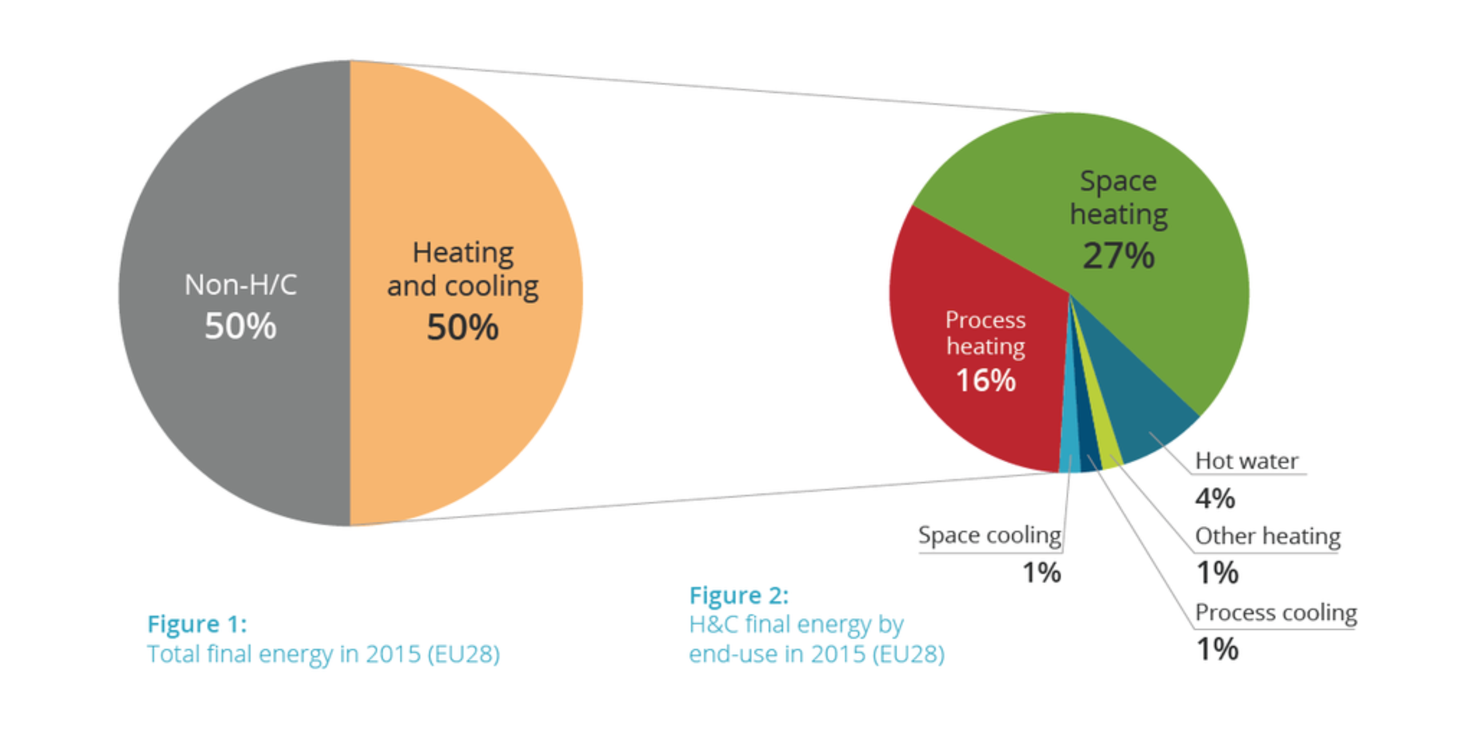
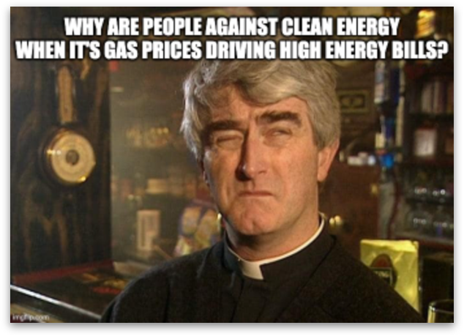
Why Heat Pumps?
Half our energy use
¾ of household energy use
A key vulnerability in our economic system
We have a once in a generation opportunity
In an energy independent, clean and competitive Europe – heat pumps will be No. 1
Notes:
https://www.eea.europa.eu/data-and-maps/daviz/co2-emission-intensity-14#tab-chart_7

Slide 4
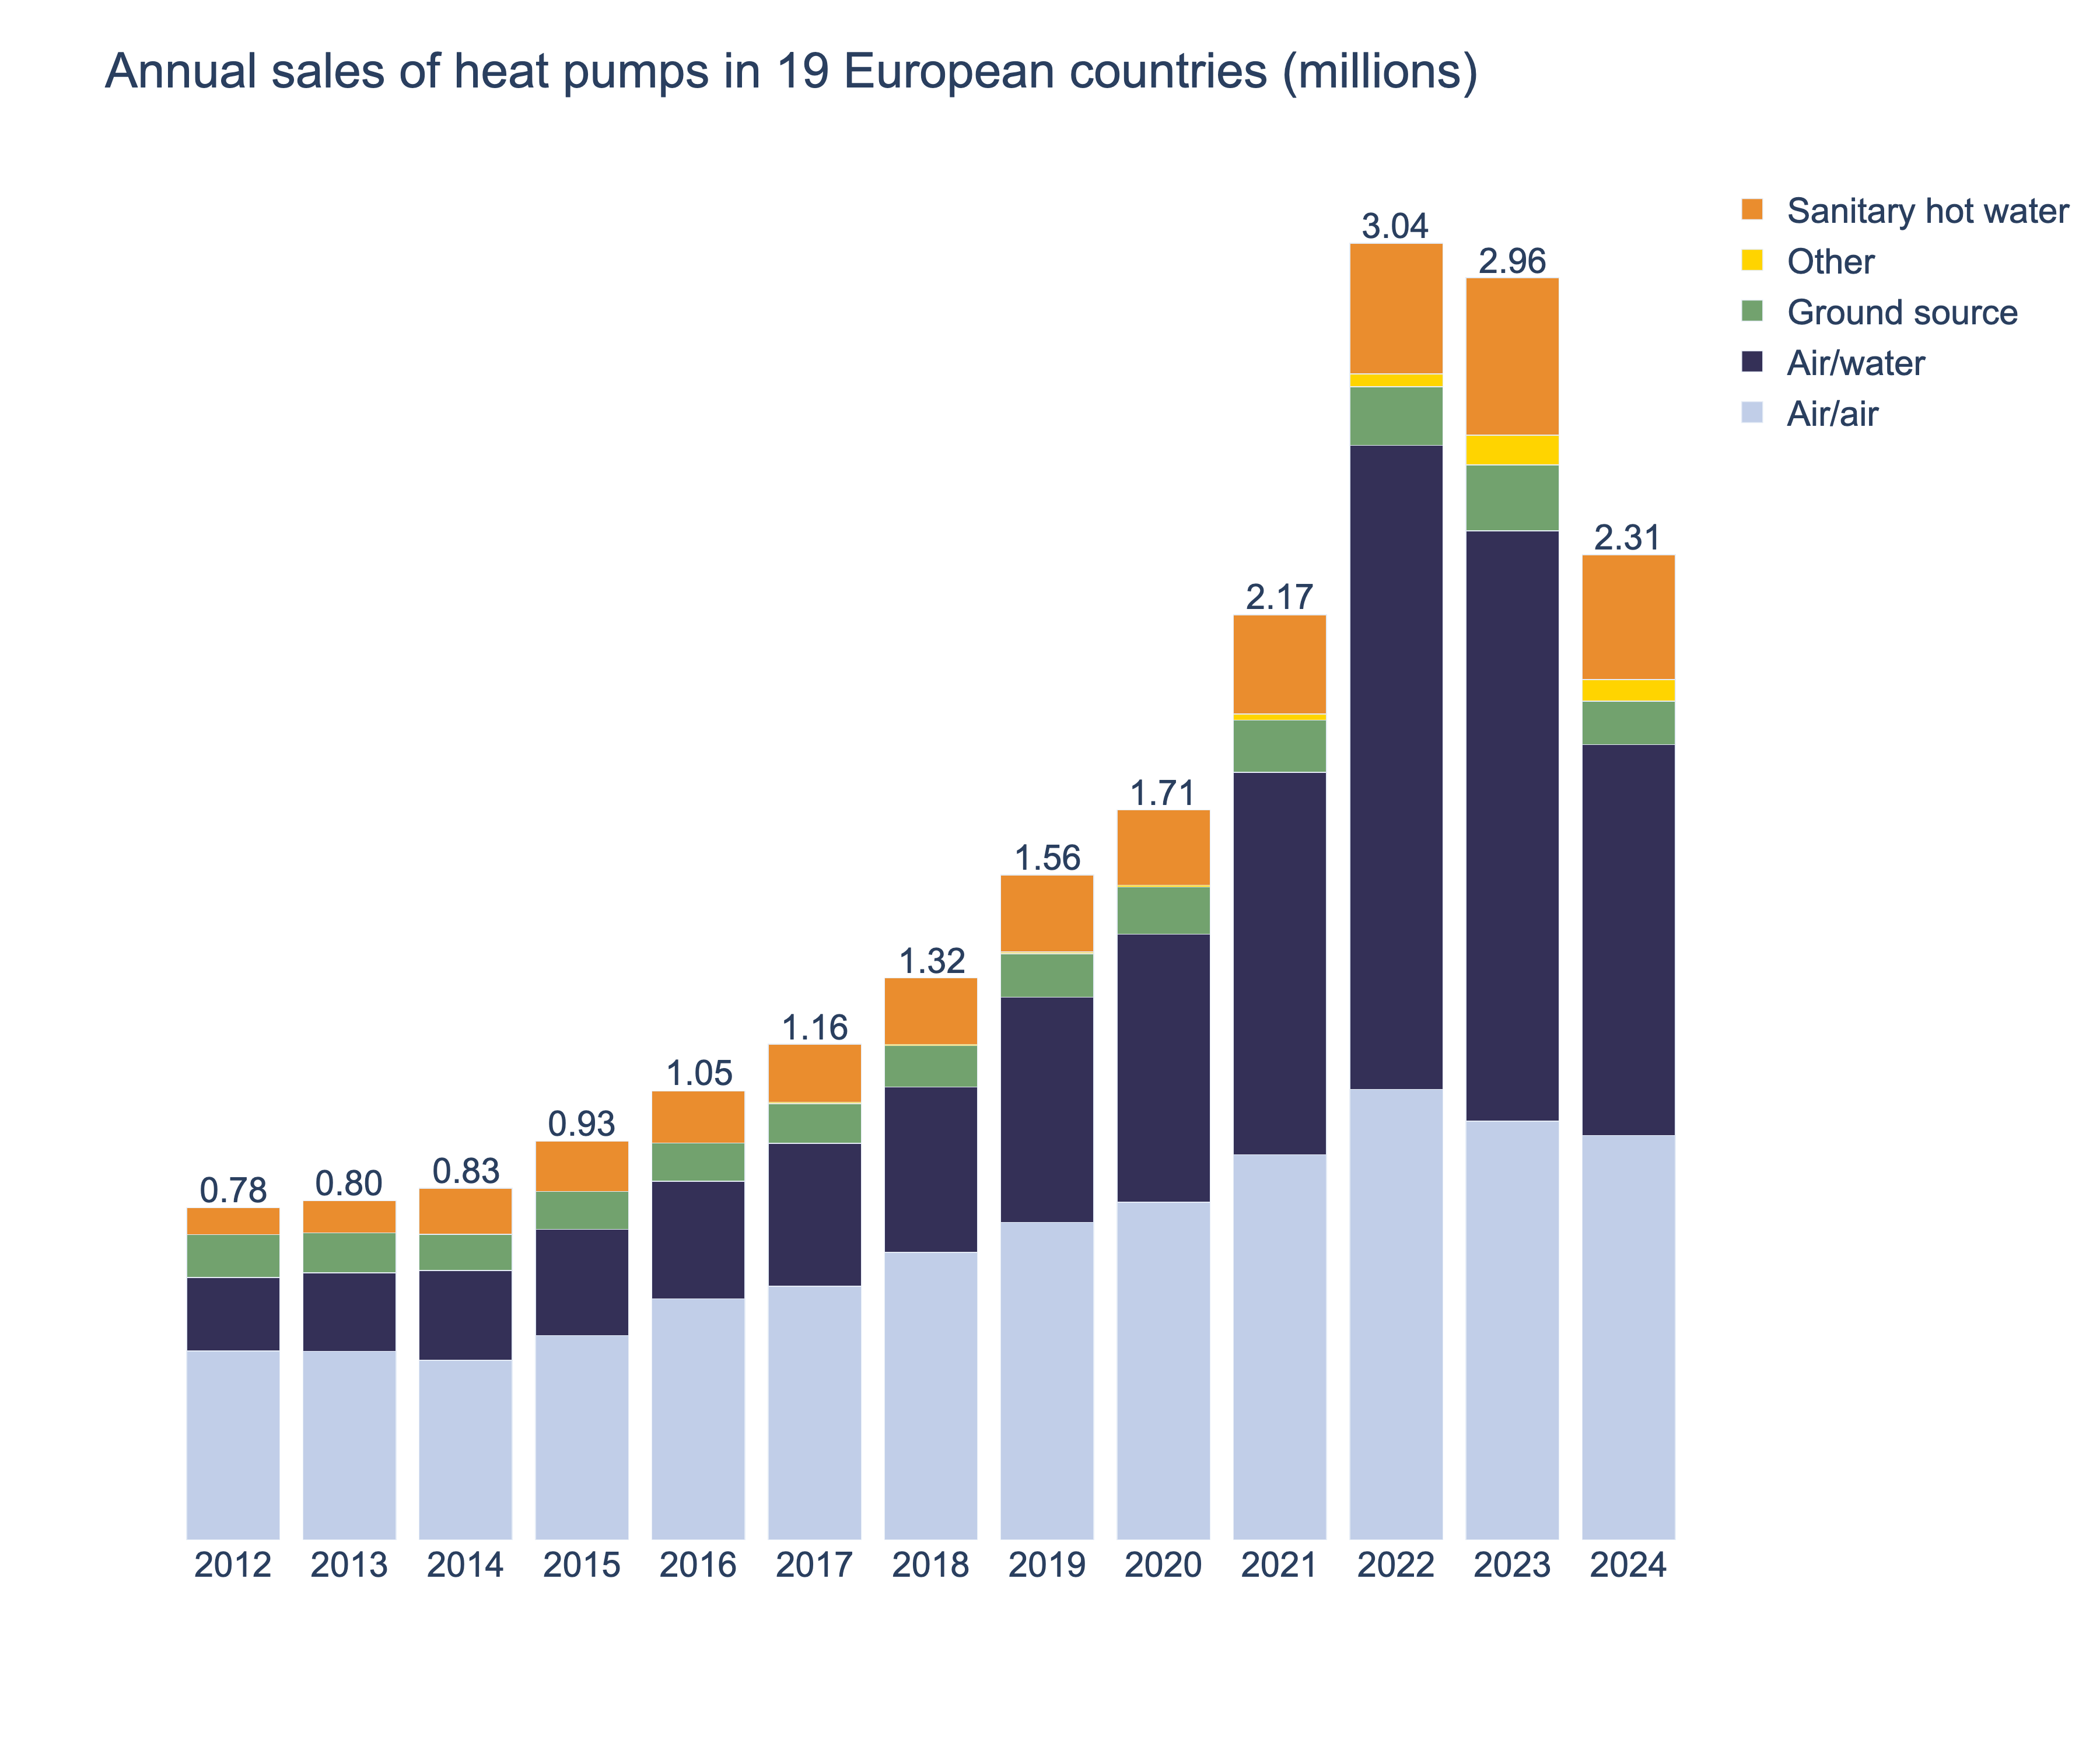
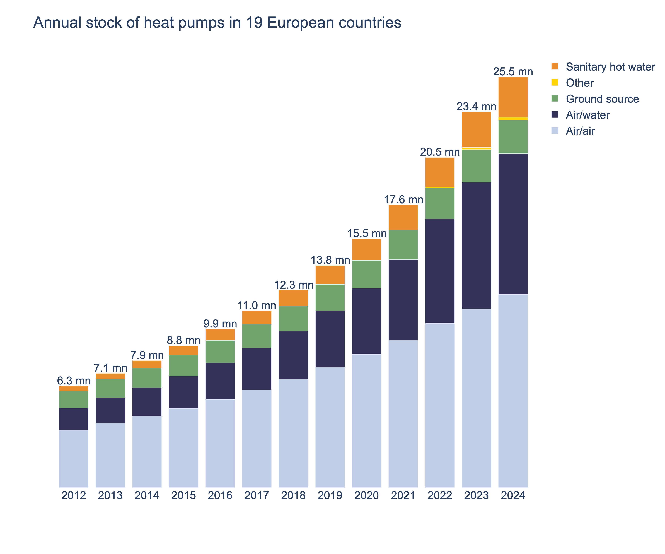
Annual sales and heat pump stock as of end 2024

Slide 5
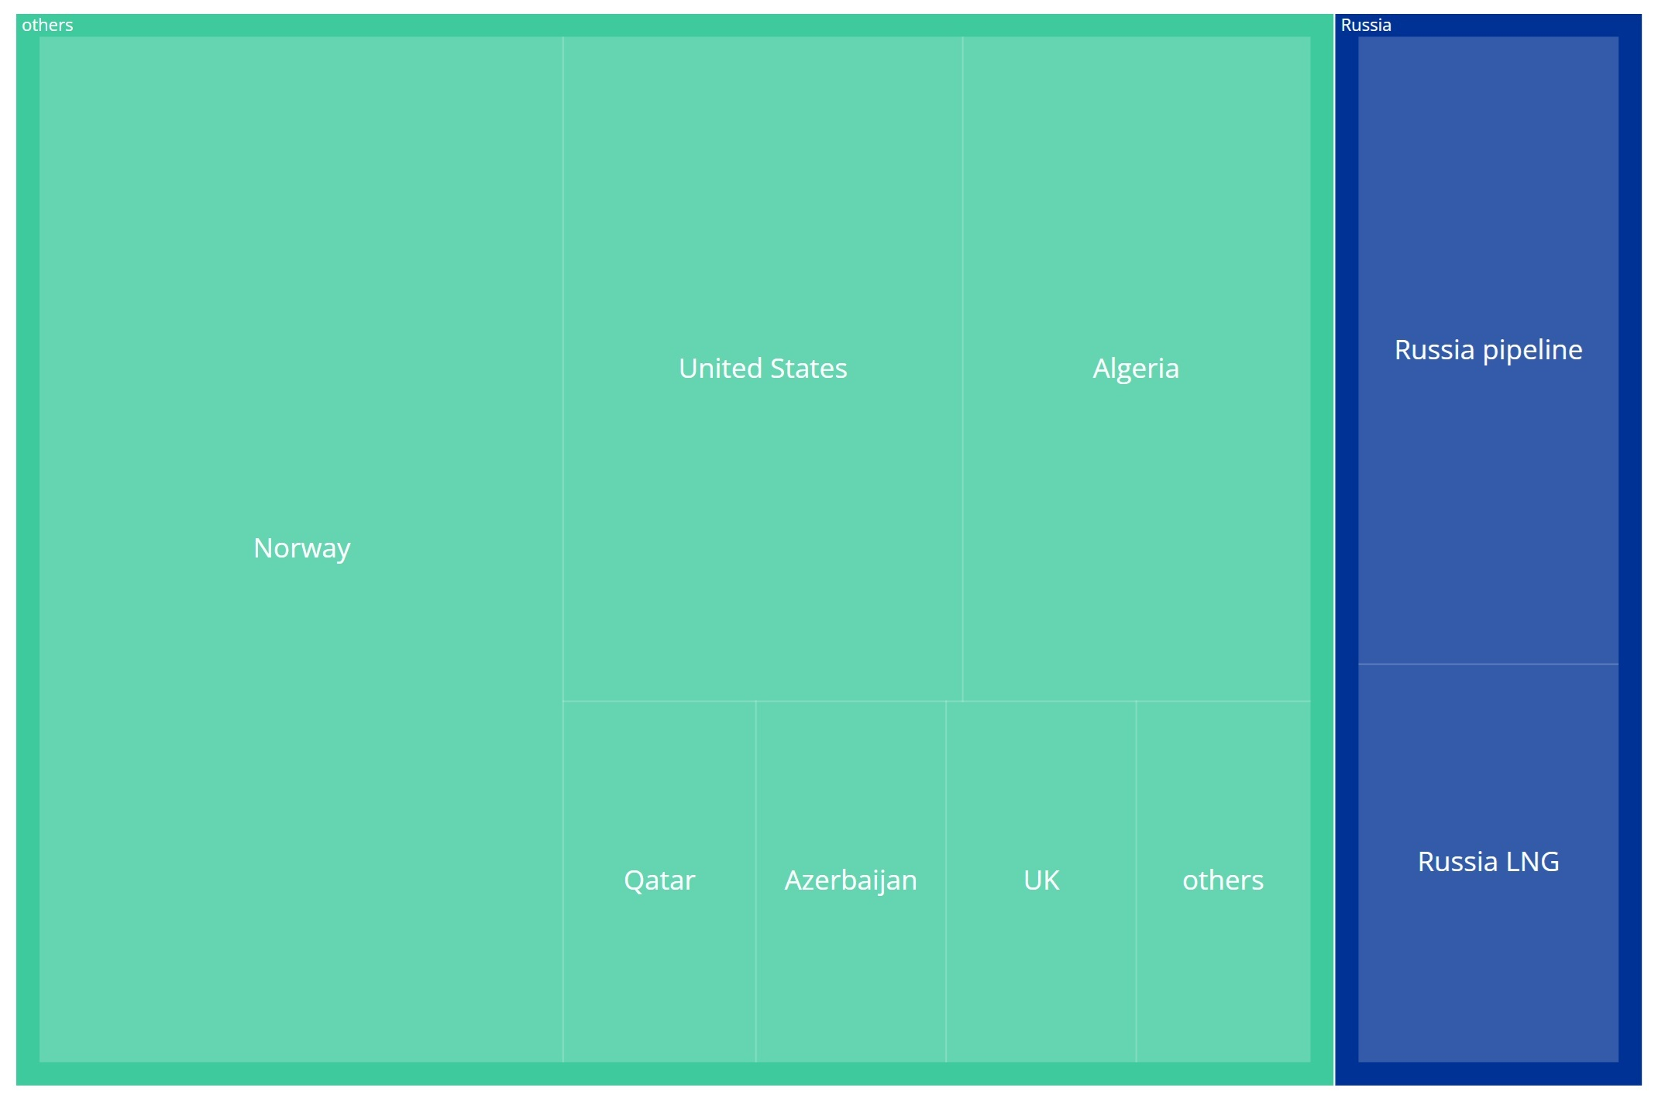
Energy Independence
EU Gas supplies 2024

Slide 6

Energy Independence
EU Gas supplies 2035

Slide 7
How do we achieve this?
Good business case
Supportive narrative & culture
Smooth customer journey
Thriving heat pump market

Slide 8
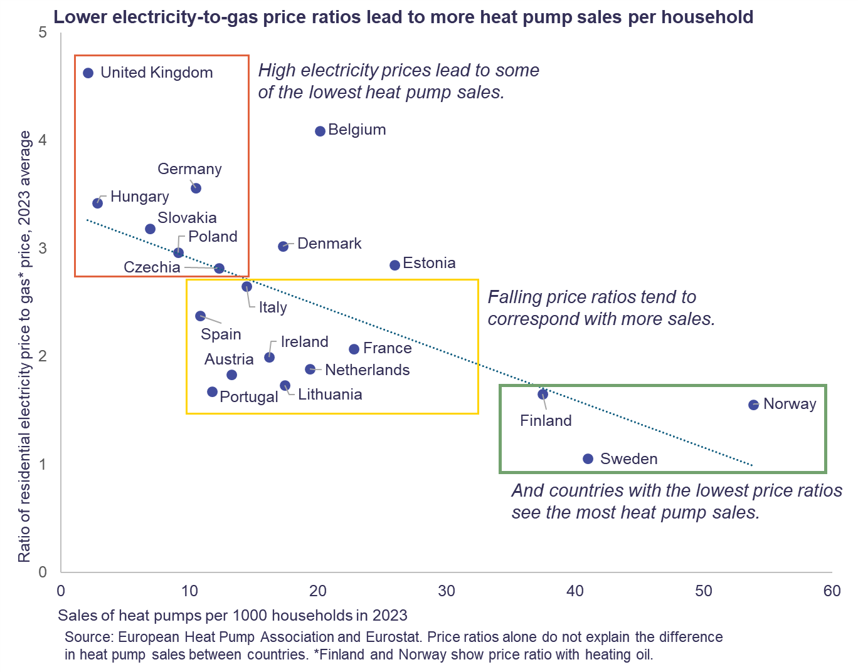

Slide 9
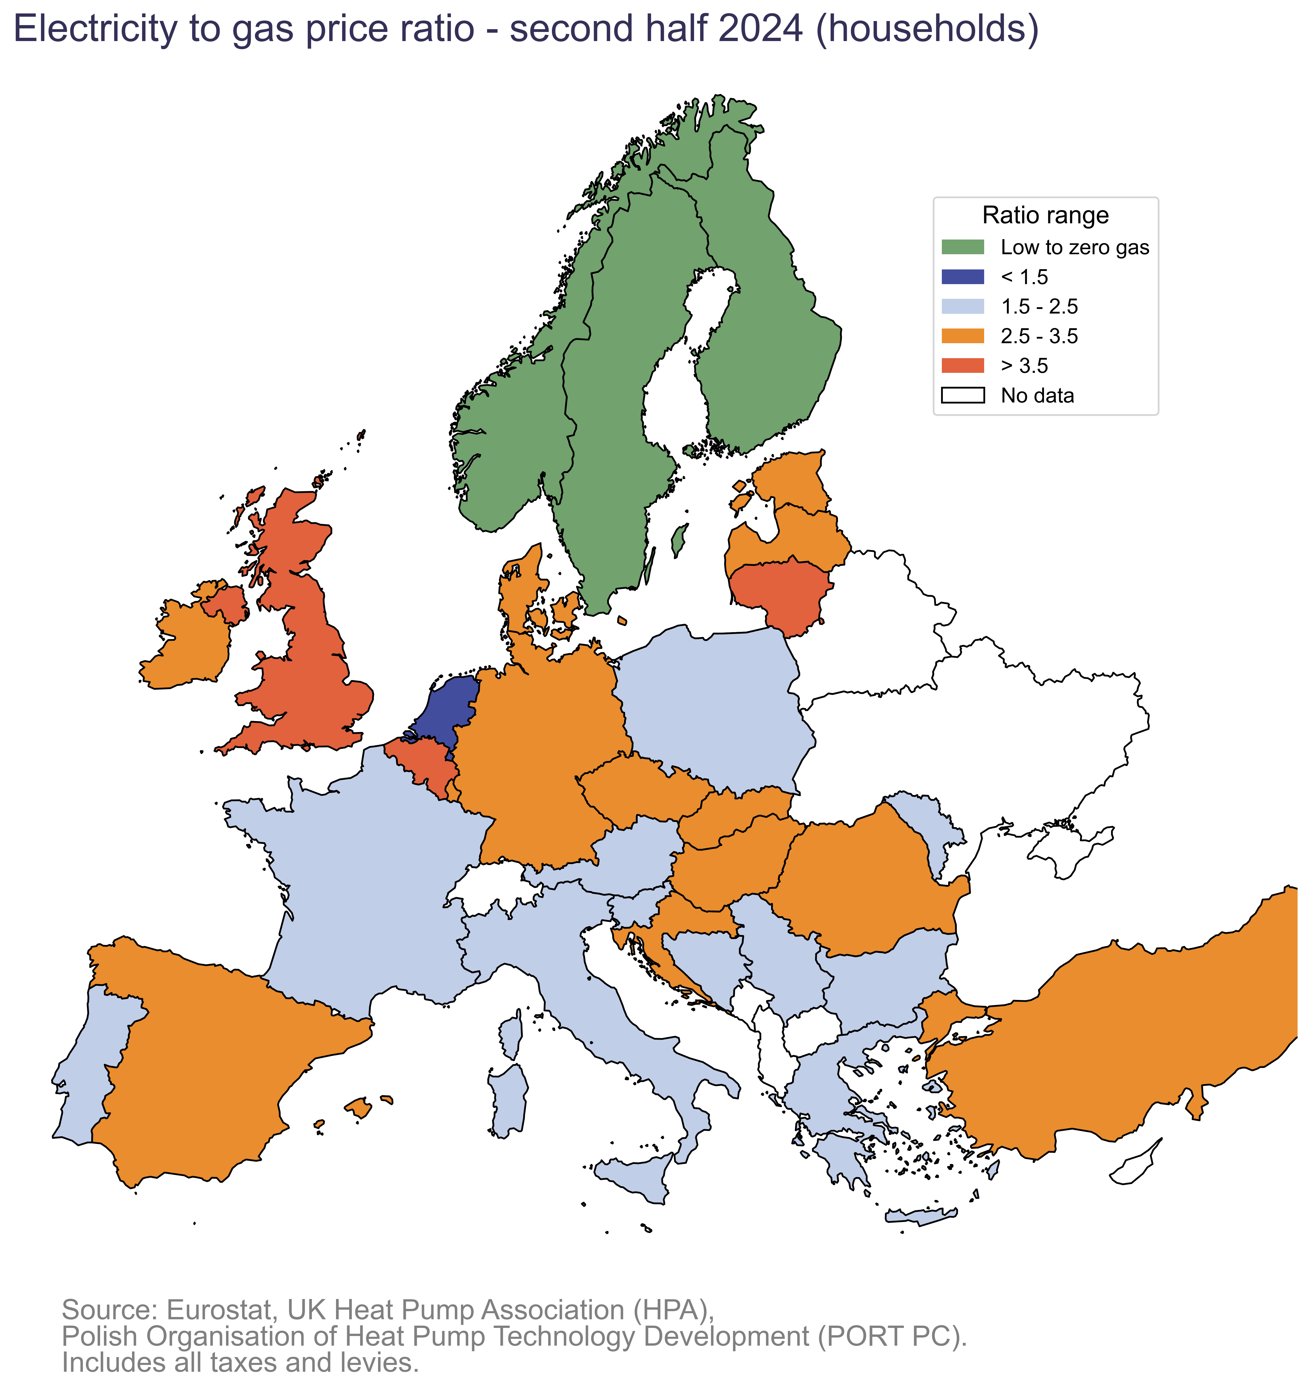

Slide 10
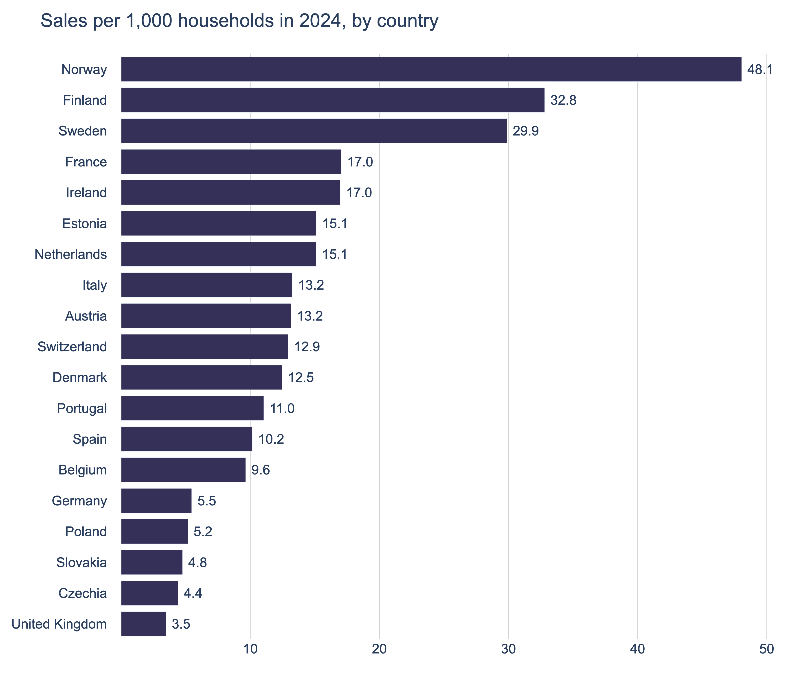
A range of different solutions for different market segments
Market segments:
Deep renovation
Shallow renovation
Emergency boiler replacement
Low income housing
Public housing
Landlords
Finance solutions:
Green mortgages
Leasing/ Loans
Social Leasing
Regulations/ Tax incentives

Slide 11

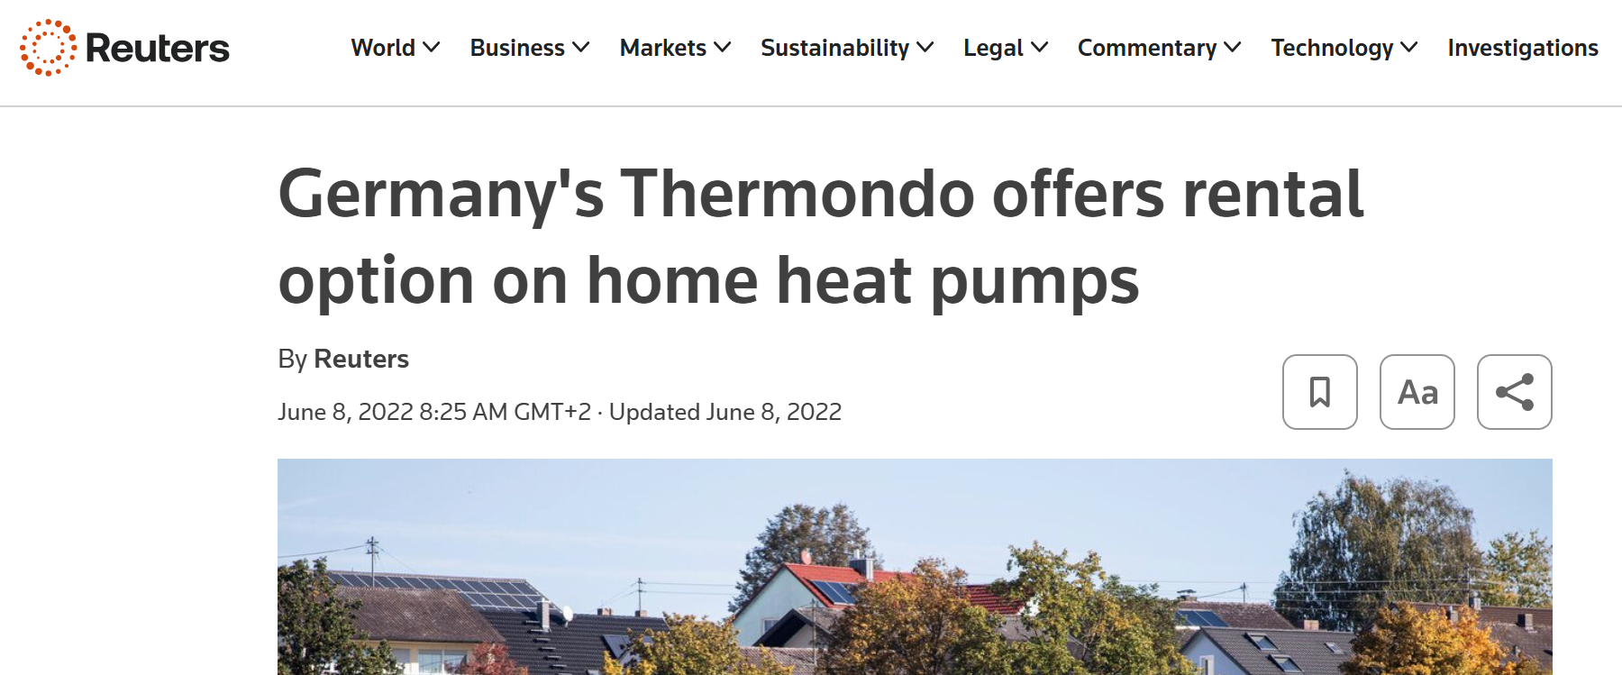
How do you lease a heat pump?
Very similar to the majority of car finance
Financed over 5-10 years on a monthly payment
Generally includes maintenance
Simple customer journey (subsidies, warranties, design, finance)
Asset backed finance

Slide 12
How do you lease a social lease heat pump?
Very similar to the majority of car finance
Financed over 5-10 years on a monthly payment
Generally includes maintenance
Simple customer journey (subsidies, warranties, design, finance)
State social subsidy on installation or finance cost
Reduced repayment rate for social lease
A few issues remain
Commission to provide guidance.
Asset backed finance needs a removable asset
Bill repayments and financing legislation may need amendments
Electricity to gas price ratio still an issue in some countries.

Slide 13

To unlock potential
Provide dedicated funding for social leasing for heat
Support social leasing with public guarantees and low-interest
Prioritise social leasing models targeting social housing providers
Simplify and fast-track subsidy and loan processes
Introduce fair and transparent social leasing contracts
Download the EHPA paper on social leasing

