Slide 2


Stephan C. Krabsen CEO of EBO Consult Vice President of Energy Communities Denmark
Operation and administration of district heating companies and energy communities
Non-profit association Improving the framework and information on energy communities

Slide 3
ENERGY COMMUNITIES AT AN INTERSECTION OF CHALLENGES
Green transition
Supports municipal climate plans Local ownership Citizens as participants = demand for renewable energy plants
National security
Decentralisation of energy supply
Strengthens competitiveness
If large companies are allowed to participate (DK) Great interest from business areas Affordable supply
Optimisation of the collective electricity grid
Balancing and flexibility

Slide 4

ENERGY COMMUNITY AVEDØRE
A PILOT PROJECT IN DENMARK

Slide 5
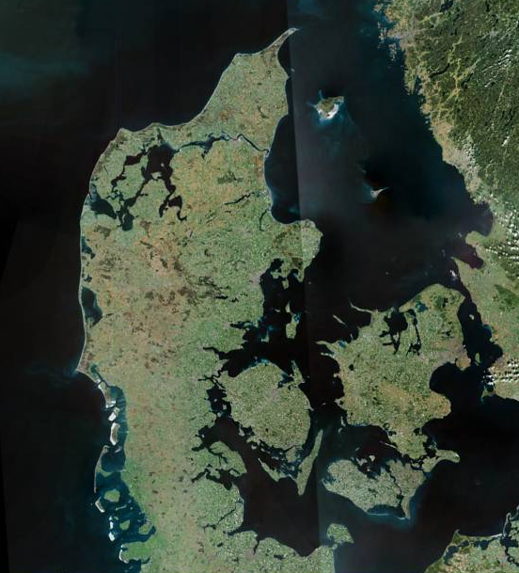
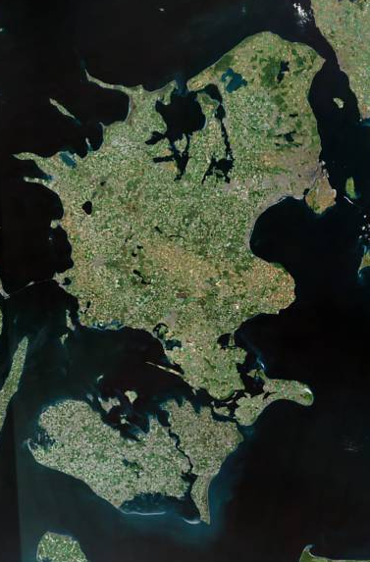
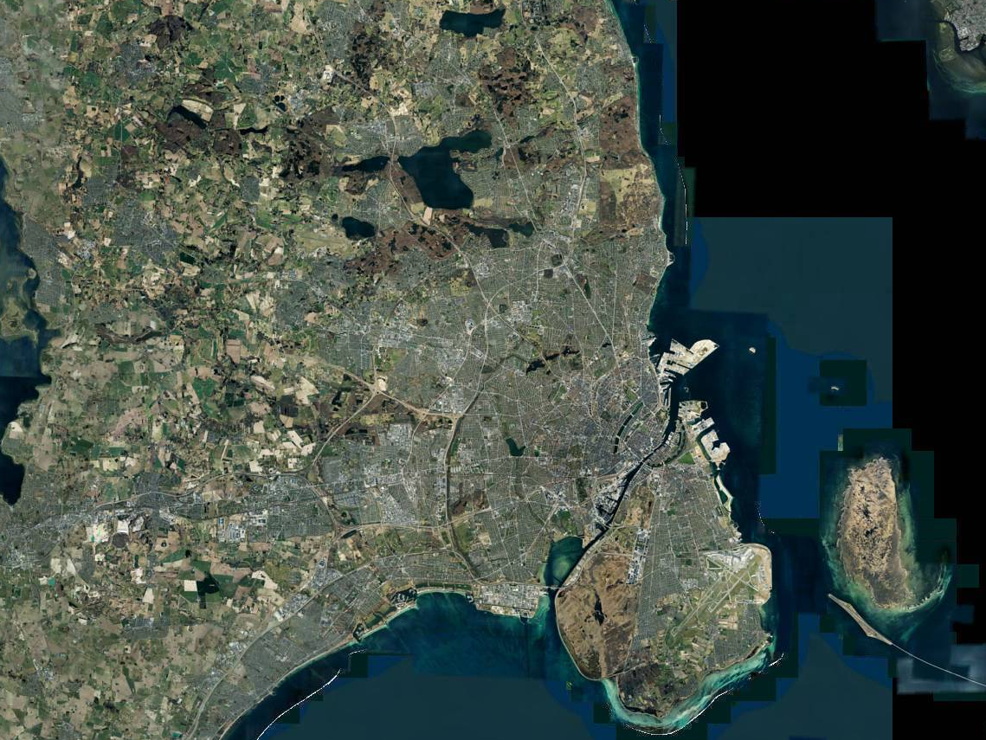
Context…
Notes:
Stephan

Slide 6
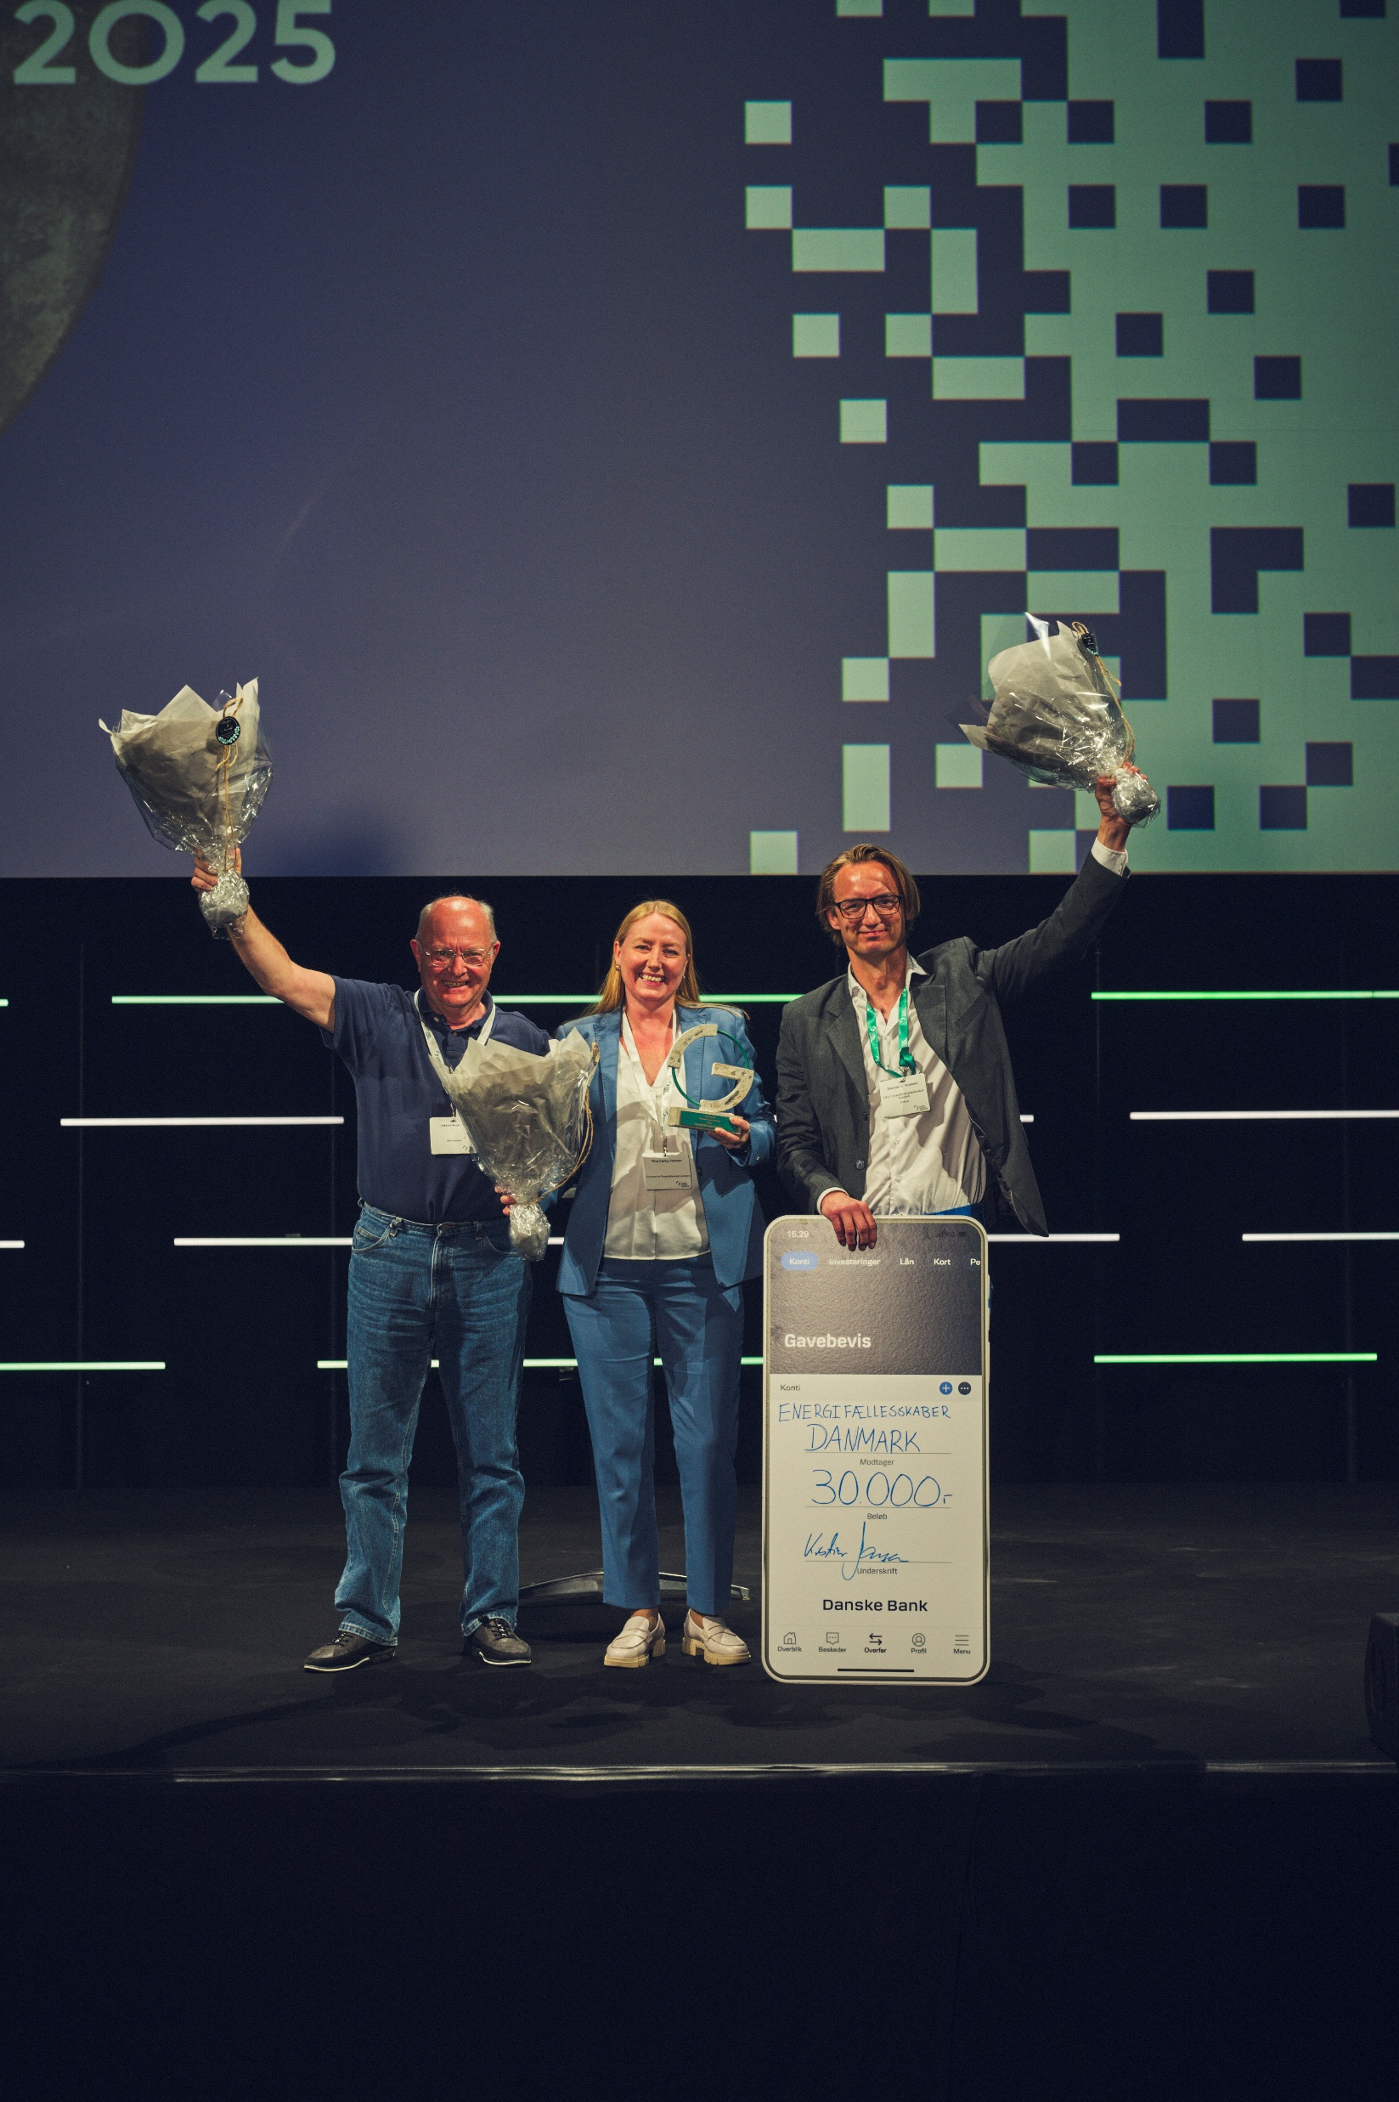
WINNER OF THE GREEN POWER DENMARK AWARD 2025
"This year's Green Power Award goes to the Energy Community Avedøre A.M.B.A., which manages to both involve the local citizens and create green innovation. Since 2021, the Energy Community has brought together citizens, housing associations, companies and utility companies around a common ambition: To make Avedøre a green powerhouse – powered by renewable energy, local production and joint ownership."
From the press release on Green Power Denmark's website on 20 May 2025
Foto: Jeppe Carlsen

Slide 7
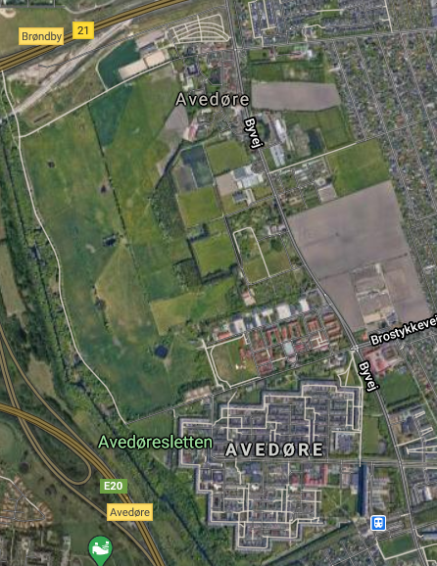
AVEDØRE VILLAGE INNOVATIVE LOCAL SELF-SUFFICIENT ENERGY SYSTEM
PRIVATE HOUSEHOLDS WITH PVS
WIND TURBINE INSTALLATION
URBAN DEVELOPMENT AREA WITH THE ENERGY COMMUNITY
PVS ON MUNICIPAL BUILDINGS
Local co-ownership No resistance towards renewable energy plants Strong will and local commitment - also to invest Support in local politics from the entire political spectrum From problem to potential
COMMERCIAL AREA WITH PVS AND CHARGING STATIONS
GREEN HIGH SCHOOL WITH CLIMATE AMBASSADORS
AVEDØRE STATIONSBY: - LOW TEMPERATURE RANGE - SOLAR HEATING SYSTEMS & PVS - HEAT PUMPS - CHARGING STATIONS - DATA CENTER
THE ENERGY STATION
SOLAR HEATING SYSTEMS & FACADES

Slide 8
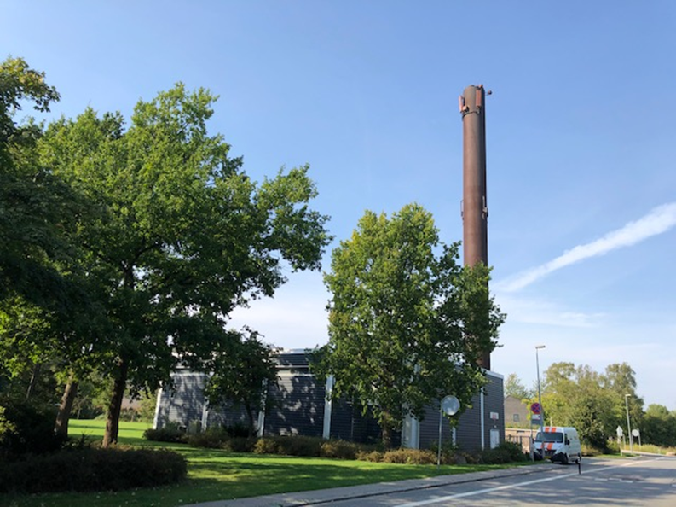
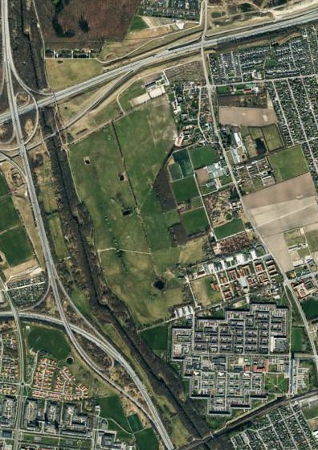
Avedøre District Heating Cooperative
Owned by all consumers (4.500)
Platform for local energy ideas
Board of directors (consumers)
Non-profit district heating utility
Notes:
Stephan

Slide 9
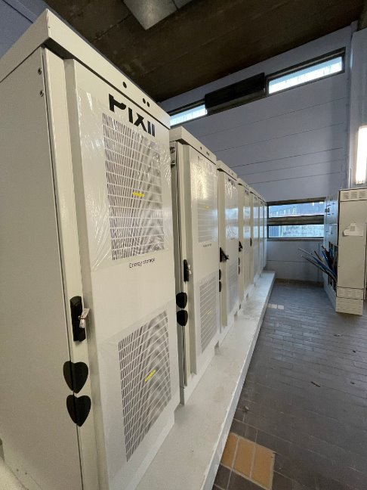
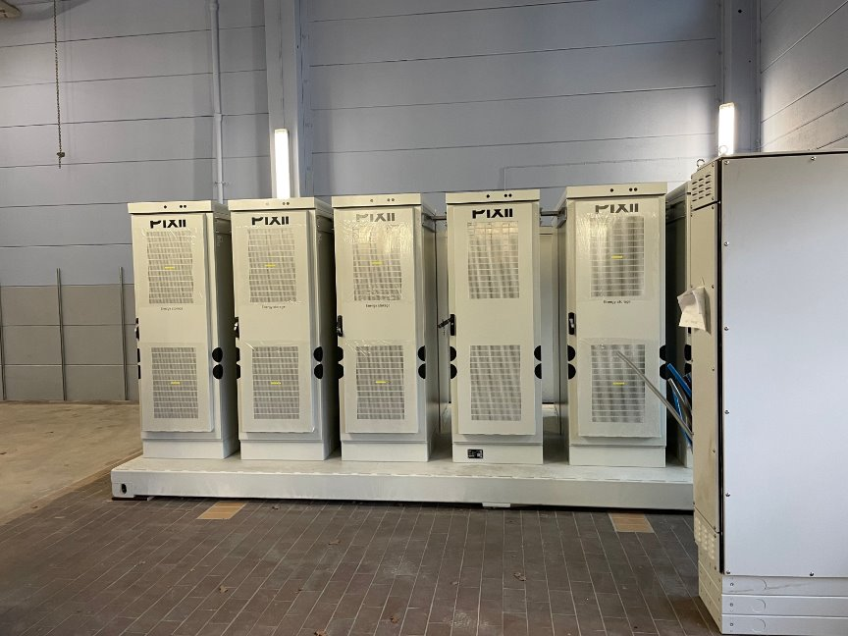
Data center located at plant
Waste-heat from data center used in DH grid
Heat pump moves surplus to grid
10% reduction in heat bill for consumers
Battery for back-up and optimization
Win-win - financially and environmentally
Notes:
Stephan

Slide 10
Innovative DH
Central heat-pump
Locally distributed heat pumps (flex-boosters)
Power from 4.000 m² PVs on noise-bank
Battery to optimize grid-usage
Owned and operated by Avedøre DHC
Notes:
Stephan

Slide 11
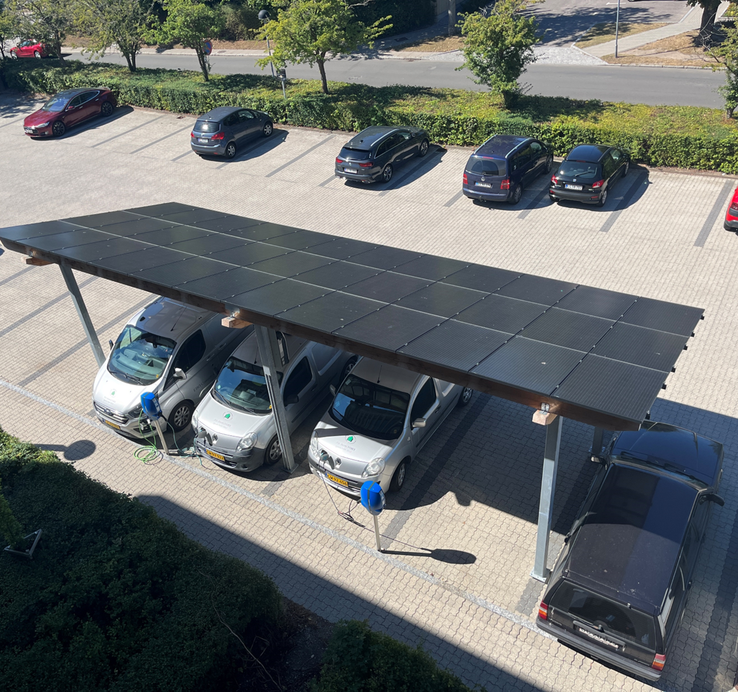
DH Cooperative → member of Energy Community Avedøre
buys locally produced PV-power
powers heat-pump (data center and grid in The Avedøre Village)
powers pumps and other electricity
powers data center
BONUS:
owners of data center – also members of ECA
=
data center runs on locally produced power
up-scaling potential is huge
Notes:
Stephan

Slide 12
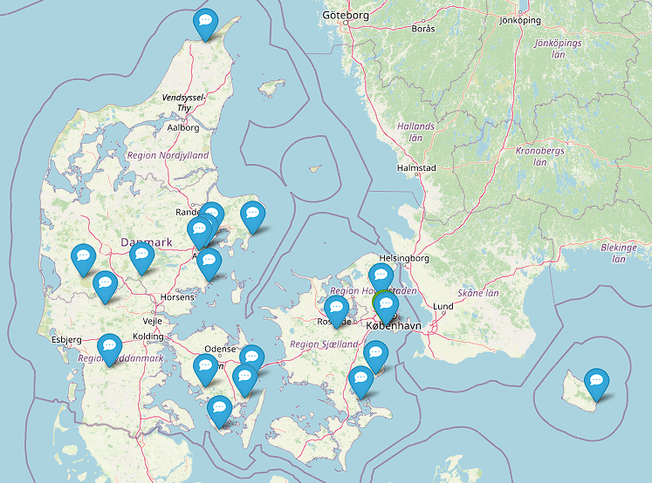
Despite the lack of a national strategy
Many ECs are on their way!

Slide 13
Common features of the good cases
The starting point is local commitment and willingness
The municipality's involvement and support are crucial
But it is a local and joint project!
The ownership lies with the participants – NOT the municipality
The municipality gives high priority to energy communities
The municipality as an active participant in the energy community with any buildings
High-level representatives from the municipality involved – part of the board
Resources from municipalities
Facilitating employee
Financial support for consulting services and development leading up to full operation

Slide 14
Recommendations to fulfill potential
A clear national strategy for the integration of energy communities in a future and holistic energy system in all member states (including Denmark)
Let the energy communities define and fulfill their role in the energy system nationally and in Europe
Financially via support schemes
Dynamically develop legal framework based on practical experiences – not on theory
Clear definition – energy communities as a specific customer type in the collective grid with specific needs and with a specific role
The willingness and potential are present locally

Slide 15
Thank you!
sck@ebo.dk

