Slide 1




Decarbonised district heating and cooling:
A major building block of Europe’s zero-carbon roadmap
EUFORES
IPM25 Copenhagen
18 October
Pauline Lucas
Policy Director

Slide 2
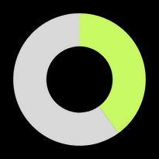
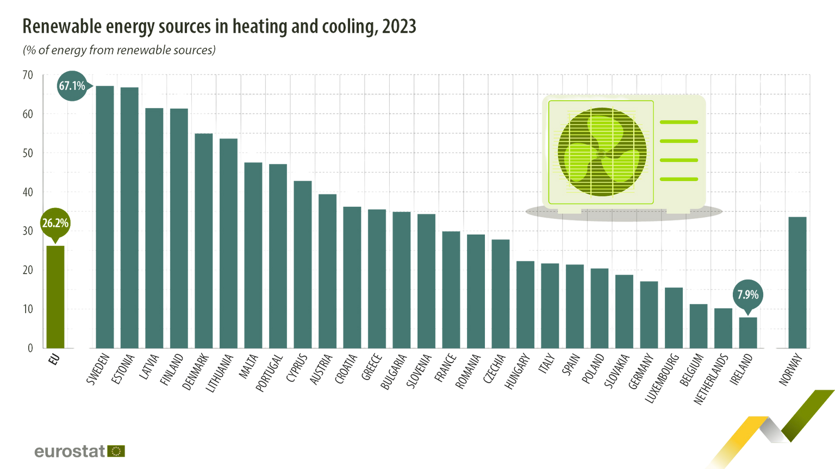

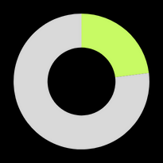


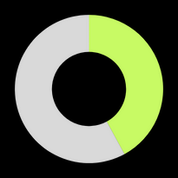





The heating & cooling decarbonisation gap
2/3 of all fossil gas consumed in the EU used to generate heat or cold in buildings and industry.
42,5% renewable
electricity
Heat decarbonisation is a matter of energy security
26,2% renewable heating & cooling
44,1% renewable and waste heat based DHC
DHC+
The Heating & Cooling Network

Slide 3
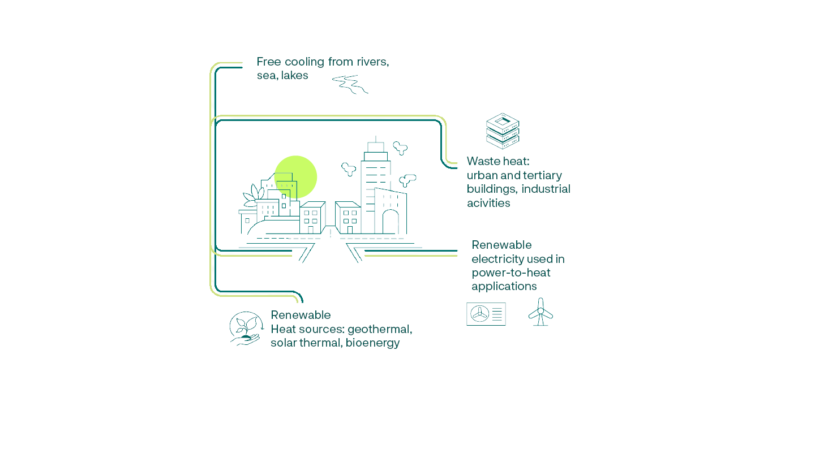
District heating and cooling:
a unique energy infrastructure
13
% of the heat market
Million citizens connected
in the EU
DHC Networks in the EU
% of renewable & waste heat
in the mix
activities
80
19.000
44,1
Harnessing local recovered and renewables energy sources
DHC+
The Heating & Cooling Network

Slide 4



On the cusp of a clean energy revolution
DHC Market Outlook 2025
from 2022 to 2023:
Trends:
Defossilisation & Diversification
Electrification & System Integration
Expansion & Growth
+9.7%
Growth over the past 5 years on the largest markets
+20%
Waste heat supply, reaching 4.1% of the mix
+44%
Large heat pumps
+80%
Electric boilers

Slide 5
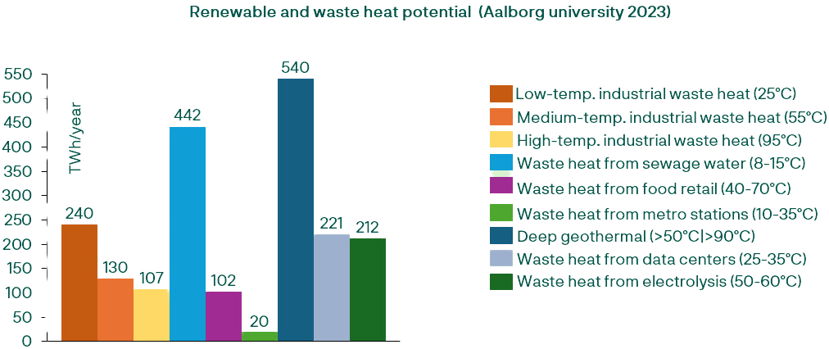
We have what it takes!
Beyond renewable electricity sources, the untapped potential of renewable and waste heat sources in Europe amount to 2000 TWh/y, equivalent to the forecasted heat demands for space and water heating by 2050 !
The Heating & Cooling Network

Slide 6
DHC enables electrification and reduce costs
10 GW
The contribution of DHC networks to reducing peak capacity needs in Sweden, according to a report by the Swedish Energy Agency
Energy system costs reduction for final consumers, resulting from the deployment of DHC networks in the Netherlands according to a recent study
Compensation paid to RES producers due to forced reduction in RES production, in 7 countries (FR, FI, DE, HU, PO, SP, UK)
40%
€7,2BN
Coupling heat and electricity infrastructures is essential to deliver a more efficient, sustainable energy system!
The Heating & Cooling Network

Slide 7
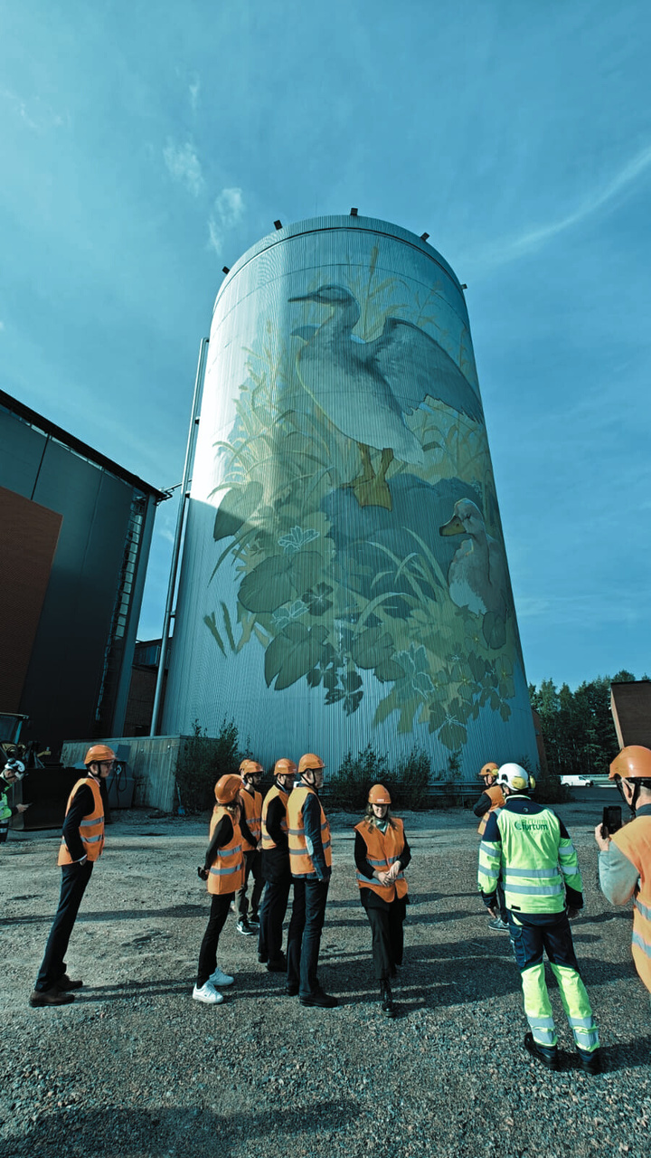
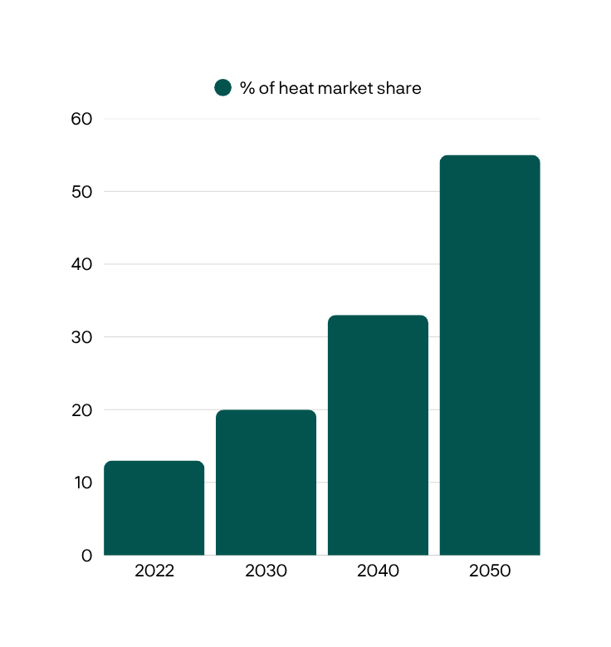

x4 growth to deliver flexibility and decarbonisation
Recommended levels:
20% in 2030
33% in 2040
55% in 2050
EU annual increase: 5,2%
43% Heat savings
Investment needs over 1,15 trllion € by 2050
Substantial investment is required to reach the potential
The Heating & Cooling Network

Slide 8




What’s next?
Commission’s Heating and Cooling Strategy (expected Q1 2026)
Support legislation implementation and bridge gaps
Heating & Cooling Planning
Provide visibility for consumers and developers
Support development and implementation of plans
Investment Strategy
Commit Member States to provide stable and dedicated funding
Mobilise private capital
De-risk renewable and waste heat projects
Fair & efficient cost structures
Reform taxation
Mutualise costs
Recognise the system value of flexibility.
DHC+
The Heating & Cooling Network

