Slide 1
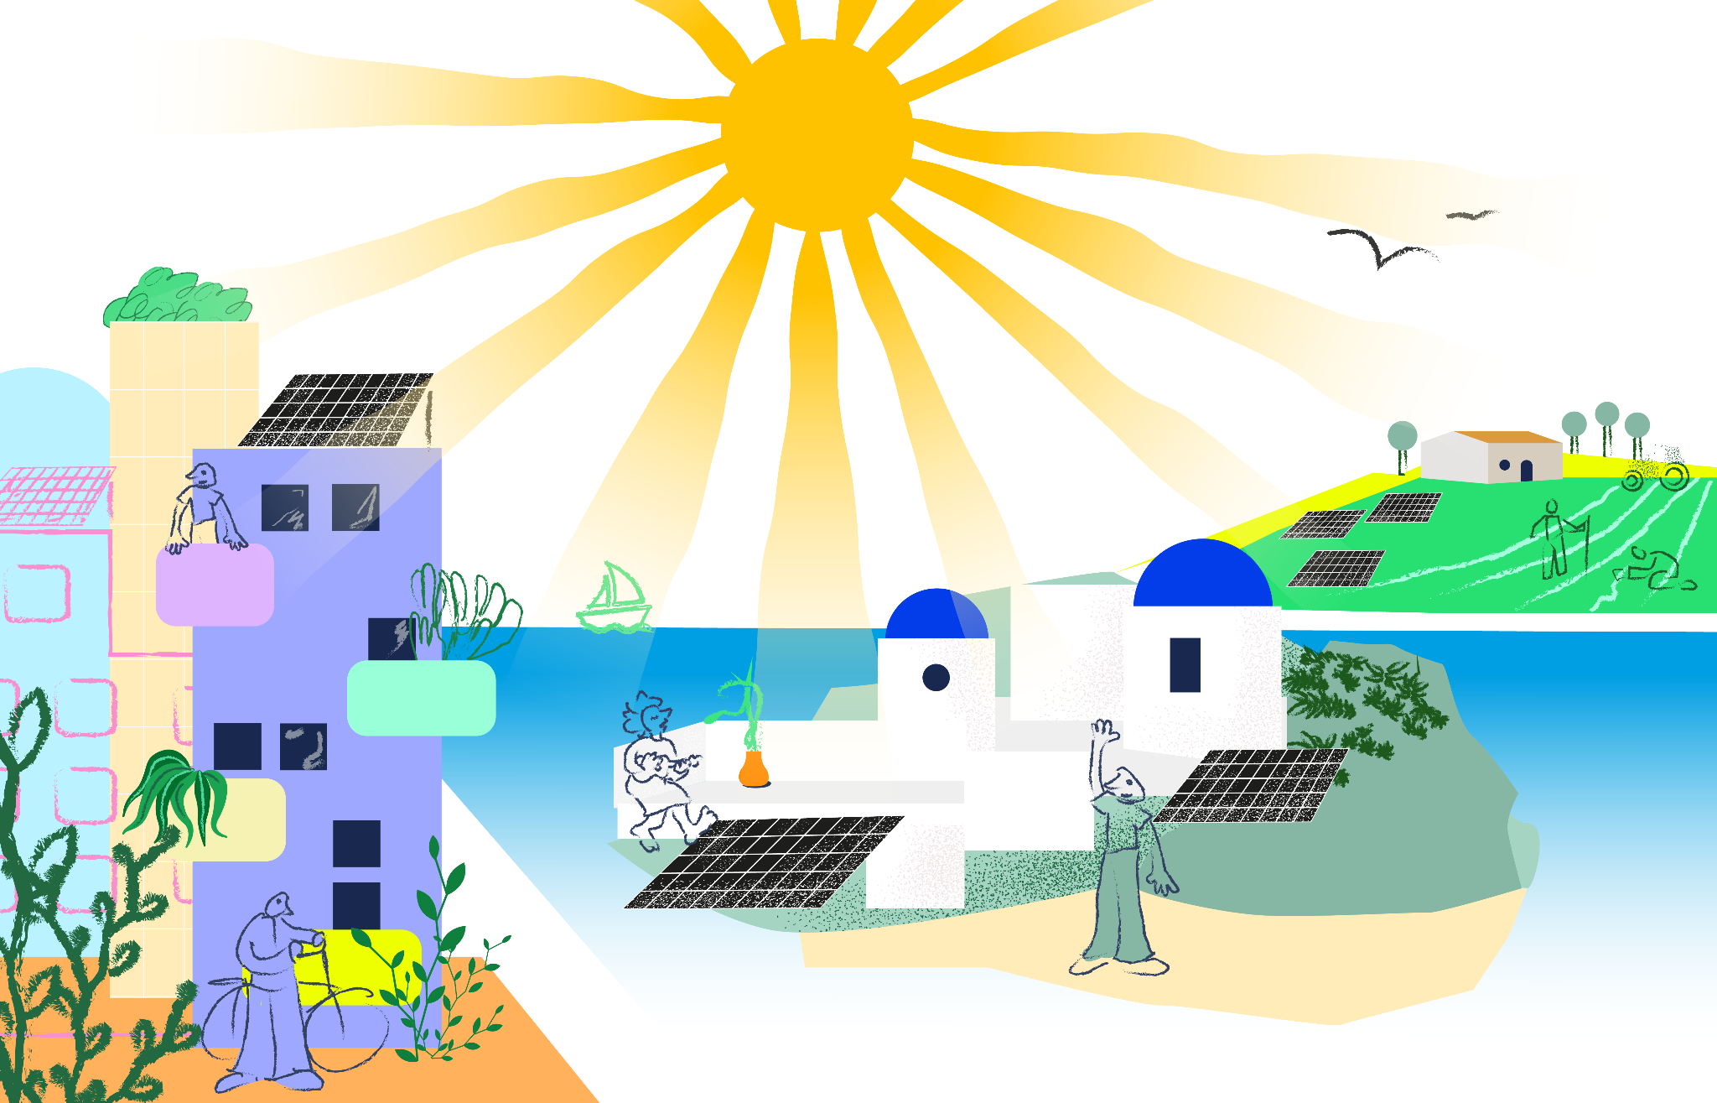
The power of citizen’s involvement
Mark Luntley | REScoop.eu
18/10/2025 | EUFORES, Copenhagen

Slide 2


Who are ?
European Federation of Energy Communities
Not for profit association
Based in Belgium
Founded in 2013
2 500+energy cooperatives
2 000+ million European citizens
Notes:
Activities
Advocacy
Foster collaboration
Support starters
Support members
Promotion

Slide 3
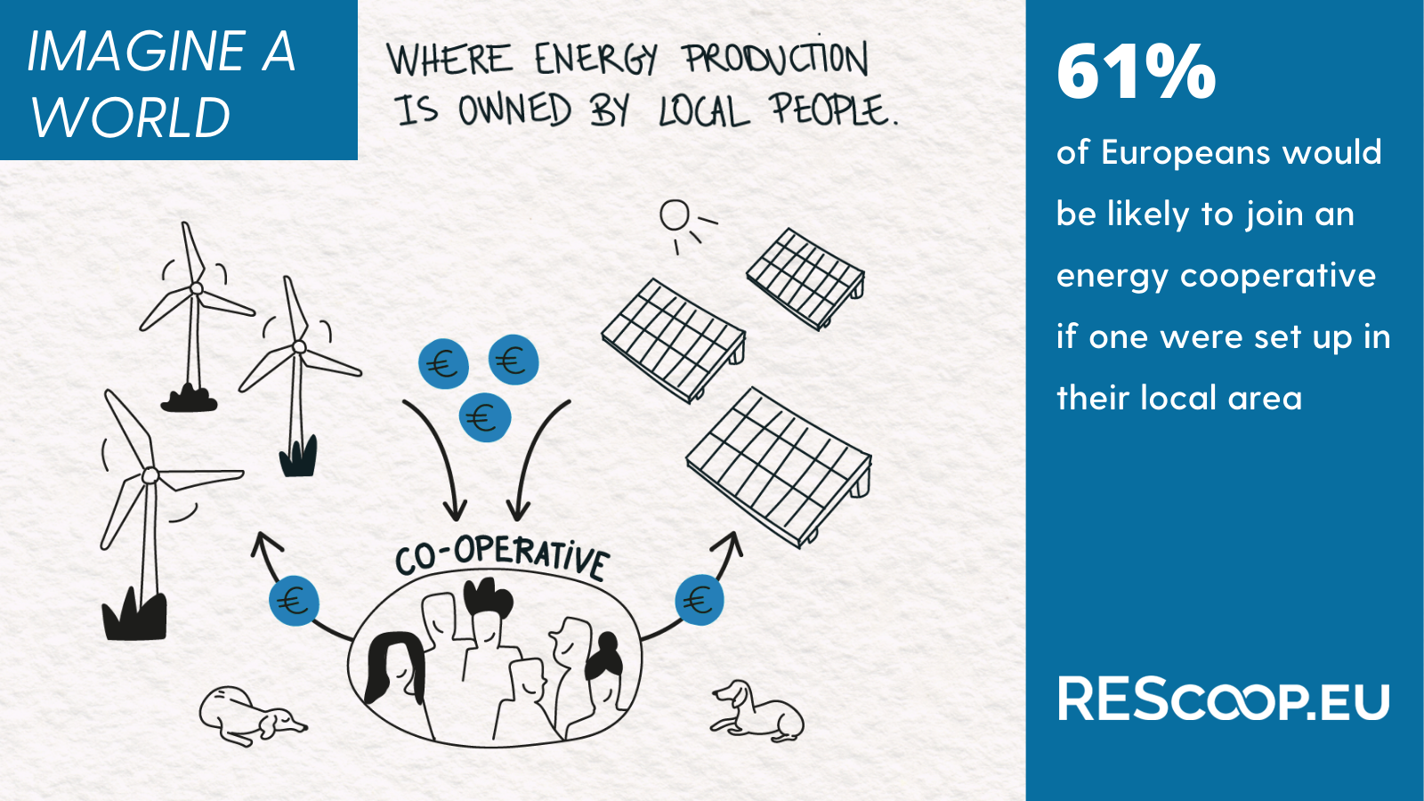
Notes:
Support for wind and solar increases substantially when people co-own the projects and there are local benefits
lower bills (81%)
local jobs (72%)
61% would be likely to join an energy cooperative if one was set up in their local area
Romania (85%), Italy (75%), Bulgaria (75%), Poland (74%), Greece (71%) and Spain (69%)

Slide 4
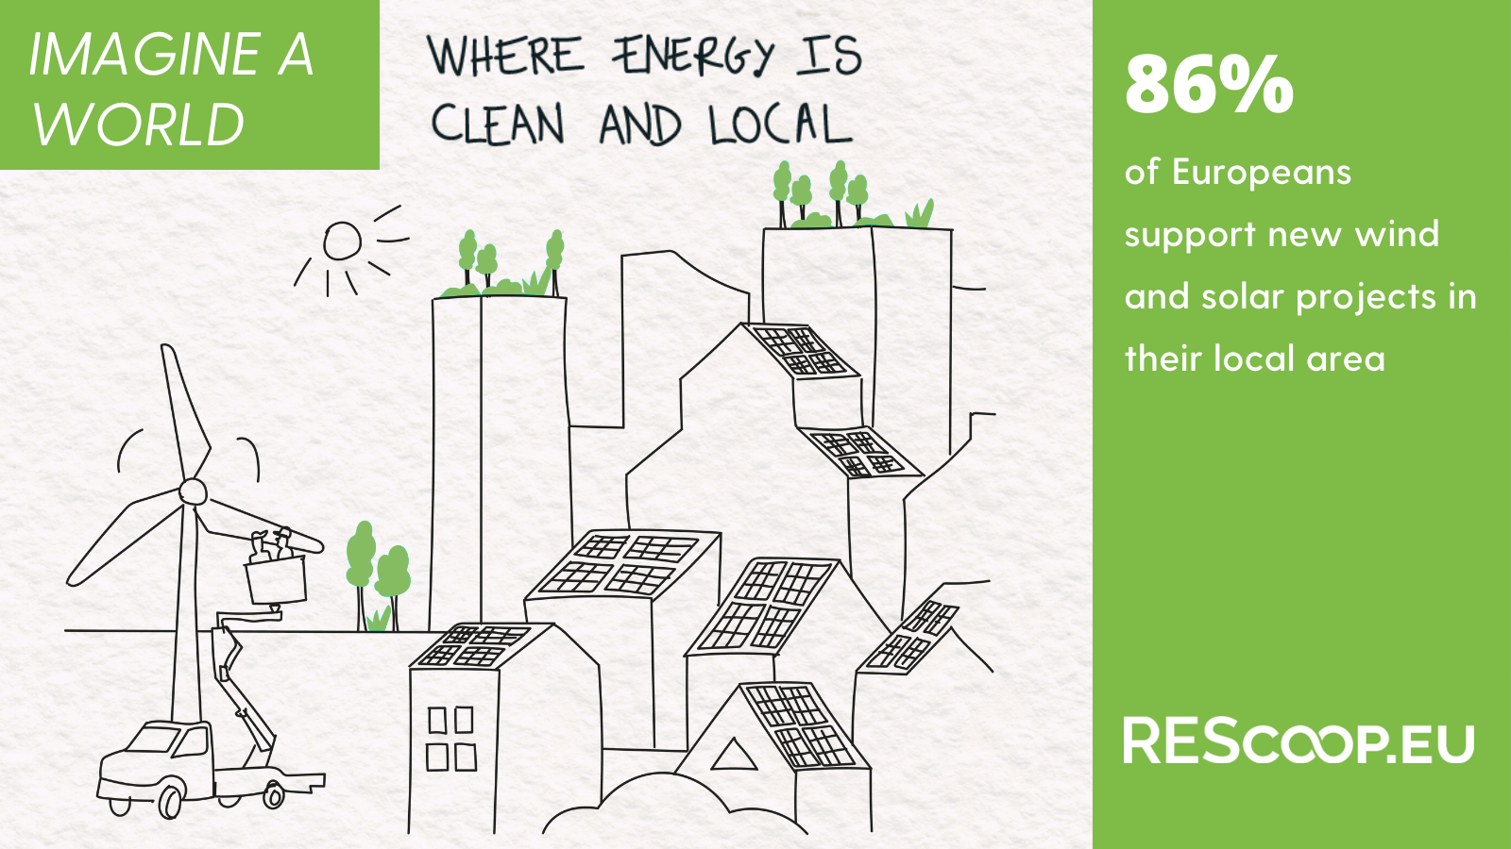
Notes:
86% of people would support new wind and solar projects near to where they live.
84% of people support more solar, 70% more wind in their neighbourhood
Onshore wind support increases to 76% when communities are engaged through the creation of local jobs, shared profits and ownership, and planning and nature protection consultations.
65% of Europeans oppose the construction of a new nuclear power station
67% oppose a new oil- or gas-fired power plant being built near to where they live

Slide 5
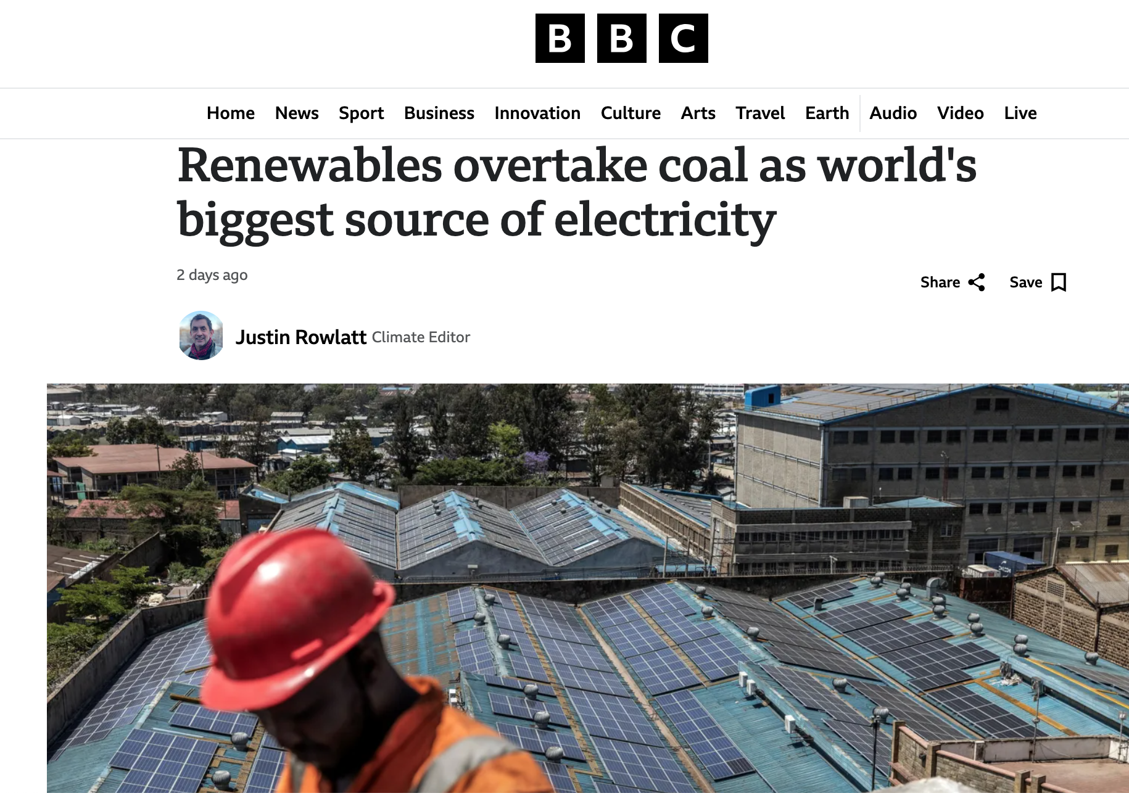
The energy transition is already underway.
Costs are falling rapidly
Renewables almost everywhere now cheaper than fossil fuels
But need to make the transition fair

Slide 6
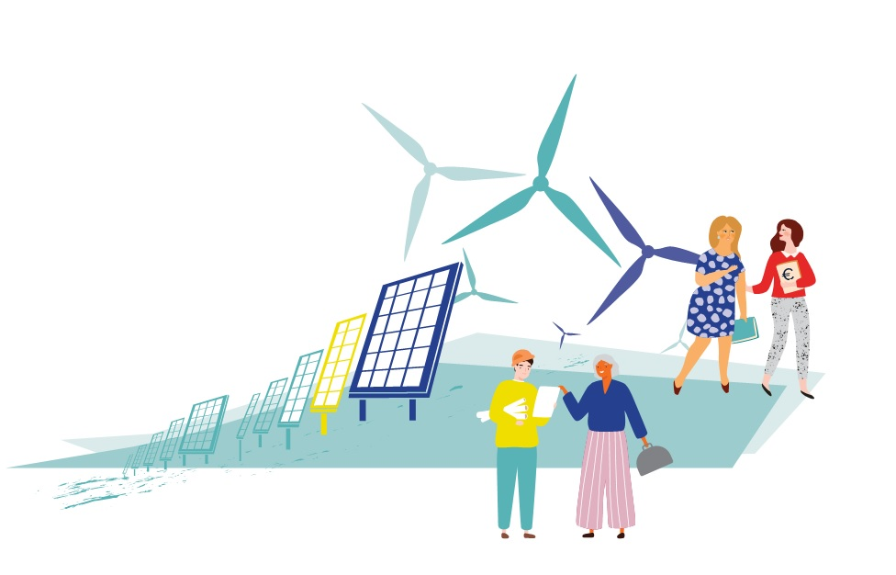
Three benefits of community energy

Slide 7
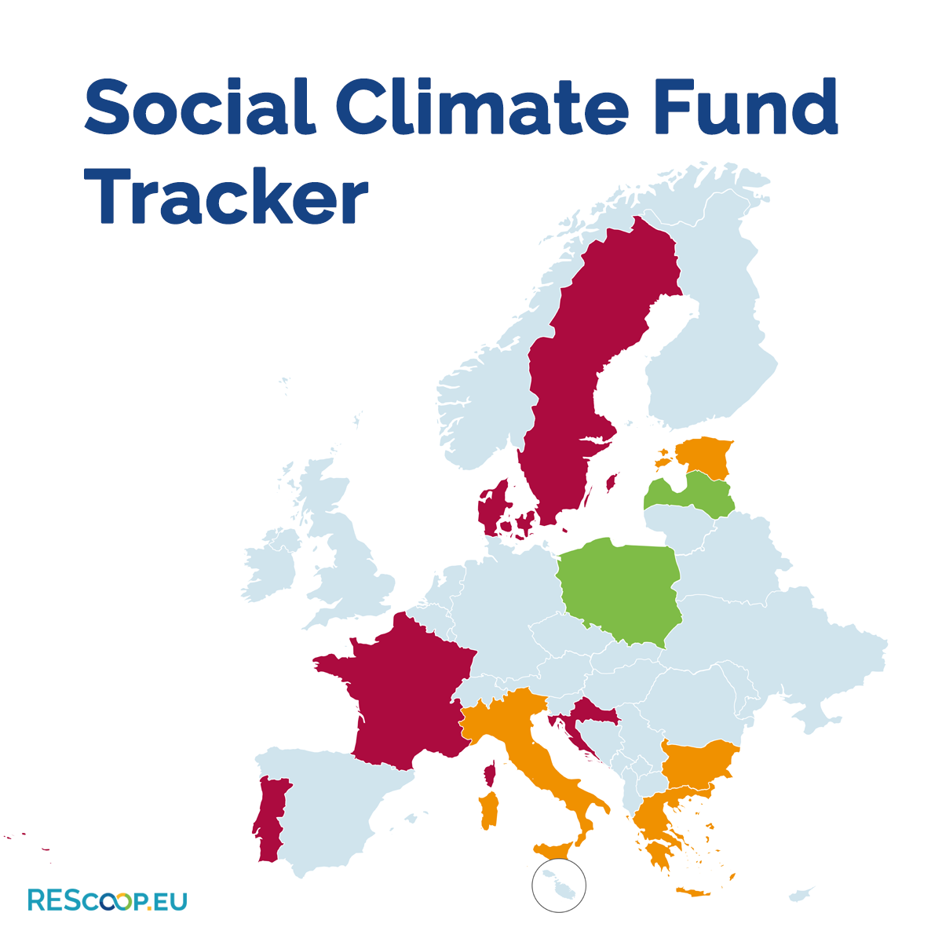
Affordability and price stability
Energy communities can produce energy locally, and ensure price stability for their members
Communities in Italy and the Netherlands kept prices stable during recent energy crisis (CEER 2024)
Danish Heat Supply Act 1979 -> not for profit district heating cooperatives in DK -> stable prices
Help reduce energy poverty for households, and boost competitiveness for small businesses

Slide 8
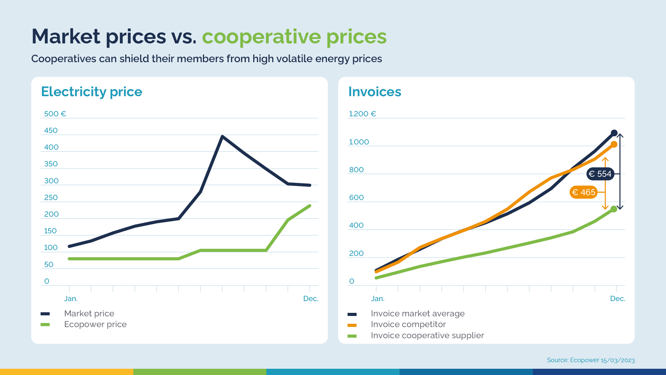

Slide 9

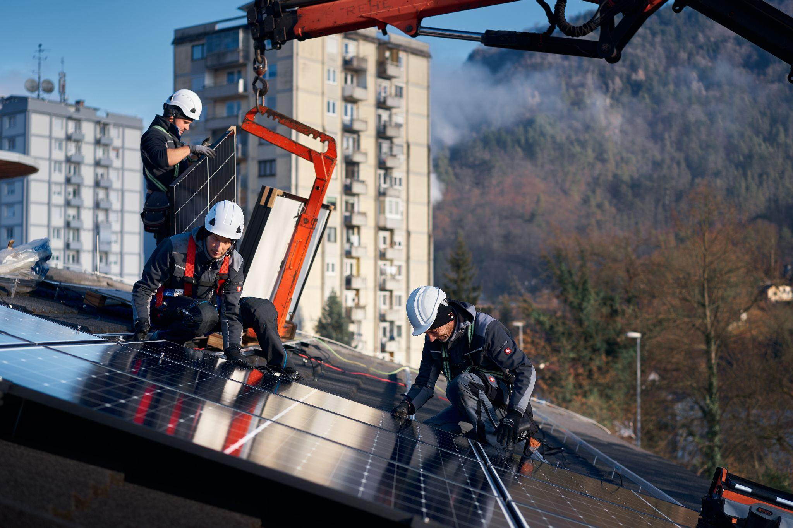
2) Energy security and grid stability
Energy regulator in Brussels & Flanders -> with the right tariff incentives energy communities can contribute to peak shaving
Growing importance for the CEE Region (e.g., Estonia, Poland, Bulgaria)
social capital & community cohesion

Slide 10
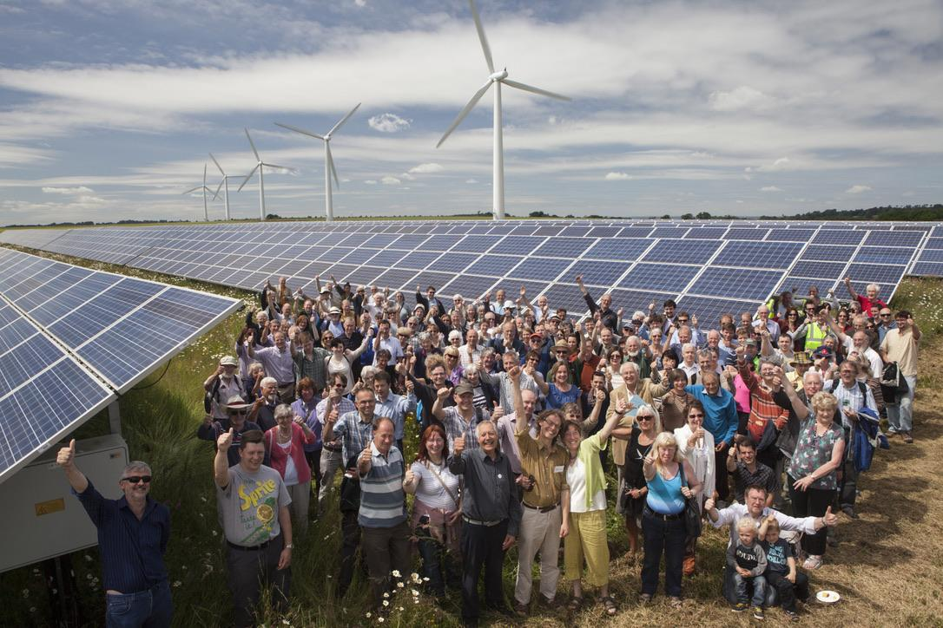
3) Crowding in citizens’ capital
Citizens can contribute 176 billion euros by 2030 for the European energy transition
co-ownership in industrial renewables projects (e.g., wind)
More social acceptance -> faster permitting

Slide 11
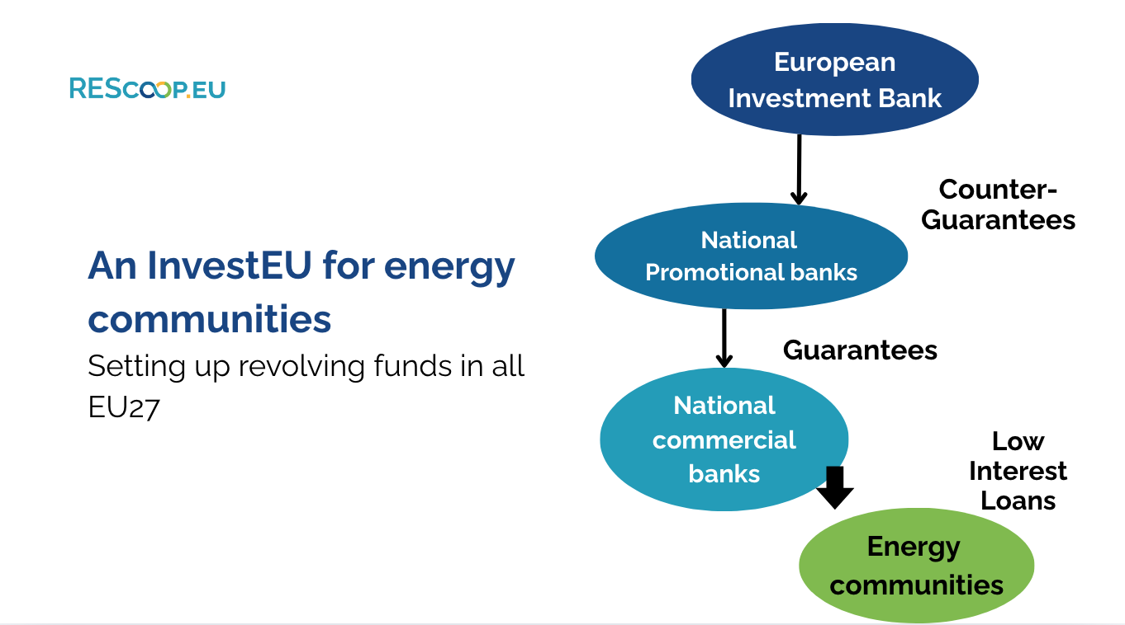
Unlocking the full potential of citizen capital
Financial instruments to de-risk projects and crowd in private capital 1. Guarantee: pan-European guarantee scheme by the European Investment Bank -> unlock cheap loans at Member State level
2. First-mover public capital: Example of the Development Fund from the Netherlands

Slide 12
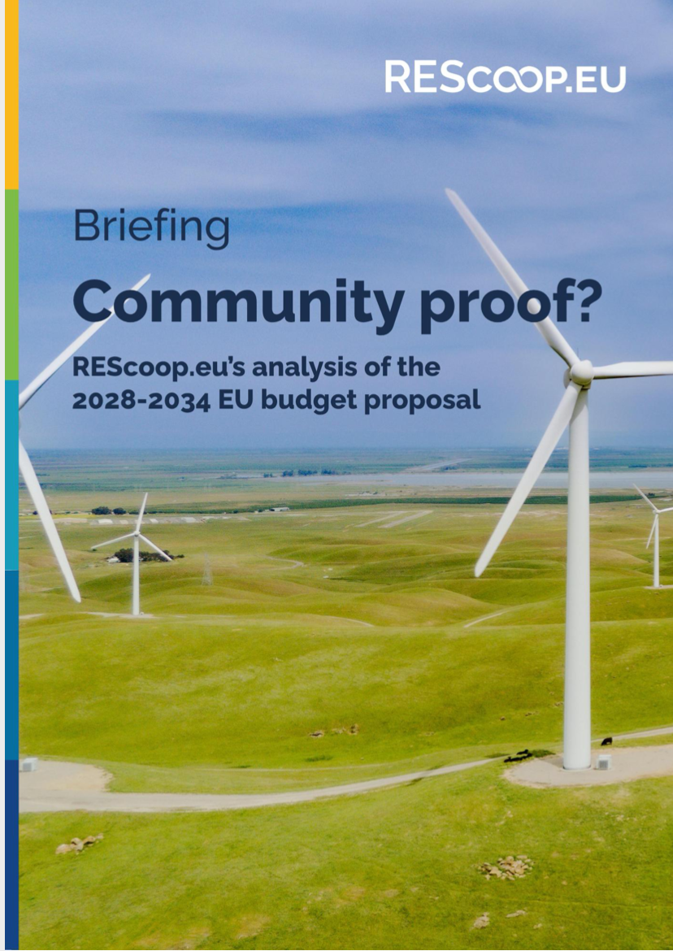
(In)efficient use of EU funds
EU Funds are not reaching the ground (REScoop.eu financing tracker)
Need more co-management with national federations of energy communities
REscoop.eu’s reaction briefing to the 2028-2034 EU budget proposal: ensure dedicated funding

Slide 13
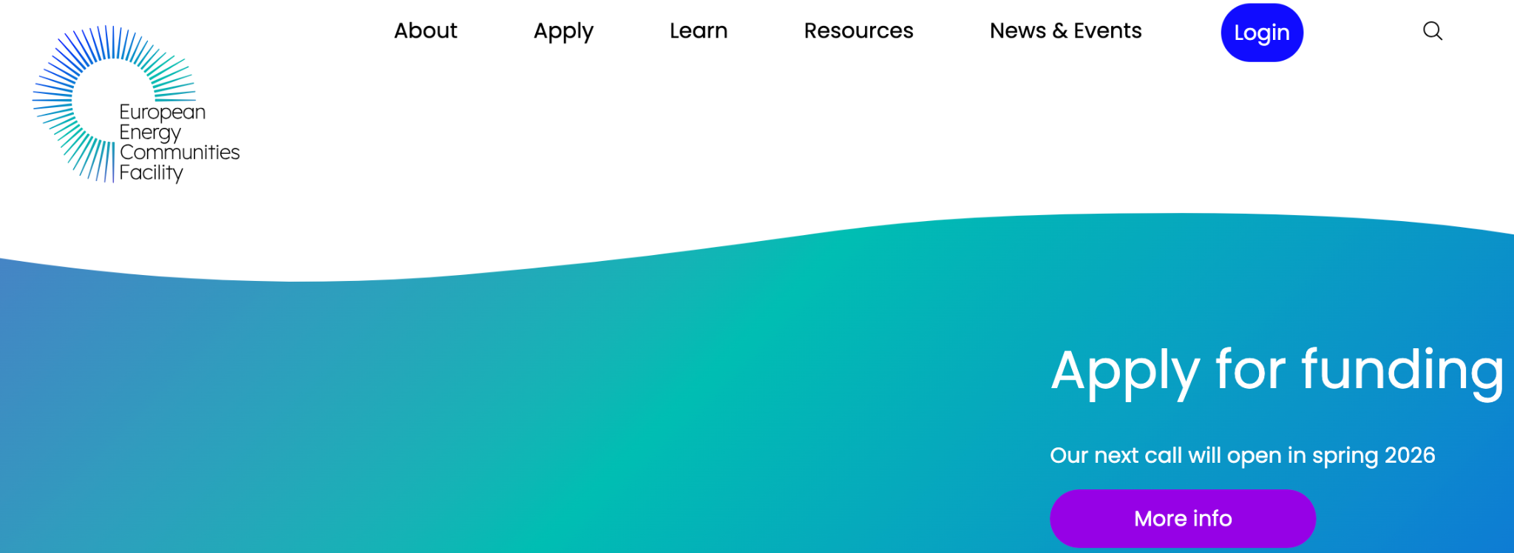
Citizens want to help
The LIFE Energy Communities Facility - 7 million euros for 146 community energy projects
First call closed end of September - 700 applications(!)
Development, lump sum grants
Simple, online, centralised application
Using national community energy expert organisations to raise awareness/build capacity
Potential to mobilise ~2 billion euros in citizen capital over 5 years

Slide 14
Get in touch!
mark.luntley@rescoop.eu
www.rescoop.eu

