Slide 1

Offshore Wind 2.0
Speeding up seabed planning and grid connection and a concrete 2040 framework for offshore wind
17-10-2025 EUFORES
IPM Copenhagen
Jørgen Madsen
Head of EU & Global Affairs – Ørsted

Slide 2
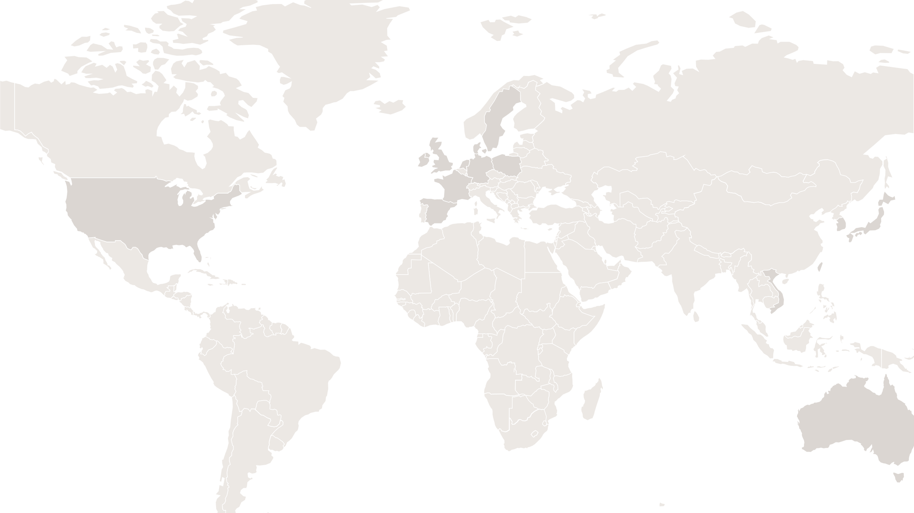
Our global footprint today
Denmark
In operation: 940MW
In operation: our CHP plants, 2,167MW power and 2,909MJ/s heat
Under development
Sweden
Sales of energy
Under construction
Under development: 11 GW
Ireland & Northern Ireland
Sales of energy
South Korea
Under development: 1,395MW
In operation: 372MW Under construction: 43MW Under development: 450MW
Poland
Under development: 2,753MW
Taiwan
Under construction: 136MW Under development: 1000MW
Under construction: 1,498MW
In operation: 1,028MW Under construction: 920MW
United States of America
Germany
Under development: 320MW
In operation: 1,346MW Under construction: 1,166MW
In operation: 162MW Under construction: 1,628MW Under development: 1,000MW
United Kingdom
In operation: 81,4MW Under construction: 128,6MW
In operation: 3,216MW Under construction: 259MW
In operation: 5,603MW Under construction: 2,852MW Under development: 5,000MW
In operation: 15MW Under construction: 16MW
In operation: 2,098MW Under development: 1,352MW
In operation: 62MW Under development: 450MW
Sales of energy
Australia
In operation: 340MW Under construction: 250MW Under development: 2,050MW
Under development: 1,000MW
Under development: 4,800MW
In operation: 20MW Under construction: 300MW
The Netherlands
Under development: 300,000 T emethanol
In operation : 752MW
Under development
Spain
Activities
Status
Offshore wind
Biomass-fired power plant
Bio plant
In operation
Onshore wind
Fossil-fueled power plant
Storage
Under construction
Solar
Renewable fuels
Sales of energy
Under development

Slide 3



We have succeeded in profoundly transforming Ørsted
93 % Fossil fuels and grids
Operating profit, DKKbn, %
99% Renewable energy
92 % Fossil fuels
Power and heat production, TWh, %
99 % Renewable energy
Notes:
SHIFT TO SLIDE ABOUT OUR TRANSFORMATION
Ørsted builds and operates clean energy assets across Europe.
We have gone from being one of Europe’s most carbon-intensive utilities to a global leader in renewable energy.
In 2007, more than 90% of our profit and generation came from fossil fuels.
In 2025, 99% will come from renewables.

Slide 4
10.2 GW
Offshore wind power installed
8.1 GW
Under construction
20M
households can be powered by the end of 2027
Notes:
SHIFT TO SLIDE ABOUT OUR OFFSHORE WIND PORTFOLIO
As a world leader in offshore wind, we currently have 10.2 GW installed and another 8.1 GW under construction.
That’s enough to power 20 million households with offshore wind by the end of 2027.
Optional: As some of you will be aware, we are facing increased regulatory uncertainty in the US. I’ll not be going into detail on that topic now, but you are welcome to reach out to me or my colleagues, if you have any questions
I mentioned the turbines behind you, but it was another place in Denmark we constructed the world’s first offshore wind farm in 1991: in Vindeby. And yes: “Vind” does mean “wind” in Danish!

Slide 5
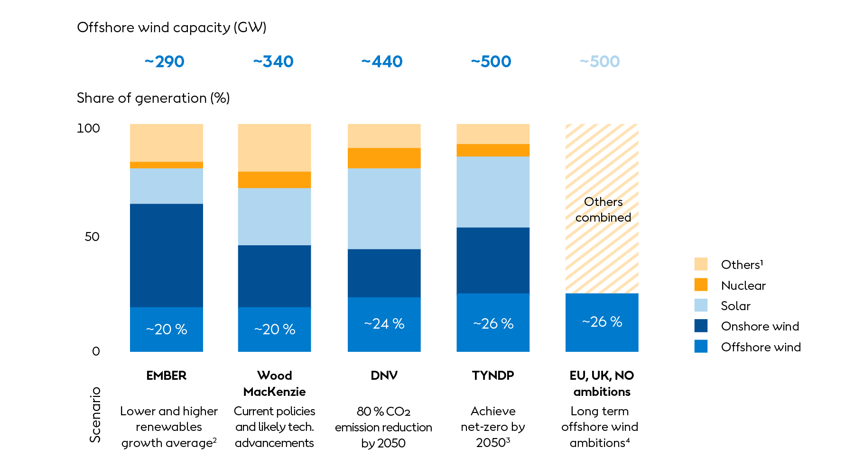
Europe needs offshore wind to ensure a clean, affordable and secure energy system
→
Offshore wind LCoE is highly competitive compared to fossil sources and nuclear
The seasonal generation profile of offshore wind complements PV solar
With a European supply chain, offshore wind is an independent and home-grown industry
In all energy forecasts offshore wind is set to play a pivotal role
→
→
→
Note: Total electricity output per year in TWh across data sources is as follows: EMBER (~6,500 TWh), Wood Mackenzie (~6,300 TWh), DNV (~6,500 TWh), TYNDP (~8,100 TWh), EU, UK, NO ambitions (~8,200 TWh); 1) Includes hydropower, biomass, gas and others; 2) Lower renewables growth based on Alternative Hydrogen Supply and Nuclear Plus scenarios, while higher renewables growth based on Higher Fossil Fuel Prices, Limited New Gas, and No Gas + CCS scenarios; 3) Generation mix from TYNDP in Europe is extrapolated using TYNDP’s projected capacity of various energy sources in Europe vs. EU; 4) Offshore wind capacity ambitions calculated by non-binding goals for the EU (~360GW), estimated UK offshore wind capacity in Future Energy Scenarios pathways to net zero (~100GW) , and communicated Norwegian capacity ambitions (~30GW), converted into the future generation mix
Source: Wood Mackenzie (2024), DNV (2024), TYNDP by ENTSO-E (2024), EMBER (2022), EU Commission, UK National Energy System Operator, Norway-EU Green Alliance, IEA World Energy Outlook (2024): Announced Pledges Scenario

Slide 6
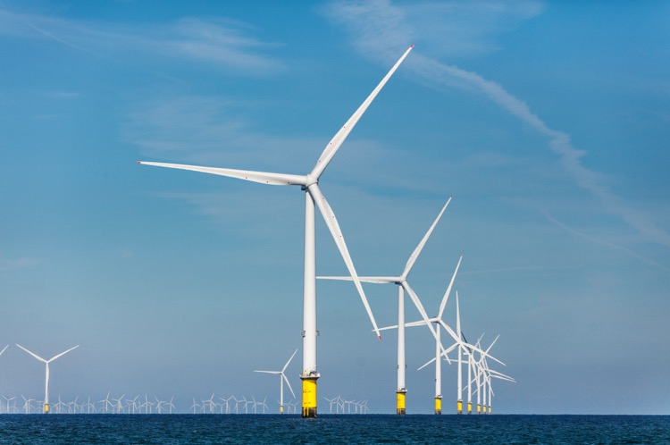
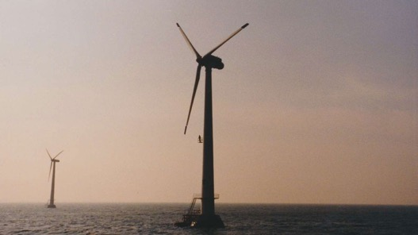
Vindeby Through its 25-year lifetime, Vindeby produced a total of 243 GWh
→
Baltica 2
243 GWh in less than a month
Notes:
SHIFT TO SLIDE WITH COMPARISON OF VINDEBY AND BALTICA 2
Through its 25 years lifetime, Vindeby produced a total of 243 GWh of green energy.
I would like to give you an idea of the progress we have made in the sector since then.
We are currently constructing an offshore wind farm in Poland (Baltica 2), which will be in operation next year. This project will meet the electricity needs of 2.5 million Polish households.
How long do you think it will take for Baltica 2 to produce the same amount of power as Vindeby did in its 25 years lifetime?
[click slide to get the 1 month visual to appear] Less than a month!
This is the power of scale. The power of innovation. And the power of industrialisation based on trust, cooperation and predictability between governments and the industry.
Governments set ambitions and provide the right frameworks. Industry can invest and deliver.

Slide 7
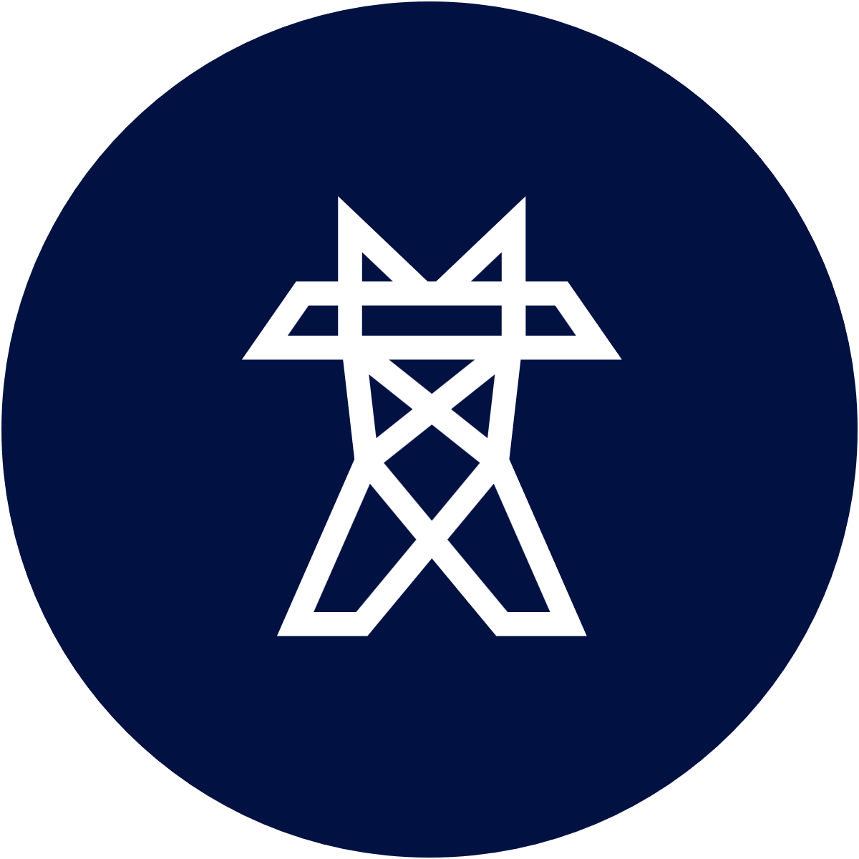

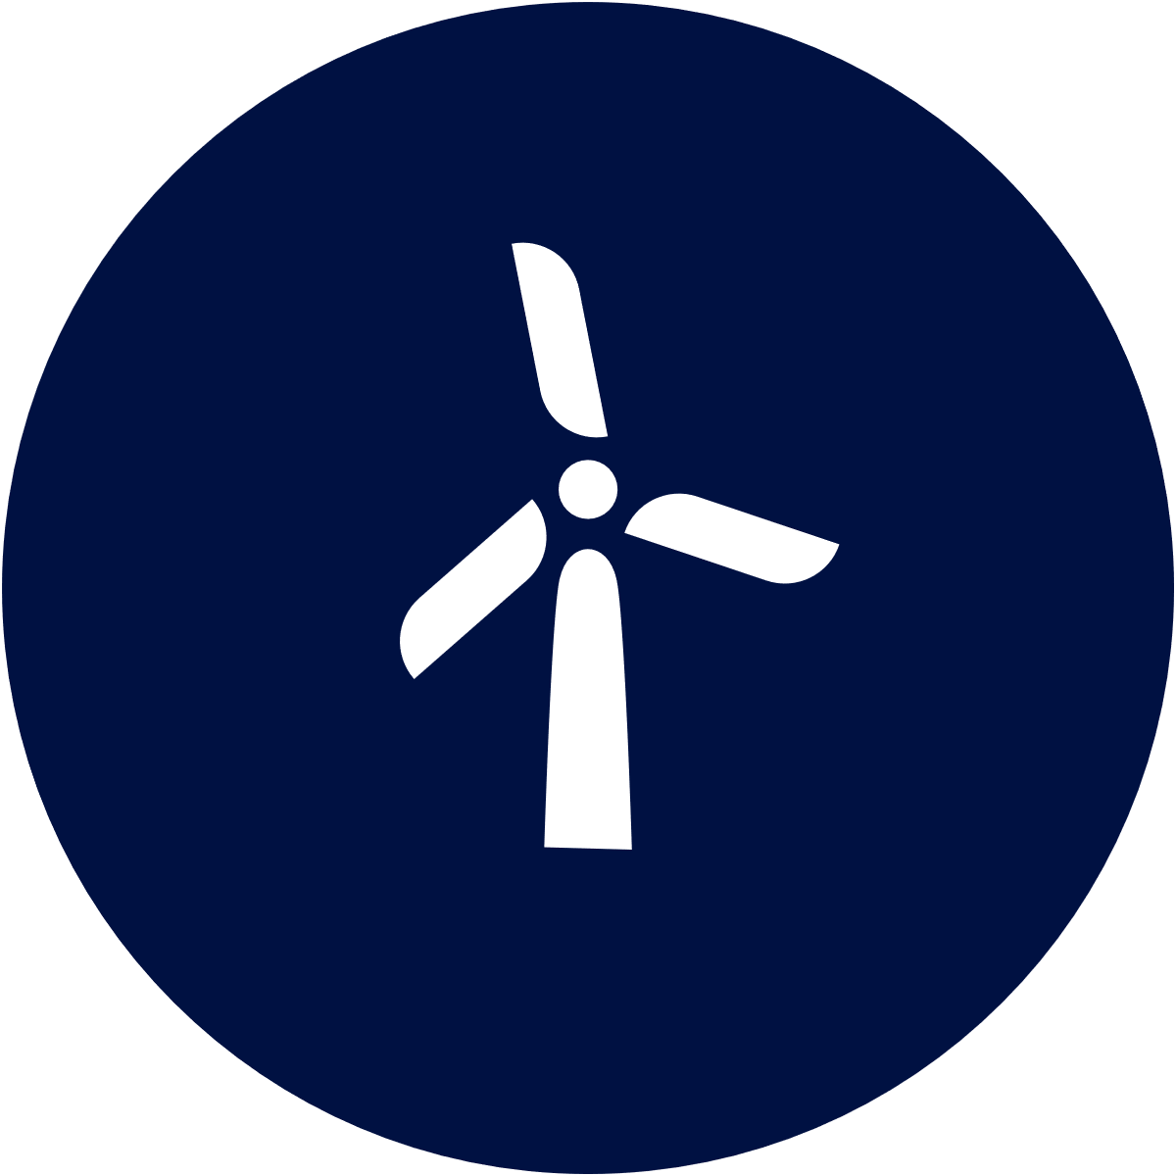
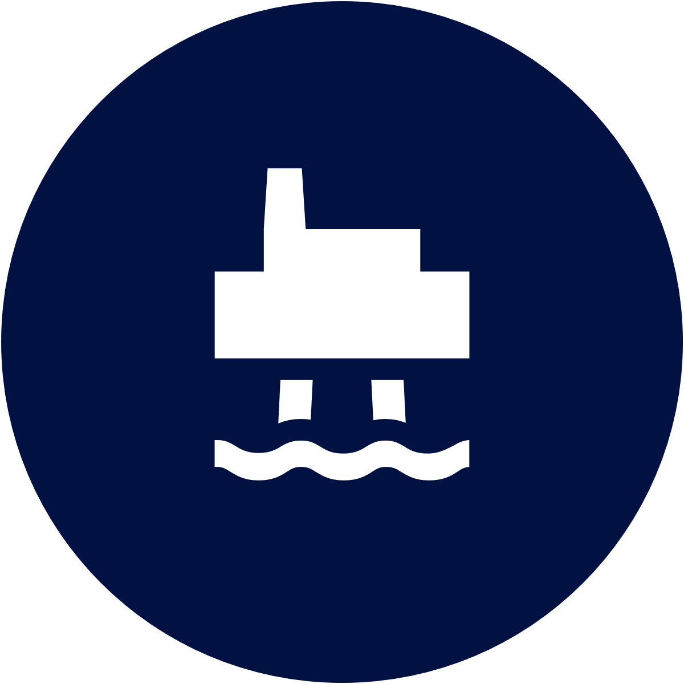
















Recent investments in the European wind industry supply chain
Notes:
SHIFT TO SLIDE ABOUT SUPPLY CHAIN IN EUROPE
Offshore wind projects such as Baltica 2 create value far beyond their host countries.
To deliver these billion-euro infrastructure projects we rely on components and services from a highly specialised supply chain – across Europe and beyond.
When building offshore wind farms, we rely on suppliers from many corners of Europe
Foundations and towers from Poland, Spain, Germany and Portugal
Cables from Italy, Sweden and Greece
Radio equipment from Austria
Generators from the Netherlands and Belgium
These are just examples, and I could go on… But my main point is that even if it may not be obvious, there are probably components being produced in your home countries to serve the offshore wind industry today.
Offshore wind is a European led industry and should remain so. With key technologies, critical components, a skilled workforce, and the ability to scale.
That does not mean doing everything by ourselves in Europe. Offshore wind is European at its heart, but it is also global in its footprint.
With a balanced approach, openness to global supply chains is not a weakness – it is a source of strength. Or in short, Resilience should pursue security – not isolation.
Thanks to Europe’s strong supply chain and political leadership, Ørsted will deepen our focus on the European market in the coming years.

Slide 8

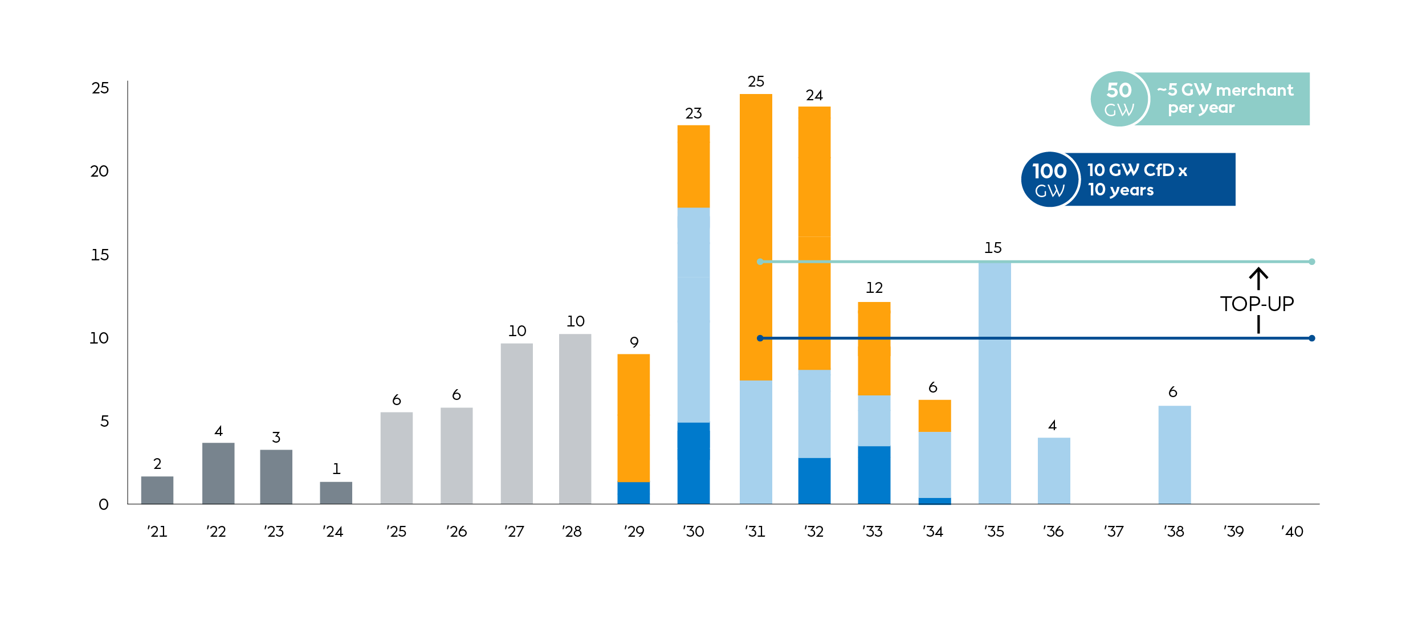
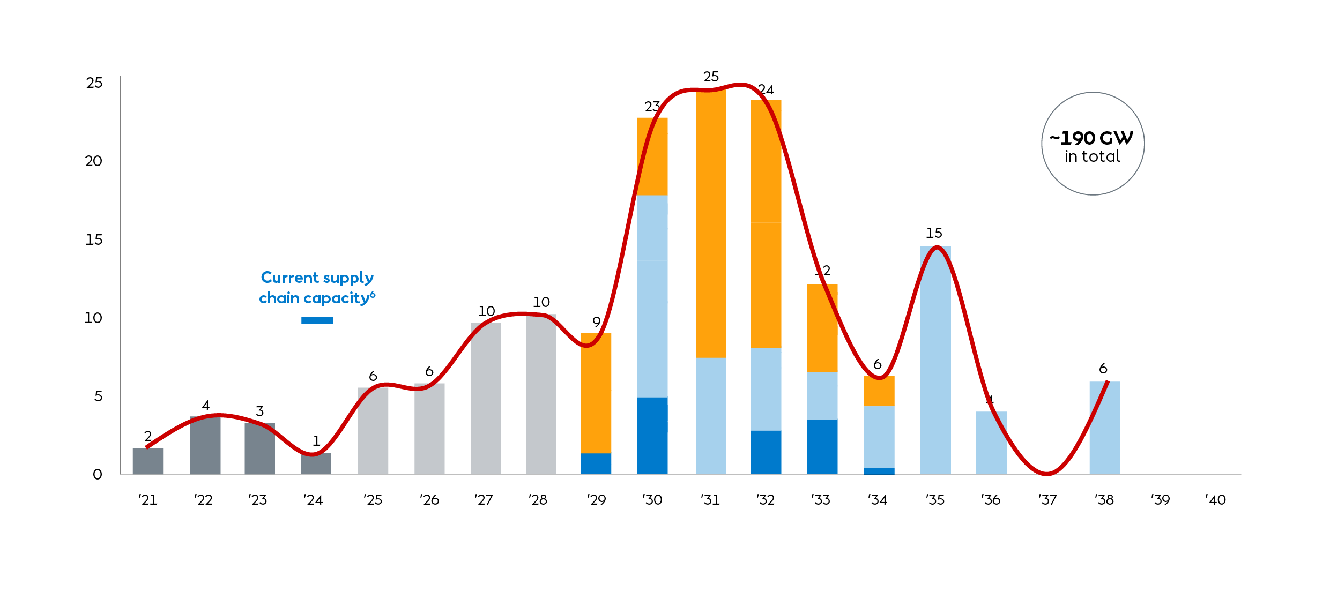
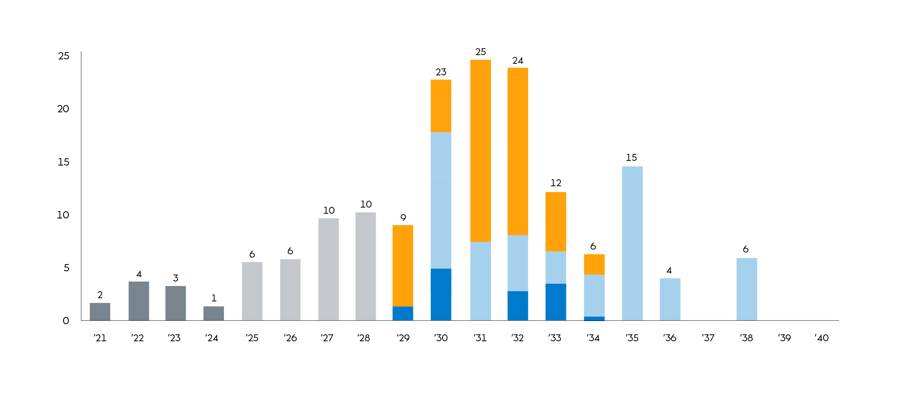
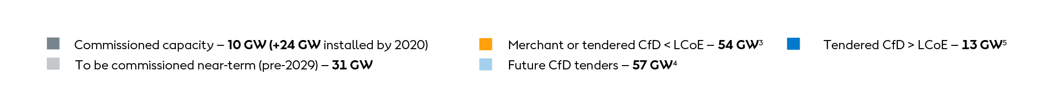
However, the buildout profile post-2030 is uncertain and incohesive
Government communicated European offshore wind commissioned capacity, GW per annum¹
The offshore wind industry doesn’t need higher targets, but more certainty & consistency
Note: 1) Only tenders with an auction year are included, while those without a commissioning year are assumed to be 5 years after tender year; 2) Projects under development and future tender auctions pipeline consists of Germany (34 GW), United Kingdom (28GW), France (19 GW), Poland (18GW), Netherlands (18 GW), Ireland (17 GW), Denmark (7 GW), Italy (4 GW), Belgium (4 GW), Greece (2 GW), Norway (2 GW), Portugal (2 GW), Lithuania (0.7 GW), Estonia (0.5 GW), Malta (0.4 GW); 3) Projects that have, or are expected to have, a merchant revenue mechanism, or already tendered CfD projects whose LCoE is estimated as being at least 5% higher than their respective ceiling prices; 4) Projects that are expected to have a CfD revenue mechanism; 5) Already tendered CfD projects, whose LCoE is estimated as being lower than their respective ceiling prices; 6) Supply chain capacity based on capacity limitation on production of blades and nacelles in Europe, 2024; 7) Uncertain communicated revenue mechanism, classified as merchant; 8) In April 2024, Denmark launched a 6 GW offshore wind tender alongside a planned 3 GW tender for the North Sea Energy Island. The 6 GW tender was later cancelled after the first phase failed to attract bids. A new 2025 tender is estimated to offer 2–3 GW for commissioning in 2032. Bornholm’s 3 GW capacity is estimated to be delayed by a year, while the North Sea Energy Island is presumed to not proceed.
Source: 4C Offshore, WindEurope, government announcements, IEA Renewables 2024, Wood Mackenzie – Europe levelized cost of electricity (LCoE) 2024.

Slide 9
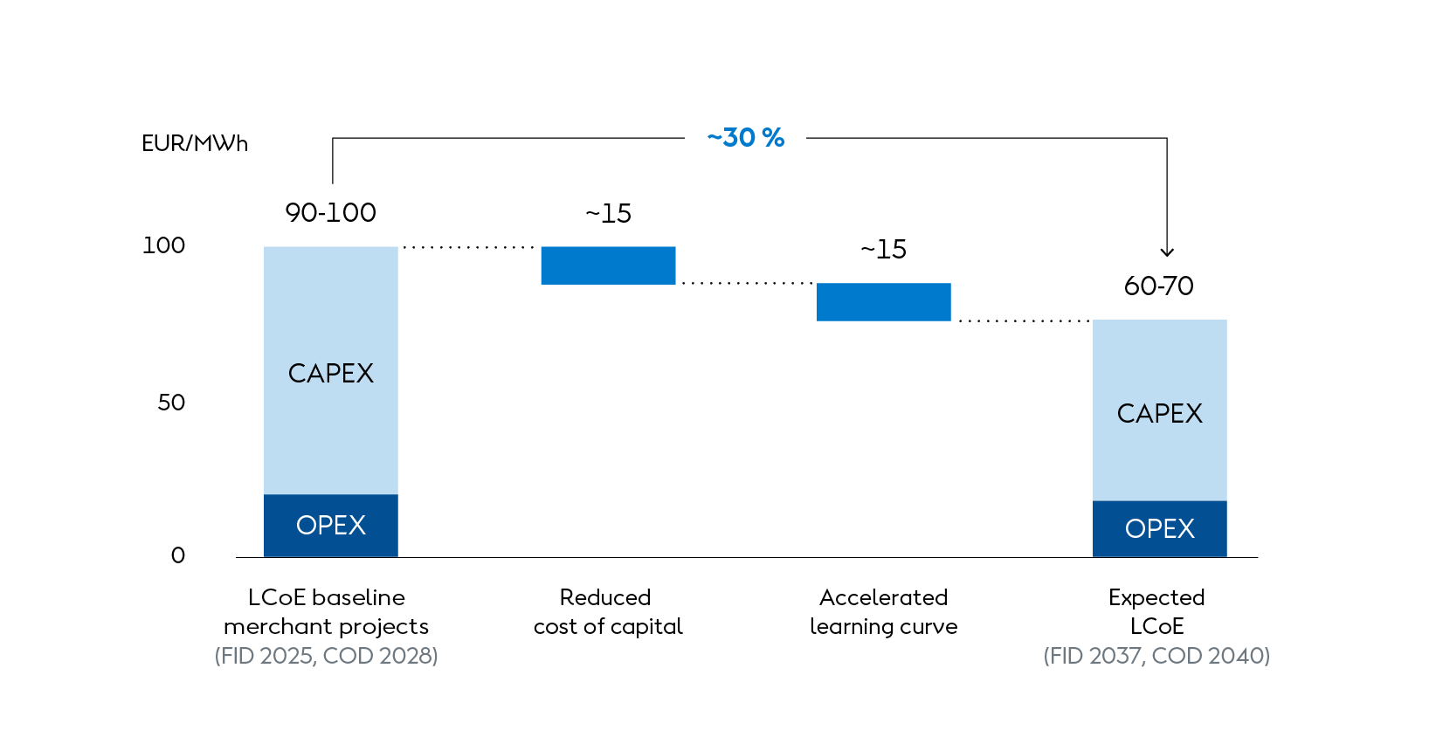
With clearer revenue and capacity certainty, the industry can reduce LCoE by ~30% by 2040
LCoE cost reduction to 2040
Note: Fixed prices based on 2024; LCoE is based on a standard calculation method showing producer’s cost of electricity and does not represent a business case perspective or the strike price level in an auction; Cost baseline estimates based on fully merchant projects in Germany, the UK, the Netherlands, and Denmark, using Wood Mackenzie’s figures for the expected mix of local and foreign inputs, excluding taxes; Impact from learning curve assumed at ~9% learning rate under 400GW buildout by 2050; Impact from CfD based on WACC reduction of ~2pp by applying CfD revenue guarantee for merchant projects; While 2025 baseline utilises merchant only projects, future CfD projects whose viability is uncertain also have elevated cost of capital; Assumed 30 years of wind farm lifetime with 3 years of construction prior to COD with equal split of yearly CapEx outflow; Capacity factor of constant 51% throughout the lifetime
Source: Wood Mackenzie (Europe levelised cost of electricity (LCOE) 2024 data - average sensitivity) for CapEx, OpEx, cost of debt, cost of equity, and capacity factor; Offshore wind
investment banking expert interviews

Slide 10
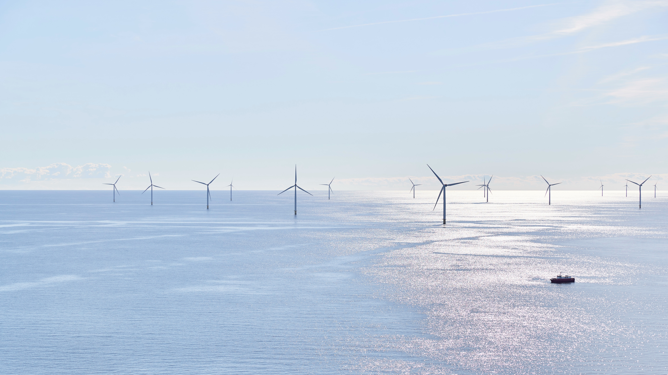

Close collaboration between governments and industry can deliver significant benefits
Governments
Industry
↓
↓
10 GW CfDs x 10 years
Government support and strong European cross-border collaboration to ensure an evenly distributed CfD-backed build-out plan
Capacity certainty
Mobilizing the investments needed to meet the necessary build-out towards 2040
~5 GW top-up per year
Tender merchant projects to promote flexible market-making by developers
~30% LCOE reduction by 2040
By reducing the 1) cost of capital (~15%) and 2) accelerating the industry learning curve (~15%)

Slide 11

Criteria for success
CfD auction pipeline
Electrification push
Grid investments
Notes:
SHIFT TO “CRITERIA OF SUCCESS” SLIDE
To succeed, three things are essential:
Mobilising all clean energy sources
Commit firmly to Contracts for Difference to de-risk projects, as seen in the UK and Poland.
Ensure a stable, coordinated pipeline with commissioning spread across years to prevent bottlenecks and allow supply chains to keep pace.
Massive electrification
Heavy industry cannot decarbonise or shield itself from volatile fossil fuel prices without switching to clean European energy.
This requires Europe to treat electrification as a societal task, not simply a cost borne by manufacturing.
Infrastructure and smart systems
Grid investments and intelligent solutions will be crucial.
With the right approach, offshore wind costs can fall by 30% over the next 10–15 years.
I am absolutely convinced that offshore wind in Europe will find its new equilibrium.
In Europe, we have some of the best seabeds, highest windspeeds, an advanced supply chain, and a deeply rooted understanding of the benefits from offshore wind.
So, we have a lot to do

Slide 12
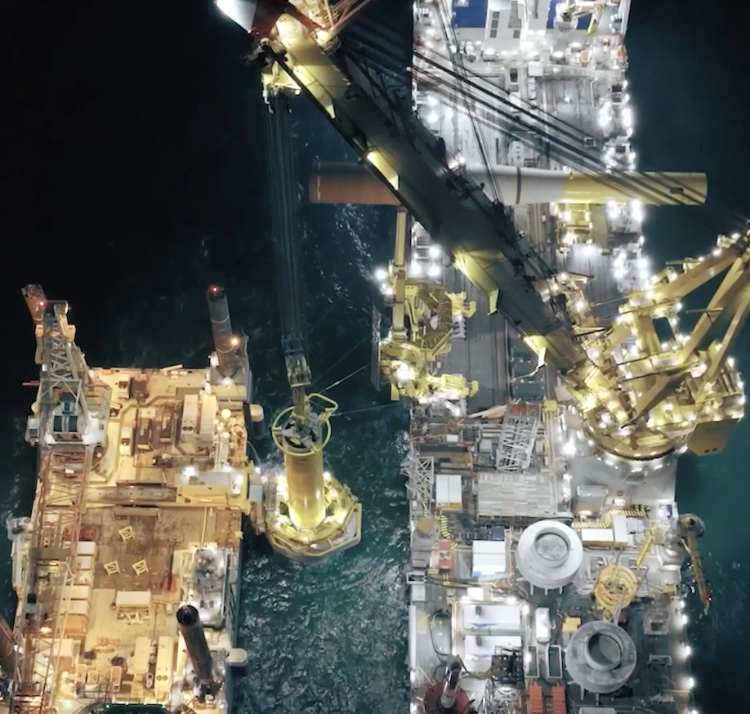
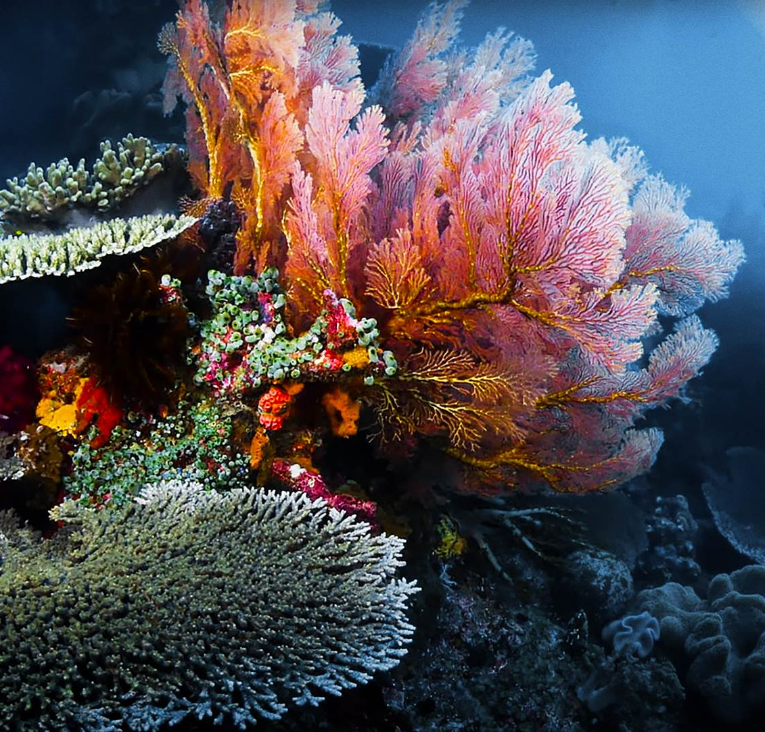
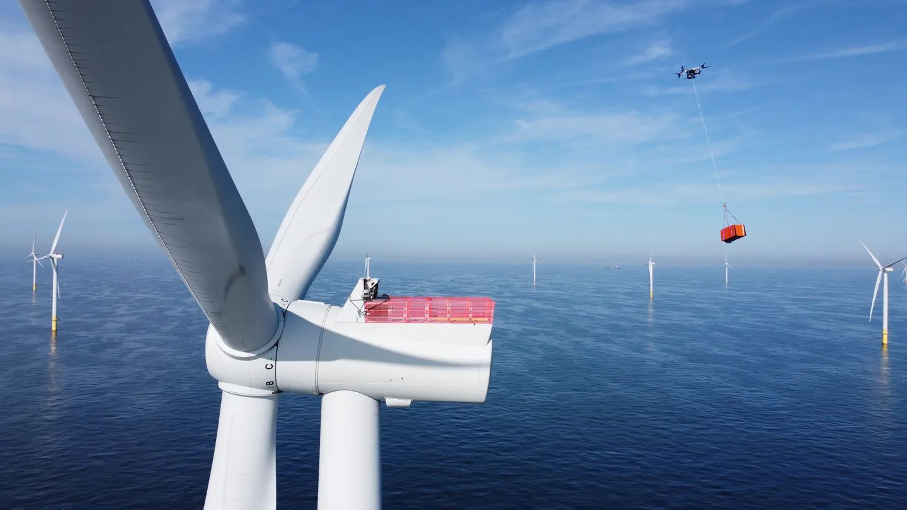
New advances in offshore wind
Low-noise installation
Bio-reefs
Heavy lift drones

