Slide 1
The experience of local authorities
David Matuška, Energy Platform of the Regions of the Czech Republic
EUFORES, Denmark, 18.10.2025

Slide 2
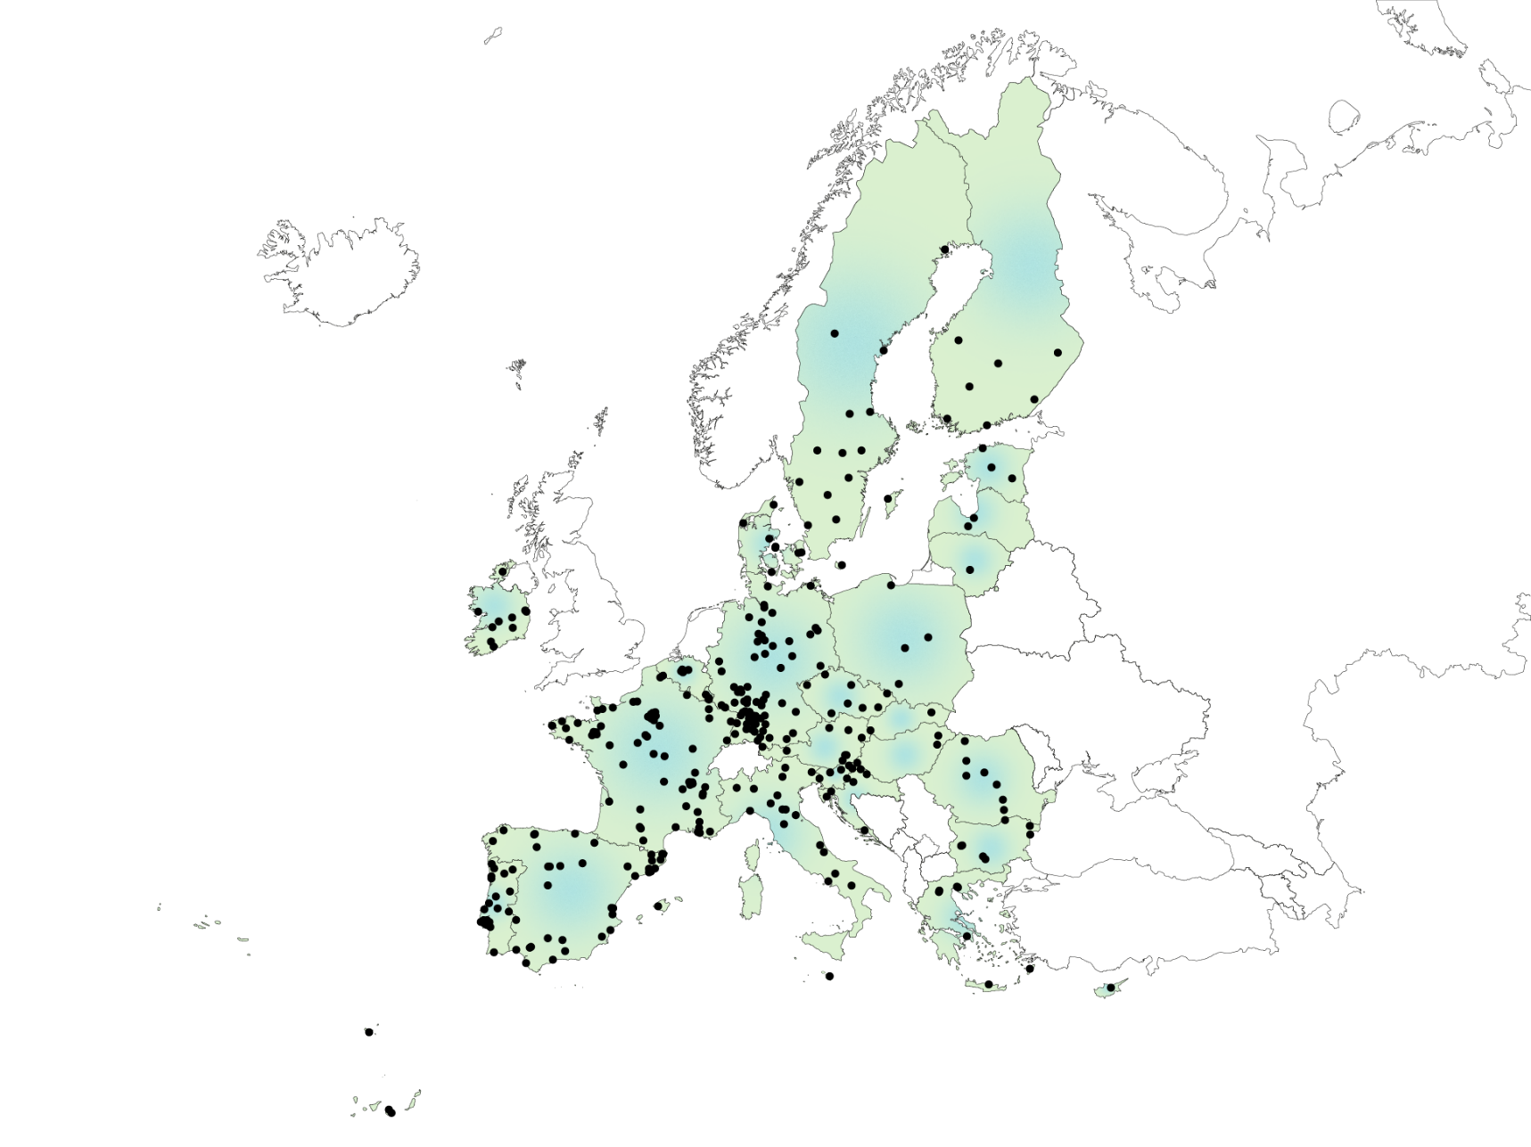
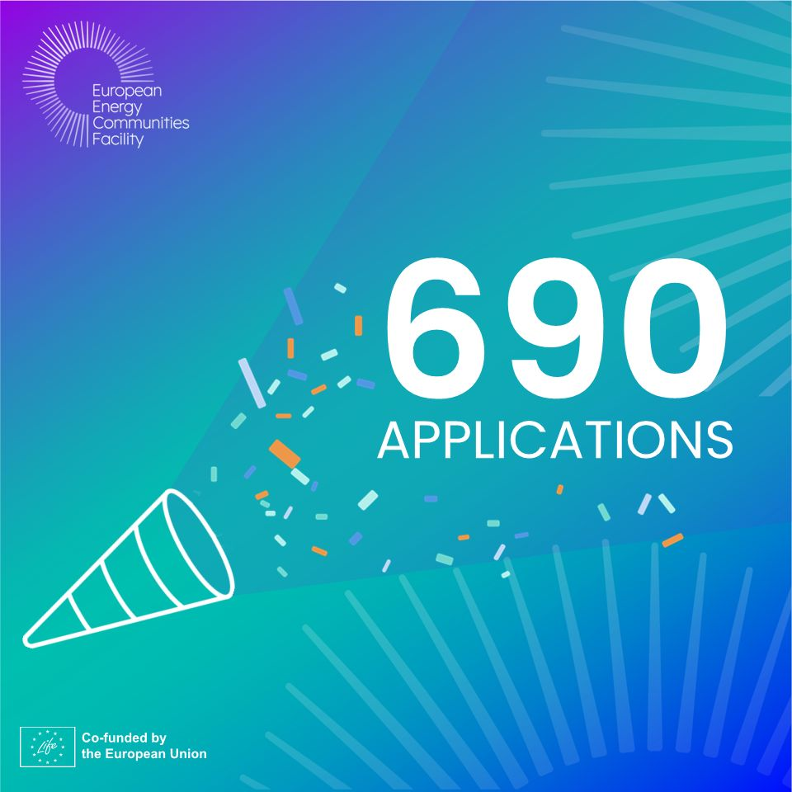

Regional Energy Agencies: Key supporters of a Citizen focused Energy Transition
energy poverty governance
the establishment of energy agency-led OSS
guidance and capacity building for all banks ​
supporting grid access for RECs
capacity-building to improve the digital capacities of REA/LEA
(Regional and Local Energy Agencies)
guidance on energy sharing
to unlock the full potential of H&C in RECs ​

Slide 3
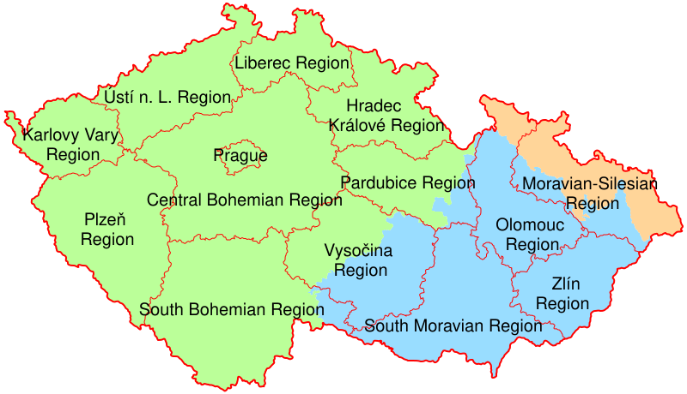
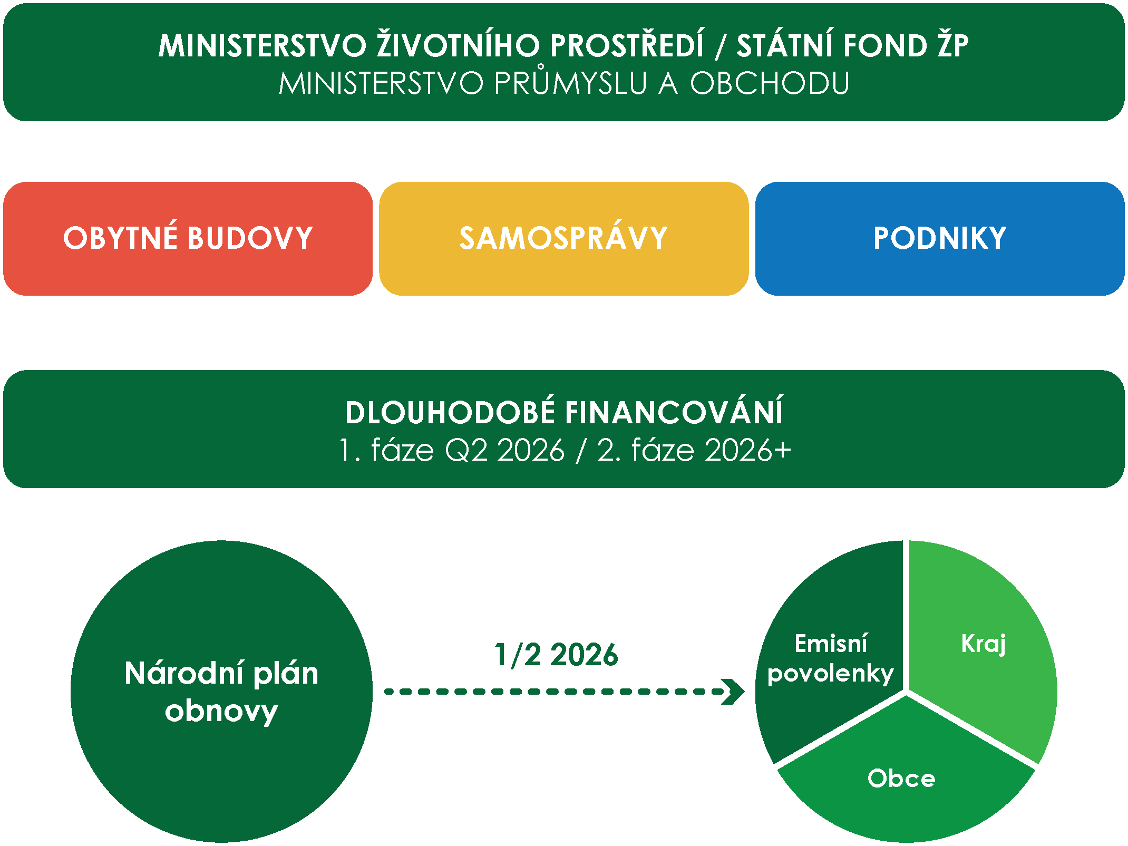
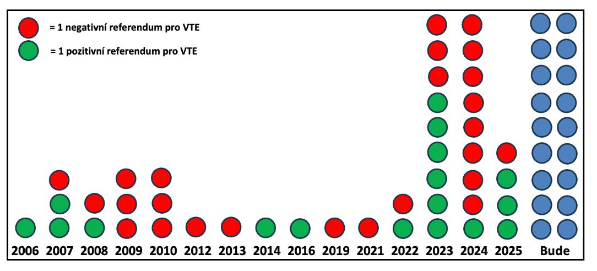
Czech view
10 900 555 inhabitants
6 258 municipalities
205 counties
14 regions
Renovation of builduings
Solar boom - potential up to 27% of consumption
Wind Energy Potential in the Czech Republic
- up to 28% of consumption
- acceleration zones
- 54 referendums (40% positive)
Energy communities (62 registered - 30.9.2025)
National Recovery Plan (RRF)

Slide 4
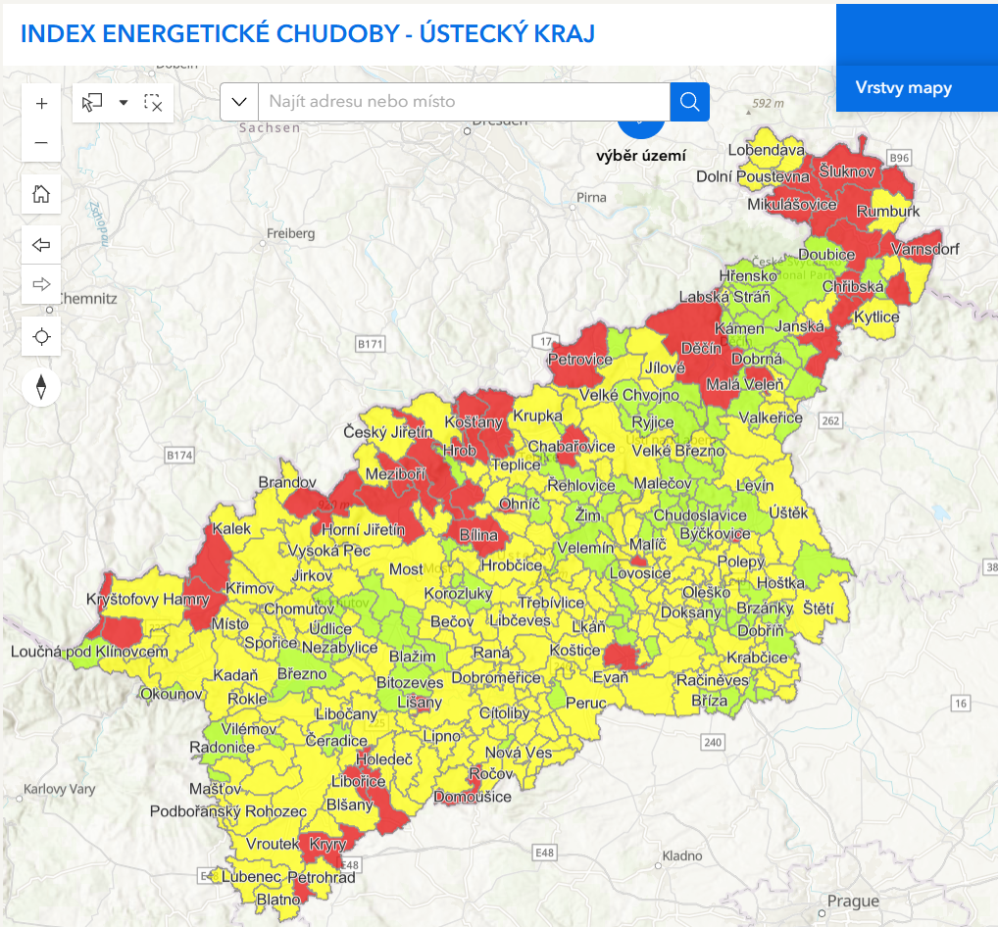
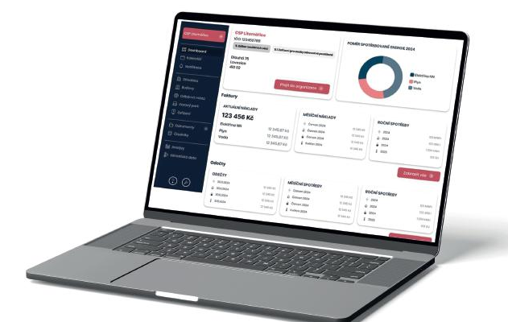

Usti Region
Just transition region
(project Transformation Center of the Usti Region, 2023-2027)
Network of public Energy experts
Consultations (320/354 municipalities)
KEM - Energy Management System (48/354 municipalities)
Renewable Energy Sources Screening (168/400 locations) https://screening.ecuk.cz
Financial model consultancy
Energy Communities
(18 municipalities, 3 energy communities)
Edification of stakeholders (workshops…)
820k
inhabitants
354
municipalities

Slide 5
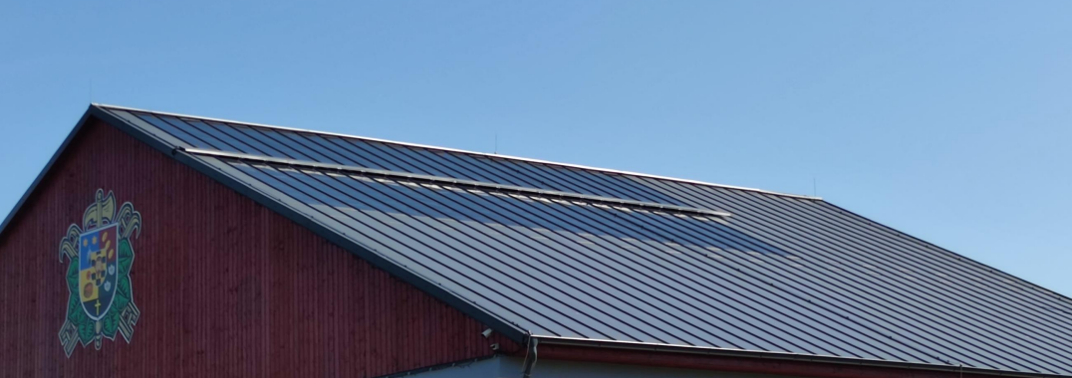
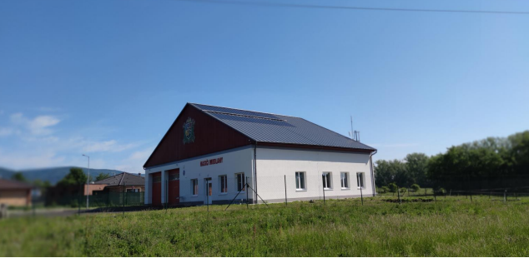
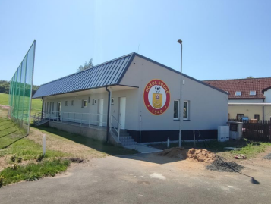
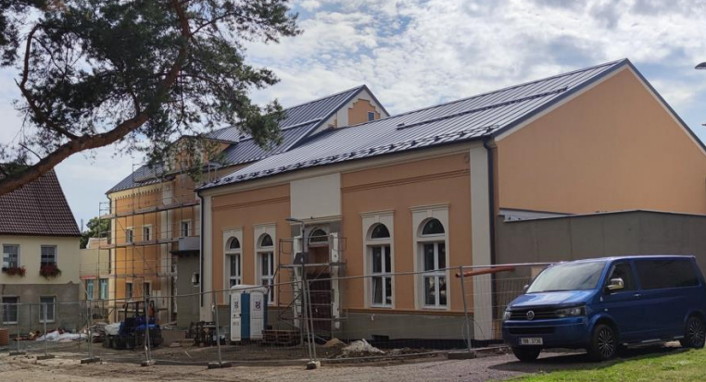
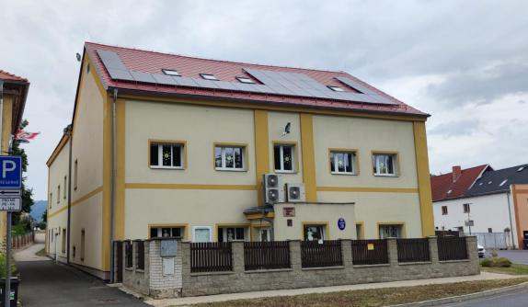
Example from Czech Republic
Fire station - 5 kWp + battery (Lindab Solar Roof 2.0) – „public lighting“
Sports building - 5 kWp + battery „island“
Kindergarten – heat pump + 10 kWp (+ recovery)
Cultural center (former cinema) - 37,3 kWp – deep renovation
Energy community „active client“– several groups (50 places of consumption)

Slide 6
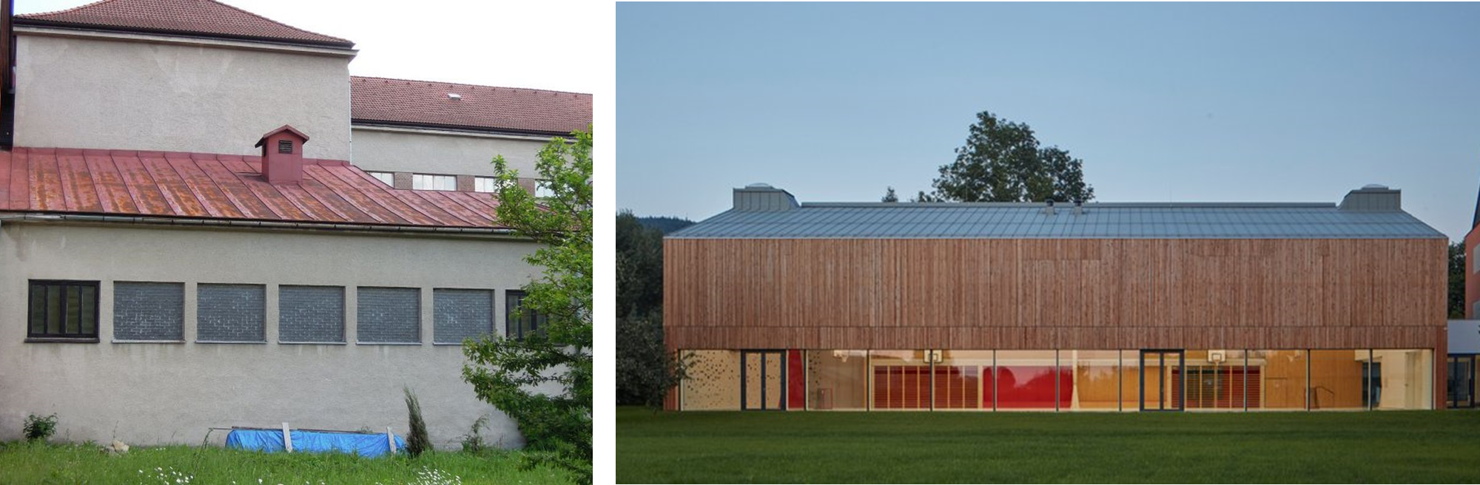
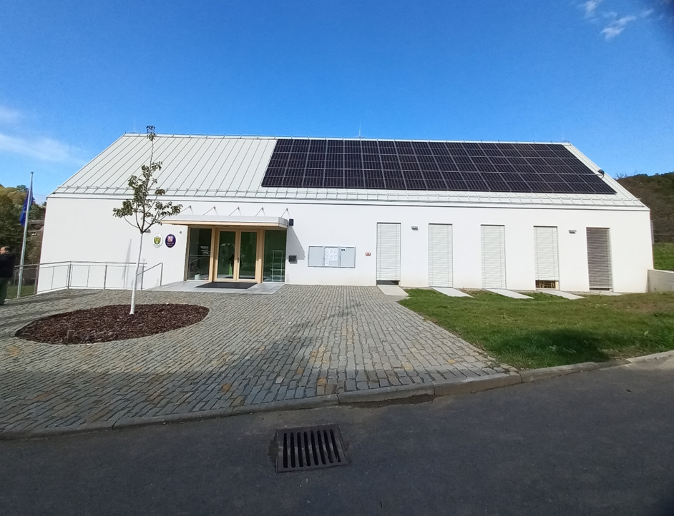
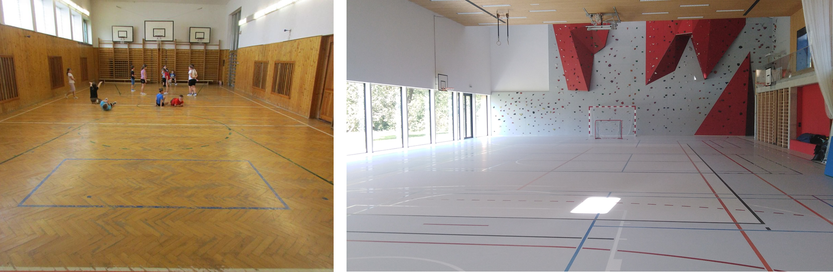
Example from Czech Republic
Zero energy building

Slide 7
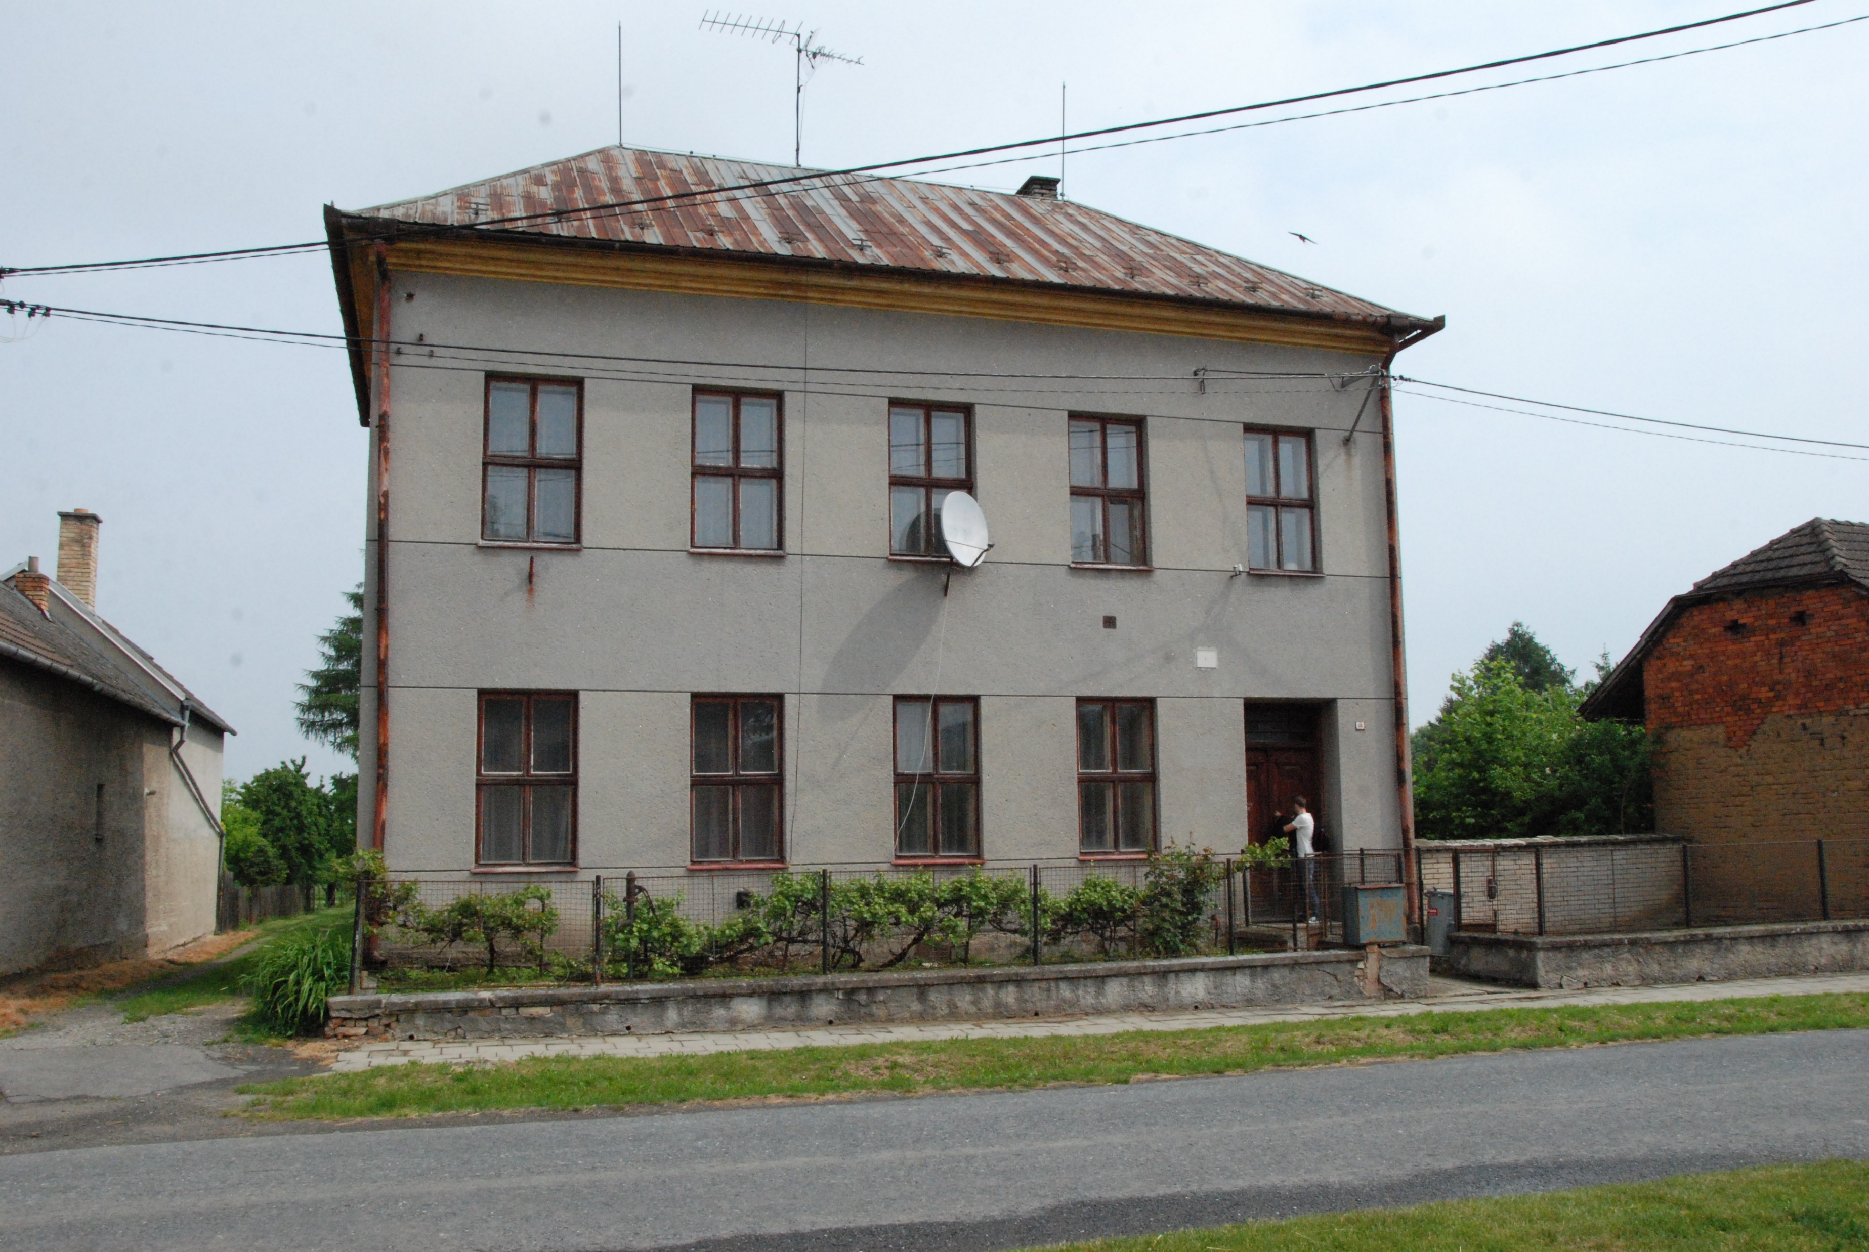
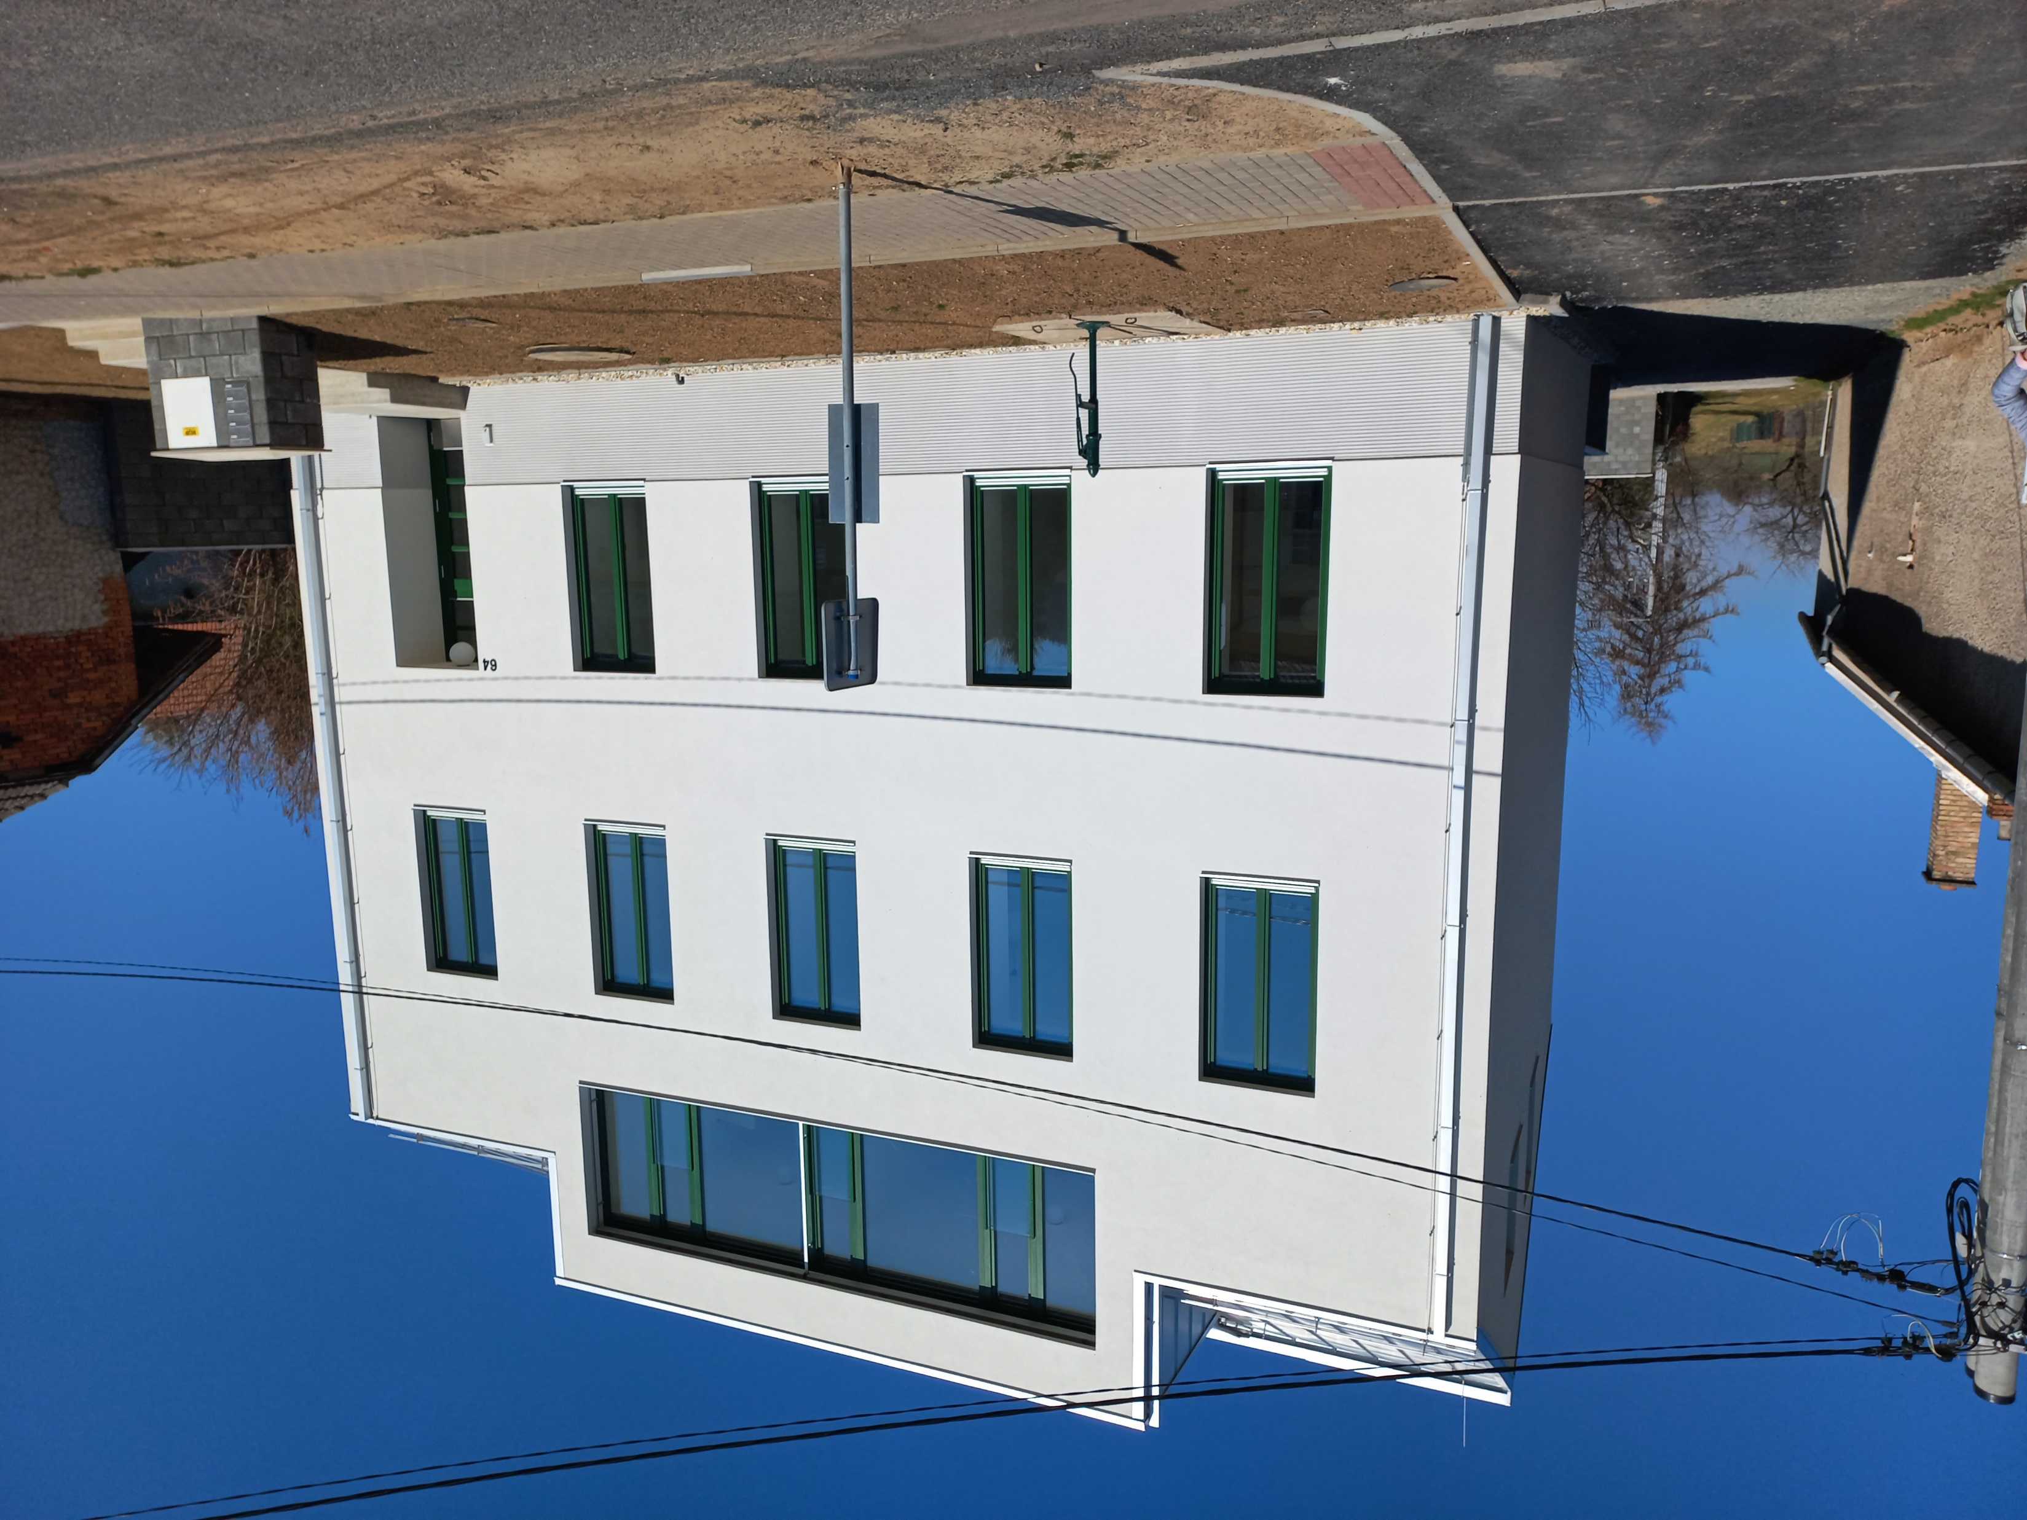
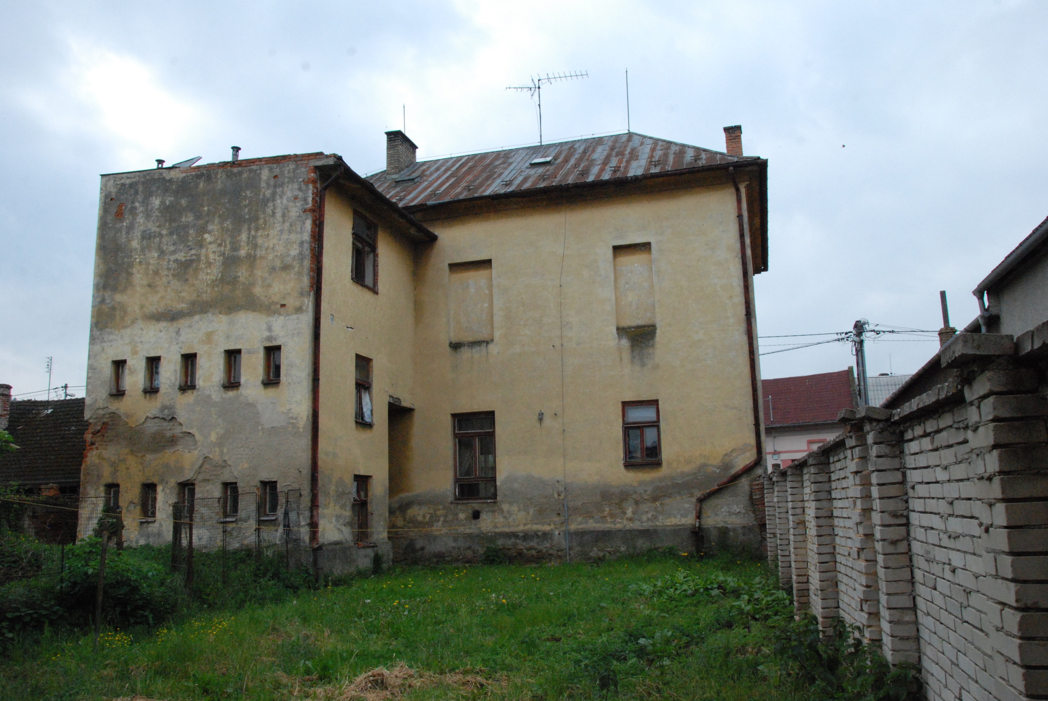
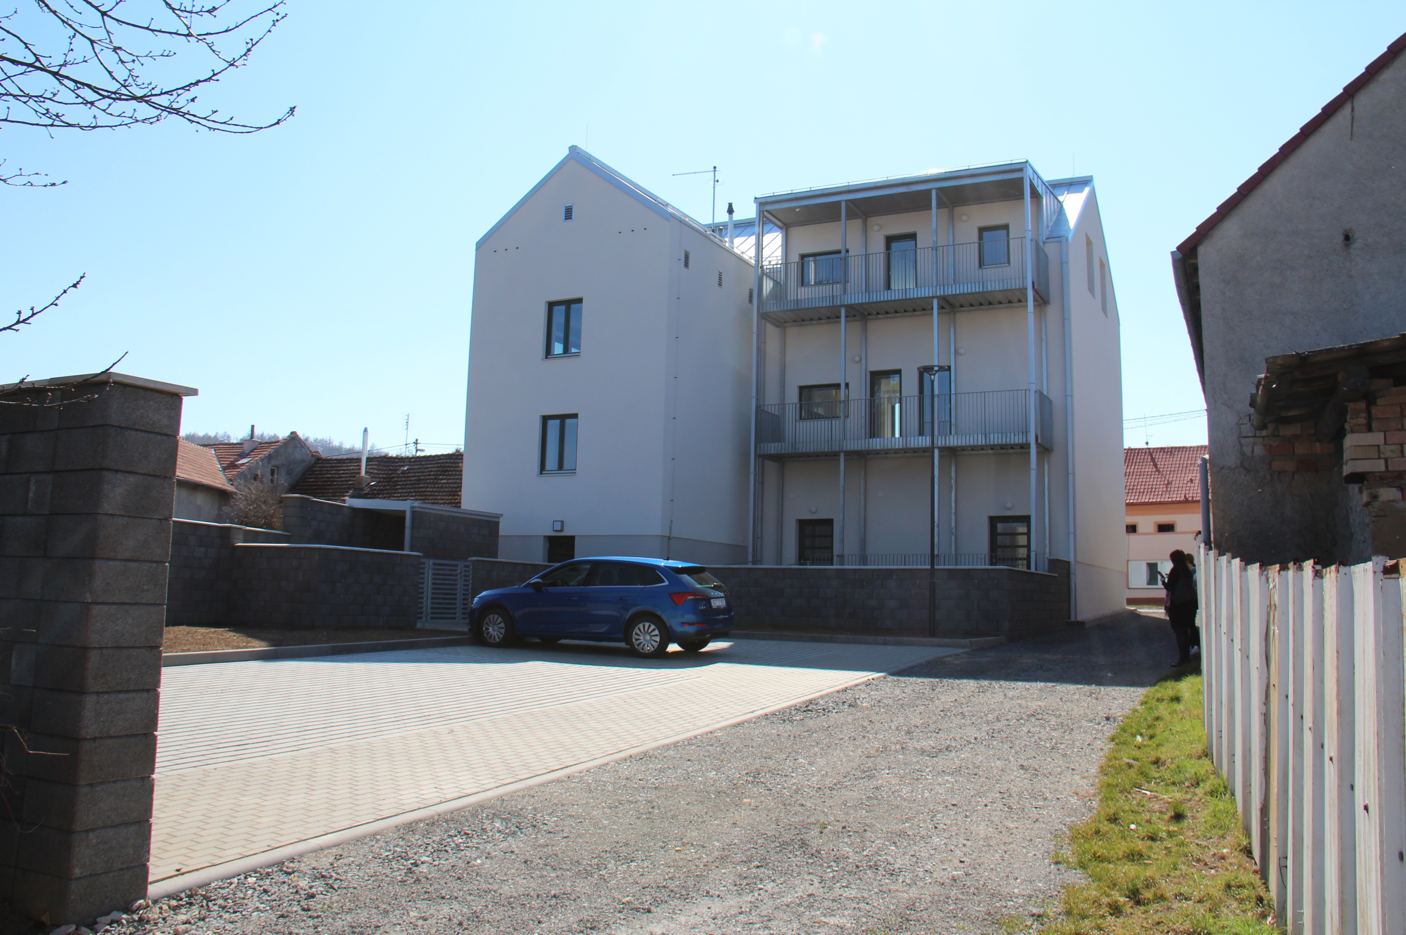
Example from Czech Republic
Social housing

Slide 8
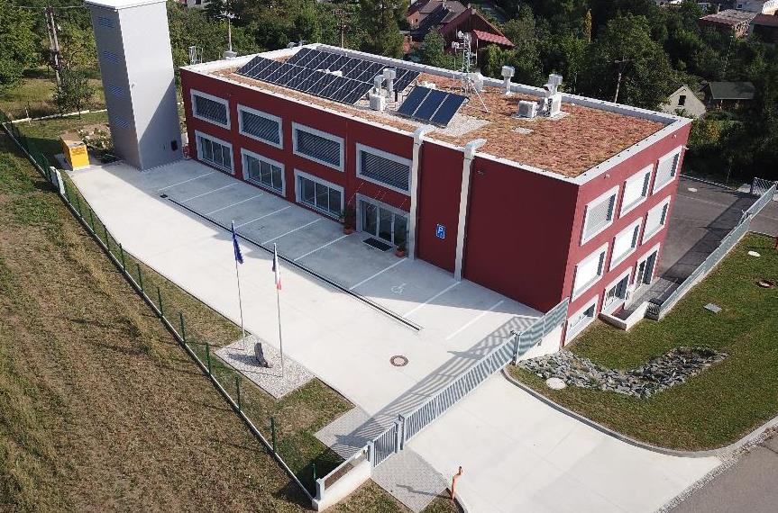
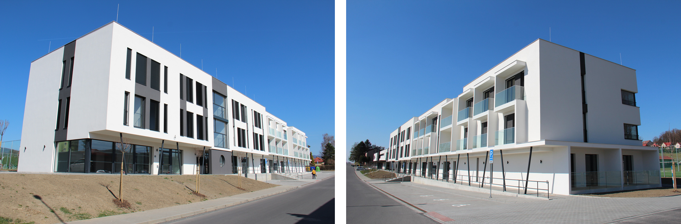
Example from Czech Republic
Fire station
Nursing home

Slide 9
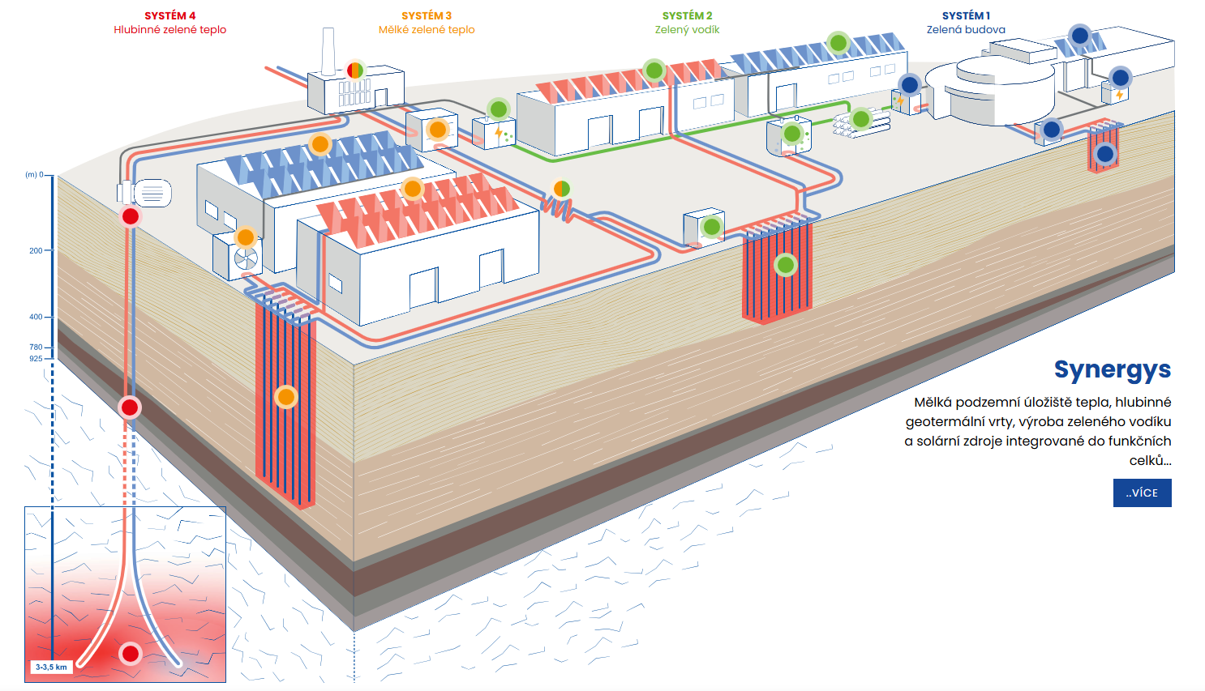
Example from Czech Republic
green hydrogen
shallow geothermal
deep geothermal

Slide 10
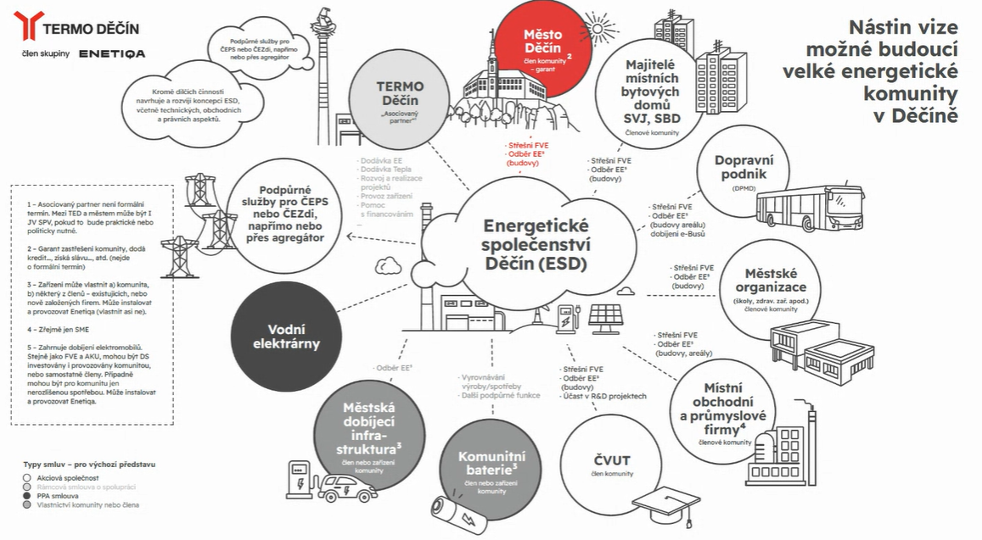
Example from Czech Republic
City Děčín
citizens
geothermal
Public transport trolley buses
Communal buildings - schools
hydroelectric power station
local industry
EV Infrastructure
Battery storage system
University

Slide 11

Thank you
David Matuška
Energy Platform of the Regions of the Czech Republic

