Slide 1

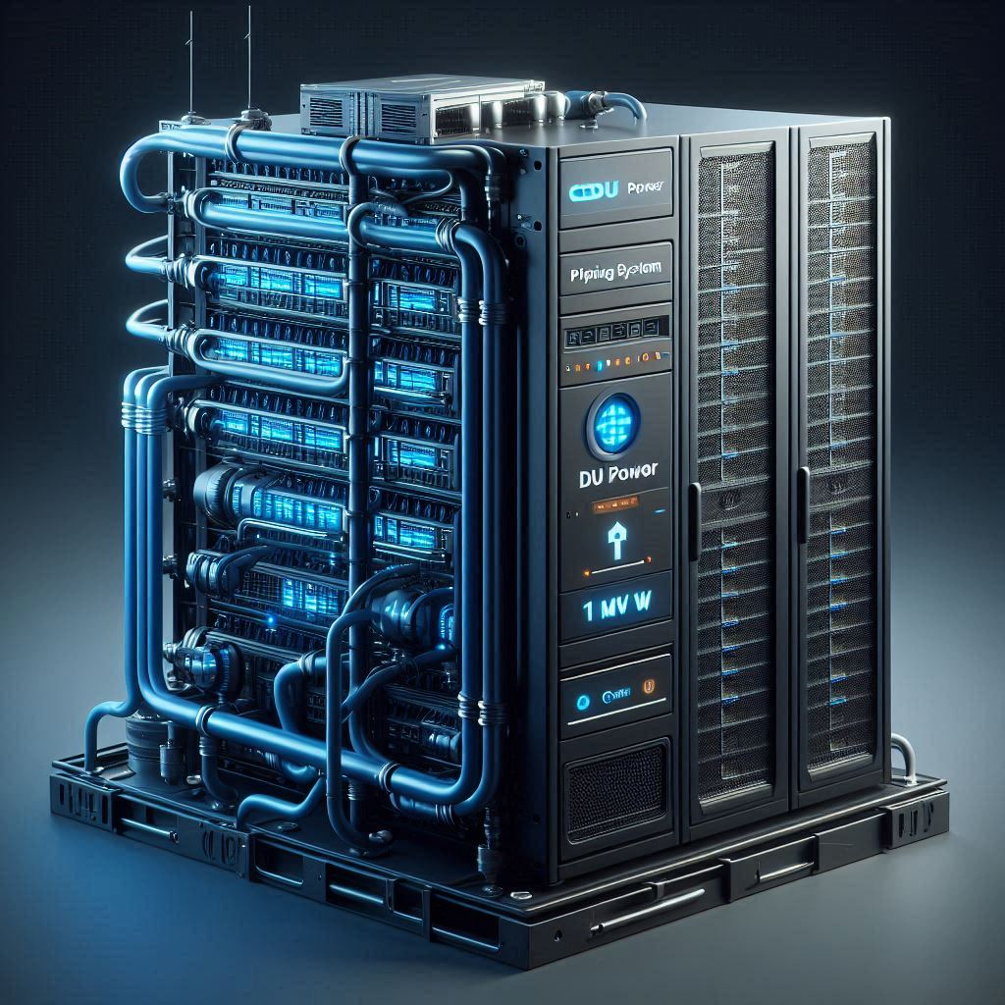
The impact of AI on the energy system
What is going on and why?
And what do we need to do?
Tor Björn Minde
RISE – Research Institutes of Sweden
IPM25, October 18th, 2025
Notes:
The impact of AI on the energy system
What is going on and why? And what do we need to do?
Tor Björn Minde, Director RISE Ice Data center, adj Professor LTU.
2025-10-18
By Tor Björn Minde, RISE, 2025
The impact of AI on the energy system

Slide 2


Comic strip about energy & AI data centers
...and not only does AI steal, pollute the environment and hallucinates inaccuracies
then they don't have to learn, think, formulate, process knowledge...
but with the energy you generate now, you can run a couple of AI data centers
although teachers can use it to correct texts too!
Yes?
but it's clear, the whole point of going to school is to get grades.
students use it to cheat
logo
Notes:
Message: The impact of data centres is visible by the general public now. It is even coming into the minds of comic strip makers.
It will be important that the discussion is based on facts since we rely on data centers for our daily life and the society would stop if they are turned off.
2025-10-18
By Tor Björn Minde, RISE, 2025
The impact of AI on the energy system

Slide 3










A full-scale research datacenter and test environment with the objective to increase knowledge and strengthen the global AI & Data Center ecosystems
RISE ICE Data Center
30+ projects, from the ground to the cloud
20+ employees
4+ MEUR turnover
Established 2016
100+ project partners
Partners: Ericsson, ABB, Vattenfall, Meta, LTU, Region North, Vertiv, BP Castrol, Alfa Laval, Grundfos, Google, Intel, Telia, Submer
2018 - 2022
2017, 2019
2023
2016, 2017
EARTO Innovation
Awards 2022
Holistic Cooling
logo
Notes:
Message: RISE ICE Data center is the leading data center research team in Europe. With a team of 100+ years of experience and 1500 sqm €20M lab facility up to 2,5 MW power and with 10+ test rigs for all things data center for example compute rooms, wind tunnels, climate chambers, liquid cooling testbeds and edge and smart grid testbed.
2025-10-18
By Tor Björn Minde, RISE, 2025
The impact of AI on the energy system

Slide 4









Digital infrastructure – including data centers
– is the foundation for AI
Applications on devices
Digital tools like IoT, AI & data
IoT
Digital Infrastructures - mobile networks, internet, and datacenters
logo
Notes:
Message: The digital infrastructure is the foundation for all ICT applications. All devices and
applications connect and communicate over the internet and are connected to data centers.
We are connected to a minimum of 40 data centers a day. Many new devices and AI applications demand more energy.
ICT= Information and Communication Technologies
2025-10-18
By Tor Björn Minde, RISE, 2025
The impact of AI on the energy system

Slide 5
Data centers vs connectivity investment sizes
Investment size
per year
Omdia
Prediction
1000 B$
AI use growth
750 B$
x2 → Data center > Mobile & Internet
Mobile & Internet
connectivity
500 B$
GSMA
Prediction
250 B$
Data centers
2015
2020
2025
2030
2040
logo
Source: Omdia Analyst Summit 2025 and Mobile Infrastructure Investment Landscape, GSMA, 2025
Notes:
Message: The data center industry is already larger than the combined mobile and internet industries, and within five years, annual investments in data centers are expected to double —driven by the rapid growth in AI demand.
2025-10-18
By Tor Björn Minde, RISE, 2025
The impact of AI on the energy system

Slide 6
Data centers vs Office construction investment sizes
Investment size
per year
80B$
Office construction USA
60 B$
→
Data center = Office construction
40 B$
AI use growth
20 B$
Data centers USA
2016
2018
2020
2022
2024
2026
logo
Source: US Census Bureau, 2025
Notes:
Message: The data center industry is as larger as the office construction industry in the USA, and within five years, data centers are expected to be double the size — driven by the rapid growth in AI demand.
2025-10-18
By Tor Björn Minde, RISE, 2025
The impact of AI on the energy system

Slide 7



Data centers in energy terms
0.03% of input power is in the data stream.
01100011101001101011
Electricity
Excess Heat
99.97% of input power is in the thermal stream.
logo
Based on: Rolf Landauer, “Irreversibility and Heat Generation in the Computing Process,” IBM J Res. Dev. 5, 183 (1961).
Notes:
Message: The CMOS technology that is the foundation for all ICT development (computers, phones, internet etc) is not efficient. Most of the electricity becomes heat.
CMOS is Complementary Metal-Oxide-Semiconductor used in integrated circuits such as micro processors like CPU, GPU, TPU.
CPU is Central Processing Unit
GPU is Graphical Processing Unit
TPU is Tensor Processing Unit
2025-10-18
By Tor Björn Minde, RISE, 2025
The impact of AI on the energy system

Slide 8
Where do the energy go? 99,97% becomes heat
(illustration)
Data Processing
(IT Software and hardware)
80-90%
Facility
(cooling, power distribution, lights)
10-20%
logo
Notes:
Message: Most of the energy in a energy efficient data center PUE=1,1-1,2 goes to the IT equipment and is transformed into heat. The losses in the facility is mostly in fans and pumps.
PUE= Power Usage Effectiveness. Measure how effective the use of power is in the facility infrastructure. It measure the energy overhead by the facility.
By Tor Björn Minde, RISE, 2025
The impact of AI on the energy system

Slide 9
Global electricity demand in data centers
Electricity
Transport
3000 TWh
Solar
2000 TWh
IEA prediction
AI use growth
1500 TWh
Flat due to Cloud
resource optimization
1000 TWh
X2 in five years
500 TWh
Germany
500 TWh
Sweden
150 TWh
2000
2010
2020
Now
2030
2040
logo
Sources: Electricity 2024 Global trends- Analysis and forecast to 2026, IEA 2024 - EPRI, Powering Intelligence, White Paper, May 2024 - Global Data Center Demand Forecast (McKinsey), 2024
Notes:
Message: A balanced projection by IEA suggests that global electricity use driven by AI demand will double within five years and triple within ten. By 2030, this increase could equal twice the current electricity usage of Germany.
The growing size of AI models and datasets is driving the increasing demand for computational performance. Today’s leading models are trained with 10 to 100 trillion parameters or data tokens.
2025-10-18
By Tor Björn Minde, RISE, 2025
The impact of AI on the energy system

Slide 10
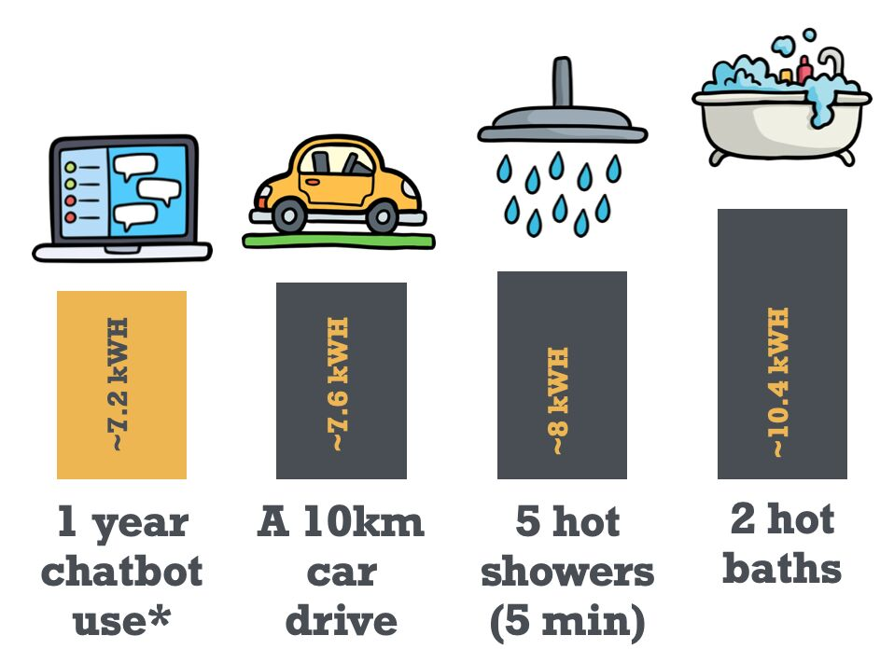
Electricity use in comparison
logo
Sources: https://engineeringprompts.substack.com/p/ai-energy-use
Notes:
Message: A bit old comparison. The processors have improved as well as the algorithms but at the same time the model sizes and compute cycles have increased.
It shows the use (inference) of the AI models is about the same size of energy use as other real-life activities.
2025-10-18
By Tor Björn Minde, RISE, 2025
The impact of AI on the energy system

Slide 11
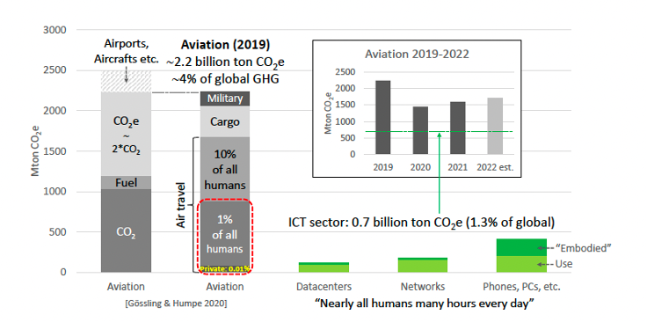
Comparing the aviation industry with the ICT industry
The energy use in data centers is around 1−2% of the global electricity use
and far below dramatic numbers shown in media.
logo
Source: Comparing aviation with ICT (Malmodin, 2022).
Notes:
Message: This is a myth buster from Ericsson. ICT as a whole has an environmental load as half of the environmental load of the aviation industry. Data centers is about a 1/10 of the total environmental load of ICT.
ICT that is fundamental for all of the population on the planet has same environmental load as 1% of the world population has using aviation.
2025-10-18
By Tor Björn Minde, RISE, 2025
The impact of AI on the energy system

Slide 12
Development of compute performance in Nvidia GPUs
Peta
FLOPS
Training
time (days)
33 days
15000
16000
30
12000
Training time GPT4
20
Processing FP4
Less training time
and energy use
8000
x2000 →
10
7 days
3600
4000
1100
8
40
9 hours
5 hours
1,5 hours
2023
2024
2025
2026
2027
logo
Sources: GTC 2025 Keynote, Jensen Huang, Founder and CEO, NVIDIA, 2025
Notes:
Message: Although compute hardware performance has improved significantly—reducing processing time and energy use—it still can't keep pace with the rapidly growing demand of AI compute
The widening gap between AI compute demand and the pace of hardware performance. improvements is a key driver behind rising energy use and the surge in data center investments.
2025-10-18
By Tor Björn Minde, RISE, 2025
The impact of AI on the energy system

Slide 13
Development of power in Nvidia GPUs
Power
per GPU
2500 W
2000 W
x4 → Higher transistor density
1500 W
1000 W
2023
2024
2025
2026
2027
logo
Sources: GTC 2025 Keynote, Jensen Huang, Founder and CEO, NVIDIA, 2025
Notes:
Message: To meet the growing demands for performance and data processing, micro-processors require higher transistor densities and an increased number of transistors—both of which contribute to greater power use per chip.
2025-10-18
By Tor Björn Minde, RISE, 2025
The impact of AI on the energy system

Slide 14
CPU/GPU heat flux (power per area)
Heatflux
W/m²
Sun’s surface
10⁷
Nuclear blast
10⁶
x10 → Higher heatflux
10⁵
Rocket motor
10⁴
2023
2024
2025
2026
2027
logo
Sources: Oktay, Sevgin, Robert Hannemann, and Avram Bar-Cohen. "High heat from a small package." Mech. Eng.;(United States) 108, no. 3 (1986).
Notes:
Message: The increasing transistor density in next-generation microprocessors leads to extreme heat flux levels—potentially exceeding those found on the surface of a nuclear explosion— posing significant challenges for cooling and thermal management.
2025-10-18
By Tor Björn Minde, RISE, 2025
The impact of AI on the energy system

Slide 15

Simplified infrastructure
100 MW Air cooled DC
Cooling
tower
Heat
re-use
Sub station
Switch gear
Chiller
IT
AHU
1 GW Liquid cooled DC
Cooling
tower
Heat
re-use
Sub station
Switch gear
Chiller
PDU
IT
CDU
AHU
logo
Notes:
Message: A very simplified drawing of the infrastructure needed for a liquid cooled power-dense AI datacenters shows that is a bit larger in size but for at least 10-fold more IT capacity. The facility hardware need to operate at higher voltage 800 VDC, need liquid cooling and more power distribution equipment. The requirement to place many GPUs in close proximity drives higher micro-processor density within individual servers and racks, leading to more compact and power-intensive data center designs.
Important is that liquid cooling is glycole, hydro-carbons or esters as liquids in closed loops. Water is only used in the cooling towers and humidifiers. If free air cooling is used in norther Europe the energy efficiency is better (lower PUE). The chillers can be removed and heat pumps make no sense but the ERE, Energy Reuse Effectiveness is worse.
2025-10-18
By Tor Björn Minde, RISE, 2025
The impact of AI on the energy system

Slide 16
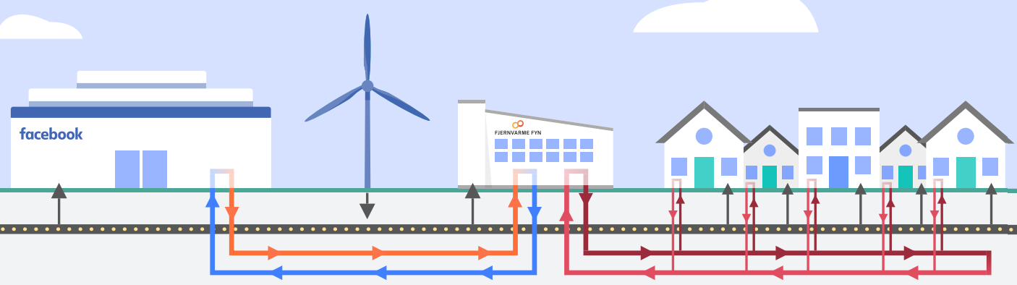
Heat reuse from data centers.
Heat pumps are commonly used to upgrade the low-grade heat from the
data center, but could it be used elsewhere?
logo
Source:https://sustainability.fb.com/
Notes:
Message: In the Nordics and other places with district heating networks a popular method is to add energy and use heat pumps to upgrade heat for the energy network. This works especially well when there is no other more efficient heat source.
The question is if there is any other possible use cases and there is. We don’t have to blindly look at only district heating. Used as is without heat pumps have a number of potential use cases like greenhouses, wood pellet drying, protein production. Alternative to heat pumps are fuel cells for areas with excess gas to upgrade the heat. There are also opportunities in water treatment, on-site cooling and heat production, solar reflectors and many more.
2025-10-18
By Tor Björn Minde, RISE, 2025
The impact of AI on the energy system

Slide 17
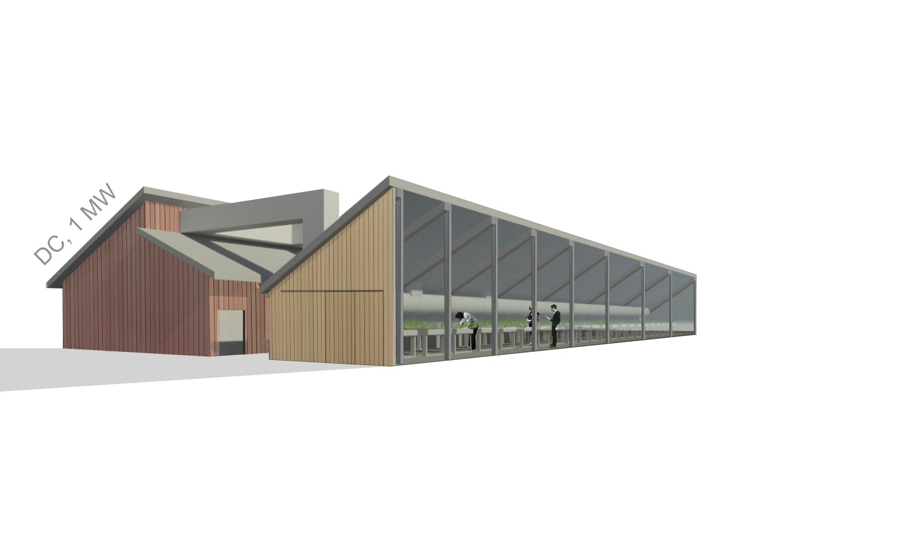






DC excess heat – Greenhouse
Medium-Scale Data Center
Power Capacity: 1 MW
Type of Farming Facility: Modular Container/
Greenhouse structure
Full capacity of Farming surface: 2400-5000 m2
Inspiration: Team design
Vision picture DC-GH: BTDC
Investment
Business model
Greenhouse
DC 1 MW
3185 Tons Peat
200 000
to
900 000 €
Establishment cost
x 410
x 1
3-5 Farmers
Community/ Sharing/ Independent/
Middle-hand model
(3000 m2)
Even or
Uneven heat dist.
1734 ton CO2eq/year
2293 tonCO2eq/year
logo
Sources: RISE 2020
Notes:
Message: A greenhouse is one example of excess heat reuse as is without upgrading the temperature. This model shows that for a 3000 sqm greenhouse a saving of about 500 tonCO2eq can be saved yearly.
Similar models exist for other use cases like mealworm farming, wood chip drying or black fly farming.
2025-10-18
By Tor Björn Minde, RISE, 2025
The impact of AI on the energy system

Slide 18








Electrical grid integration
Peak shaving
Energy arbitrage
Ancillary services
50 Hz
48,5 Hz
51,5 Hz
logo
Notes:
Message: A data center can support the power grid in a couple ways and be active on different frquency markets. It can also support the grid by beeing a good neigbour. First it can peak shave and stay under a max power draw using algoritmic measures or battery capacity. Second it can adapt to the pricing models and do energy arbitrage. Fill the batteries when prices are low and use batteries when prices are hig, It can also be active on some of the frquency market using its battery capacity. All actions require investments and need a business models or incentive models to be worth while for the operators.
2025-10-18
By Tor Björn Minde, RISE, 2025
The impact of AI on the energy system

Slide 19





Sustainable Data Centres:
Powering Digital Growth Responsibly
Core pillars for a sustainable data center
Energy Efficiency
Powered by Renewables
Circular Design
Optimized cooling, server utilization, and power management. Real-time monitoring, and transparent reporting that enables continuous efficiency improvements and accountability.
Transition to 100% clean energy through solar, wind, and hydroelectric sources with battery storage for grid independence.
Reuse, repair, and recycle IT and building materials. Equipment refurbishment, component harvesting, and responsible e-waste management extend lifecycle and reduce material demand.
Water-Wise Operations
Heat res-use and grid flexibility
Closed-loop cooling systems, rainwater harvesting, and greywater recycling minimise freshwater withdrawal and wastewater discharge.
Re-use of excess heat in community heating, industry processes, farming or on-site to improve other metrics as well as supporting the grid with frequency stabilization.
logo
Notes:
Message: It is important to look at sustainability from a holistic perspective: A truly sustainable facility achieves performance, resilience, and responsibility - delivering seamless operations whilst minimising carbon footprint, resource use and ecological impact. It also enable heat reuse and support of the energy grids.
Key Performance Indicators
Power Usage Effectiveness (EN 50600‐4‐2): Total facility energy / IT equipment energy
CUE: CO₂ emissions / IT energy
Water Usage Effectiveness (EN 50600‐4‐9 : Liters / IT energy
Energy Reuse Factor (EN‐50600‐4‐6): : Reused energy / total energy
2025-10-18
By Tor Björn Minde, RISE, 2025
The impact of AI on the energy system

Slide 20

Overview of the Energy Efficiency Directive and Its Goals
Directive Requirements
  All data centres over 500 kW IT power must report KPIs on energy and resource efficiency under the directive.
Sustainability Goals
  The directive supports the EU Green Deal and aims for climate-neutral data centres by 2030.
Standardization and Transparency
  The regulation promotes standardized data collection and transparency across EU Member States.
Continuous Improvement
  The directive fosters a culture of ongoing energy efficiency improvements in digital infrastructure.
logo
Notes:
The European Union has established a robust policy frame-work to enhance the energy performance and sustainability of data centres. Central to this effort is Directive 2023/1791, complemented by Delegated Regulation (EU) 2024/1364. These regulations mandate that all data centres with an installed IT power demand of at least 500 kW must report key performance indicators (KPIs) related to energy and resource efficiency.
The overarching goals are to assess and improve the energy efficiency of data centres, support the EU Green Deal, and align with the Digital Decade targets, which aim for climate-neutral data centres by 2030. The directive also seeks to standardize data collection across Member States, enhance transparency, and foster a culture of continuous improvement. By implementing these measures, the EU aims to reduce the environmental impact of digital infrastructure while maintaining competitiveness and innovation in the sector.
2025-10-18
By Tor Björn Minde, RISE, 2025
The impact of AI on the energy system

Slide 21
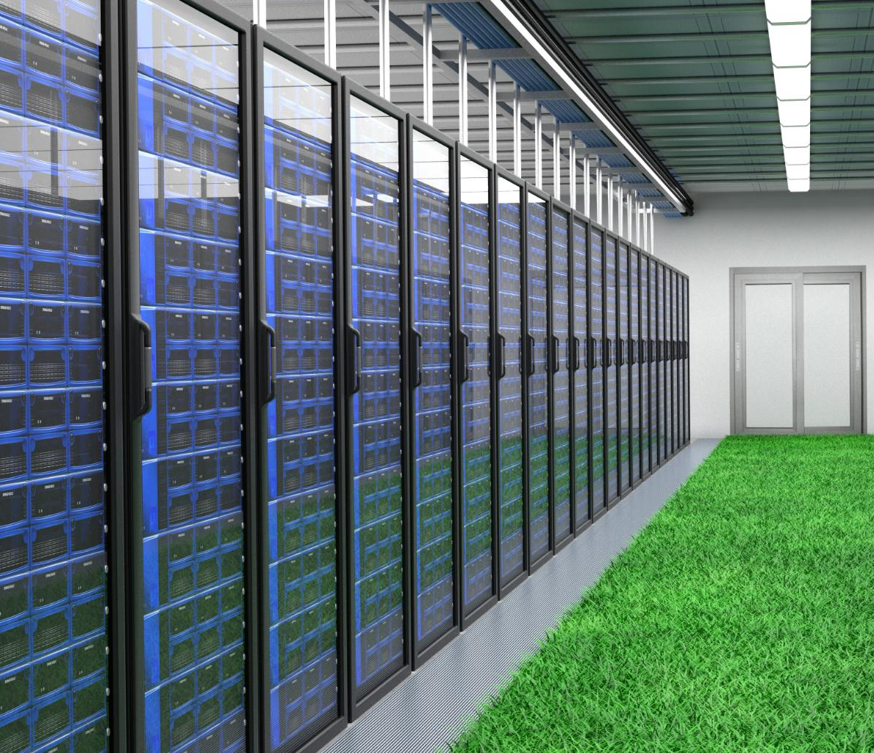
Future development of legislation
EU Sustainability Label?
  Can the EU-wide multi-criteria sustainability label enhance transparency and fosters market-driven environmental improvements.
  Minimum Performance Standards?
  Suggestion for MPS for data centres include strict PUE and WUE targets to boost energy and water efficiency by 2030. Can carrots be used?
Renewable Energy Usage Targets?
  Aiming for 100% renewable energy use in data centres to reduce carbon footprint and support sustainability.
Suggestion
– to lower the reporting threshold to 300kW, aligned with the German Energy Efficiency Act. Use incentives for sustainability actions.
logo
Notes:
Looking ahead, the EC wants to implement transformative measures to further enhance the sustainability of data centres. One of the key initiatives is the introduction of Minimum Performance Standards (MPS) by 2030. These include an operational PUE of less than 1.5 for existing data centres, a design PUE of less than 1.3 for new centres, and an operational PUE of less than 1.4 within three years of commissioning. Additionally, a WUE threshold of less than 0.4 m³/MWh and a 100% renewable energy usage target are proposed.
Complementing these standards is the development of an EU-wide sustainability label, designed as a multi-criteria rating scheme. This label will provide transparency and comparability across facilities, encouraging market-driven improvements. The label includes indicators such as PUE, WUE, REF, and ERF, along with contextual data on energy sourcing, water use, and circularity measures. These initiatives aim to create a level playing field, drive innovation, and support the EU’s climate neutrality objectives.
2025-10-18
By Tor Björn Minde, RISE, 2025
The impact of AI on the energy system

Slide 22
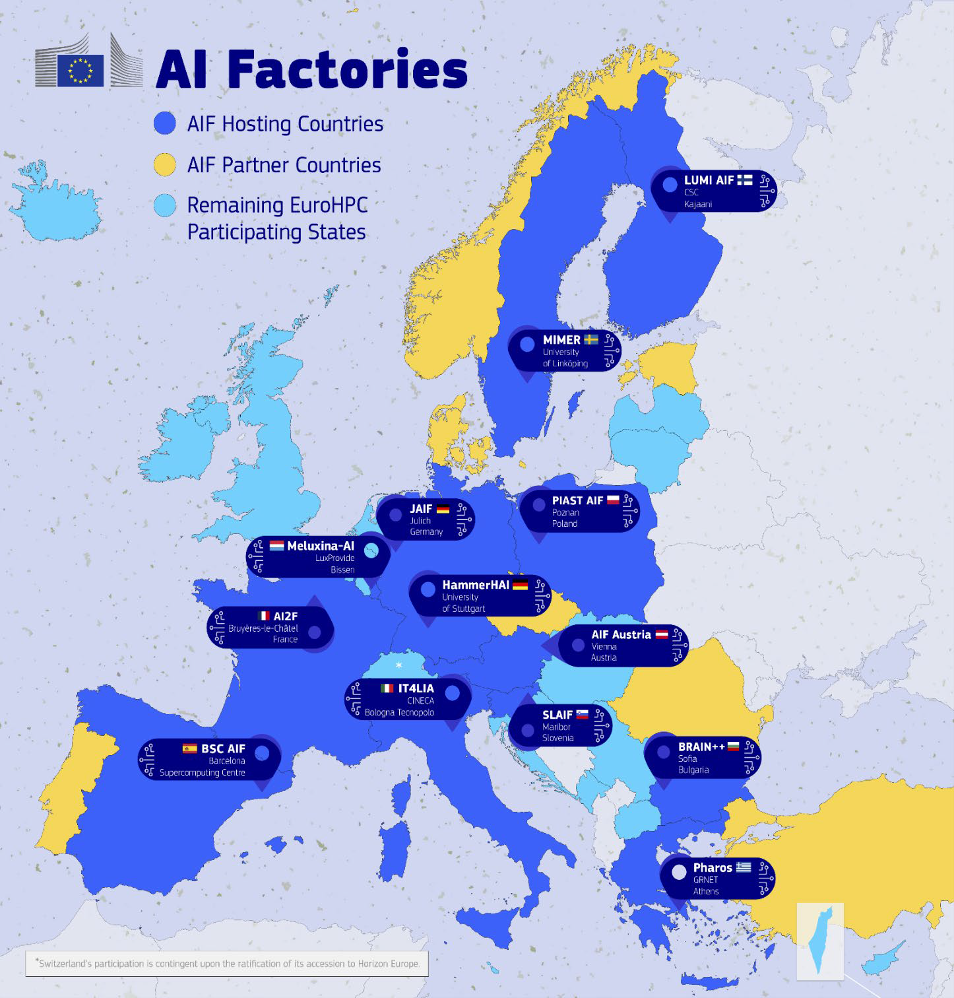

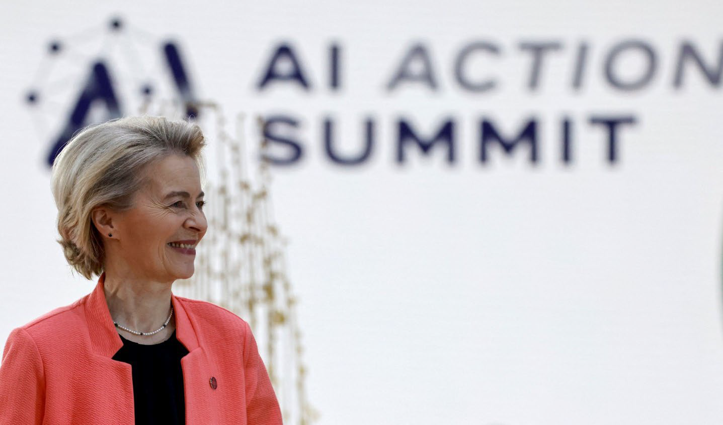
AI Factories – EU development
Vision:
Five AI Giga factories
Ensuring EU Sovereignty
AI Continent Action Plan
PPP and €20bn
logo
Sources: EuroHPC Governing Board, 2025
Notes:
As part of the vision of making the EU an AI Continent, Europe has launched the AI Factories initiative based on Europe’s world-class network of EuroHPC supercomputers. At the February 2025 AI Summit of Paris, President von der Leyen launched the idea of scaling up this initiative by investing in AI GigaFactories (AIGFs), which was then also reflected in the Competitiveness Compass along with the AI Factories investments.
The establishment of the first-ever AI GigaFactories on European soil will require a significant effort of investment and policy coordination, which should bring clear added value to EU competitiveness.
2025-10-18
By Tor Björn Minde, RISE, 2025
The impact of AI on the energy system

Slide 23
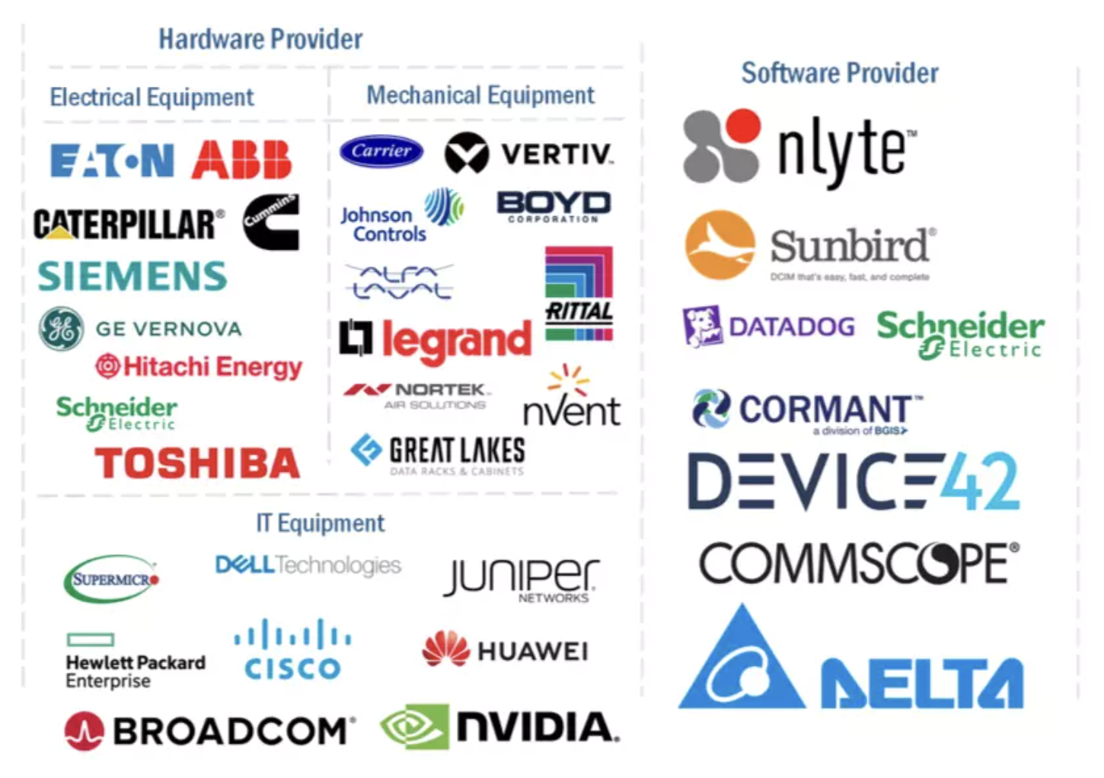
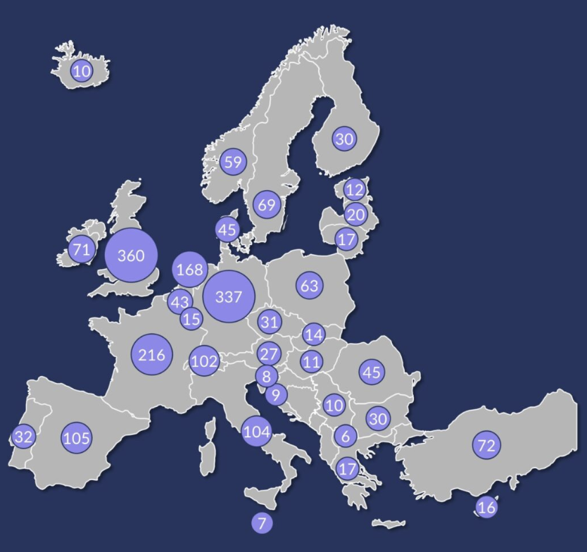







European value chain
Data center operators
Construction companies
logo
Sources: Mordor Intelligence, Datacenter Forum, MarketandMarkets, 2025
Notes:
The value chain for data centers contain many parts like the desgn and construction, then all infrastructure vendors, finally the operators. Builders and de-commisiong is not included in this slide. Noteworthy is that Europe is strong in all sectors except IT equipment. The slide only shows main European data center operators. There are many more European operators and of course all American hyperscalers and colocation operators. In the facility area Europe has many main providers delivering world-wide.
2025-10-18
By Tor Björn Minde, RISE, 2025
The impact of AI on the energy system

Slide 24
Conclusions
Demanding AI applications require more energy and
most of the energy become excess heat.
New micro processors and algorithms improve performance
and energy efficiency.
The new micro processors will have heat fluxes like nuclear
reactors that requires liquid cooling.
Sustainable data centers are energy efficient, use renewable
energy, have circular design, use water wisely and interact
with the energy grids (electricity & heat)
Europe has a strong facility industry that needs some love
logo
Notes:
2025-10-18
By Tor Björn Minde, RISE, 2025
The impact of AI on the energy system

