Slide 1
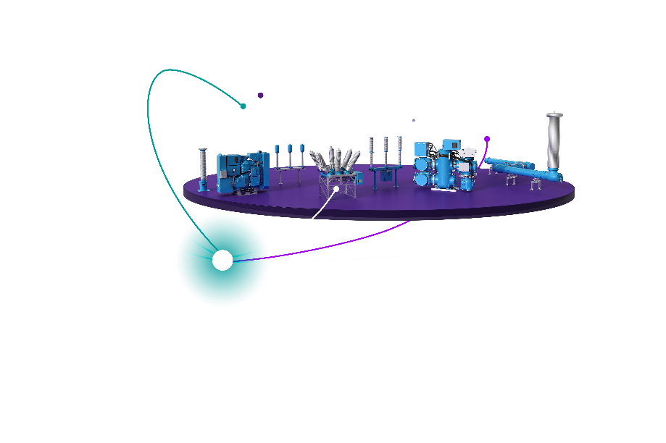
Offshore wind in the Northern Seas & the Baltic Sea
Philipp Offenberg,
Head of Government and Executive Affairs Office Brussels, Siemens Energy
17 October 2025

Slide 2
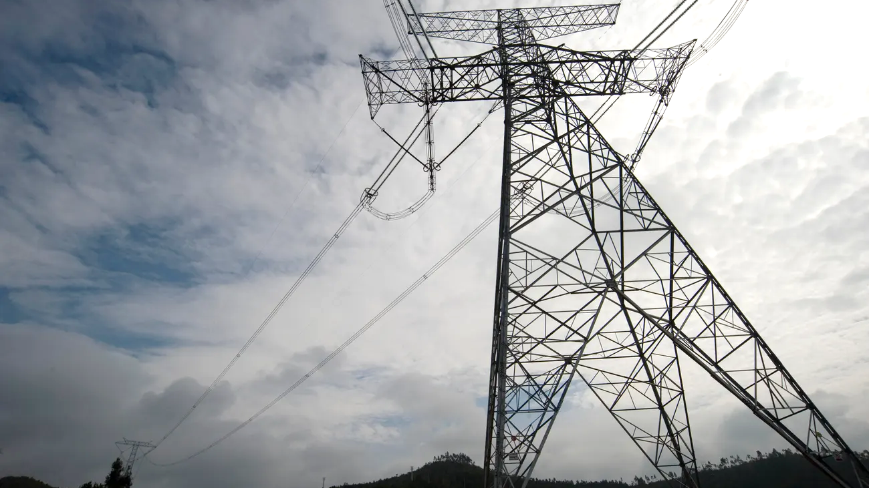
Europe needs an affordable and secure grid fast.
+ 60% electricity demand
~500.000 km grid modernization
>€500bn grid investments

Slide 3
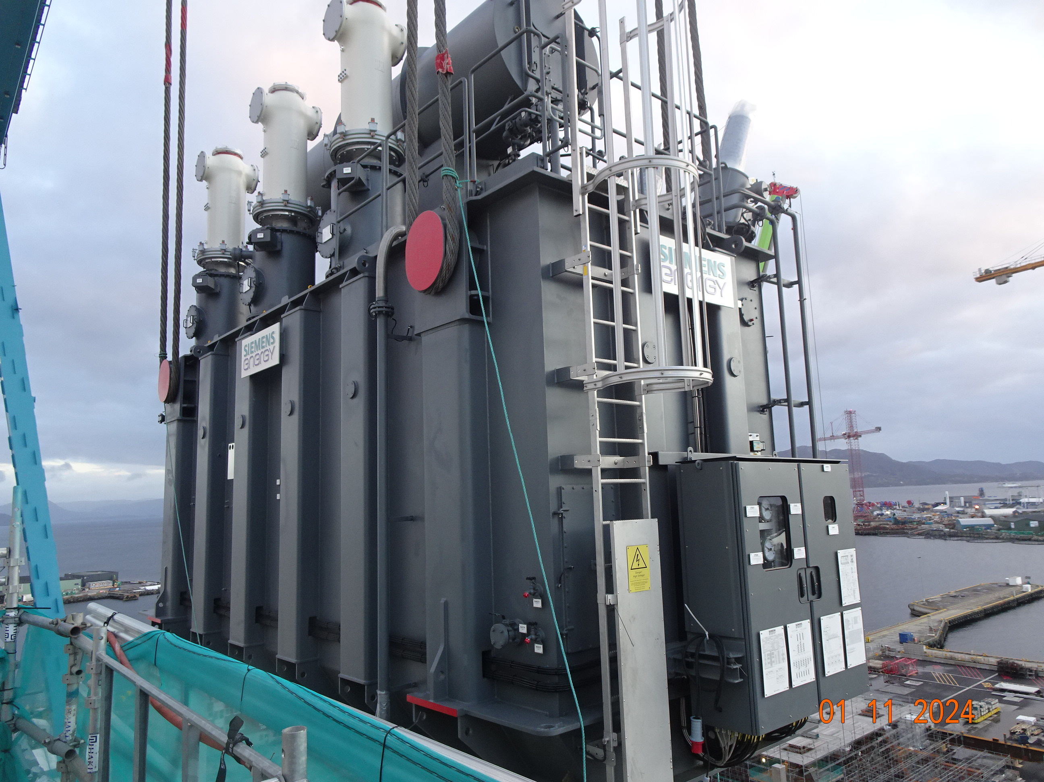
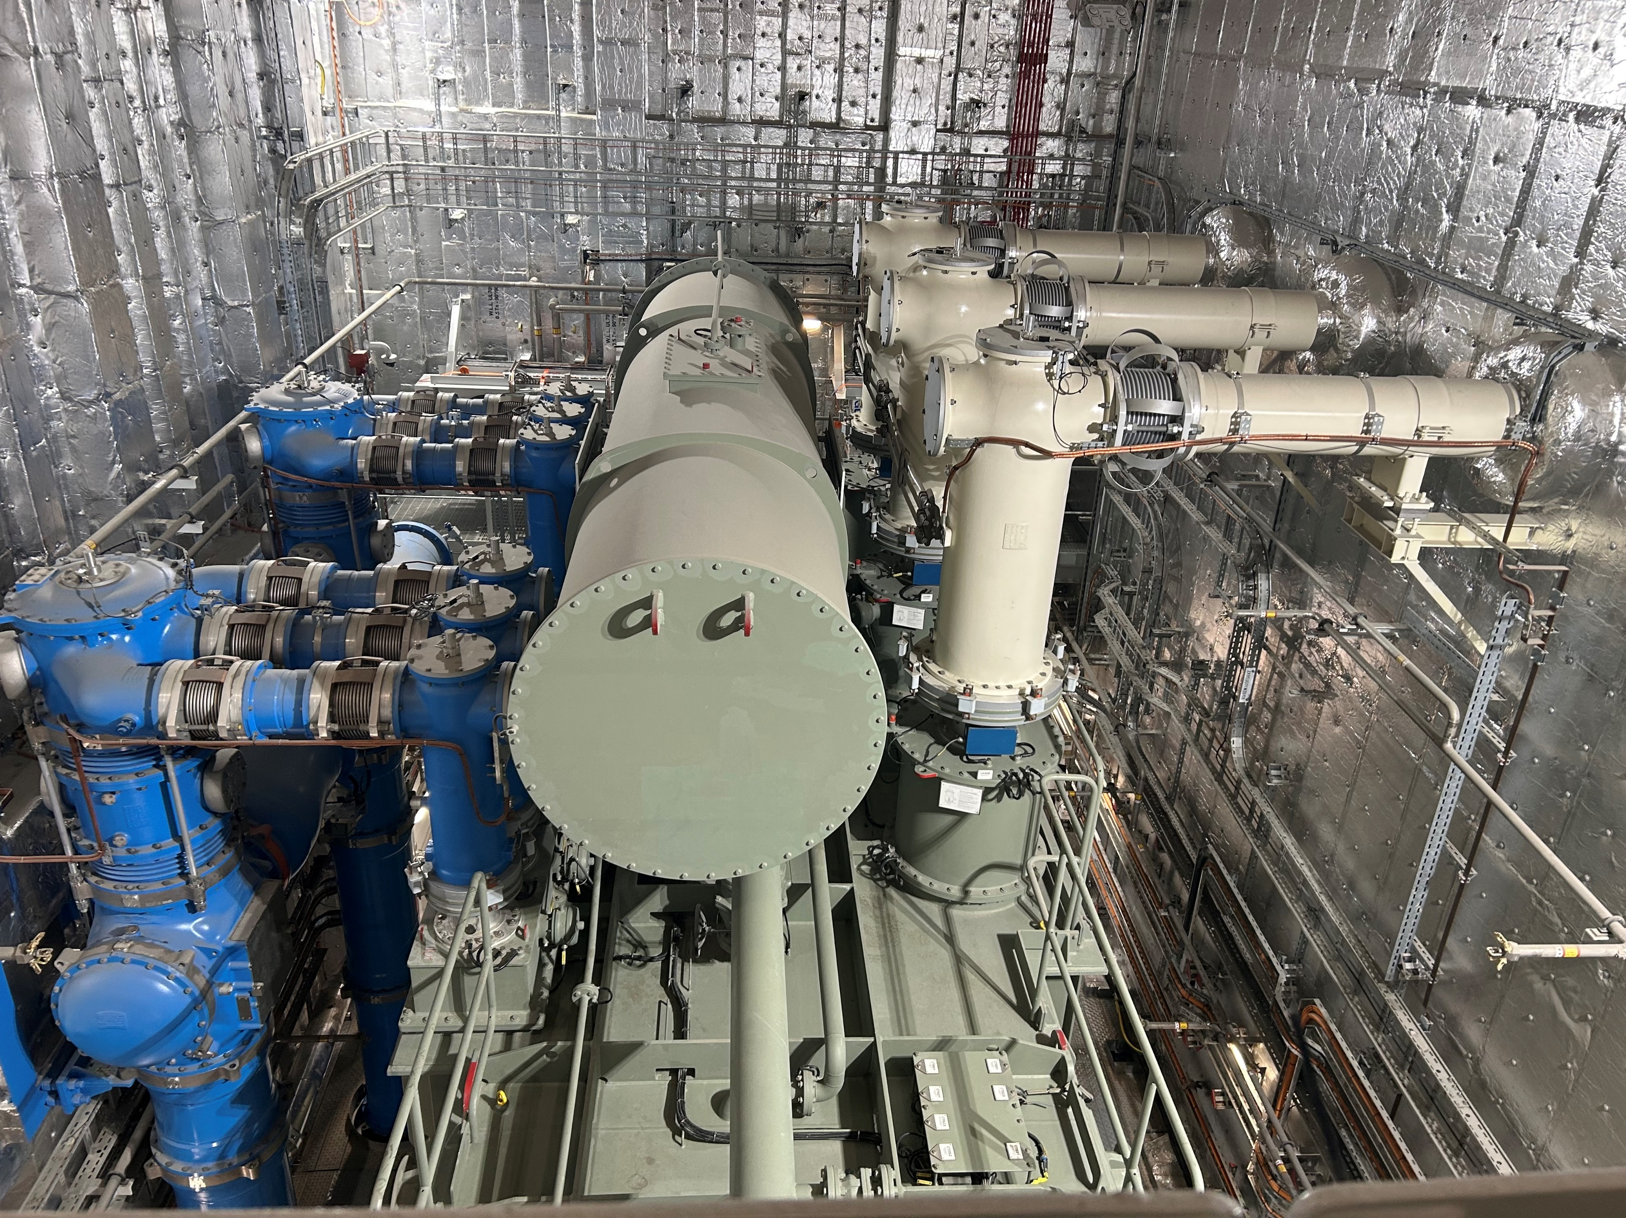
More capacity instead of complexity.
*Design requests examples:
Preferred/exclusive suppliers
Color scheme
Corrosion protection
Specific composite material
Door locking mechanism
Illuminations
40 TSOs =
40+ design requests*
Two Converter Transformer for HVDC Offshore Converter Platforms

Slide 4
Complexity hinders necessary industrial production
Additional specifications
Customer specific standards and individual applicable guidelines, e.g. color scheme, corrosion protection, composite material
Preferred and exclusive suppliers
R&D and Prototyping
Develop new solutions and features for changing market requirements (e.g. DC meshed grids; Grid Forming behavior)
Rules and Standards
International rules & standards e.g. IEC
Consenting / permitting requirements
Supply chain blacklist, i.e. insecure/unsafe suppliers
Basic Functionality
Transmission of Energy with predefined Rating, availability, reliability, Losses and maintainability
Required Features and ancillary services

Slide 5
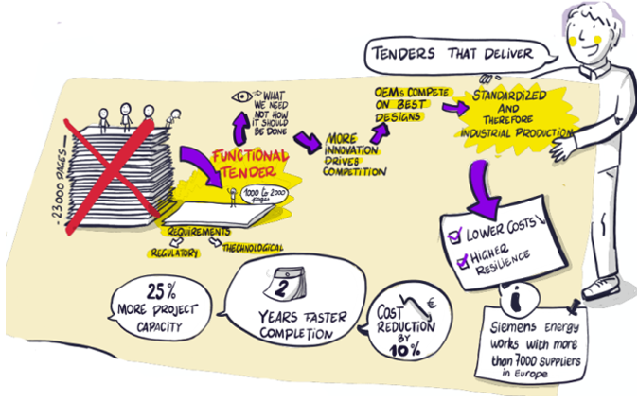
Simplified tenders that deliver:

