Slide 1

EU ETS2
Emissions Trading System for Road Transport, Buildings and Additional Sectors
Mette Quinn, Head of Unit for ETS Policy Coordination and International Carbon Markets
DG CLIMA B1 – European Commission

Slide 2
Why ETS2
EU ETS is the cornerstone of EU emission reductions, with industry and power sector emissions now around 50% lower than in 2005 and on track to reach 2030 targets.
Road transport and building heating – 36% of EU GHG emissions – have gone against the trend and remain heavily (90% and 50%) reliant on fossil fuels.
Fossil fuel imports cost the EU nearly EUR 400 billion in 2024.
Shifting to cleaner energy sources offers a four-dividend solution
Europe’s geopolitical and energy independence
address high and volatile energy prices, driven by oil and gas imports
opportunities for EU cleantech companies and jobs
decarbonise these sectors in a technology-neutral, competitiveness-friendly way

Slide 3

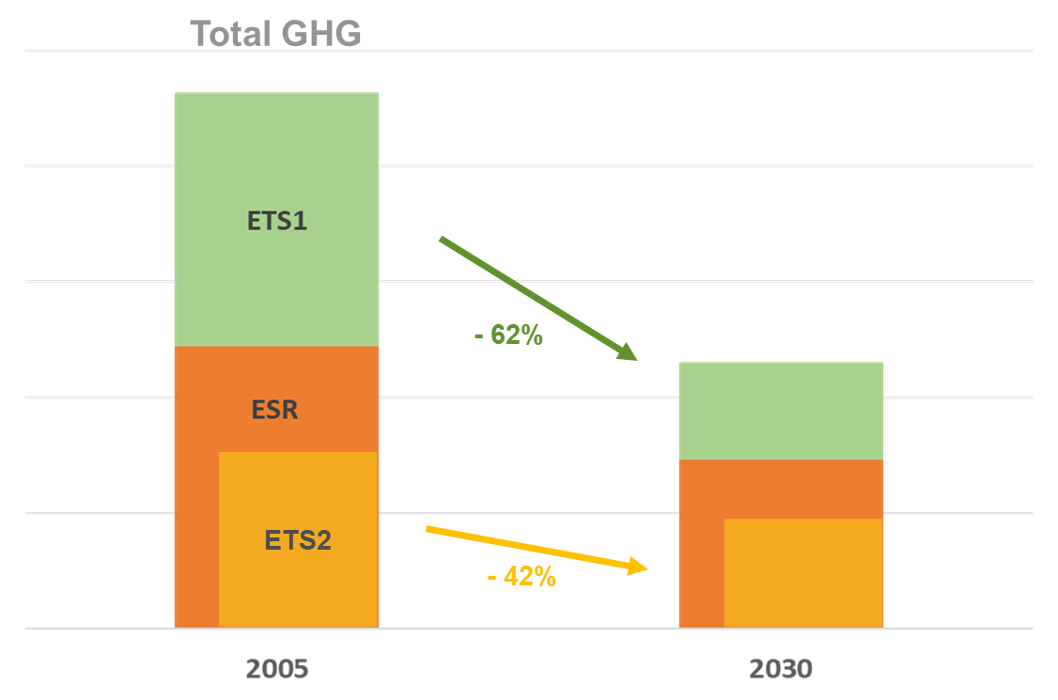
Decarbonisation by EU policies

Slide 4
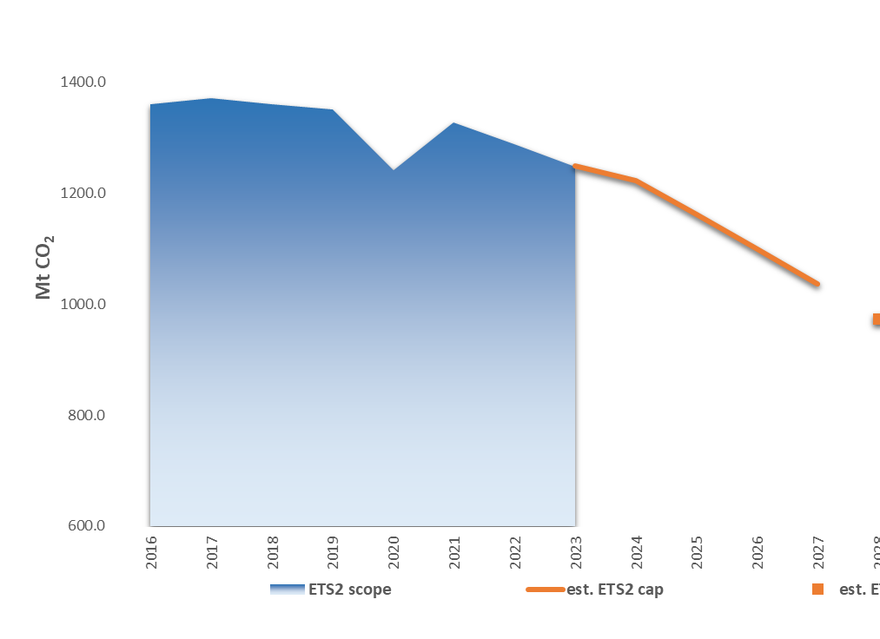
Design
New, separate emissions trading system named ETS2 adopted in 2023.
Covering and addressing CO2 emissions from fuel combustion in buildings, road transport and additional sectors.
To become fully operational in 2027. Monitoring and reporting already in full progress across Member States.
100% auctioning, no free allocation.
ETS2 2027 cap: 1036 Mt CO2.
Target: -42% by 2030.

Slide 5

Smooth Start
NECPs
Price safeguards
ETS2
Revenue use
2023 on track

Slide 6

Policy Mix
Support measures
Social Climate Fund, national ETS2 revenues, Modernisation Fund, Cohesion Funds, RRF, InvestEU, …
Pricing
carbon pricing, energy taxation, fiscality, …
Updated EU Targets
renewables, energy efficiency, buildings, climate, …
Standards & Measures
Stricter CO2 standards, alternative fuels infra, national policies, …

Slide 7
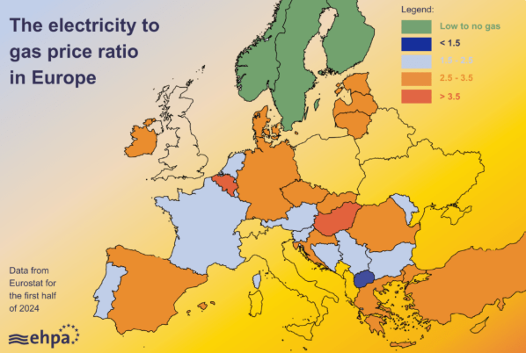
Policy Mix Fiscality
Electricity more than twice as expensive as gas for households in most EU countries
High electricity taxation and high fossil fuel subsidy levels disincentivise shift to electrification
National action is key
Household electricity-to-gas price ratio. Data from Eurostat (2024), visual by EHPA (2024)

Slide 8


Revenue Use
20% highest income households responsible for 1/3 of emissions
20% lowest income households responsible for less than 1/10 of emissions
Social Climate Fund
National ETS2 Revenues
EUR 86,7 billion (2026-2032)
Inclusive investments to decarbonise housing and road transport
As early as mid-2024
For vulnerable groups, in or at risk of energy or transport poverty
Redistributive between and within Member States
At least EUR 270 billion by 2030
All revenues to be spent on purpose
Prioritizing middle- and lower-income groups
Annual reporting
Guidance on succesfully tested and tried best practices

Slide 9

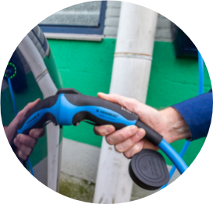

Social Climate Fund
Investments in energy efficiency, renewable energy, clean heating & cooling
Finance zero- & low-emission mobility & transport, including public transport
Optional: limited, targeted & temporary direct income support

Slide 10
Other supporting instruments
Many other EU funds (RRF, Cohesion Funds, Modernisation Fund, ETS1 revenues, …) are at Member States’ disposal.
EIB’s extensive experience in blending grants, loans, and guarantees can be directly leveraged under ETS2 revenues, using proven models developed for Cohesion Funds and the Recovery and Resilience Facility.
Two relevant “off-the-shelf” InvestEU products (Sustainability Guarantee and Microfinance Guarantee) can be tailored to support these objectives, particularly for energy efficiency and low-emission transport investments.

Slide 11
Thank you
© European Union 2025
Unless otherwise noted the reuse of this presentation is authorised under the CC BY 4.0 license. For any use or reproduction of elements that are not owned by the EU, permission may need to be sought directly from the respective right holders.

