Slide 1


For a people-centred ETS2 implementation
Federico Terreni - Climate Policy Manager
Transport & Environment (T&E)
IPM25 Copenhagen, 17/10/2025

Slide 2
ETS2: Introduction
The ETS2 is essential to meet the EU’s climate objectives, which cannot be achieved without putting a price on carbon pollution.
There is a legitimate concern that this could disproportionately and negatively impact low-income people.
It is up to Member States whether the ETS2 becomes regressive or progressive in their country.
→ T&E recommends the following measures for a successful ETS2 implementation within the existing regulatory framework:

Slide 3
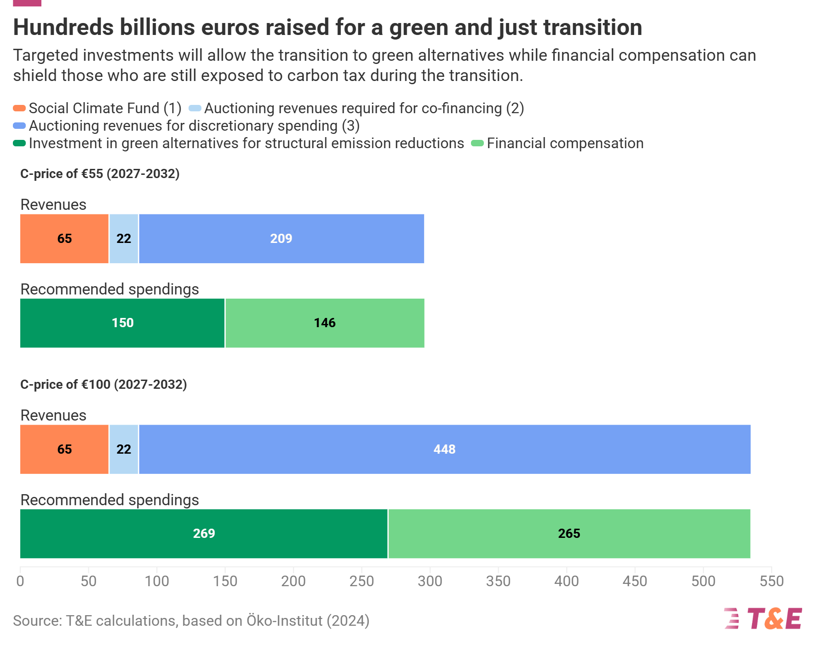

1. Put all ETS2 revenues to work
and return at least half of what people pay as financial compensation
Compensating low- and lower-middle incomes is essential to a just transition.
Different design options for income support:
Targeted direct income support (DIS);
Population-wide climate dividends;
Reducing electricity bills or income taxes.
Remainder of revenues for investments: active mobility, public transport, shared mobility services, scrappage schemes, charging infrastructure, low-cost EV leasing, etc.

Slide 4
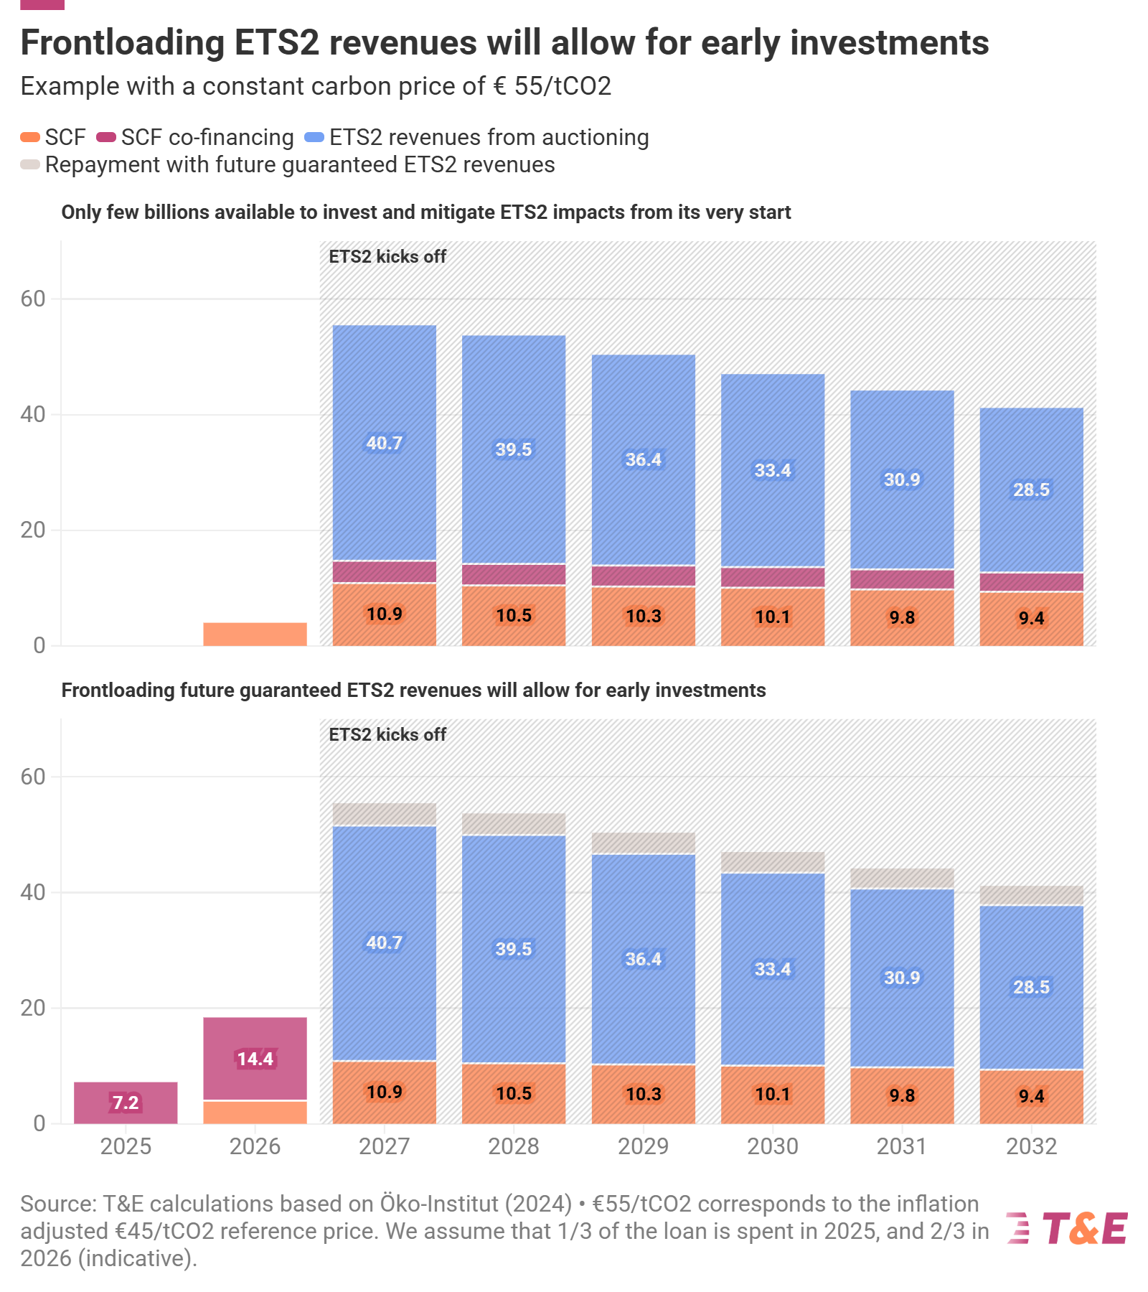
2. Frontloading the Social Climate Fund
To ensure investments start at scale before the ETS2 kicks in
Can be done under the current regulatory framework:
Undersubscribed loan part of the Recovery and Resilience Facility (RRF) or EIB
Co-financing part of SCPs
Repaid with future guaranteed ETS2 revenues

Slide 5
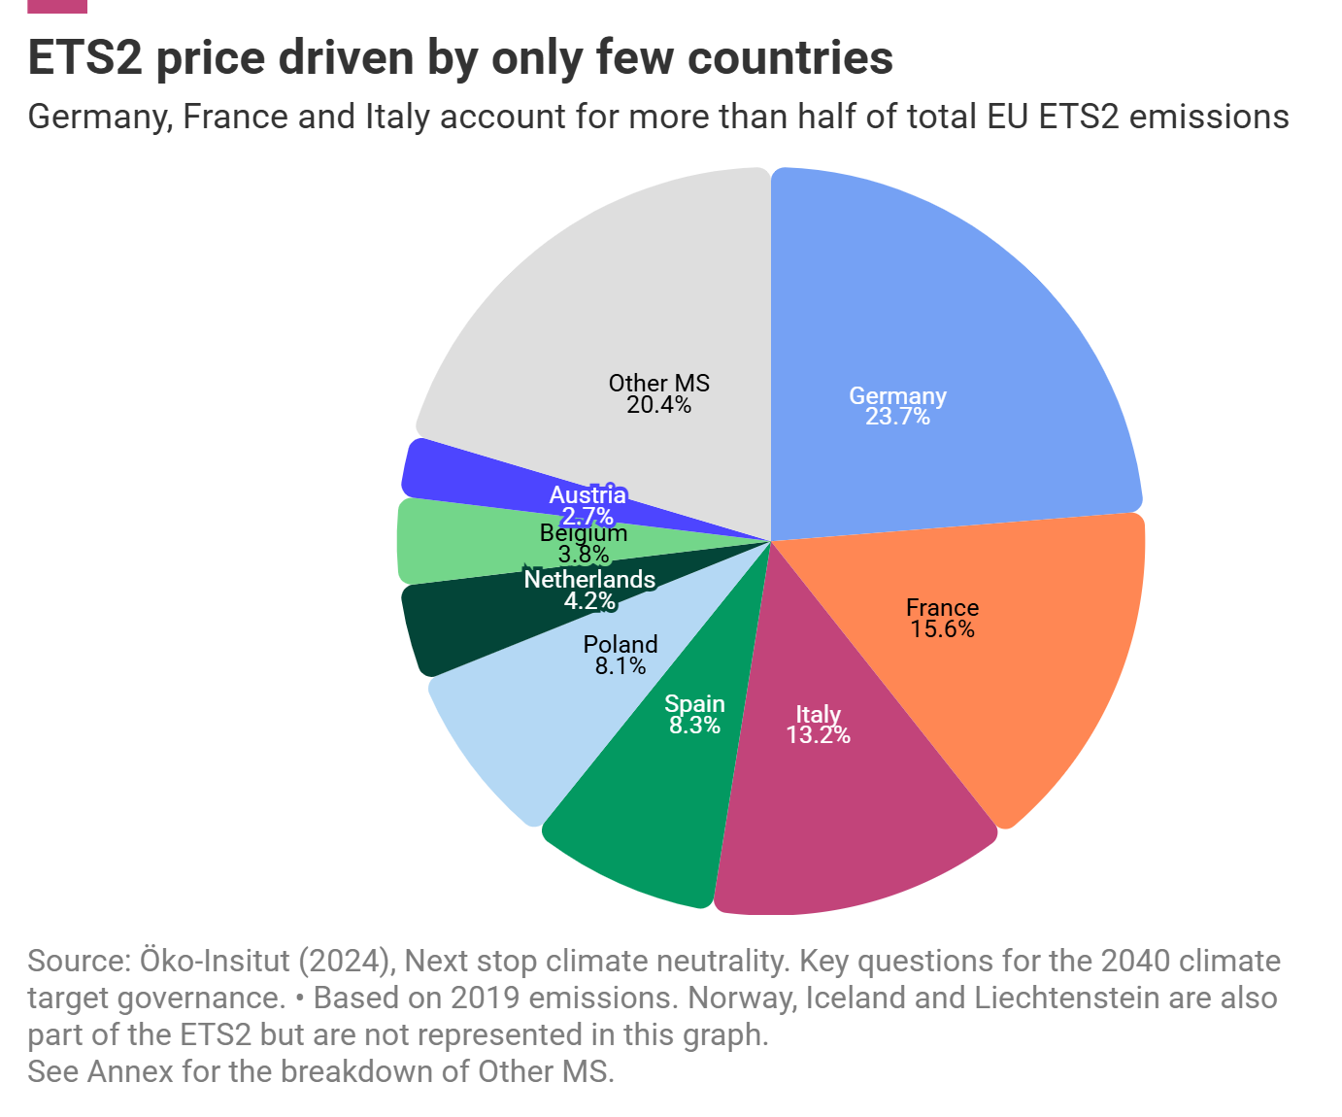
3. Improve national and EU-level policies
Effective price control starts with ambitious complementary policies.
EU: Greening Corporate Fleets, 2030 and 2035 car CO2 targets;
EU: Platform for low-cost EV leasing;
Member States’ NECPs fall short of ESR national climate targets.
ETS2 price mainly driven by Germany, France, and Italy → big potential to drive prices down

Slide 6
Social leasing for affordable EVs

Slide 7

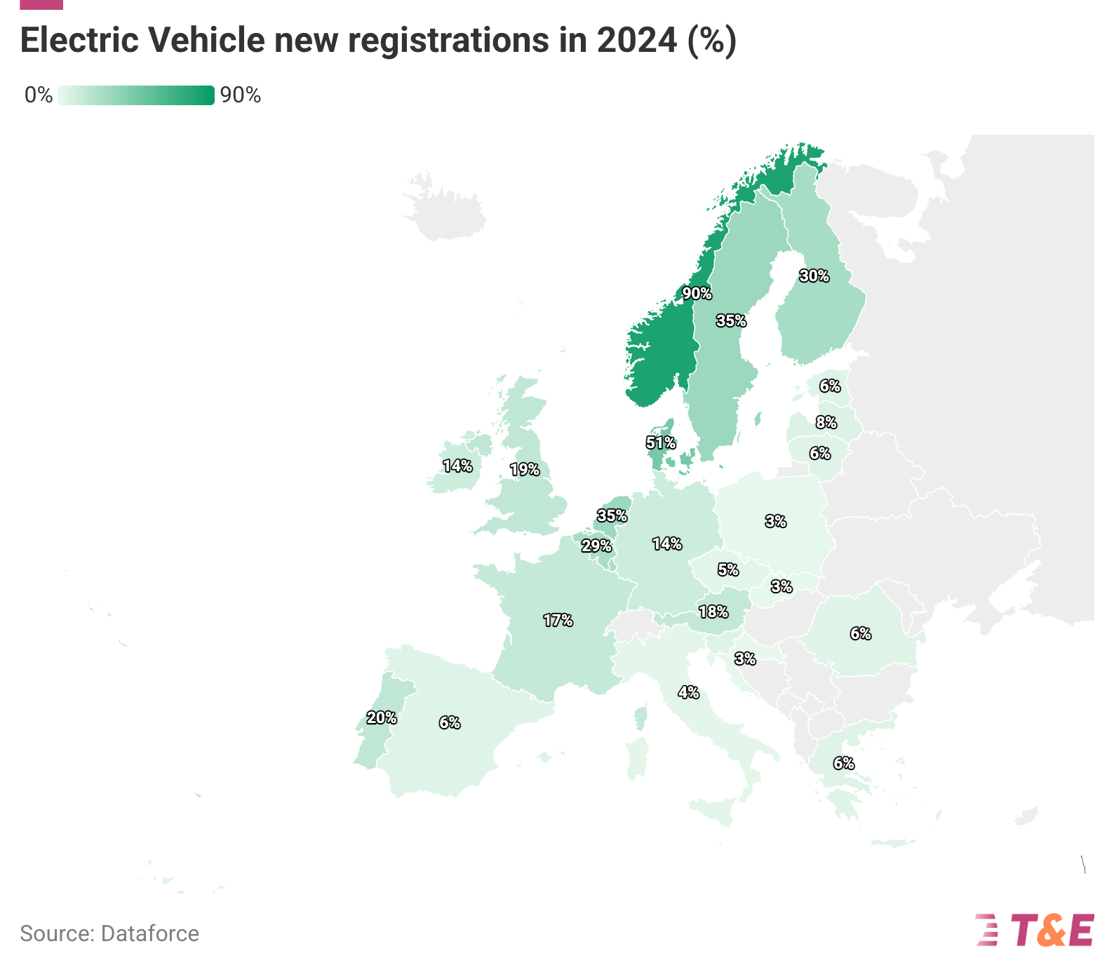
Challenges linked to a car-dominated system
Car dependency and lack of alternatives
80% of kilometres are travelled by car in the five countries analysed.
Uneven electrification progress across MS
Uneven electrification rates deepen divides
High fuel prices
Fuel expenses account for an average of 6.5% of household income in Europe.
These challenges create social barriers in the transition to EVs & clean transport

Slide 8
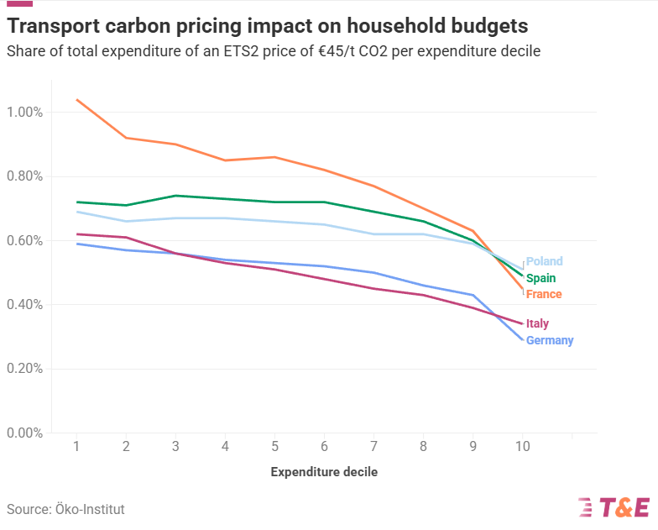
The disproportionate impact of fuel costs on low- and middle-income populations

Slide 9
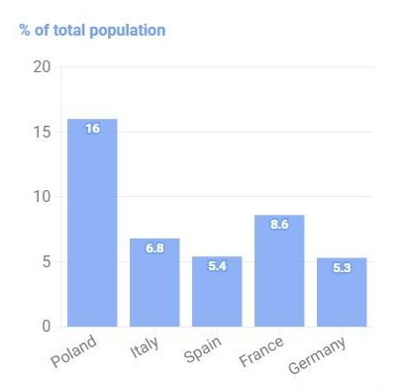
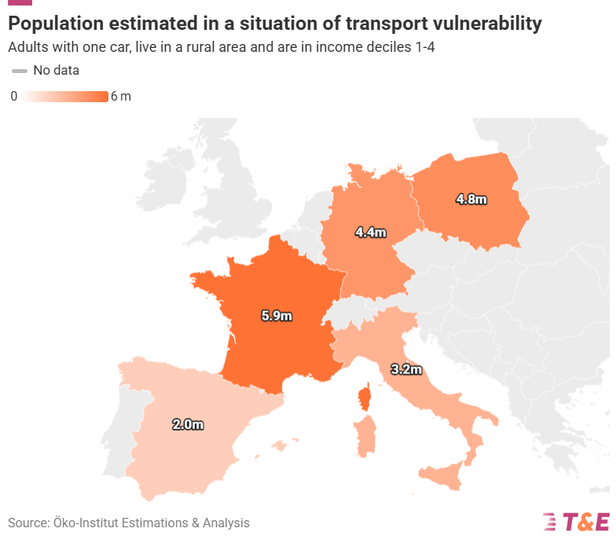
20 millions of Europeans in a situation of transport vulnerability
Transport vulnerability:
(Adults) that own a car
Living in a rural area
Low-income groups

Slide 10
Key takeaways:
The success of the transition to sustainable mobility depends on providing support to European citizens, with a focus on the most vulnerable.
Key measures are needed, including social leasing, support for car-sharing, the development of active mobility modes, and strengthening public transport.
Member States must anticipate the rise in fuel costs that will result from ETS2 already in 2025.

Slide 11
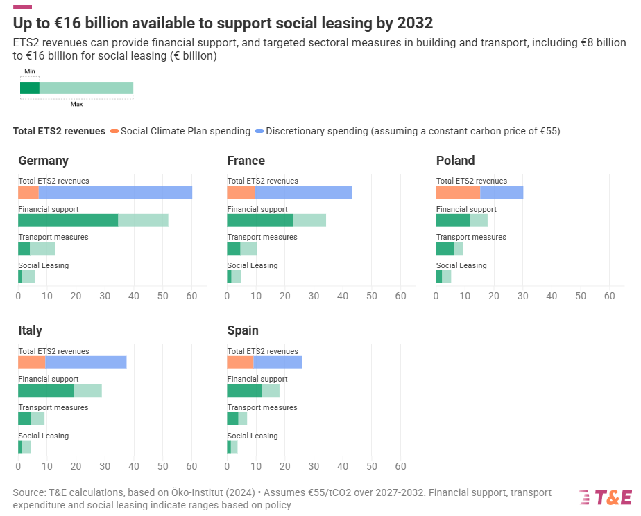
Quantifying available resources
Financial support: Between 50% and 75% of the costs paid under ETS2 in each Member State.
Split between transport and buildings: 50% for road transport (close to its ETS2 emission share, 58%)
Split of transport measures: ⅓ for social leasing assumed

Slide 12
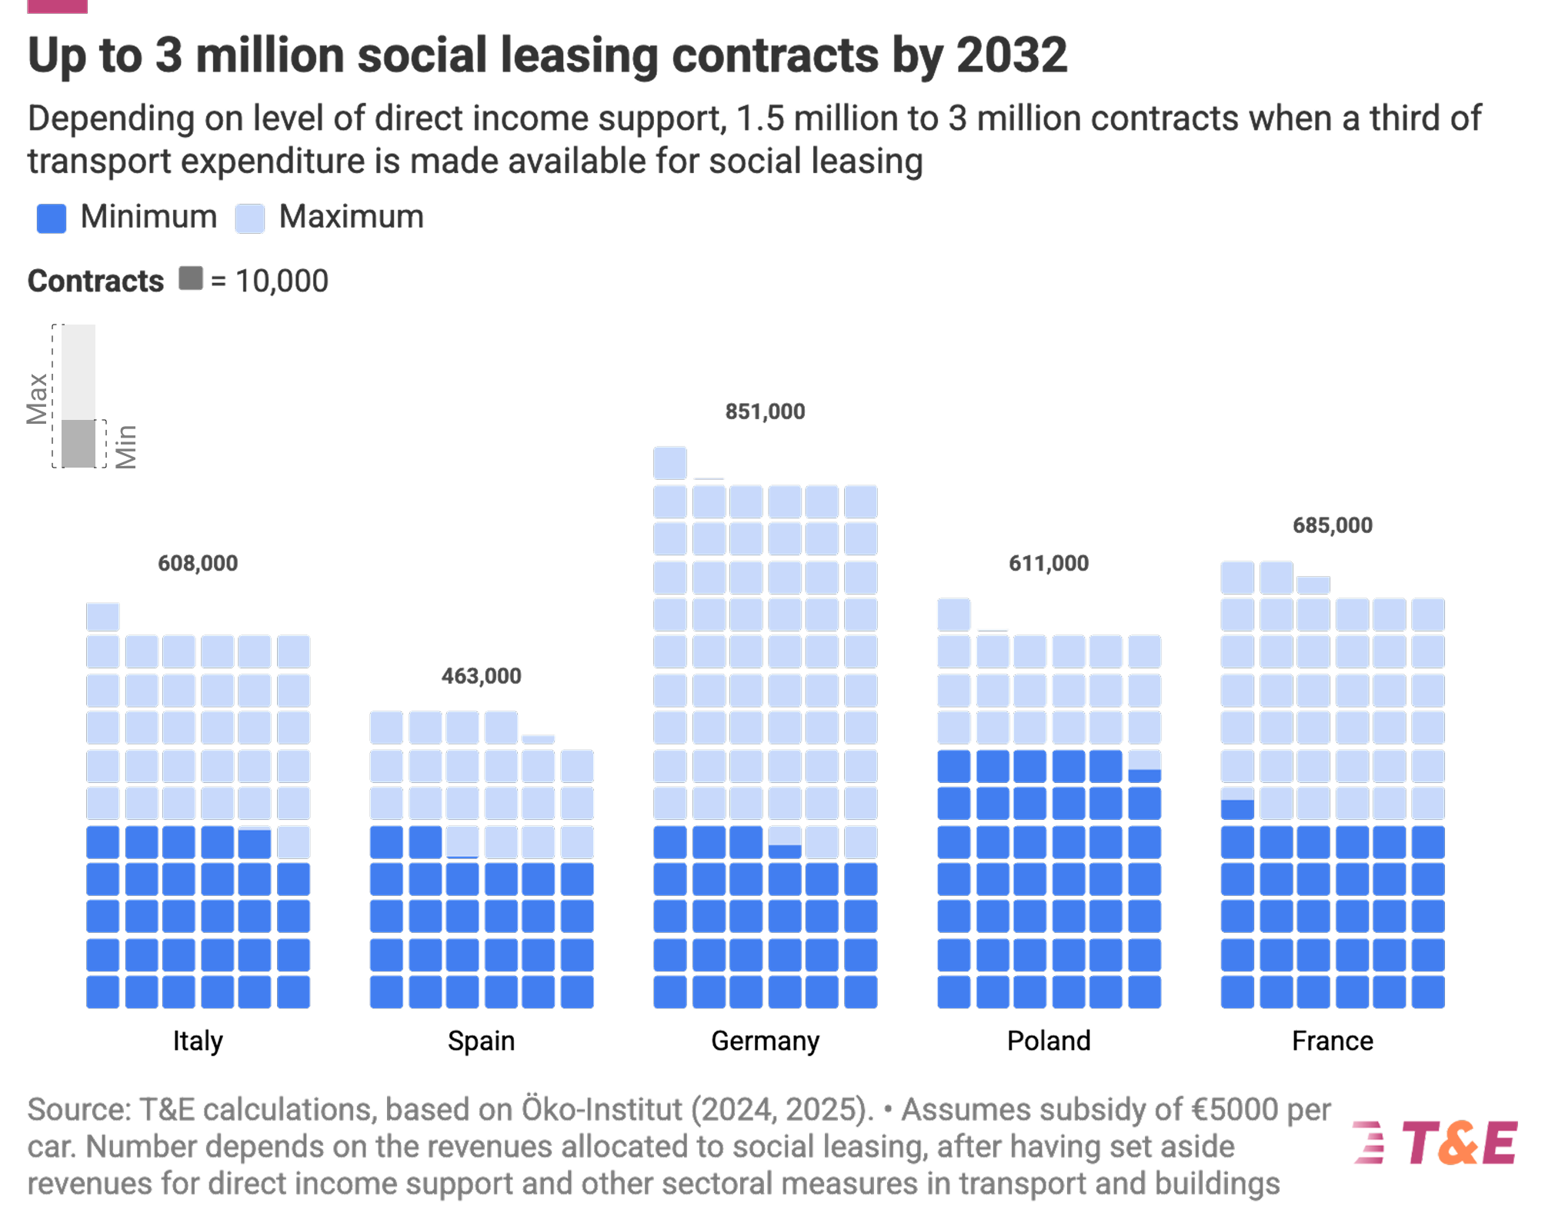
The potential of social leasing
ETS2 revenues could fund the leasing of up to 3 million EVs by 2032

Slide 13
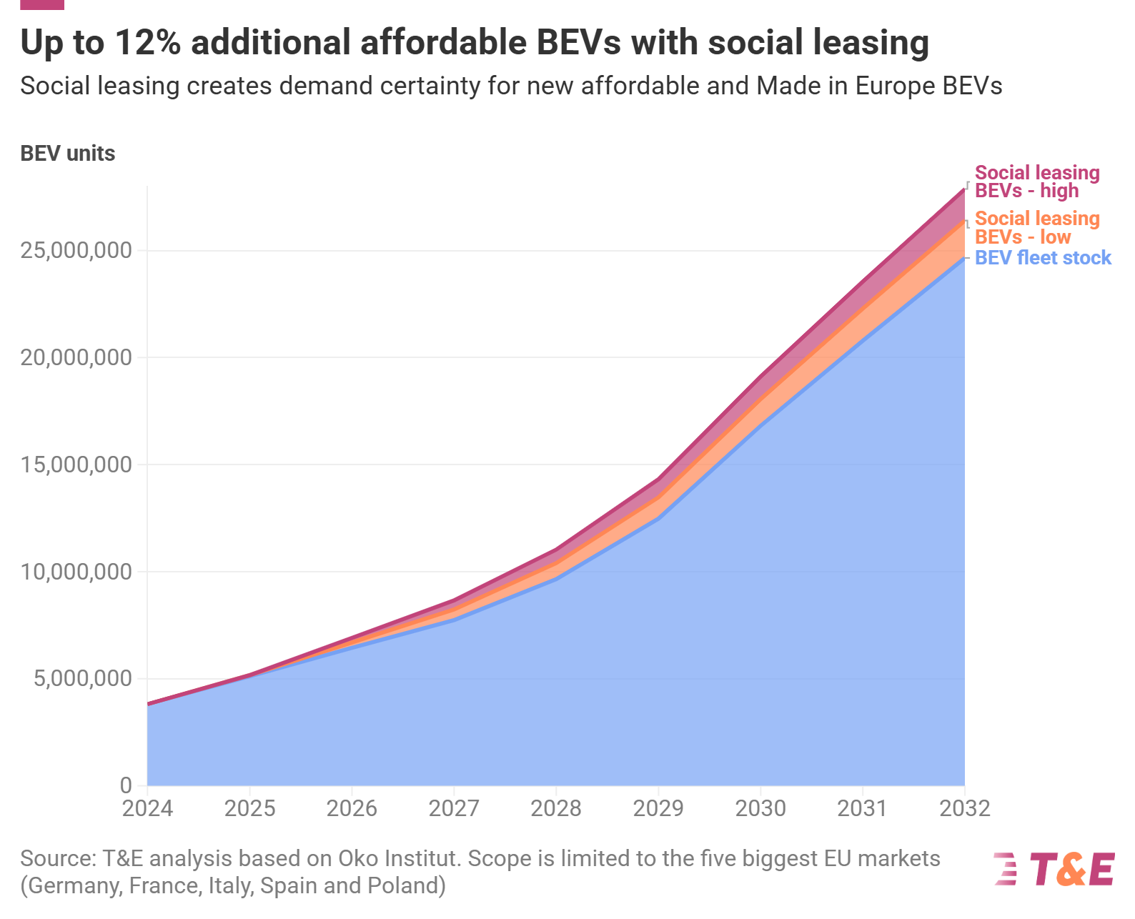
Social leasing will create demand for EVs among a new market segment
The 3-million social leasing schemes would lead to an increase of up to 12% of the total EV fleet in 2032.
This new demand provides a high level of demand certainty which allows the car industry to plan accordingly the volumes of affordable Made-in-EU EVs.

Slide 14

Thank you
Federico Terreni - Climate Policy Manager
Transport & Environment (T&E)
IPM25 Copenhagen, 17/10/2025

