Slide 1

Mirella Vitale SVP, Marketing Communications, and Public Affairs

Slide 2



The efficiency dividend
€150b
€540
44 bcm
annual turnover of EU efficiency industry
annual household savings (2023)
gas imports avoided = more than EU imported from Russia last year

Slide 3
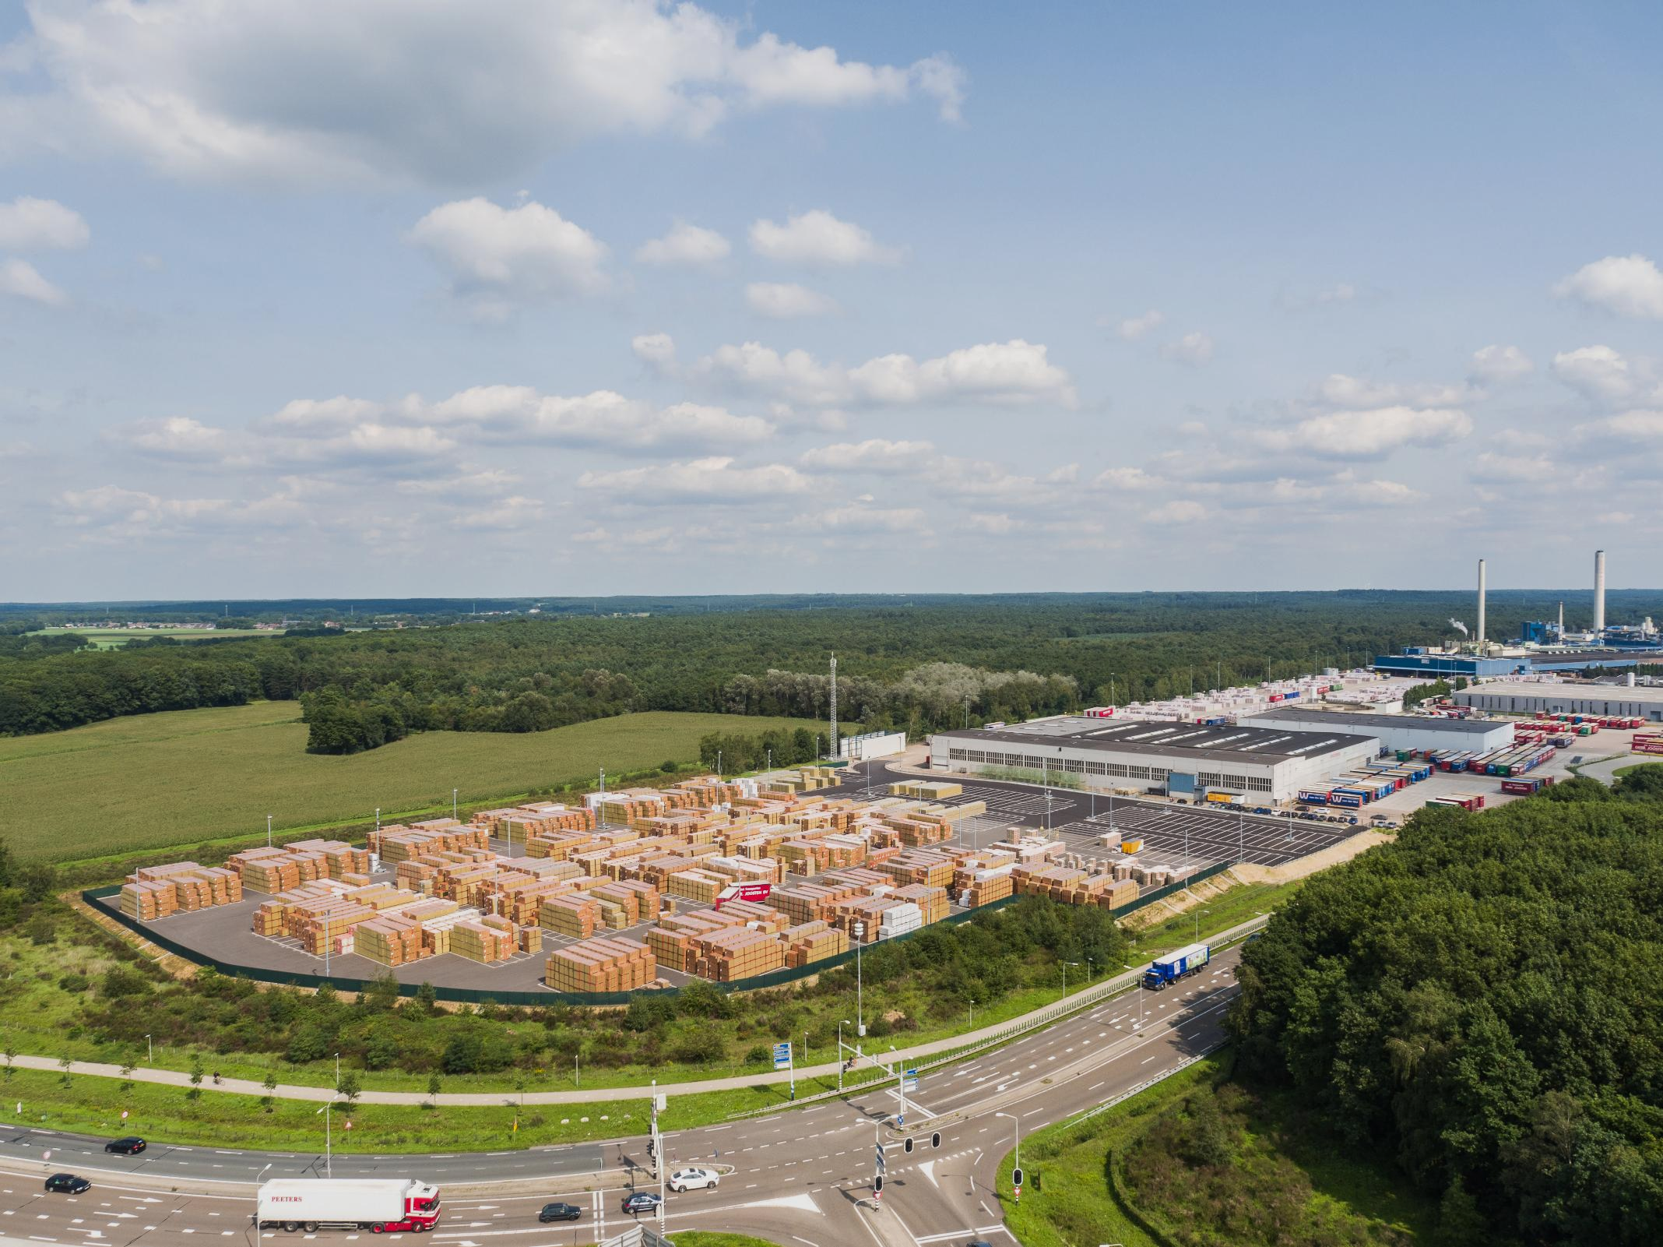



Energy efficiency: Europe’s first fuel for competitiveness
8,000 employees in Europe
24 European factories
ca. €300 million per new plant
3

Slide 4

Turning ambition into investment
Factories
Planned factories

Slide 5

CONFIDENCE TO INVEST Policy clarity and predictability drive investment, jobs, and competitiveness.
A clear 2040 target

