Slide 1
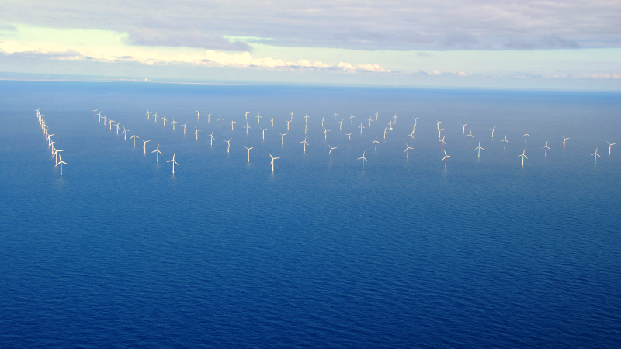
Running a high wind energy electric system in a secure way
KLAUS WINTHER
VICE PRESIDENT SYSTEM OPERATION, ENERGINET

Slide 2
Index, 2010 = 100
ELECTRIFICATION MUST MAINTAIN MOMENTUM IN THE GREEN TRANSISIONT
Since 2010, electricity generation from wind and solar has more than tripled, while electricity consumption has remained largely unchanged. An increase in flexible electricity consumption will enable continued expansion of renewable energy and is crucial for an efficient and affordable green transition – without compromising Denmark’s high level of supply security.
Electricity consumption
Renewable production
Kilde: Energinets Miljøberetning 2024. Indekstal, hvor 2010 = 100

Slide 3
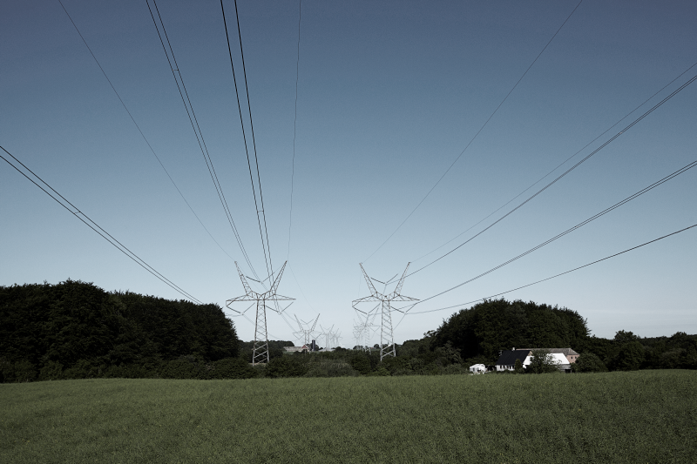

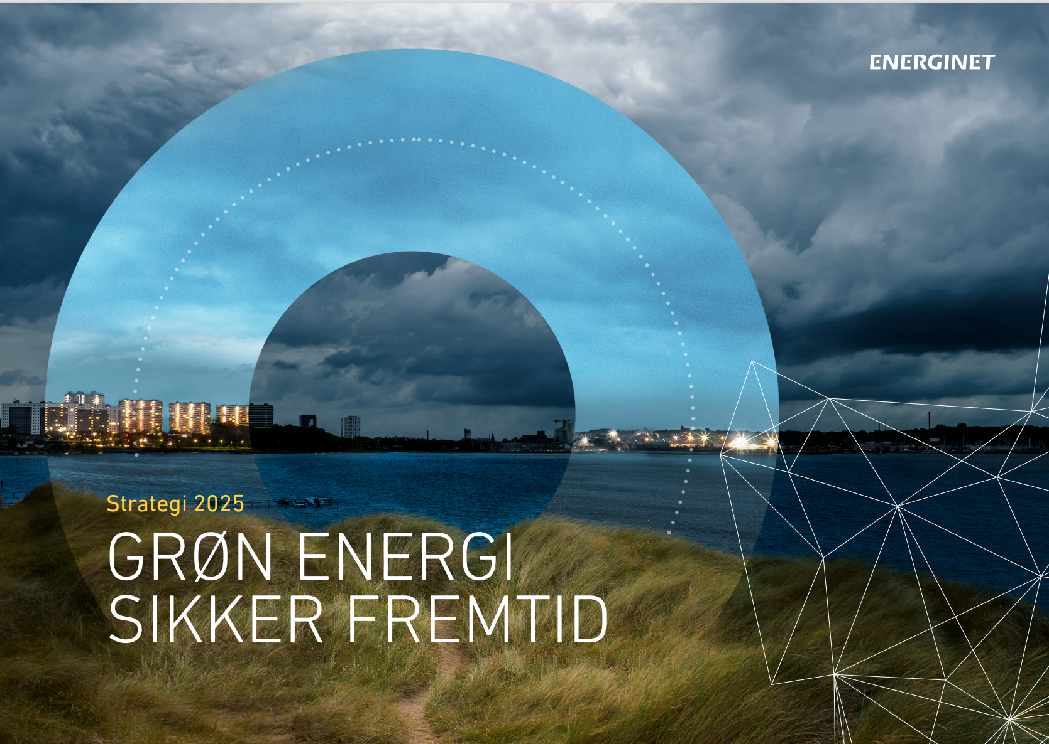

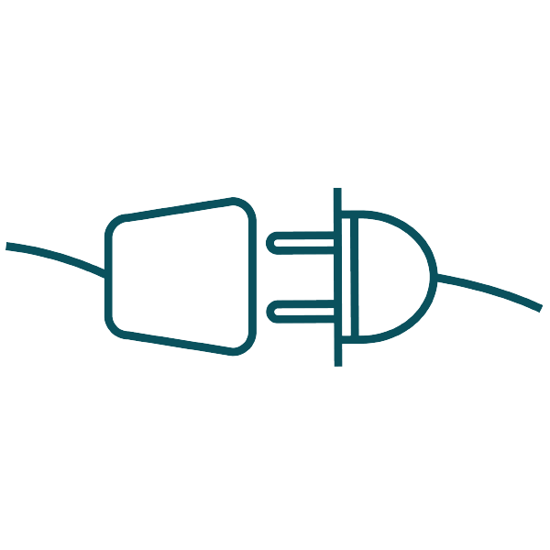





OPERATE AND BALANCE THE TRANSMISSION SYSTEMS
7 CENTRAL PARAMETERS OF SECURITY OF SUPPLY
… and electrification!
ADEQUACY
ANCILLARY SERVICES AND BALANCING
DYNAMIC STABILITY
CYBER SECURITY AND PREPAREDNESS
REQUIREMENTS AND GRID CODES
PEOPLE AND PROCESSES
INFRASTRUCTURE
GREEN ENERGY WITH HIGH STABILITY AND QUALITY
A RESILIENT ENERGY SYSTEM

Slide 4
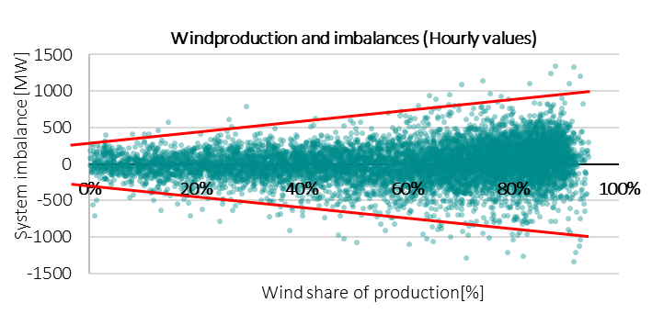
Consumption and production flexibility is key to keep the system in balance

Slide 5


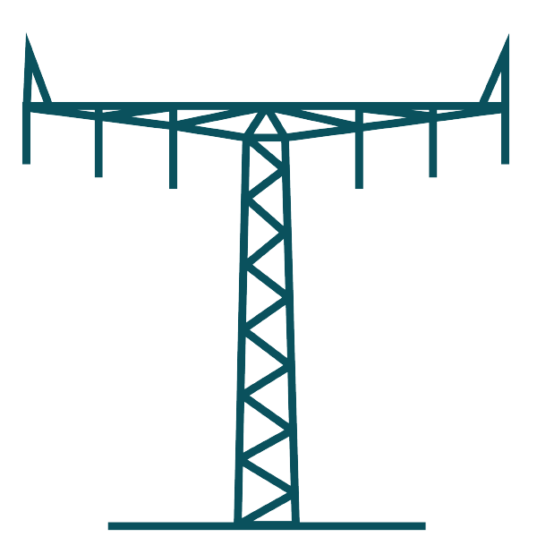

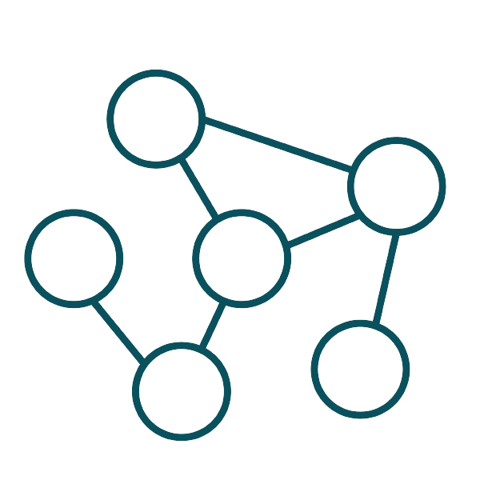

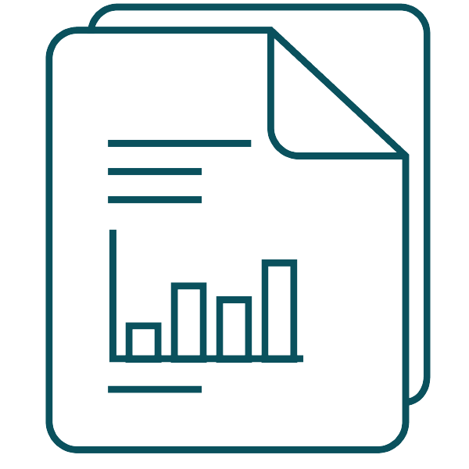
Requirements and grid codes
There is more to it than just plugging in an asset….
Why?
What?
How?
A NEW REALITY
WE REGULATE, SO WE CAN…
Requirements for Generators (RfG)
FROM central and ideal production with few units TO decentralized, non-consistent and autonomus production with many assets
Production facilities > 0,8kW
 facility,  requirements
Retain Security of supply
Demand Connection Code (DCC)
Covers demand facilities connected to the TSO grid
Avoid cascading of incidents and enlargement of faults
Technical Regulations (tekniske forskrifter)
Follow-up and analyze events for improving and learning
Technical regulations fill the holes that EU regulations do not cover
Balancing
Stability
Quality

Slide 6
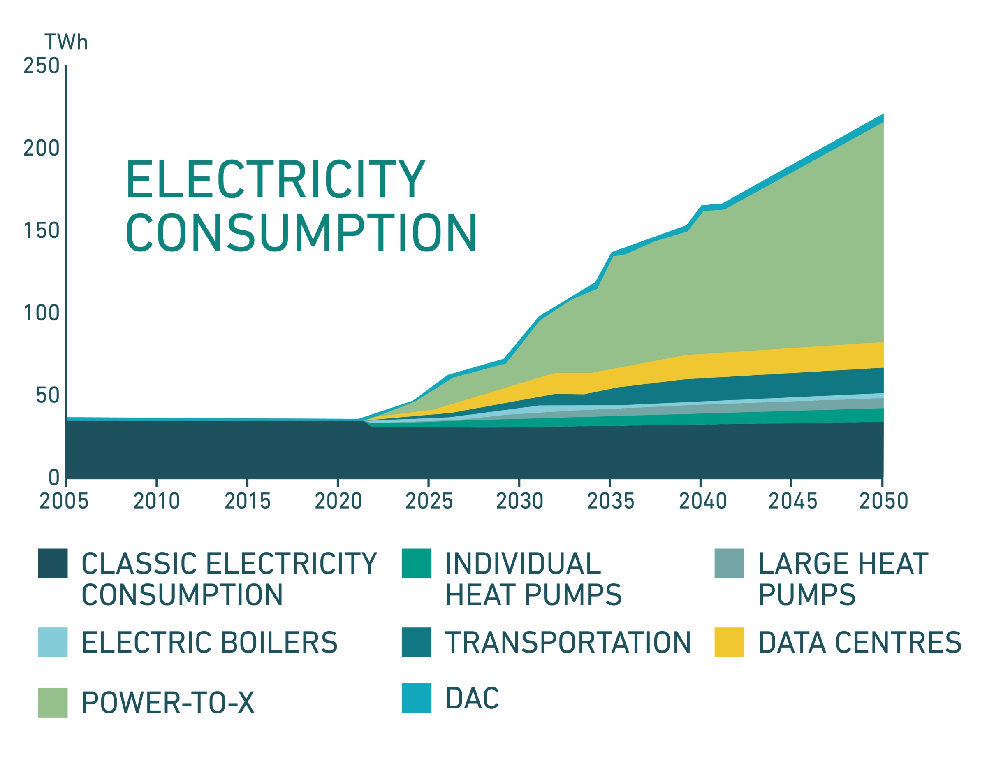
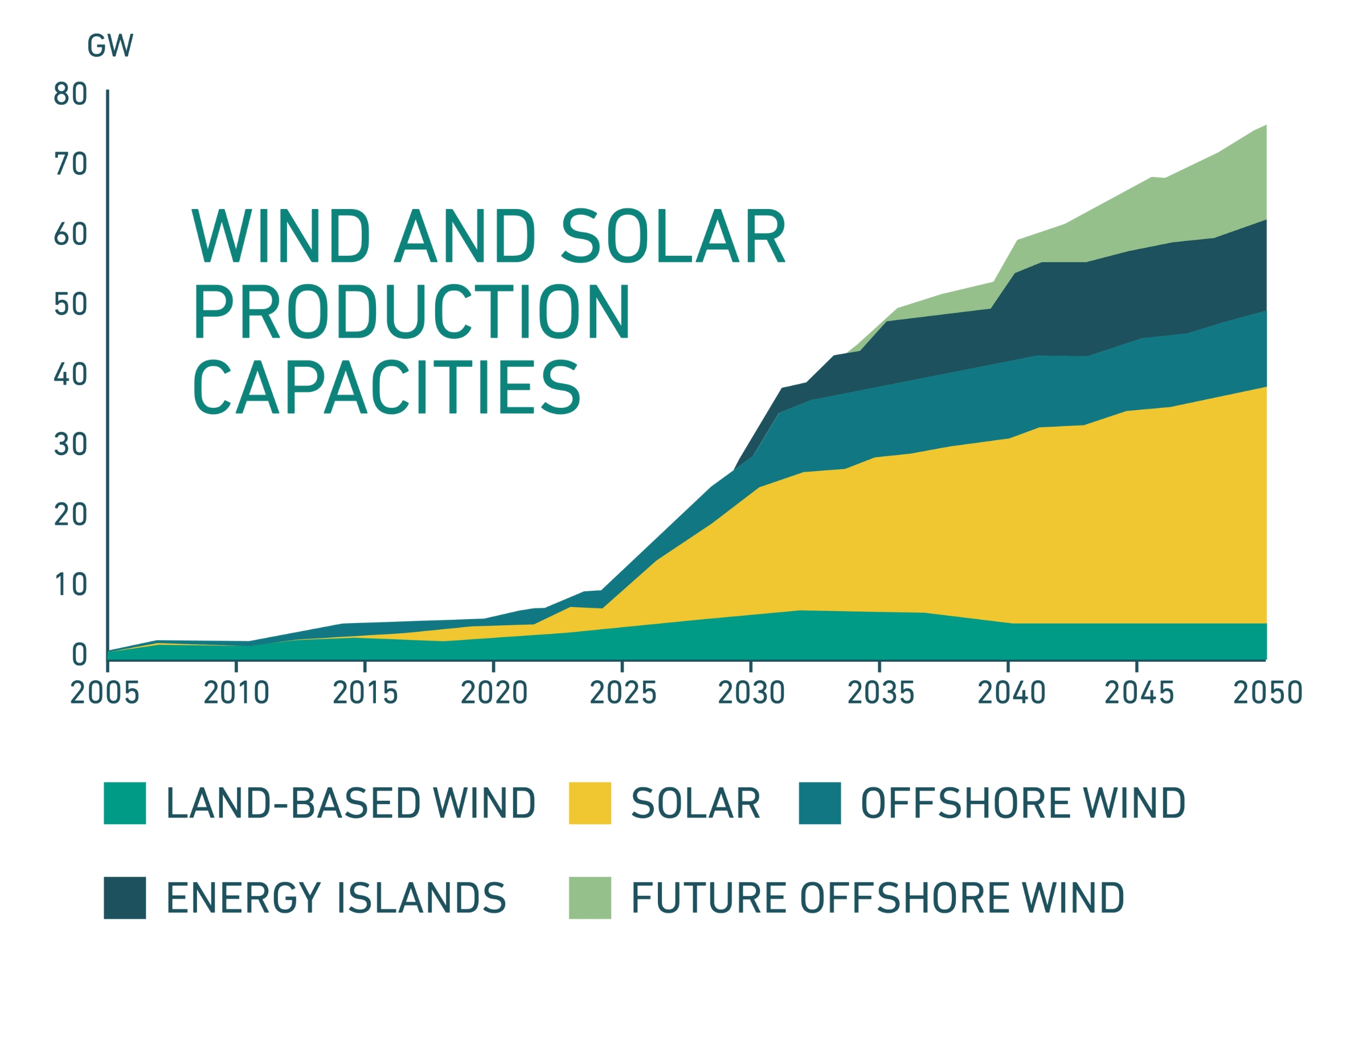
ELECTRICITY CONSUMPTION AND PRODUCTION CAPACITY
RENEWABLE ENERGY PRODUCTION AND ELECTRIFICATION MUST GO HAND IN HAND
Notes:
Danish electricity consumption will explode – even before 2030 it is expected to double. And the expansion of solar cells and wind turbines will grow even faster – production will almost triple by 2030.
The electricity generation of the future will typically be generated at sea or in parts of Denmark where there is neither an electricity grid to transmit the electricity away, nor a consumption that can absorb the new production.
In order to succeed in this extreme trend, we need to expand the electricity grid in time. Otherwise, cables and power lines risk becoming showstoppers for the green transition. Source: Danish Energy Agency's Analysis Assumptions for Energinet 2023. The graphs will be updated when we receive new updated data (AF25) from the Danish Energy Agency

Slide 7
KWI@energinet.dk

