Slide 1
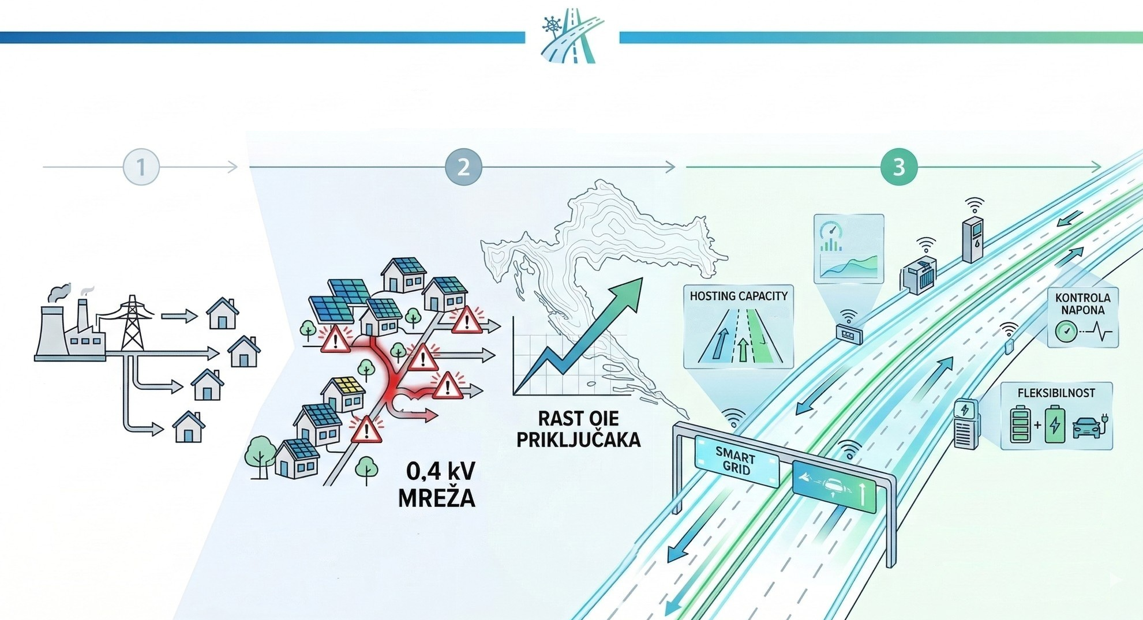
Distribution Network in the Context of Energy Transition
Anton Marušić, dipl.ing.el.
HEP- DSO d.o.o.
Director & Chairman of the Board

Slide 2

Presentation content:
Growth Dynamics of Distributed Energy Resources, Connection Voltage
Bidirectional Flows in an Active Grid
Technical Challenges and Flexibility
Digital Transformation of Management

Slide 3
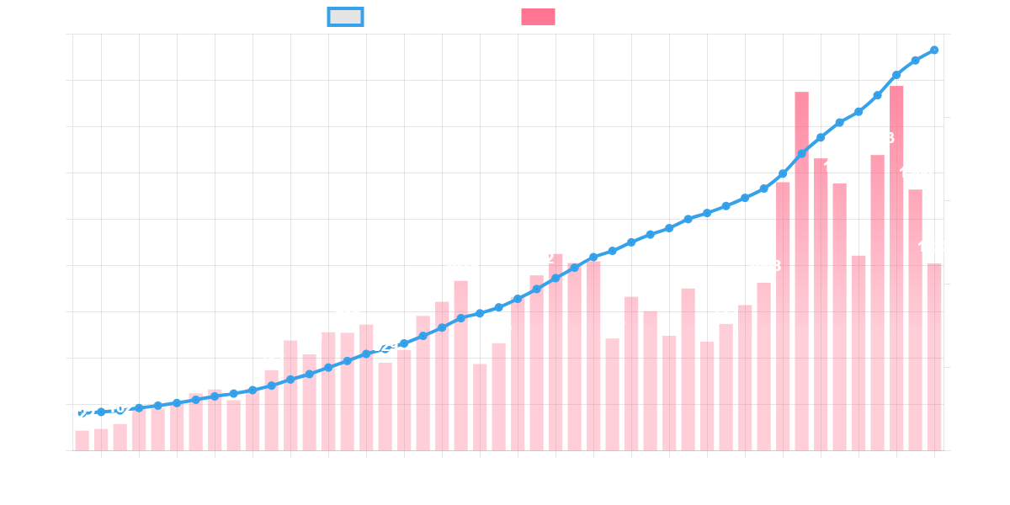
Dynamics of Connecting Power Generation Facilities

Slide 4
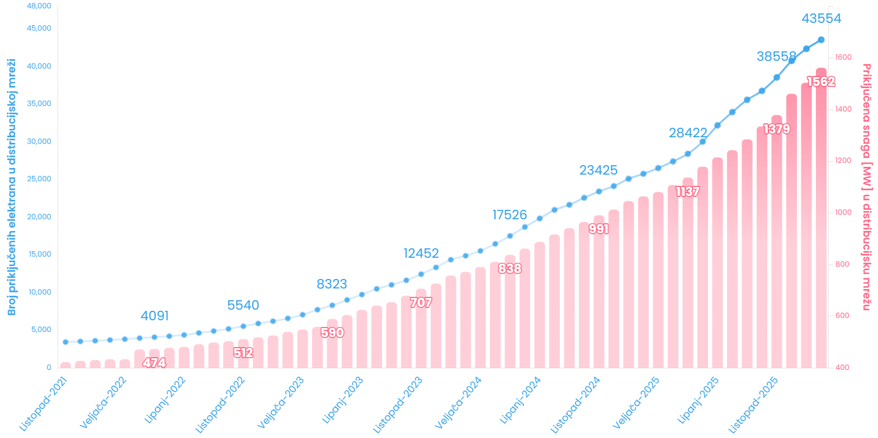
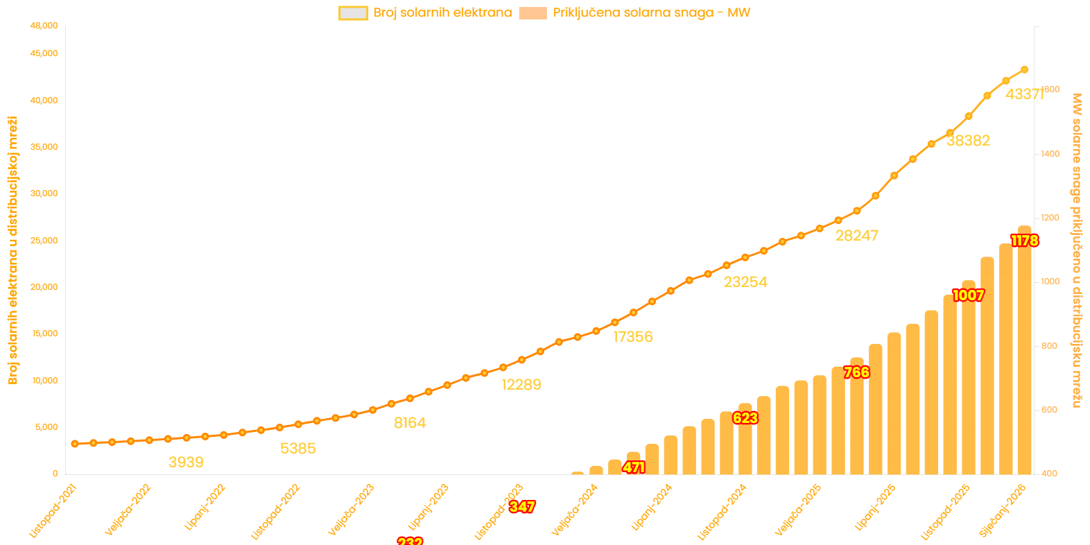
Dynamics of Connecting Power Generation Facilities

Slide 5
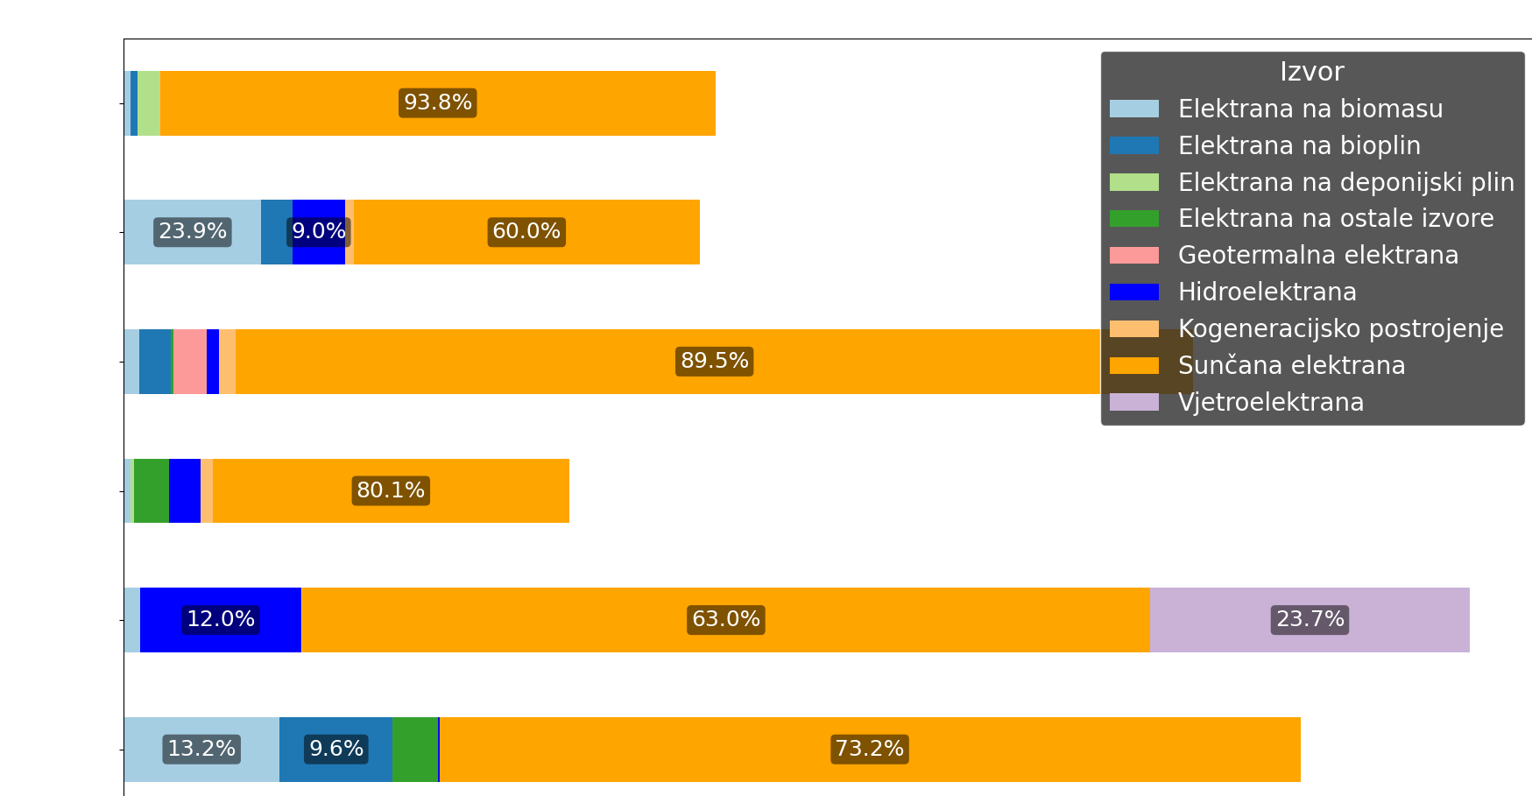
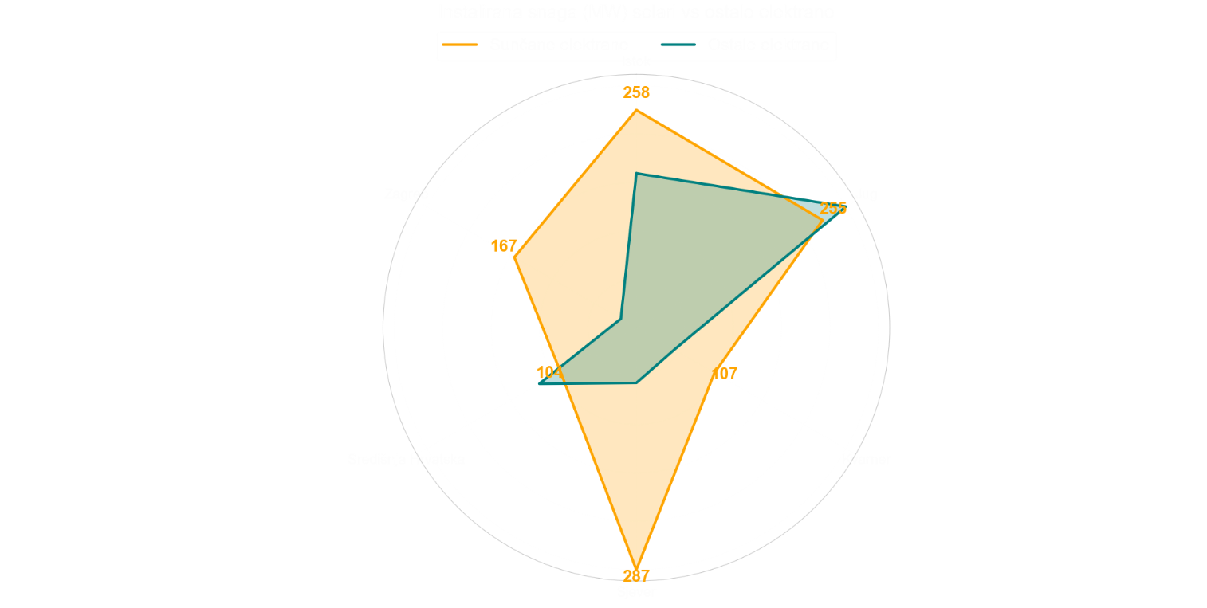
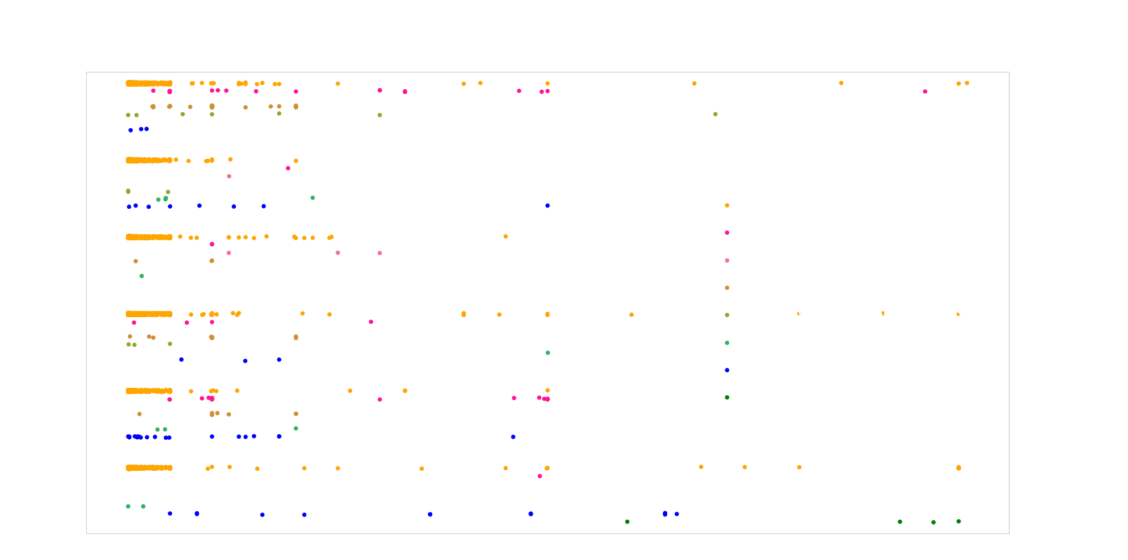
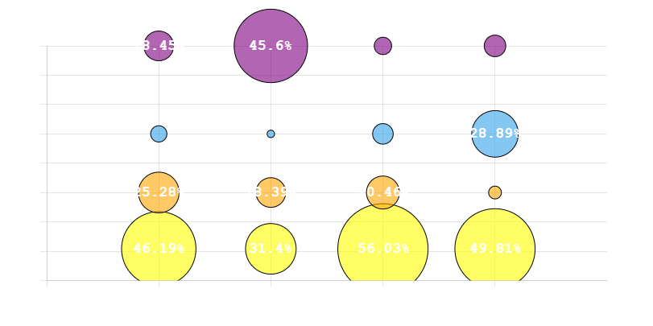
Središnja
Središnja
O,4kV

Slide 6
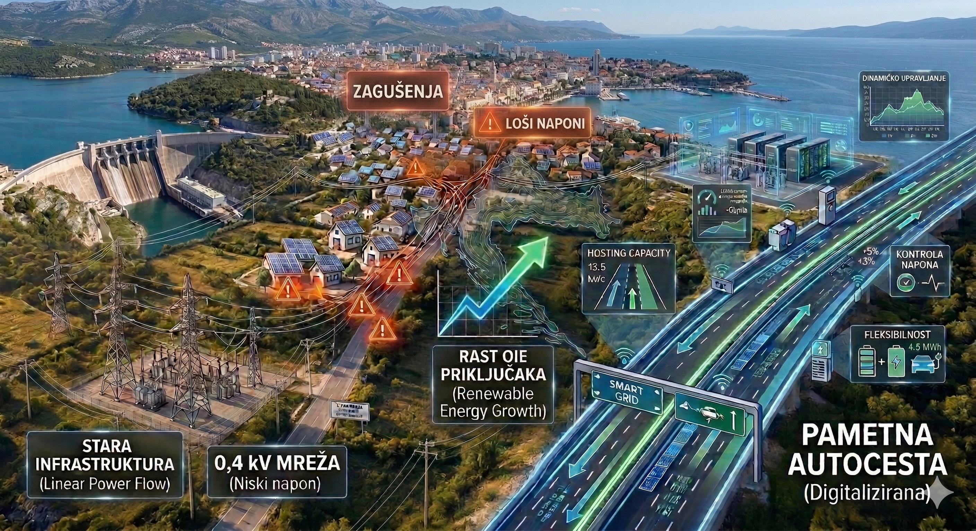
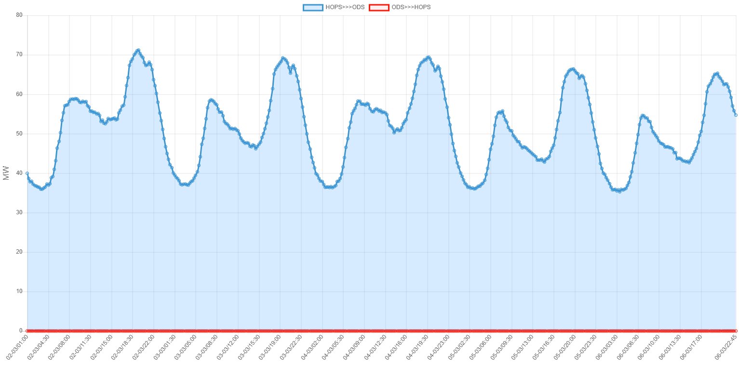
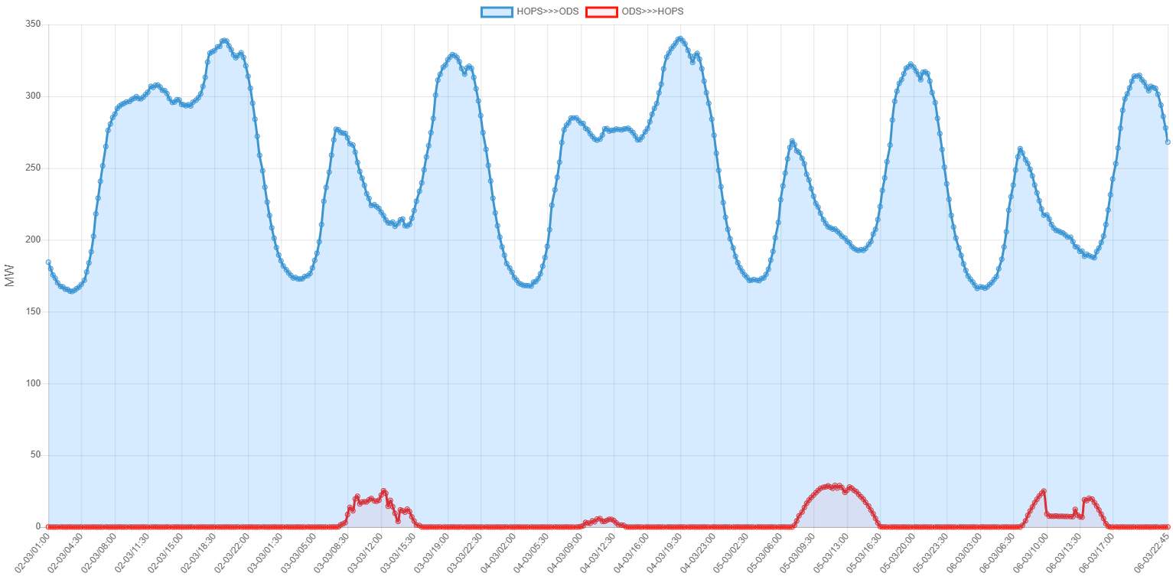
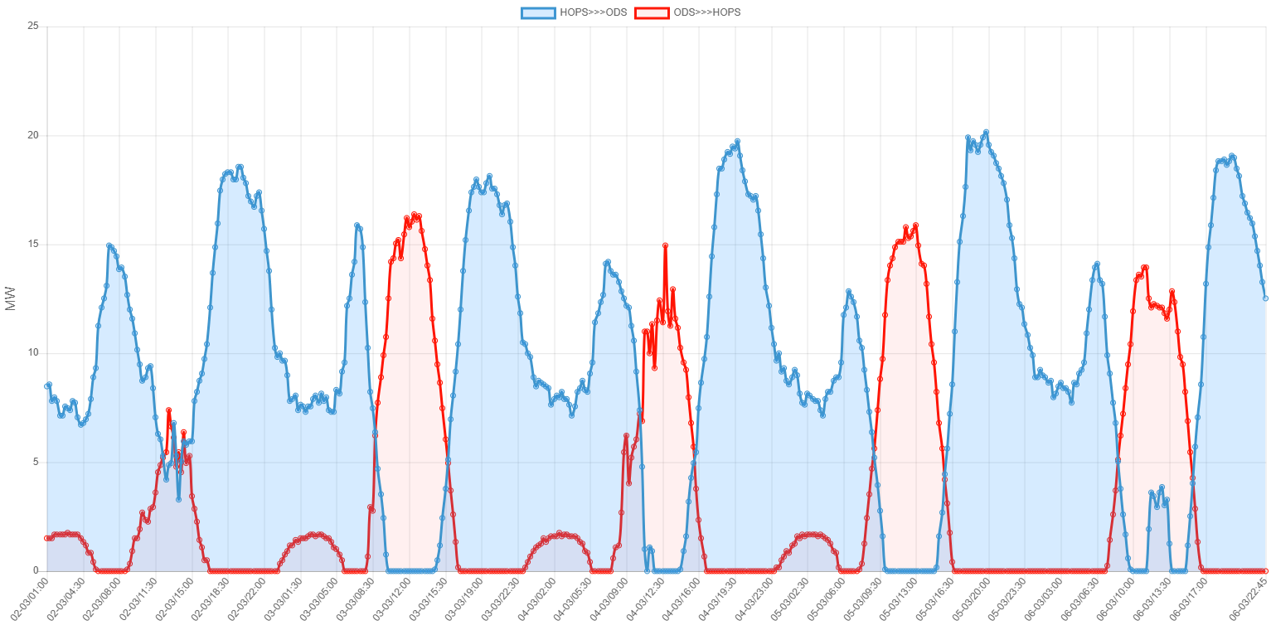
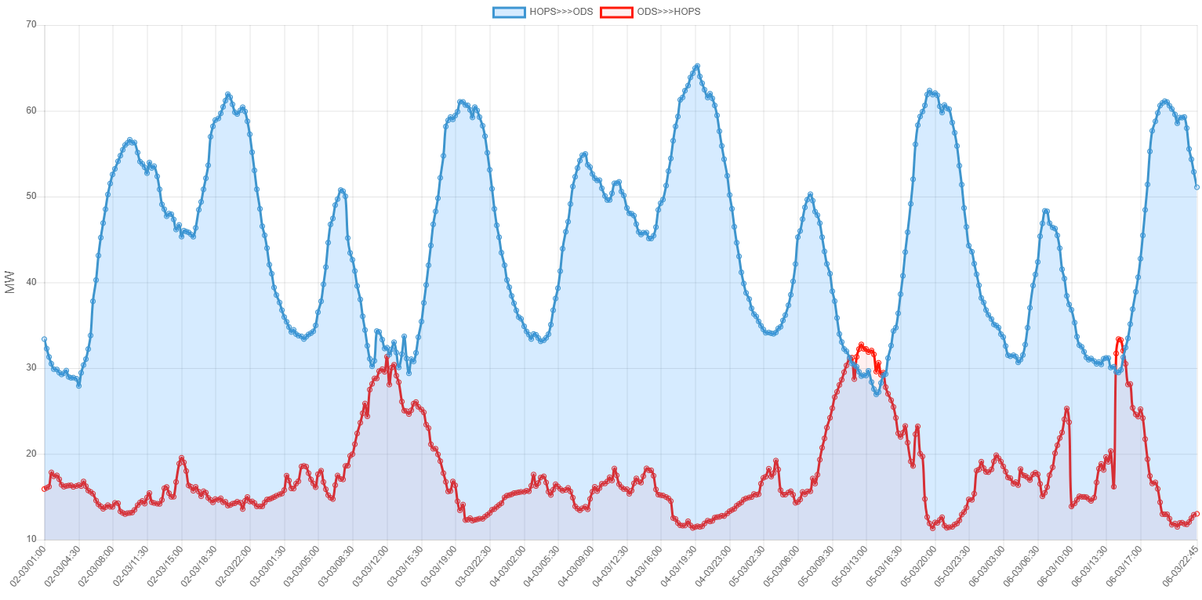
Load Diagrams at the Interface with the Transmission Network
DP Elektrojug Dubrovnik
Elektrodalmacija Split
DP Virovitica
DP Šibenik

Slide 7
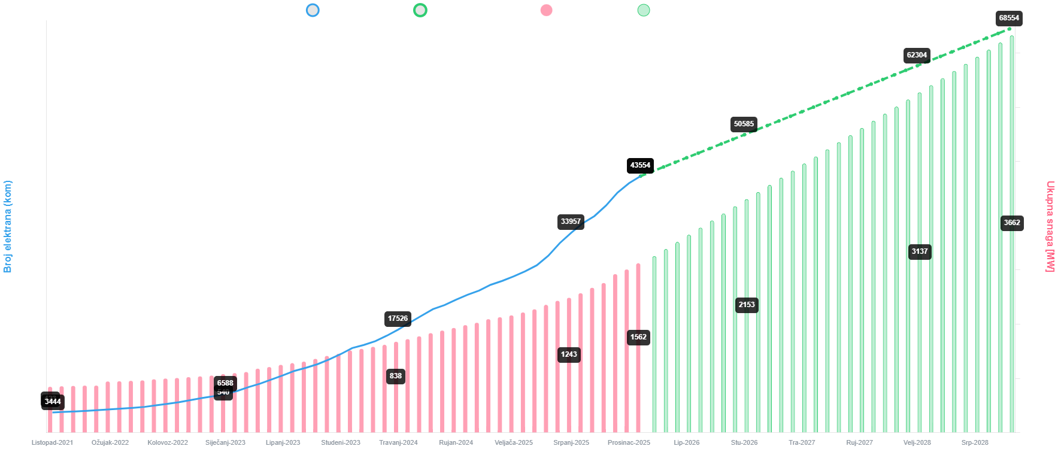
Continuation of Transition – A New Wave of Connections
7

Slide 8
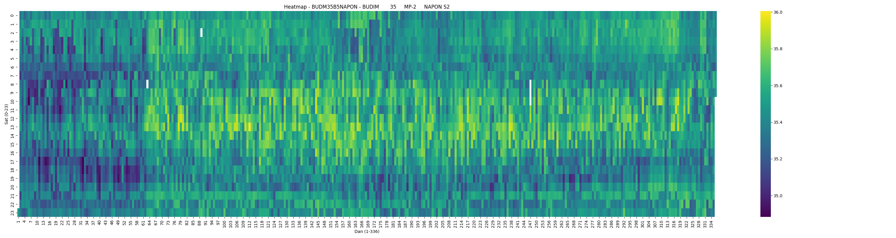
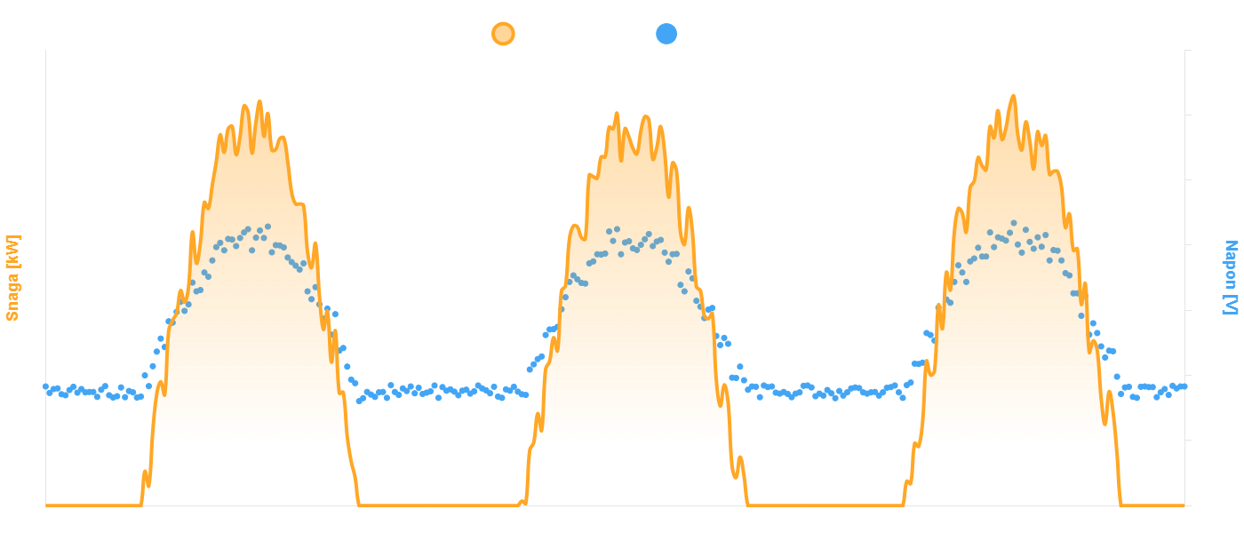

Slide 9
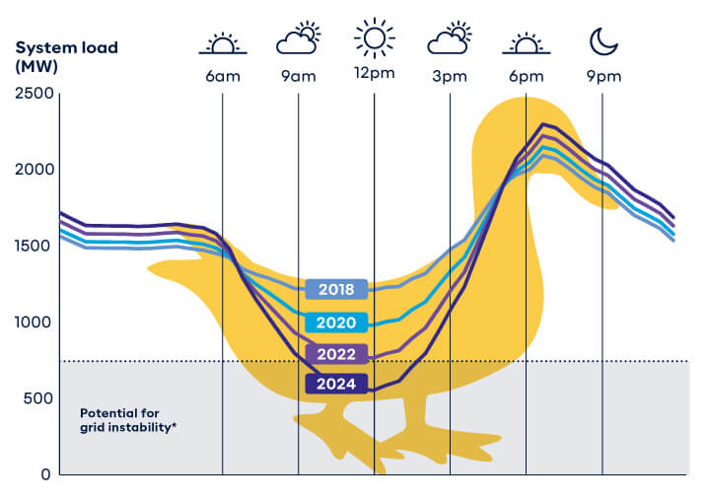
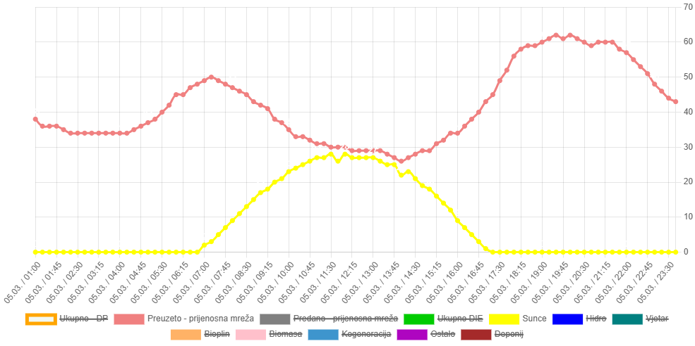
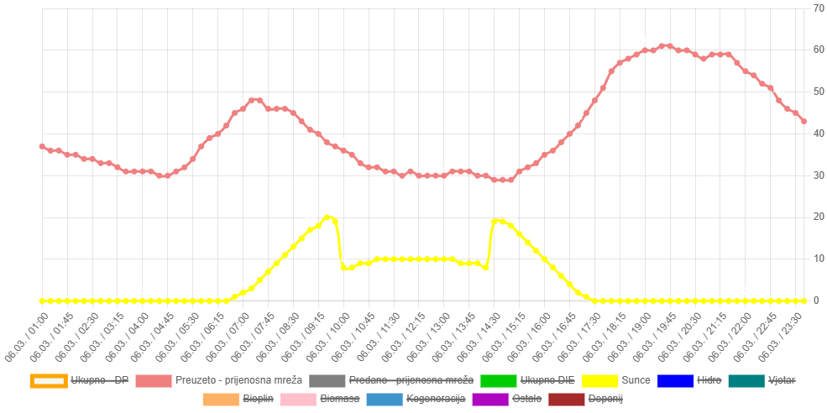
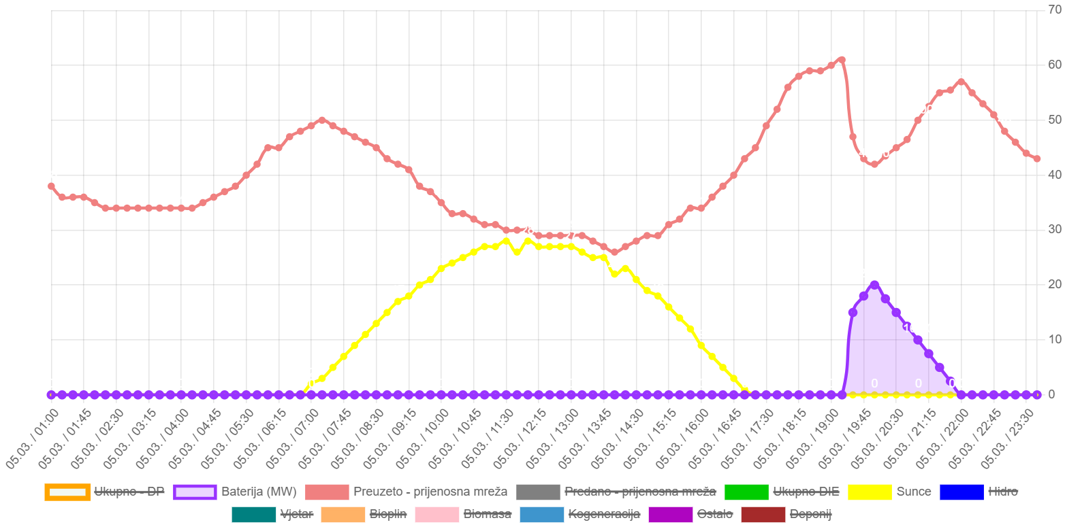
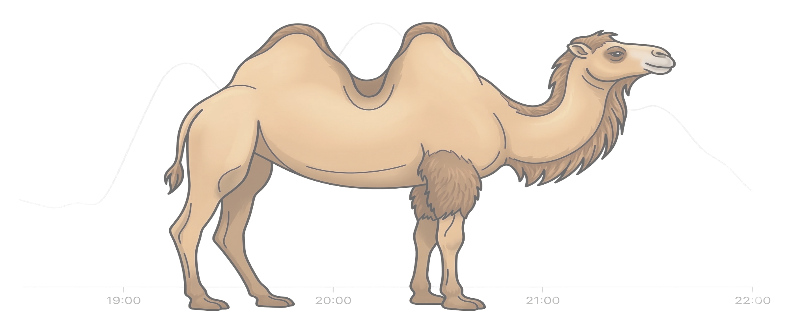

9

Slide 10
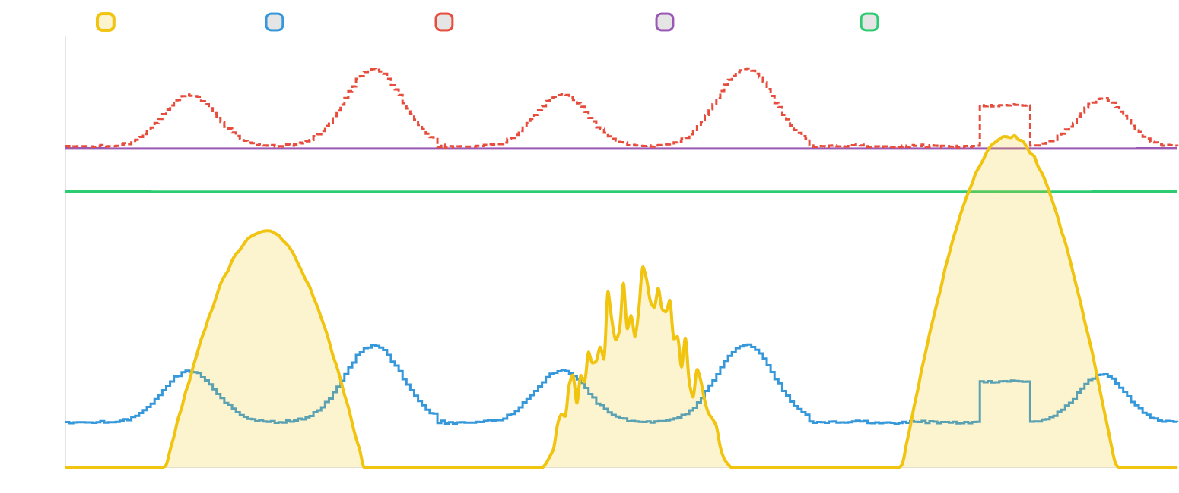
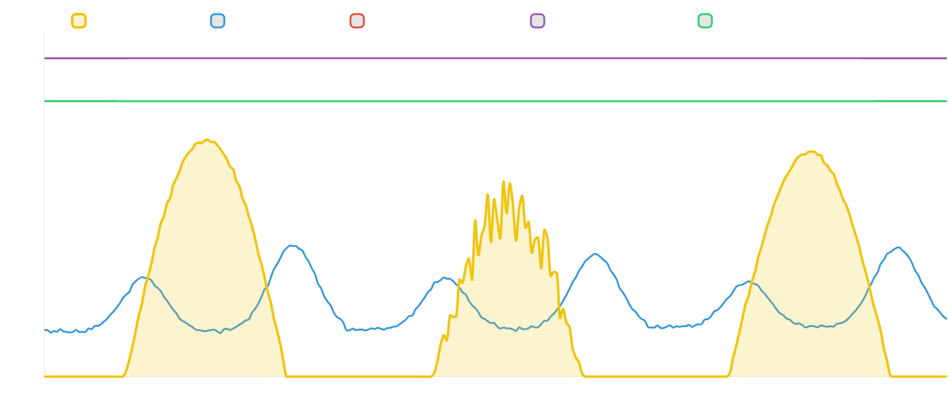
Hosting capacity, Flexibility
10

Slide 11
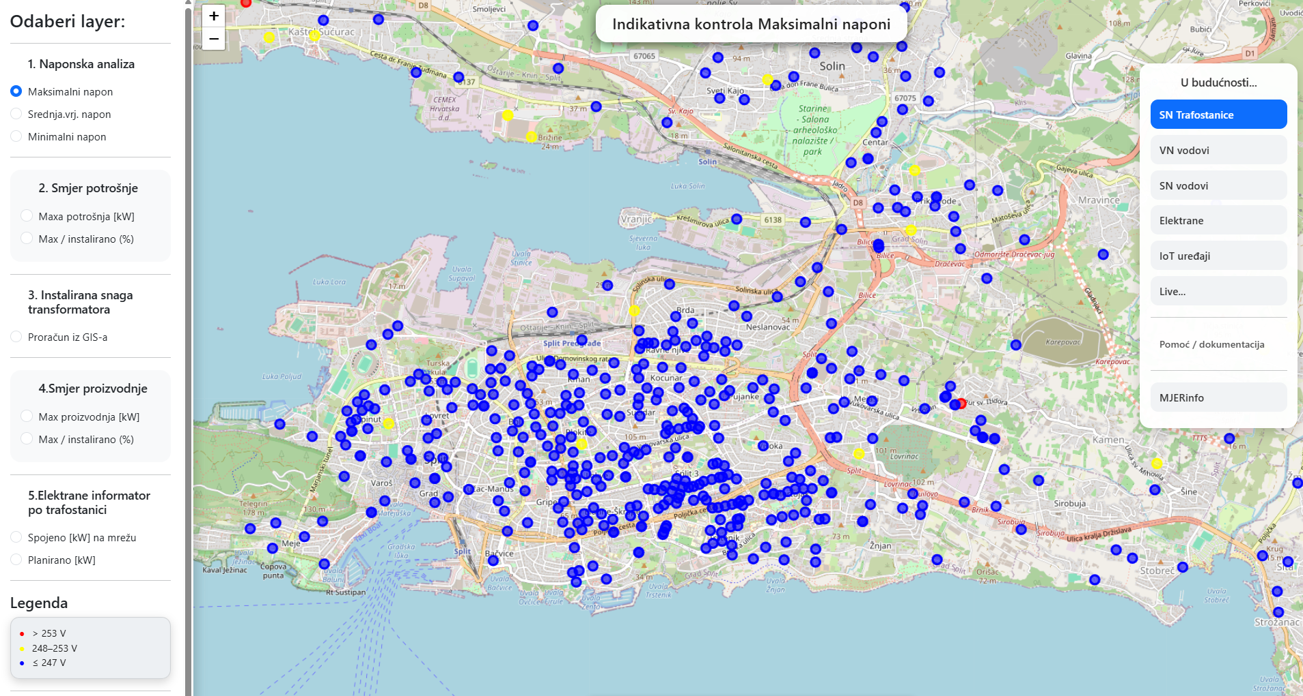
Development of Digitalization and Applications

Slide 12
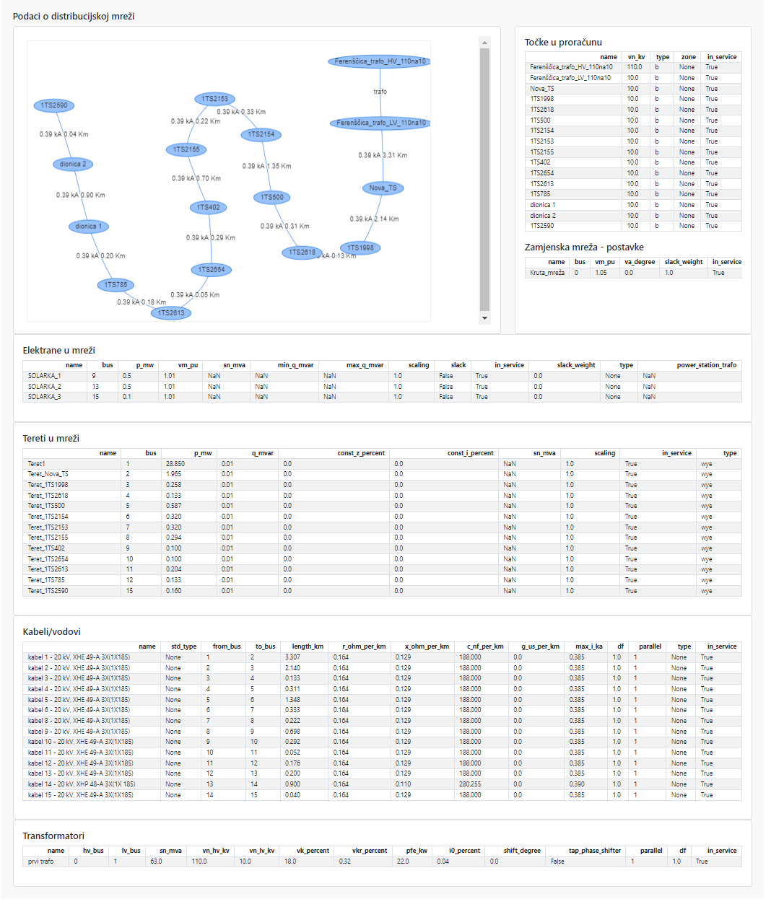
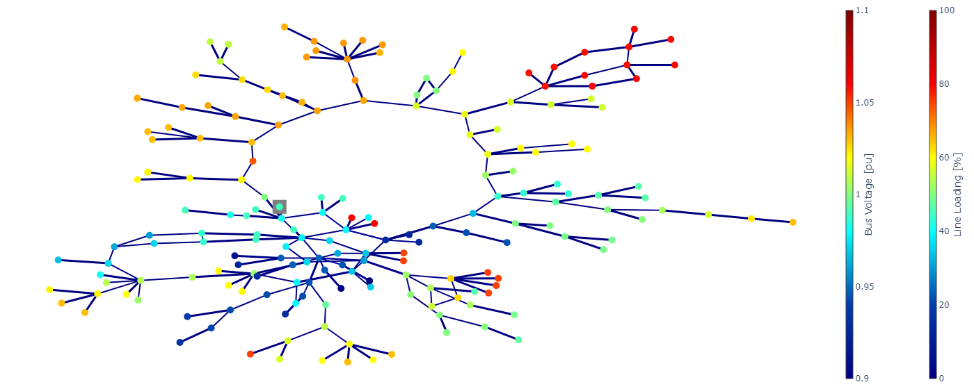
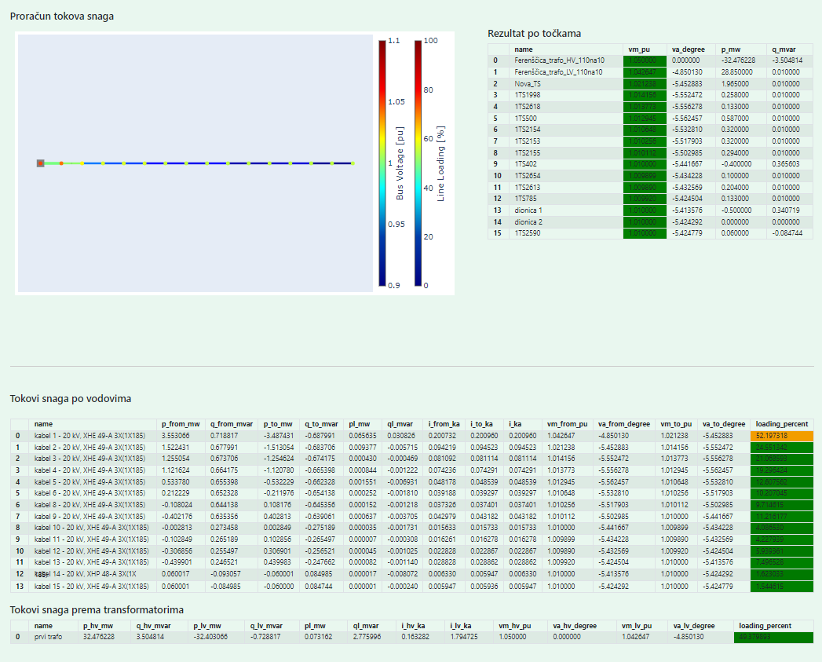
Development of Digitalization and Applications
12

Slide 13

Thank you for your attention!
Questions?

