Slide 1

Ditte Juul Jørgensen
22 Avril 2026
EUFORES National Parliamentary
Workshop, Croatia
Louis Krawczyk
Directorate-General for Energy
Delivering the Clean Industrial Deal
Implications for Croatia’s energy system and industrial competitiveness

Slide 2
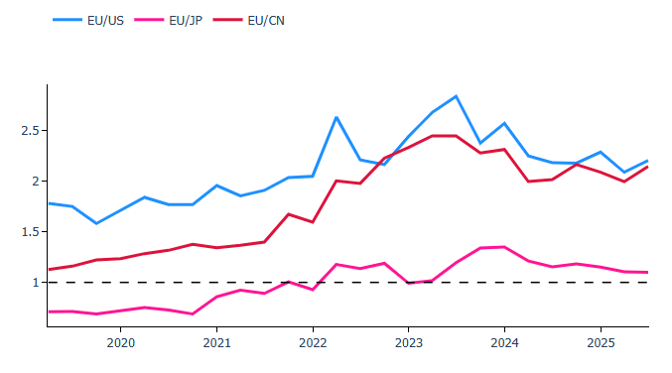
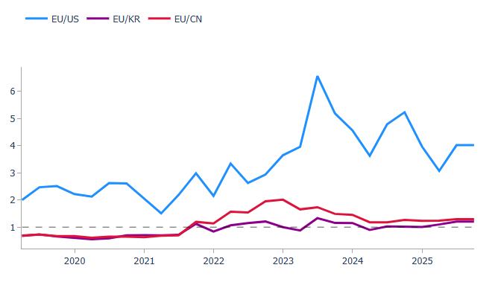
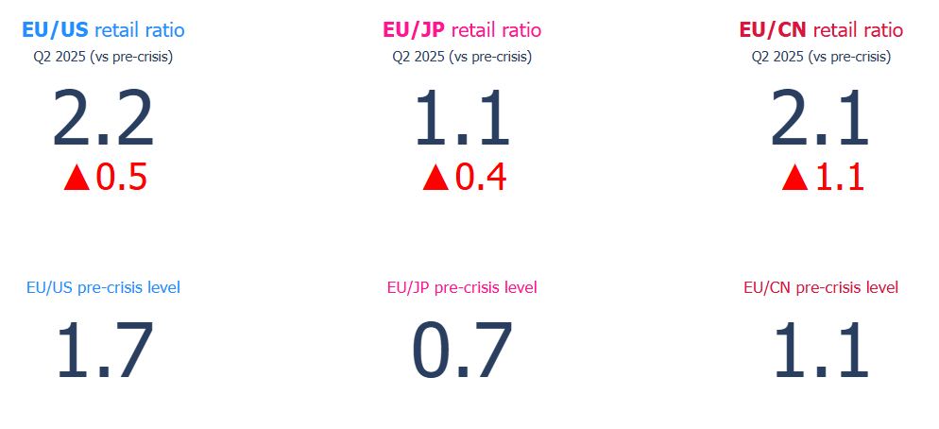
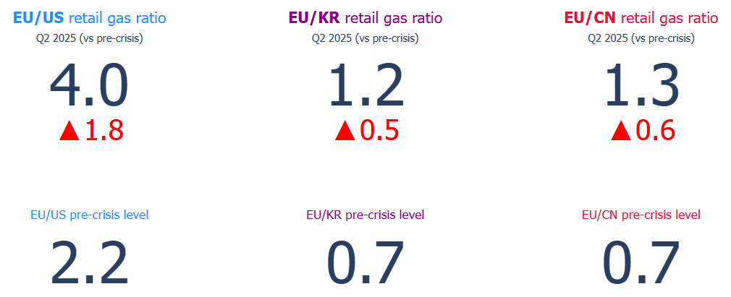
EU companies pay significantly higher energy prices
Industrial electricity price differentials between the EU and its trading partners
Industrial gas price differentials between the EU and its trading partners

Slide 3
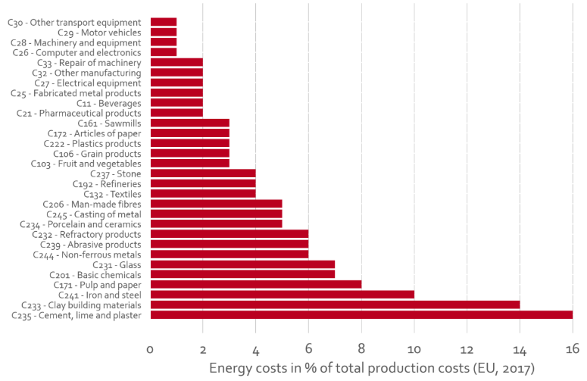
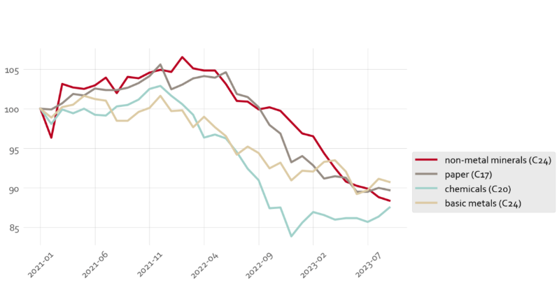
Energy intensive industries are most exposed
Energy cost share for selected manufactured products
EU total production of energy-intensive industries, indexed to 100 in Jan-2021

Slide 4
Decarbonization,
the EU’s only way out

Slide 5
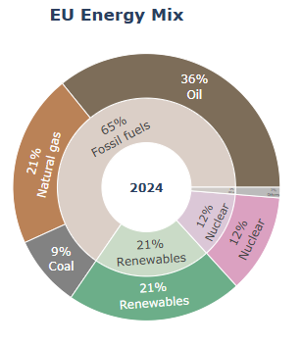
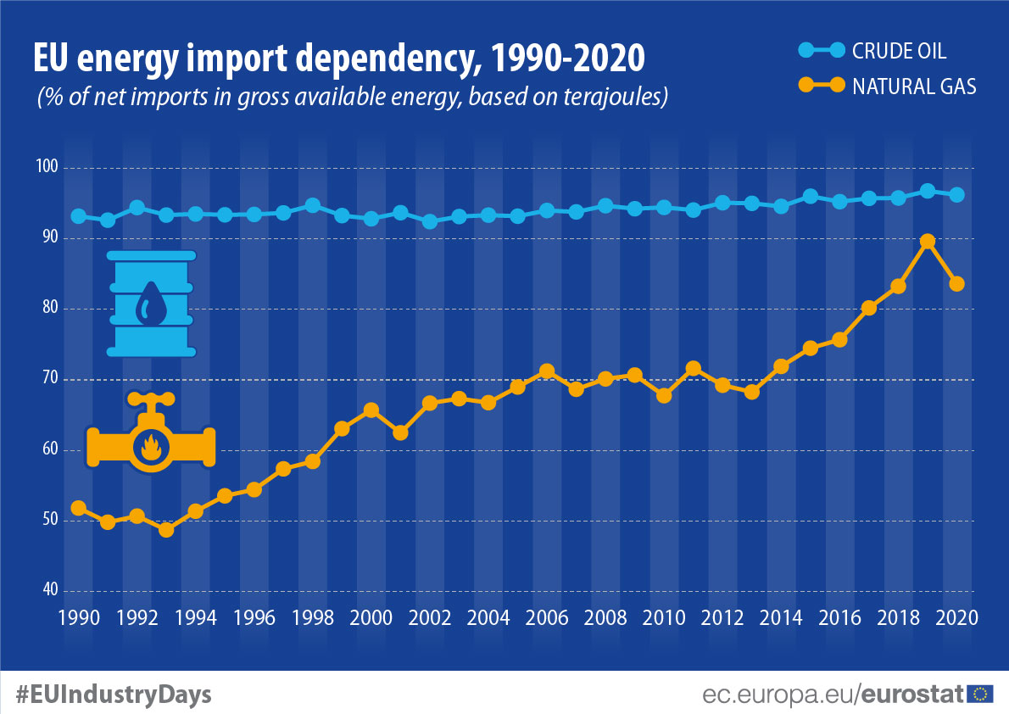
Fossil fuels are volatile, expensive and locks the EU into harmful dependencies (1/2)
Notes:
The levelised costs of electricity (LCOE) is a method for comparing the average cost of generating one unit of electricity (commonly measured in megawatt-hours, MWh) over the entire lifespan of a power-generating asset or project, taking into account all costs associated with building and operating the power plant (capital expenditures, operating and maintenance costs, fuel costs (if applicable), financing costs, and decommissioning costs (if applicable))

Slide 6
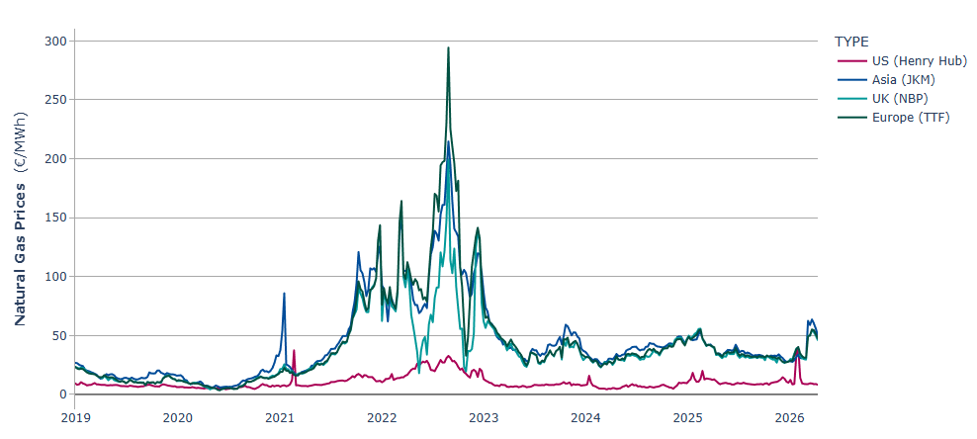
Fossil fuels are volatile, expensive and locks the EU into harmful dependencies (2/2)
International Natural Gas prices (€/MWh)
Notes:
The levelised costs of electricity (LCOE) is a method for comparing the average cost of generating one unit of electricity (commonly measured in megawatt-hours, MWh) over the entire lifespan of a power-generating asset or project, taking into account all costs associated with building and operating the power plant (capital expenditures, operating and maintenance costs, fuel costs (if applicable), financing costs, and decommissioning costs (if applicable))

Slide 7
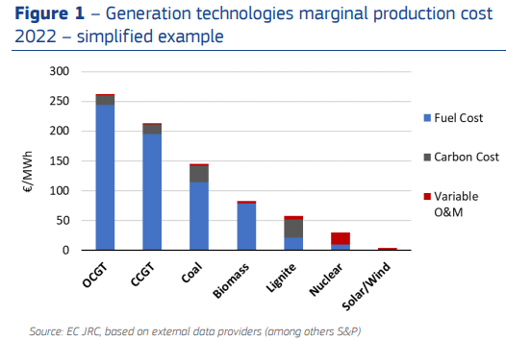
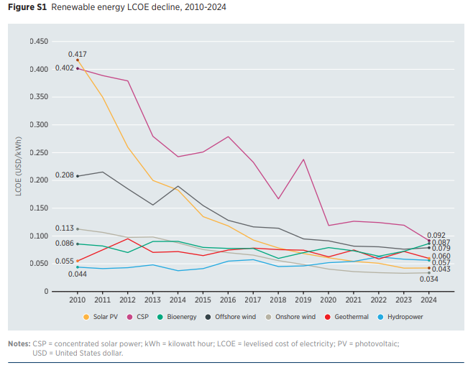
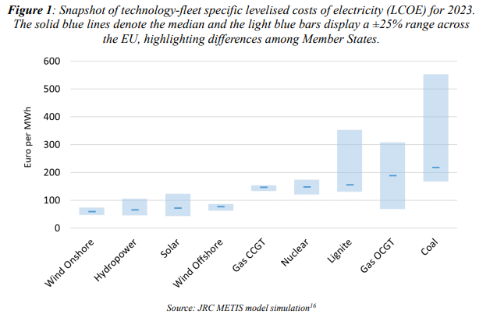
A rising cost advantage for renewables
Notes:
The levelised costs of electricity (LCOE) is a method for comparing the average cost of generating one unit of electricity (commonly measured in megawatt-hours, MWh) over the entire lifespan of a power-generating asset or project, taking into account all costs associated with building and operating the power plant (capital expenditures, operating and maintenance costs, fuel costs (if applicable), financing costs, and decommissioning costs (if applicable))

Slide 8
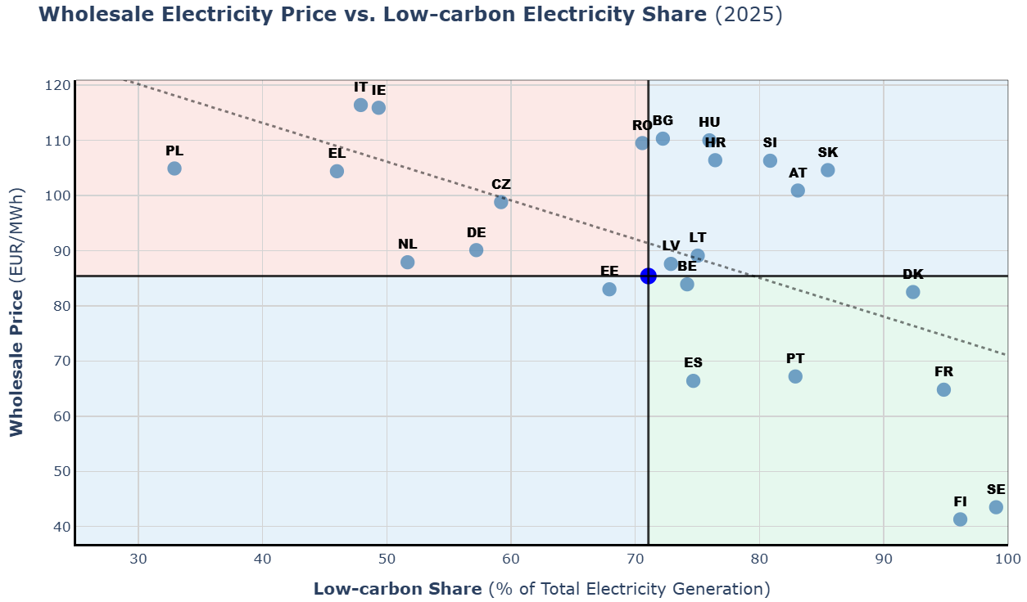
Result: high low-carbon energy = cheap electricity

Slide 9
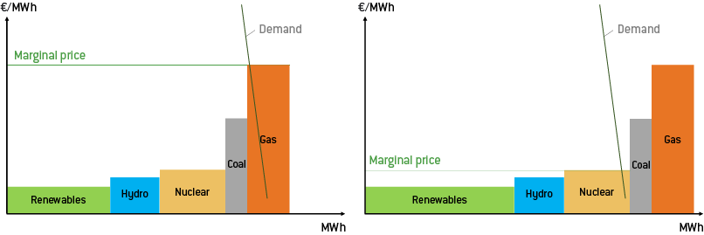
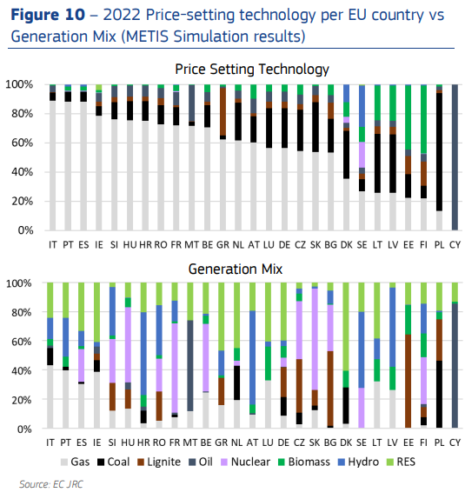
The merit order and price-setting dynamics in EU

Slide 10
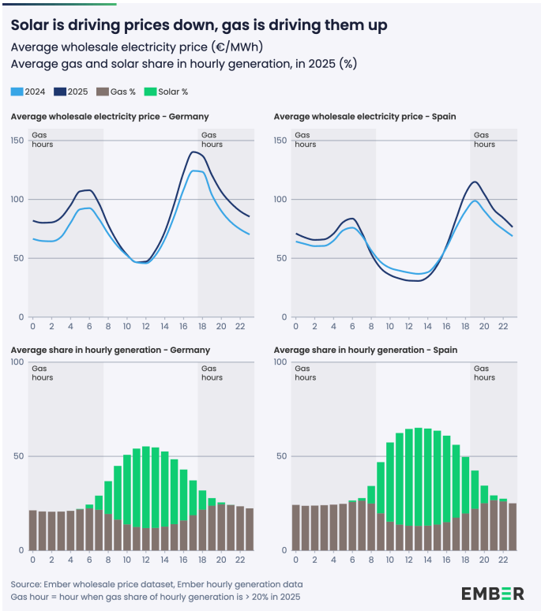
The need to improve the electricity system flexibility

Slide 11
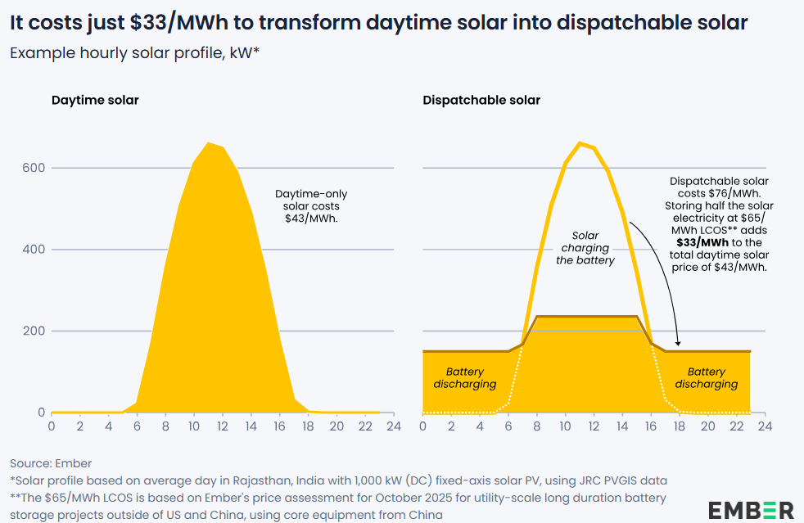
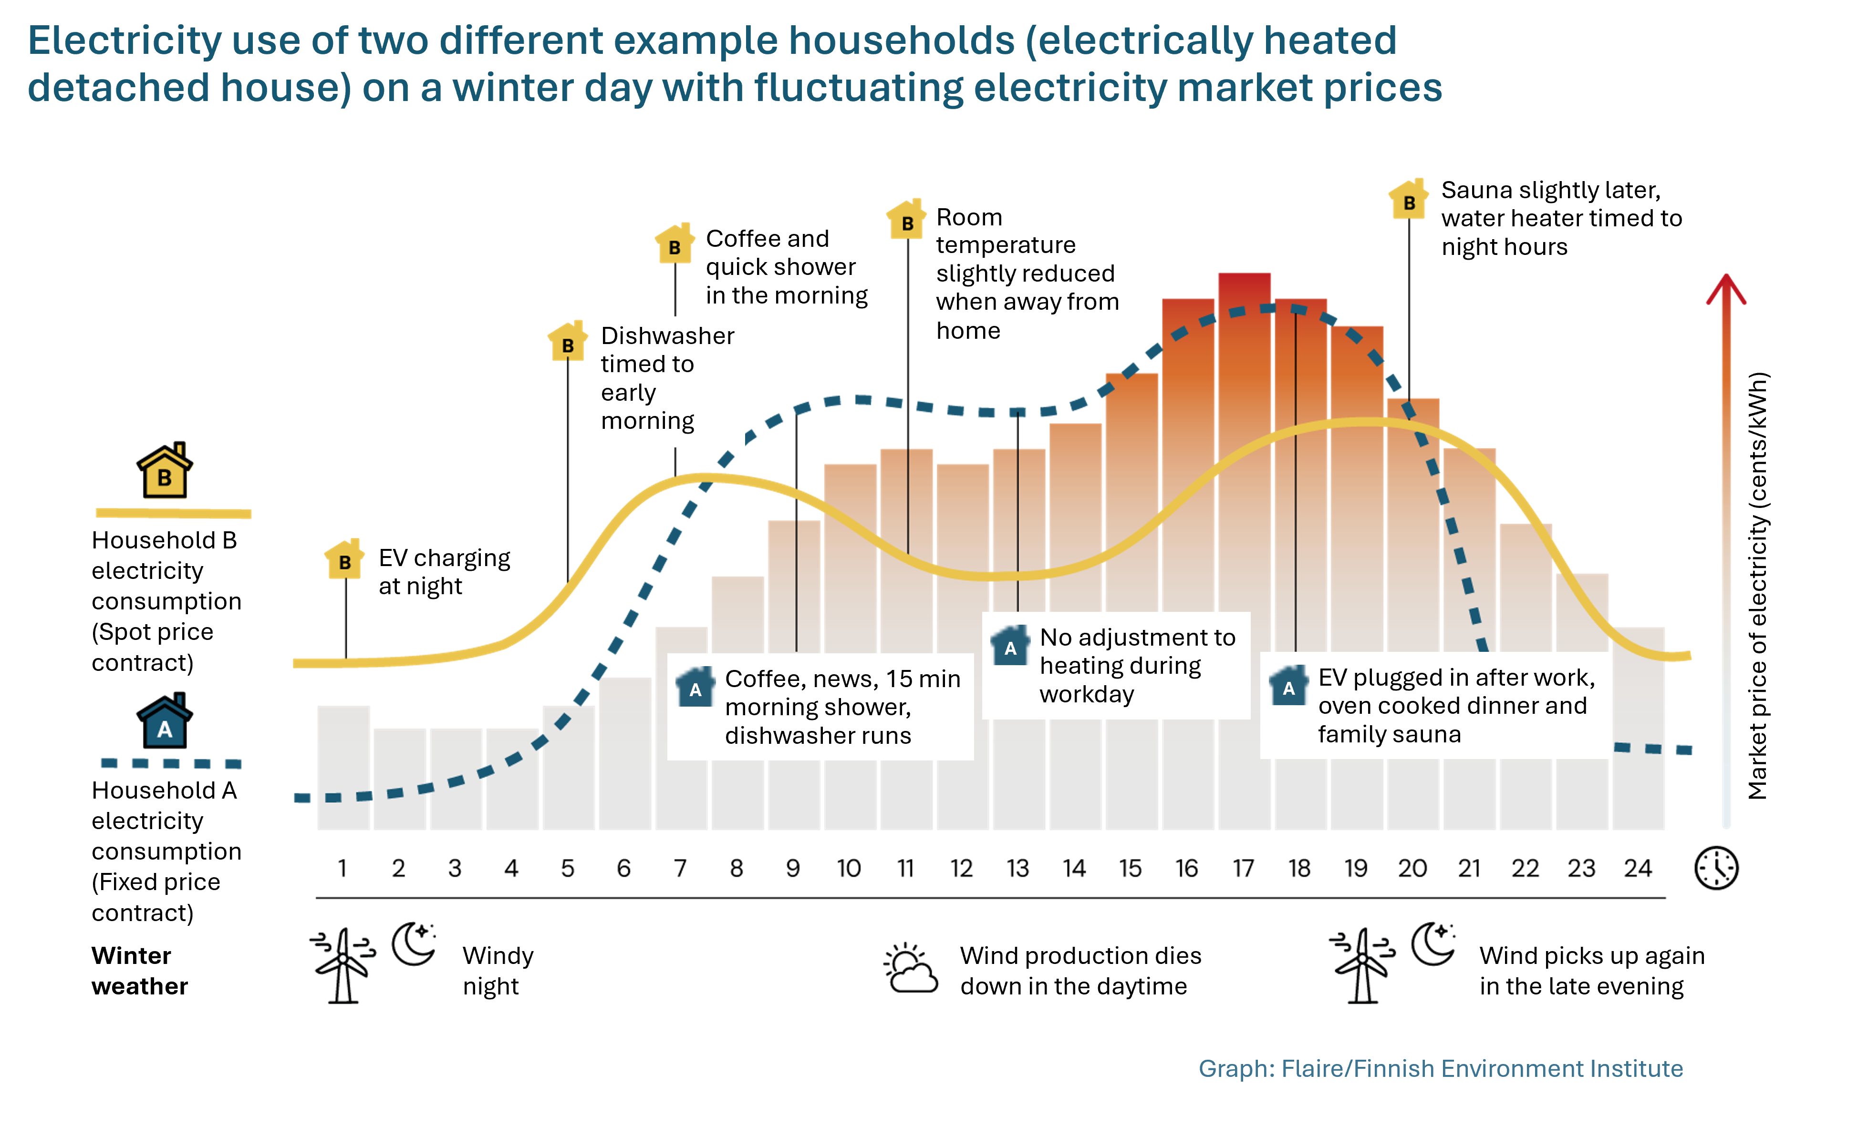
Solution: storage, demand-side response and…

Slide 12
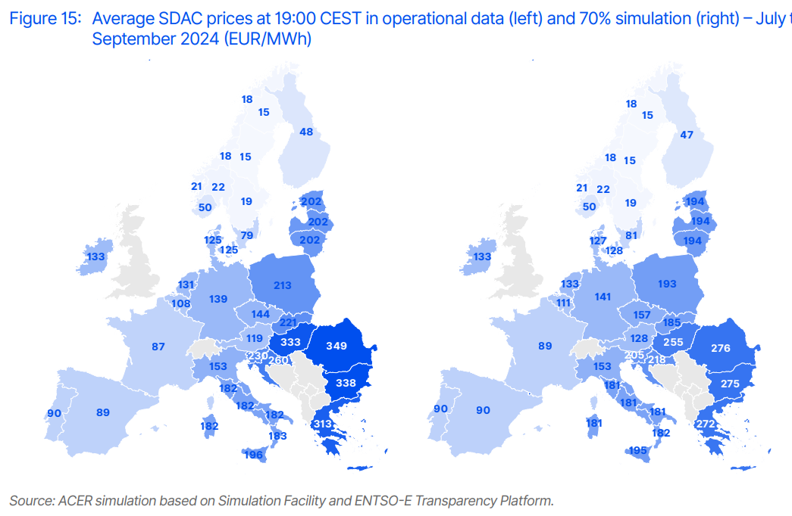
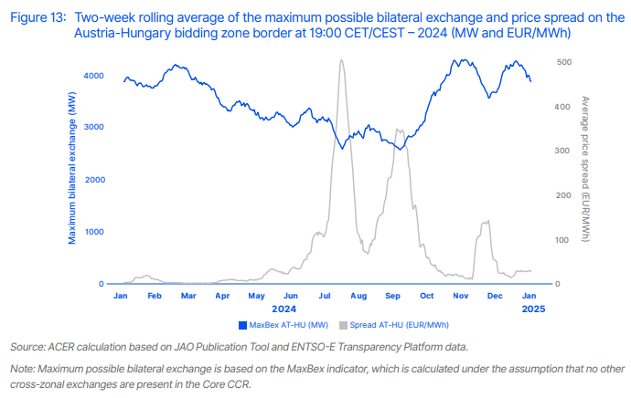
Interconnectivity!

Slide 13
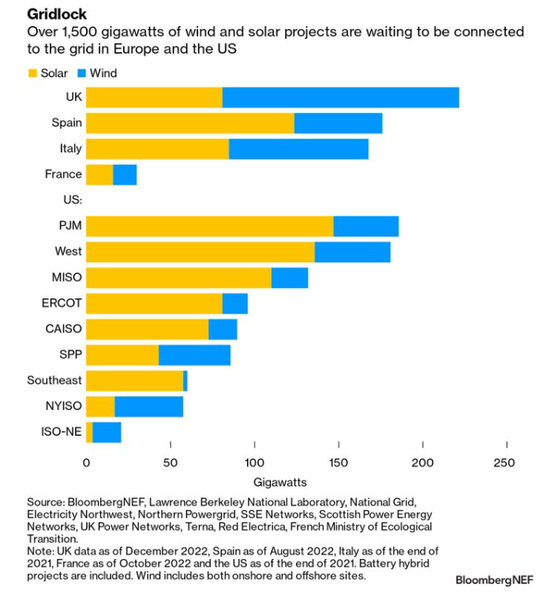
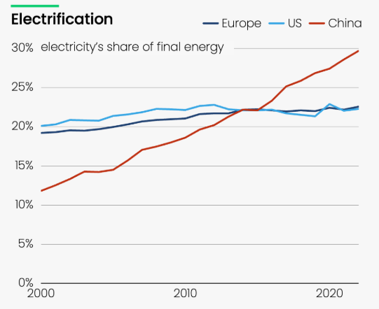
Grid reinforcement needs and stagnant electrification

Slide 14
A comprehensive policy framework at EU level

Slide 15
EU targets for 2030 under Fit for 55 and REPowerEU
32%
40%
42.5%
Renewable Energy Directive (RED)
Energy Efficiency Directive (EED)
-32.5%*
-36%*
-9%**
-11.7%**
45%
-13%
2018
Fit for 55 proposal
REPowerEU proposal
March 2023 Agreement
* relative to 2007 reference scenario
** relative to 2020 reference scenario

Slide 16


Competitiveness compass
Closing the innovation gap
A joint strategy for decarbonisation & competitiveness
Increasing security & reducing excessive dependencies
Clean Industrial Deal &
Action Plan for Affordable Energy
16

Slide 17
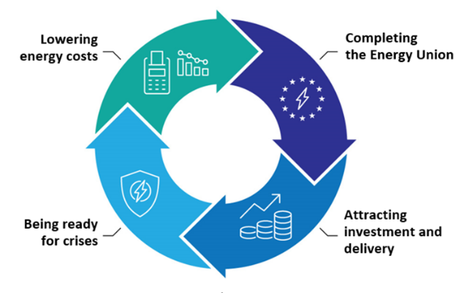
The Action Plan for Affordable Energy 4 Pillars, 8 Actions
Action 1: Making electricity bills more affordable
Action 2: Bring down the costs of electricity supply
Action 3: Improve gas markets for fair energy prices
Action 4: Energy efficiency: delivering energy savings
Action 5: Completing the Energy Union
Action 7: Security of supply for price stability
Action 8: Price crisis preparedness
Action 6: A tripartite contracts for affordable energy for Europe’s industry

Slide 18

Action Plan for affordable energy – 2026 initiatives
Electrification
Electrification Action Plan
White Paper on deepening the electricity market
Consumers
Citizens Energy Package (published in 03/26)
Security and digitalisation
Review of the energy security framework
Post-2030 framework
Review of the Governance regulation
Strategic roadmap for digitalisation and AI in energy
Clean Energy Investment Strategy (published in 03/26)
Investments
Renewable energy and energy efficiency frameworks
Grids
Grids Package (published in 12/2025)

Slide 19
Annex

Slide 20
The EU’s enabling framework to boost flexibility
The EU supports the four key mechanisms through targeted funding, regulation and market reforms.
Battery Energy Storage Systems (BESS)
Interconnection Flexibility
EU Innovation Fund: €10B+ for clean tech including BESS
Important Projects of Common European Interest (IPCEI) for batteries
NER400 & Horizon Europe grants for large-scale storage pilots
2024 Electricity Market Design Regulation removes barriers for storage to participate in all markets
CEF Energy: €5.8B for cross-border grid projects (2021–27)
TEN-E Regulation fast-tracks Projects of Common Interest (PCIs)
15% interconnection target by 2030 for all Member States
ENTSO-E coordinates cross-border balancing and redispatch
Pumped Storage Hydropower (PSH)
Demand-Side Flexibility
CEF Energy & Cohesion Funds support PSH upgrades
Revised Renewable Energy Directive streamlines permitting
New market design allows PSH to monetise flexibility services
State aid guidelines permit capacity payments to incentivise long-duration storage
Energy Efficiency Directive: mandatory smart meter rollout
Market Design reform mandates demand response access to all market timeframes
Aggregators given legal status to participate in wholesale & balancing markets

Slide 21

Thank you
© European Union 2025
Unless otherwise noted the reuse of this presentation is authorised under the CC BY 4.0 license. For any use or reproduction of elements that are not owned by the EU, permission may need to be sought directly from the respective right holders.
Slide xx: element concerned, source: e.g. Fotolia.com; Slide xx: element concerned, source: e.g. iStock.com
Notes:
Update/add/delete parts of the copy right notice where appropriate.
More information: https://myintracomm.ec.europa.eu/corp/intellectual-property/Documents/2019_Reuse-guidelines%28CC-BY%29.pdf

