Slide 1
Implementing EU energy efficiency policies: priorities and opportunities for Croatia
EUFORES National Parliamentary Workshop, Croatia – 16 April 2026
Louis Krawczyk, European Commission, DG Energy

Slide 2
Energy efficiency policy triple dividend
1) Competitiveness
Clean Industrial Deal and Affordable Energy Action Plan
New Energy Efficiency Impetus: European Grids Package (already adopted), (upcoming) Heating and Cooling Strategy, Electrification Action Plan, Strategic Roadmap for digitalisation and AI in the energy sector
2) Decarbonisation
Green Deal and Fit for 55 Package: including Energy Efficiency Directive, Renewable Energy Directive, Energy Performance of Building Directive
3) Energy security
Phase–out of strategic dependencies
Strengthen the resilience of EU energy system vis-a-vis geopolitical crises impacting the global energy market

Slide 3
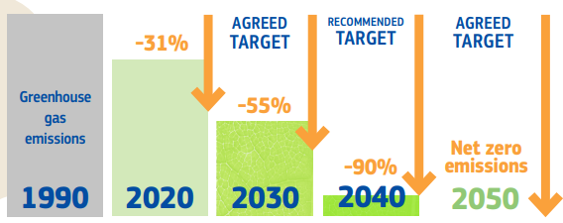
EU Climate and Energy Targets
EU Climate law : “The world’s first climate-neutral continent by 2050”
75% of emissions from energy => clear EU energy policy goals and targets
Greenhouse Gas Emission Reduction Targets
Renewable Energy Directive (RED):
2030 RES Target
32%
42.5%
Target in 2018
Target in 2023
Agreed TARGET
Energy efficiency (EED):
2030 EED Targets of 2018 as reinforced in 2023
– 11.7% final energy consumption by 2030 compared to 2020 baseline
‘FIT FOR 55’

Slide 4
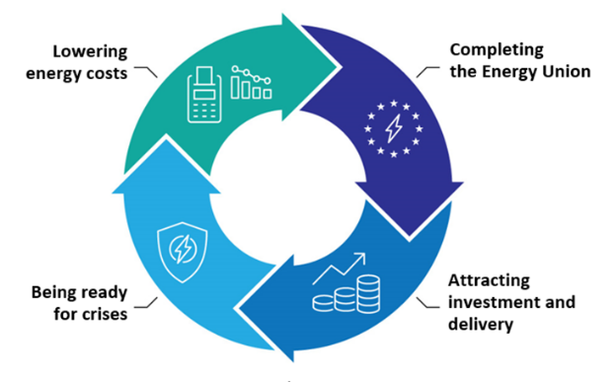
The Action Plan for Affordable Energy
Action 1: Making electricity bills more affordable
Action 2: Bring down the costs of electricity supply
Action 3: Improve gas markets for fair energy prices
Action 4: Energy efficiency: delivering energy savings
Action 5: Completing the Energy Union
Action 7: Security of supply for price stability
Action 8: Price crisis preparedness
Action 6: A tripartite contract for affordable energy for Europe’s industry

Slide 5

Energy Efficiency
Without improvements in energy efficiency over the last 20 years, the EU’s energy consumption today would have been about 30% higher.
10 Energy Efficiency Action Points:
Support and simplify implementation
Mainstream energy efficiency in EU energy policymaking
Strengthen sector-specific policies and product standards
Facilitate financing and investment
Enhance collaboration and cooperation
Create a tradeable energy efficiency market
Develop skills for energy efficiency
Boost research and innovation funding and partnerships
Promote international cooperation
Increase energy efficiency awareness

Slide 6
Energy Efficiency Directive Recast (EU) 2023/1791
Updated EU energy efficiency targets to 11.7% reduction in primary and final energy consumption: indicative PEC target of 992.5 Mtoe, binding FEC target of 763 Mtoe
Strenghten annual national energy saving obligations to 1,49% in average with step-wise approach and exclusion of savings from direct fossil fuels combustion. Including a Just transition sub-target
Reinforcement of the Energy Efficiency First Principle accross sectors
Update the definition of energy efficient district heating and cooling, introducing the 2050 trajectory for efficient district heating and cooling system, and introduce local heating and cooling plans for municipalities (over 45.000).
Update thresholds for energy audits (10TJ/year) and energy management system requirements (85TJ/year) for enterprises
Increase the exemplary role from the public sector: annual reduction of 1.9% of public sector energy consumptions, increase the annual renovation rates to 3% of the public buildings over 250 m2.
Reinforces provisions on financing to leverage further private capitals
Introducing measures to alleviate energy poverty and boost consumer empowerment
11.7%
Decrease
in energy consumption
Stepwise increase
in annual cumulative energy savings
obligation in end use:
1.3% as of 2024
1.5% as of 2026
1.9% as of 2028

Slide 7
Focus areas of the EPBD recast
RENOVATION
DECARBONISATION
Minimum Energy Performance Standards
National trajectories for the progressive renovation of the residential building stock
National Building Renovation Plans
Introduction of zero emission buildings as standard for new buildings
Solar deployment in buildings
Calculation of whole life cycle carbon
Phasing out incentives for fossil fuels and new legal basis for national bans
ENABLING FRAMEWORK
Strengthened Energy Performance Certificates
Renovation passports
Sustainable finance & energy poverty
One-stop-shops
Deep renovation standard
National energy performance databases
MODERNISATION & SYSTEM INTEGRATION
Infrastructure for sustainable mobility
Smart Readiness Indicator
Indoor air quality: ventilation and other technical building systems
Digitisation, data access and exchange

Slide 8
Energy Efficiency Directive recast
Adoption of the final text on 13 September 2023: Directive (EU) 2023/1791
Entry into force on 10 October 2023
Transposition period of 2 years
Energy Performance of Buildings Directive recast
Adoption of the final text on 15 December 2021: Directive (EU) 2024/1275
Entry into force on 28 May 2025
Transposition period of 2 years (29 May 2026)

Slide 9
Boosting Energy Efficiency Financing (March 2026 Package)
The Energy Efficiency investment gap to deliver on the 2030 energy efficiency targets amounts to EUR 170 billion per year.
The Strategic Framework: Clean Energy Investment Strategy (CEIS)
Mobilising Capital: Strategy launched March 10, 2026 (COM/2026/116) to drive private investment with €75 billion in EIB support over three years.
De-risking Innovation: Stepping up support for next-generation clean technologies and energy efficiency through InvestEU.
New Pilot Scheme: A €500 million initiative to accelerate the uptake of "Energy Efficiency as a Service" models.
Expected Impact for Stakeholders:
1) Scale: Transition from grants to repayable financing and blended solutions.
2) Accessibility: Deployment of project development assistance and investment aggregators.
3) Simplification: Streamlined renovation journeys to raise awareness and stimulate market demand.

Slide 10
Thank you for your attention

