Slide 1
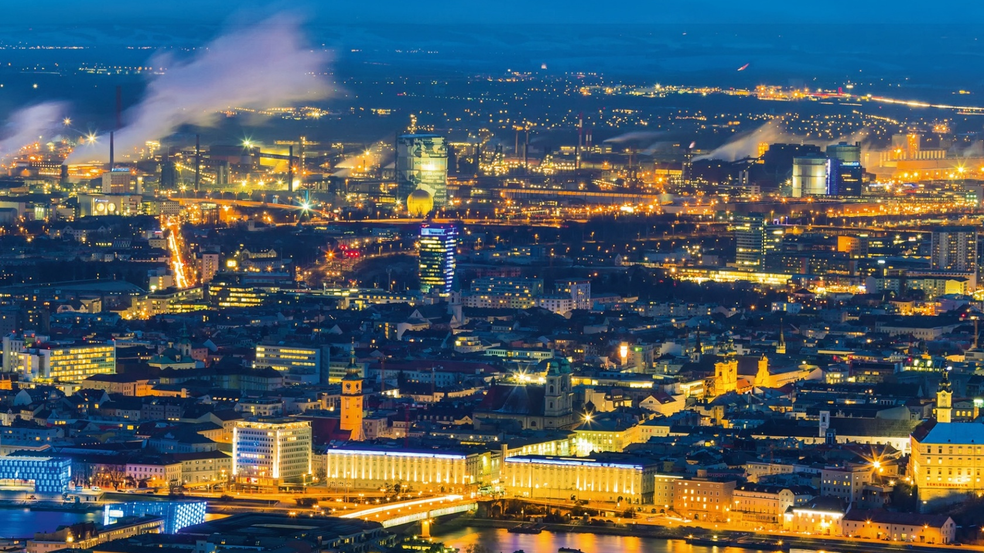







What’s the Story? Narratives for the Clean Industrial Deal Christiane Egger
OÖ Energiesparverband, Austria
christiane.egger@esv.or.at

Slide 2
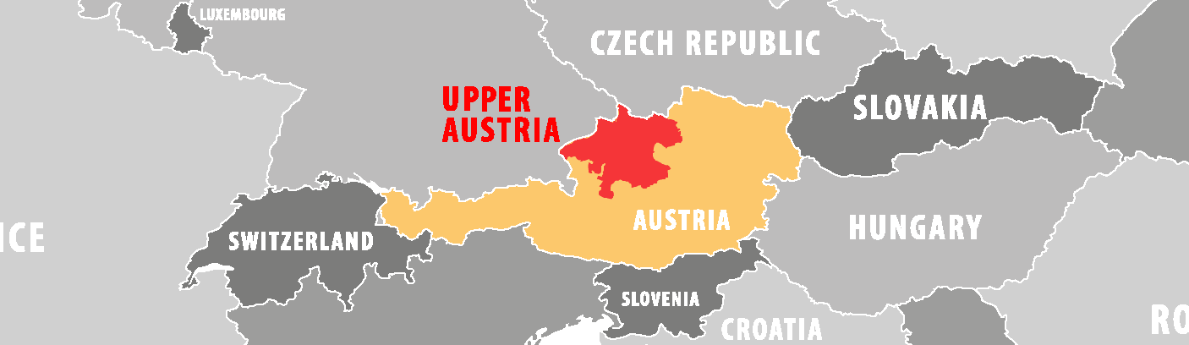


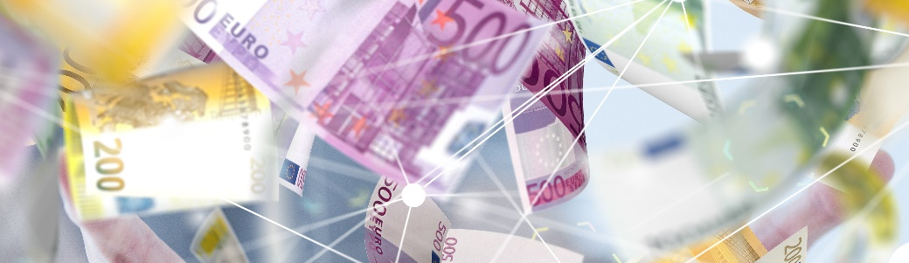
The region of Upper Austria
Capital: Linz
Population: 1.5 million
Industrial heartland of Austria
>25 % of Austrian exports
89 % renewable electricity
68 % space heating from renewables
41 % renewables in industry
3.5 billion Euro annual investments
in the energy transition

Slide 3





This project has received funding from the European Union’s LIFE Programme under Grant Agreement No. 101076918

Slide 4
Climate neutrality
Investment barriers
Know-how barriers
Mindset barriers

Slide 5
Climate neutrality
Investment barriers
Know-how barriers
Mindset barriers

Slide 6
Climate neutrality =
transformation of industry and society at times where a lot of change is already happening
Status quo (=fossil-fuel based) perceived to be "safe" (as it worked well in the past)

Slide 7
Clean Industrial Deal:
"Decarbonisation is a powerful driver of growth"

Slide 8
Clean Industrial Deal:
"Decarbonisation is a powerful driver of growth" Are enough people truly convinced of this?
Are you truly convinced?

Slide 9
Clean Industrial Deal:
"Decarbonisation is a powerful driver of growth"
New narratives are needed!

Slide 10
The images in people's minds
Expensive
Energy transition
Climate
Not interesting for me

Slide 11
Narratives: Gaining buy-in from wider groups in society
Renewable energy makes us stronger
Less dependent from other countries
Cool jobs
Less CO₂

Slide 12
Narratives: We also need to overcome counter-narratives ("killer arguments")
Let's get serious about the industrial energy transition!
We do not have the technologies yet.
China and US don't do it, why should we?
The investments are too high

Slide 13
WHY is climate neutrality
a good deal
for businesses and for countries?

Slide 14
Why industry decarbonisarion for competitiveness?
Energy security, lower risks
Stable energy costs
Cleantech innovation
Investments and jobs
Modernisation and productivity increase
Climate protection

Slide 15
IS THIS "NICE TO HAVE" OR A "MUST HAVE"?

Slide 16
DO WE REALLY HAVE A CHOICE?
Will yesterday's world come back (soon)?
pre Ukraine war
pre Chinese manufacturing boom
pre Trump
The critical question is the speed of the transition.

Slide 17
Can we afford it? Example Germany 2023 - 2045
Investments in the energy transition and energy costs
Business as usual scenario
13,300 billion Euro total costs
20% investment costs
80% energy costs
plus further investments required after 2045
Source: PwC

Slide 18
Can we afford it? Example Germany 2023 - 2045
Investments in the energy transition and energy costs
Business as usual scenario
13,300 billion Euro total costs
20% investment costs
80% energy costs
plus further investments required after 2045
Accelerated transition scenario
13,200 billion Euro total costs
40% investment costs
60% energy costs
no further investments required after 2045
Source: PwC

Slide 19
How develop successful narratives? Language matters!
"Change" is often not positively connotated in the public - preceived as risky, destablisation, loss of economic and social status
-> Creating trust - positive examples
-> By not acting, we may lose control, let's use our strengths
-> Perserving competitiveness, prosperity, stability
-> Avoid technocratic terminoloy (except when speaking to technocrats☺)

Slide 20
How develop successful narratives? It is the economy!
Economic arguments foster societal acceptance - beyond
simplistic pay-back times
maintain economic stability and increase security
provide resilience against price shocks and control of energy cost
maintain and create jobs
stay internationally competitive by using our innovation potential
preserve the value of buildings through ensuring good energy performance
-> quantify benefits of action -> show impacts of inaction, compared to costs of transformation
-> consider experience with transformation as economic asset
-> illustrate by economic data

Slide 21
How develop successful narratives? Know your target groups to create buy-in!
A successful energy transition needs a multitude stakeholders and all society groups!
-> "the bait must please the fish, not to the fisher!"
-> listen to what is important to different groups
-> putting people at the center
-> who can be good messengers
-> people have short term questions, long-term answers will not work
-> yesterday’s narratives don’t work today

Slide 22
How develop successful narratives? Take a strategic approach!
Accompany new policies with a communication strategy (beyond a press release!)
-> aim at upfront positive connotation -> start with quantified benefits for your audience, put risks into perspective and manage expectations -> explain intention of measures (why transformation is the better alternative?) -> build positive and clear narratives, illustrated by data - preserving stability and increasing resilience - maintaining and fostering competitiveness - providing security and freedom - enabling growth and innovation - using economic assets smartly - putting people’s interests in the focus

Slide 23



Our goal in Upper Austria: Industrial Energy Transition Leader
Innovation Ecosystem: industry, researchers and public bodies work together (NEFI)
Funding: 3 billion Euro from the federal government for the industrial energy transition
Cleantech: Support for developing products and services for the world markets (CTC)
Skills: Dedicated university and school programmes
41 % renewables in industry energy consumption
Narrative: We show how companies are becoming climate-neutral and thereby increase their competitiveness and profits
We show how companies are becoming climate-neutral and thereby increase their competitiveness and profits.

Slide 24





World Sustainable Energy Days 2026: 24 – 27 February 2026
International conference on the energy transition and climate neutrality with 600+ participants from over 50 countries in Wels/Austria
European Energy Efficiency Conference
European Pellet Conference
Young Energy Researchers Conference
Workshop Energy Communities
Large tradeshow on sustainable energy
Call for Papers: 10 October 2025
www.wsed.at

