Slide 1
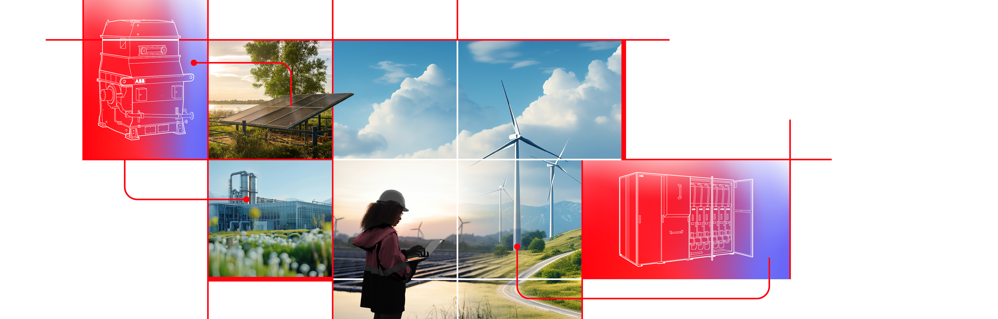

European Forum for Renewable Energy Sources
12th of September 2025
Electricity: fundament of society & development
Jukka Patrikainen
© 2025 ABB. All rights reserved.

Slide 2

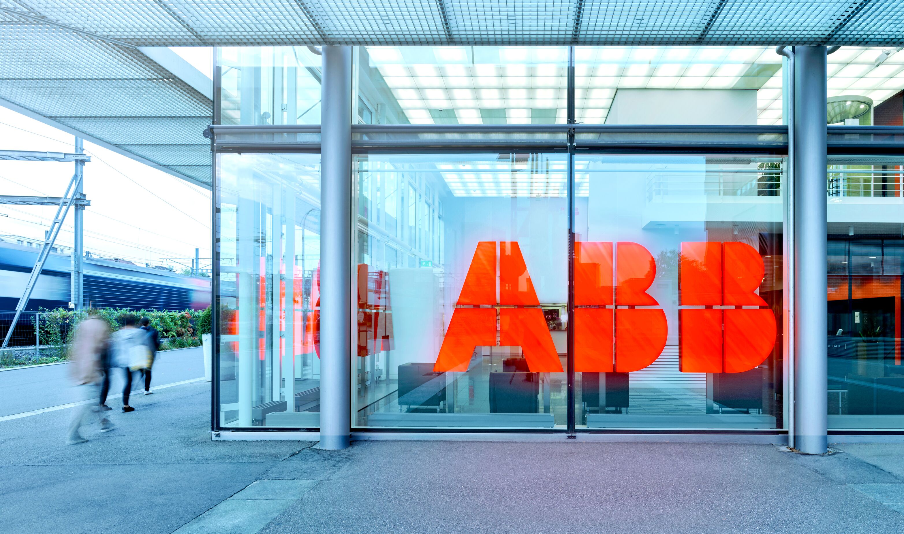
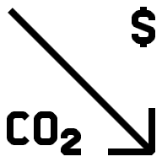




Digital & AI
ABB at a glance
2024 Facts & Figures
Global market position of ABB’s business areas
177
Manufacturing
sites globally
105,000+
Employee globally
$33 bn
Revenue
18.1%
Operational
EBITA margin
#1
Motion
#2
Electrification
$1.3 bn
R&D investment
26,000+
Patents
7
Research centers
200+
Partners
Open innovation ecosystem
#2
Process Automation
#2
Robotics
2023 Sustainability highlights
76%
Reduction of own scope 1 and 2 GHG emissions
Compared to 2019 baseline
74Mt
Avoided customer
GHG emissions
Through lifetime of products sold from
2022 to 2023
21%
Women in senior management roles
77/100
Employee
engagement score

Slide 3
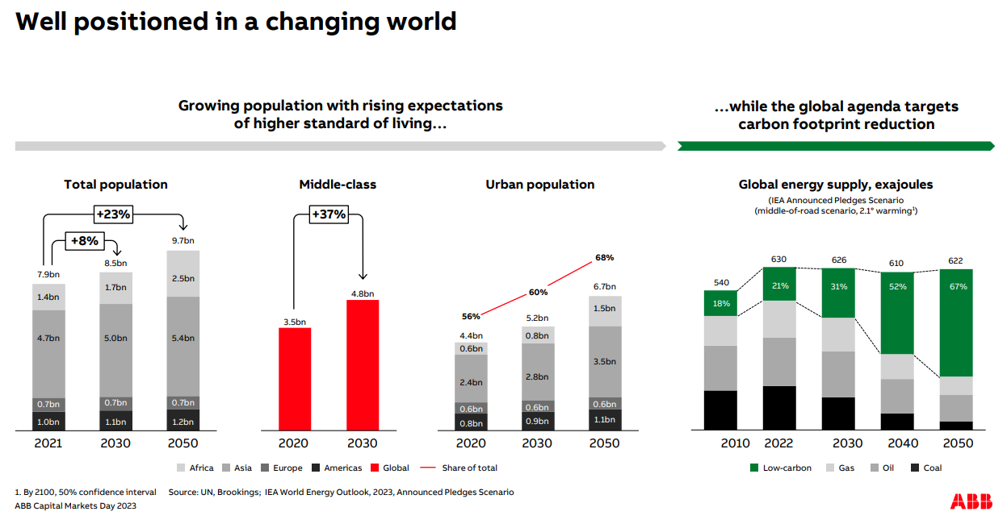
Global megatrends

Slide 4
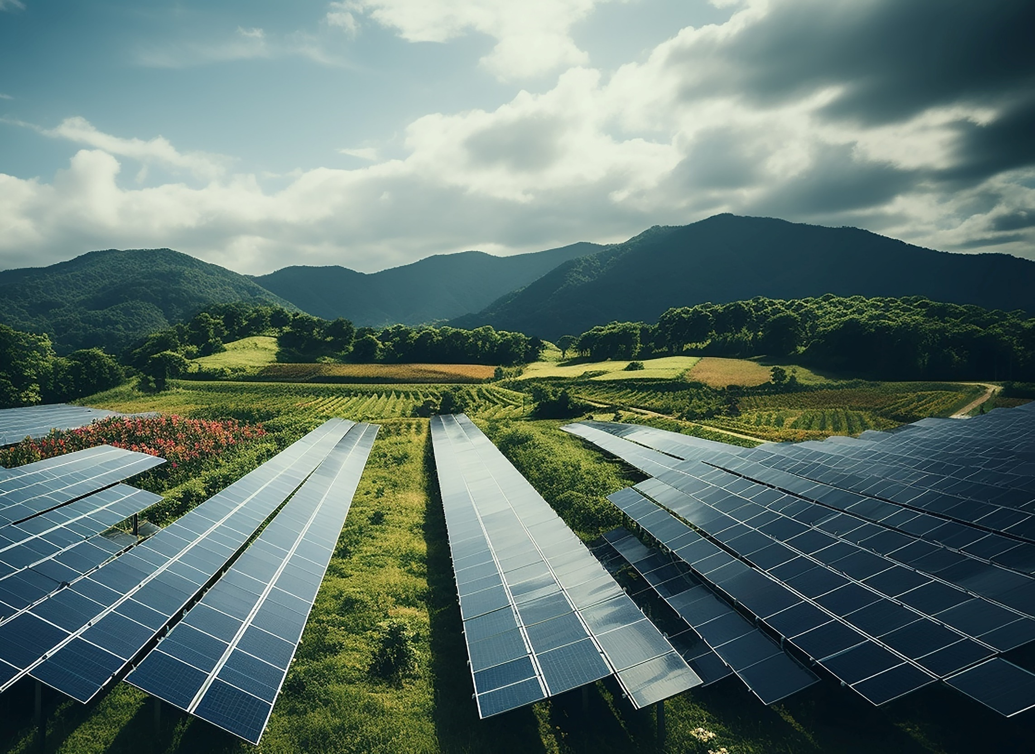



THE WORLD NEEDS ELECTRIFICATION SOLUTIONS MORE THAN EVER
DEMAND FOR ELECTRICITY
>50% of decarbonization
is driven by electrification
electricity growing
>10x faster¹
ENERGY
TRANSITION
3X more renewable integration
needed by 2030
~50% more grid investment
needed by 2030
ENERGY
EFFICIENCY
2x more energy efficiency improvements
needed by 2030
Source: IEA 2023 report, McKinsey; 1. than other energy sources in 2022–30 and vs. 2016 – 2022.
Improvements needed by 2030 in order to reach net-zero targets by 2050
Notes:
The increasing focus on a net-zero future, reducing energy costs and improving security, means there is a greater need for energy efficiency, renewables, and a more resilient grid.
The International Energy Agency (IEA) has highlighted the need to double energy efficiency improvements by 2030 to reach net-zero by 2050.
The world also needs to triple integration of renewables by 2030 (Source IEA October 2023).
In the same timescales, electricity will grow >10x faster than other energy sources.
More than 50% of decarbonization will be driven by electrification.
Growing electrification demand will require ~50% higher average annual investment in electricity grids by 2030.

Slide 5
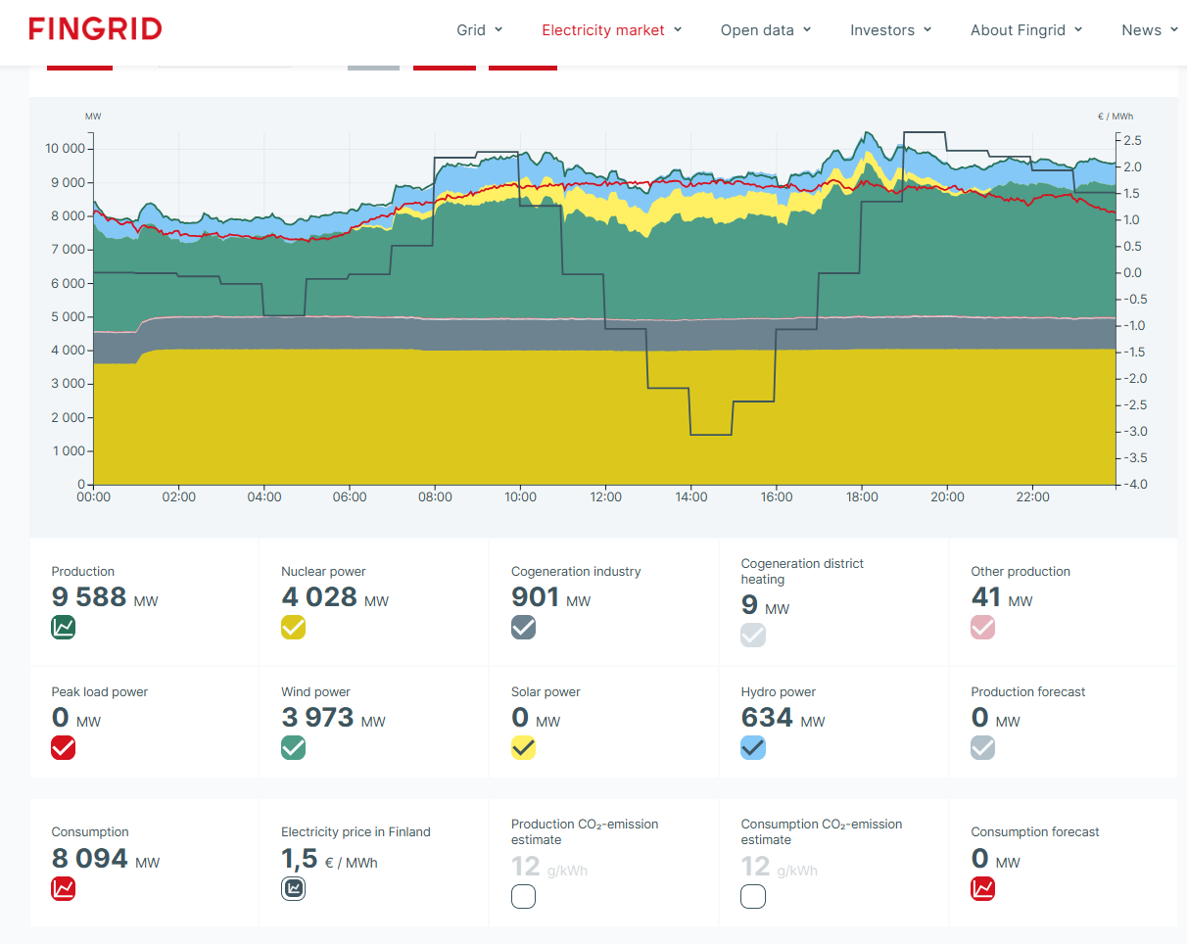

All the eggs cannot be in the same basket
Price (and source) of energy is key input & decision KPI for industrial investments
It’s also excellent business opportunity to all of us
Private consumers asking stable, cheap and also sustainable energy more and more

Slide 6
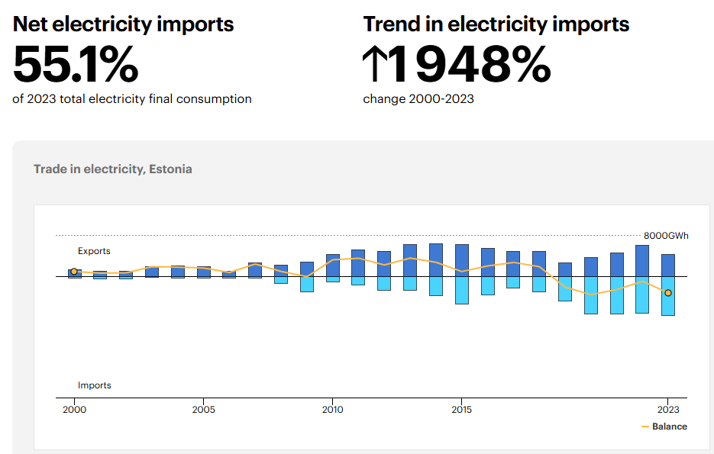
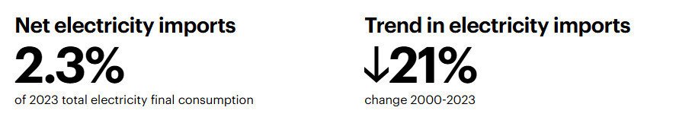
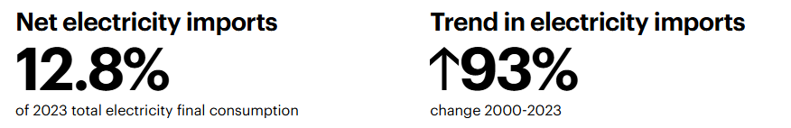
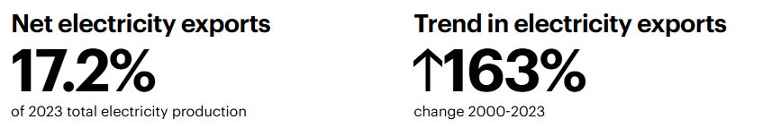
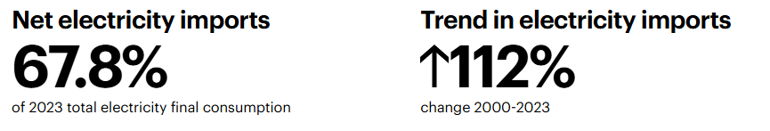
Source; IEA (International energy agency www.iea.org )
Estonia, electricity import/export
Finland;
Latvia;
Sweden;
Lithuania;
We need to change this trend
Long term energy strategy
Energy is investment to Estonian future, not a cost

