Slide 1


Renewable energy producers’ view on the Estonian energy transition: Where to go from here?
Silver Sillak
Estonian Renewable Energy Association

Slide 2









Estonian Renewable Energy Association
Established in 2011
We represent the largest wind, solar, bio- and hydroenergy producers in Estonia
We work towards a gradual transition to renewable energy

Slide 3
My presentation today
Where are we?
Where to go from here?
What is holding us back?
What should we do?

Slide 4
Where are we?

Slide 5
Renewable energy consumption in Estonia
Notes:
Renewable energy is used most, or 70%, in the heating sector, most of which is wood chips, but also heat pumps. In some district heating regions such as Tartu, Pärnu, Keila, Kärdla, Rapla and Paide, over 95% of renewable energy is already used. The greatest growth potential in the coming years is in electricity production, of which 39% of total consumption currently comes from renewable sources, but in the near future it will be possible to produce 100% of domestic electricity from wind, solar, biomass and biogas.

Slide 6
Electricity production in Estonia

Slide 7
Renewable electricity production in 2024

Slide 8
New electricity production capacities

Slide 9
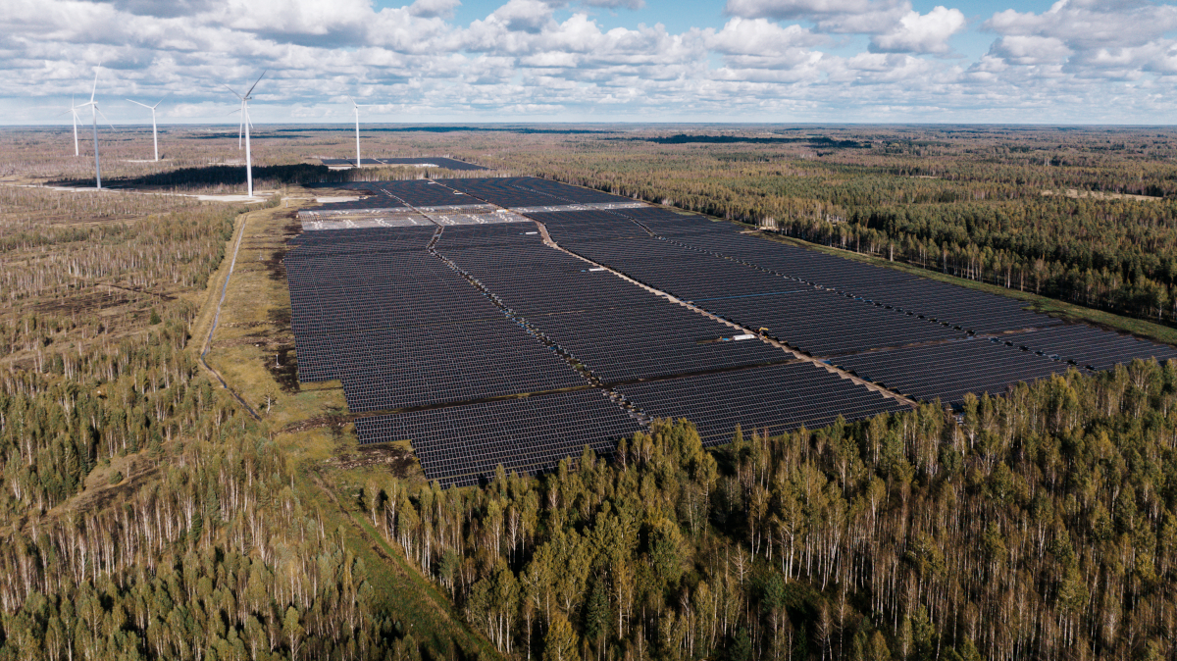

Slide 10
Where to go from here?

Slide 11
Energy Sector Organisation Act § 32¹. National renewable energy target
(1) By the year 2030, renewable energy will account […] for at least 100 per cent of gross final consumption of electricity.

Slide 12
Why 100% renewable electricity?
Utilization of domestic renewable resources
Less dependence on imported energy
Greater energy efficiency
Cheaper energy prices
Less workplace accidents
Cleaner air
No mining and toxic waste
Climate change mitigation

Slide 13
What is holding us back?

Slide 14
What is holding us back?
Slow planning and permitting
Unattractive investment conditions
Untapped electrification and efficiency potential
Lack of clear and ambitious vision

Slide 15
Planning and permitting
This year only two municipal wind farm plans have been approved. Both have been challenged in court, meaning the projects will not be built any time soon.
Since the Planning Act was amended in March 2022 to accelerate the deployment of renewable energy, no building permits for wind farms have been issued.

Slide 16
Investment conditions
Electricity market is influenced by strict regulation and very high price fluctuation. Market uncertainty makes it difficult to raise necessary capital.
CfDs are the preferred mechanism in EU for incentivising investment in new production capacity and are beneficial for both producers and consumers.
Estonian government does not plan to continue with CfDs.

Slide 17
Unused potential for electrification
There is a large untapped potential for electrification of heating, transport and industry
Increasing electricity demand would enlarge market for PPAs and, combined with flexibility solutions, help reduce electricity price volatility.
Electrification can enable 30–60% energy savings in these sectors due to efficiency gains in comparison to fuel combustion.

Slide 18
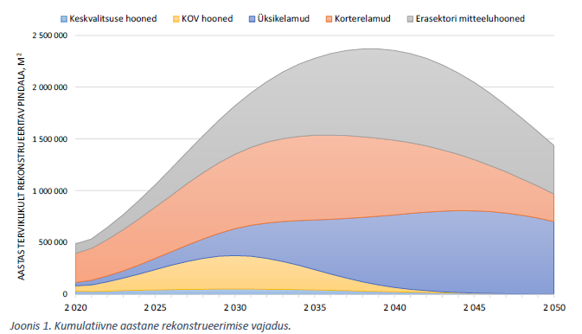
Reconstruction wave needed to unlock efficiency gains
Reconstruction can reduce energy consumption of buildings by 60%.
It can also enable the
development of more efficient district heating
based on low temperature heat.

Slide 19
Lack of vision
New energy economy development plan has been prepared for four years.
The latest version lacks detail and ambition.
We have now fallen behind not only Nordic countries but also Latvia and Lithuania.
Instead of reaping the benefits of new domestic energy generation, Estonia will rely on import.

Slide 20
What should we do?

Slide 21
What should we do?
Provide clear and ambitious vision for energy economy
Simplify and accelerate planning and permitting
Establish a long-term, predictable investment environment through CfD-based tenders
Support electrification and efficiency in heating, transport and industry

