Slide 1
Waybiller
Biomass and Bioenergy: Innovation in heating supply chain
Kert Kaspar Tammaru
Notes:
E-estonia has done the e-thing again. This time with E-waybills Transport document is a required by the autosea

Slide 2






~100 000 Monthly
e-waybills created
All documents are accessible in real time
Automated operational workflows
eFTI certified platform
Notes:
Our effort to replace paper documents with digital counterparts resonates with eFTI DIRECTIVE.

Slide 3
Renewable energy directive (RED)
RED I (2010) → laid the foundation (targets, sustainability rules).
RED II (2021) → Digital proofing and operational rules. Applied to biomass plants ≥ 20 MWth.
RED III (2025) → tightened rules and applies to biomass plants ≥ 5 MWth.
Notes:
What did RED II mean to receivers : Receivers had now requirement to control every incoming delivery manually to make sure it is ok to burn. THis created lot of extra manual work to bioenergy producers.

Slide 4
Innovation in biomass sector
E-waybills became industry standard for material deliveries
Automated control layers for Proof of Sustainability (PoS) performed at the creation of documents against local forestry database E-waybill platforms apply real time economy principles to the supply chain of biomass material Public API allows companies to pull their data for invoicing, analysing or for any other purpose.
Notes:
Waybill is a platform that connects supply chain of biomass delivery to one place. Storing all historical data, we even allow trucks to preform material weighing though our application.

Slide 5
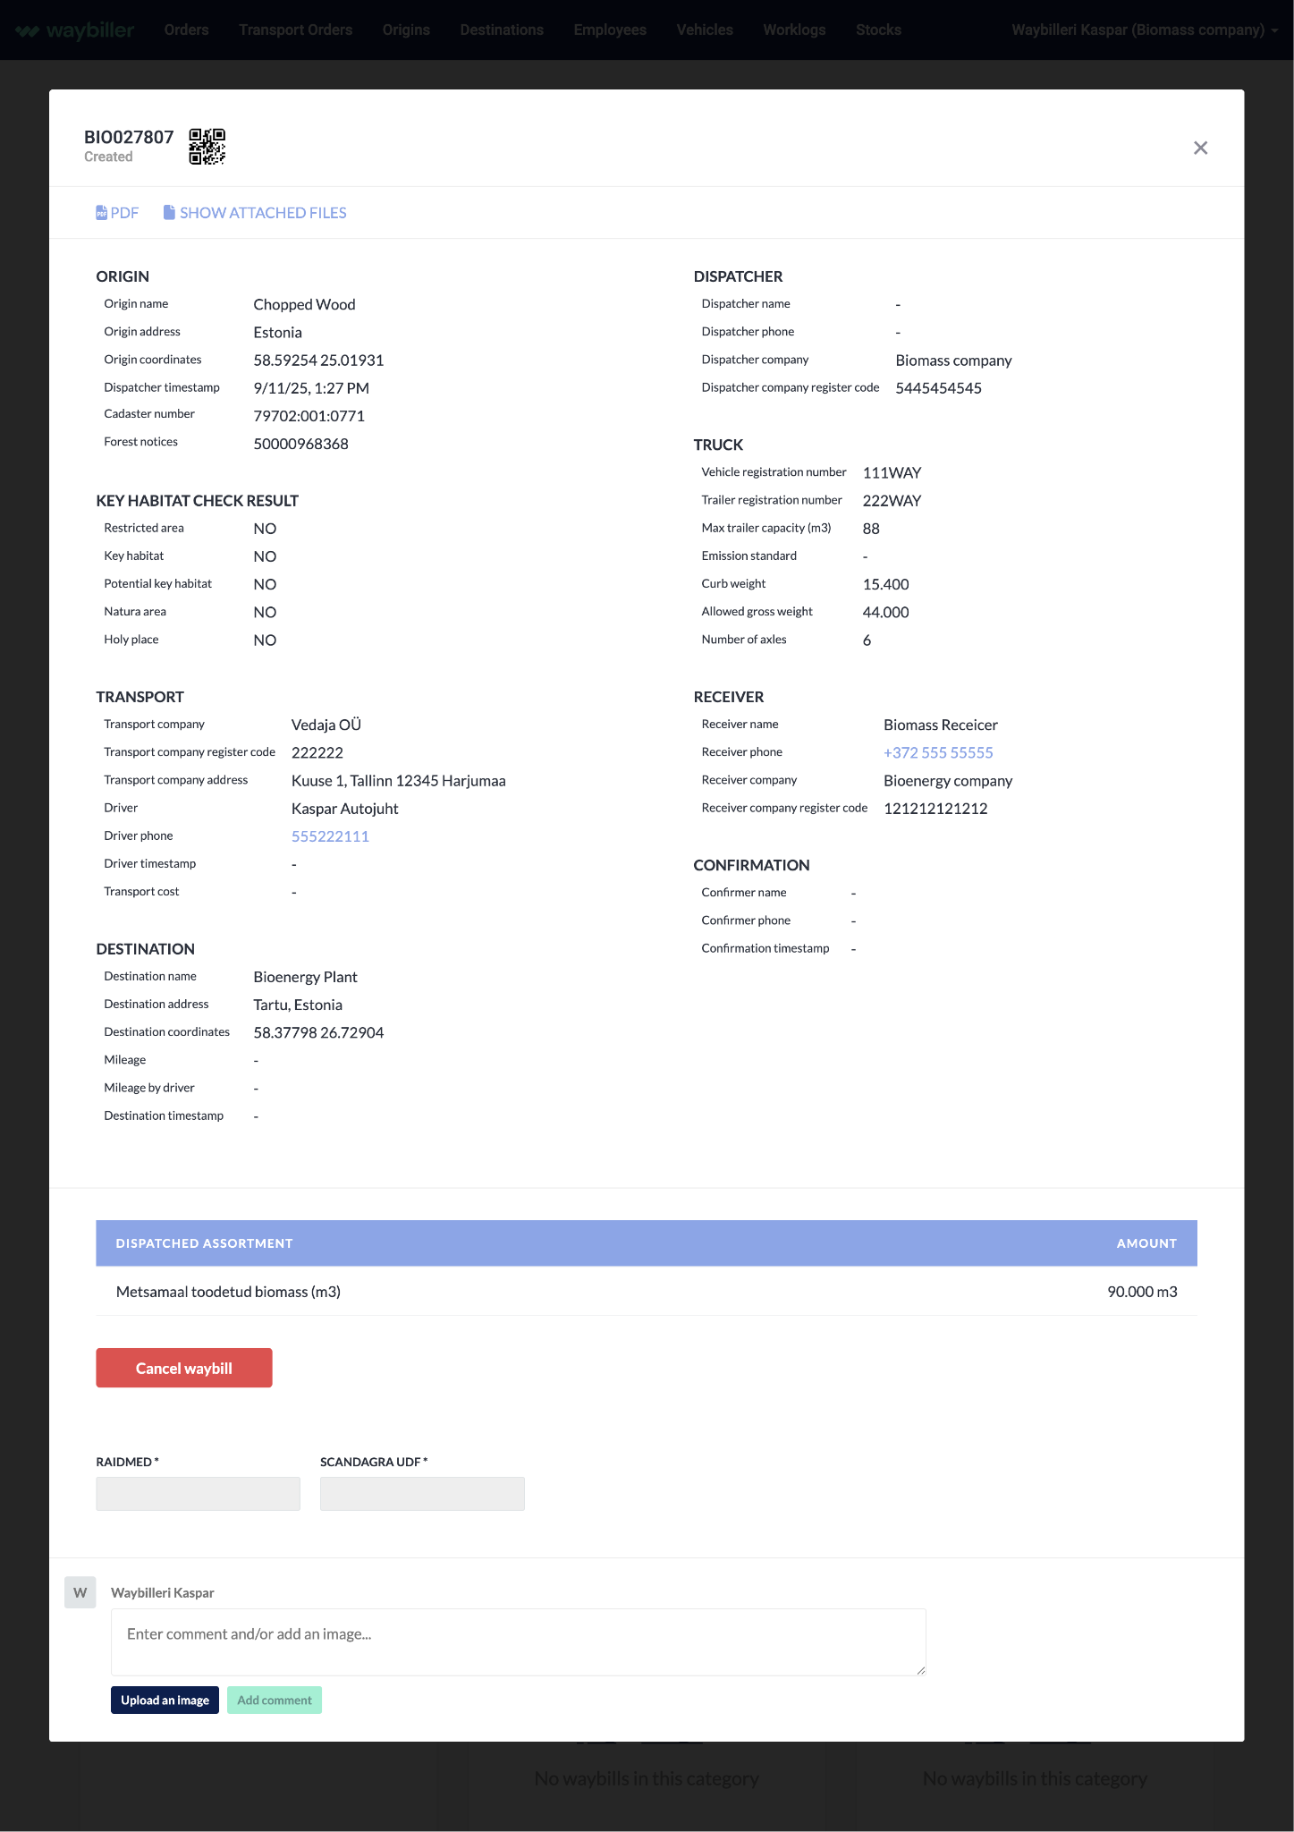
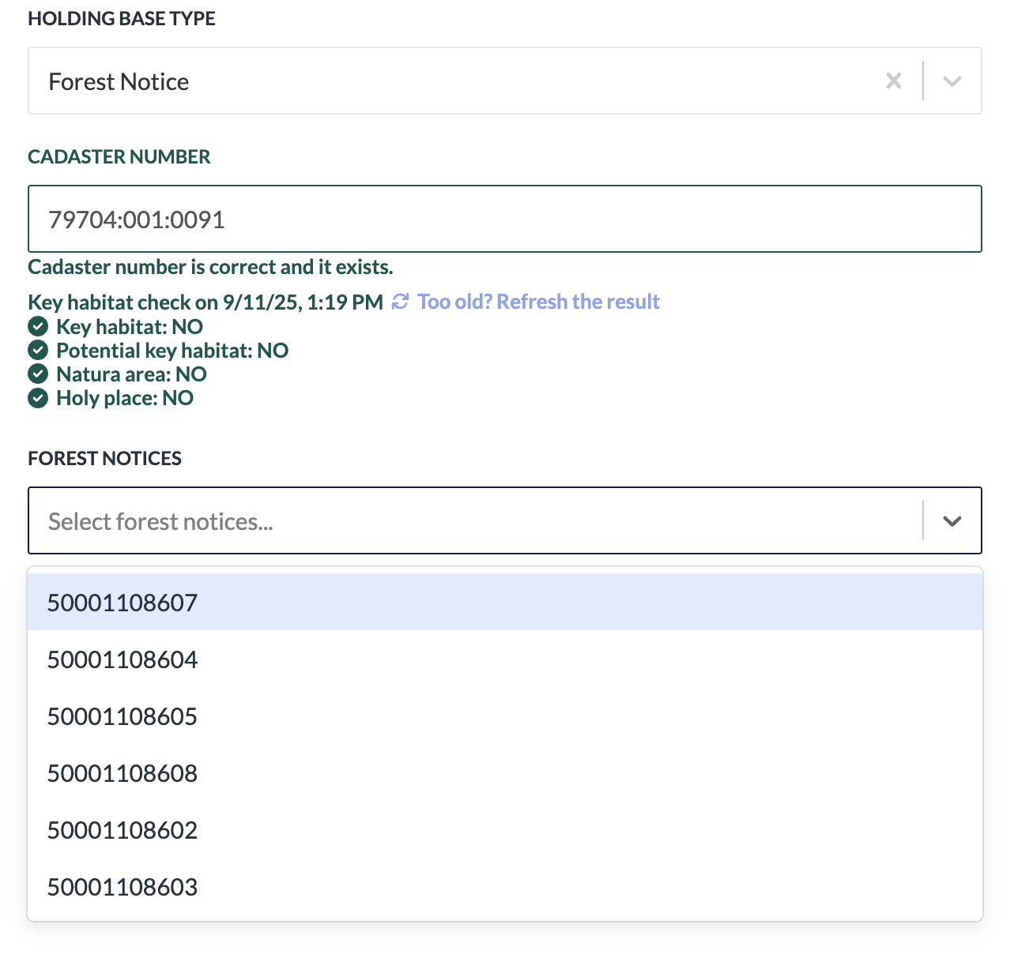
Notes:
Now i am going already into detail but what i am highlighting here is that digital system actually eliminates the mistakes from the process. Saves huge amount of manual work on checking and inserting data manually

Slide 6
Notes:
Now i am going already into detail but what i am highlighting here is that digital system actually eliminates the mistakes from the process. Saves huge amount of manual work on checking and inserting data manually

Slide 7
Key changes
100% Paperless
Standardised processes
Machine readable data
Material names became standardised by the RED categories
Unified stock management logic (FIFO)
REST API for data movements
Weighing system integrations eliminate mistakes
Bioenergy producers made digital documents mandatory.
All drivers had to have a smart device and account in e-waybill platform

Slide 8
Results
Unloading process with e-waybills is about 25% faster compared to same process with paper Waybills
E-waybill is single source of truth for delivery data and it is accessible to all involved parties online. All deliveries are digitally recorded and historically traceable.
Integrating internal softwares and ERPs to e-waybill platforms are saving companies hundreds of hours over the sector on inserting same set of data manually

Slide 9
Thank you!
Kert Kaspar Tammaru

