Slide 1

Key role of energy in building a sustainable, competitive and secure future
- Lessons from Finland
Photo: Unsplash / Mika Korhonen
Atte Harjanne
National Parliamentary Workshop with the Parliament of Finland (NPWS Finland), September 10 2025

Slide 2
The Big Picture
Global CO2 emissions [Mt]
Source: IIASA AR6 Scenario Explorer & Our World in Data

Slide 3
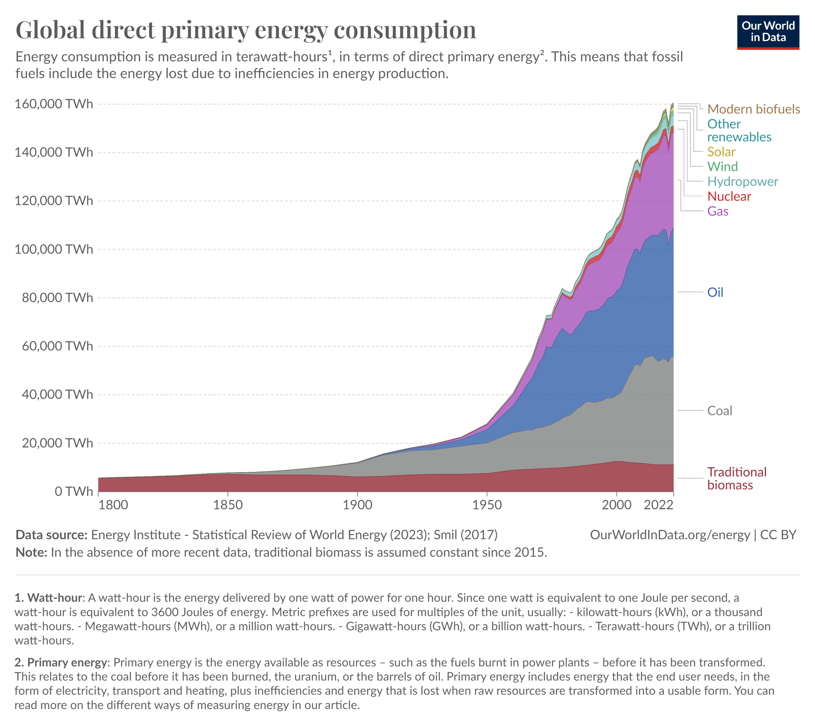
The Big Picture
Oil, coal & gas ~ 80 %
Unsustainable biomass ~ 7 %

Slide 4
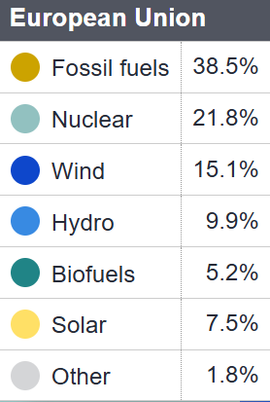
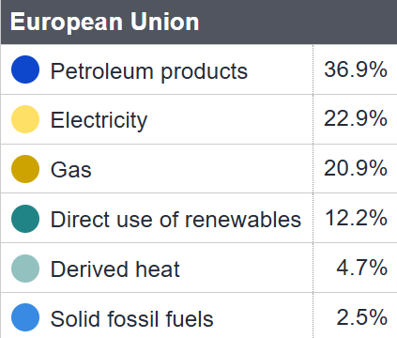
EU still has work to do as well
(2022)
Source: European Commission

Slide 5
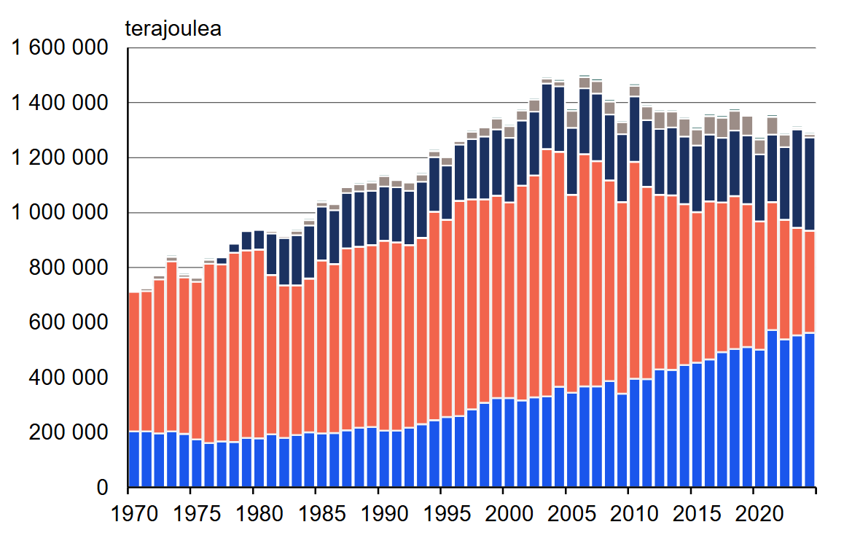
How about Finland?
Total energy consumption ~360 TWh
Imported electricity
Nuclear
TJ
Fossil fuels + peat
~75 % of renewable energy is biomass
Renewables
Source: Statistics Finland

Slide 6
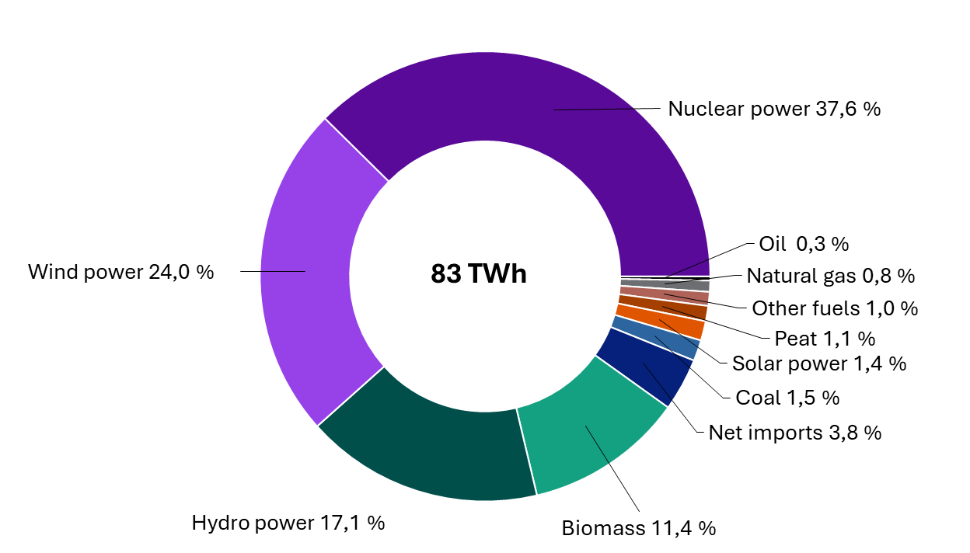
Finnish Electricity Mix
Electricity production by source 2024
Projected electricity demand growth by 2050 → 136 TWh
Source: Finnish Energy

Slide 7
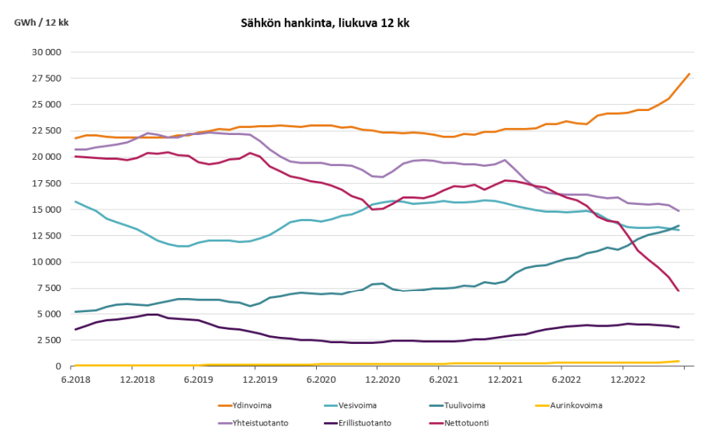
Energy Security
Electricity by source
nuclear
CHP
hydro
import
wind
solar
non-CHP combustion
Source: Finnish Energy, 2023
Notes:
"Muut-sektori sisältää kotitalouksien, julkisen ja yksityisen palvelusektorin, maa- ja metsätalouden sekä rakennustoiminnan sähkön ja polttoaineiden kulutuksen."

Slide 8
Energy Affordability
EU average
Finland
Source: Finnish Energy
Notes:
"Muut-sektori sisältää kotitalouksien, julkisen ja yksityisen palvelusektorin, maa- ja metsätalouden sekä rakennustoiminnan sähkön ja polttoaineiden kulutuksen."

Slide 9
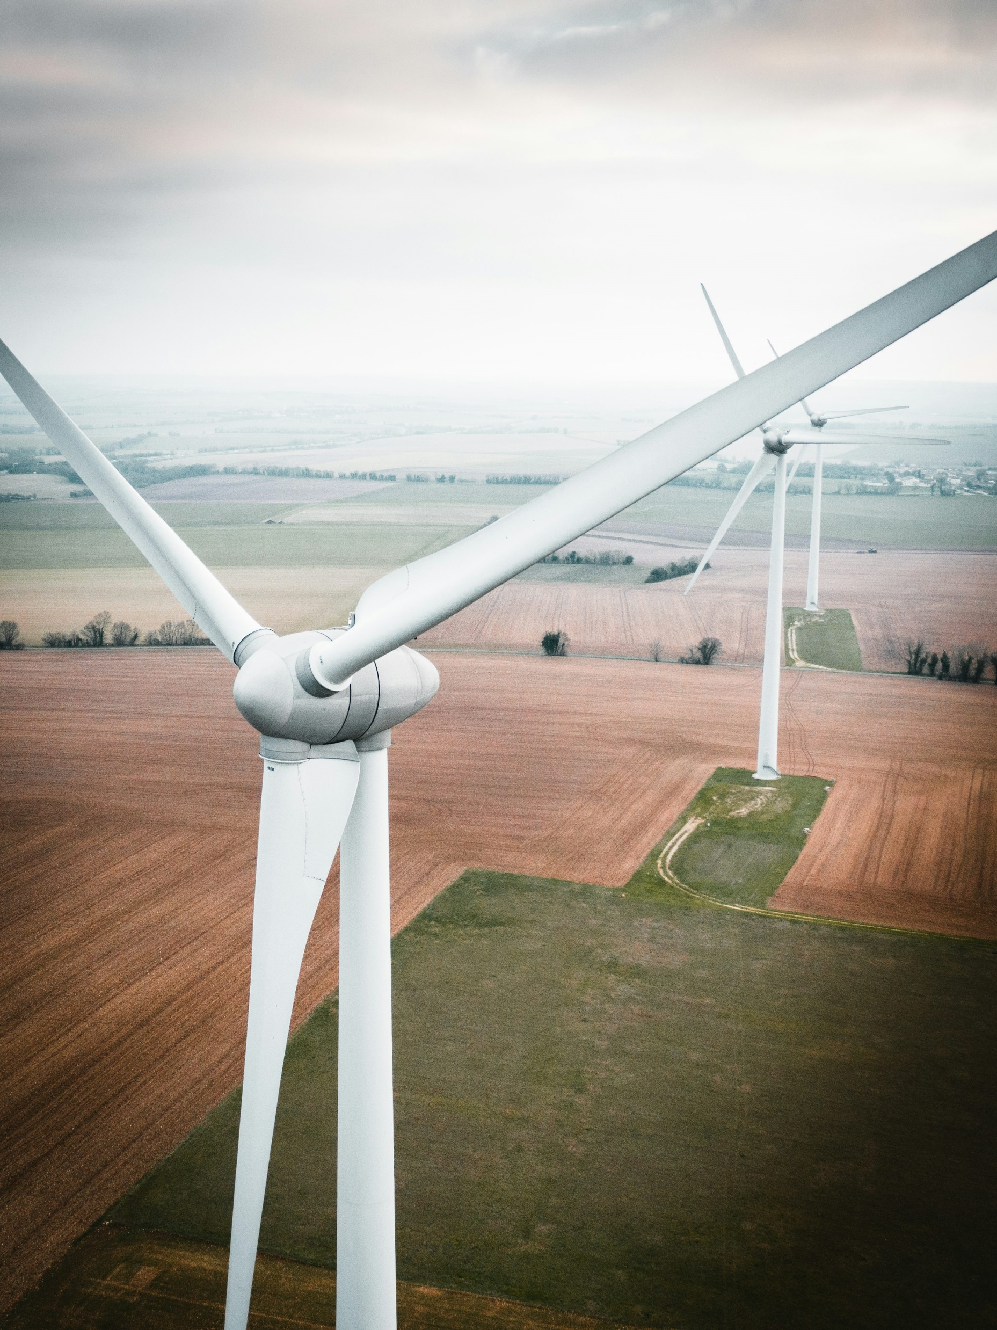
Conclusions
Investing in clean energy and efficiency is good for:
Economy
Climate
Nature
Security
Cost of living

Slide 10
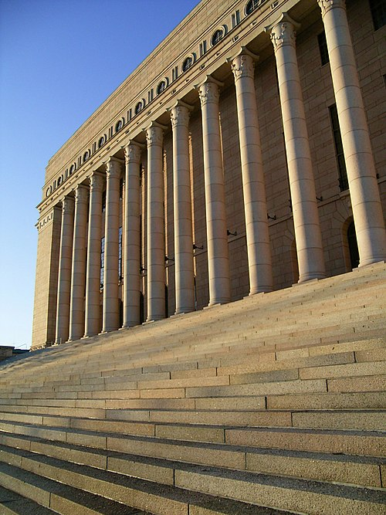
Welcome!
Source: Wikimedia Commons, user: Cako

Slide 11


Kiitos!
Thank you!
Photo: Unsplash / Mika Korhonen
Atte Harjanne
atte.harjanne@eduskunta.fi
+358 40 591 5565
@atteharjanne.vihreat.fi
linkedin.com/in/atteharjanne

