Slide 1


Wind Energy
Developments of the markets in Finland
Eufores 10.9.2025
Heidi Paalatie
Director of Operations
renewablesfinland.fi

Slide 2


Kuva: Christa Könönen
Suomen uusiutuvat ry
Renewables Finland, SURF =
Onshore wind power +
Offshore wind power +
Industrial-scale solar +
Hybrid projects & BESS

Slide 3
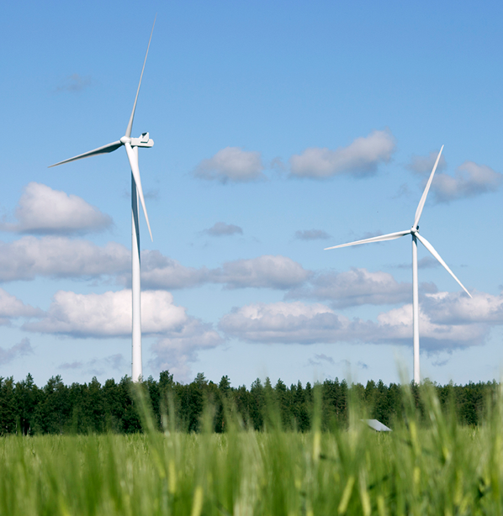

Photo: wpd windmanager
^{Wind power now}
^{8,9 GW}
^{1920 turbines}
^{~25 %}
6/2025

Slide 4
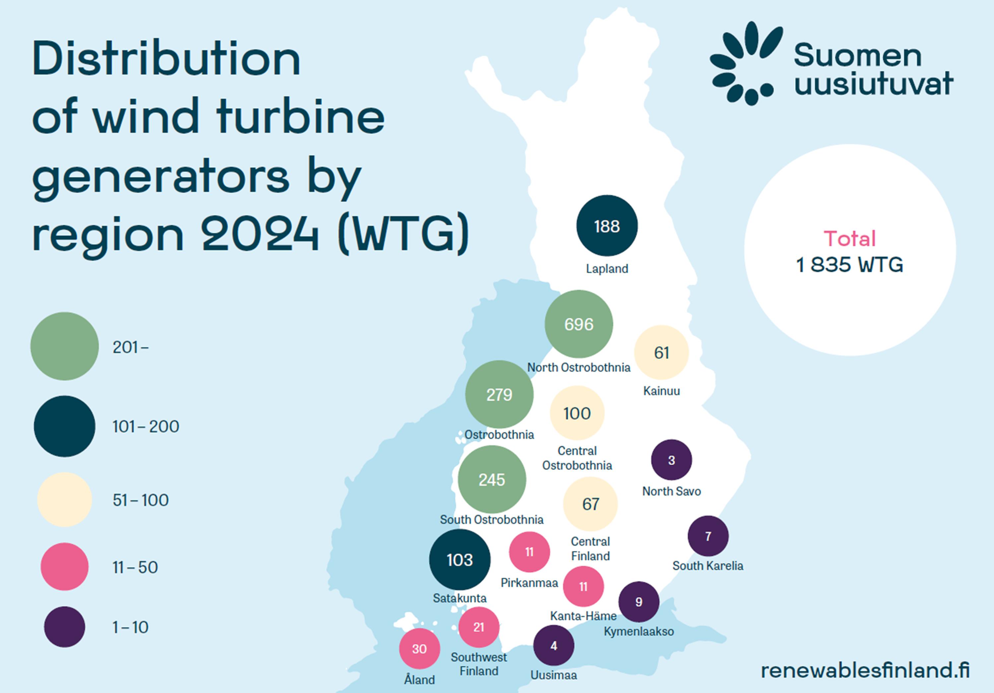

Slide 5

Slow down in construction after several good years
^{2025 adding 1129 MW}
^{(174 turbines)}
^{2026: none?}
^{2027-2028: 583 MW +}
Kuva: Pixabay

Slide 6
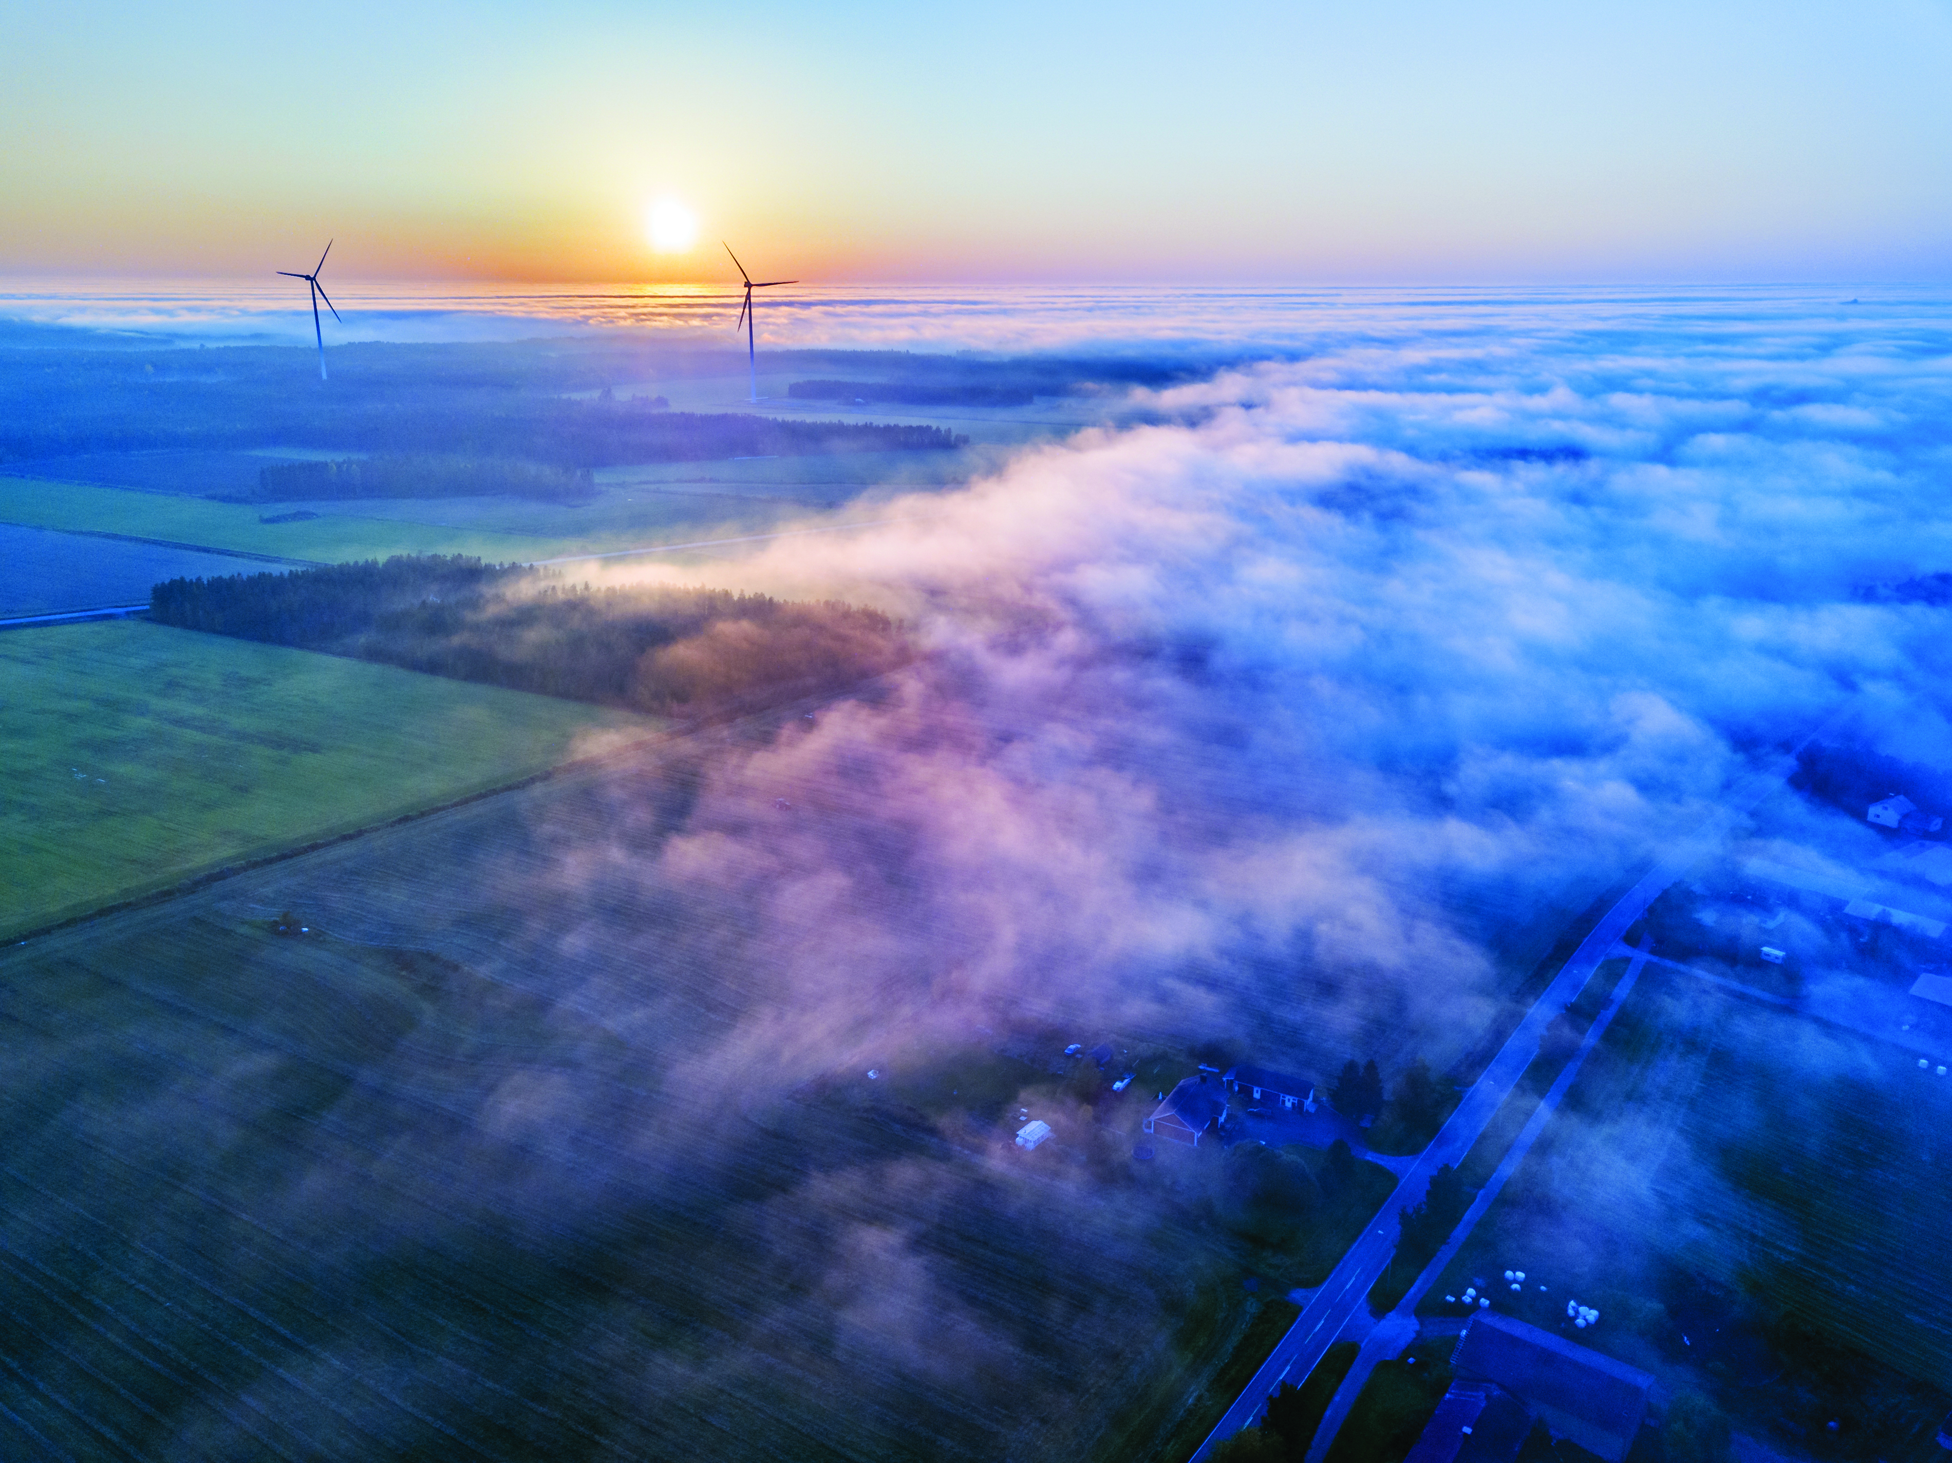
Kuva: Ville Suorsa
^{4,1 GW ready to invest BUT}
^{times are difficult for}
^{production & investments}
Super high imbalance costs & other electricty market issues
^{Consumption growing slow}
Uncertainty in the policy framework

Slide 7
Kuva: Ville Suorsa
^{The industry needs certainty}
Sensible science / impact based set-back distance
  Governmental proposal on land use planning legislation: 8-times tip-height from housing
Property tax must remain fully benefit of municipality
Co-location of radars & wind power
Sensible regulation on dismantling
Offshore needs a push & clarity!

Slide 8


It takes two to tango
The new green industry needs the electricity production investments and vice versa.
And Finland needs the new industry!

Slide 9

30.9.2025 | Kaapelitehdas, Helsinki
windfinland.fi

