Slide 1
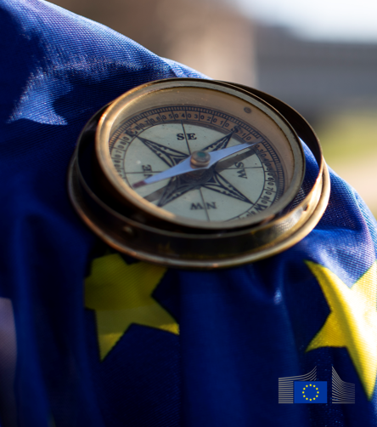
EUFORES - NATIONAL PARLIAMENTARY WORKSHOP Helsinki,10 September 2025
The Clean industrial deal: balancing sustainable energy and industry
Giuliana Bongiorno
F.2 Relations with Member States and the Energy Community
DG Energy, European Commission

Slide 2

The Competitiveness Compass
Closing the innovation gap Decarbonisation and competitiveness Reducing dependencies, increasing security
simplifying the regulatory environment, reducing burden and favouring speed and flexibility
fully exploiting benefits of scale offered by the Single Market by removing barriers
financing through a Savings and Investments Union and a refocused EU budget
promoting skills and quality jobs while ensuring social fairness
better coordinating policies at EU and national level

Slide 3
Clean Industrial Deal
Affordable Energy: Europe’s energy prices are higher than those of trading partners, impacting competitiveness, especially for energy-intensive sectors
Lead Markets: Lack of stable and predictable market demand for clean tech products
Circularity and Access to Materials: High dependence of EU industry on critical raw materials. Materials are not reused sufficiently; precious materials are being thrown away
Financing: Not enough investments to support decarbonisation, electrification and competitiveness of the industry
Global Markets and International Partnerships: The EU has scarce primary materials needed for the clean transition. There is a global race for access to markets, raw materials and new technologies
Skills Enhancement: Businesses need access to workers with the right skills. Offer quality jobs and ensure just transition

Slide 4
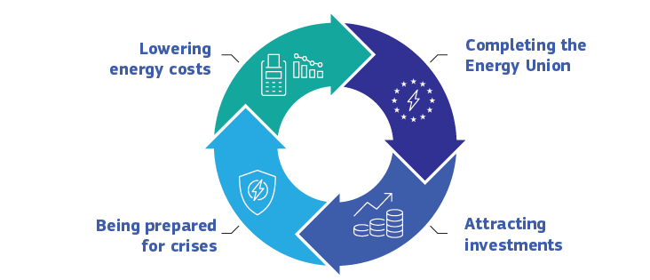
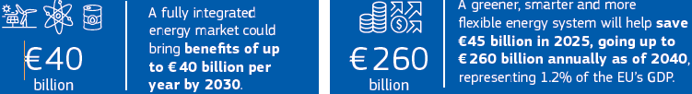
Affordable Energy Action Plan

Slide 5
Pillar I: Lowering energy costs
Action 1
Making electricity bills more affordable
Action 2
Bring down costs of electricity supply
Action 3
Ensuring well-functioning gas markets
Action 4
Energy efficiency – delivering energy savings
2025
2025
2026
More efficient network charges
Long-term electricity supply contracts
2025
2025
Ensuring well-functioning gas markets
An energy efficiency market of European dimension
Reduced permitting times
Reduced taxes & levies
Harnessing EU purchasing power to get a better deal for imported natural gas
Give consumers access to more efficiency appliances & products
Grid expansion & modernisation
Increased retail competition
Boosting flexibility

Slide 6




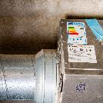

Pillar II: Completing the Energy Union
Q1 2026
2025
Electrification Action Plan
Clean Energy Investment Strategy
2026
From 2025
Roadmap on Digitalisation & AI
Deeper Electricity Market Integration
Q1 2026
Timing tbc
Heating & Cooling Strategy
Simplify, strengthen & modernise Energy Union governance

Slide 7
Pillar III: Attracting investment & ensuring delivery
A tripartite contract
Member States
EIB
Regulatory & taxation framework
Policy clarity
Business environment with scale, visibility and off-take demand
European Commission
Affordable energy to power for economic growth
Goods needed by consumers, EU economic growth & employment
Clean energy producers
Energy consuming industry
Energy demand & long-term energy contracts
Affordable energy supplies to remain globally competitive

Slide 8


Pillar IV: Being ready for potential crises
Security of supply &
price stability
Price crisis preparedness
New regulatory framework
Avoid price peaks during energy crises
Increase cross-border access to cheap electricity
When necessary

Slide 9


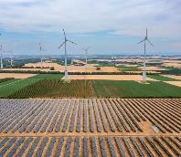

Benefits to European consumers
Lowering electricity taxation
Potential to approx. halve tax component of energy bills.
Accelerating electrification share by 40% by 2030
€32 billion/year in energy system cost savings in 2030
Electricity market integration, renewables, flexibility
40% lower wholesale electricity prices on average in the EU.
Energy market integration
€40-43 billion per year in benefits for EU citizens by 2030.
The full delivery of the Action Plan for Affordable Energy can enable the EU’s fossil fuel import bill to drop year after year towards €130 billion of savings per year by 2030, representing an estimated 0.65% of GDP by 2030.
Notes:
Looking into recent and upcoming developments, I would like to highlight some of the most important elements delivered and on going:
The launch of an Energy Union Task Force, on 16 June under the Polish Presidency, to increase coordination across the Energy Union and enhance the governance of the electricity system. It consist of high-level representatives from the Commission and Member States, supported by relevant EU bodies.
Guidance on how to make network charges more efficient and a recommendation on how to lower electricity taxes at the beginning of July.
Using the flexibilities under the Energy Taxation Directive, these measures could have an immediate effect, as taxes and network charges account for 40% respectively of the final prices for SMEs. This is accompanied by guidance on innovative forms of renewables and on grid and storage areas.
The ongoing preparation of a Clean Energy Investment Strategy including a de-risking initiative to unlock private capital supporting the €570 billion per year investment needs of the clean energy transition.
On Jun 25, 2025 the Commission has adopted a new State aid framework accompanying the Clean Industrial Deal which will help Member States designing support measures and de-risking instruments for the rollout of clean energy
Tripartite contracts for affordable energy were launched last week on the first on offshore wind, and the second on storage and flexibility. More of such contracts are under consideration.
Work on infrastructure with the upcoming grids package and ongoing negotiations for the Connecting Europe Facility on which we count on the EP support.
The delegated act on projects of common interest and projects of mutual interest, the white paper on electricity market and the clean energy investments strategy are also planned for this autumn.
We worked extensively on nuclear with the PINC and preparatory stage of the Small Modular Reactors action plan
Enhancing energy security will contribute to reducing instability. The swift handling and advancing on the REPower regulation is strategic in this area. Next year, the Commission will come forward with proposals for the revision of the Security of supply in the electricity and gas sector
Looking into next year the reflection is also ongoing on the post-2030 energy framework.
In addition, overall, the Clean Industrial Deal serves as a framework for engaging in a dialogue with industries.
The Commission will tailor action to the specific needs of individual sectors. For example, we have presented an Action Plan for the automative industry and an Action Plan on Steels and Metals [adopted on 19/03]. A Chemicals Industry Package, set for adoption in late 2025, will recognise the strategic role of the chemicals sector as “industry of industries”.
Benefits:
Affordable Energy Action Plan: electrification could create up to €260 billion of savings annually by 2040.
We have made progress, but the clock is ticking. The EU could lose up to €103 billion by 2040 from increased energy system costs if no action is taken. We have the policy vision in place, what it needs now is execution with speed and scale.

Slide 10
Recent and upcoming developments
26 February, Action Plan on Affordable Energy
03 March, Legislative proposal on the extension of the Gas Storage Regulation
16 June, Energy Union Task Force
17 June, legislative proposal on REPowerEU roadmap Communication with concrete measures
Jun 25, New State aid framework accompanying the Clean Industrial Deal
2 July, Recommendation on Network Charges
Sept 25, MFF second package and 1st tripartite signed in Copenhagen last week
    Industrial Decarbonisation Accelerator: Act Speed-up permitting for industrial access to energy and industrial decarbonisation
    Recommendation on energy taxation
    Guidance on CfD design including combining CfD and PPAs
    Guidance on promoting remuneration of flexibility in retail contracts
European Grids Package, Roadmap on Digitalisation & AI
Q4 2025
Q1 2026

Slide 11
Financing the clean transition
The Clean Industrial Deal will mobilise over €100 billion to support EU-made clean manufacturing
New Clean Industrial Deal State Aid Framework to accelerate the approval of state aid to roll out renewable energy, decarbonise industry and ensure sufficient manufacturing capacity of clean tech
EIB ‘Grids manufacturing package’ for the European supply chain to provide counter-guarantees to manufacturers of grid components, with an indicative amount of at least EUR 1.5 billion.
Strengthen the Innovation Fund and industrial decarbonisation bank, aiming for €100 billion in funding, based on available funds in the Innovation Fund, additional revenues resulting from parts of the ETS as well as the revision of InvestEU
Dedicated call under Horizon Europe to stimulate research and innovation in these areas
Amendments to the InvestEU Regulation to increase the amount of financial guarantees that InvestEU can provide to support investments. This will in turn mobilise up to €50 billion for the deployment of clean tech, clean mobility and waste reduction.
Next MFF proposal: increase CEF-E budget from 5.84 billion to 29.91 billion
European Competitiveness Fund: clean transition and Industrial Decarbonisation part budget €865 billion
Notes:
As part of the Clean Industrial Deal, the Commission will also focus on ensuring proper financing for the transition and on attracting investment, accompanied by simpler rules and processes.
Clean Industrial Deal State Aid Framework
On 25 June 2025, the Commission adopted a new state-aid framework supporting the Clean Industrial Deal (CISAF) to enable Member States to push forward the development of clean energy, industrial decarbonisation and clean technology.
The Commission also agreed with EIB on State aid rules to ensure that financing provided by the EIB Group from its own resources falls outside the scope of state-aid rules along with all its consequences. (This is particularly relevant for Important Projects of Common European Interest (IPCEIs), which are critical to Europe’s strategic autonomy in areas like clean technologies and advanced manufacturing.
EIB will facilitate equity co-investment programs with Member States, including in early-stage funds, funds managed by first-time investment teams and funds in European regions with less a developed venture capital ecosystem.
The agreement facilitates and accelerates the deployment of the InvestEU programme, for which the EIB Group has already mobilised billions of euros in investments for innovation, sustainability, competitiveness, and social inclusion. This paves the way for a new equity co-investment product under InvestEU and sets the stage for a review of the guarantee agreement to streamline State aid provisions in line with evolving policy priorities.
The new Clean Industrial Deal State aid framework will allow for simplified and quicker approval of State aid measures for the roll-out of renewable energy, industrial decarbonisation and manufacturing capacity in clean tech.
In addition to the strengthening of Innovation Fund we propose an Industrial Decarbonisation Bank, aiming for EUR 100 billion in funding.
Moreover, we will work to boost demand for clean products.
The Industrial Decarbonisation Accelerator Act will increase demand for EU-made clean products, by introducing sustainability, resilience, and made in Europe criteria in public and private procurements, building on the Net-Zero Industry Act.
Cleantech
The EIB will also introduce a ‘Grids manufacturing package’ for the European supply chain to provide counter-guarantees to manufacturers of grid components, with an indicative amount of at least EUR 1.5 billion. This package will provide these businesses with needed certainty to ramp-up production. The EIB Group will continue to boost the pace of energy investments, as it did recently under REPowerEU.
The EIB Group boosts the Clean Industrial Deal and strengthens Europe’s leadership in technology through TechEU, the EU’s largest financing programme to date in support of innovation, with the goal to attract talent, capital and investment in Europe. These actions include the reinforcement of cross guarantees for wind energy production and three new instruments to strengthen Europe’s competitiveness:
A €1.5 billion package to provide counter-guarantees through partner banks to grid component manufacturers to ensure sustainable supply, giving companies greater certainty to ramp up production of electricity networks across Europe. This will facilitate the integration of renewable energy into the grid and the delivery of affordable power to EU businesses and households.
To provide liquidity and working capital for highly innovative small and medium-sized enterprises active in developing green technologies, the EIB and Commission are launching a €250 million CleantechEU guarantee scheme.
A €1.5 billion top-up to a successful EIB programme supporting European wind turbine and component manufacturers.

Slide 12
Thank you.
Fill in copyright information.
giuliana.bongiorno@ec.europa.eu
© European Union 2024
Unless otherwise noted the reuse of this presentation is authorised under the CC BY 4.0 license. For any use or reproduction of elements that are not owned by the EU, permission may need to be sought directly from the respective right holders.
Slide xx: element concerned, source: e.g. Fotolia.com; Slide xx: element concerned, source: e.g. iStock.com
Notes:
Conclusion
The rest of 2025 and 2026 will be decisive in determining whether Europe’s clean industrial ambitions remain aspirations or become tangible realities.
Cutting red tape, electrifying industry, modernizing grids, and deploying clean technologies are core levers that will decide Europe’s industrial future
We are currently discussing the next MFF:the proposals would increase the CEF-E budget from EUR 5.84 billion for 2021-2027 to EUR 29.91 billion for 2028-2034.
National and regional partnership plans: Combines EU funds implemented by Member States and regions into a coherent, tailored planning process. With a total of EUR 865 billion, these national plans will be essential to ensure EU support mainly national investments, eg in national transmission or distribution grids.
European Competitiveness Fund: The “Clean Transition and Industrial Decarbonisation” part has a EUR 67.4 billion budget for the duration of the next MFF. It is expected to leverage significant funds to meet investment needs through guarantees and financial instruments. It will support to energy research together with Horizon Europe.
We also need investments in key EU projects which increasingly benefit beyond the territory of the host countries, and which cannot progress without additional
The proposed Competitiveness Fund, and the Industrial Decarbonization Bank must be directed toward upgrading Europe’s existing industrial base, not just new projects.
We urge National Parliaments governments, policymakers, and fellow industry leaders to seize this moment: invest boldly in digitalization, back innovation with forward-thinking policy, and work together to build a more competitive industrial future.
We have the policy vision in place, what it needs now is execution with speed and scale. We would like to know if there are still barriers you face that we have not addressed!
Happy to discuss further!

