Slide 1
Solar Energy in Finland? Of course – Outlook on the PV market in a Nordic country
Christer Nyman
Executive director - SARY
Solar Energy Finland
Suomen Aurinkoenergiayhdistys

Slide 2
Solar Energy Finland
Founded 1979
Solar industry lobbying and legislative work participation
Raising and developing the industry's competence level
Member of Solar Power Europe (SPE) and Solar Heat Europe(ESTIF)

Slide 3
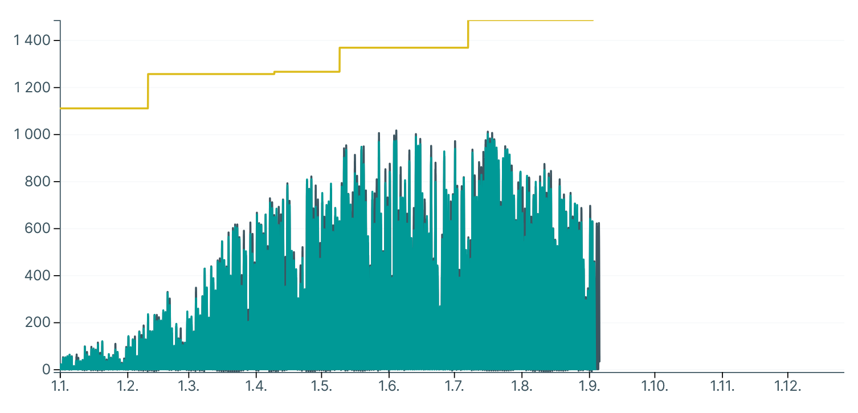
Solar power grid generation 2025
Total solar production estimated capacity 1485 MW (1.9.2025)
Source: Fingrid

Slide 4
Solar PV market in Finland
Market areas
Small houses (detached houses, semi-detached houses, row houses)
Farms
Apartment buildings
Large land installations, industrial scale (over 1 MW)
All market areas are currently growing in numbers, with large installations mostly (in MW)

Slide 5
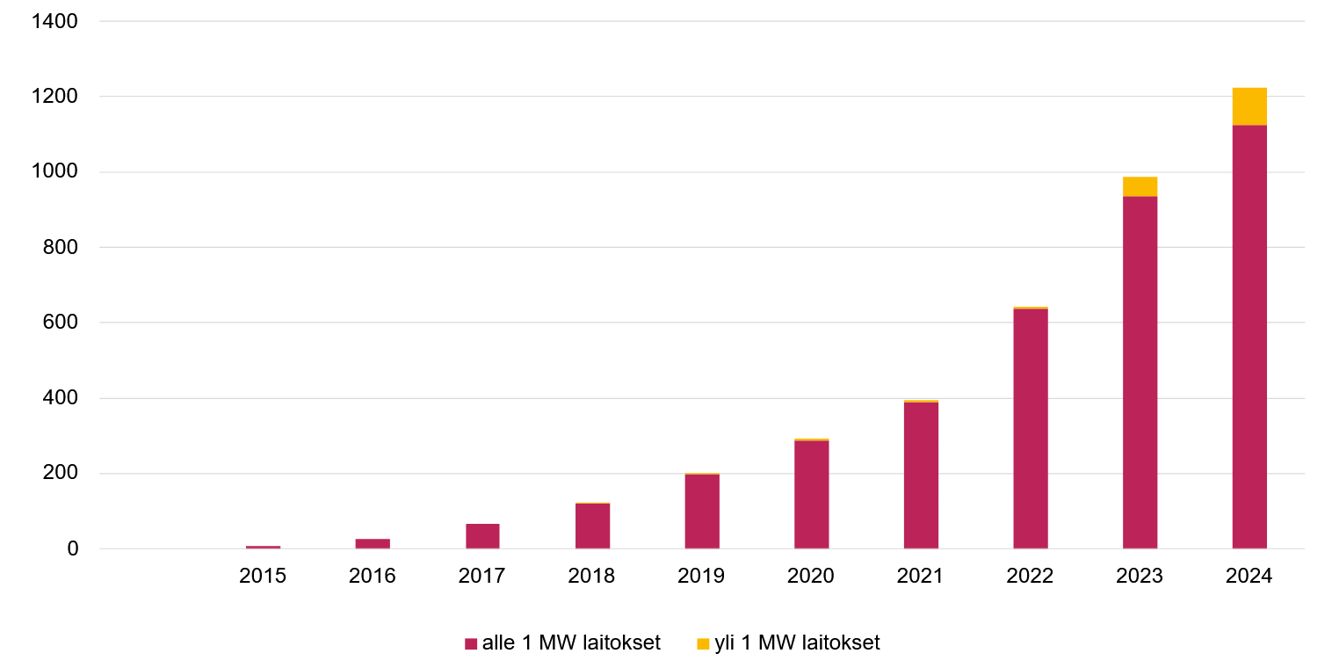
Grid connected PV 2015-24
31.12.2024 1247 MW
~100 MW plant (>1 MW) 2024
2025
251 MW industrial capacity
By June 125,7 MW new to grid
By Dec 300 MW more to grid

Slide 6
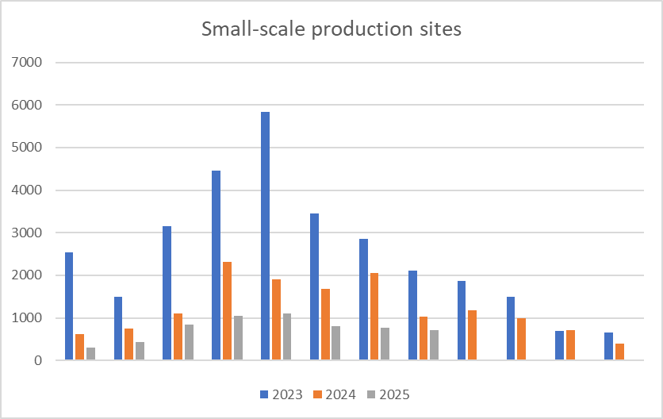
Finland 2023 – 2025 (August) < 1MWp PV
Addition of small-scale production sites
11452 1-8 .2024
Source: Fingrid Datahub

Slide 7
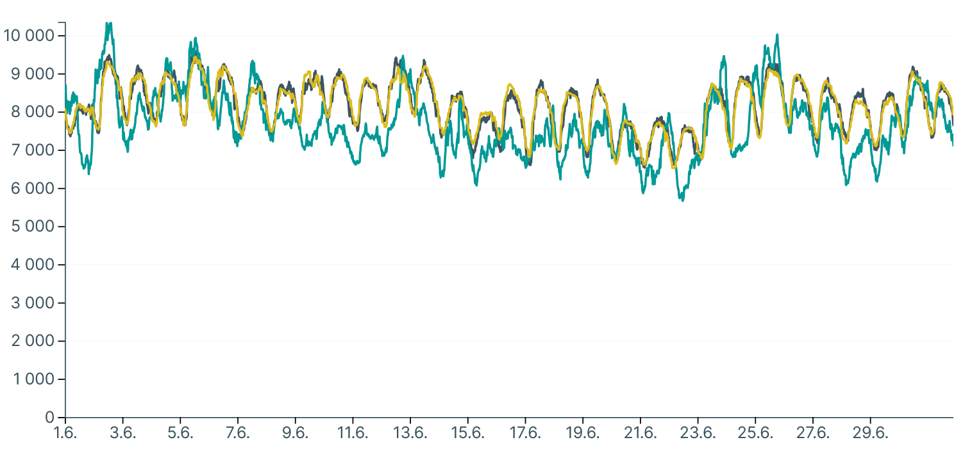
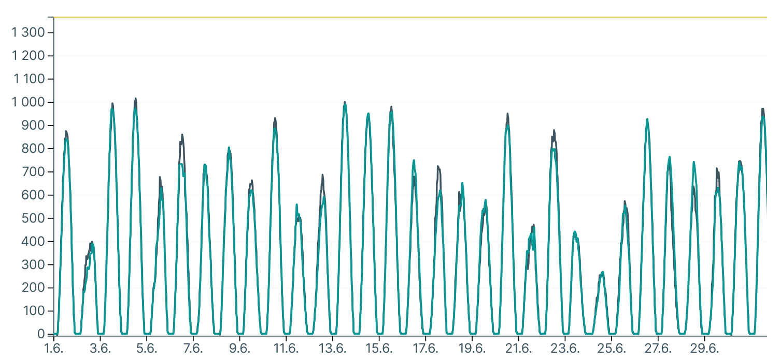
Electricity consumption- production 2025
Max el. prod 13864 MW (Jan)
Max June consumption 9560 MW
Max June PV production 1000 MW, ~10 % of consumption by PV
Due to increase in electricity demand until 2030, the production increase is expected to 11% - 40%
MW
MW
Source: Fingrid

Slide 8
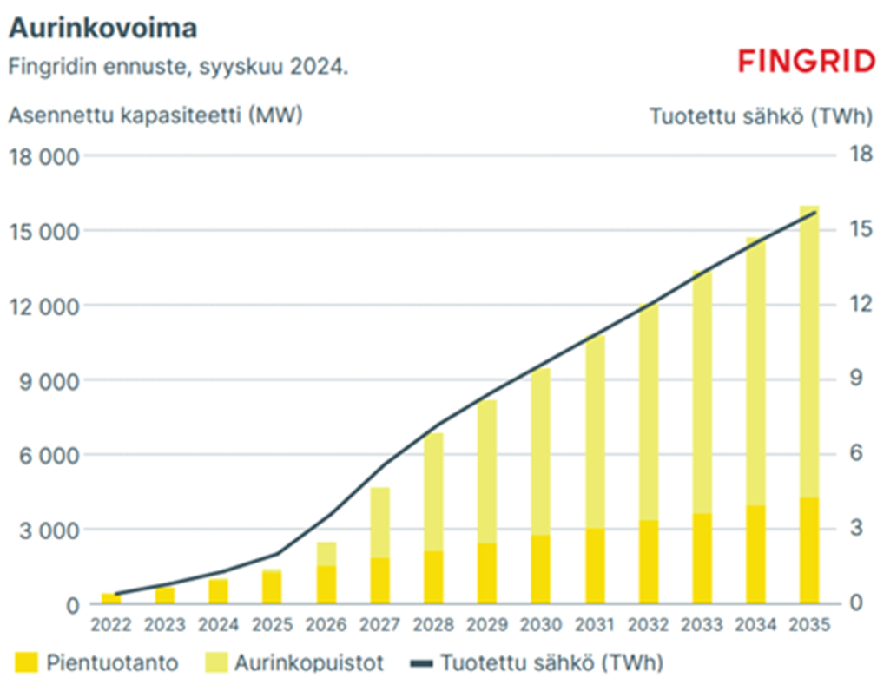
Future grid connected PV 2035
Fingrid prediction:
Installed PV capacity 2022 -2035
9000 MW by 2030
16000 MW by 2035

Slide 9
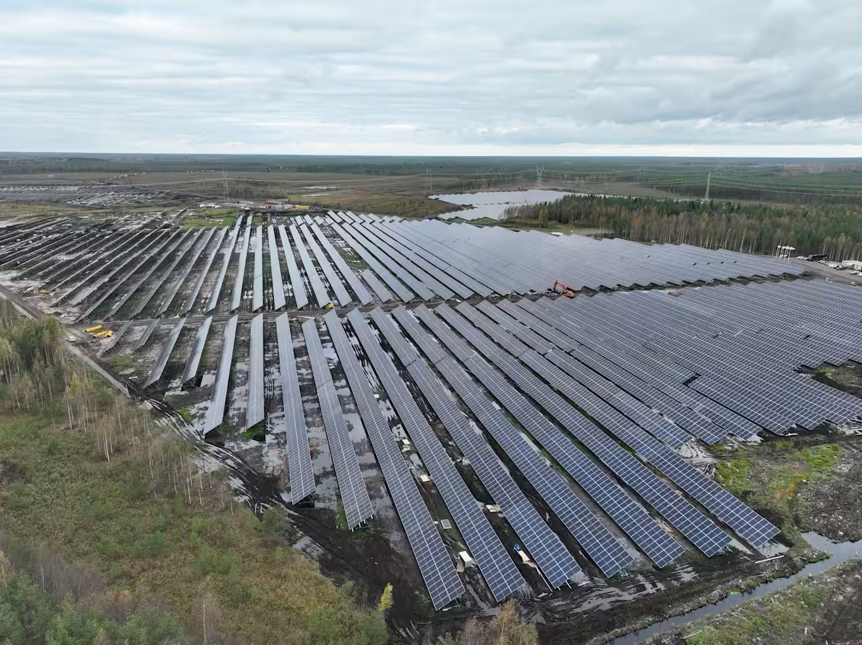
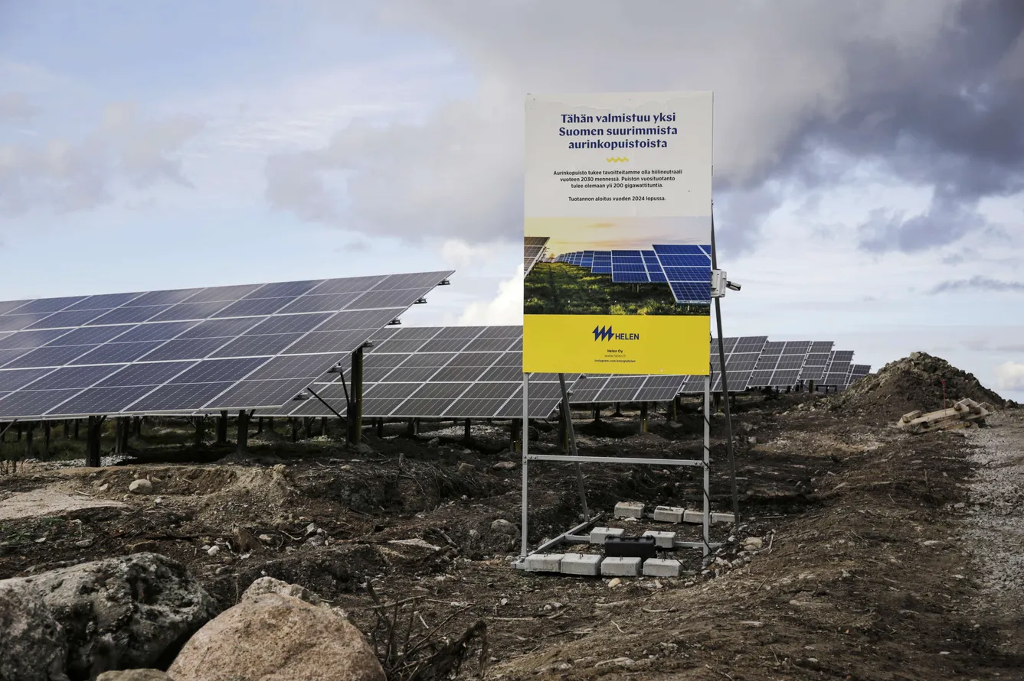
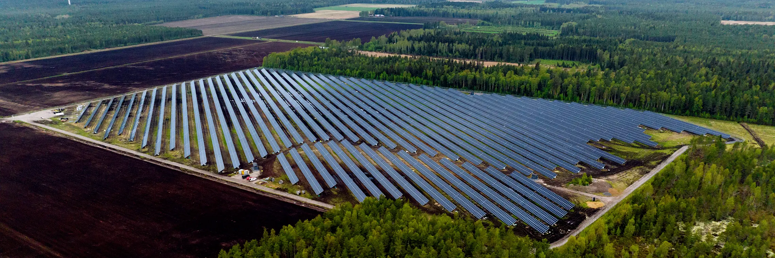
Large land installations >1 MWp
Photo: Kalanti, Helen 206 MWp constuction
Photo: Skarta Energy 53 MWp
Over 25 other >1MW installations in operation
425 MW increase during 2025
Photo: Onninen ,Kalajoki, Solarigo 13 MWp

Slide 10
Thank you
10.09.2025
Christer Nyman

