Slide 1
Renewable Energy Directive –
Role and Opportunities for Bioenergy in Finland
Harri Laurikka
Bioenergy Association of Finland
September 10th 2025

Slide 2
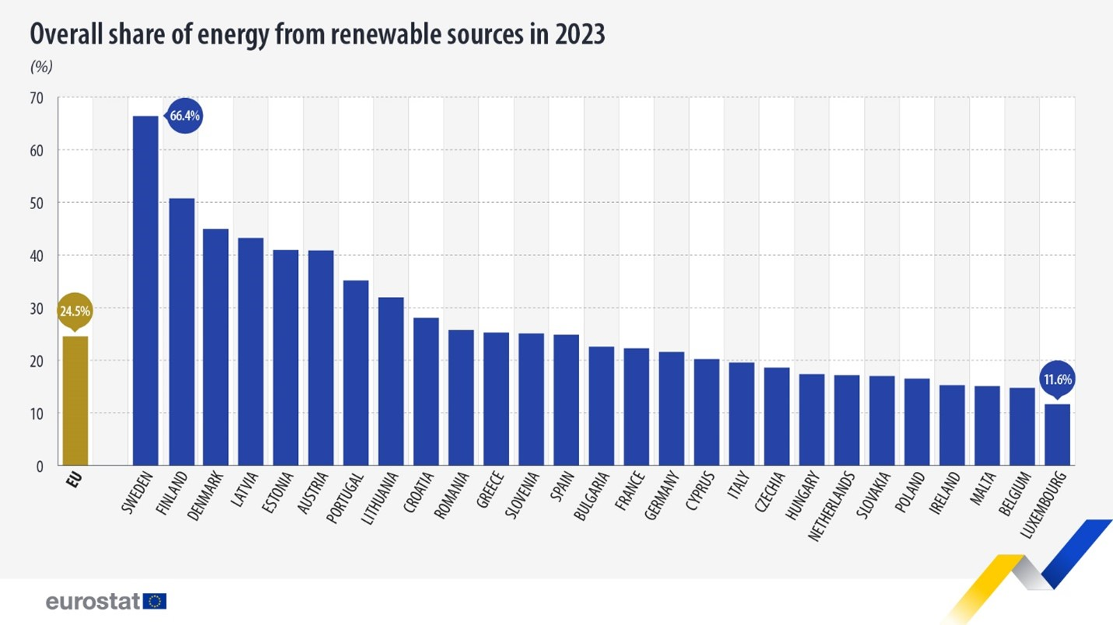
Finland is No 2 in the EU on Renewable Energy
Goal in REDIII for 2030: 42.5 %
Finland’s target 2030: 62 %
Figure: Eurostat 2025, additions by the author

Slide 3
Bioenergy represented 73% of Finnish renewable energy in 2023.
Bioenergy use is therefore decisive for the goal of achieving the national renewables target.
In the current investment pipeline, most bioenergy-related projects are in bio-CO2 capture and logistics, biorefineries and biogas.
RFNBO subtargets in the REDIII Directive have contributed to the high number of RFNBO projects in Finland.

Slide 4
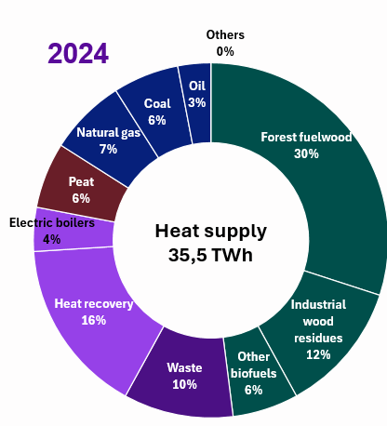
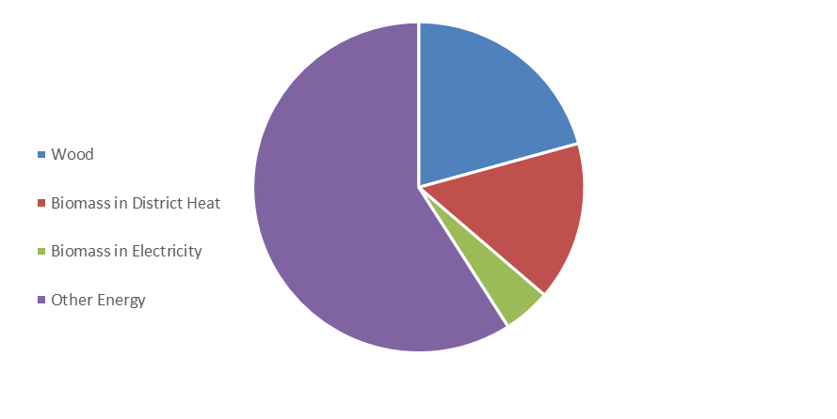

Bioenergy is an Essential Part of Energy Security – particularly in Heating
District Heat:
Energy Consumption in Households 2023:
Sources: Statistics Finland 2024, Finnish Energy 2024
Source: Finnish Energy, 2025

Slide 5
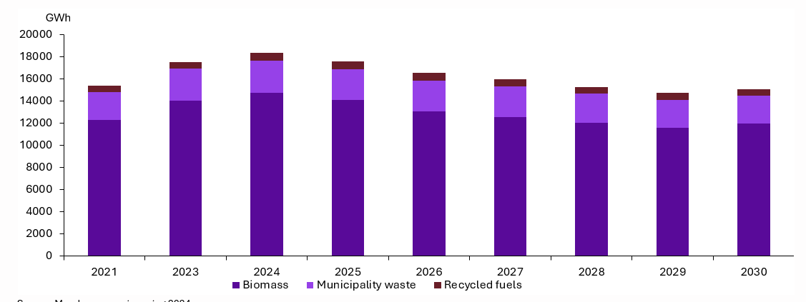
Bioenergy use in district heating not expected to grow any longer due to electrification
Source: Finnish Energy, survey to members spring 2024

Slide 6
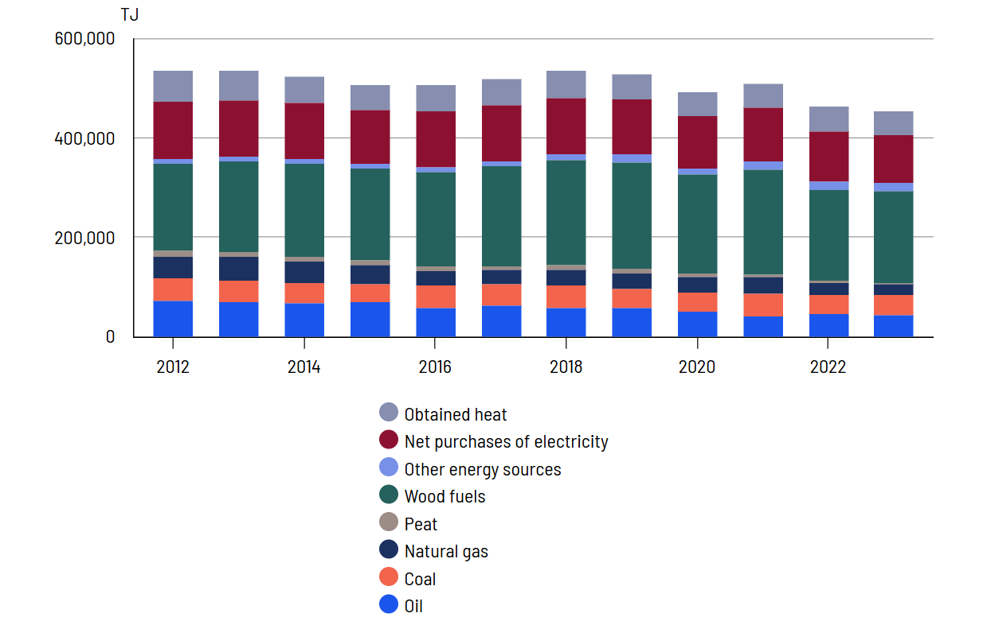
Energy Use in Industry 2012-2023
Bioenergy 53 % (approximation)
Bioenergy 13 % (approximation)
All in all, bioenergy close to 50 % in 2023 => stays significant towards 2035
Figure: Statistics Finland 2024, additions by the author

Slide 7
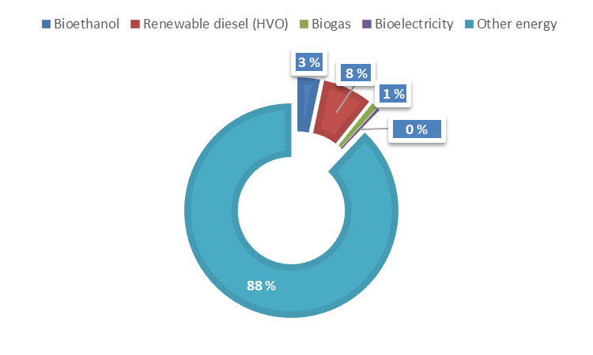
Energy Use in Transport 2024
All in all, bioenergy 12 % , expected to grow towards 2030
Data: Statistics Finland 2025, additions by the author

Slide 8



Thank You for Your Interest!
www.bioenergia.fi
harri.laurikka@bioenergia.fi

Slide 9
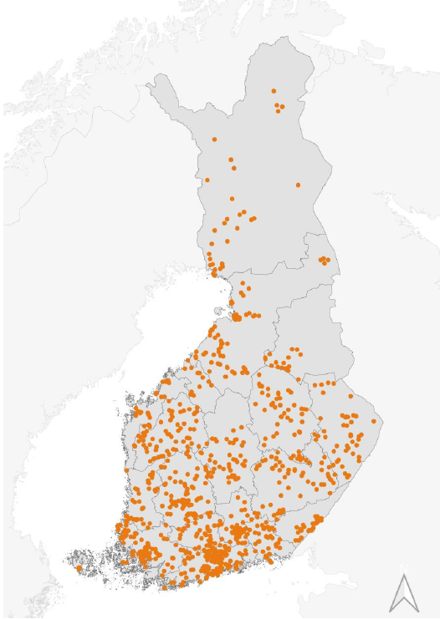
District heating – decentralised efficiency
Ca 500 district heating networks, 0,5 – 2700 MW
Peak production ca 13 000 MW
Consumption ca 30-35 TWh/a
Over 16 000 km heating networks
Utilises mainly local biomasses, some imports from the Baltic sea region
Crucial for preparedness and self-reliance
Provides flexible platform for a multitude of solutions to heat cities and villages
Image source: Finnish Energy

