Slide 1
Best Practices from One of Finland’s Most Climate-Ambitious Regions

Slide 2
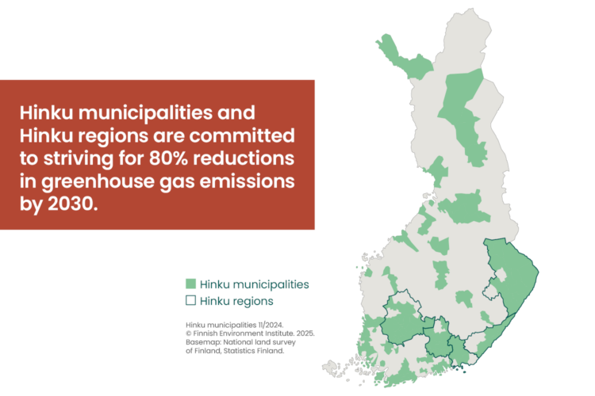
*
*from 2007 levels

Slide 3
In 2030 Pirkanmaa has a fossil-free, efficient and reliable energy system, that is environment friendly and fair.

Slide 4
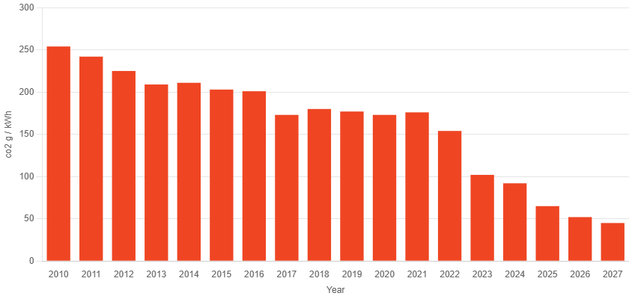
In 2030 Pirkanmaa has a fossil-free, efficient and reliable energy system, that is environment friendly and fair.
District heating carbon footprint (g/kWh)

Slide 5

In 2030 Pirkanmaa has a fossil-free, efficient and reliable energy system, that is environment friendly and fair.

Slide 6

In 2030 Pirkanmaa has a fossil-free, efficient and reliable energy system, that is environment friendly and fair.

Slide 7

In 2030 Pirkanmaa has a fossil-free, efficient and reliable energy system, that is environment friendly and fair.

Slide 8

In 2030 Pirkanmaa has a fossil-free, efficient and reliable energy system, that is environment friendly and fair.

Slide 9


Slide 10
Pictures
Slide 2 https://hiilineutraalisuomi.syke.fi/en/
Slide 4 https://www.tampereenenergia.fi/en/
Slide 7 Circwaste project
Slides 5-6 and 8-9 Microsoft 365 stock images

