Slide 1

Implementing Energy Efficiency at Local Level: Lisboa E-Nova, a partner for Lisbon’s climate neutrality
Carlos Contente de Sousa, Lisboa E-Nova
NATIONAL PARLIAMENTARY WORKSHOP
Shaping Portugal’s Energy Future: Policy, Renewables,
and Energy Efficiency
Lisbon, 17th June 2026

Slide 2
ABOUT US
We work for the future
Vision
Mission
Positioning
A smart and climate-neutral Lisbon in 2030, able to overcome the climate transition challenges and ensure the sustainability, inclusion, security and resilience of the city and inhabitants.
of its citizens..
Based on its experience and technical knowledge, Lisboa E-Nova aims to be the catalyst for the city's transformation, contributing to a city's energy transition process capable of ensuring climate neutrality in 2030.
by 2030.
Lead by example in the energy transition process towards decarbonization, at the metropolitan, national and European scales, in line with Lisbon’s climate targets.

Slide 3
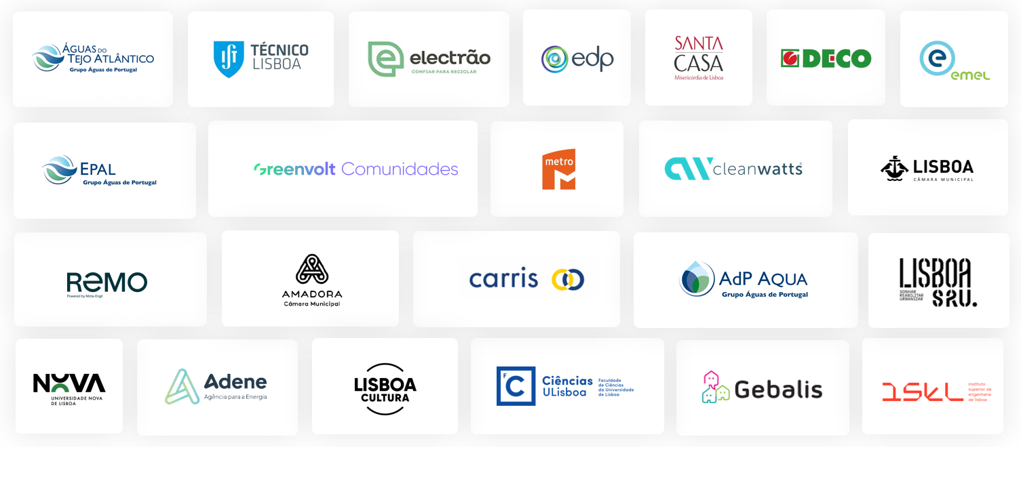
OUR ASSOCIATES

Slide 4
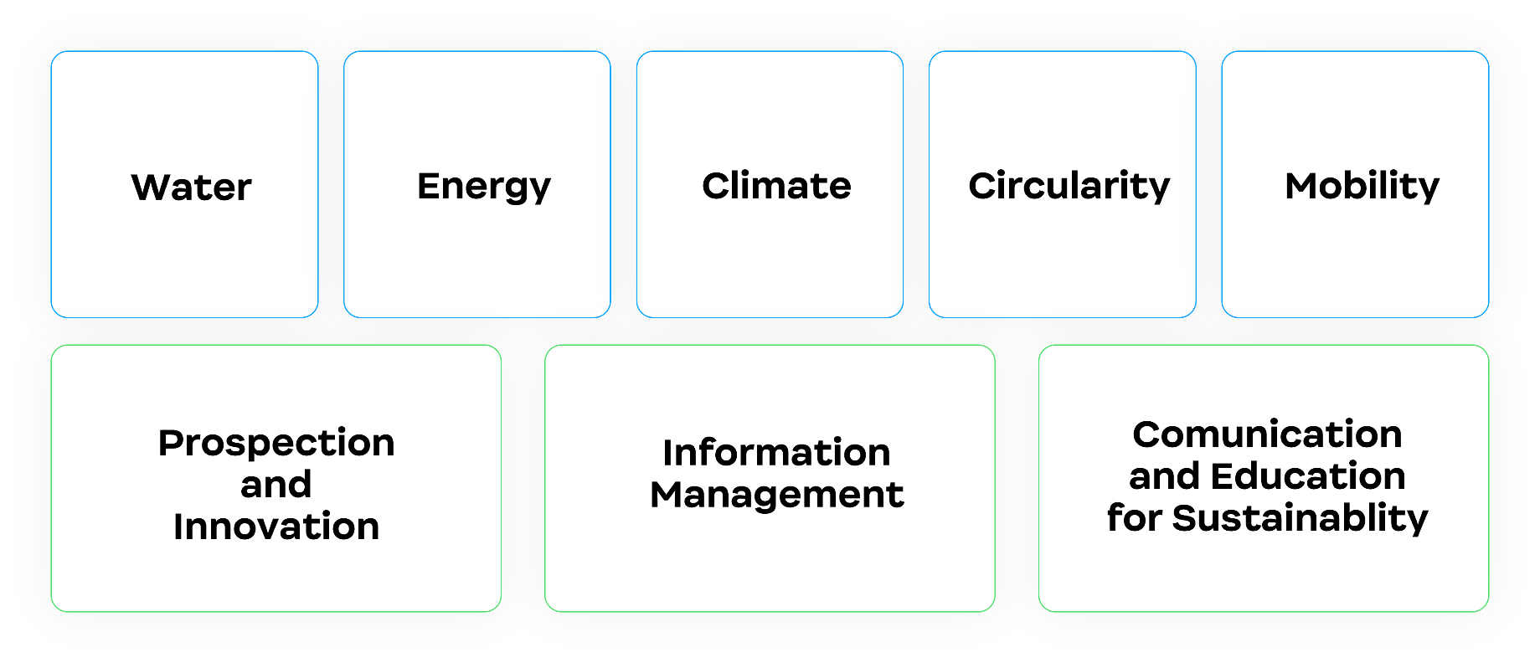
AREAS OF EXPERTISE/INTERVENTION

Slide 5
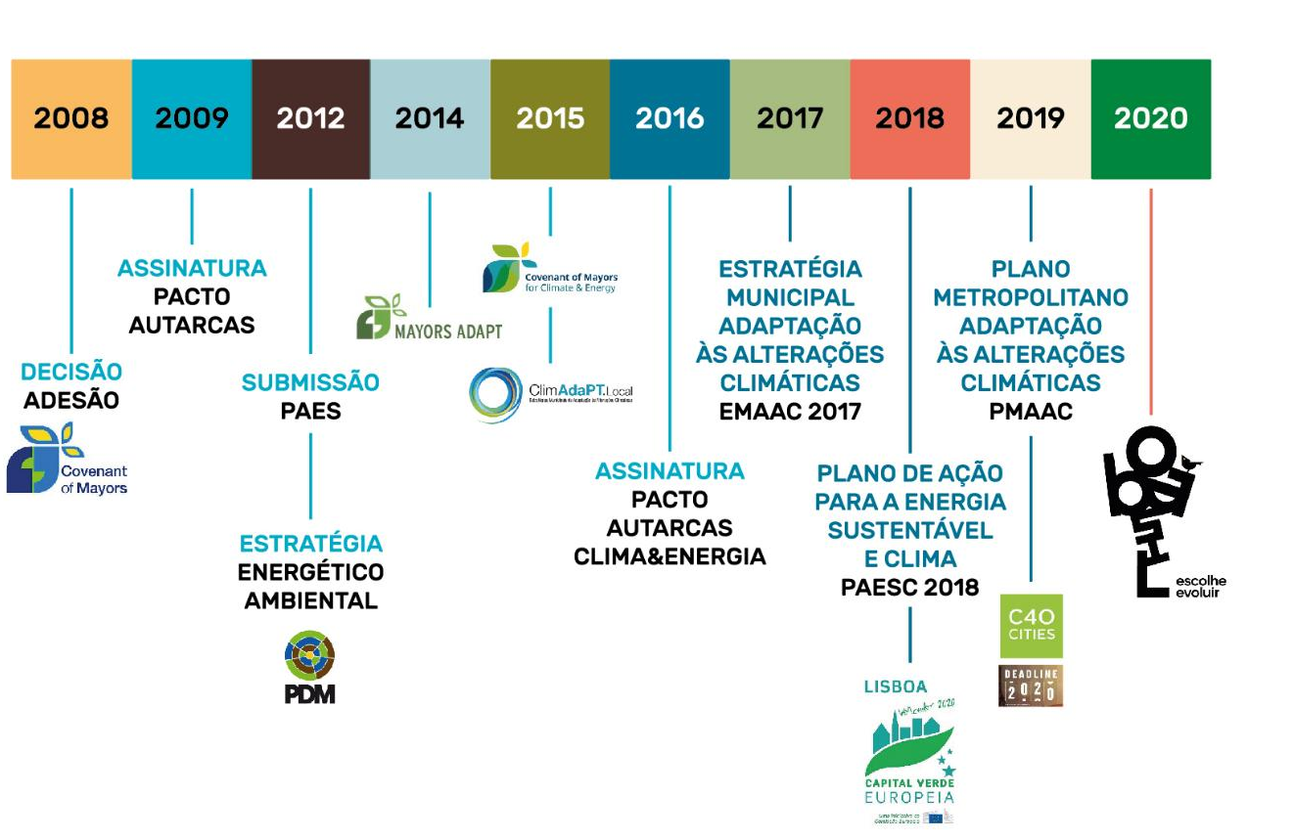





CLIMATE ACTION IN LISBON
2004
CRIAÇÃO
LISBOA E-NOVA

Slide 6
LISBON: SOME NUMBERS
50 000 buildings
  Residential: 43 000 (88%)
Households: 242 000
  Of which 23 570 are public
Integrated public transport in the city, including all 18 metropolitan area municipalities: Rail, Metro, Light Rail (Tram), Funiculars, Public Elevators, Bus, Ferry Boats
The world's first largescale hybrid public bikeshare system:
  since 2017: from 43 stations and 409 bicycles (conventional and pedelec) in 4 boroughs.
  2026: to 195 stations and 2 090 bicycles (all pedelec) in all of Lisbon's 24 boroughs
100 km²
546 000
Inhab.
(2021)
925 959
Inhab. + commuters

Slide 7

EU MISSION “CLIMATE NEUTRAL AND SMART CITIES BY 2030”
  Lisbon’s City Climate Contract:
  Climate neutrality in Lisbon will be anticipated to 2030 (from 2050)
  Compensate residual emissions in 2030: approx. 750 ktCO₂e
  Continue to address inequalities, ensuring a fair and inclusive energy transition: a fight focused on eradicating energy poverty.
  Lisboa E-Nova provides technical assistance to the Municipality in the preparation of the City Climate Contract
  Electrification and energy efficiency are key
  6,8 billion EUR investment in energy efficiency and renewables (mitigation component)

Slide 8
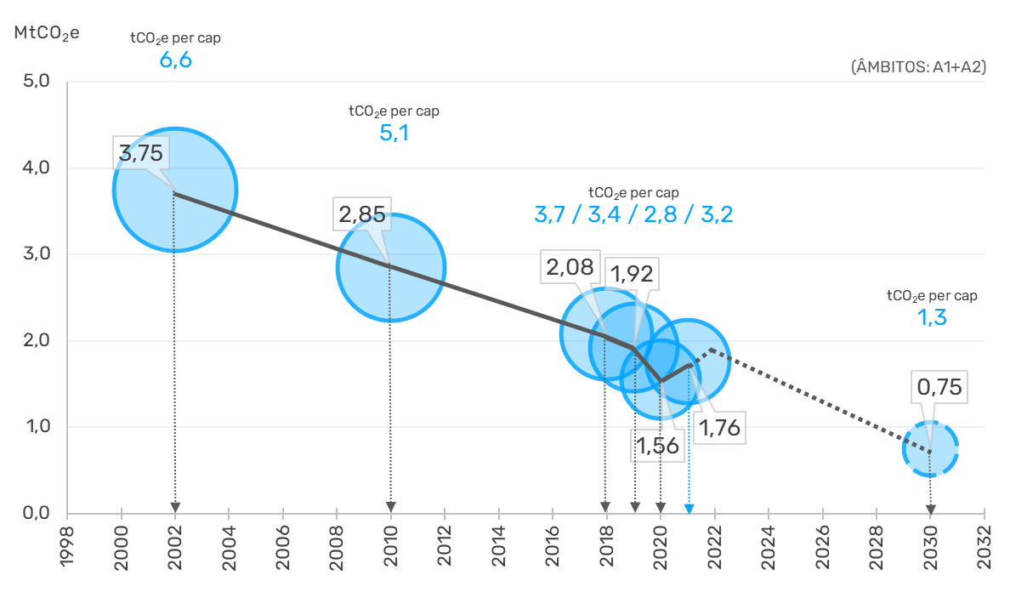
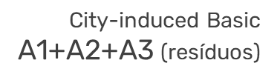

TARGETS/COMMITMENTS FOR GHG REDUCTION
City Climate Contract Lisboa 2030
2002-10
▼24%
▼0,90
MtCO₂e
2002-19
▼49%
▼1,82
MtCO₂e
2002-30
▼3,00
MtCO₂e
▼80%
Ad. 2019-30
▼1,17 MtCO₂e
▼61%
+
▼0,75
MtCO₂e
Remoções
Sumidouros
Compensação
Emissões GEE | Tetos de emissão e metas 2030 (A1/A2/A3 | 70%)

Slide 9
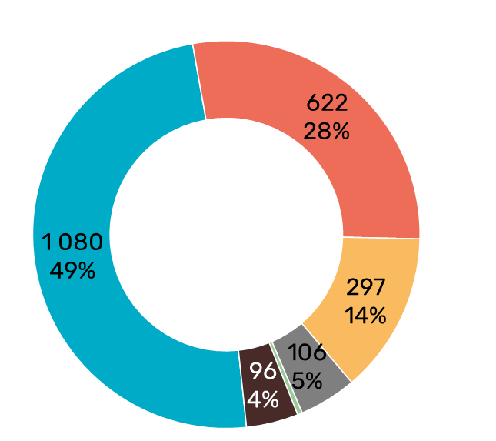
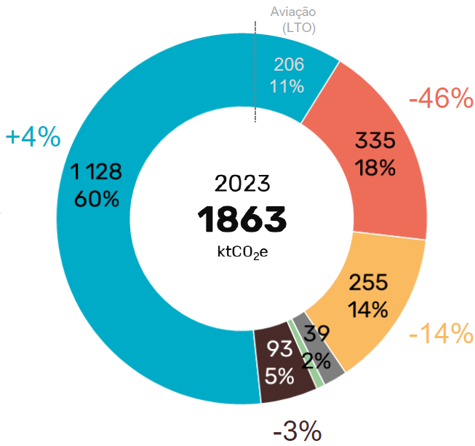
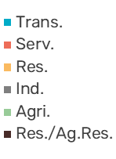
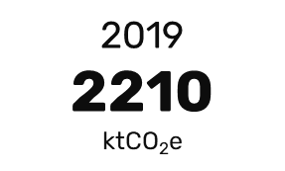
GHG EMISSIONS LISBON 2019-2023
Sectoral Analysis
Aviação (LTO)
232
10%
16% reduction between 2019 and 2022;
Emissions’ reduction in household and services sectors (scope 2 – electricity decarbonization);
Transport sector: increased emissions.

Slide 10
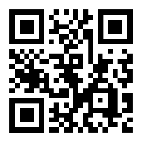

City4Climate - Gémeos Digitais Urbanos para a Ação Climática
  Develop and implement a Digital Twin framework tailored for climate action governance, eliminating the 2 year gap of the available data.
  Integrate real-time data and predictive analytics to support decision-making and accelerate decarbonization.
  Simulate scenarios on key urban components such as emissions, air quality, mobility, energy, and the environment.
  Create a scalable and interoperable architecture aligned with EU standards for climate adaptation and mitigation.
city4climate.pt

Slide 11
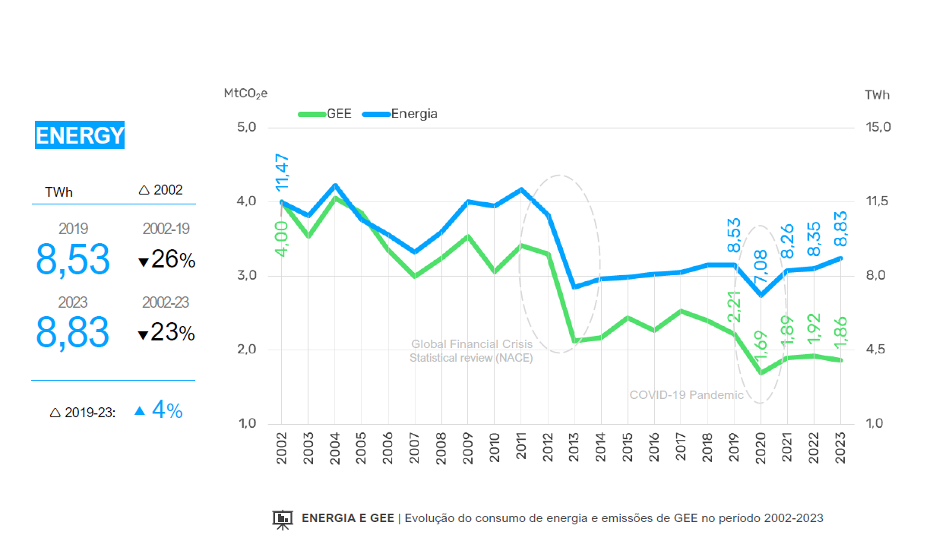
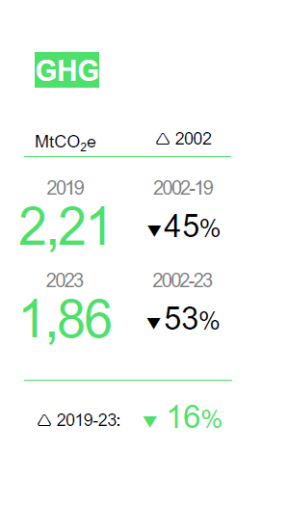
ENERGY AND GHG EMISSIONS LISBON 2002-2023
Decoupling between carbon emissions and energy consumption due to Electrification.
Energy Efficiency has to be present!

Slide 12
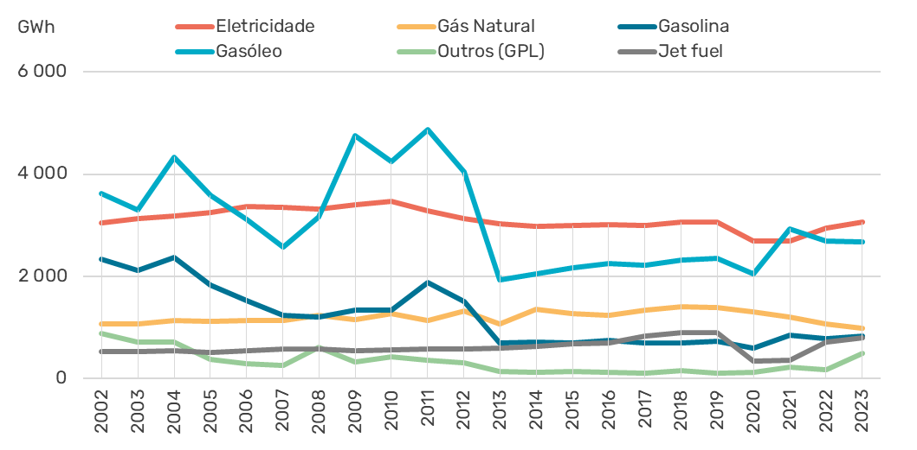
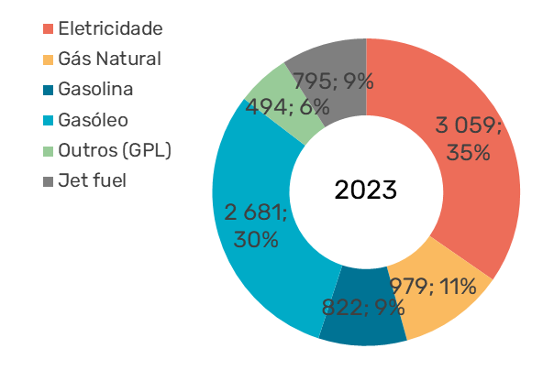
ENERGY CONSUMPTION LISBON 2002-2023
Electricity (35%) and Diesel (30%): 2/3 of the total energy consumption
Natural Gas: 11% of the total energy consumption

Slide 13
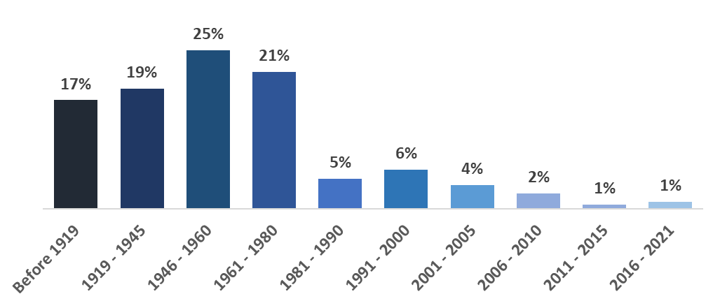
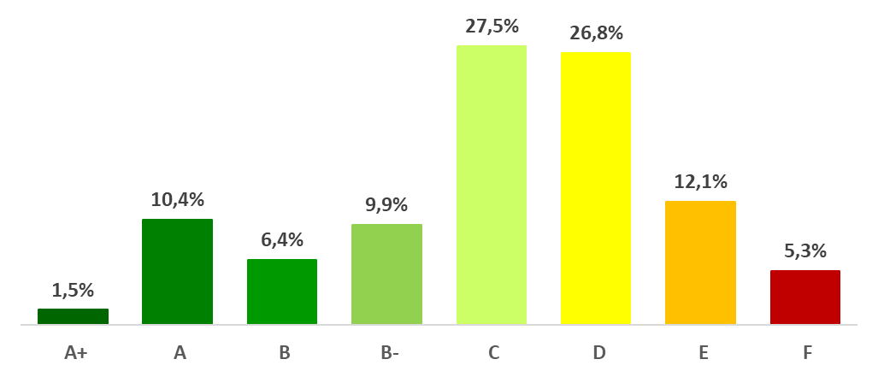
LISBON RESIDENTIAL BUILDING STOCK
Distribution of residential building stock by construction period
Energy performance certificates of residential buildings
82%
72%
Source: INE
Source: SCE

Slide 14
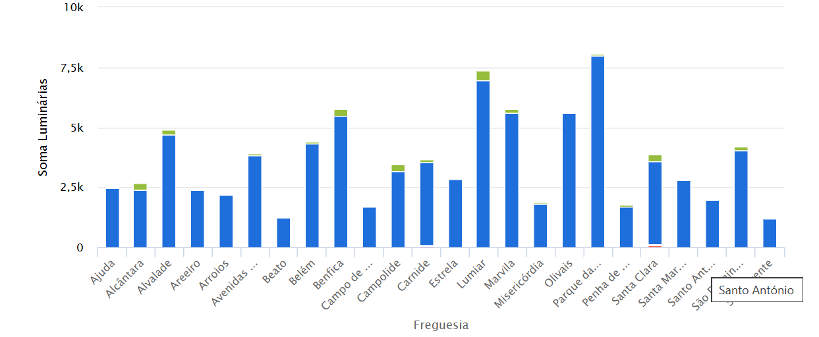
LISBON’S PUBLIC LIGHTING
Source: E-REDES Open Data
Over 85 000 luminaries in the city
LED in green (very low penetration)

Slide 15
ELENA: SETTING THE SCENARIO
  In 2019 the residential and services sectors represented 42% of the Lisbon's total energy consumption and Greenhouse Gas (GHG) emissions. In addition, public lighting is another crucial sector, accounting for 70% of CML's electricity consumption.
  Lisboa E-Nova identified an opportunity: the ELENA Programme, managed by the EIB.
  ELENA supports project development services, strengthening Lisboa E-Nova's capacity to provide technical assistance to Lisbon Municipality and to leverage investment to improve energy efficiency in municipal buildings and public lighting.

Slide 16
LISBON ALLIANCE
  Lisboa E-Nova's project "Lisbon Alliance – Accelerate pubLic buiLding renovatIon And public lighting eNergy effiCiEncy“
  Starting date: 1st April 2025 | Duration: 36 months
  Budget (for project development services): 1.6 M€ (90% financed by ELENA)
  Investment in energy efficiency: 44.6 M€ (leverage factor: ~28 times)
  The project development services are being done by Lisboa E-Nova, using its team and specialized external consultancy.
  The investment program will be done by the Municipality – CML, SRU and GEBALIS – and/or other municipal/public companies/entities.

Slide 17
LISBON ALLIANCE
The Energy Efficiency Investment programme submitted to the EIB contains 3 main dimensions:
  Residential buildings: renovation of 55 existing residential buildings intended for social/affordable housing (77,605 m²), by improving the thermal performance of the building’s envelope and renovating technical systems
  Energy savings: 54%

Slide 18
LISBON ALLIANCE
  Non-residential buildings: renovation of 11 existing non-residential buildings, mostly schools (32,175 m²) – technical systems (air conditioning and lighting) and improvement of thermal performance of the building’s envelope.
  Energy savings: 64%
  Public lighting: renovation of existing lighting technologies, replacing them with LED and introducing smart management systems. At least 16,000 luminaires were assumed to be replaced.
  Energy savings: 70%

Slide 19
LISBON ALLIANCE: A FEW EXAMPLES
  SRU - Urban Rehabilitation Society
  Rehabilitation of José Gomes Ferreira Secondary School: building envelope, natural ventilation and PV – estimated investment: 19 M€
  GEBALIS – Lisbon Public Housing
  Rehabilitation of Alfinetes and Quinta das Salgadas neighbourhoods (34 buildings/364 dwellings) – estimated investment: 8 M€
    Building envelope (thermal insulation, windows)
    PV and mechanical ventilation
    Energy certification: from D, E, F to C or B-;

Slide 20
LISBON ALLIANCE: LEVERAGE ENERGY EFFICIENCY INVESTMENT IN LISBON
  Over 100 M€: projected investment in rehabilitation of residential municipal buildings by Lisboa E-Nova’s partners GEBALIS, SRU, CML – energy efficiency (building envelope, improving thermal comfort).
  Raise the projects’ ambition and quality and serve as a test bed for energy efficiency measures.
  A tangible contribution to the climate neutrality targets of Lisbon.

Slide 21
Thank you for your attention
carloscontente@lisboaenova.org

