Slide 1
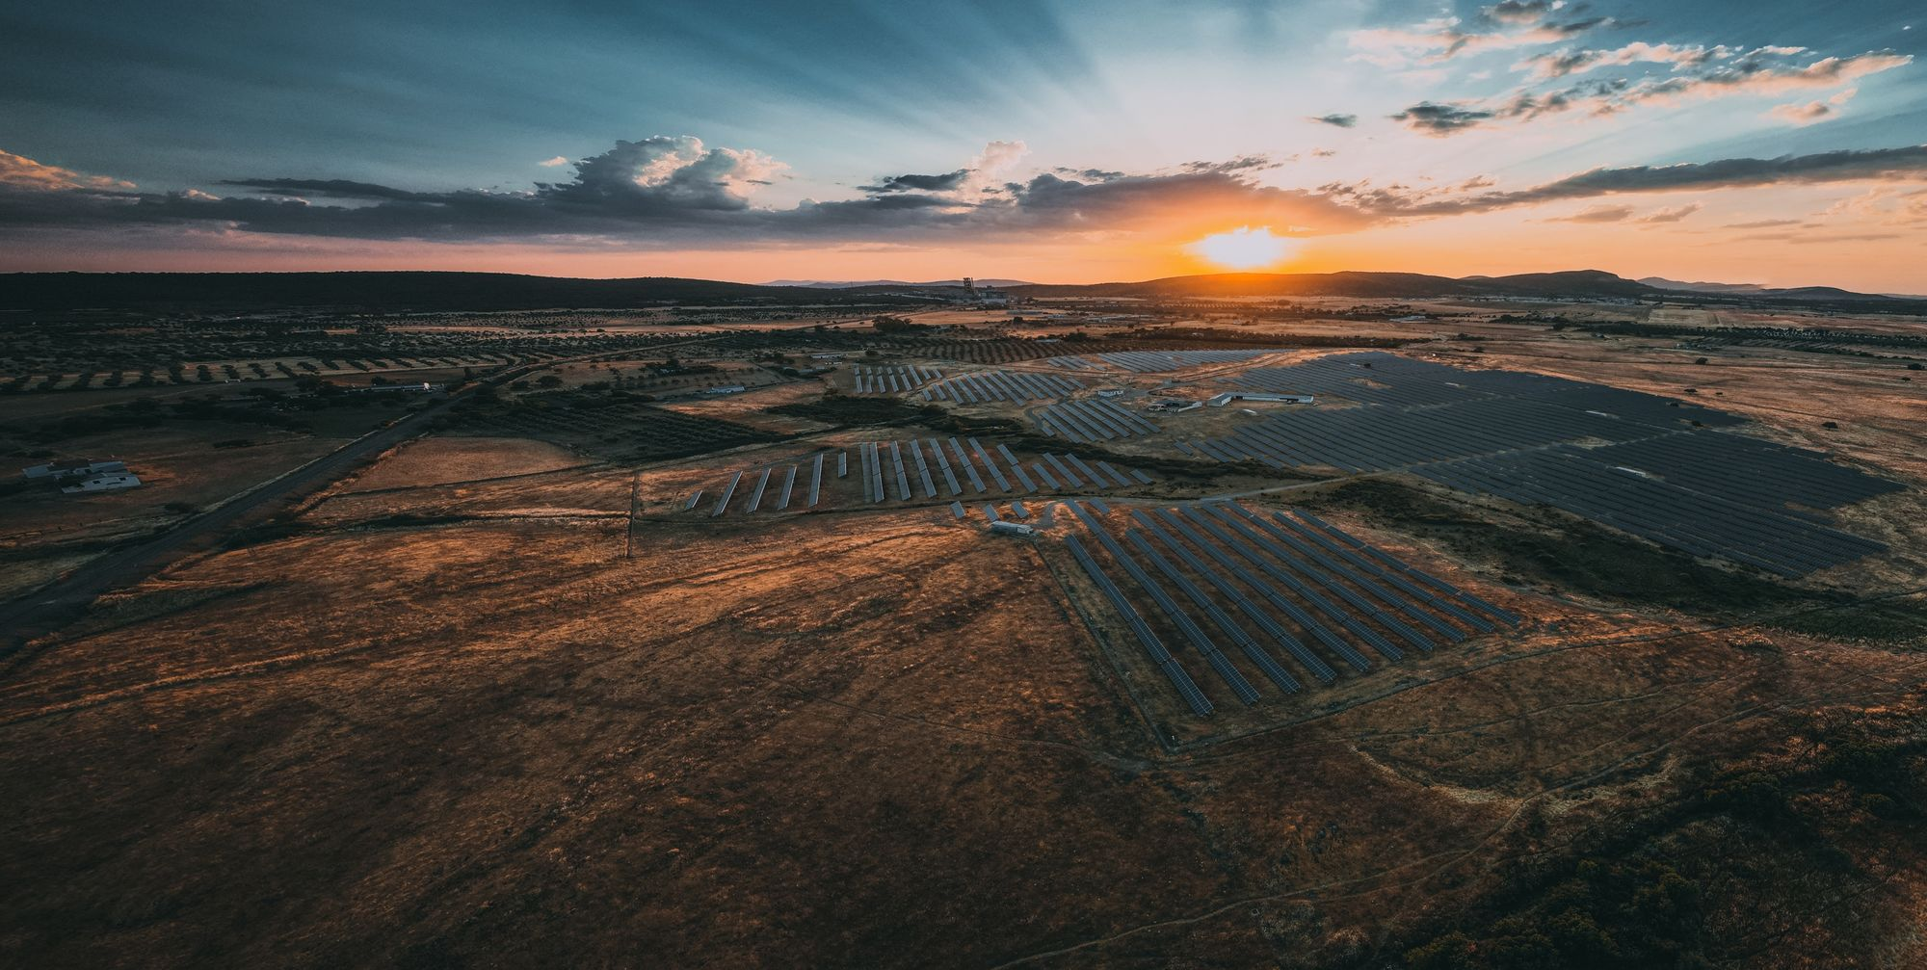
Energy Storage as a System Enabler
Batteries and Flexibility for a Renewable Grid
17th June 2026
Beatriz Llorente
Head of Growth for Iberia, Sonnedix

Slide 2
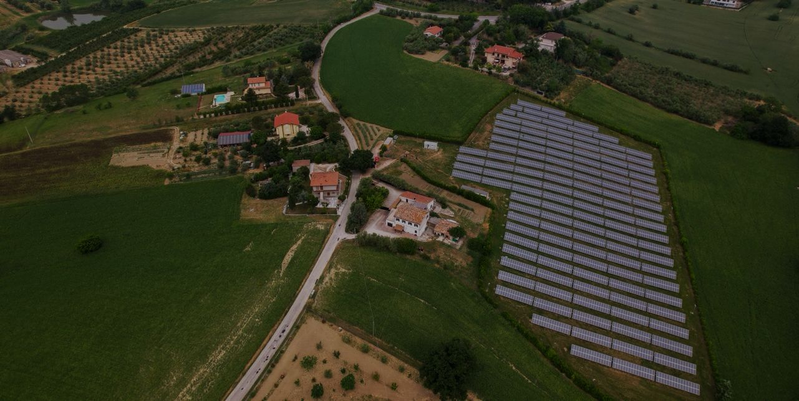
Sonnedix in Portugal
Who we are and what we're building

Slide 3
A Global Renewable Energy Producer
11 GW+ Global Capacity
Solar, wind and storage across three continents. Our 6 GW+ development pipeline spans multiple markets and technologies.
Portugal: A Growing Market
Operating in Portugal since 2022, with ~330 MWp of operating solar across 10 plants. It is one of our most active markets today, with ~250 MW of co-located storage now under construction.
Long-term Local Partner
We develop, build and operate our projects for the long term. Our commitment to Portugal's energy future is enduring.

Slide 4
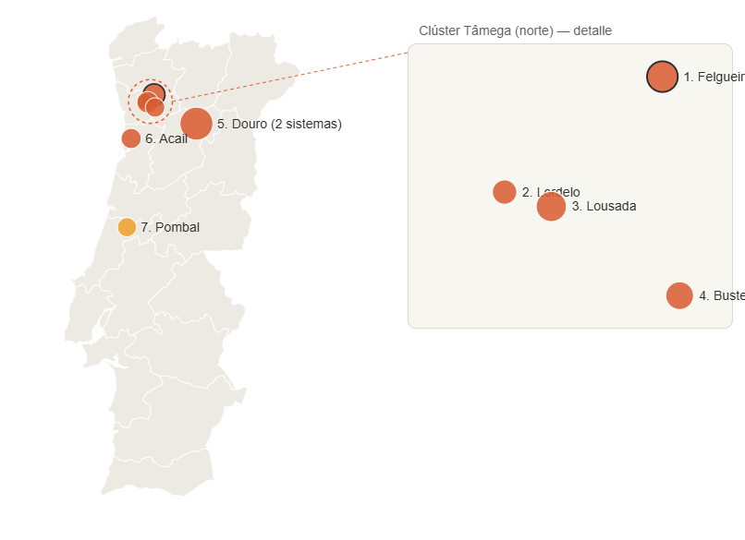
Hybridising Portugal’s Solar Fleet | Our Active Projects
Project | Region | Solar | Storage | Status
Douro | Norte | 149 MWp | 110 MW BESS (2 systems) | In construction
Felgueiras | Norte | 40 MWp | 32 MW BESS | In construction – energising
Lousada | Norte | 37 MWp | 30 MW BESS | In construction
Acail | Norte | 28 MWp | 24 MW BESS | In construction
Bustelo | Norte | 24 MWp | 21 MW BESS | In construction
Lordelo | Norte | 15 MWp | 11 MW BESS | In construction
Pombal | Centro | 28 MWp | 20 MW BESS | Late-stage development

Slide 5
Felgueiras | Our First Hybrid Project to Reach NTP
A 39.9 MWp solar plant in Felgueiras (Norte) paired with a 32 MW co-located battery — fully financed, in construction and now energising. The first hybrid project in our Portuguese fleet to reach Notice to Proceed.
1st
Hybrid project in our PT fleet to reach NTP
39.9 MWp
Co-located solar
32 MW
Battery storage (BESS)
~100%
Output under a hybrid PPA
A regulatory pioneer
First solar-plus-storage project in our Portuguese portfolio to reach Notice to Proceed (BESS NTP July 2024).
We worked side by side with the authorities on the hybridisation framework — moving ahead of the regulation itself.
Establishes a replicable permitting and grid-access path for co-locating storage on operating solar.
A bankable commercial model
Fully financed and in construction; BESS reached COD in May 2026 and the solar plant is energising in June 2026.
Underpinned by a hybrid PPA, with close to 100% of output contracted.
39.9 MWp of solar paired with a 32 MW battery — proof the hybrid model works and is bankable.

Slide 6
Our Commitment for the System, for Industry, for Society
Optimisation
Industrial Competitiveness
Energy Security
More value for the system and for consumers
Stable, cost-effective clean power to energy-intensive users.
Reducing Portugal's exposure to price spikes from geopolitical shocks

Slide 7
The Regulatory Ask
What needs to change to unlock storage

Slide 8
Three Barriers Holding Back Storage Today
Portugal gave storage a legal identity in 2022 but ERSE has yet to issue the secondary regulation needed to fully operationalize it. Without tariff rules and system service definitions, the legal category exists on paper only — and investment cannot follow.
Regulation Without Implementation
Existing solar plants cannot add batteries without a grid permit modification even if within the approved area. Also, procedures to get the consumption are not clear and are taking more tan expected. The result: longer times of response for consumption that result in delays on permitting
Grid Access Effectively delayed and consumption limitations
No clear bankable remuneration signal for flexiblity. Announced capacity market would be a game changer for the deployment and bankability of BESS.
No Remuneration Signal for Flexibility

Slide 9
Four Asks for Policymakers
Complete Regulatory Framework
Create consumption Hybridisation Pathway
01
02
Publish the secondary regulation under DL 15/2022 to operationalise storage participation in tariffs and system services.
REN and Eredes to set the procedures and investments needed for consumption availability.
Solid bankable long term revenues
Align Storage with PNEC 2030
03
Capacity market to be implemented to support BESS investment case.
04
Make storage a named priority in PNEC implementation, with investment signals that enable Portugal’s solar build-out to be absorbed by the grid.

Slide 10
Portugal Can Lead | If the Framework Keeps Pace
Market Reform
Grids & Permitting
Energy Demand
Develop remuneration mechanisms that recognise storage’s system value during surplus renewable generation and negative or near-zero MIBEL prices.
Position storage as an enabler of industrial electrification, providing stable clean power while reducing Portugal’s exposure to gas price volatility and import dependency.
Streamline hybridisation authorisations and fast-track BESS at existing solar sites, reducing permitting timelines from years to months.
Notes:
Portugal's renewable sector is a European success story. But without storage and flexibility, that success hits a ceiling: surplus energy is curtailed, prices spike when generation drops, and industry cannot rely on green power.
Battery storage — especially co-located with existing solar plants — is the tool that breaks that ceiling.
The technology is proven. The investment appetite is real. What is missing is a regulatory framework that allows storage to be built with confidence.
Portugal has the chance to lead Europe in storage deployment. The window is open. The question is whether regulation will unlock it — or keep it closed.

Slide 11

Thank you

