Slide 1
The Clean Industrial Deal
NATIONAL PARLIAMENTARY WORKSHOP
Carlos Maravall Rodríguez
Country Coordinator for Portugal, DG ENER
Lisboa, 17 June 2026

Slide 2
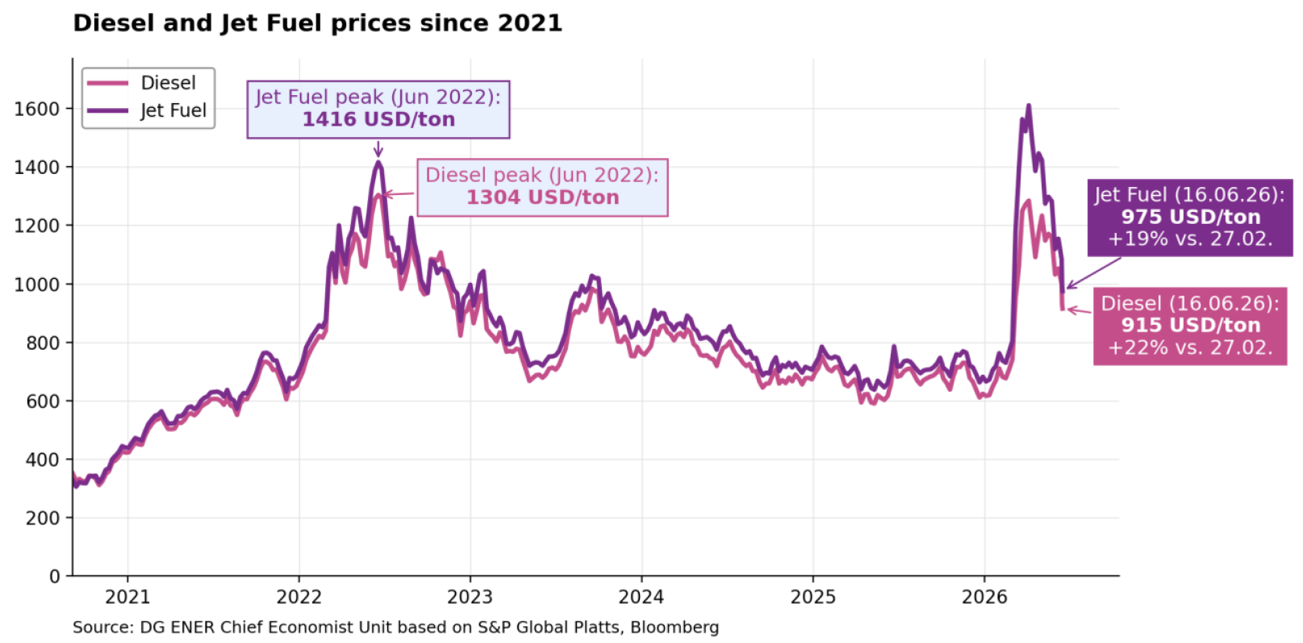
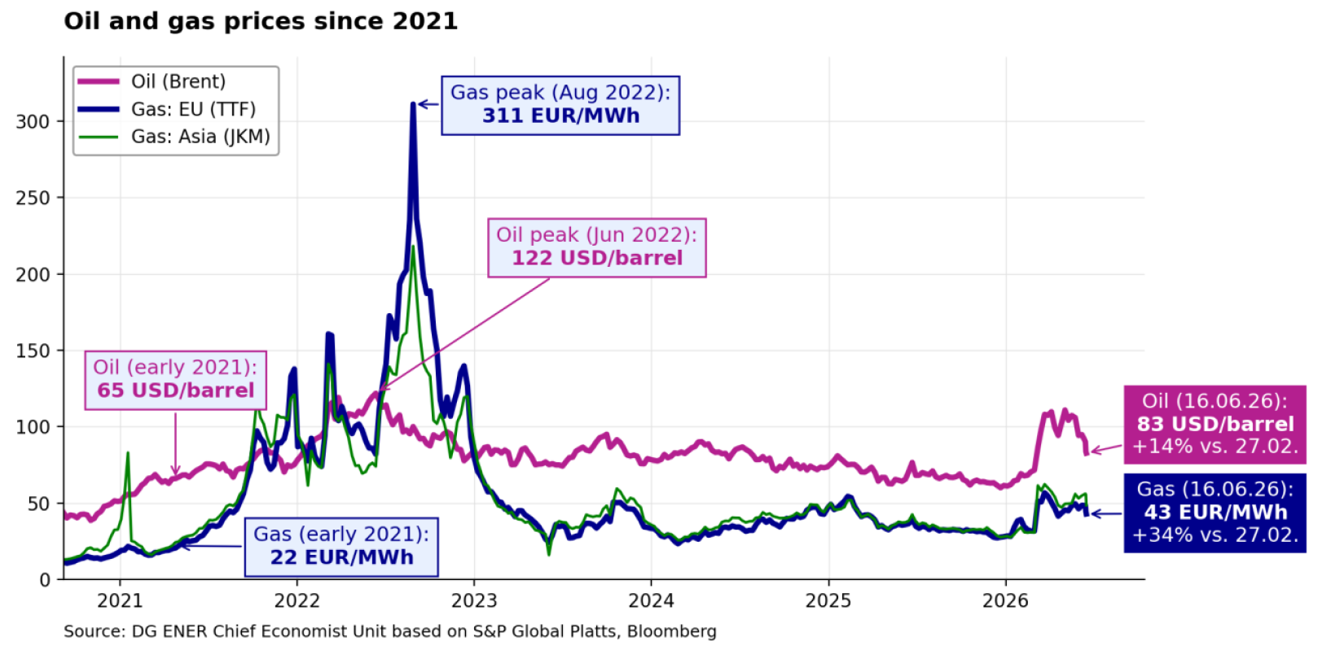
Another energy price shock
1

Slide 3
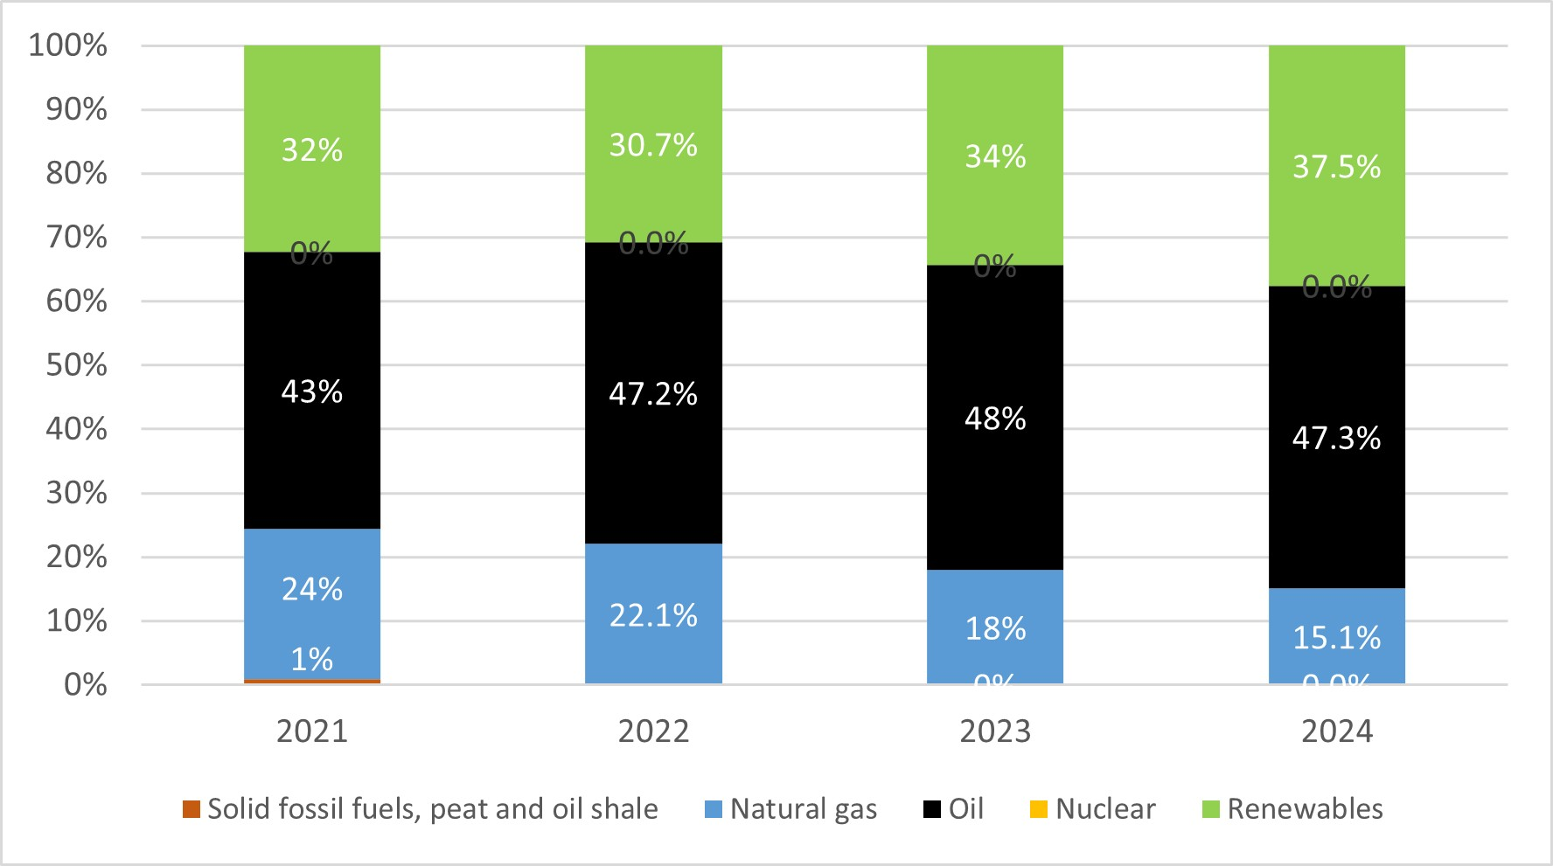
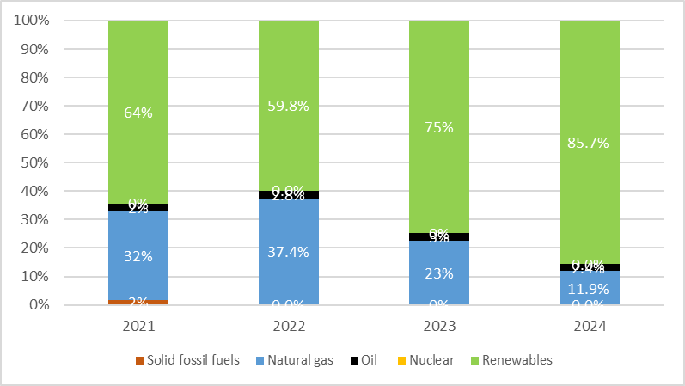
Need more clean, homegrown energy
2
Energy mix (Portugal)
Electricity mix (Portugal)
Energy mix (European Union)
CLEAN: Renewables: 20% Nuclear: 12%.
FOSSIL FUEL: Oil: 38%, Natural gas: 21%, Solid fossil fuels: 10%.
Electricity mix (European Union)
CLEAN: Renewables: 48% Nuclear: 23%.
FOSSIL FUEL: Oil: 2%, Natural gas: 16%, Solid fossil fuels: 11%.

Slide 4
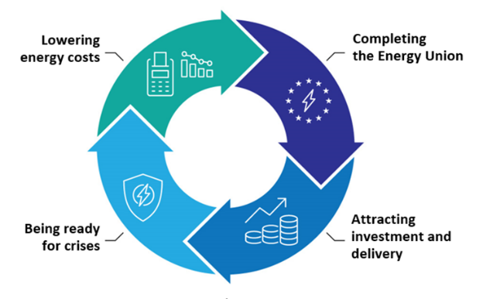
Action Plan for Affordable Energy (Feb 2025)
3
Embedded in the Clean Industrial Deal
Action 1: Making electricity bills more affordable
Action 2: Bring down the costs of electricity supply
Action 3: Improve gas markets for fair energy prices
Action 4: Energy efficiency: delivering energy savings
Action 5: Completing the Energy Union
Action 7: Security of supply for price stability
Action 8: Price crisis preparedness
Action 6: Tripartite contracts for affordable energy for Europe’s industry

Slide 5

Action Plan for Affordable Energy – initiatives
4
Grids
European Grids Package (12/2025)
Consumers
Citizens Energy Package (03/26)
Security and digitalisation
Strategic Roadmap for digitalization & AI in energy (06/26)
Electrification
Electrification Action Plan
Clean Energy Investment Strategy (03/26)
Investments
Network charges
Post-2030 framework
Review of the Governance regulation
Renewable energy and energy efficiency frameworks
Implementing Set (Recommendations) (04/26)
Review of the energy security framework

Slide 6
European Grids Package
5
Initiative:
Communication ‘European Grids Package’
Revision of the TEN-E Regulation
Amending RED, EMD and Gas Directive to support the acceleration of permit granting procedures
[electricity] Guidance on efficient and timely grid connections
[electricity] Guidance on design of contracts for difference
Aim:
Infrastructure planning: Better & more coordinated cross-border planning framework
Financing: ensuring fair and transparent cost-sharing
Simplification measures, such as retention of PCI/PMI label under specific cases
Accelerate permitting
Make best use of existing electricity infrastructure and strengthen the security of critical cross-border energy infrastructure.

Slide 7
Cross border interconnections
6
European Highways
2nd PCI/PMI list (April 2026)
Pyrenean crossings [Better integrate Iberian Peninsula with continental Europe]
Great Sea Interconnector [EL–CY connection end CY electricity isolation]
Harmony Link [Strengthen power links of Baltics]
TransBalkan Pipeline (TBP) reverse flow [Improve energy supply to Balkan & eastern region]
Bornholm Energy Island [Turn Baltic Sea into offshore interconnector hub]
Improve price stability and energy security in southeastern Europe
SoutH2 Corridor [The South hydrogen corridor]
Southwest hydrogen corridor from Portugal to Germany
Second PCI/PMI list contains 235 projects in total.
100 hydrogen projects on the 2nd List , 35% more than in the 1st list.
Projects in AT, BE, CZ, DK, EE, FI, FR, DE, EL, IT, LT, LV, PL, PT, ES, SE.
New Connecting Europe Facility call is open since 30 April until 30 September 2026.

Slide 8
Clean Energy Investment Strategy
7
To boost investment
Problem definition: Clean energy transition needs EUR 660 billion per year in 2026-2030. However, public funds are not enough and private investment is not progressing fast enough.
Opportunity: Institutional investors control over EUR 12 trillion of assets in Europe. They want long-term stable returns. Energy projects can provide that.
Objective: Mobilise private capital for energy transition to help bridge the investment gap.
Approach: Actions to de-risk projects and attract a wider investor base – including institutional capital – to finance infrastructure, clean technologies, and energy efficiency.
European Investment Bank is a key partner, intending to deliver over EUR 75 billion of financing over the next three years to support the clean energy transition objectives.
The strategy’s dimensions
Supporting Access to Capital Markets
An upgraded investment dialogue and strategic funding
De-risking via enhanced use of Public Funds

Slide 9
The Citizens Energy Package: Communication
8
PILLAR | FLAGSHIP
I. Lower energy bills for households | Lower electricity bills by carrying out tax reviews and supporting electrification Swift implementation of the EC guidance on network charge design Boost clean, efficient technologies within the European Energy Efficiency Financing Coalition Simplification of the switching process and comparison of offers
II. Protecting and empowering consumers | 5. EC guidance on energy communities and self-consumption + implementing regulation on data interoperability + practical guides on community energy projects 6. EC guidance on remuneration of flexibility in retail contracts + Implementing Regulation on data interoperability requirements and procedures 7. Code of service on consumer rights to energy suppliers + EC guidance on the summary of key contractual terms and conditions + EC guidance on supplier risk management
III. Tackling energy poverty and vulnerability | 8. Updated EC recommendation on energy poverty + technical assistance and funding of EU projects 9. EC guidance on protecting vulnerable against disconnections
IV. Implementing existing EU laws Clean Energy Package Implementation package + engagement and communication activities

Slide 10
AccelerateEU (April 2026)
9
Comprehensive plan of actions and measures to address rising energy costs and further reduce dependency on volatile fossil fuel markets, due to the escalating Middle East conflict
Aim is to provide immediate relief to consumers facing energy price spikes and accelerate the transition to clean, secure and affordable clean energy.
5 pillars of AccelerateEU
Closer EU coordination
Protecting consumers and businesses
More homegrown clean energy
Stepping up our energy system
Boosting investments

Slide 11
Upcoming initiatives: Electrification Action Plan
10
Electrification rates:
Global average (21%), Japan (31%) or China (29%)
To increase electrification, the Plan
Focus on barriers to further electrification: both horizontal & sector-specific (e.g. industry, transport,..). Set out actions to continue deploying clean energy.
High cost of electricity compared to gas (taxes, prices).
Upfront cost of solutions to electrify (Electric vehicles, Heat pumps).
Infrastructure. Switching systems: from gas grid to electricity grid.
Innovation. Some solutions – but high temperature solutions not there.
Skills. Manufacturing.
EU (23%), Spain (24%)

Slide 12

Upcoming initiatives: Network charges and taxation
11
New Legislative proposal
  Based on 3 pillars: 1) Network charges, 2) Smarter grids, 3) Taxation.
  Provide incentives to make optimal use of grid infrastructure, promote system-friendly consumption, and clarify how NRAs can make targeted reductions to network charges.
  Allow MS to remove restrictions to reduce energy taxes for specific users (e.g. energy-intensive industries and vulnerable households, while ensuring electricity is taxed less than gas.
  Goal: allow fast and effective adoption of measures, that can tackle this and other crises.
July 2025 Guidance
  Action Plan for Affordable Energy was followed by Guidance.
  Aim was to future-proof network charges &:
  Set out key design features of network tariff methodologies;
  Highlight best practices in MS; and
  Underline the importance of independent National Regulatory Authority (NRAs) to set cost-reflective network tariffs.

Slide 13
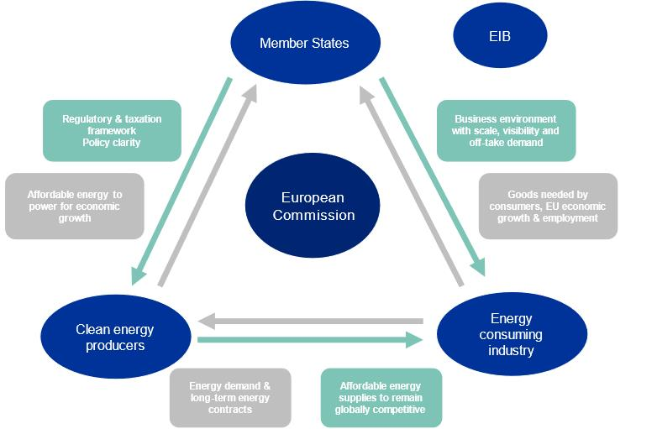
Upcoming initiatives - Tripartite agreements for affordable energy
12
Affordable Energy Action Plan – Action 6: A tripartite agreement to ensure affordable energy for Europe’s industry
Two targeted for signature at the margins of the 26 June TTE Council: biogas and storage.

Slide 14




Upcoming initiatives: Review of the Energy Security Framework
13
Ensure continuous adaptation
Increasingly decarbonized, electrified and integrated energy mix
Reinforce resilience
Against emerging risks, e.g. climate change or cyber-attacks
Draw lessons from the crises
Covid-19 pandemic, 2021-2023 energy crisis
Strive for simplification
Build a streamlined reporting process & more dynamic crisis management

Slide 15
Post-2030: A New Climate & Energy Framework
14
Overall policy architecture
Coherent architecture design for long-term decarbonisation
2040 Climate target: –90 %
Security, affordability and competitiveness
Strategic investments: Mobilising capital at scale
Investment scale-up: from €240 bn (2020) → €695 bn/year 2031-2040
Next MFF (2028–34): €1.98 tn envelope
Leverage National Regional Partnership Plans
Transform National Energy Climate Plans into investment tools
Simplification: streamlining for results
Build on the Governance Regulation with further streamlining of planning, reporting and investment tracking
Integrate and simplify monitoring and reporting
Leverage digitalisation
Partnership with Member States: ensuring coordinated action
Energy Union Task Force, bilateral engagement and regional formats
Encourage peer-to-peer learning and knowledge exchange
Implementation Dialogues & “reality checks”

