Slide 1
Energy Efficiency: Policy and Funding
NATIONAL PARLIAMENTARY WORKSHOP
Carlos Maravall Rodríguez
Country Coordinator for Portugal, DG ENER
Lisboa, 17 June 2026

Slide 2
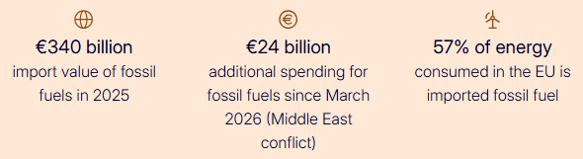
Current global context
Key facts on fossil fuel imports:
Without efficiency gains of the past 20 years, EU’s energy consumption would be 30% higher = combined annual use of France, the Netherlands, Austria, and Finland in 2022.
In today’s crisis, we would have to import 2 oil tankers and 5 LNG carriers more every day.
Energy efficiency contributes to the EU’s competitiveness, affordability and climate objectives.
Call to… accelerate the Clean Energy Transition.
Notes:
€340 billion import value of fossil fuels in 2025
€24 billion additional spending for fossil fuels since March 2026 (Middle East conflict)
57% of energy consumed in the EU is imported fossil fuel

Slide 3
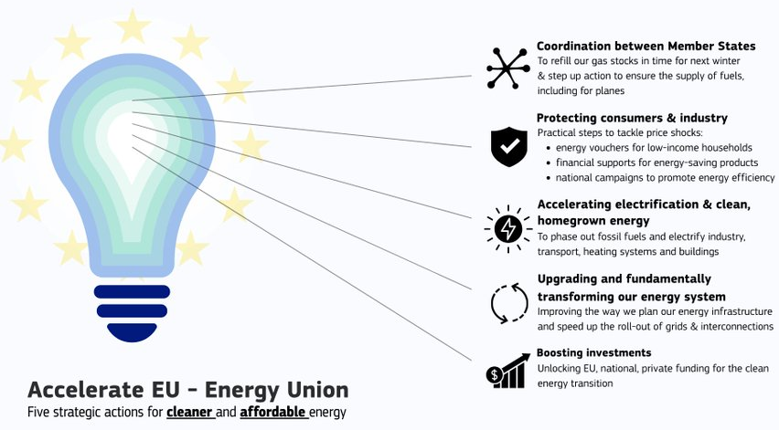
AccelerateEU Communication
The Communication addresses EU’s rising energy costs on volatile fossil fuel markets and aims to accelerate the clean energy transition and strengthen our energy resilience.
targeted immediate actions to protect European citizens and small enterprises.
structural actions to make our energy system long-term resilient, via homegrown clean energy and energy efficiency.
AccelerateEU – Energy Union - affordable and secure energy through accelerated action – Energy COM/2026/370 published 22 April 2026
Notes:
5 Pillars
1. Increased EU coordination
Gas storage filling and possible oil stock releases
Fully mobilising the EU Energy and Raw Materials Platform
Availability of refining capacities
Fuel Observatory – mapping supply, prioritising sourcing of alternative jet fuel supply and optimise distribution
EC guidance on existing flexibilities for aviation
Revision the Oil Stock Directive
2. Protecting consumers and industry from price shocks
Catalogue of replicable measures to produce energy savings and system efficiency gains, and measures to replace fossil fuels with homegrown clean energy
Digital repository of national emergency measures to promote good practices
State aid temporary framework
Assistance for Member States to develop targeted, timely and temporary measures
Guiding principles
Templates
Consumer protection and empowerment
Social leasing schemes for clean and efficient technologies + assist Member States in financial incentives
3. Accelerating shift to homegrown clean energy and electrification
The Commission will take action on electrification (incl. target), heating and cooling, geothermal energy (incl. EU-wide database, derisking and insurance schemes)
Solar thermal: uptake of large-scale projects
Biomethane: scale-up of existing plants, reduce permitting bottlenecks, improve transport of feedstocks
Targeted review of the production criteria for renewable hydrogen
Map capacities to complement feedstocks with circular and bio-based materials
4. Stepping up our energy system
Support for the conclusions of negotiations on Grids package before the summer.
Fast-track work to ensure the implementation of the Energy Highways.
Identify end-of-life cycle electricity generation plants to repower them
Support through the Energy Regulation Academy to implement key reforms
Legal proposal on network charges and taxation
Emphasis on implementation
5. Boosting investment
Clean Energy Investment Summit
AccelerateEU investment chapter
Assessment of further rules simplification needs to deploy EU funds for clean energy transition
EU ETS – update and modernise
Assist Member States in using EU ETS for targeted measures
Standardised financial products for clean heating and renovation (with the EEFC)
eSAF Early Movers Coalition

Slide 4



Energy Efficiency Financing Support Package
2.
Guidance on unlocking private investments in Energy Efficiency (EED Art. 30)
1.
Report to co-legislators on Energy Efficiency Financing in Europe (EED Art. 30 + EPBD Art. 9)
3.
Guidance on One-Stop Shops OSS (EED Art. 22 + EPBD Art. 18)
What
Assessment of effectiveness of public funding in leveraging private investments in EE
Recommendations and best practice examples to help MS and market actors to accelerate energy efficiency
Guidance to make OSS a central instrument at local/regional level to support MS and stakeholders
Stimulate reflection on state of EE financing and how to bridge the investment gap
Inform discussions around next-MFF and the future EU and national programmes
Scale-up blending financing solutions + financial instruments
Enable uptake innovative financing and energy services
Deploy project development assistance + investment aggregators
Support MS in establishing OSS services in their services in line with EED/EPBD
Make easier investment and renovation journey for citizens and enterprises
Raise awareness and stimulate demand
Expected
impact

Slide 5
Upcoming Energy Efficiency Policy
Post-2030
Energy Efficiency Framework
  Call for Evidence & Public Consultation (March – June)
  Stakeholder workshops (June – July)
  Established fora (CA-EED, EED Expert Group, Energy Efficiency Financing Coalition, Efficiency Action Forum 2030)
Heating and Cooling
  Support local integrated planning for clean, efficient, locally sourced H&C
  Speed up deployment of smart clean heating, including heat pumps and heat recovery.
  Improve system efficiency with urban networks using waste heat, renewable heat, and flexible electricity demand.
Data Centre Energy Efficiency Package
  Report on the energy efficiency of data centres in the EU
  Delegated Regulation establishing a common Union rating scheme for data centres
  Public consultation on establishing minimum performance standards for data centres in the EU
Notes:
Post 230 EE Framework:
Call for evidence: 19 March - 16 April
Open public consultation: 20 March - 12 June
Stakeholder consultations: June/July TBC (probably 12/06 and 10/07)
Youth consultation happened already. The Young Energy Ambassadors provided a written input in February/March
Action Plan on Electrification + Clean Heating and Cooling (tbc)
- Integration of H&C dimensions into the Electrification Action Plan to foster the potential of energy efficiency and clean heating and cooling towards electrification-ready smart energy system in Europe
Data centres energy efficiency package:
- Key deliverables of the Roadmap announced by Commissioner Jørgensen in June 2025

Slide 6
Thank you !

