Slide 1
Chasing the Sun: Portugal’s Solar Boom and the Race to Scale
NATIONAL PARLIAMENTARY WORKSHOP – EUFORES
Susana Serôdio
Policy and Market Intelligence
17.06.2026

Slide 2
About Us - APREN
Act as a single national voice, bringing together the efforts and contributions of our associates and team to defend the interests of the Association;
Develop and communicate contributions for effective energy policy proposals and strategies
Expand the scope and size of the renewable energy market for its associates
Further consolidate Portugal's position as a reference country in the global growth and development of the sector
Communicate the benefits and potential of direct and indirect renewable electrification technologies to a wide range of key audiences
Notes:
APREN is a non profitable association that represents companies on renewable energy sector with focus direct and indirect renewable electrification. Ours represent more 90% of renewable electricity installed capacity, so we act as single voice to develop contributions to formulate effective energy policy proposals and strategies that can consolidate Portugal’s position as reference country in global growth.

Slide 3
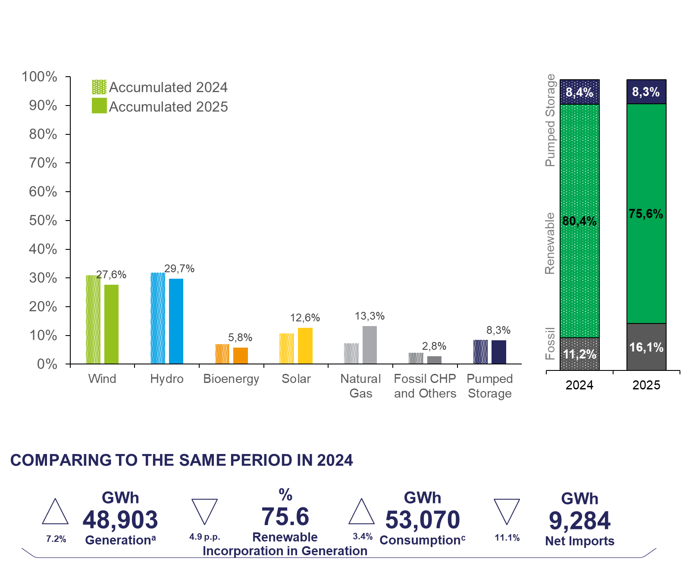

Electricity Generation in 2025
HYDRO
14,501 GWh
WIND
13,474 GWh
SOLAR
6,143 GWh
Solar is the third-largest renewable electricity source
Source: REN 2025; APREN analysis
Notes:
“Starting on the left, this chart shows the generation breakdown by source.
Wind and hydro remain the two largest contributors to electricity generation.
Wind represents roughly around the high-20% range of total generation. Solar continues to grow, now above 12%.
In 2024, renewables accounted for about 80% of generation.
In 2025, this decreases slightly to around 75–76%.
This reduction is mainly explained by:
Lower hydro availability compared to the very strong hydro year in 2024, and an increase in consumption of 3.5%

Slide 4
Renewable Installed Capacity in Portugal
Source: DGEG 2025; APREN analysis
Notes:
This chart illustrates the growth of renewable installed capacity in Portugal from 2015 to 2025.
Over this period, total renewable capacity increases steadily, rising from around 12 gigawatts in 2015 to more than 22 gigawatts by 2025. This reflects Portugal’s strong commitment to expanding clean energy.
Hydropower and wind remain the backbone of the system throughout the decade. Both sources maintain large shares of total capacity, providing stability and consistent generation.
However, the most significant change is in solar photovoltaic energy. Starting from a relatively small base, solar capacity grows rapidly after 2020 and becomes one of the main drivers of overall expansion by 2025.
Other sources such as biomass, waste, biogas, and geothermal contribute smaller and relatively stable shares.
Overall, the chart highlights a clear diversification of Portugal’s renewable mix, with strong growth led by solar, while hydro and wind continue to play central roles.

Slide 5
Solar PV Installed Capacity, 2012–2025
FiT suspended
Self-consumption regulation
Market driven regulation
New regulation
2012
2015
2019
2022
2023
2024
+ 1.1 GW
6.8 GW
+ 1.8 GW
+ 1.2 GW
+ 0.8 GW
Source: DGEG 2025; APREN analysis
Notes:
This chart shows the evolution of solar PV installed capacity in Portugal between 2012 and 2025.
For several years, growth was relatively modest. However, from 2019 onwards — following new regulatory frameworks and solar auctions — the market accelerated significantly.
The real turning point comes after 2022. Annual additions increase sharply: around 0.8 gigawatts in 2022, 1.2 gigawatts in 2023, and a record 1.8 gigawatts in 2024. By 2025, total installed capacity is expected to reach approximately 6.8 gigawatts.
In just three years, Portugal has nearly doubled its solar capacity. While small and medium-scale installations continue to grow, large-scale solar plants are driving most of this expansion.
Overall, this trajectory highlights how regulatory stability and competitive auctions have transformed solar PV into one of the fastest-growing energy sources in the country.

Slide 6
NECP targets
NECP Targets for 2025
NECP Revision Targets for 2030
80% renewable electricity
8.1 GW Hydropower
8.4 GW Solar PV
6.3 GW Onshore + 0.3 GW Offshore
93% renewable electricity
20.8 GW Solar PV
10.4 GW Onshore + 2.0 GW Offshore
5.5 GW electrolysers capacity
8.1 GW Hydropower
1 GW battery storage
15.1 GW large-scale
5.7 GW small-scale
Notes:
By 2025, the goal was 80% renewable electricity and 8.4 gigawatts of solar PV.
In the revised 2030 targets, ambition increases significantly: 93% renewable electricity and 20.8 gigawatts of solar PV — more than doubling solar capacity. Of this, around 15.1 gigawatts will be large-scale and 5.7 gigawatts small-scale.
Wind capacity also rises to 12.4 gigawatts combined onshore and offshore, alongside new targets for hydrogen electrolyzers and battery storage.
Overall, the message is clear: solar becomes the central pillar of Portugal’s energy transition toward 2030.

Slide 7
How much is Portugal shining?
To meet its 2030 solar target, Portugal must install at least:
2.8 GW per year
+1.1
+1.8
2030 Target
Notes:
This slide asks a simple question: how fast does Portugal need to grow solar to meet 2030 targets?
Installed capacity reached around 6.8 gigawatts in 2025, while the 2030 target stands at 20.8 gigawatts.
That means Portugal must install at least 2.8 gigawatts per year between now and 2030.
Although recent years showed strong growth — especially in 2023 and 2024 — a slowdown is now visible.
The key challenge is clear: maintaining a sustained acceleration in solar deployment to stay aligned with the 2030 ambition.

Slide 8
Regulatory Changes
Exceptional measures for RES projects
Environmental framework | new thresholds
DL 30-A/2022
Case-by-case analysis for EIA conducted by the permitting authority
EIA framework for H2 projects
Projects must include proposals that benefit local communities
Case-by-case analysis not required for projects <15 ha, located less than 2 km from other PV plants and with grid connection <10 km
EIA for projects >100 ha in non-sensitive areas
EIA for projects >10 ha in sensitive areas
DL 11/2023
Review of DL 15/2022
04/2022
10/2022
02/2023
12/2024
X/2026
Amends the exceptional measures for RES projects
Alignment with RED III
Binding permitting deadlines (12 months in acceleration areas / 24 months outside)
Recognition of renewables, storage and grid infrastructure as overriding public interest
Simplified repowering procedures
New compensation for municipalities
New deadlines for municipalities
<2% occupied area: municipalities cannot reject a project due to landscape impact
DL 99/2024
DL 72/2022
Notes:
This timeline summarizes the key regulatory changes supporting renewable energy deployment in Portugal.
In 2022, exceptional measures were introduced to simplify environmental licensing and accelerate projects, including faster EIA procedures.
In 2023, the environmental framework was revised, introducing new thresholds that exempt smaller projects from case-by-case assessments and streamline approvals.
Looking ahead to 2024 and 2026, further alignment with the EU Renewable Energy Directive will simplify permitting, recognize renewables as overriding public interest, and ease repowering procedures.
Overall, regulation has progressively shifted toward faster, more predictable permitting — a critical factor to sustain solar growth toward 2030.

Slide 9

Priorities for the Upcoming Regulatory Frameworks
Measure | Existing Framework | Implemented | Priority
Single contact point & digitalisation | 🟢 | 🔴 | High
Deadlines for permit granting | 🟢 | 🟡 | Medium
Acceleration areas | 🟡 | 🔴 | Medium
Overriding public interest | 🟡 | 🔴 | High
Simplified repowering rules | 🟢 | 🔴 | High
Hybrid / Storage | 🟢 | 🟢 | Low
Flexible Agreements | 🟢 | 🔴 | High
Auctions (CfDs) | 🟢 | 🔴 | High

Slide 10
Iberia electricity market vs Europe
Portugal €/MWh | 77.9  | 66.1 
Spain €/MWh | 76.7  | 65.2 
France €/MWh | 67.5  | 61.1 
Italy IT-NORD €/MWh | 115.5  | 116.2 
Germany €/MWh | 94.2  | 89.5 
Austria €/MWh | 114.0  | 98.6 
Denmark DK1 €/MWh | 82.2  | 81.1 
Denmark DK2 €/MWh | 82.4  | 82.5 
Norway NO2 €/MWh | 68.8  | 66.8 
Legend
 Hourly arithmetic average price (December 2025)
 Hourly arithmetic average price (2025 accumulated)
During December 2025, Portugal recorded a minimum hourly price in MIBEL of 0.5 €/MWh*.
The maximum hourly price was 158.1 €/MWh*.
NO2
DK1
DK2
MINIMUM PRICES (DEC.)
MAXIMUM PRICES (DEC.)
DE
1st France | €/MWh 0.00 |  | 1st Germany | €/MWh 332.68
2nd Spain Portugal | €/MWh 0.50 |  | 2nd Austria | €/MWh 308.40
3rd Norway NO2 | €/MWh 3.42 |  | 3rd Denmark DK2 | €/MWh 308.36
AT
FR
IT-NORTH
PT
ES
Source: ENTSO-E, OMIE; APREN analysis
Note: given recent changes in the data reporting format by the ENTSO-E platform, the price values presented correspond to the bidding zones, when applicable. As such, in the case of Italy, Denmark and Norway only the bidding zones with interconnection with neighbouring countries were considered.
* Due to the unavailability of information on the OMIE platform, it is currently not possible to provide data regarding market-clearing technologies.

Slide 11
Key bottlenecks – what’s slowing Portugal down
SPEED
Permitting
Slow licensing
Complex regulation
Fragmented governance
Projects delayed for years
STABILITY
Market Conditions
Price volatility
Uncertain investment signals
TRUST
Social acceptance
Communities feel excluded
Growing territorial conflicts
Biodiversity concerns
Financing risk increasing
Competition for land and territory use
Taxation
ACCESS
Grid Readiness
Delayed approval of grid investment and development plans
Limited grid availability
No access to flexible agreements

Slide 12
Upcoming changes for 2026
New Battery Auction (BESS)
Launch of a 750 MVA auction for battery storage capacity
Strengthening system adequacy and energy security
Support for flexibility and peak management
Auction of Pego’s Remaining Injection Capacity
Mobilisation of remaining capacity at the Pego hub
Approximately 300 MVA available
Strategic reallocation following coal phase-out
Revision of Decree-Law 15/2022
Transposition of key RED III provisions
Binding permitting deadlines (12 / 24 months)
Operationalisation of overriding public interest
Introduction of Renewables Acceleration Areas
Pre-identified zones suitable for renewable deployment
Streamlined environmental and permitting procedures
Reduced maximum approval timelines (up to 12 months)
Government-backed guarantee mechanism PPAs
Designed to reduce counterparty risk in case of buyer default
Could improve bankability and investor confidence for new renewable projects
Signals policy focus on market stability and revenue certainty
Notes:
Looking ahead to 2026, several important regulatory and market changes are expected.
First, a new battery storage auction will launch 750 megawatts of capacity, strengthening system adequacy, energy security, and flexibility.
Second, the auction of Pego’s remaining injection capacity will mobilize around 300 megawatts, strategically reallocating grid capacity after the coal phase-out.
Third, the revision of Decree-Law 15/2022 will transpose key RED III provisions, introduce binding permitting deadlines, operationalize overriding public interest status for renewables, and simplify repowering.
Finally, Renewable Acceleration Areas will be introduced. These pre-identified zones will benefit from streamlined environmental and licensing procedures, with approval timelines reduced to as little as 12 months.
Together, these measures aim to provide greater certainty for investors and accelerate deployment toward 2030 targets.

Slide 13
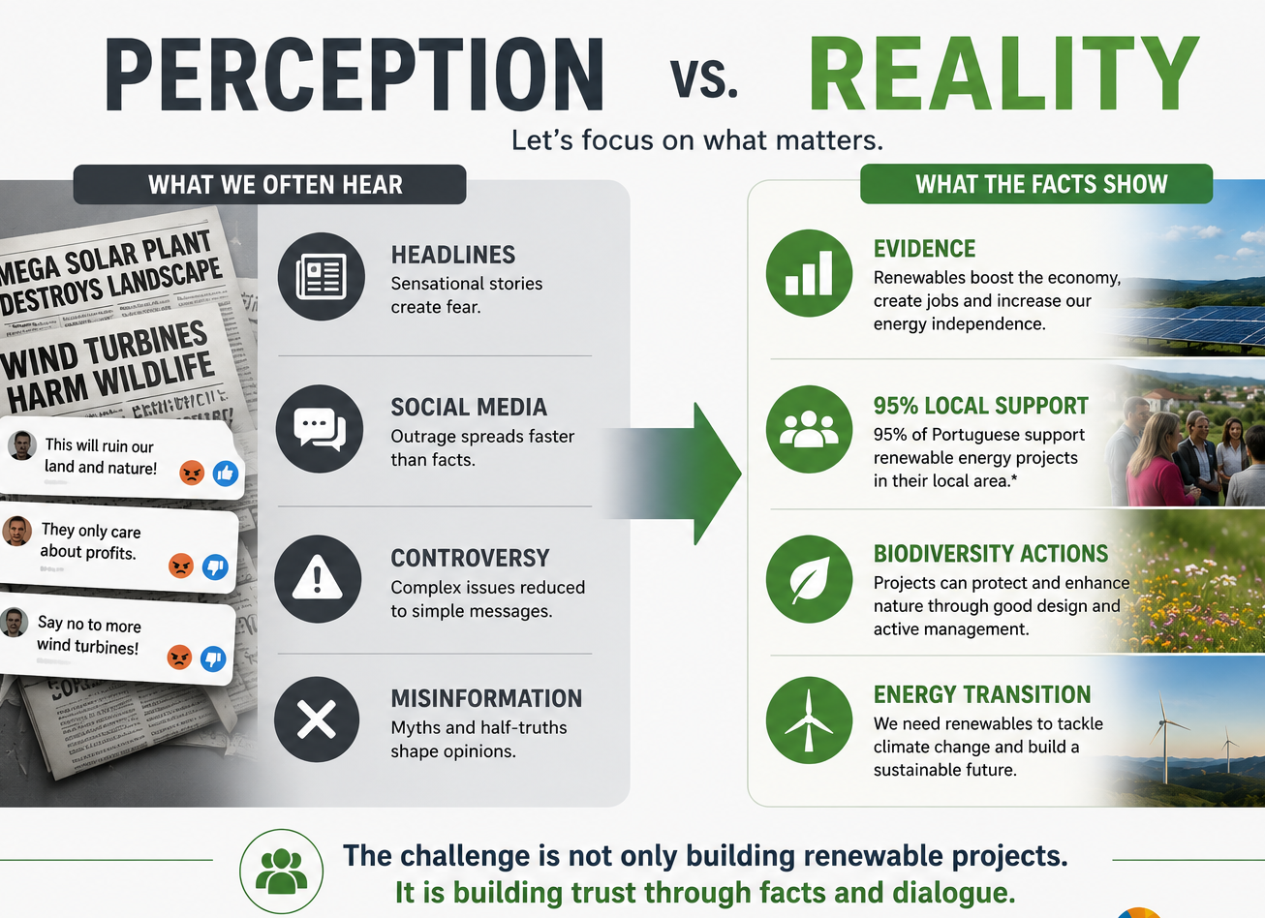
APREN’s Latest:
Building Evidence, Trust, and Conditions to Accelerate Renewables
Economic Impact of Renewables
  Renewable energy contributed €5.34 billion to Portugal's GDP in 2024, driving economic growth and saving €42 billion since 2018.
Public Acceptance and Support
  95% of Portuguese people support local renewable projects, with a strong preference for investment in renewables over fossil fuels.
Biodiversity and Local Development
  BioImpacte+ shows renewable energy can align with biodiversity conservation.
Regulatory Streamlining
  APREN’s permitting guide simplifies the licensing process, reducing regulatory bottlenecks and fostering project development.
Notes:
---
This slide references information from the following file: https://www.apren.pt/wp-content/uploads/2026/05/PR-estudo.pdf,https://www.apren.pt/wp-content/uploads/2026/05/PR-95-dos-portugueses-apoiam-projetos-de-energia-renovavel-nas-suas-localidades.pdf,https://www.apren.pt/eventos/eventos-apren/bioimpacteparedesdecoura/,https://www.renovaveismagazine.pt/apren-guia-de-licenciamento-de-projetos-renovaveis-onshore/,https://www.dgeg.gov.pt/pt/destaques/guia-de-licenciamento-projetos-de-energia-renovavel-onshore/
APREN’s latest work highlights its role as a strategic actor in advancing the renewable energy transition in Portugal by combining economic analysis, public engagement, environmental integration, and regulatory support. First, the association’s macroeconomic impact study, developed with EY-Parthenon, demonstrates that renewable energy is not only a climate solution but also a key economic driver. In 2024, the sector contributed approximately €5.34 billion to GDP, representing over 1% of the national economy, with projections showing potential growth of more than 370% by 2040 if barriers such as permitting delays and infrastructure constraints are addressed. Additionally, renewables have delivered significant cost savings, with €42 billion saved in the electricity market since 2018, benefiting households and companies alike.
Second, APREN has reinforced the social dimension of the energy transition through a nationwide survey conducted with Marktest. The results reveal exceptionally strong public acceptance of renewable energy projects, with 95% of Portuguese respondents supporting such projects in their local communities. Furthermore, 91% favor increased investment in renewables over fossil fuels, and 90% believe Portugal should prioritize the deployment of additional renewable projects. These findings underline a critical enabler for the transition: public trust and willingness to host new infrastructure locally.
Third, through the BioImpacte+ initiative, APREN is actively demonstrating that renewable energy deployment can go hand in hand with biodiversity conservation and local development. The project fosters collaboration among stakeholders and showcases real-world examples where renewable installations contribute positively to ecosystems. For instance, efforts associated with biodiversity protection have resulted in measurable outcomes such as a 95% reduction in livestock losses from predator attacks, the monitoring of multiple ecosystems, and large-scale reforestation initiatives.
Finally, APREN’s guide on permitting addresses one of the main bottlenecks in renewable deployment: regulatory complexity. Developed in collaboration with national authorities like APA and DGEG, the guide maps the entire licensing process, clarifying requirements and simplifying procedures for developers, regulators, and communities. Together, these initiatives illustrate how APREN is bridging the gap between policy ambition and on-the-ground delivery by strengthening economic evidence, fostering social acceptance, promoting environmental sustainability, and improving regulatory efficiency.

Slide 14
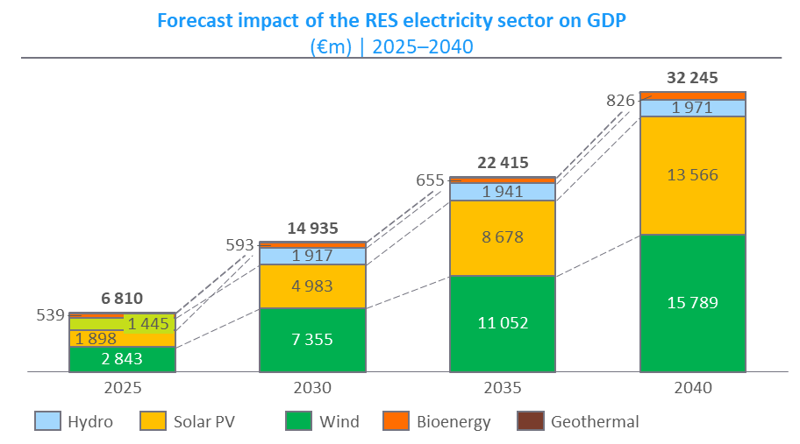
Portugal’s Industrial Opportunity
Strong Renewable Energy Base
Portugal benefits from high renewable energy penetration ensuring a sustainable energy mix and stable prices for industries.
Clear Green Industry Opportunity
Portugal attracts electrified manufacturing, renewable hydrogen, and data centers relying on clean, affordable energy.
Strategic Economic Outcomes
Green industry fosters reindustrialization, economic diversification, job creation, and sustainable long-term growth in Portugal.

Slide 15
Thank you
Susana Serôdio
Policy and Market Intelligence
susana.serodio@apren.pt

