Slide 1

What’s the Story?
Narratives for the Energy Transition
National Parliamentary Workshop Spain, 19th June 2026
Daniel Becker, Guidehouse, Germany
This project has received funding from the European Union’s LIFE Programme under Grant Agreement No. 101076918

Slide 2








This project has received funding from the European Union’s LIFE Programme under Grant Agreement No. 101076918

Slide 3
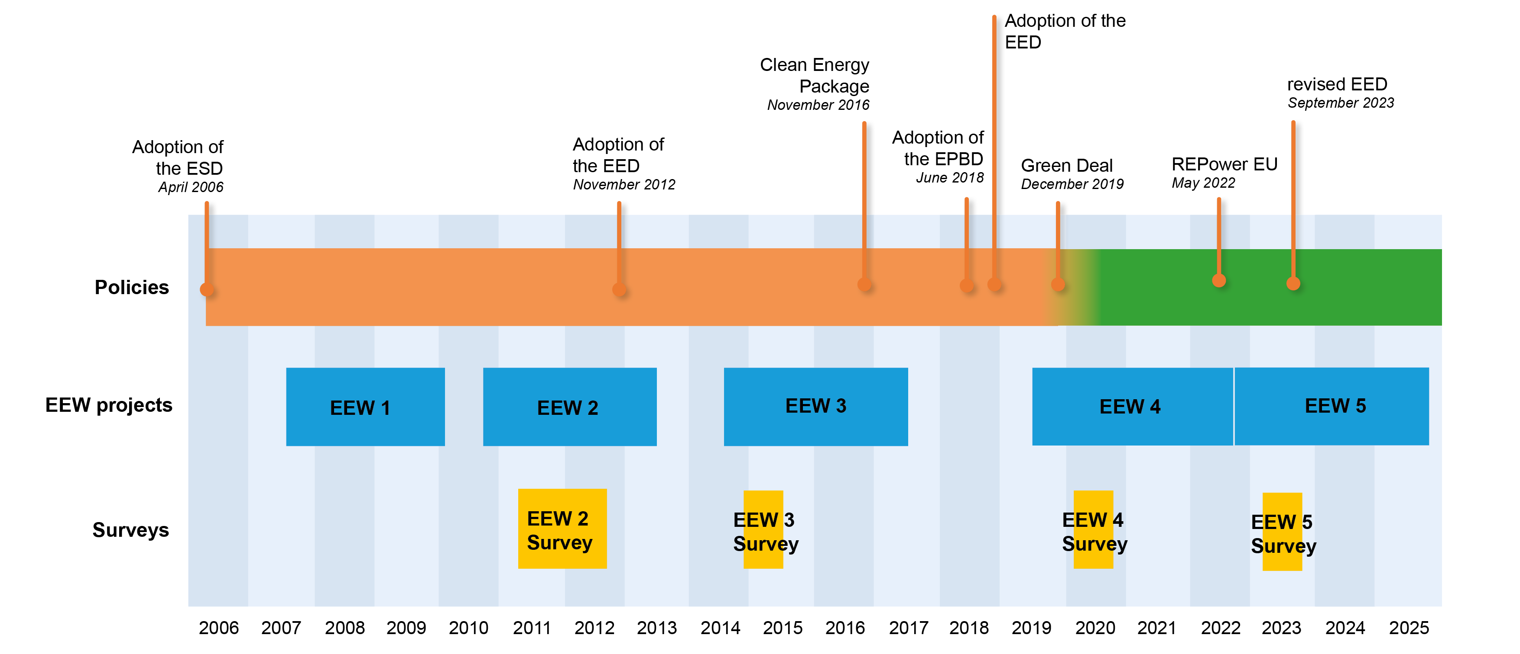
Energy Efficiency Watch Timeline

Slide 4
Energy Efficiency Watch Survey, Parliamentary Events and Stakeholder Workshops
views of experts and stakeholders
on progress "on the ground" in energy efficiency policies in their respective country
gather insights for narrative development in Member States
perceptions of experts on the progress in their own country
Survey: More than 1,370 experts from all Member States participated
Stakeholder Workshops: 10 in 10 countries, participating over 15 countries
Parliamentary Events: 25+ events with 200+ MP/MEPs and 600+ stakeholders

Slide 5
In your personal opinion, which of the following
mid-term strategies is best to keep industry in your country?
Support the fastest possible energy transition
Support the energy transition, but not too fast in order to protect jobs
Support fossil fuel energy costs
No matter what we do, in the mid-term, industry will leave Europe

Slide 6
  NARRATIVE INPUTS: The Clean Industrial Deal in the public debate

Slide 7
Climate neutrality
Investment barriers
Know-how barriers
Mindset barriers

Slide 8
Climate neutrality
Investment barriers
Know-how barriers
Mindset barriers

Slide 9
Clean Industrial Deal:
"Decarbonisation is a
powerful driver of growth"

Slide 10
Clean Industrial Deal:
"Decarbonisation is a
powerful driver of growth"
Are enough people truly convinced of this?
Are you truly convinced?

Slide 11
Clean Industrial Deal:
"Decarbonisation is a powerful driver of growth"
New narratives are needed!

Slide 12
The images in people's minds
Expensive
Energy transition
Climate
Not interesting for me

Slide 13
Narratives: Gaining buy-in from wider groups in society
Renewable energy makes us stronger
Less dependent from other countries
Cool jobs
Less CO₂

Slide 14
Narratives: We also need to overcome counter-narratives
("killer arguments")
Let's get serious about the industrial energy transition!
We do not have the technologies yet
China and US don't do it, why should we?
The investments are too high

Slide 15
HOW to explain that
the Clean Industrial Deal
is beneficial
for citizens, businesses and for countries?

Slide 16
A matter of connotation
The Clean Industrial Deal is often characterized as:
Great transformation, disruption, fundamental change
But such terminology is often not positively connotated, being associated with
Uncertainty and according risks (societal, individual)
Structural ruptures leading to poverty
Destabilization and loss of control

Slide 17
How to positively connotate change
Creating trust is the essential first step
Don’t avoid the term change, but take the fear out of it, put it into right perspective
‘The EU is a role model for successful transformations’
‘the EU became one of the most competitive economic regions in the world – let’s now take the logical next steps…’
‘If we don’t act, we may lose control – but we know how to use our potential wisely…’
‘Change is not for change’s sake – but because we aim for preserving competitiveness, prosperity and stability…’

Slide 18

The role of policy framework
Policy framework is the solution, not the problem
Key for success, and a differentiator to other world regions, is the EU’s good level of regulatory framework
Policies should not be put at risk, but streamlined towards a fast and firm transition
They are an asset for EU’s competitiveness through innovation
A well-structured policy pathway flanked by clear narratives helps mobilize necessary investment

Slide 19
Why industry decarbonisation for competitiveness?
Energy security, lower risks
Stable energy costs
Cleantech innovation
Investments and jobs
Modernisation and productivity increase
Climate protection

Slide 20
10 simple rules to develop successful narratives
Understand the relevance of the right narrative
Manage the meta-level connotation of your narratives
For broad political consent, avoid mingling economic and other - e.g. ethical – arguments, if one creates more buy-in than the other
Use full set of economic parameters - rather than focusing only on short payback times / advantage of energy cost savings
The world is changing, so must our narratives – understand who your target group is, adjust message to societal and time related context
Put people in the focus of your narrative and take them along
The framework is the solution not the problem – don’t steer
by technocratic targets but by enabling key stakeholders
Never get into reaction mode! Always establish an upfront communication strategy
Put each narrative under a positively connotated guiding principle
Yes, we can! Communicate the success, not the struggle
YES,
WE CAN!
☺

Slide 21
IS THIS "NICE TO HAVE" OR
A "MUST HAVE"?

Slide 22
DO WE REALLY HAVE A CHOICE?
  Will yesterday's world come back (soon)?
  pre Ukraine war
  pre Chinese manufacturing boom
  pre Trump
  The critical question is the speed of the transition.

Slide 23
Let's start with better narratives today!

Slide 24
Independence
Let's start with better narratives today!
Innovation
Security
Stable energy costs
Productivity
Jobs
Climate
Modernisation
Investments

Slide 25
Thank you!
www.energy-efficiency-watch.org
https://managenergy.ec.europa.eu
www.eufores.org
https://www.energiesparverband.at/
https://guidehouse.com

